Slide 1
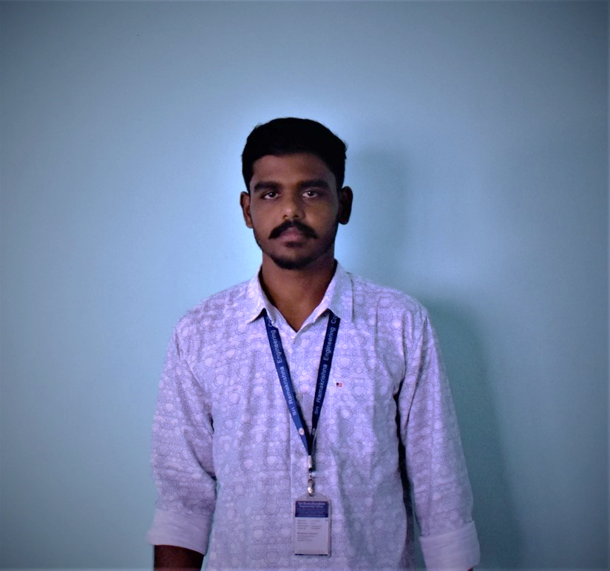
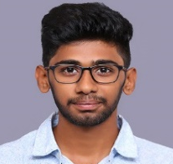

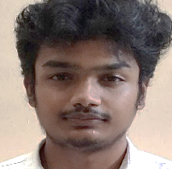
A CNN-LSTM prediction model for Inventory Demand Forecasting
0200
Author 1
Photo
Author 2
Photo
Author 3
Photo
Author 4
Photo
Karthik K
Nithin Soundar S J
Ram Prasanth N
Rithick Roshan R
Sri Ramakrishna Engineering College
Coimbatore, Tamil Nadu

Slide 2
Challenge Statement
Airlines face major expense in replacement of serviceable parts such as tyres due to damage.
The challenge statement expects the solution to predict the time window for the replacement of aircraft wheels.
The solution must take into factor all the parameters such as aircraft type, vendor, components in the tyre, defects observed, environment and their life cycles, as they influence the life expectancy of the tyres.
Since both overstocking and understocking have a negative impact on the airlines and faulty prediction might cause fatal damage, accuracy must be the primary concern.
The preferred solution is a AI model that predicts the time window of the replacement of the tyres.
0200

Slide 3
Concept / Scope of solution
The concept of the solution is
To develop a AI model that can predict the time window for the tyre replacement.
The proposed solution is a deep learning algorithm, Convolutional Neural network and Long short term Memory Cell network.
Since accuracy is the primary concern, various optimizers and activation function are compared in order to choose the best suited model.
Optimizers such as Nadam, Adam and Activation functions such as ReLU and Swish are juxtaposed.
The CNN-LSTM Algorithm in general predicts the required features with a RMSE of 0.3
The Model that has incorporated NADAM optimizer and the Swish Activation Function seems to have a comparatively lower RMSE curve in the graph.
0200

Slide 4
SWOT Analysis
STRENGTH
WEAKNESS
Continuous improvement- The model itself improves with respect to the large number of data fed into it.
Scalability- Its performance can always be improved with better tech.
When a large amount data is fed, a powerful GPU is required to process the data.
Scope for improvement
Improve aircraft safety
Data Corruption
OPPORTUNITIES
THREATS
0200

Slide 5
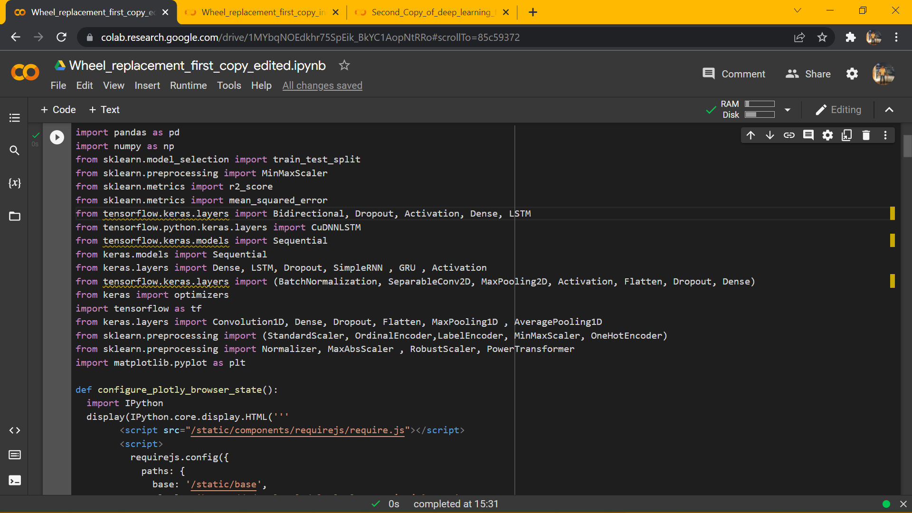
Implementation
Libraries Used:
Pandas- used for data manipulation and analysis.
Numpy- used to perform a wide variety of mathematical operations on arrays.
Tensor Flow- Python library for fast numerical computing.
Keras- Python library for developing and evaluating deep learning models.
Scikit Learn- used to build ML/ DL models.
Matplotlib- data visualization and graphical plotting library for Python.
0200

Slide 6
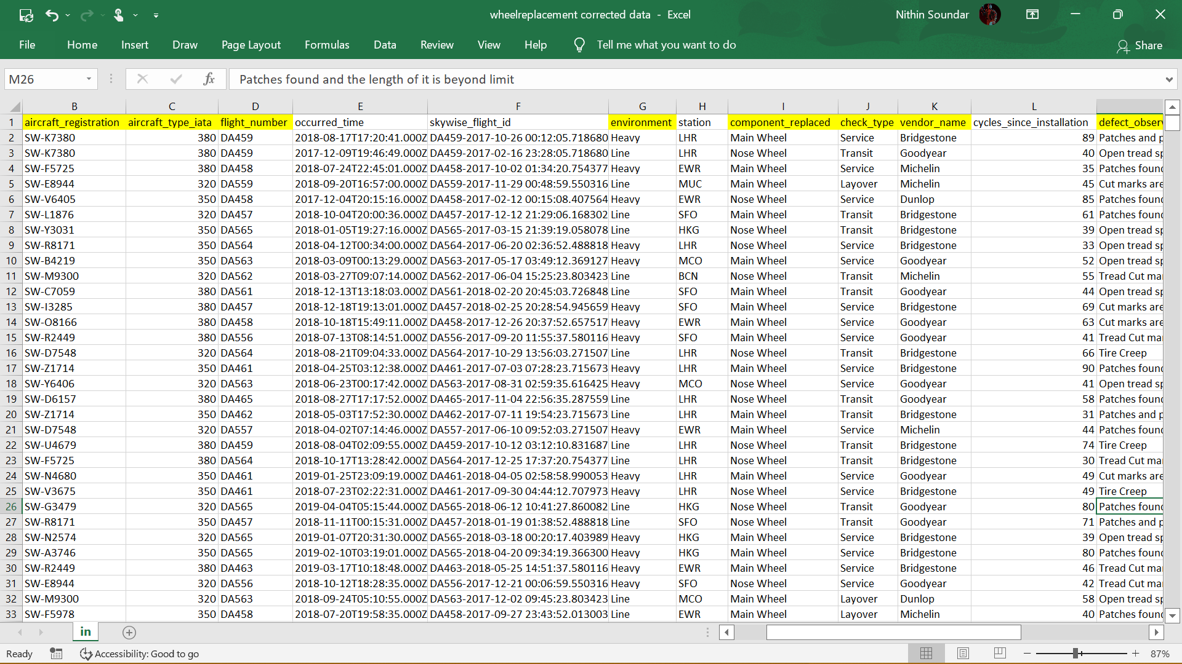
Implementation
Among the 13 columns, 8 were taken as the input features.
Aircraft_registration, aircraft_type, flight_number, environment, component_replaced, check_type, vendor_name, defect_observation are the features that relate to the forecasting procedure.
These features are taken as labels and used to predict the cycles_since_installation.
0200

Slide 7
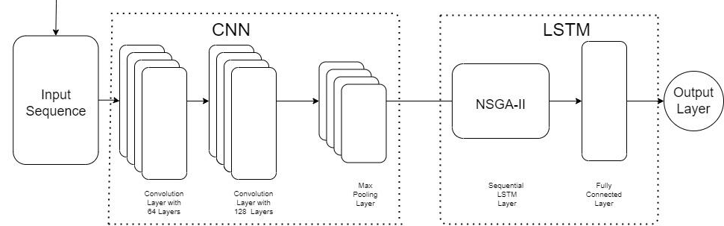
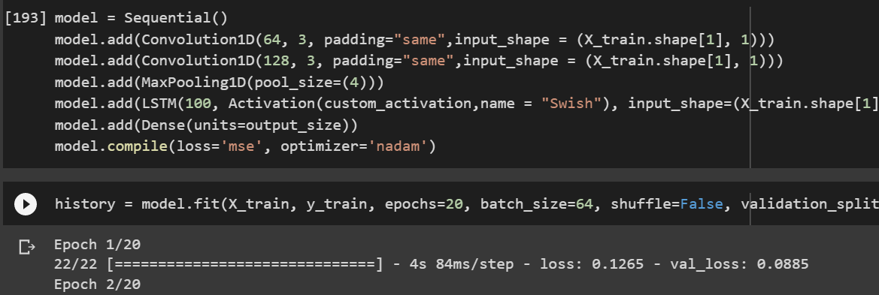
Implementation
0200

Slide 8

POC Demo
0200

Slide 9
Analysis
S. No | Model | Swish (epochs-20) |  | ReLU (epochs-20)
 |  | Validation MSE | Validation RMSE | Validation MSE | Validation RMSE
1 | CNN- LSTM ADAM optimizer | 0.09175 | 0.3029 | 0.0924 | 0.3040
2 | CNN- LSTM NADAM optimizer | 0.0916 | 0.3027 | 0.0928 | 0.3047
CNN-LSTM algorithm with Nadam optimizer and Swish activation function gives a lower RMSE score.
0200

Slide 10
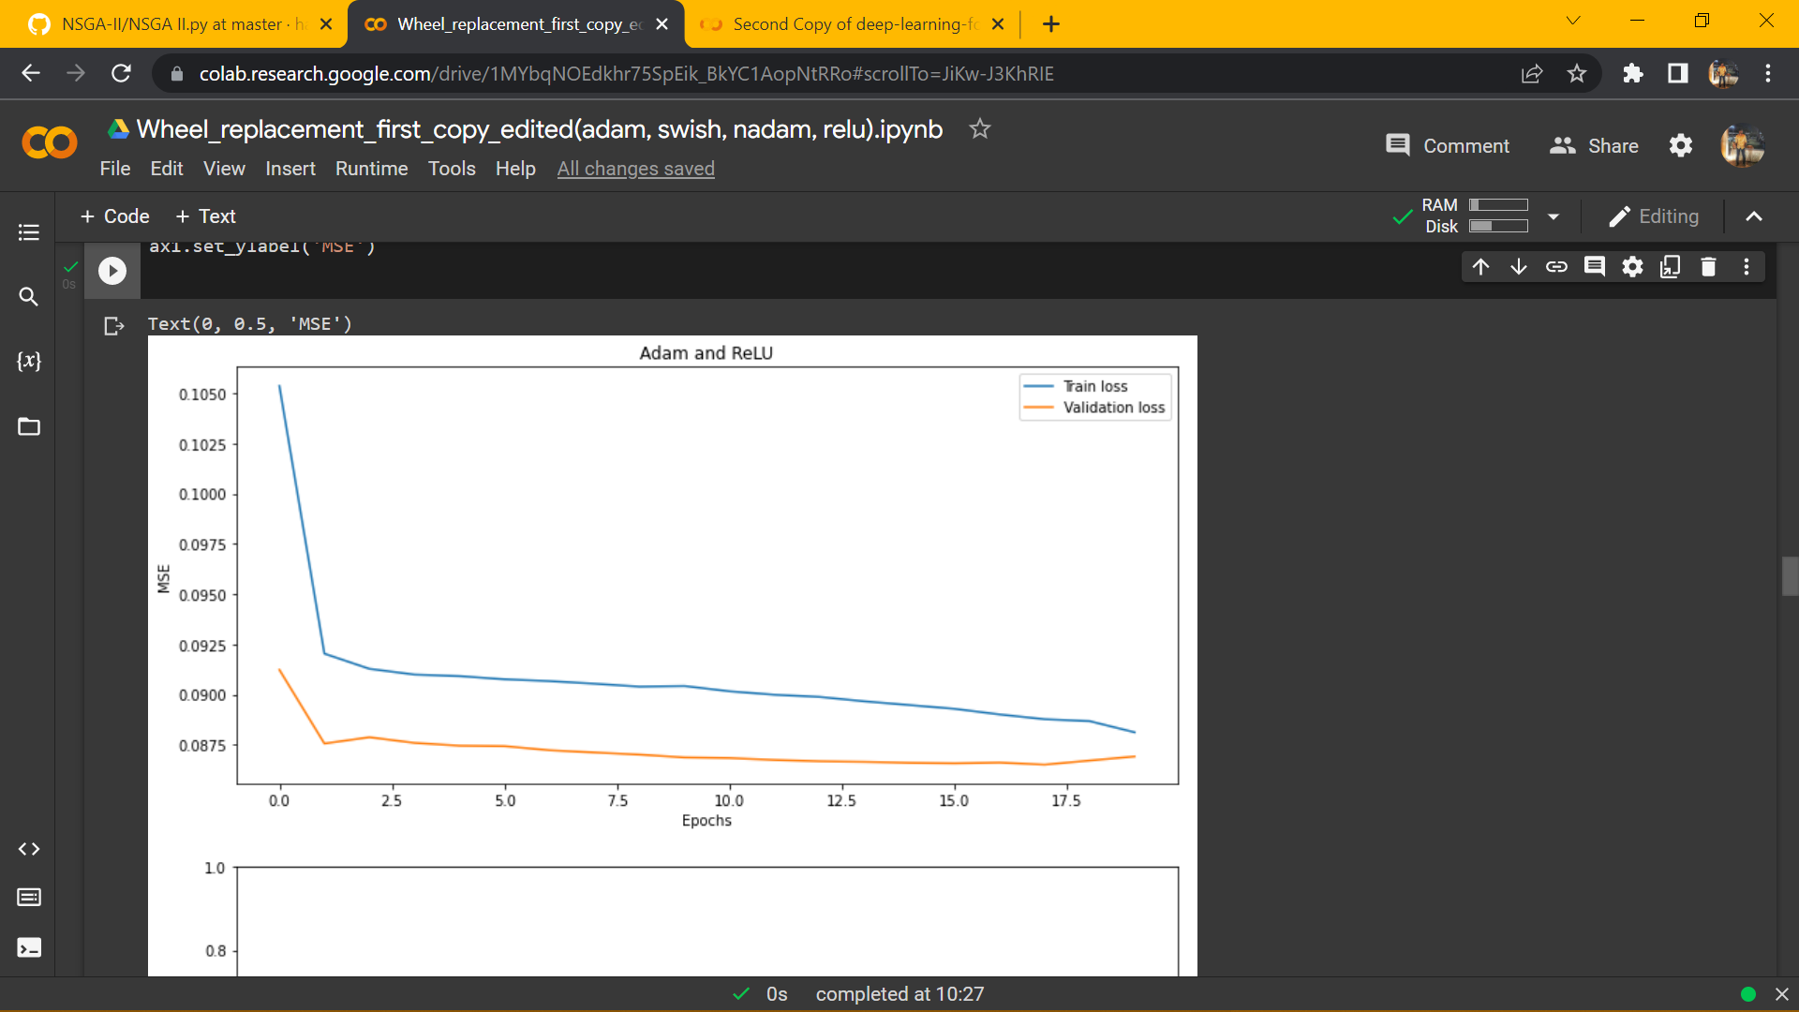
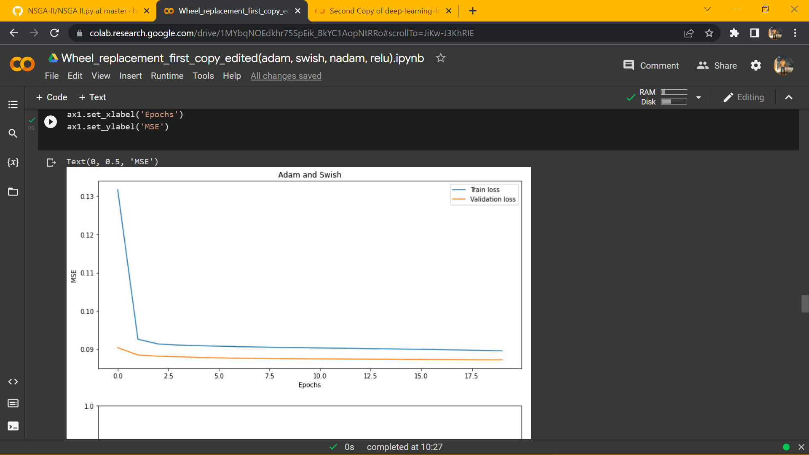

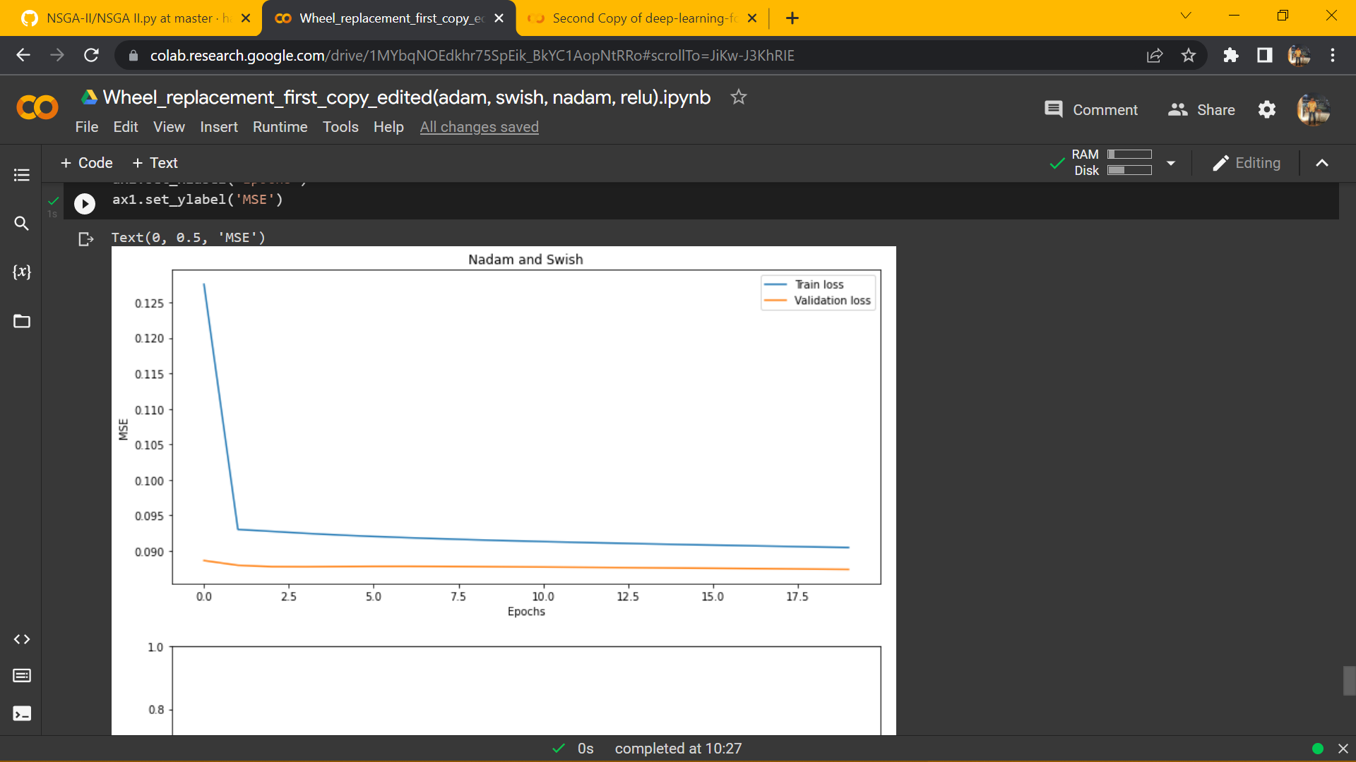
Analysis
It can be inferred that the RMSE reduces as the epochs increases and after 20 epochs we get a constant graph.
0200

Slide 11
Cost for POC vs MVP
Cost for Developing POC
Approximate cost for POC to MVP
Nil
Jetson Nano Developer kit- 20,000 INR
0200

Slide 12
Result / Conclusion
Predicting the demand is a challenging task as these depend on multiple parameters that form complex patterns.
Nonetheless, this model has obtained results regardless of these complex patterns. The model was fed data consisting of historic data which was pre-processed.
Various models were compared and the best fit model was obtained.
For future works, deep learning models which consider other parameters can be implemented.
0200

Slide 13
References
Nor Atiqah Zolpakar and Swati , “Application of Multi-objective Genetic Algorithm (MOGA) Optimization in Machining Processes”.
You Ji, Shiliang Sun, “Feature selection for ensembles using Non-dominated Sorting in Genetic Algorithms” 2010 Sixth International Conference on Natural Computation, Publisher: IEEE
Sakorn Mekruksavanich and Anuchit Jitpattanakul, “A Multichannel CNN-LSTM Network for Daily Activity Recognition using Smartwatch Sensor Data”. 2021 Joint International Conference on Digital Arts, Media and Technology with ECTI Northern Section Conference on Electrical, Electronics, Computer and Telecommunication Engineering, Publisher: IEEE
0200

Slide 14
Thank You

