Slide 1
Final Presentation
AI And ML Capstone Project
Automatic Resume Segregation
Ramkiran (C0793773)
Sree Rukmini (C0795474)
Nithin Tata (C0789951)
Sai Charitha (C0787250)

Slide 2
Agenda
Who made this project
What problem we are solving
Timelines taken in producing this product
Generations in hiring system
Requirement analysis
Project Design and development
Implementation Details
Results and discussion
Conclusion and future scope

Slide 3
Who are we?
Nithin Tata
3+ years of experienced software engineer with handson in devops, data warehousing etc.
Sree Rukmini Thumu
3+ years of experience as Java developer
Ramkiran Sampathi
3+ years of experience in software engineering with handson in Data Science, Bi Data etc.
Sai Charitha Paleru

Slide 4
What problem we are Solving?
→ Parsing helps user not manually write the things what he already mentioned in resume
→ Helping recruiters in saving time to find the best one.
→ Helping users to save time in filling multiple forms and details whcihathey had already mentioned in the resume

Slide 5
Generations in hiring system
First Generations: Job posts in newspapers, TV etc and inviting applications via mail
Second Generations: Agencies are acting as middlemen in first stage to figure out right person
Third Generations: Initial level of processing is totally carried out machines in providing basic idea about applicant to recruiter.
Notes:
1:In this System the Hiring team would publish their vacancies and invite applicants.
Methods of publishing were newspaper, television and mouth.
The interested candidates would then apply by sending there resumes. These resumes were then
received and sorted by the hiring team and shortlisted candidates were called for further rounds of
interviews.
The whole process would take lot of time and human efforts to find right candidate suitable for
their job roles.
2:As the industries have grown, there hiring needs has rapidly grown. To serve this
hiring needs certain consultancy units have came into existence. They offered a solution in which
the candidate has to upload their information in a particular format and submit it to the agency.
Then these agencies would search the candidates based on certain keywords. These agencies were
middle level organizations between the candidate and company. These systems were not flexible
as the candidate has to upload there resume in a particular formats, and these formats changed
from system to system.
3:This is our proposed system, which allow the candidates to upload their resumes in
flexible format. These resumes are then analyzed by our system, indexed and stored in a specific
format. This makes our search process easy. The analyzing system works on the algorithm that
uses Natural Language Processing, sub domain of Artificial Intelligence. It reads the resumes and
understands the natural language/format created by the candidate and transforms it into a specific
format. This acquired knowledge is stored in the knowledge base.

Slide 6
Software Requirements
Software requirements:
→ Python 3.8
→ NLTK
→ Machine learning
→ Google Firestore DB
Cloud requirements:
→ Serverless Architecture
→ Ubuntu 20.0
→ 60 sec run time
→ 1GB memory and 2 Core CPU

Slide 7
Project Design and Development
Software Architectural Designs:
→ GUI(Graphical User Interface): Interface for user and recruiter to login, upload resumes, see profiles, add jobs
→Function Trigger and processing Block: Triggers serverless function deployed on google cloud and completes process related to NLTK and stores data into Database.
→Database: We used Nosql data base called firebase to store records(documents) and firestore bucket to save resumes into cloud

Slide 8
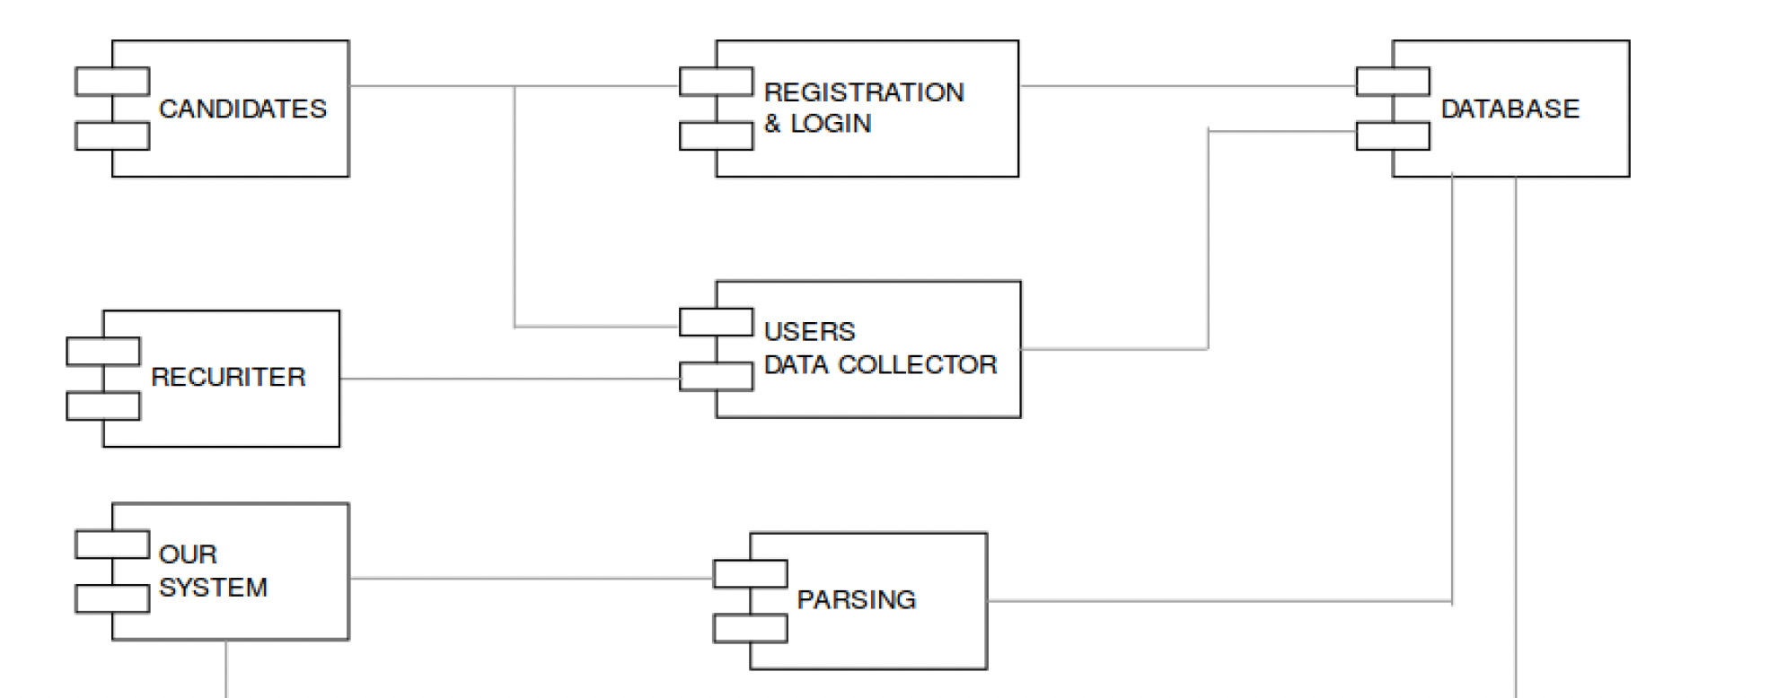
Project Design and Development GUI

Slide 9
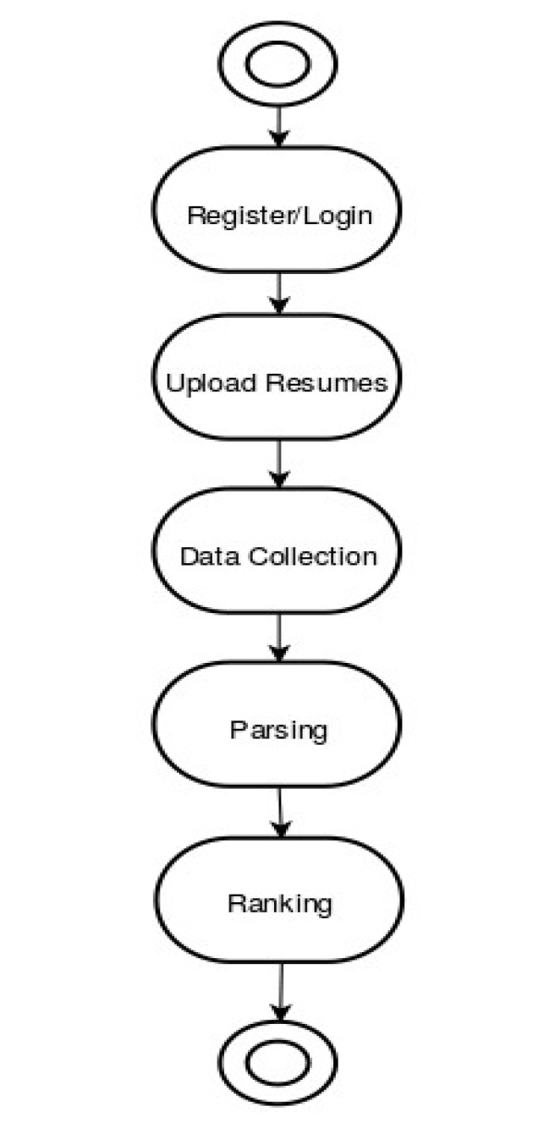
Flow diagram
User needs to login using their Google account for registration
User can upload resume and can wait for further process
Our system will collect and process the Resume data and start parsing
Finally after parsing and collecting necessary information from the resumes, the system will start ranking the Resumes

Slide 10
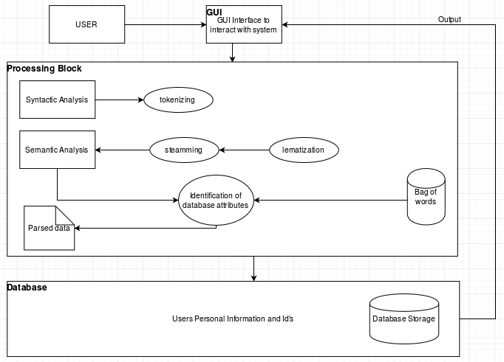
Software design architecture
Uploaded resumes are parsed using Natural language processing libraries like NLTK and Spacy
Parsed resumes are semantically compared with the job descriptions for ranking
We used Machine Learning algorithms like KNN for fetching the best fit resume to the given job description

Slide 11
Assumptions and Dependencies
Assumptions
→ User uploads only the resumes formatted in PDF, word, or txt files
→ Only a multiple of 15 users are using system at a time.
→ The Parser parses the resumes and convert them into the text file and then
that text file is read to get the attributes of the candidate and store them in
structured form in the json file.
Dependencies
→ For GUI Angular has been used
→ Python programing language, NLTK, SciKit learn are used to parse and rank the
Resume documents and store the information in unstructured form.

Slide 12
Detailed analysis
→ Domain Establishment
→ Registration or Login Module
→ Parsing & Ranking
→ Morphological Analysis
→ Syntactic Analysis
→ Semantic Analysis
Notes:
Domain Establishment: This module is responsible for creating user accounts and database
creation as the proposed system is domain independent and would be used by multiple users.
Registration or Login Module: If the new user want to interact with our system he needs to
simply register into our system by completely filling details i.e. validation. If the user is already
existing he needs to login.
Parsing & Ranking: Parsing module is responsible for parsing the document and storing it in
json format which will later be used by the ranking module. Ranking module will then use the
json file and rank the candidates information according to his/her skills and the information will
be stored in the database.
Morphological Analysis: Morphology in linguistics is the study and description of how words
16
are formed in natural language
In this phase the sentence is broken down into tokens- smallest
unit of words, and determine the basic structure of the word.
Syntactic Analysis: The objective of the syntactic analysis is to find the syntactic structure of the
sentence.It is also called Hierarchical analysis/Parsing, used to recognize a sentence, to allocate
token groups into grammatical phrases and to assign a syntactic structure to it.
Semantic Analysis: Semantic Analysis is related to create the representations presentations for
meaning of linguistics inputs. It deals with how to determine the meaning of the sentence from the
meaning of its parts.

Slide 13
Model Performance
Out of all the models that were used to classify we got better performance with Linear SVM and XGBoost with minute differences in Cross validation scores
Accuracy can be improved if the data size is more to train the model since train and test data are not in Correlation
Linear SVM is taking more time compared to XGBoost which made us choose XGBoost over SVM for the UI integration
Model | Accuracy Score
Multinomial Naive Bayes | 57.57
Decision Tree | 58.76
Linear SVM | 63.84
XGBoost | 64.98

Slide 14
Cloud Technology
Challenges
→ Google Cloud
→ Google Cloud functions
→ Google logger → Firebase
→ Fire store
→ Server less are slower
→ Machine learning required large memory
→ Google logger are easy and cloud logging → Firebase to store documents in No-Sql DB
→ Fire store to save files and SCM(Source Code management)

Slide 15
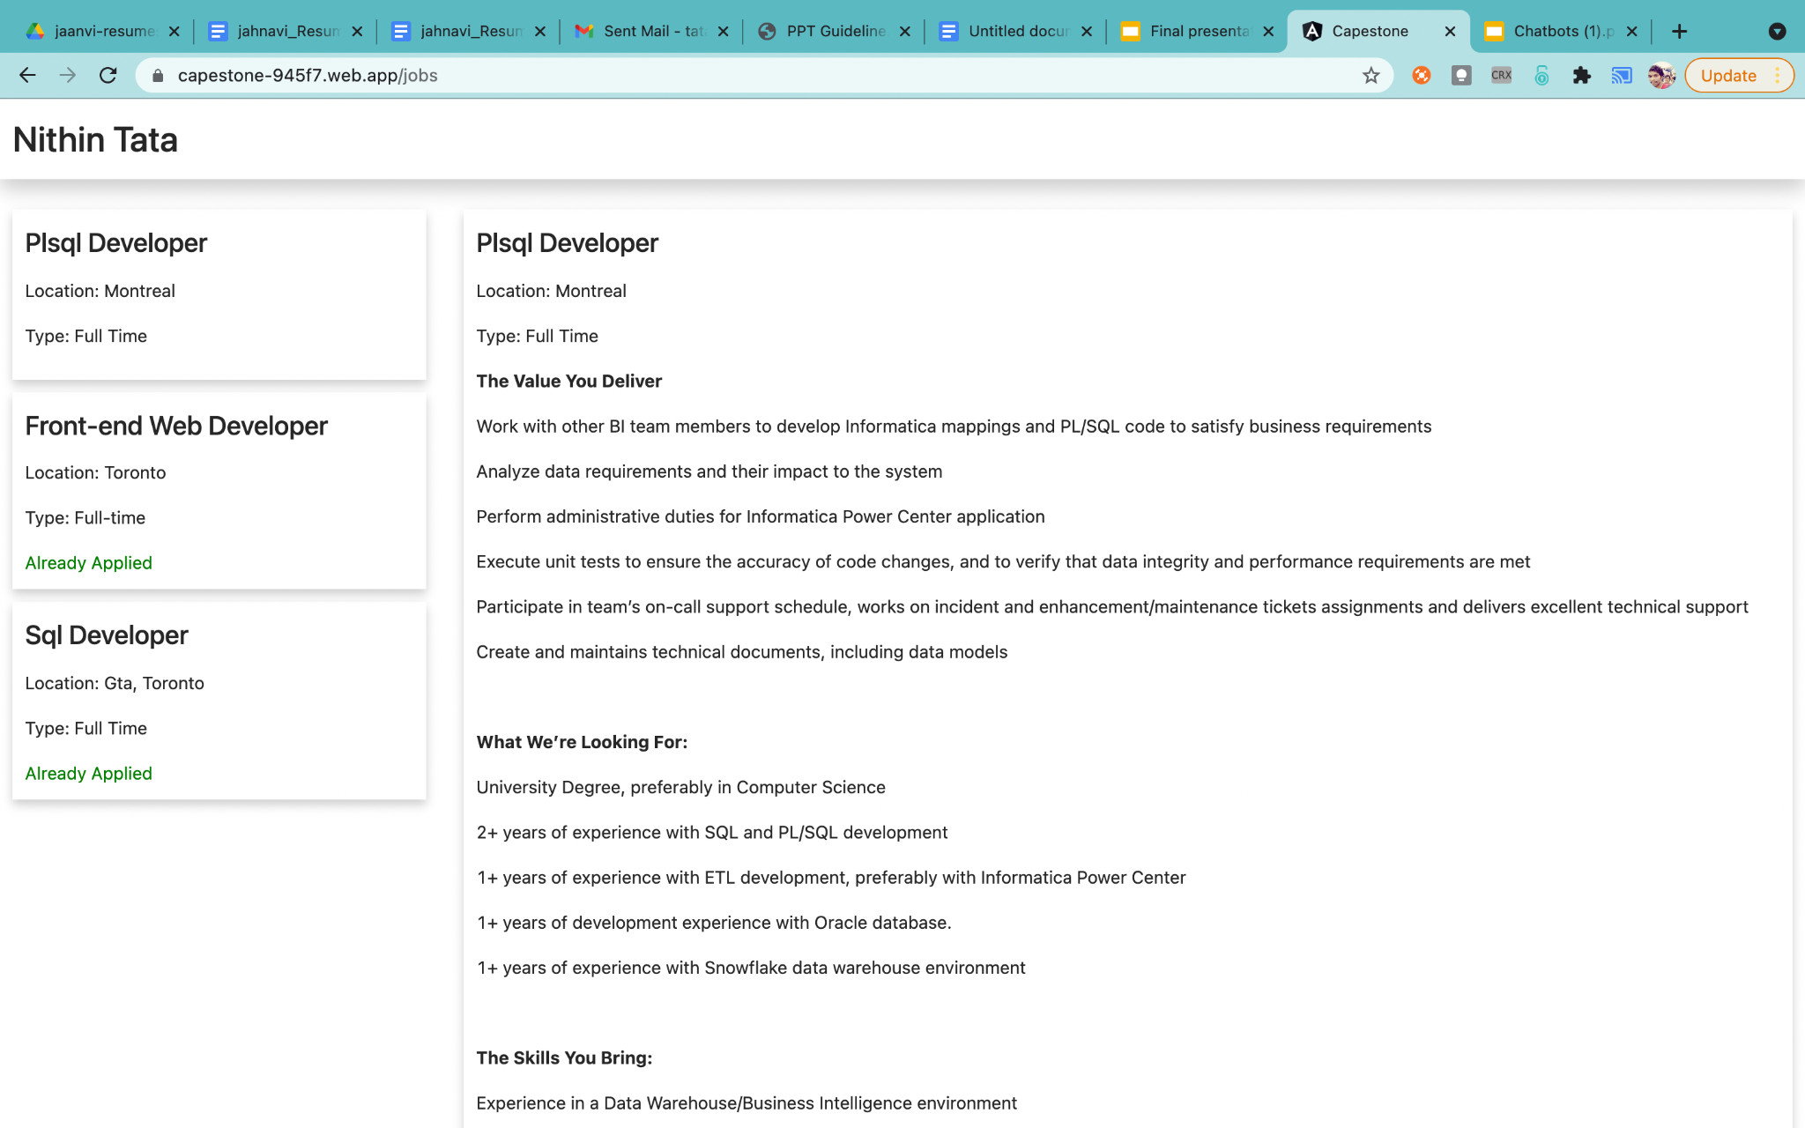
User page to upload resume

Slide 16
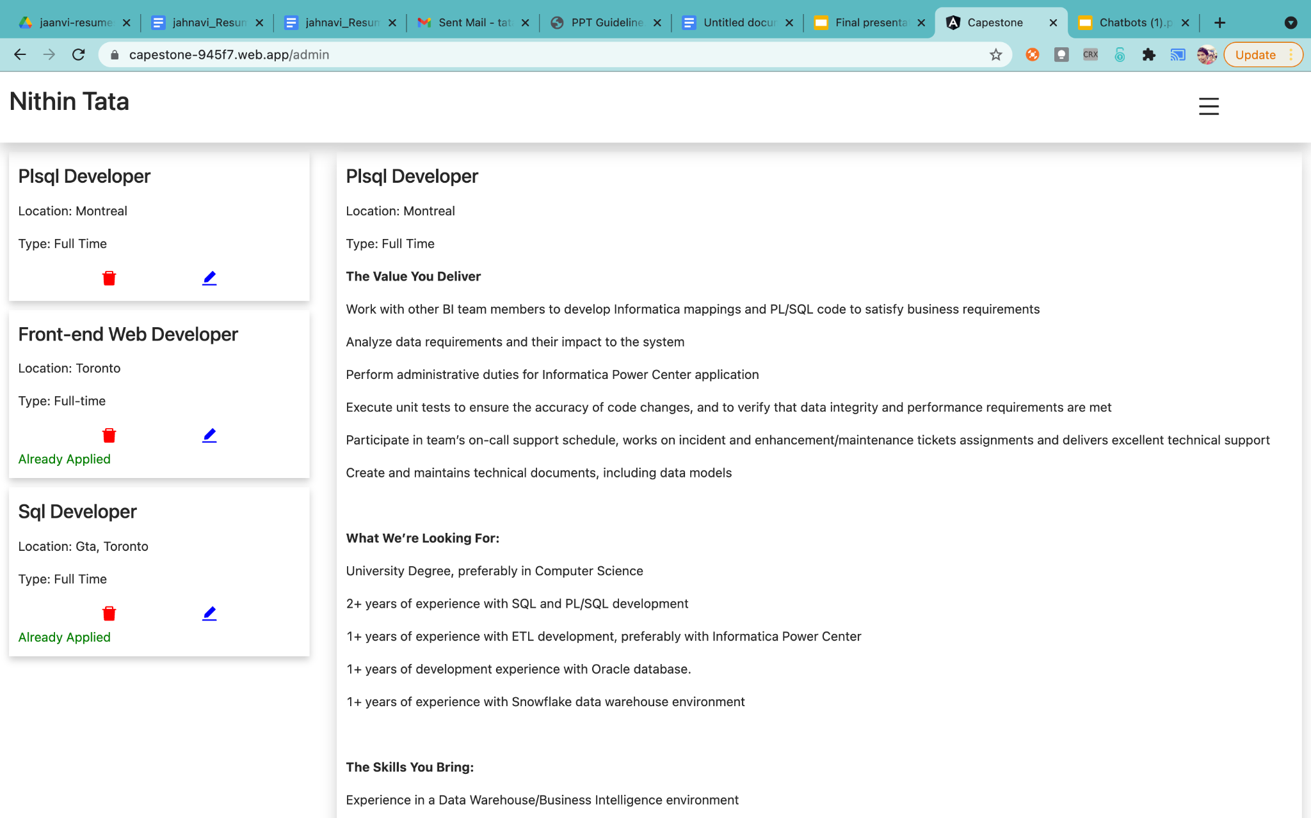
Admin page to add update posts

Slide 17
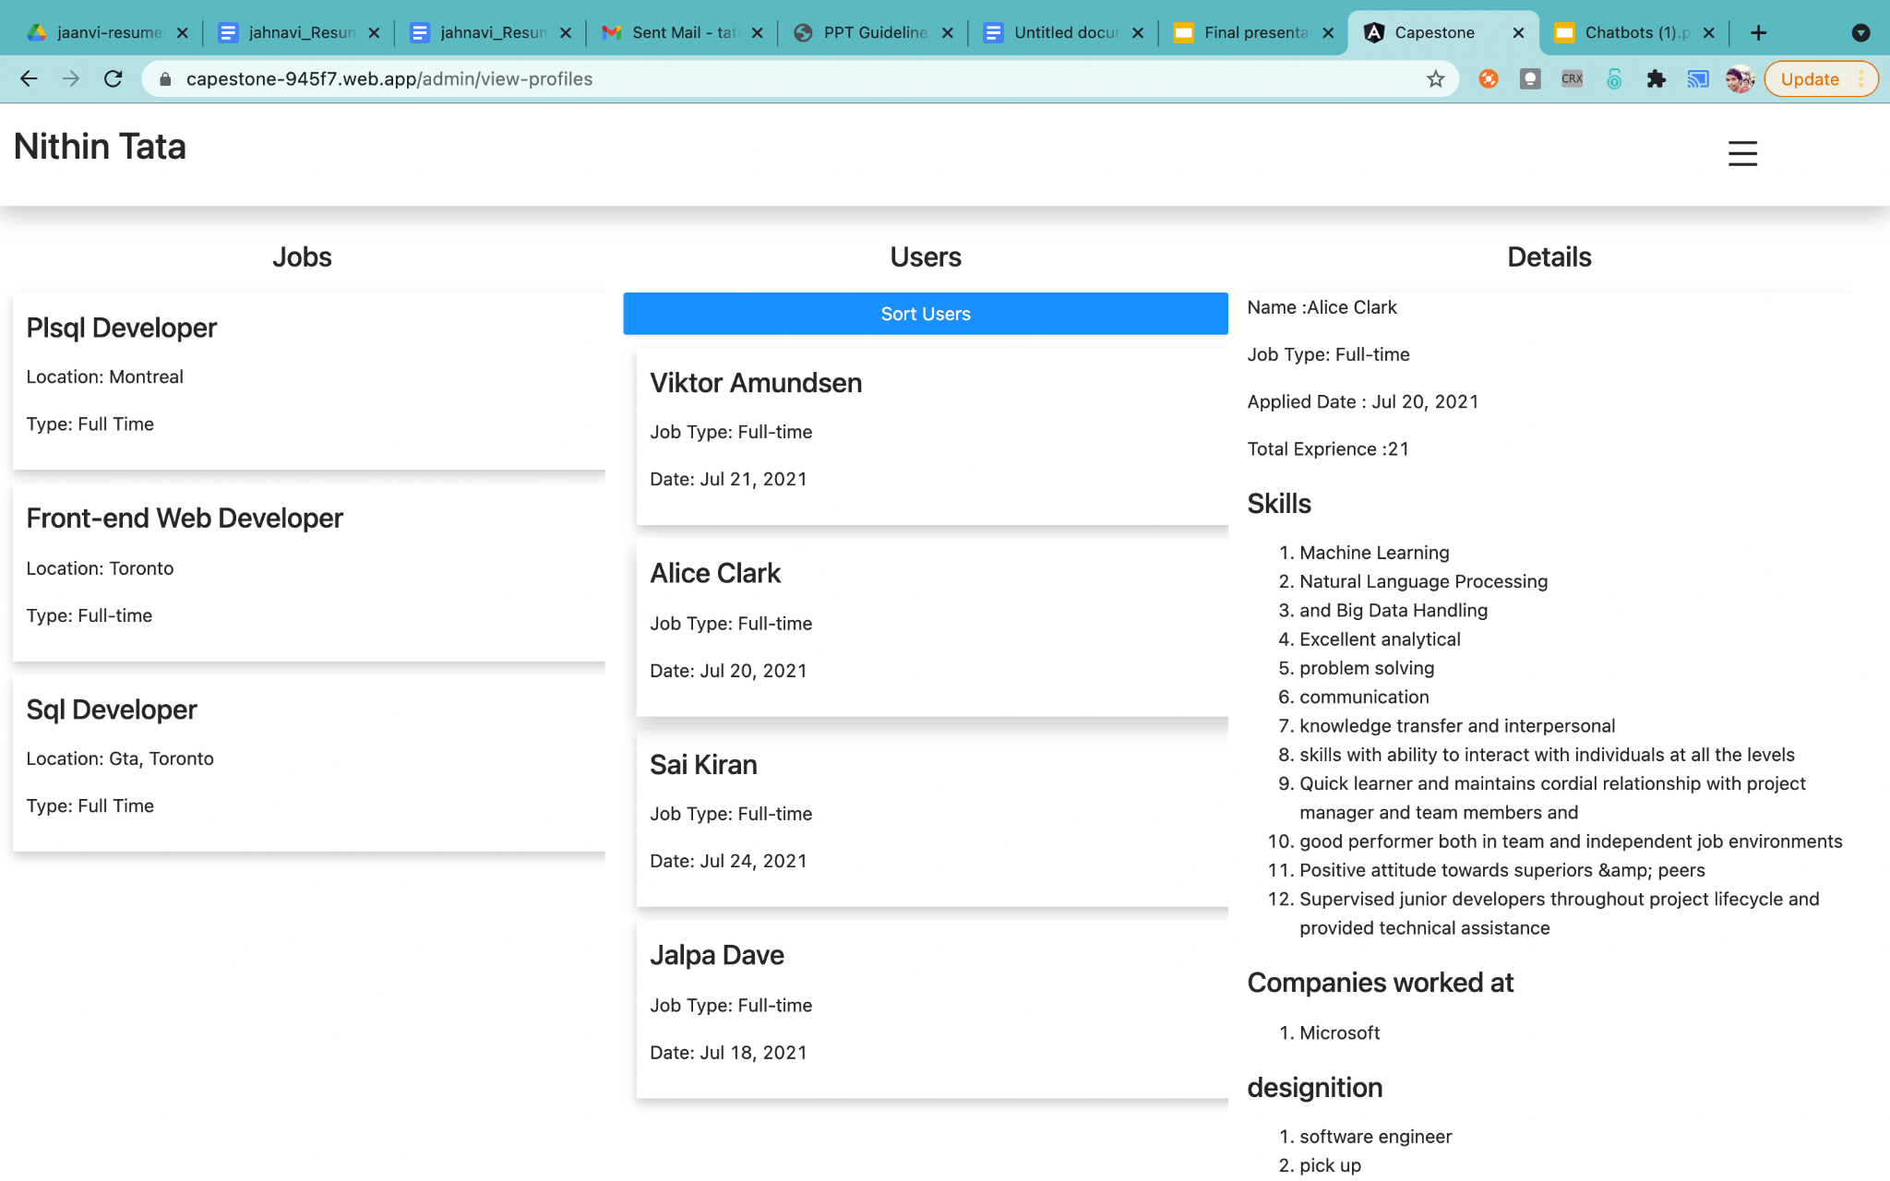
Admin page to add view-profiles

Slide 18
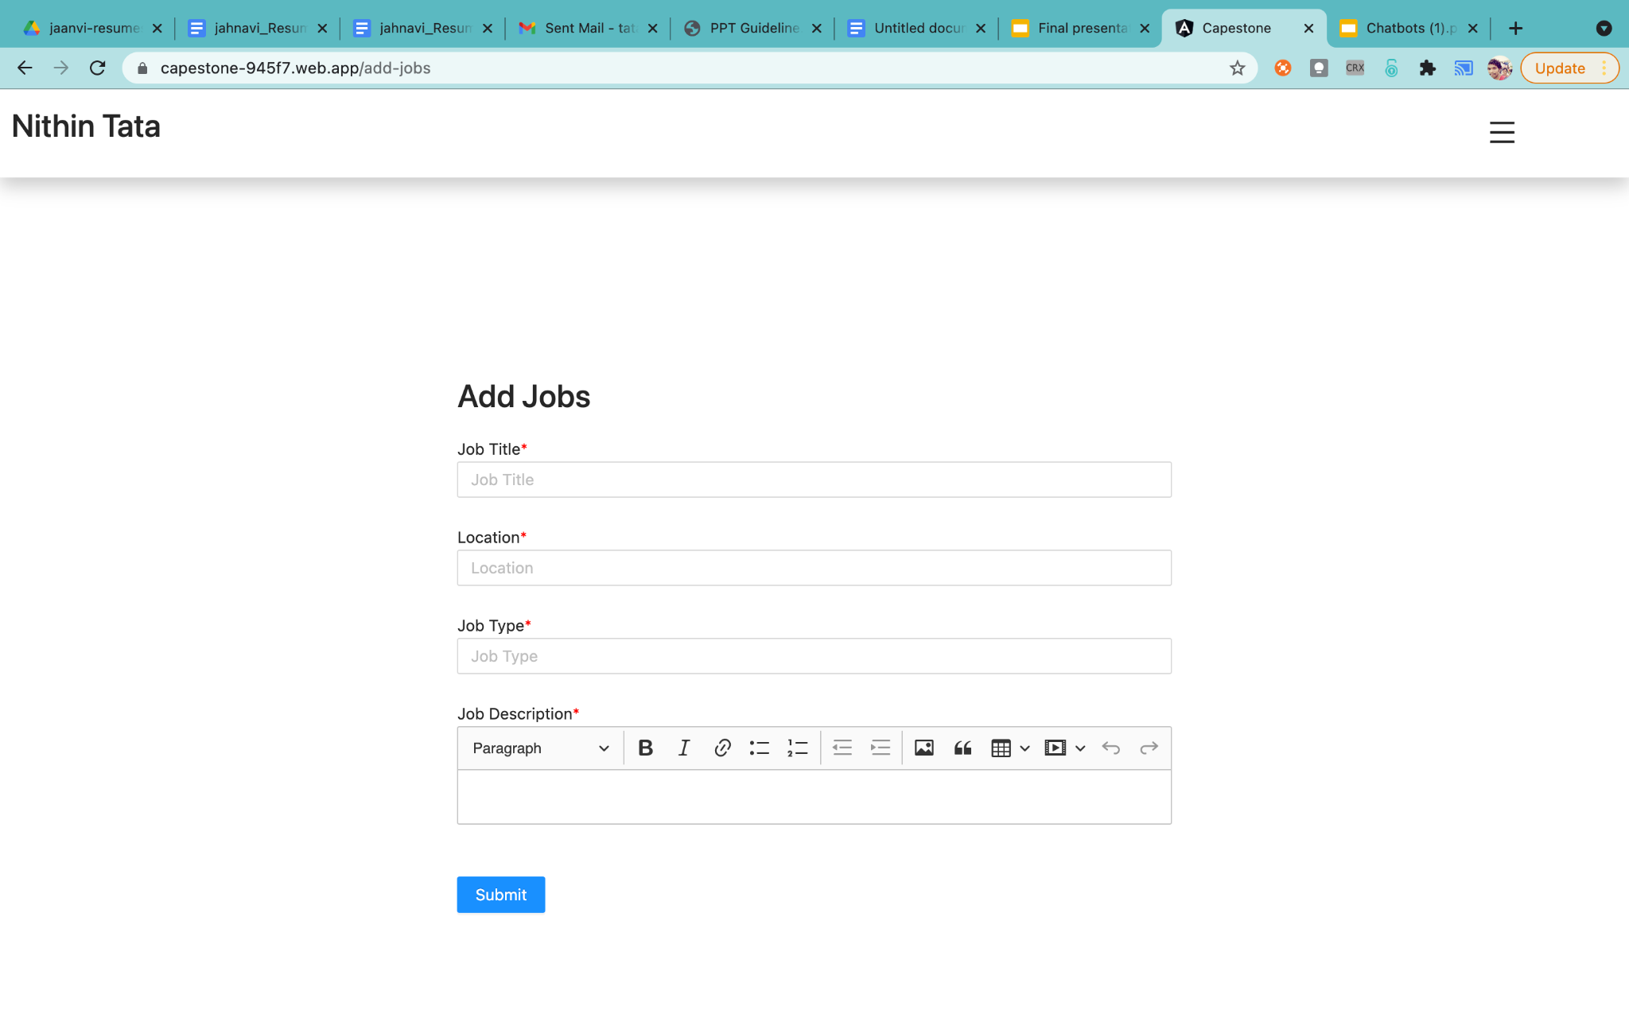
Admin page to add job posts

Slide 19
Demo and page URLs.
To Apply jobs:
https://capestone-945f7.web.app/jobs
To view Admin Dashboard:
https://capestone-945f7.web.app/admin

Slide 20
Results and Discussion
Test cases and Results : When the candidate submits his/her resume it is ranked and stored in the database and later retrieved when required GUI.

Slide 21
Future Scope
The application can be extended further to other domains like Telecom, Healthcare, Ecommerce and public sector jobs. At present this works only for software related jobs.
At present ranking is only done based on the uploaded resume, future parameters like linkedin posts, stack overflow profile and Github repos also be considered in future version.

Slide 22
Conclusion
Our system will provide better and efficient solution to current hiring process. This will provide potential candidate to the organisation and the candidate will be successfully be placed in an organisation which appreciate his/her skills and ability. The user interface is also very simple to use for both employees who want to apply for jobs and for recruiters who want to add jobs without any hassle.

Slide 23
Any Questions?

Slide 24
Thank You

