Slide 1

AGI HACKATHON 2026: CO2 Emissions and Cost Optimization through Celonis
</>JavaCuppaMatcha</>
Noah Graber, Isaac Elias, Nafkot Makonnen, Nithin Vijaykumar, Omar Mohamed, Tyrike Daniels

Slide 2
Problem Statement: How can we reduce cost of travel while also reducing environmental impact?

Slide 3
Process Optimization:
Net-Zero Path:
Unfunded Missed Trips (Saves 2 million kg CO2)
Reimbursed Anomalies ($6M saved)
Ad-hoc Transport (Saves $16.2M)
Booking Timing (Saves $3.5M)
CO2 Offset
Using saved money to buy carbon credit
Beneficial for EU Regulation
Attractive to Investors and Customers

Slide 4
Process Optimization: Unfunded Missed Trips
1,059,518.36 kg (n = 573)
Amount of CO2 spent on out-of-policy, purposeless trips that never end up getting approved.
3,000,030.71 kg (n = 2255)
Amount of CO2 spent on general trips (both in and out of policy) that never end up getting approved but have no listed reason.
AVERAGE: 2,029,774.54 kg

Slide 5
Process Optimization: Reimbursed Anomalies
$5,977,500 (n = 2,791)
Amount of money spent on out-of-policy trips that, without authorization…
Change/miss flights
Change means of transportation
Change hotels
A good policy to implement may be to deny reimbursement in these cases

Slide 6
Process Optimization: Reimbursed Anomalies
4,802,659.02 kg CO2 (n = 2,791)
Emissions removed by eliminating the aforementioned cases
6,869,234.49 kg CO2 (n = 12,645)
Emissions removed by making the remainder of out-of-policy emissions operate on the average CO2 emissions of in-policy trips (Minimizing first/business class flights, etc.)
TOTAL CO2 REDUCED: 11,671,893.51 kg

Slide 7
Preferred vs Optimal Transport
Objective: $16.2M travel cost optimization opportunity
Problem: Identify systematic cost inefficiencies and their respective optimizations
Solution: Algorithmic vehicle selection based on distance thresholds exposed via simulation
Impact: 19,853 suboptimal trips → $16.2M annualized savings
Important note:
This analysis excludes net cost and carbon footprint information discovered unfunded missed trips & reimbursed anomalies

Slide 8
Preferred vs Optimal Transport
Approach: Identified cost leakage channels
Asses misallocation: Premium vehicles for inefficient routes
Suboptimal expenditure & operating expenses: Wrong transportation mode selection
Lack of systemic Decision framework: Ad-hoc vehicle choices
Case Study: Hamburg-Berlin (255 km)
Current: BMW 3 diesel → $3,900
Optimal: FIat 500 electric → $668
Variance: $3,232 (83% cost inefficiency)
Alpha Opportunity: Systematic, not random (unpredictable)
Notes:
Capital expenditure — CAPEX
Operating exepensises — OPEX
Ad-hoc — describes something created or done for a specific, immediate purpose or situation, rather than as part of a general plan

Slide 9
Preferred vs Optimal Transport
Results: Optimization framework
Data pipeline:
Monte Carlo simulation → Alternative scenarios
Find distances between cities, identify best-fit mode of transportation in terms of reduced travel costs
Distance (km) | Total Savings | Trip Count | Avg. Savings
300-800 | 3,895,482 | 4,431 | 879
50-300 | 270,572 | 241 | 1122
1,500-10,000 | 11,989,806 | 13925 | 861.03
Notes:
Ad-hoc — describes something created or done for a specific, immediate purpose or situation, rather than as part of a general plan

Slide 10
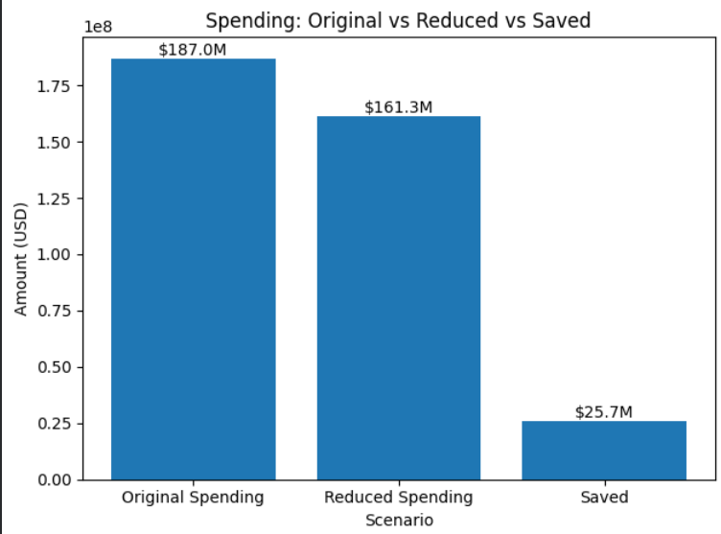
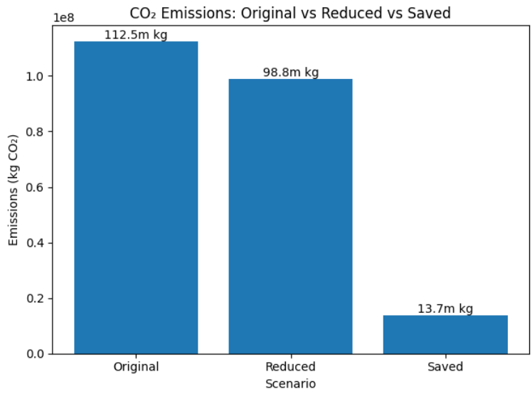
Total Money and CO2 Saved

Slide 11
Carbon Offset: Carbon Credits and Going Net Zero
What is a carbon Credit?
1 credit = 1 metric ton CO2 emission
Counteracts emissions through verified vendors
Example: Pay X$ and third party will remove Y kg of CO2
How official is it?
Verified venders follows VCS (Verified Carbon Standard)
Official documentation
Gives authority to make legal and financial claims in regards to emissions

Slide 12
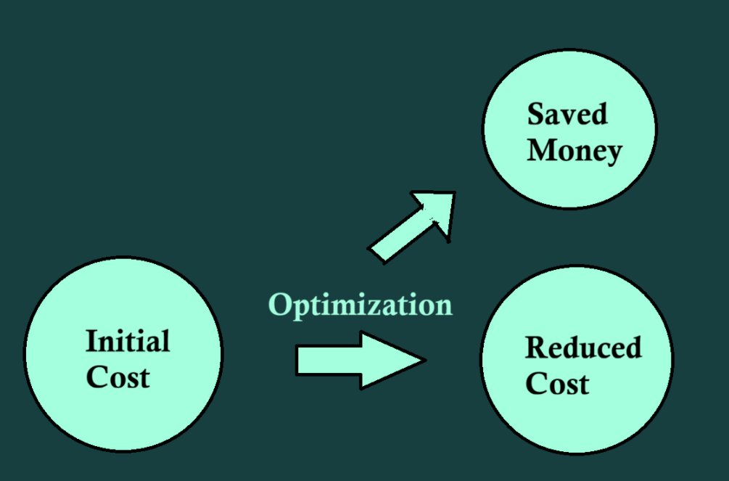

Slide 13
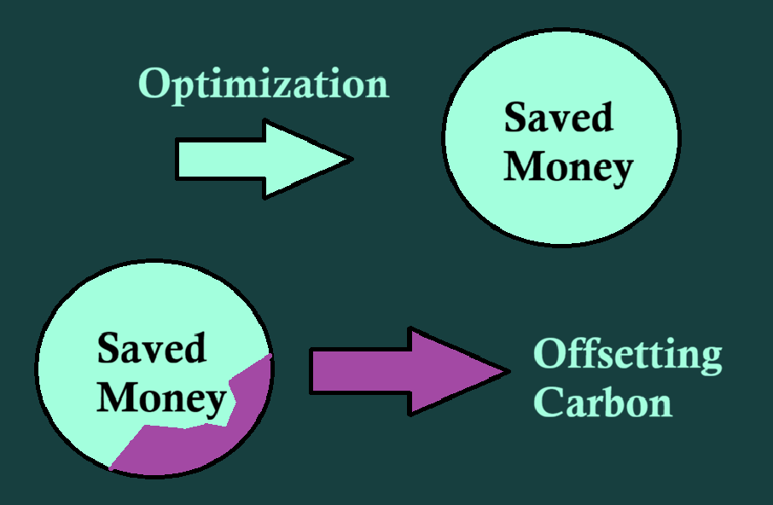

Slide 14
Carbon Offset: Cost Analysis
How much does it cost to remove 1 tonne of CO2?
1 credit = 1 metric ton CO2 emission
Depends on time of year and company
Approximately 10 - 20 dollars per company
Specific Examples:
CoolEffect.org lets you purchase 1 credit for $12
TradeWater.co lets you purchase 1 credit for $21
Most official vendors lay within this range

Slide 15
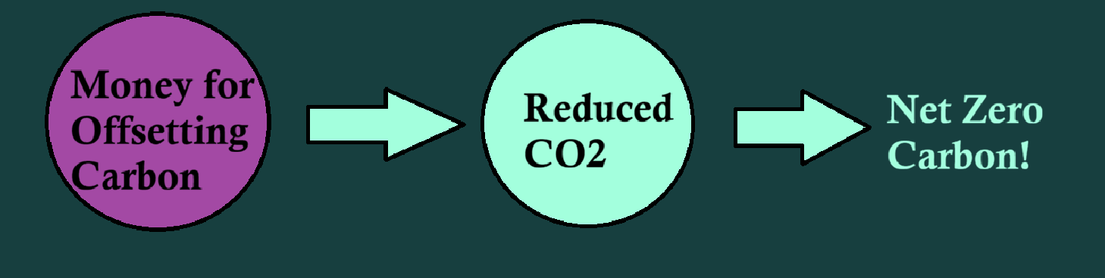
Carbon Offset: Cost Analysis
By using the price of a carbon credit set at $12:
Makes price to remove carbon 83.3kg/$
Remaining carbon emissions total to 98.8 million kg
It would cost 1.186 million $ to completely offset the remaining emissions
That’s only 0.63% of the original travel costs!

Slide 16
Carbon Offset: Legal and Company Benefits
Even without direct emissions, the organization remains subject to carbon taxation
Most company emissions fall under Scope 3, covering indirect value chain emissions
Scope 3 includes suppliers, transportation, and employee commuting Offsetting Scope 3 emissions is essential to achieving net zero and reducing financial risk
Notes:
Although our organization does not generate significant direct emissions, we are still accountable for Scope 3 emissions, which make up the majority of our reported carbon footprint. These are indirect emissions that occur across the value chain, including suppliers, transportation, and employee commuting, and they sit outside our direct operations. While Scope 3 emissions are not directly taxed, they are increasingly required to be reported and scrutinized by regulators, investors, and customers, making their measurement and reduction essential to achieving our net-zero commitments and managing long-term business risk. Using carbon credits allows us to compensate for unavoidable emissions by funding certified projects that reduce or remove carbon elsewhere, directly lowering our net reported emissions while we continue to drive operational reductions.

Slide 17
Carbon Offset: Legal and Company Benefits + green ROI
ESG Overview
Measures environmental, social, and governance performance beyond financials
Critical for risk management, investor confidence, and long-term sustainability Carbon Offsets and Green ROI
Enhance brand reputation, customer loyalty, and investor appeal
Support compliance while improving efficiency and CSR outcomes
Notes:
ESG stands for Environmental, Social, and Governance, a framework used to measure a company's sustainability, ethical impact, and risk management beyond just financial performance. It is critical for attracting investors, reducing operational risks, enhancing reputation, and ensuring long-term viability by meeting stakeholder demands for responsible corporate behavior. The Carbon Offset also increases our green ROI, I by enhancing brand reputation, boosting customer loyalty, attracting investors, and ensuring regulatory compliance, while also driving operational efficiencies and supporting Corporate Social Responsibility.

Slide 18
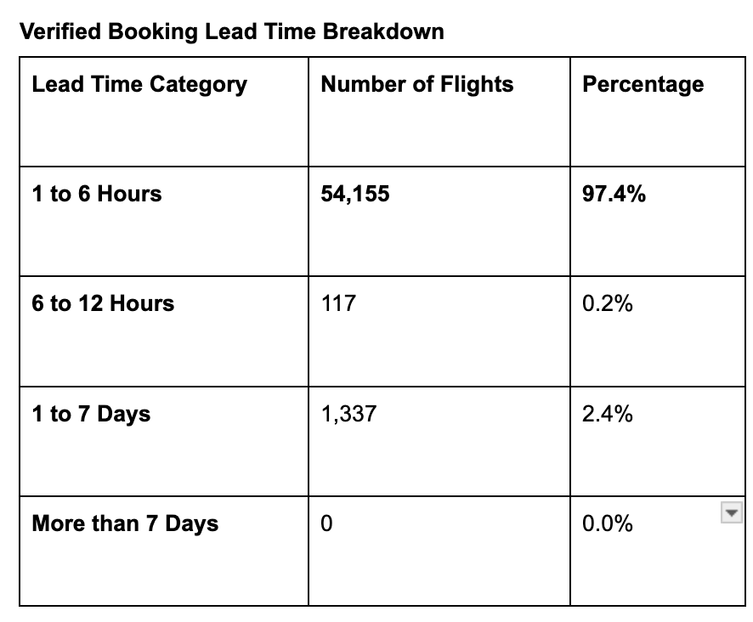
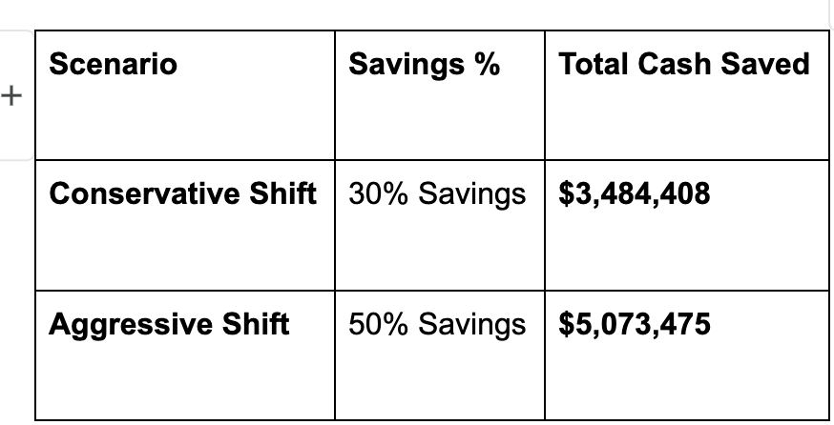
Last min book and potential saving
Change last minute booking to 7 - 14 days.
Avoid same-day seats. “walk-up" fares
Here is what you could save on that $116M spend on last min booking.(1 - 6 hours).
Notes:
Most of the trips are booked at the last minute By enforcing a 7 to 14 days advance booking policy, we eliminate the premium that have to be paid for same-day seats. Based on airline industry benchmarks for advance vs. "walk-up" fares, here is what you could save on that $116M spend on last min booking.(1 - 6 hours).

Slide 19
Policy suggestion.
From most of the given data, 21,299 trips were in high-class flights.
Business Class: 20,015 trips (42.9$ Million | 47.9 Million kg of CO2 emission)
First Class: 1,284 trips (2.7$ Million | 4.2 Million kg CO2)
Policy changes.
Level 6,000 -8,000 downgrade to economy
Level 10,000 downgrade to Business
Estimated SAVINGS: 6.8 MIllion dollars
Estimated Carbon Reduction: 17 Million kg CO2

Slide 20
Conclusion: Total Saved/Reductions
Pool of Potential Savings Before CO2 Offset: $25.7 million
Pool of Potential Savings After CO2 Offset: $24.5 million
CO2 Reduced Before Carbon Offset: 13.7 million kg
Total CO2 Reduced: 112.5 million kg CO2

