Slide 1

Final Group Project PROG8790 | Android Wear Development
HomeCareSquad – Professional home services at one place
Group 11

Slide 2

Group Members
Nithish Jagadeesan - 8875048
Shubham Sunilkumar Pandey - 8788878
Arpitkumar Solanki - 8866682

Slide 3
Application Description
With the help of this mobile app, HomeCareSquad, customers can quickly and easily complete jobs around the house by connecting with various home service providers.
HomeCareSquad can assist you with any home-related service, including plumbing, cleaning, repairs, gardening, and more.
HomeCareSquad guarantees that users can quickly identify and employ reputable professionals for their unique needs.

Slide 4

Objective
Features | Giinie | HomeCareSquad
Login and Signup
Service Listings
Scheduling and Booking
User-Friendly Interface
Payment
AI Chatbot
Camera, Microphone, Geolocation

Slide 5
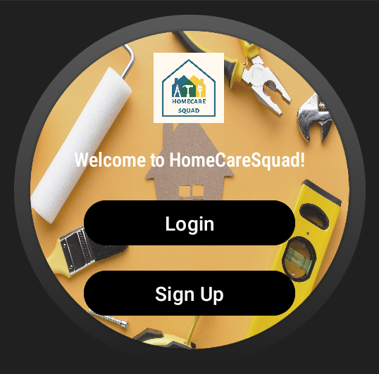
Key Features
1. Home Page
The homepage features prominently displayed login and signup buttons, offering users easy access to begin their journey with our platform.

Slide 6
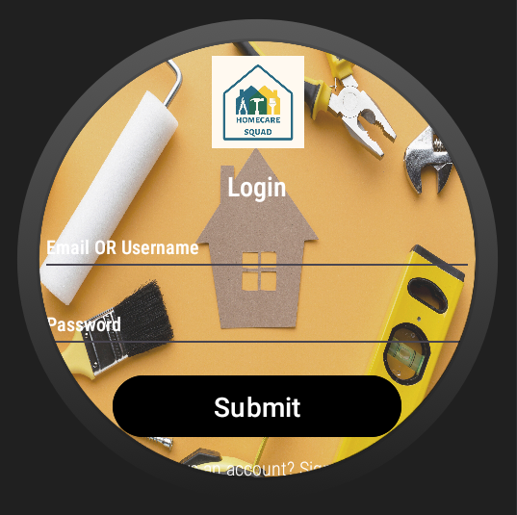
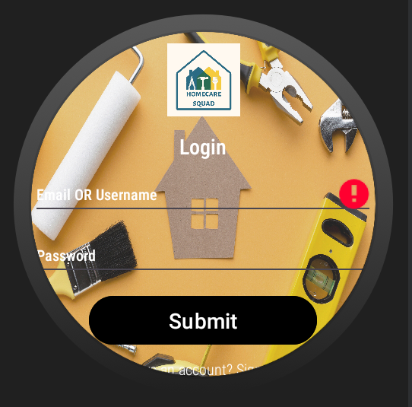
Key Features
2. Login Page
The login page provides a straightforward interface where users can securely access their accounts by entering their credentials.

Slide 7

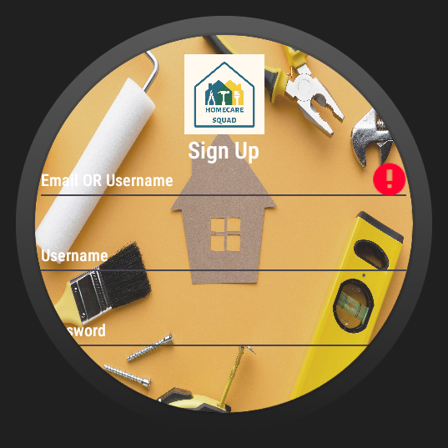
Key Features
3. Signup Page
The signup page allows new users to create accounts quickly and easily by providing necessary information, enabling them to join our platform and access our services.

Slide 8

Key Features
4. Service Listings
The service listings page displays a comprehensive list of available home care services, providing users with a variety of options to choose from based on their needs and preferences.

Slide 9

Key Features
5. Service Details Page
The service details page offers a detailed breakdown of the selected service, presenting users with three distinct levels of service: basic, standard, and premium.

Slide 10
Service Levels
Each level comes with its own set of features and pricing options, empowering users to choose the option that best suits their requirements and budget
Basic-level services typically offer essential features or functionalities at the lowest cost, providing the fundamental level of service without additional frills or enhancements.
Standard-level services usually include a broader range of features or higher quality compared to basic services, offering a middle-ground option with moderate pricing.
Premium-level services represent the highest tier, offering the most comprehensive features, highest quality, or additional perks compared to basic and standard services, often at a premium price.

Slide 11
Service offerings price list
Service | Basic | Standard | Premium
Plumbing | $29.99 | $39.99 | $49.99
Cleaning | $24.99 | $34.99 | $44.99
Repairs | $19.99 | $29.99 | $39.99
Gardening | $129.99 | $139.99 | $149.99
Home Spa | $49.99 | $59.99 | $69.99
Electrical | $39.99 | $59.99 | $79.99

Slide 12
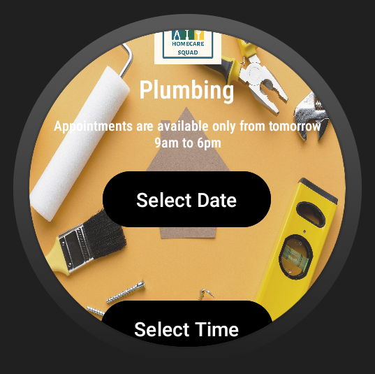
Key Features
6. Appointment Page
The appointment page facilitates scheduling by allowing users to select preferred dates and times for their service. Upon confirmation, it seamlessly transitions users to the payment page, ensuring a hassle-free booking experience.

Slide 13
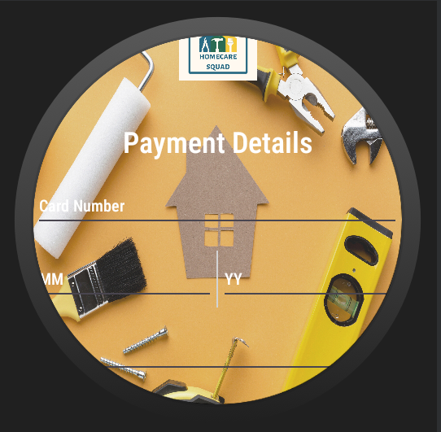
Key Features
7. Payment Page
The payment page provides a secure platform for users to complete transactions for their selected services. It offers multiple payment options and ensures the confidentiality of users' financial information, guaranteeing a safe and convenient payment process.

Slide 14
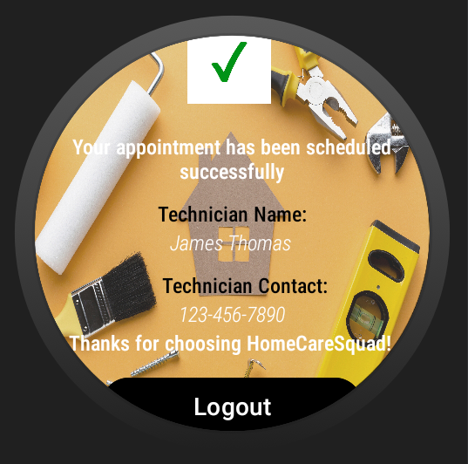
Key Features
8. Confirmation Page
The confirmation page serves as a final confirmation step, displaying details of the scheduled appointment, including the selected services, and technician details. It reassures users that their appointment has been successfully booked and provides any additional information they may need, such as contact details or instructions for the appointment.

Slide 15
Upcoming Updates
We're excited to share our future plans that we’ll enhance the user interface to provide an even better experience.
One of the key features we're introducing is an AI chatbot, which will be available to assist users in real time, making interactions more intuitive and efficient.
Additionally, in the future users have the ability to conveniently view their past bookings directly within the app, allowing for easier access to their service history.
Furthermore, we’ll implement a feedback and review system directly within the app, empowering users to share their thoughts and experiences seamlessly.
These improvements aim to make our platform more user-friendly, engaging, and responsive to the needs of our valued users.

Slide 16
Thank You!

