Slide 1
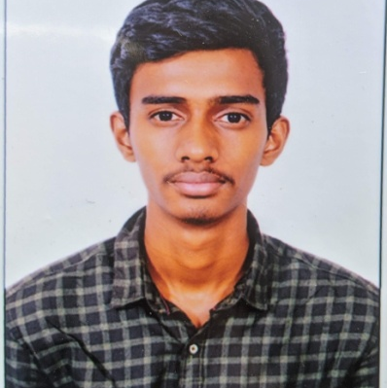



Nithish Reddy Gangannagari
Analyst/Software Engineer
Bachelor of Engineering
Electronic and communication: 2018- 2022
Skills
Bangalore
Java 8 /J2EE | Java Basics, OOPS, Generics, Collections, Arrays, Loops, Lambda Exp, Stream API Junit, Mockito, Servlets
Spring core | IOC & Dependency Injection, Autowire
Spring REST | REST controllers, Implementation of GET, POST, PUT & DELETE, Bean Validation & Exception Handling, Testing Services, Controller & Repository layer
Spring Data JPA | Implement DAO layer using spring Data repositories, Transaction Management
Spring Boot Microservices | Spring Boot Starters, annotations, Messaging Service, Sync/Async comms, Swagger API documents
Spring Cloud | Eureka, Netflix Ribbon, Feign Client, Netflix Hystrix, Netflix Zuul & Config Server
React | Components, Hooks, Event handling, Redux, Reducers.
Database | MongoDB No Sql Basics Postgres SQL RDS Basics
UI Tech | HTML 5 & CSS 3,JavaScript, ES6 & TypeScript Reusable templates, Optimized UI Designed
Tools | Git, Postman, Maven, IDE
Add On skills | Communications, Team management. Peer learning
gnitishreddy0245@gmail.com
+91 9618729788
A4
Full Stack Developer
Hands on experience in creating microservices with Springboot, Spring Security, Spring Cloud API Gateway, Eureka server, load balancing, JWT security Authentication, Role Based Authorization,RabbitMQ,Junit5,Mockito.
Proficient in creating Single page Web Application in React with Authentication with route guards, React reactive forms, React routing,Html5,CSS3,Bootstrap 5.
Hands on experience in implementing Microservice architecture with NodeJs & spring boot, MongoDB Atlass
Implemented Nodejs and ExpressJs in case study and upskilling his knowledge continuously.
Experience in creating documentation with Java docs and swagger and in unit testing using Junit, Mockito
In-Depth understanding of deploying spring boot applications in Github repository
CropDeal Application
Completed end to end case study of CropDeal Application along with JWT authentication, Swagger and payment testing using Stripe, responsive UI with Tailwind CSS and Angular used for user interface.
WebDeveloper :Zero to Mastery course at Udemy
Completed this course and Designed responsive portfolio website using HTML5 CSS3 Bootstrap and Javascript.
Certified AWS Cloud Practitioner
Certified in "python for everybody" from Coursera by University of Michigan
Certified in "python development " from Udemy by ZTM academy
Check out my work on GitHub & Video Profile

