Slide 1
CHAT APPLICATION USING KOTLIN
-

Slide 2
DESCRIPTION
CometChat UI Kit for Android is a comprehensive collection of pre-built UI components that simplify the integration of advanced in-app chat features. It supports one-on-one messaging, group chats, stickers, and audio/video calling, providing an out-of-the-box solution for real-time communication. With customizable themes, fonts, and a variety of extensions, the UI Kit allows developers to quickly create a rich and interactive chat experience.
Key Features
Instant Messaging: Real-time text messaging for both individual and group chats with support for multimedia sharing.
Extensions: Comes with 12 powerful extensions such as Stickers, Calls (audio/video), File Sharing, and more, which can be easily enabled via the CometChat Dashboard.
Call Integration: Full support for one-on-one and group audio/video calling using the CometChat Calls SDK, with customizable UI for incoming call notifications.
Customizable Themes: Choose between light and dark themes, or fully customize the look and feel of the chat UI with colors, fonts, and layouts.
Message Composer: A robust message composer component, supporting text, stickers, media, and quick replies.
Incoming Call UI: The CometChatIncomingCall component provides an intuitive UI for answering or declining incoming calls, fully customizable for your app.
User Experience Focused: Designed to provide a smooth and interactive user experience with minimal setup.
Easy Integration: Simple setup with step-by-step guides, and automatic integration of features once enabled from the dashboard.
Benefits
Comprehensive Chat Solution: Full messaging, audio/video call, and media-sharing features in a single package.
Rich Extensions: Enhance your chat app with fun and engaging features like stickers, calls, and real-time file sharing.
Seamless Communication: Real-time, lag-free messaging and calling for optimal user interaction.
Time-Saving: Developers can integrate a fully functional chat system without the need for building from scratch.

Slide 3
Main Activity.java:
package com.cometchat.kotlinsampleapp.activity
import android.content.Intent
import android.content.res.ColorStateList
import android.os.Bundle
import android.view.View
import android.widget.ImageView
import android.widget.LinearLayout
import android.widget.ProgressBar
import android.widget.TextView
import android.widget.Toast
import androidx.appcompat.app.AppCompatActivity
import androidx.appcompat.widget.AppCompatImageView
import androidx.appcompat.widget.AppCompatTextView
import androidx.core.content.ContextCompat
import com.bumptech.glide.Glide
import com.cometchat.chat.core.CometChat
import com.cometchat.chat.exceptions.CometChatException
import com.cometchat.chat.models.User
import com.cometchat.chatuikit.shared.cometchatuikit.CometChatUIKit

Slide 4
import com.cometchat.chatuikit.shared.cometchatuikit.UIKitSettings.UIKitSettingsBuilder
import com.cometchat.chatuikit.shared.resources.utils.Utils
import com.cometchat.kotlinsampleapp.AppConstants
import com.cometchat.kotlinsampleapp.AppUtils
import com.cometchat.kotlinsampleapp.AppUtils.Companion.fetchDefaultObjects
import com.cometchat.kotlinsampleapp.BuildConfig
import com.cometchat.kotlinsampleapp.R
import com.google.android.material.card.MaterialCardView
import org.json.JSONObject
class MainActivity : AppCompatActivity() {
private lateinit var user1: MaterialCardView
private lateinit var user2: MaterialCardView
private lateinit var user3: MaterialCardView
private lateinit var user4: MaterialCardView
private lateinit var ivLogo: AppCompatImageView
private lateinit var progressBar: ProgressBar
private lateinit var tvCometChat: AppCompatTextView
private lateinit var parentView: LinearLayout
private lateinit var gridLayoutContainer: LinearLayout
private lateinit var stateMessage: TextView

Slide 5
private lateinit var stateLayout: LinearLayout
private lateinit var user1Name: TextView
private lateinit var user2Name: TextView
private lateinit var user3Name: TextView
private lateinit var user4Name: TextView
private lateinit var user1Avatar: ImageView
private lateinit var user2Avatar: ImageView
private lateinit var user3Avatar: ImageView
private lateinit var user4Avatar: ImageView
override fun onCreate(savedInstanceState: Bundle?) {
super.onCreate(savedInstanceState)
val uiKitSettings =
UIKitSettingsBuilder().setRegion(AppConstants.REGION).setAppId(AppConstants.APP_ID)
.setAuthKey(AppConstants.AUTH_KEY).subscribePresenceForAllUsers().build()
CometChatUIKit.init(this, uiKitSettings, object : CometChat.CallbackListener<String?>() {
override fun onSuccess(s: String?) {
CometChat.setDemoMetaInfo(appMetadata)
if (CometChatUIKit.getLoggedInUser() != null) {
fetchDefaultObjects()

Slide 6
startActivity(
Intent(
this@MainActivity,
HomeActivity::class.java
)
)
finish()
} else {
viewInit()
}
}
override fun onError(e: CometChatException) {
Toast.makeText(this@MainActivity, e.message, Toast.LENGTH_SHORT).show()
}
})
}
private fun viewInit() {
setContentView(R.layout.activity_main)
parentView = findViewById(R.id.parent_view)

Slide 7
progressBar = findViewById(R.id.progress_bar)
stateMessage = findViewById(R.id.state_message)
stateLayout = findViewById(R.id.state_layout)
gridLayoutContainer = findViewById(R.id.grid_layout_container)
user1 = findViewById(R.id.user1)
user2 = findViewById(R.id.user2)
user3 = findViewById(R.id.user3)
user4 = findViewById(R.id.user4)
ivLogo = findViewById(R.id.ivLogo)
tvCometChat = findViewById(R.id.tvComet)
user1Name = findViewById(R.id.user1_name)
user2Name = findViewById(R.id.user2_name)
user3Name = findViewById(R.id.user3_name)
user4Name = findViewById(R.id.user4_name)
user1Avatar = findViewById(R.id.user1_avatar_image)
user2Avatar = findViewById(R.id.user2_avatar_image)
user3Avatar = findViewById(R.id.user3_avatar_image)
user4Avatar = findViewById(R.id.user4_avatar_image)
user1.visibility = View.GONE
user2.visibility = View.GONE
user3.visibility = View.GONE
user4.visibility = View.GONE

Slide 8
user1.setOnClickListener {
findViewById<View>(R.id.user1Progressbar).visibility = View.VISIBLE
login(user1.tag.toString())
}
user2.setOnClickListener {
findViewById<View>(R.id.user2Progressbar).visibility = View.VISIBLE
login(user2.tag.toString())
}
user3.setOnClickListener {
findViewById<View>(R.id.user3Progressbar).visibility = View.VISIBLE
login(user3.tag.toString())
}
user4.setOnClickListener {
findViewById<View>(R.id.user4Progressbar).visibility = View.VISIBLE
login(user4.tag.toString())
}
if (Utils.isDarkMode(this)) {
ivLogo.imageTintList = ColorStateList.valueOf(resources.getColor(R.color.white))
} else {
ivLogo.imageTintList =

Slide 9
ColorStateList.valueOf(resources.getColor(com.cometchat.chatuikit.R.color.cometchat_primary_text_color))
}
setUpUI()
}
private fun setUsers(users: List<User>) {
progressBar.visibility = View.GONE
stateLayout.visibility = View.GONE
gridLayoutContainer.visibility = View.VISIBLE
for (i in users.indices) {
if (i == 0) {
user1Name.text = users[i].name
Glide.with(this).load(users[i].avatar).error(R.drawable.ironman)
.into(user1Avatar)
user1.tag = users[i].uid
user1.visibility = View.VISIBLE
} else if (i == 1) {
user2Name.text = users[i].name
Glide.with(this).load(users[i].avatar).error(R.drawable.captainamerica)
.into(user2Avatar)
user2.tag = users[i].uid
user2.visibility = View.VISIBLE

Slide 10
} else if (i == 2) {
user3Name.text = users[i].name
Glide.with(this).load(users[i].avatar).error(R.drawable.spiderman)
.into(user3Avatar)
user3.tag = users[i].uid
user3.visibility = View.VISIBLE
} else if (i == 3) {
user4Name.text = users[i].name
Glide.with(this).load(users[i].avatar).error(R.drawable.wolverine)
.into(user4Avatar)
user4.tag = users[i].uid
user4.visibility = View.VISIBLE
}
}
}
private fun login(uid: String) {
CometChatUIKit.login(uid, object : CometChat.CallbackListener<User?>() {
override fun onSuccess(user: User?) {
fetchDefaultObjects()
startActivity(Intent(this@MainActivity, HomeActivity::class.java))
finish()
}

Slide 11
override fun onError(e: CometChatException) {
Toast.makeText(this@MainActivity, e.message, Toast.LENGTH_SHORT).show()
}
})
}
private fun setUpUI() {
if (AppUtils.isNightMode(this)) {
Utils.setStatusBarColor(
this, ContextCompat.getColor(
this, R.color.app_background_dark
)
)
parentView.backgroundTintList =
ColorStateList.valueOf(ContextCompat.getColor(this, R.color.app_background_dark))
tvCometChat.setTextColor(resources.getColor(R.color.app_background))
} else {
Utils.setStatusBarColor(this, resources.getColor(R.color.app_background))
parentView.backgroundTintList =
ColorStateList.valueOf(resources.getColor(R.color.app_background))
tvCometChat.setTextColor(resources.getColor(R.color.app_background_dark))

Slide 12
}
}
private val appMetadata: JSONObject
get() {
val jsonObject = JSONObject()
try {
jsonObject.put("name", resources.getString(R.string.app_name))
jsonObject.put("type", "sample")
jsonObject.put("version", BuildConfig.VERSION_NAME)
jsonObject.put("bundle", BuildConfig.APPLICATION_ID)
jsonObject.put("platform", "android")
} catch (e: Exception) {
e.printStackTrace()
}
return jsonObject
}
fun createUser(view: View?) {
startActivity(Intent(this, CreateUserActivity::class.java))
}
}

Slide 13
:AndroidManifest.xml
<<?xml version="1.0" encoding="utf-8"?>
<manifest xmlns:android="http://schemas.android.com/apk/res/android"
xmlns:tools="http://schemas.android.com/tools">
<uses-permission android:name="android.permission.INTERNET" />
<uses-permission android:name="android.permission.READ_EXTERNAL_STORAGE" />
<uses-permission android:name="android.permission.MANAGE_EXTERNAL_STORAGE" />
<uses-permission android:name="android.permission.WAKE_LOCK" />
<application
android:name="com.cometchat.kotlinsampleapp.Application"
android:allowBackup="true"
android:dataExtractionRules="@xml/data_extraction_rules"
android:fullBackupContent="@xml/backup_rules"
android:icon="@mipmap/ic_launcher"
android:label="@string/app_name"
android:requestLegacyExternalStorage="true"
android:roundIcon="@mipmap/ic_launcher_round"
android:supportsRtl="true"

Slide 14
android:theme="@style/Base.Theme.CometChatSampleAppKotlin"
tools:targetApi="31">
<activity
android:name="com.cometchat.kotlinsampleapp.activity.LoginActivity"
android:exported="false" />
<activity
android:name="com.cometchat.kotlinsampleapp.activity.HomeActivity"
android:exported="false" />
<activity
android:name="com.cometchat.kotlinsampleapp.activity.CreateUserActivity"
android:exported="false" />
<activity
android:name="com.cometchat.kotlinsampleapp.activity.ComponentLaunchActivity"
android:exported="false" />
<activity
android:name="com.cometchat.kotlinsampleapp.activity.ComponentListActivity"
android:exported="false" />
<activity
android:name="com.cometchat.kotlinsampleapp.activity.MainActivity"
android:exported="true">
<intent-filter>
<action android:name="android.intent.action.MAIN" />

Slide 15
<category android:name="android.intent.category.LAUNCHER" />
</intent-filter>
</activity>
<meta-data
android:name="preloaded_fonts"
android:resource="@array/preloaded_fonts" />
</application>
</manifest>
Application.kt
package com.cometchat.kotlinsampleapp
import android.app.Application
import android.content.res.Configuration
import com.cometchat.chat.core.Call
import com.cometchat.chat.core.CometChat
import com.cometchat.chatuikit.calls.CometChatCallActivity
import com.cometchat.chatuikit.shared.resources.theme.CometChatTheme
import com.cometchat.chatuikit.shared.resources.theme.Palette
import com.cometchat.kotlinsampleapp.AppUtils.Companion.isNightMode

Slide 16
class Application : Application() {
override fun onCreate() {
super.onCreate()
addCallListener()
if (isNightMode(this)) {
Palette.getInstance().mode(CometChatTheme.MODE.DARK)
}
}
override fun onConfigurationChanged(newConfig: Configuration) {
super.onConfigurationChanged(newConfig)
if (isNightMode(this)) {
Palette.getInstance().mode(CometChatTheme.MODE.DARK)
} else {
Palette.getInstance().mode(CometChatTheme.MODE.LIGHT)
}
}
private fun addCallListener() {
val LISTENER_ID = System.currentTimeMillis().toString() + ""
CometChat.addCallListener(LISTENER_ID, object : CometChat.CallListener() {

Slide 17
=
override fun onIncomingCallReceived(call: Call) {
CometChatCallActivity.launchIncomingCallScreen(applicationContext, call, null)
}
override fun onOutgoingCallAccepted(call: Call?) {}
override fun onOutgoingCallRejected(call: Call?) {}
override fun onIncomingCallCancelled(call: Call?) {}
})
}
}

Slide 18
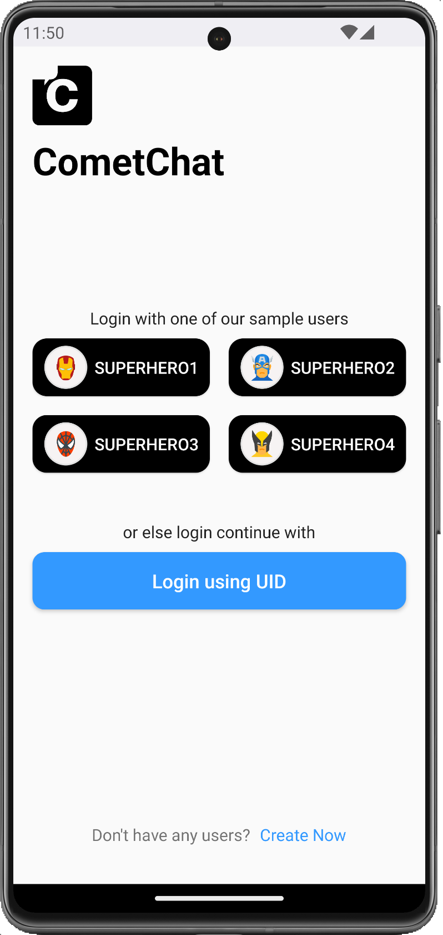
Main Screen

Slide 19
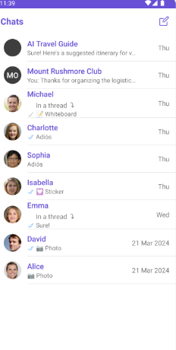
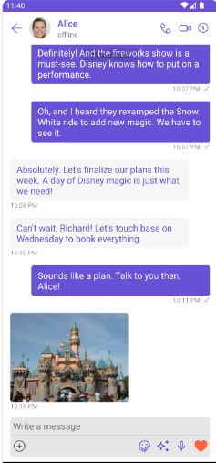

Slide 20
