Slide 1
TNSDC-Generative AI
Brain Tumor Detection In Deep Learning Using CNN
Presented by :Nithish Kumar K.S
au211521104099
Pre-Final Student,
Computer Science and Engineering,
Panimalar Institute of Technology.

Slide 2

OUTLINE
Problem Statement
Proposed Solution
System Approach
Algorithm
Result
Conclusion
References

Slide 3
PROBLEM STATEMENT
Problem Statement:
Develop an efficient Convolutional Neural Network (CNN) model for the automated detection and classification of brain tumors from magnetic resonance imaging (MRI) scans. The objective is to create a robust AI system capable of accurately identifying various types of brain tumors, including gliomas, meningiomas, and pituitary adenomas, to assist radiologists in early diagnosis and treatment planning. The model should be capable of handling varying tumor sizes, locations, and imaging conditions, while achieving high sensitivity and specificity to ensure reliable clinical application.

Slide 4
PROPOSED SOLUTION
One of the commonly cited solutions for brain tumor detection using Convolutional Neural Networks (CNNs) is the work by Kamnitsas et al., titled "Efficient multi-scale 3D CNN with fully connected CRF for accurate brain lesion segmentation." Here's a summary of their proposed solution:
Title: Efficient multi-scale 3D CNN with fully connected CRF for accurate brain lesion segmentation
Authors: Konstantinos Kamnitsas, Christian Ledig, Virginia F.J. Newcombe, Joanna P. Simpson, Andrew D. Kane, David K. Menon, Daniel Rueckert, and Ben Glocker
Published: 2017

Slide 5
SYSTEM APPROACH
Hardware:
CPU: The system requires a CPU with sufficient processing power to handle the computational demands of Convolutional Neural Network (CNN) training and inference. A multi-core processor, preferably with a clock speed of at least 2 GHz or higher, is recommended.
Memory: A minimum of 8 GB RAM is recommended for smooth operation, especially during model training, where large datasets are processed. More RAM may be required for handling larger datasets or concurrent user requests.
Internet Speed: A stable internet connection is necessary for downloading and updating Python packages, model weights, and serving the web application. A broadband connection with a minimum download speed of 5 Mbps and upload speed of 1 Mbps is sufficient for most purposes.
Software:
Python: The system is built using Python programming language

Slide 6

ALGORITHM
1. **Data Collection and Preprocessing:**
- Gather a dataset of brain MRI scans containing both tumor and non-tumor cases.
- Preprocess the MRI images by:
- Normalizing intensity values.
- Resizing images to a uniform dimension.
- Augmenting data through techniques like rotation, flipping, and shifting.
2. **Model Architecture Design:**
- Design a CNN architecture for tumor detection, comprising convolutional, pooling, and fully connected layers.
- Choose appropriate activation functions (e.g., ReLU) and regularization techniques (e.g., dropout) to prevent overfitting.
- Experiment with different architectures and hyperparameters to optimize performance.
3. **Data Splitting:**
- Split the dataset into training, validation, and test sets.
This algorithm provides a general framework for developing a brain tumor detection system using CNNs. The specific implementation details may vary based on the chosen CNN architecture, dataset characteristics, and deployment requirements.

Slide 7
ALGORITHM - CONT.
4. **Model Training:**
- Train the CNN model using the training data:
- Feed batches of preprocessed MRI images into the network.
- Compute the loss using a suitable loss function (e.g., binary cross-entropy).
- Update the model parameters using an optimization algorithm (e.g., Adam).
5. **Model Evaluation:**
- Validate the trained model using the validation set:
- Evaluate the model's performance using metrics like accuracy, precision, recall, and F1-score.
- Adjust hyperparameters based on validation performance to improve the model.
6. **Model Testing:**
- Assess the model's performance on unseen data using the test set:
- Feed test MRI images into the trained model.
- Obtain predictions and calculate evaluation metrics to assess real-world performance.
7. **Deployment:**
- Deploy the trained model as a web-based or standalone application for practical use:
- Implement a user-friendly interface for uploading MRI scans and obtaining predictions.
- Integrate the model into the clinical workflow to assist radiologists in diagnosis and treatment planning

Slide 8
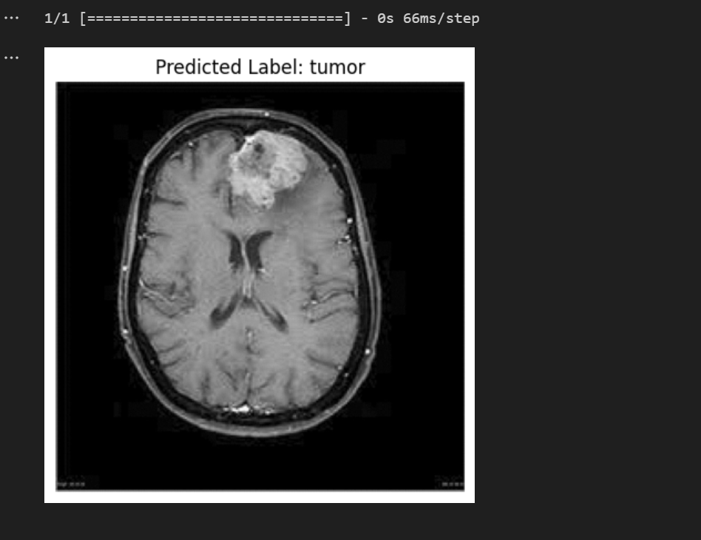
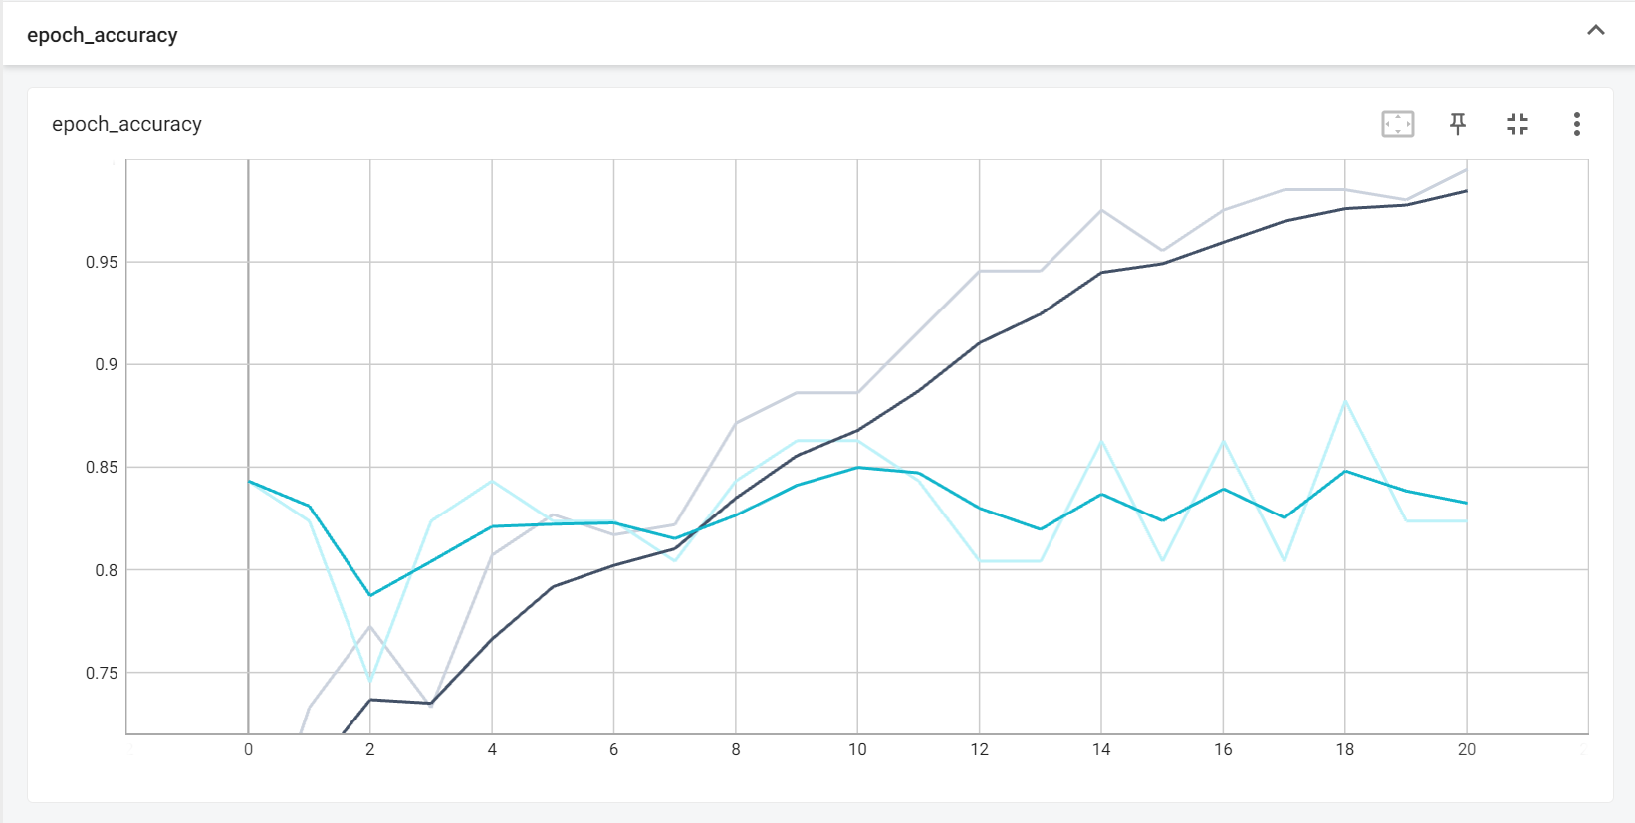
RESULT
Model Accuracy
Test Prediction

Slide 9
Conclusion
In conclusion, employing Convolutional Neural Networks (CNNs) for brain tumor detection represents a significant advancement in medical imaging technology. Through the development and refinement of CNN models, researchers and healthcare professionals have made substantial strides in automating the detection and classification of brain tumors from MRI scans.
The use of CNNs offers several key advantages in this domain. Firstly, CNNs can effectively learn complex patterns and features from raw image data, enabling them to accurately identify subtle abnormalities indicative of brain tumors. Additionally, CNN-based approaches can handle large volumes of data efficiently, allowing for the analysis of extensive datasets to improve detection accuracy and generalization.
Moreover, CNN-based brain tumor detection systems have the potential to enhance clinical practice by providing radiologists with valuable decision support tools. These systems can assist in early diagnosis, treatment planning, and monitoring of brain tumor patients, ultimately leading to improved patient outcomes and quality of care
Overall, brain tumor detection using CNNs holds tremendous promise for revolutionizing the diagnosis and management of brain tumors. With further advancements in technology and collaboration between researchers, clinicians, and industry partners, CNN-based approaches have the potential to make a profound impact on healthcare delivery and patient outcomes in the years to come.

Slide 10
REFERENCES
Python: https://python.org/
Numpy: https://numpy.org/
PyTorch: https://pytorch.org/
Flask: https://flask.palletsprojects.com/en/3.0.x/
Inspiration: https://projectworlds.in/artificial-intelligence-project-handwritten-digits-recognition/

