Slide 1
Name: NITHISH.A
3rd year B.E.CSE
NM ID :au421221104024
Email ID :nk8012630@gmail.com
3/21/2024 Annual Review

Slide 2
PROJECT TITLE Network Intrusion Detection
3/21/2024 Annual Review

Slide 3


AGENDA
PROBLEM STATEMENT
PROJECT OVERVIEW
WHO ARE THE END USERS?
YOUR SOLUTION AND ITS VALUE PROPOSITION
THE WOW IN YOUR SOLUTION
MODELLING
RESULTS
3/21/2024 Annual Review

Slide 4

PROBLEM STATEMENT
The problem statement for network intrusion detection involves identifying and classifying unauthorized, malicious activities or behaviors within a computer network. This includes detecting various types of attacks such as denial of service (DOS), distributed denial of service (DDOS), malware infections, brute force attacks, and other forms of unauthorized access or data exfiltration.
3/21/2024 Annual Review

Slide 5

PROJECT OVERVIEW
Network Intrusion detection (IDS) and prevention (IPS) systems are systems that attempt to discover unauthorized access to an enterprise network by analyzing traffic on the network for signs of malicious activity
.
3/21/2024 Annual Review

Slide 6

WHO ARE THE END USERS?
Organizations
Network Administrators
Security Analysts
Incident Response Teams
Compliance Officers
Executives and Managers
Security Researchers
3/21/2024 Annual Review

Slide 7

YOUR SOLUTION AND ITS VALUE PROPOSITION
My solution for network intrusion detection combines signature-based and anomaly-based detection to proactively identify and mitigate threats. Its value lies in enhancing network security by swiftly detecting and responding to security incidents, reducing the risk of data breaches and reputational damage.
3/21/2024 Annual Review

Slide 8

THE WOW IN YOUR SOLUTION
The "wow" factor in our solution for network intrusion detection lies in its ability to leverage cutting-edge machine learning and artificial intelligence techniques to continuously adapt and improve its detection capabilities. By utilizing advanced anomaly detection algorithms, deep learning models, and reinforcement learning approaches, our solution can effectively identify even the most sophisticated and previously unseen threats in real-time.
3/21/2024 Annual Review

Slide 9
MODELLING
Network intrusion detection modeling involves creating mathematical or computational representations of network traffic to detect potential security threats using techniques like statistical analysis, machine learning, or AI. These models help distinguish between normal and malicious activity, enhancing network security by minimizing false positives and false
3/21/2024 Annual Review

Slide 10
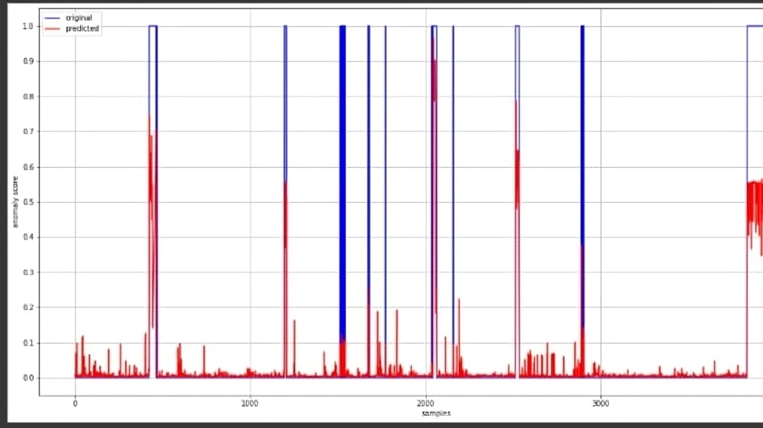
RESULTS
Looking at the plot below, we can see that the model is able to succesfully identify most of the anomalies i.e the samples where both the blue and red lines are high.
Demo Link
3/21/2024 Annual Review

