Slide 1
PORTFOLIO
WEBSITE
My First Step Towards Full Stack Development
@nithishkumar

Slide 2
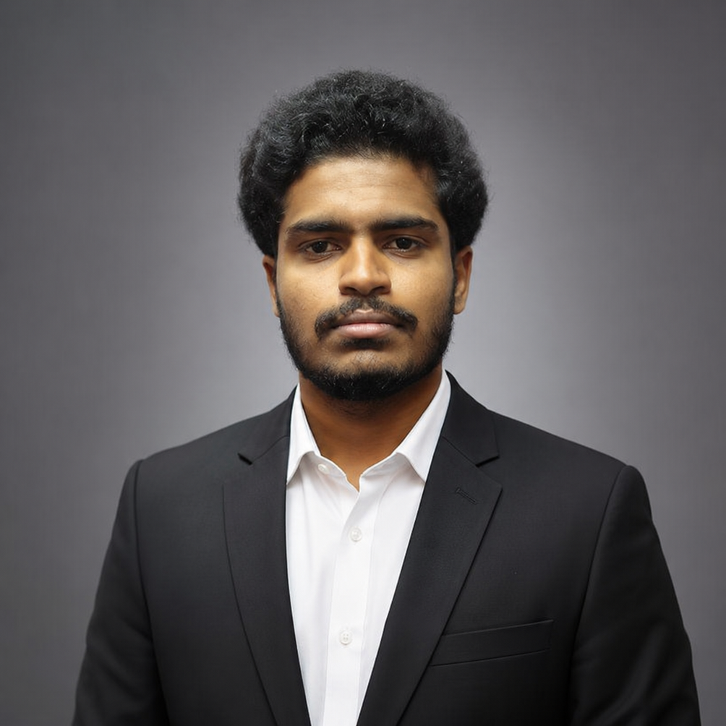
WHO AM I ?
I am a final-year Electronics and Communication Engineering student with a strong interest in software development and web technologies. As part of my Full Stack Development learning journey, I developed a personal portfolio website to showcase my skills, projects, education, and career aspirations. This project reflects both my technical growth and my commitment to continuous learning.
The Backbone of the Digital World

Slide 3

WHY THIS PROJECT?
Different Roles, One Goal
The Personal Portfolio Website is a multi-page web application developed using HTML5. The primary goal of the project is to create a professional platform where visitors can learn about my background, technical skills, projects, and career objectives. The website serves as my digital identity and demonstrates my understanding of website structure and navigation..

Slide 4
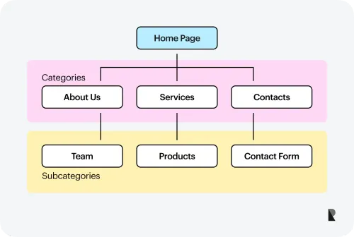
WEBSITE STRUCTURE
✔ Home Page
✔ About Me
✔ Skills
✔ Projects
✔ Contact
✔ Education Information
Designing What Users See

Slide 5
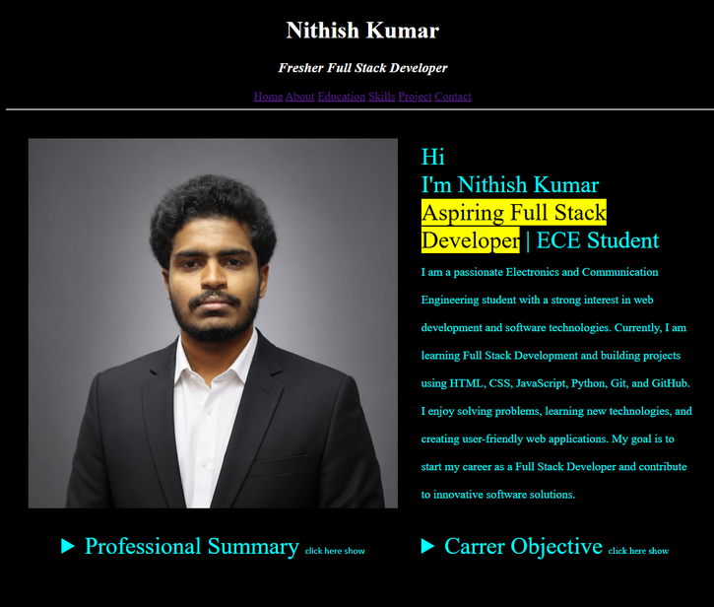
HOME PAGE
Powering the Website Behind the Scenes
•Professional Introduction
• Career Objective
• Professional Summary
• Navigation Menu
• Profile Information

Slide 6
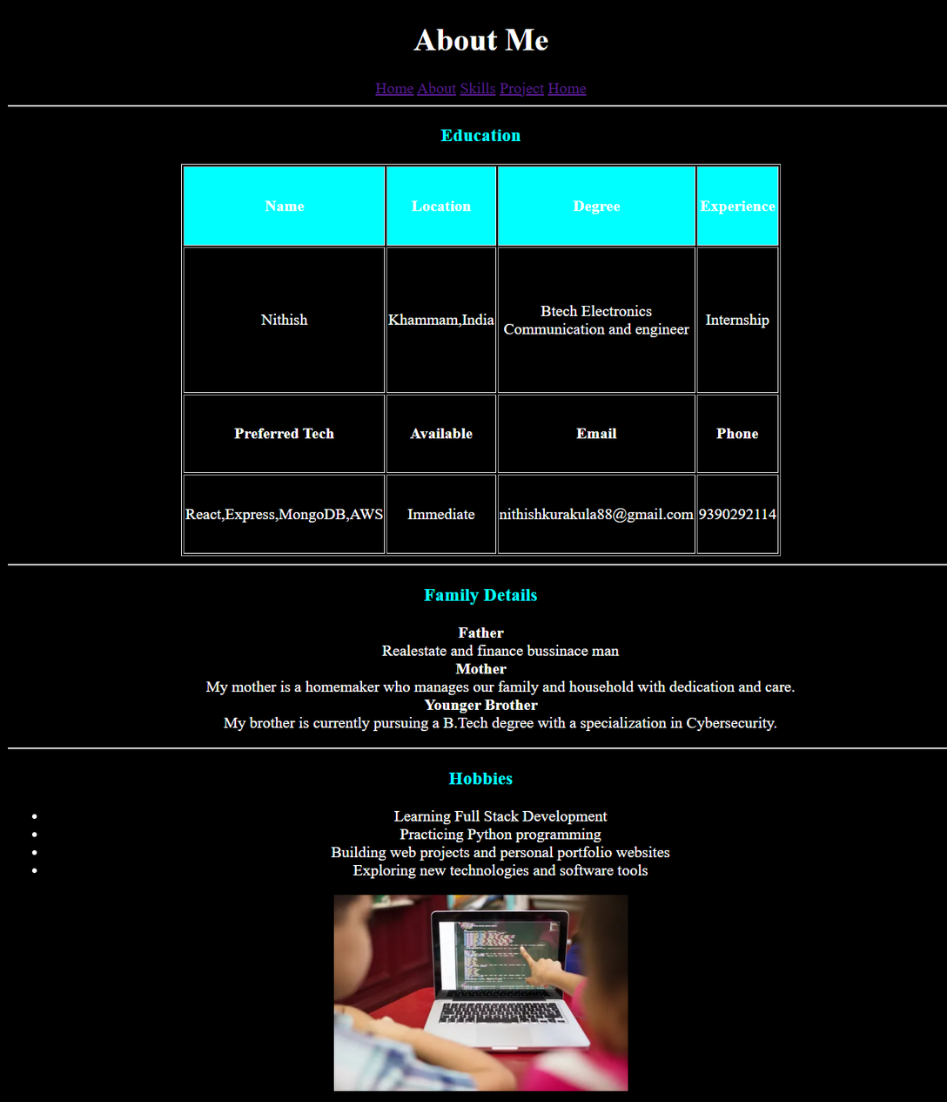
ABOUT PAGE
A Web Developer’s Toolbox
The About Page provides detailed information about my background, interests, hobbies, and career goals. It helps visitors understand my journey as an aspiring Full Stack Developer and gives a more personal introduction beyond technical skills and academic qualifications.

Slide 7

SKILLS PAGE
From Idea to Live Website
TECHNICAL SKILLS
💻 HTML5
🎨 CSS3
🐍 Python
🔧 Git & GitHub
📝 VS Code
SOFT SKILLS
✔ Problem Solving
✔ Self Learning
✔ Team

Slide 8
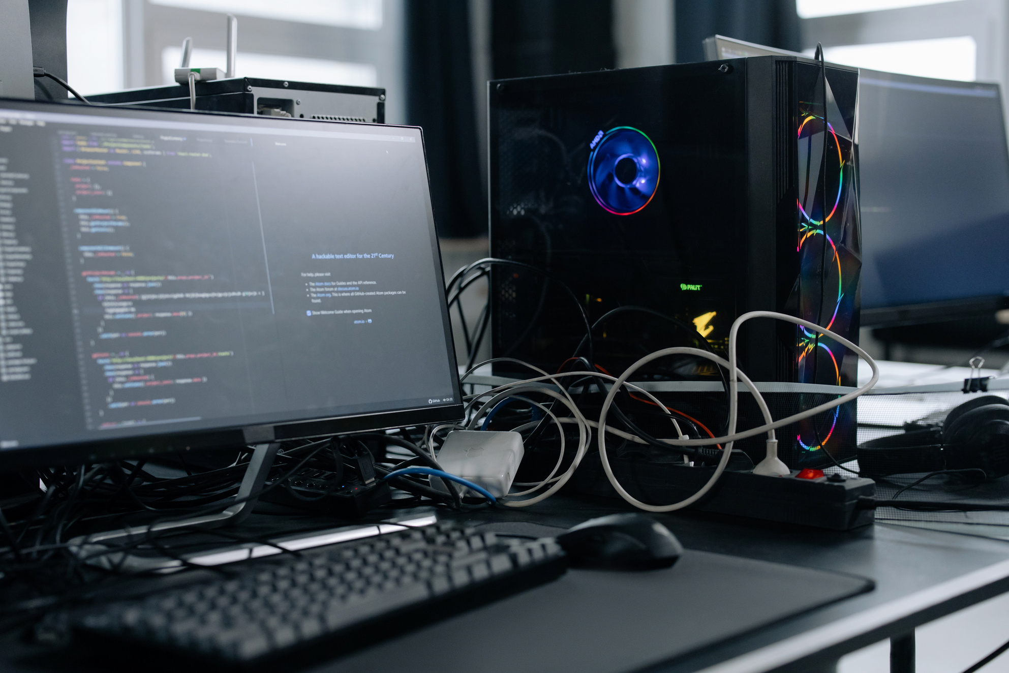
PROJECT SHOWCASE
🛒 E-Commerce Product Showcase Website
🌐 Personal Portfolio Website
🎲 Ludo Game UI
💾 Hybrid Memory Design Using ECC, EDC & BIST
Each project demonstrates different technical concepts and practical implementation skills.

Slide 9

HTML CONCEPTS USED
CORE HTML FEATURES
• Hyperlinks
• Tables
• Lists
• Images
• Details & Summary Tags
• Multi-Page Navigation
• Semantic Structure

Slide 10

CHALLENGES FACED
Powering the Website Behind the Scenes
During the development process, I faced challenges in organizing multiple pages, managing navigation links, and designing a structured layout using only HTML. These challenges helped me improve my problem-solving abilities and strengthened my understanding of web page architecture and content organization.

Slide 11
CONCLUSION
The Personal Portfolio Website represents my first major step toward becoming a Full Stack Developer. Through this project, I gained practical experience in HTML development, website structuring, and content organization. It serves as a foundation for future web development projects and motivates me to continue learning modern technologies.

Slide 12
WEBSITE DEVELOPER
Building the Web That Connects the World
@reallygreatsite

