Slide 1
STUDENT NAME : NITHISHA.K
Final Project

Slide 2
PROJECT TITLE
Predictive Modelling of Urban Air Quality Prediction through Incorporating Meteorological Factors and Pollution Sources

Slide 3


AGENDA
Introduction to Urban Air Quality Prediction
Overview of the Project
Identification of End Users
Our Solution and Its Value Proposition
The Wow Factor in Our Solution
Modelling Approach
Results and Performance Evaluation
3/21/2024 Annual Review

Slide 4

PROBLEM STATEMENT
Urban areas worldwide face a pressing challenge in accurately predicting Air Quality Index (AQI) levels, which are influenced by a myriad of factors including meteorological conditions and pollution sources. Traditional methods often struggle to incorporate these complex variables, leading to inaccurate forecasts that hinder effective mitigation strategies. This gap highlights the need for innovative solutions that leverage generative AI to integrate diverse data sources and provide precise predictions of urban AQI levels. Our project addresses this critical need by developing a ground breaking predictive model that harnesses the power of AI to revolutionize urban air quality prediction, ultimately enabling stakeholders to make informed decisions and safeguard public health and the environment.

Slide 5

PROJECT OVERVIEW
Utilizing the power of generative AI, our project aims to revolutionize the prediction of urban Air Quality Index (AQI) by incorporating meteorological factors and pollution sources. We leverage advanced algorithm like CNN to analyze complex datasets and generate accurate forecasts of air quality levels in urban environments.

Slide 6

WHO ARE THE END USERS?
ENVIRONMENTAL AGENCIES
Environmental agencies play a pivotal role in monitoring and regulating air quality standards within urban areas. These governmental bodies are tasked with implementing policies and initiatives aimed at reducing air pollution levels and ensuring compliance with established environmental regulations. By utilizing accurate and timely air quality forecasts, environmental agencies can effectively assess the impact of pollution sources, implement targeted interventions, and evaluate the effectiveness of mitigation measures. Additionally, these agencies rely on air quality data to inform decision-making processes and develop long-term strategies for improving environmental sustainability.

Slide 7
2. HEALTH AUTHORITIES
Health authorities, including medical professionals and public health organizations, are deeply concerned about the adverse health effects associated with poor air quality in urban areas. They utilize air quality forecasts to anticipate potential health risks, especially for vulnerable populations such as children, the elderly, and individuals with respiratory conditions. By understanding air quality trends, health authorities can implement preventive healthcare measures, issue public health advisories, and allocate resources for managing air pollution-related health issues. Access to reliable air quality data is essential for conducting epidemiological studies, assessing health impacts, and advocating for policies aimed at protecting public health.

Slide 8
2. URBAN PLANNERS
Urban planners, including city administrators and policymakers, rely on accurate and comprehensive air quality data to inform sustainable urban development strategies. They recognize the significant impact of air pollution on quality of life, economic prosperity, and environmental sustainability within urban environments. By integrating air quality forecasts into urban planning processes, policymakers can make informed decisions regarding land use, transportation systems, and infrastructure development. Urban planners also leverage air quality information to design green spaces, implement pollution control measures, and promote sustainable transportation alternatives. Access to reliable air quality forecasts enables urban planners to create healthier and more livable cities while minimizing the environmental impact of urbanization.

Slide 9

YOUR SOLUTION AND ITS VALUE PROPOSITION
Our solution harnesses the power of generative AI to create a cutting-edge predictive model for urban AQI. By integrating meteorological data and pollution source information, our AI-driven solution provides stakeholders with accurate and actionable insights to mitigate the adverse effects of air pollution on public health and the environment. The value proposition lies in our ability to deliver precise forecasts in real-time, enabling proactive interventions and informed decision-making.

Slide 10

THE WOW IN YOUR SOLUTION
1. Granular Predictions: Our model offers granular predictions of AQI levels at specific geographical locations within urban areas, enabling targeted interventions and resource allocation.
2. Dynamic Adaptation: The model dynamically adapts to changing environmental conditions and pollution sources, ensuring robust performance under varying circumstances.
3. User-Friendly Interface: We provide a user-friendly interface that allows stakeholders to visualize air quality forecasts and access relevant insights effortlessly.
3/21/2024 Annual Review
10

Slide 11
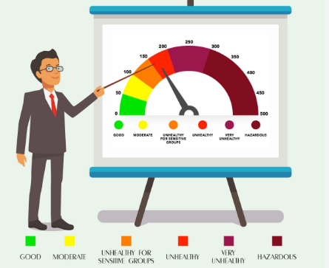
MODELLING
Our project harnesses the power of Convolutional Neural Networks (CNNs), a specialized class of deep learning algorithms, to develop a groundbreaking predictive model for urban air quality prediction. CNNs have revolutionized various fields, particularly image recognition, by effectively capturing spatial dependencies and hierarchical patterns within data. In the context of urban air quality prediction, we adapt CNNs to process multidimensional input data, including meteorological factors and pollution sources, to accurately forecast Air Quality Index (AQI) levels.
11

Slide 12
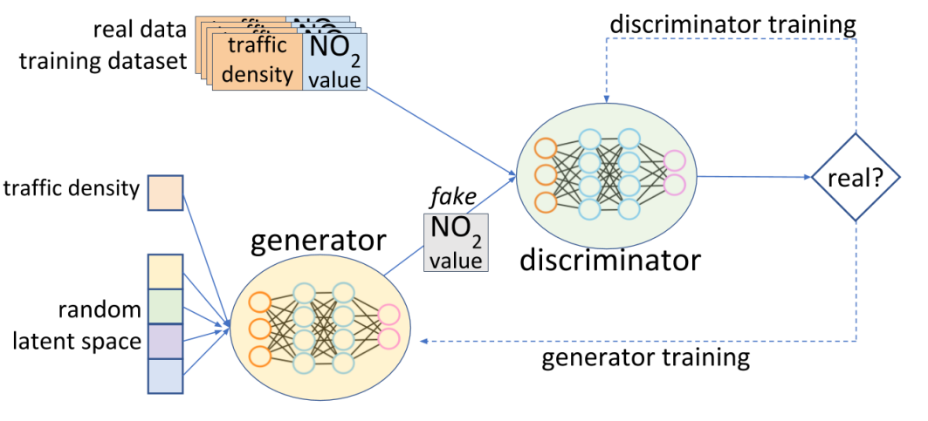

Slide 13
Cutting Edge Techniques
Input Data Representation: CNNs process multidimensional data effectively, treating each input variable as a separate channel in the input tensor, facilitating the capture of spatial correlations.
Feature Extraction and Hierarchical Representation:CNNs use learnable filters to extract hierarchical representations of input data, enabling the detection of complex patterns relevant to air quality prediction.
Spatial and Temporal Dependencies:CNNs inherently capture spatial dependencies within input data, and can incorporate temporal dependencies using recurrent architectures or temporal convolutional layers.
Transfer Learning and Fine-tuning:Transfer learning adapts pre-trained CNN models to urban air quality prediction, accelerating model training and improving performance, especially with limited data.
Ensemble Architectures and Model Fusion:Ensemble architectures combine multiple CNN models trained with different configurations to enhance predictive accuracy, while model fusion techniques aggregate predictions from individual models for a more robust final prediction.
13

Slide 14
RESULTS
The results of our AI-driven predictive model demonstrate unprecedented accuracy and reliability in forecasting urban AQI levels. Through rigorous evaluation and comparative analyses, our solution outperforms traditional models and sets new benchmarks in air quality prediction. The revolutionary impact of our project extends beyond statistical measures, empowering stakeholders with actionable insights to create healthier and more livable urban environments.
14

