Slide 1
PROJECT TITLE
BOOK A DOCTOR USING MERN
APPLICATION NAME : PRESCRIPTO
BY TEAM MEMBERS
K. NITHISHA
R. POOJA
P. MAHALAKSHMI
S. NIVETHA

Slide 2
ABSTRACT
This paper presents the development of a Doctor Appointment Booking platform using the MERN stack (MongoDB, Express, React, Node.js). The platform provides a user-friendly interface where users can easily search for doctors and schedule appointments from the comfort of their homes. The frontend is built with React, offering a responsive design and real-time updates on doctor availability. The backend, developed using Node.js and Express, exposes RESTful APIs to handle user authentication, appointment booking, and data retrieval from a MongoDB database. MongoDB is used to store user profiles, doctor information, and booking details. Key features include real-time availability updates, JWT-based user authentication, and secure data handling. The system optimizes the user experience with advanced scheduling options and ensures reliable performance, making appointment booking seamless and efficient. The platform can be deployed using cloud services like Cloudinary and MongoDB Atlas for scalability and accessibility.

Slide 3
INTRODUCTION
This project focuses on building a doctor booking system using the MERN stack, which consists of MongoDB, Express.js, React, and Node.js
The system allows patients to easily search for doctors based on their specialization, location, and availability, and book appointments in real-time. Doctors can manage their schedules, view patient information, and confirm or reject appointment requests.
By utilizing modern web technologies, this project aims to provide a streamlined, efficient, and user-friendly platform for both patients and healthcare providers

Slide 4
SOFTWARE AND PLATFORMS
SOFTWARE: VS Code is widely used for MERN application development due to its robust support for JavaScript, Node.js, and React, along with extensions for MongoDB integration. It provides a powerful environment for writing, debugging, and managing both frontend and backend code.
BACKEND: The backend development such as Mongo DB, Cloudinary and node.js are used to handle the server request and interaction with user, appointment and doctor.
FRONTEND: For user authentication, appointment forms and for profile management we used React as a designing tool.

Slide 5
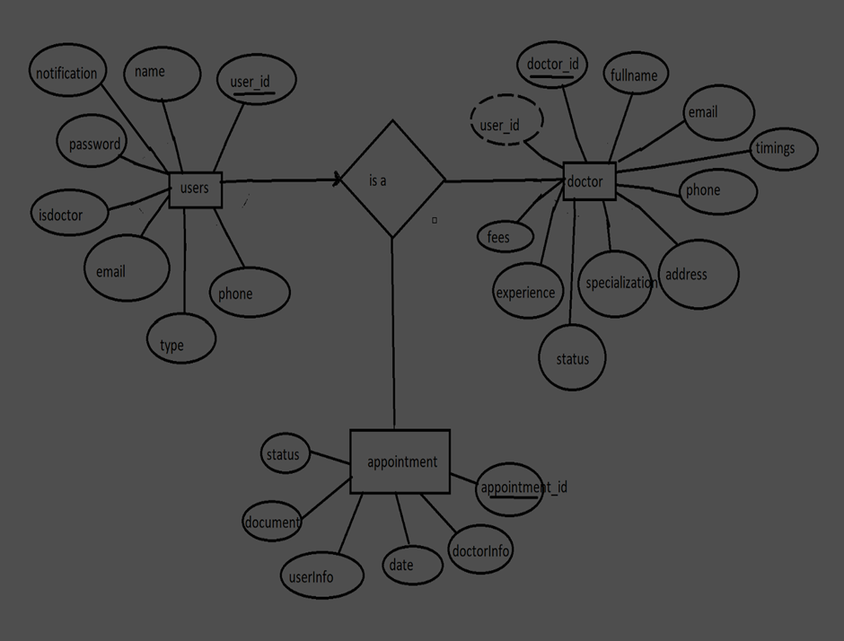
ER DIAGRAM

Slide 6
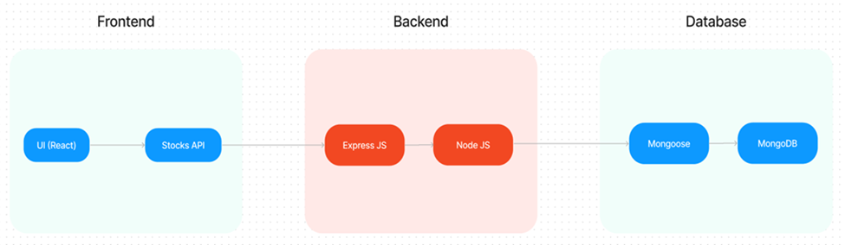
TECHNICAL ARCHITECTURE

Slide 7
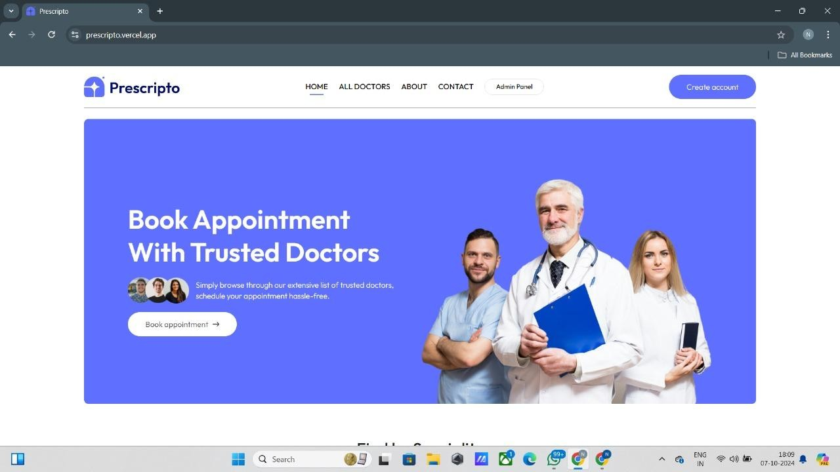
SCREENSHOT OF MODEL
STEP 1 : Open the website or webpage to book an appointment with the doctors as
we developed application named as PRESCRIPTO

Slide 8
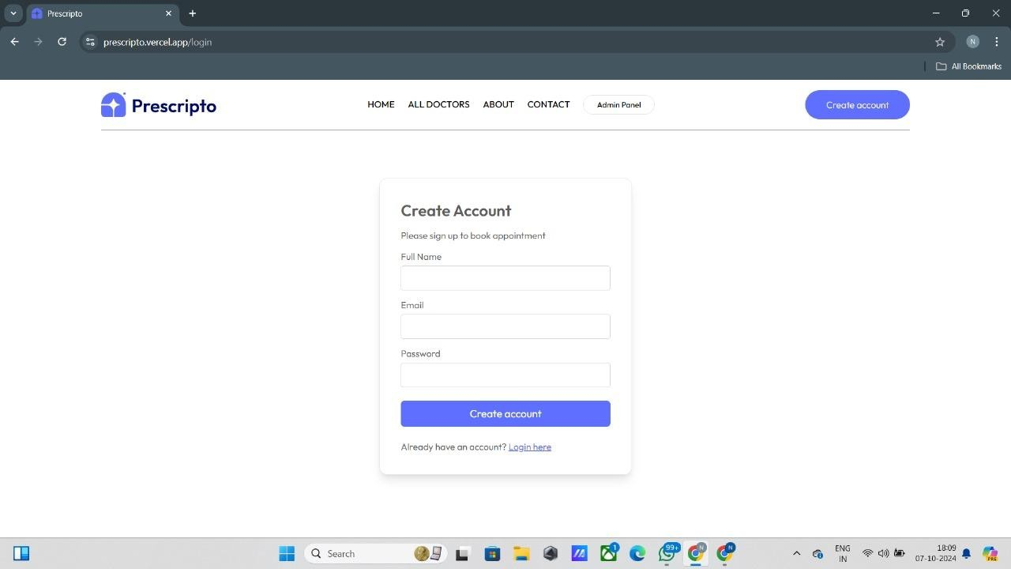
STEP 2 : If you are a new user then first create an account page by using your mail id and name or login with your create mail id

Slide 9
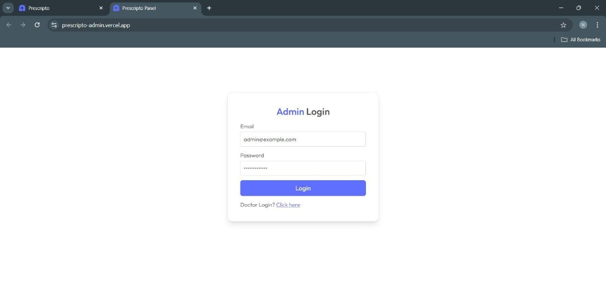
STEP 3: If you are a doctor click into the admin login page to enter into doctor's login page.

Slide 10
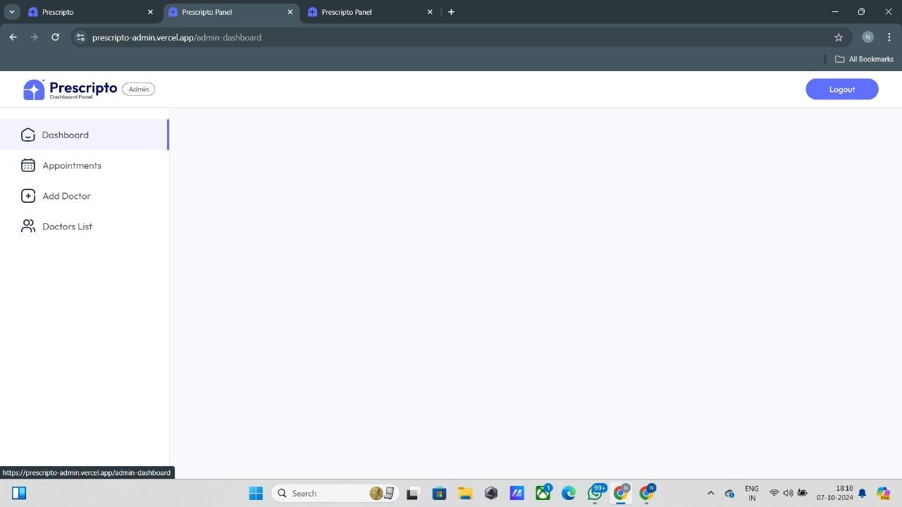
STEP 4 :After login your id, you can able to see the prescripto dashboard panel and their features

Slide 11
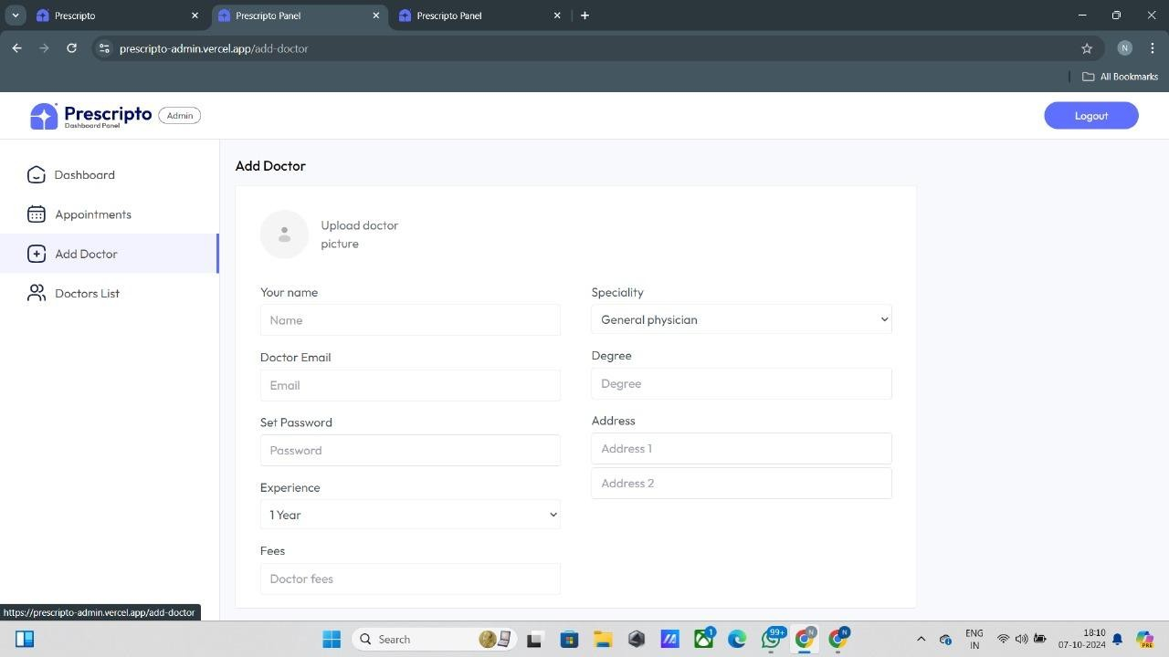
STEP 5:Next step is to add the doctor specialist in your page to know more about the doctor appointment and their speciality

Slide 12
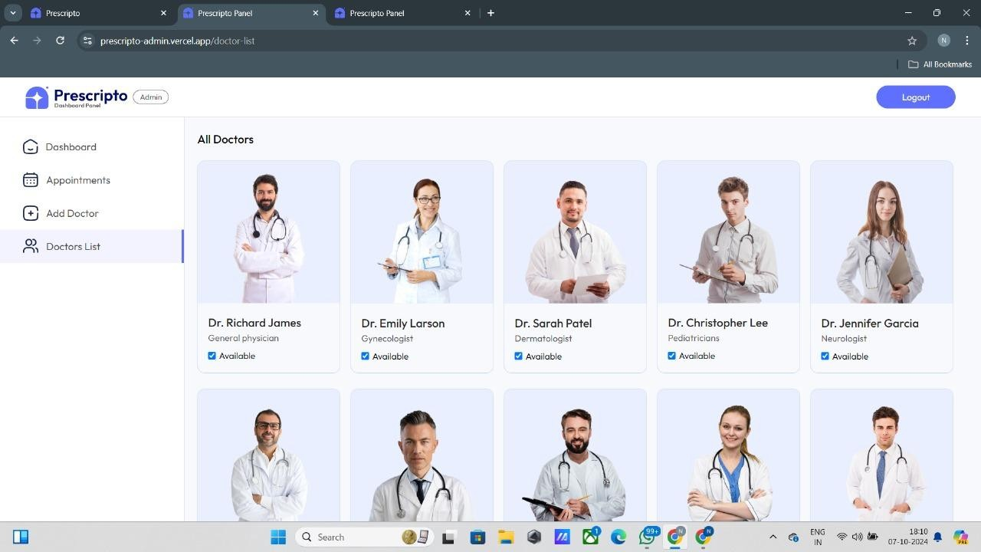
STEP 6: You can see the top class specialist in a list. In that list you can add your needed specialist and doctor in your add doctor pannel

Slide 13
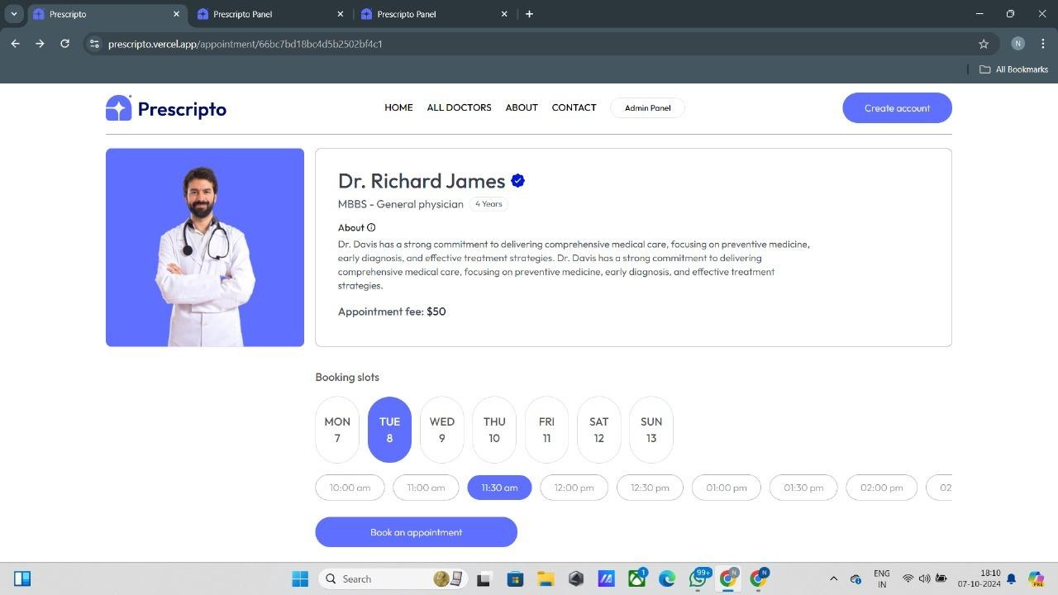
STEP 7: After add your doctor specialist in a list, you can able to book a doctor based on their booking slot and your schedule for your needed counseling and treatment.

Slide 14
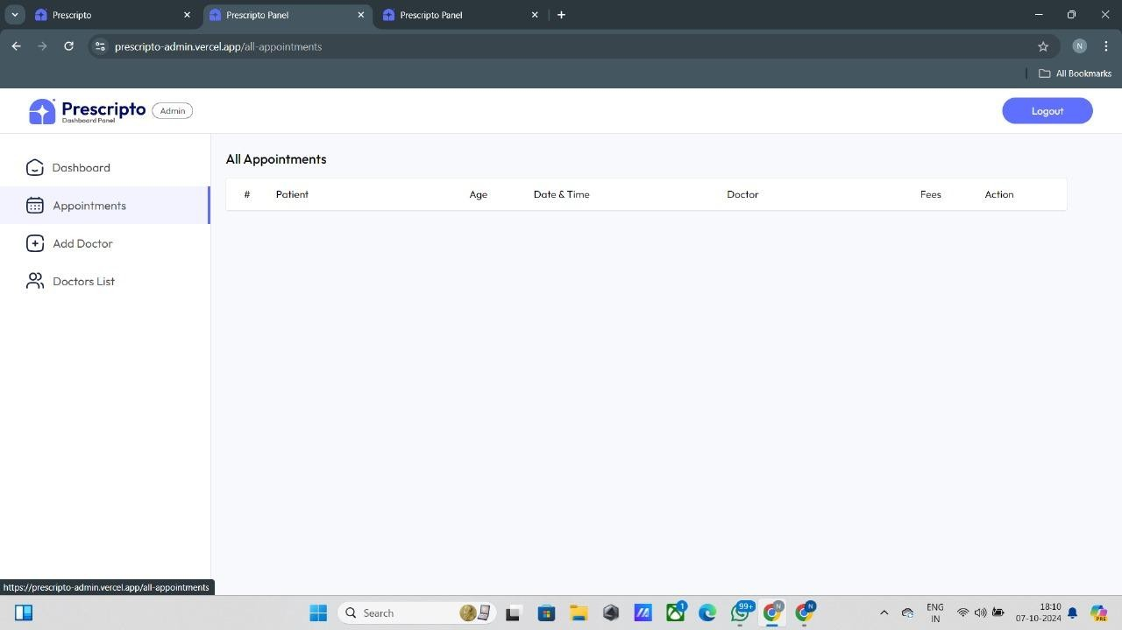
STEP 8: If you are in a doctor's login, you can see your patient and their details of their appointment booking.

Slide 15
CONCLUSION
The "Book a Doctor" application, built using the MERN stack, offers a seamless and user-friendly platform for scheduling medical appointments. Designed with accessibility in mind, it caters particularly to elderly individuals, allowing them to easily book appointments in advance without any hassle. The application provides a reliable solution for users to find doctors, check availability, and schedule consultations with just a few clicks.
By allowing patients to connect with healthcare providers from the comfort of their homes, the application contributes to better time management, reduced travel stress, and quicker access to necessary medical services.
Overall, this application has the potential to greatly improve the healthcare experience for people of all ages, particularly the elderly and those in remote areas, contributing to a more efficient healthcare system.

