Slide 1


Department of Computer Science and Engineering
IOT BASED CONNECTED PET COMPANION
Mrs.G.M.SASIKALA
Assistant Professor
B21A2425C24
PRAVEEN.M(210701193)
MONASHREE.D(210701165)

Slide 2
Problem Statement and Motivation
Modern lifestyles often require pet owners to leave their pets alone for extended periods, leading to concerns about potential accidents, health issues. The motivation for this project arises from the need for a comprehensive solution that offers proper diet and monitoring to mitigate these issues. The project aims to provide peace of mind for pet owners by ensuring their pets are cared for even in their absence. Additionally, it fosters better pet well-being through real-time health monitoring, enhancing the bond between pets and owners.

Slide 3
Objectives
Pet Health Monitoring
Promote Pet Well-being
Provide Convenience for pet owners
Temporary Pet Companion

Slide 4
Abstract
IOT based connected pet companion presents an innovative solution to modern pet care challenges by integrating IoT technology into a comprehensive system. This smart pet house combines features like pet feeding with temperature monitoring to enhance pet safety and well-being. Key components include sensors to monitor temperature, food and water levels. By providing a unified platform for monitoring health condition,proper diet ,this project seeks to address the limitations of current pet care solutions.

Slide 5
System Architecture
The system architecture includes a mobile application, cloud server, IoT controller, sensors. The user interacts with the system through the mobile app. The cloud server bridges communication between the app and IoT controller, sending instructions and receiving data. The IoT controller manages all connected components, including a temperature sensor for temperature monitoring, servo motors for dispensing food and water. This setup enables automated, remote pet care, promoting health and well-being even in the owner's absence.

Slide 6
List of Modules
Food dispenser
Water dispenser
Temperature monitoring

Slide 7
Functional Description for each modules with DFD and Activity Diagram
Food Dispenser Module:
The food dispenser utilizes ultrasonic sensor to continuously detect the pet. When the pet comes near ultrasonic sensor, the system triggers the dispensing mechanism to release a specific quantity of food to replenish the bowl. This ensures the pet always has an adequate amount of food available while preventing over-dispensing or wastage. The system operates automatically but can also be manually controlled via Online Cloud platform, providing flexibility for the owner.

Slide 8
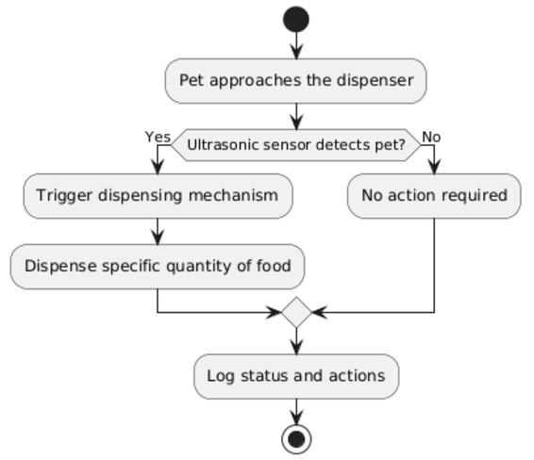
Functional Description for each modules with DFD and Activity Diagram

Slide 9
Functional Description for each modules with DFD and Activity Diagram
Water Dispenser Module:
The water dispenser utilizes ultrasonic sensor to continuously detect the pet. When the pet comes near ultrasonic sensor, the system triggers the dispensing mechanism to release a specific quantity of water to replenish the bowl. This ensures the pet always has an adequate amount of water. The system operates automatically but can also be manually controlled via Online Cloud platform, providing flexibility for the owner.

Slide 10
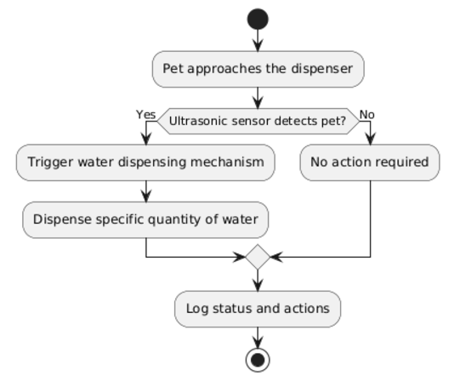
Functional Description for each modules with DFD and Activity Diagram

Slide 11
Functional Description for each modules with DFD and Activity Diagram
Temperature monitoring:
This module monitors the pet’s body temperature via sensors in the collar. Owners receive alerts through the Online Cloud platform when temperature exceeds a particular level. It integrates real-time data processing, sensor management, and communication protocols to ensure seamless operation.

Slide 12
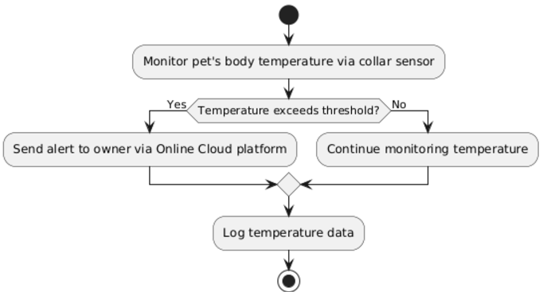
Functional Description for each modules with DFD and Activity Diagram

Slide 13
Implementation & Results of First Module
The system dispenses food when the pet approaches or upon manual activation, ensuring proper portion control based on real-time data. This prevents overfeeding and promotes a healthier diet for the pet. Additionally, the system adapts to the pet's eating habits, providing more precise and customized feeding schedules. Compared to the existing system, which follows a timed dispensing model without monitoring the bowl's content, our system offers improved accuracy and efficiency.

Slide 14
Conclusion & Work for Phase II
The first module, the Food Dispenser, has been successfully developed with automated dispensing . This ensures efficient food management tailored to the pet's needs while minimizing waste and enhancing convenience for pet owners. The second phase of the project will focus on completing the Water Dispenser and Temperature Monitoring Modules. These modules will integrate similar automation features, such as weight-based water refilling and health monitoring via collar sensors, while enhancing functionality with advanced analytics, manual controls, and seamless integration into the cloud platform.

Slide 15
References
FAdetokunbo A. Adenowo, Jonathan C. Anyi, James A. Akobada. (2022). Internet of Things based Pet Feeder Automation using Raspberry Pi. Godavari Institute of Engineering and Technology, India.
Madhu R, Addula Swetha, Sanjana Dharmavar, Tejashwini V J, Vidhya Shree N. (2023). Smart Pet Monitoring and Feeder using IoT. International Journal of Advanced Research in Science, Communication and Technology, 3(7), 1-10.
Helmi Che Hasni, Suhazlan Suhaimi. (2022). Pet Feeding System. International Journal of Recent Technology and Applied Science.

Slide 16
Paper Publication Status
Applied and Waiting for acceptance

Slide 17
Thank You

