Slide 1
Operating Systems (22CSC15N)
BE(CSE) V-Semester
Prepared
by
J Shiva Sai
Assistant Professor
Department of Computer Science and Engineering
Chaitanya Bharathi Institute of Technology

Slide 2
Course Objectives:
This course aims to:
1. Understand the basic concepts and design of an operating system.
2. Interpret the structure and organization of the file system.
3. Learn Inter Process Communication mechanisms and memory management approaches.
4. Explore cloud infrastructures and technologies.

Slide 3
Course Outcomes:
Upon completion of this course, students will be able to:
1. Understand the basics of Operating systems and its major components.
2. Illustrate the concepts related to process management.
3. Distinguish various memory management techniques.
4. Apply concepts of process synchronization and deadlocks to a given situation.
5. Evaluate various file allocation methods and security as well as recovery features in the designing Operating system.

Slide 4
UNIT-1
Introduction to Operating Systems: Computer System overview, Components of a computer system, functions of OS, Examples and different types of OS (RTOS vs. desktop vs. mobile etc.), OS distributions and versions.
OS architectures: Micro-kernel, Layered, Kernel Approaches and examples, Linux/Unix OS Design and architecture overview.

Slide 5
Operating System
A program that acts as an intermediary between a user of a computer and the computer hardware
Operating system goals:
  Execute user programs and make solving user problems easier
  Make the computer system convenient to use
  Use the computer hardware in an efficient manner
  Examples: Windows, Linux, Unix and Mac OS, etc.

Slide 6
Computer Structure
Computer system can be divided into four components:
  Hardware – provides basic computing resources
    CPU, memory, I/O devices
  Operating system
    Controls and coordinates use of hardware among various applications and users
  Application programs – define the ways in which the system resources are used to solve the computing problems of the users
    Word processors, web browsers, video games
  Users

Slide 7
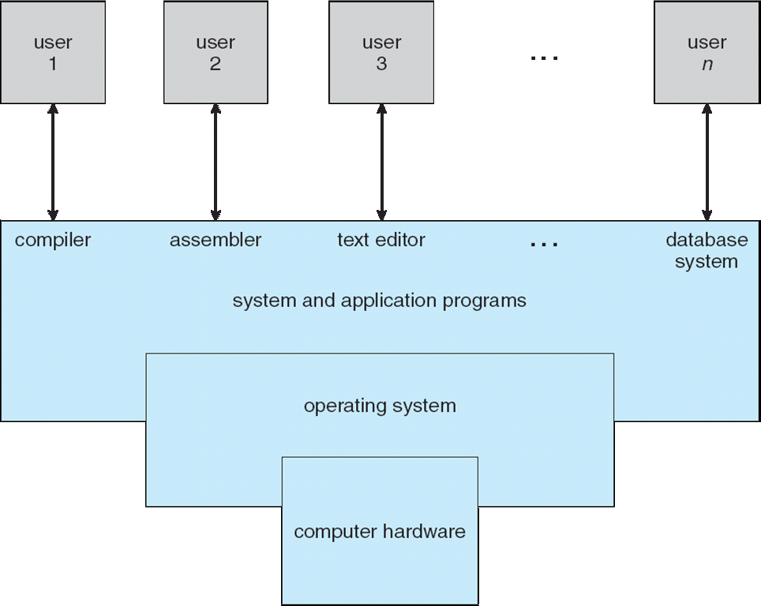
Four Components of a Computer System

Slide 8
Operating System Definition
OS is a resource allocator
  Manages all resources
  Decides between conflicting requests for efficient and fair resource use
OS is a control program
  Controls execution of programs to prevent errors and improper use of the computer

Slide 9
Computer Startup
bootstrap program is loaded at power-up or reboot
  Typically stored in ROM or EPROM, generally known as firmware
  Initializes all aspects of system
  Loads operating system kernel and starts execution

Slide 10
Operating System Components
An operating system has various components that perform different tasks for proper execution of programs. Following are main components of the operating system.
    Process
    Memory
    Input / Output
    File
    Protection & Security

Slide 11
Process Management
A process can be a program in execution that needs resources like CPU time, memory, files and I/O devices to accomplish its tasks. The operating system is responsible for
Creating and terminating user and system processes
Suspending and resuming processes
Providing mechanisms for process synchronization
Providing mechanisms for process communication
Providing mechanisms for deadlock handling

Slide 12
Main Memory Management
Main memory is a large array of bytes. It is a repository of quickly accessible data shared by the CPU and I/O devices. It contains the code, data, stack, and other parts of a process. The central processor reads instructions of a process from main memory during the machine cycle. The OS is responsible for the following activities in connection with memory management.
Keeping track of free memory space
Keeping track of which parts of memory are currently being used and by whom
Deciding which processes are to be loaded into memory when memory space becomes available
Deciding how much memory is to be allocated to a process
Allocating and deallocating memory space as needed
Ensuring that a process is not overwritten on top of another

Slide 13
Secondary Storage Management
The programs to be executed, along with the data they access, must be in the main memory or primary storage during their execution. Since main memory is too small to accommodate all data and programs, and because the data it holds are lost when the power is lost, the computer system must provide secondary storage to backup main memory. Most programs are stored on a disk until loaded into the memory and then use disk as both the source and destination of their processing. Like all other resources in a computer system, proper management of disk storage is important.
The operating system is responsible for the following activities in connection with disk management:
Free-space management
Storage allocation and deallocation
Disk scheduling

Slide 14
Input /Output Management
The input and output subsystem consists of:
A memory management component that includes buffering, caching and spooling
A general device-driver interface
Drivers for specific hardware devices

Slide 15
File Management
Computers can store information on several types of physical media, e.g. magnetic tape, magnetic disk and an optical disk. The operating system maps files onto physical media and accesses these media through storage devices. Operating system is responsible for the following activities pertaining to file management:
Creating and deleting files
Creating and deleting directories
Supporting primitives (operations) for manipulating files and directories
Mapping files onto the secondary storage

Slide 16
Protection and Security
Protection – any mechanism for controlling access of processes or users to resources defined by the OS
Security – defense of the system against internal and external attacks
Huge range, including denial-of-service, worms, viruses, identity theft, theft of service

Slide 17
Networking
A distributed system is a collection of processors that do not share memory, peripheral devices. Instead, each processor has it own local memory and clock, and the processors communicate with each other through various communication lines, such as high- speed buses or networks.
A modern OS contains built-in software designed to simplify networking. Typical OS software includes an implementation of TCP/IP and related utility programs such as ping and traceroute, along with device drivers and other software to automatically enable the Ethernet or wireless interface for a device. The operating systems of mobile devices normally provide programs to enable Wi-Fi, Bluetooth, and other wireless connectivity.

Slide 18
Types of Operating System
Batch OS
Multi-Programmed OS
Multi-Processor OS
Distributed OS
Multi-tasking OS
Time-sharing OS
Real-time OS

Slide 19
Types of Operating System
Batch Processing:
In Batch processing same type of jobs batch (BATCH- a set of jobs with similar needs) together and execute at a time.
The OS was simple, its major task was to transfer control from one job to the next.
The job was submitted to the computer operator in form of punch cards. At some later time the output appeared.
The OS was always resident in memory.
Common Input devices were card readers and tape drives.
This type of operating system does not interact directly. There is an operator which takes similar jobs having same requirement and group them into batches. It is the responsibility of operator to sort the jobs with similar needs.

Slide 20
Multiprogramming Operating System
In this concept, two or more user programs can be in main memory and can be executed concurrently. The CPU can give time to various programs despite sitting idle when one is busy with I/O operations.
When one program is waiting for I/O transfer there is next program ready to utilize the processor. Therefore, several processes can share the time of the CPU.

Slide 21
Multiprogramming
OS
Job 1
Job 2
Job 3
Job 4
Job 5
Figure dipicts the layout of multiprogramming system.
The main memory consists of 5 jobs at a time, the CPU executes one by one.
Advantages:
Efficient memory utilization
Throughput increases
CPU is never idle, so performance increases.

Slide 22
Multitasking/Time Sharing Systems
Time sharing, or multitasking, is a logical extension of multiprogramming.
Multiple jobs are executed by switching the CPU between them.
In this, the CPU time is shared by different processes, so it is called as “Time sharing Systems”.
Time slice is defined by the OS, for sharing CPU time between processes.

Slide 23
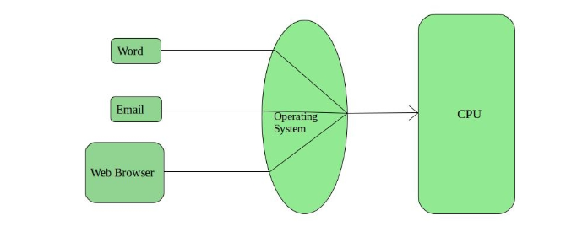

Slide 24
Multiprocessor Operating System
refers to the use of two or more central processing units (CPU) within a single computer system. These multiple CPUs are in a close communication sharing the computer bus, memory and other peripheral devices. These systems are referred as tightly coupled systems.
  Also known as parallel systems, tightly-coupled systems
  Advantages include:
    Increased throughput
    Economy of scale
    Increased reliability – graceful degradation or fault tolerance

Slide 25
Real Time Operating System
These types of OS serves the real-time systems.
Hard Real-Time Systems:
These OS are meant for the applications where time constraints are very strict and even the shortest possible delay is not acceptable. These systems are built for saving life like automatic parachutes or air bags which are required to be readily available in case of any accident.
Soft Real-Time Systems:
These OS are for applications where for time-constraint is less strict.
eg. electronic games

Slide 26
Network operating system
is an operating system that manages network resources: essentially, an operating system that includes special functions for connecting computers and devices into a local area network (LAN).
manages multiple requests (inputs) concurrently and provides the security necessary in a multiuser environment.
It may be a completely self-contained operating system, such as Unix, Windows 2000, or Mac OS

Slide 27
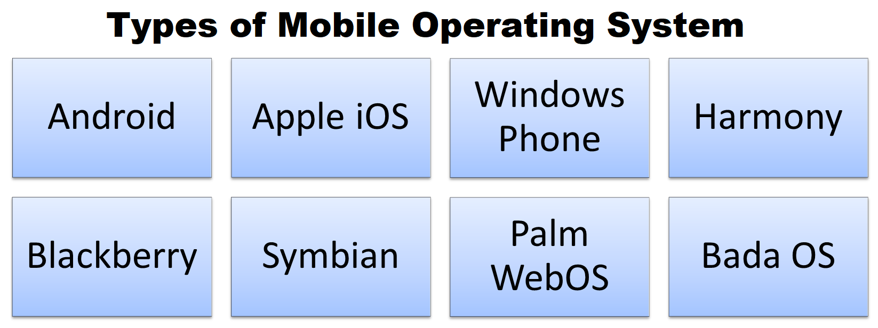
Mobile operating system
foundational software that manages smartphone and tablet hardware, allowing you to run apps, manage power, and connect to cellular networks.
The two primary systems are Google's open-source Android and Apple's proprietary iOS.

Slide 28
Mobile operating system
The mobile OS landscape is defined by a few key players and specialized platforms
Android
iOS
HarmonyOS
KaiOS: A lightweight OS designed for basic, non-touchscreen push-button phones, bringing 4G and apps like WhatsApp to budget devices.Every mobile OS provides an app store (like the Google Play Store or Apple's App Store) to download software and manage hardware components like the camera, Bluetooth, and GPS.

Slide 29
Functions of OS
Memory Management
Process Management
Device Management
File Management
Security
Job Accounting
Error Detection
Coordination between software and user

Slide 30
Operating System Structure
General-purpose OS is very large program
Various ways to structure ones
  Simple structure – MS-DOS
  Monolithic -- UNIX
  Layered approach – an abstraction
  Microkernel –Mach
  Modular
  Hybrid

Slide 31
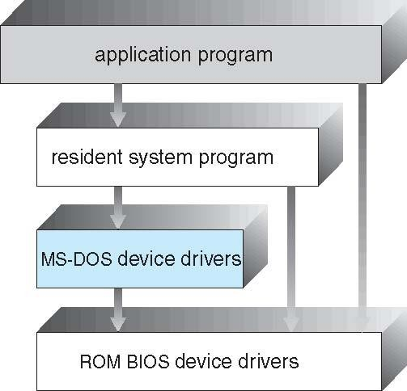
Simple Structure -- MS-DOS
MS-DOS – written to provide the most functionality in the least space
  Not divided into modules
  Although MS-DOS has some structure, its interfaces and levels of functionality are not well separated

Slide 32
Non Simple Structure -- UNIX
UNIX
limited by hardware functionality,
the original UNIX operating system had limited structuring. The UNIX OS consists of two separable parts
Systems programs
The kernel
  Consists of everything below the system-call interface and above the physical hardware
  Provides the file system, CPU scheduling, memory management, and other operating-system functions; a large number of functions for one level

Slide 33
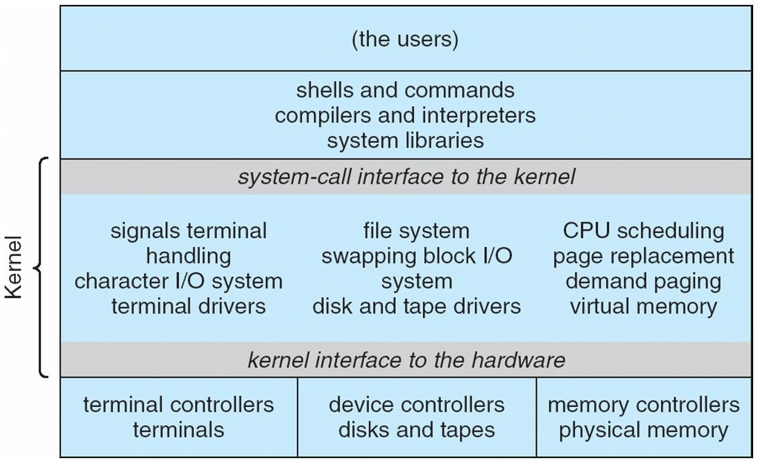
Traditional UNIX System Structure(MONOLITHIC Structure)
Beyond simple but not fully layered

Slide 34
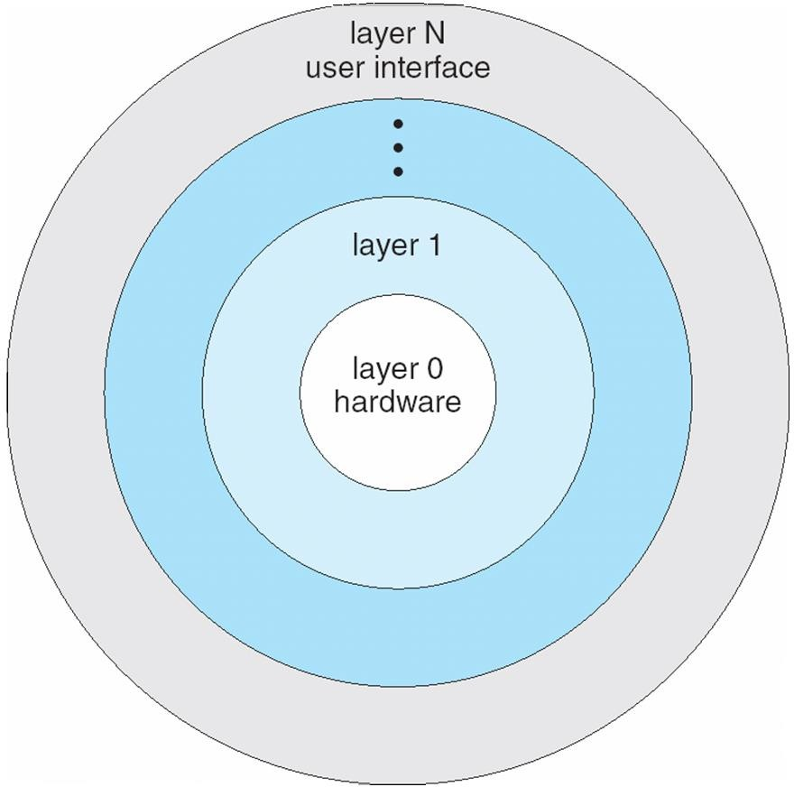
Layered Approach
The operating system is divided into a number of layers (levels), each built on top of lower layers.
  The bottom layer (layer 0), is the hardware; the highest (layer N) is the user interface.
With modularity, layers are selected such that each uses (operations) and services of only lower-level layers
The main advantage is simplicity of construction and
debugging.
The main difficulty is defining the various layers.
functions

Slide 35
Microkernel System Structure
Moves as much from the kernel into user space
Mach example of microkernel
Communication takes place between user modules using message passing
Benefits:
  Extending the operating system becomes much easier.
  Any changes to the kernel tend to be fewer, since the kernel is smaller.
  More reliable (less code is running in kernel mode)
  More secure
Detriments:
  Performance overhead of user space to kernel space communication

Slide 36
Microkernel System Structure
Application Program
File System
Device Driver
user mode
messages
messages
Interprocess Communication
memory managment
CPU
scheduling
kernel mode
microkernel
hardware

Slide 37



Microkernel System Structure
User Space Processes
File Management | Process Server | Device Drivers | Pager
Micro Kernel (IPC , Scheduling)
Kernel Space

Slide 38
Modules
Many modern operating systems implement loadable kernel modules
  Uses object-oriented approach
  Each core component is separate
  Each talks to the others over known interfaces
  Each is loadable as needed within the kernel
Overall, similar to layers but with more flexible
  Linux, Solaris, etc

Slide 39
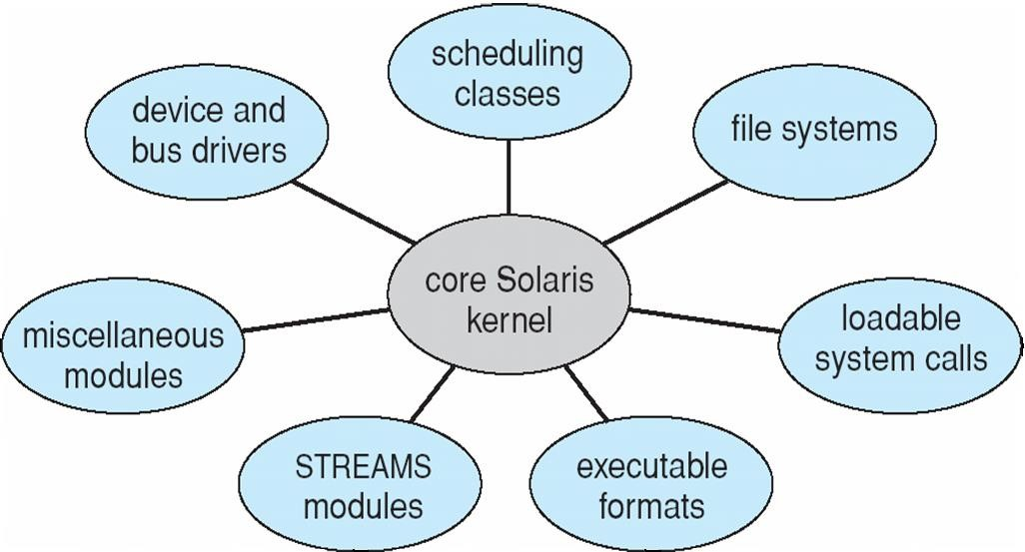
Solaris Modular Approach

Slide 40
Hybrid Systems
Most modern operating systems are actually not one pure model
  Hybrid combines multiple approaches to address performance, security,
usability needs
  Linux and Solaris kernels in kernel address space, so monolithic, plus modular for dynamic loading of functionality
  Windows mostly monolithic, plus microkernel for different subsystem
personalities

Slide 41
Hybrid Systems
Most modern operating systems are actually not one pure model
  Hybrid combines multiple approaches to address performance, security,
usability needs
  Linux and Solaris kernels in kernel address space, so monolithic, plus modular for dynamic loading of functionality
  Windows mostly monolithic, plus microkernel for different subsystem
personalities
Apple Mac OS X hybrid, layered, Aqua UI plus Cocoa programming environment
  Below is kernel consisting of Mach microkernel and BSD Unix parts, plus I/O kit and dynamically loadable modules (called kernel extensions)

Slide 42
Mac OS X Structure
graphical user interface
Aqua
application environments and services
Java Cocoa
Quicktime
BSD
kernel environment Mach | BSD
I/O kit |  | kernel extensions

Slide 43







iOS
Apple mobile OS for iPhone, iPad
  Structured on Mac OS X, added functionality
  Does not run OS X applications natively
    Also runs on different CPU architecture (ARM vs. Intel)
  Cocoa Touch Objective-C API for developing apps
  Media services layer for graphics, audio, video
  Core services provides cloud computing, databases
  Core operating system, based on Mac OS X kernel

Slide 44
Android
Developed by Open Handset Alliance (mostly Google)
  Open Source
Similar stack to IOS
Based on Linux kernel but modified
  Provides process, memory, device-driver management
  Adds power management
Runtime environment includes core set of libraries and Dalvik virtual machine
  Apps developed in Java plus Android API
    Java class files compiled to Java bytecode then translated to executable than runs in Dalvik VM
Libraries include frameworks for web browser (webkit), database (SQLite), multimedia, smaller libc

Slide 45
Android Architecture
Applications
Application Framework
Libraries
Android runtime
SQLite
openGL
Core Libraries
surface manager
media framework
Dalvik virtual machine
webkit
libc
Linux kernel

Slide 46
Virtual Machines
A virtual machine takes the layered approach to its logical conclusion. It treats hardware and the operating system kernel as though they were all hardware
A virtual machine provides an interface identical to the underlying bare hardware
The VM creates the illusion of multiple processes, each executing on its own
processor with its own (virtual) memory

Slide 47
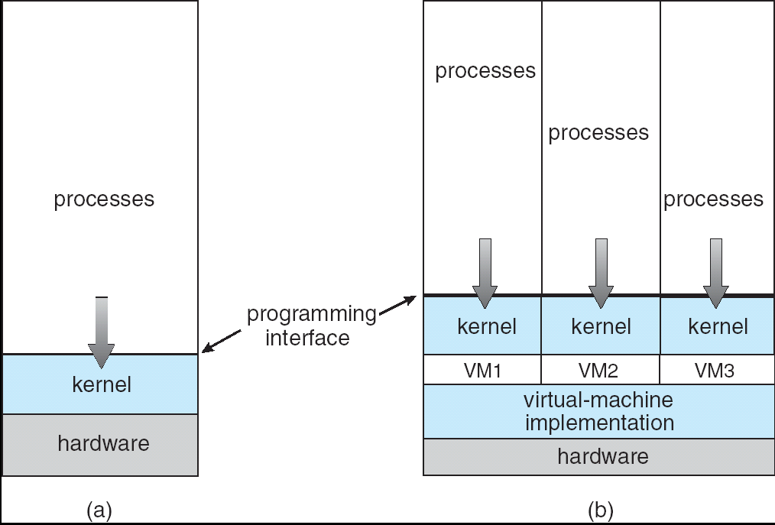
System Models
Non-virtual Machine
Virtual Machine

Slide 48
Virtual Machines - Implementation
How to create several VM when we have only one set of hardware resources?
  Sharing resources
CPU
  Time-shared scheduling
Printers/card readers
  Spooling
Memory
  Virtual memory
HD
  Its not possible to have full HD for each VM!

Slide 49
Advantages/Disadvantages of Virtual Machines
Advantage:
Complete protection/isolation of system resources between VMs
Perfect vehicle for operating-systems research and development
  If the OS you are developing crashes, just restart the VM
Useful when you have applications for different OSs
Disadvantage
No direct sharing of resources between different VMs
Difficult to implement completely

Slide 50
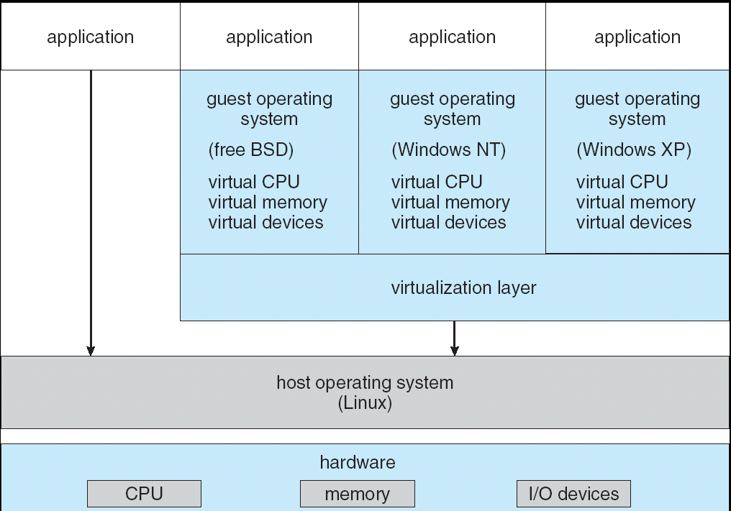
Example: VMware Architecture

Slide 51
comparison between the two kernel types
Monolithic Kernel (e.g., Linux)
All-in-one: Every major service runs together inside one big kernel.
Fast performance: Services talk directly to each other without extra steps.
Higher risk: If one service crashes, the whole system goes down.
Large size: The kernel itself is big because it holds everything.
Microkernel (e.g., QNX, Minix)
Bare minimum: The kernel only handles the most essential tasks.
Separate services: Drivers and file systems run outside the kernel as separate apps.
High safety: If a driver crashes, the system stays up and restarts it.
Slower speed: Moving data between separate parts takes more time.

Slide 52
Types of OS
Operating System can also be classified as,-
Single User Systems
Multi User Systems

Slide 53
Single User Systems:
Provides a platform for only one user at a time.
They are popularly associated with Desk Top operating system which run on standalone systems where no user accounts are required.
Example: DOS

Slide 54
Multi-User Systems
Provides regulated access for a number of users by maintaining a database of known users.
Refers to computer systems that support two or more simultaneous users
Ex: All mainframes and are multi-user systems.
Example: Unix

Slide 55
Operating-System Operations
Dual-mode operation allows OS to protect itself and other system components
  User mode and kernel mode
  Mode bit provided by hardware
    Provides ability to distinguish when system is running user code or kernel code
    Some instructions designated as privileged, only executable in kernel mode
    System call changes mode to kernel, return from call resets it to user

Slide 56

Transition from User to Kernel Mode

Slide 57
User mode
When the computer system run user applications like creating a text document or using any application program, then the system is in the user mode. When the user application requests for a service from the operating system or an interrupt occurs or system call, then there will be a transition from user to kernel mode to fulfil the requests.
Kernel Mode
When the system boots, hardware starts in kernel mode and when operating system is loaded, it start user application in user mode. To provide protection to the hardware, we have privileged instructions which execute only in kernel mode. If user attempt to run privileged instruction in user mode then it will treat instruction as illegal and traps to OS.

Slide 58
Linux/Unix OS Design and architecture overview.
T
Unix and linux foundational layered architecture
isolate privileged operations in kernel space from user-facing applications in user space.
The kernel acts as the core interface, bridging physical hardware and system software through system calls
The 4 Core Layers
Hardware: The physical parts like CPU, memory, and disks.
Kernel: The brain that manages memory, schedules tasks, and controls hardware.
Shell: The text interface where you type commands for the system.
Applications: Your daily programs, tools, and apps.

Slide 59
Linux/Unix OS Design and architecture overview.
Key Design Rules
Everything is a file: The system treats hardware, folders, and documents exactly the same.
Do one thing well: Programs are small, simple, and connect together to do complex work.
Strict separation: Apps cannot touch hardware directly; they must ask the kernel for permission.

Slide 60
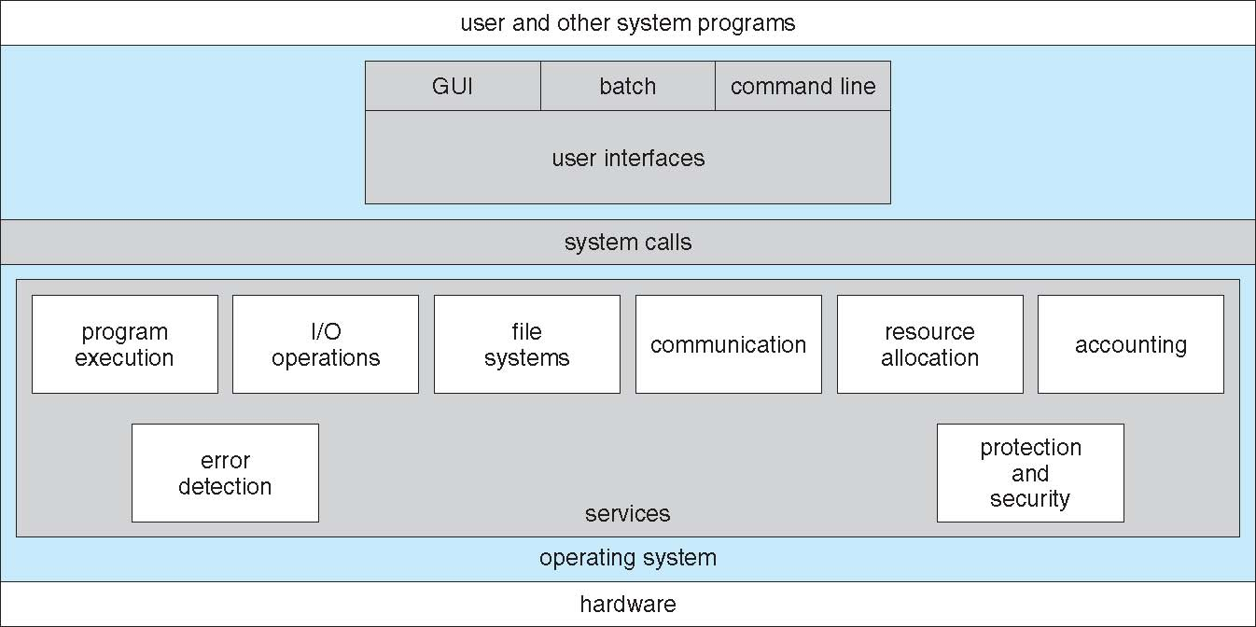
A View of Operating System Services

Slide 61
Operating System Services
Operating systems provide an environment for execution of programs and services to programs and users
One set of operating-system services provides functions that are helpful to the user:
  User interface - Almost all operating systems have a user interface (UI).
    Varies between Command-Line (CLI), Graphics User Interface (GUI),
  Program execution - The system must be able to load a program into memory and to run that program, end execution, either normally or abnormally (indicating error)
  I/O operations - A running program may require I/O, which may involve a file or an I/O device

Slide 62
Operating System Services (Cont.)
One set of operating-system services provides functions that are helpful to the user (Cont.):
  File-system manipulation - The file system is of particular interest. Programs need to read and write files and directories, create and delete them, search them, list file Information, permission management.
  Communications – Processes may exchange information, on the same computer or between computers over a network
    Communications may be via shared memory or through message passing (packets moved by the OS)
  Error detection – OS needs to be constantly aware of possible errors
    May occur in the CPU and memory hardware, in I/O devices, in user program
    For each type of error, OS should take the appropriate action to ensure correct and consistent computing
    Debugging facilities can greatly enhance the user’s and programmer’s abilities to efficiently use the system

Slide 63
Operating System Services (Cont.)
Another set of OS functions exists for ensuring the efficient operation of the system itself via resource sharing
  Resource allocation - When multiple users or multiple jobs running concurrently, resources must be allocated to each of them
    Many types of resources - CPU cycles, main memory, file storage, I/O devices.
  Accounting - To keep track of which users use how much and what kinds of computer resources
  Protection and security - The owners of information stored in a multiuser or networked computer system may want to control use of that information, concurrent processes should not interfere with each other
    Protection involves ensuring that all access to system resources is controlled
    Security of the system from outsiders requires user authentication, extends to defending external I/O devices from invalid access attempts

Slide 64
System Calls
Programming interface to the services provided by the OS
Typically written in a high-level language (C or C++)
Mostly accessed by programs via a high-level Application Programming Interface (API) rather than direct system call use

Slide 65
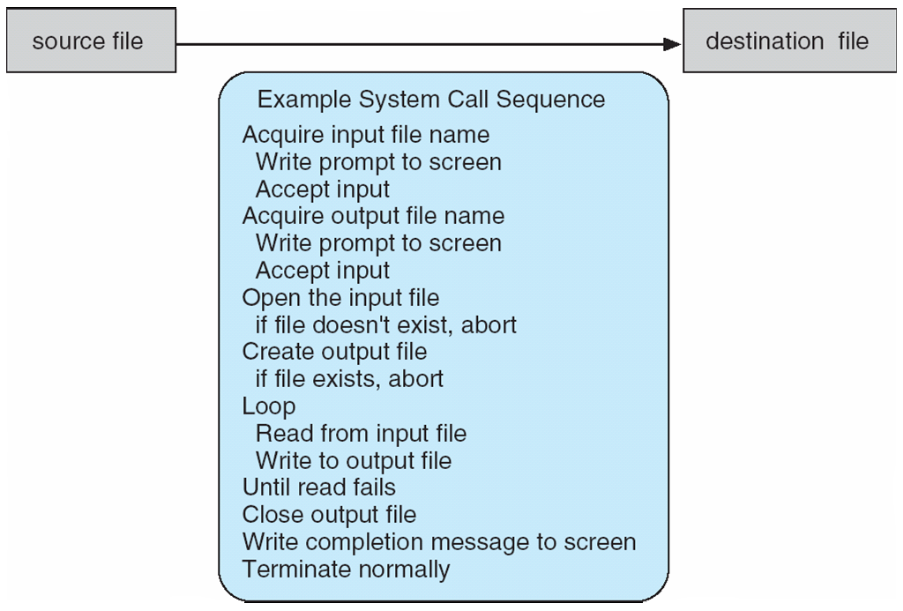
Example of System Calls
System call sequence to copy the contents of one file to another file

Slide 66
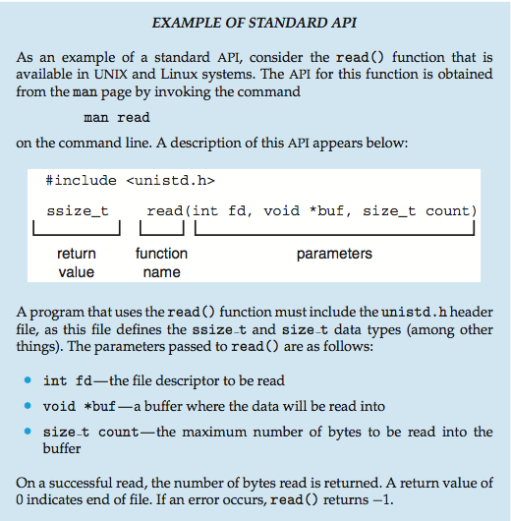
Example of Standard API

Slide 67
System Call Implementation
Typically, a number associated with each system call
  System-call interface maintains a table indexed according to these numbers
The system call interface invokes the intended system call in OS kernel and returns status of the system call and any return values
The caller need know nothing about how the system call is implemented
  Just needs to obey API and understand what OS will do as a result call
  Most details of OS interface hidden from programmer by API

Slide 68
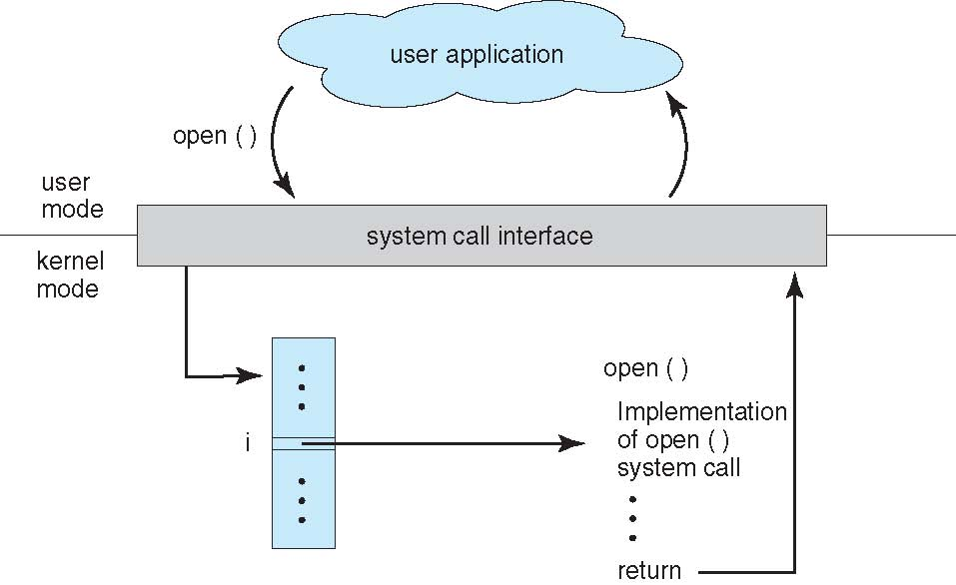
API – System Call – OS Relationship

Slide 69
System Call Parameter Passing
Often, more information is required than simply identity of desired system call
Three general methods used to pass parameters to the OS
  Simplest: pass the parameters in registers
    In some cases, may be more parameters than registers
  Parameters stored in a block, or table, in memory, and address of block passed as a parameter in a register
    This approach taken by Linux and Solaris
  Parameters placed, or pushed, onto the stack by the program and popped off the stack by the operating system
  Block and stack methods do not limit the number or length of parameters being passed

Slide 70
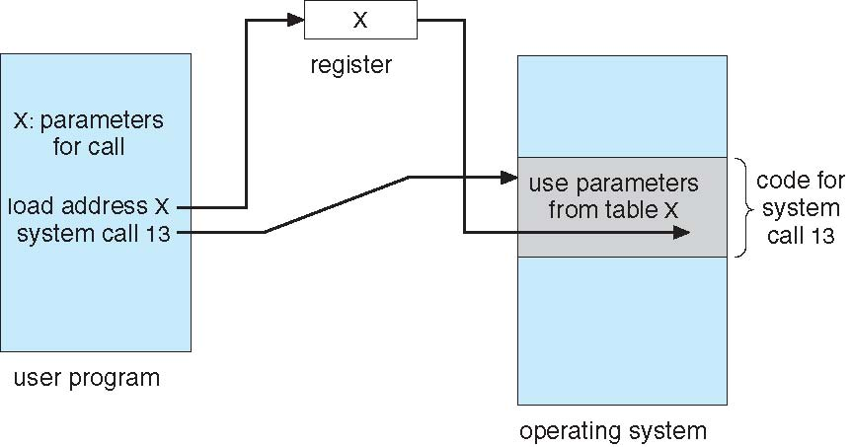
Parameter Passing via Table

Slide 71
Types of System Calls
Process control
  create process, terminate process
  end, abort
  load, execute
  get process attributes, set process attributes
  wait for time
  wait event, signal event
  allocate and free memory

Slide 72
Types of System Calls
File management
  create file, delete file
  open, close file
  read, write, reposition
  get and set file attributes
Device management
  request device, release device
  read, write, reposition
  get device attributes, set device attributes
  logically attach or detach devices

Slide 73
Types of System Calls (Cont.)
Information maintenance
  get time or date, set time or date
  get system data, set system data
  get and set process, file, or device attributes
Communications
  create, delete communication connection
  send, receive messages if message passing model to host name or process name
    From client to server
  Shared-memory model create and gain access to memory regions
  transfer status information
  attach and detach remote devices

Slide 74
Types of System Calls (Cont.)
Protection
  Control access to resources
  Get and set permissions
  Allow and deny user access

Slide 75
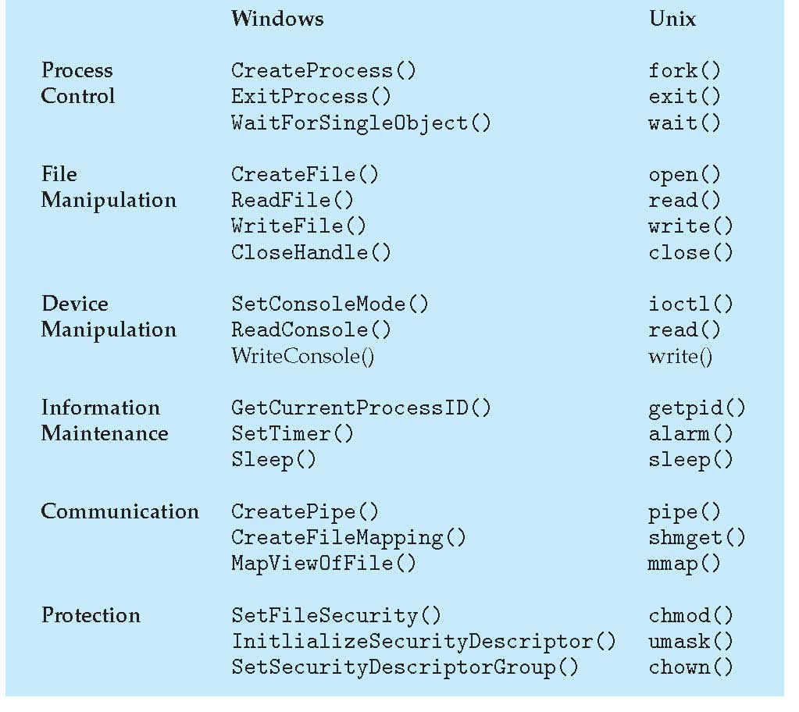
Examples of Windows and Unix System Calls

Slide 76
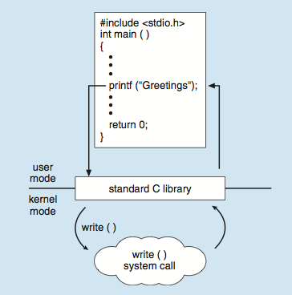
Standard C Library Example
C program invoking printf() library call, which calls write() system call

