Slide 1
Unit-2
Process management: Program vs. process, process states, Process Control Block (PCB), OS services and system calls (fork, wait, exec, getpid, getppid etc.), system calls vs. System programs, Process scheduling- Process context switching, scheduling algorithms, scheduling criteria.
Inter Process Communication: Linux IPC Mechanisms, RPC, RPC exception handling and Security issues.

Slide 2
Process Concept
An operating system executes a variety of programs:
  Batch system – jobs
  Time-shared systems – user programs or tasks
Process – a program in execution; process execution must progress in sequential fashion
Multiple parts
  The program code, also called text section
  Current activity including program counter, processor registers
  Stack containing temporary data
    Function parameters, return addresses, local variables
  Data section containing global variables
  Heap containing memory dynamically allocated during run time

Slide 3
Process Concept (Cont.)
Program is passive entity stored on disk (executable file), process is active
  Program becomes process when executable file loaded into memory
Execution of program started via GUI mouse clicks, command line entry of its name, etc

Slide 4
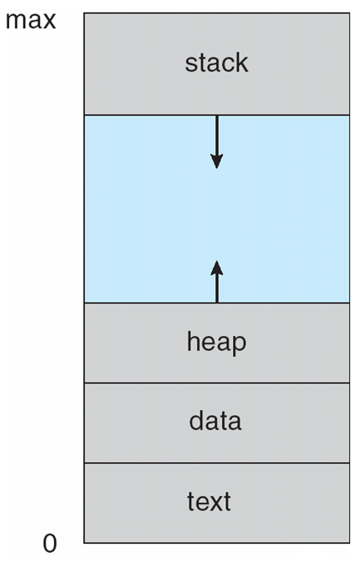
Process in Memory

Slide 5
Process State
As a process executes, it changes state
  new: The process is being created
  running: Instructions are being executed
  waiting: The process is waiting for some event to occur
  ready: The process is waiting to be assigned to a processor
  terminated: The process has finished execution

Slide 6

Diagram of Process State

Slide 7

Process Control Block (PCB)
Information associated with each process
(also called task control block)
Process state – running, waiting, etc
Program counter – location of instruction to next execute
CPU registers – contents of all process-centric registers
CPU scheduling information- priorities, scheduling queue pointers
Memory-management information – memory allocated to the process
Accounting information – CPU used,
I/O status information – I/O devices allocated to process, list of open files

Slide 8
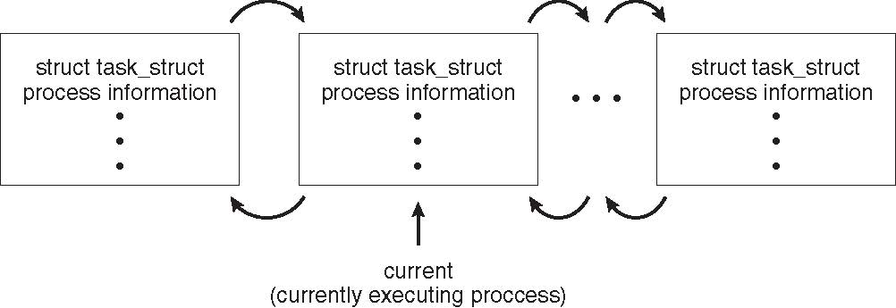
Process Representation in Linux
Represented by the C structure task_struct
pid t_pid; /* process identifier */
long state; /* state of the process */
unsigned int time_slice /* scheduling information */
struct task_struct *parent; /* this process’s parent */
struct list_head children; /* this process’s children */
struct files_struct *files; /* list of open files */
struct mm_struct *mm; /* address space of this process */

Slide 9
Operations on Processes
System must provide mechanisms for:
  process creation,
  process termination,

Slide 10
Process Creation
Parent process create children processes, which, in turn create other processes, forming a tree of processes
Generally, process identified and managed via a process identifier (pid)
Resource sharing options
  Parent and children share all resources
  Children share subset of parent’s resources
  Parent and child share no resources
Execution options
  Parent and children execute concurrently
  Parent waits until children terminate

Slide 11
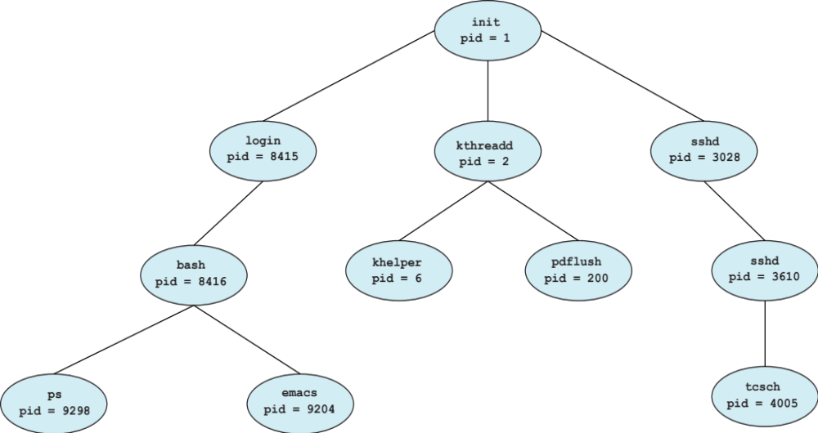
A Tree of Processes in Linux

Slide 12
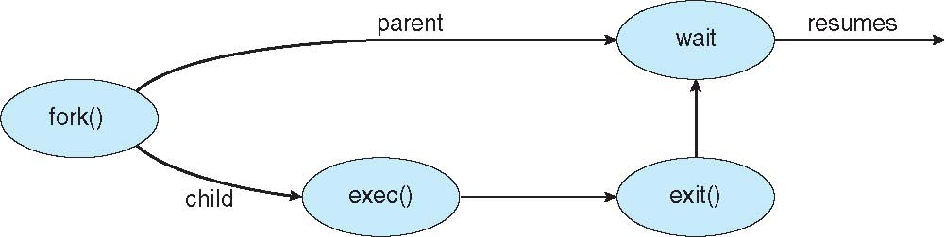
Process Creation (Cont.)
Address space
  Child duplicate of parent
  Child has a program loaded into it
UNIX examples
  fork() system call creates new process
  exec() system call used after a fork() to replace the process’ memory space with a new program

Slide 13
fork()
Fork system call is used for creating a new process, which is called child process, which runs concurrently with the process that makes the fork() call (parent process).
After a new child process is created, both processes will execute the next instruction following the fork() system call.
It takes no parameters and returns an integer value.
Here the parent and Child have Separate Address space
Below are different values returned by fork().
Negative Value: creation of a child process was unsuccessful.
Zero: Returned to the newly created child process.
Positive value: Returned to parent or caller. The value contains process ID of newly created child process.

Slide 14
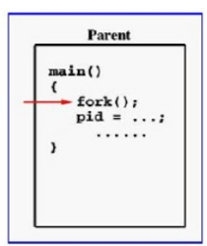
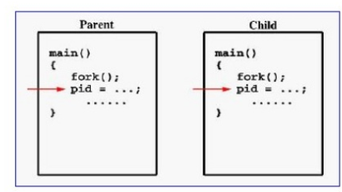

Slide 15
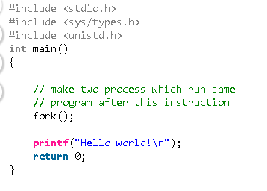
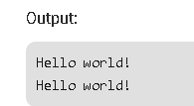

Slide 16
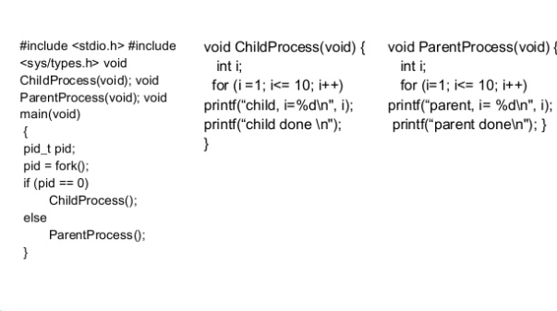

Slide 17
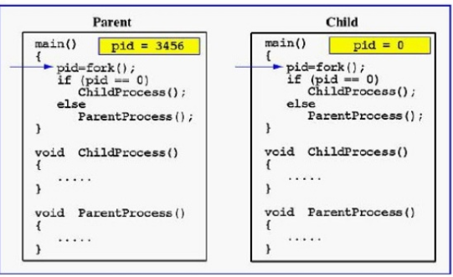
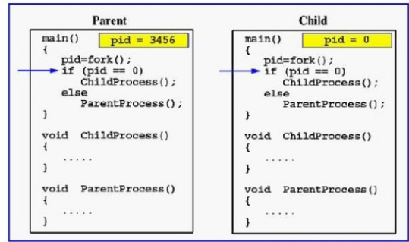

Slide 18
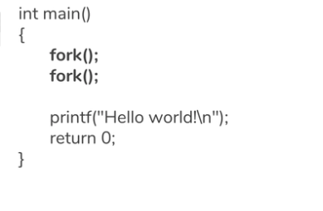
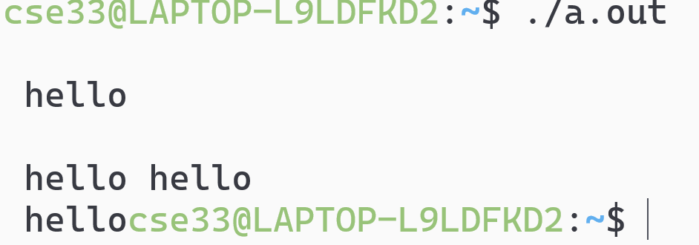
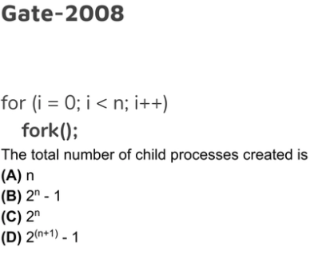
Ans:B

Slide 19
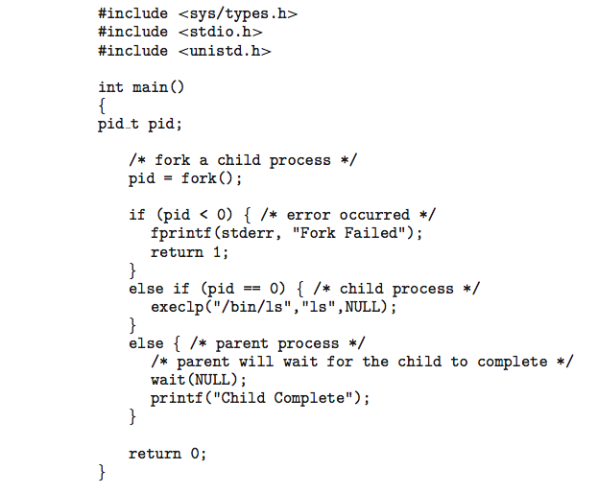
C Program Forking Separate Process

Slide 20
Process Termination
Process executes last statement and then asks the operating system to delete it using the exit() system call.
  Returns status data from child to parent (via wait())
  Process’ resources are deallocated by operating system
Parent may terminate the execution of children processes using the abort() system call. Some reasons for doing so:
  Child has exceeded allocated resources
  Task assigned to child is no longer required
  The parent is exiting and the operating systems does not allow a child to continue if its parent terminates

Slide 21
Process Termination
Some operating systems do not allow child to exists if its parent has terminated. If a process terminates, then all its children must also be terminated.
  cascading termination. All children, grandchildren, etc. are terminated.
  The termination is initiated by the operating system.
The parent process may wait for termination of a child process by using the wait()system call. The call returns status information and the pid of the terminated process
pid = wait(&status);
If no parent waiting (did not invoke wait()) process is a zombie
If parent terminated without invoking wait , process is an orphan

Slide 22
orphan process is a computer process whose parent process has finished or terminated, though it (child process) remains running itself.
A zombie process or defunct process is a process that has completed execution but still has an entry in the process table as its parent process didn't invoke an wait() system call.

Slide 23
System Program
System Program: provides environment to develop and execute
Application S/w
  Provides service to user
System S/w
  Provides service to different application

Slide 24
Types of System Programs
Status Information
Communication
File Management
File Modification
Program Loading and executing
Programming Language Support
Application Programs

Slide 25
Process Scheduling
Maximize CPU use, quickly switch processes onto CPU for time sharing
Process scheduler selects among available processes for next execution on CPU
Maintains scheduling queues of processes
  Job queue – set of all processes in the system
  Ready queue – set of all processes residing in main memory, ready and waiting to execute
  Device queues – set of processes waiting for an I/O device
  Processes migrate among the various queues

Slide 26
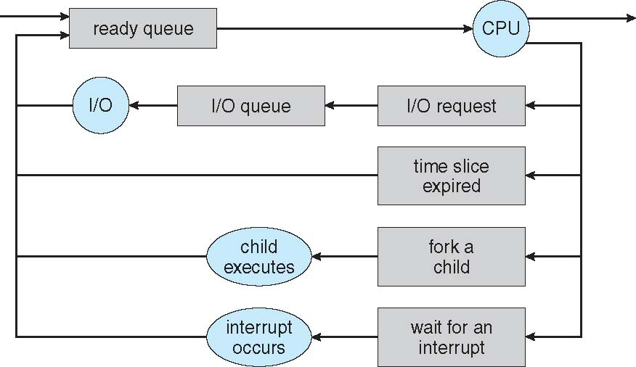
Representation of Process Scheduling
Queueing diagram represents queues, resources, flows

Slide 27
Schedulers
Short-term scheduler (or CPU scheduler) – selects which process should be executed next and allocates CPU
  Short-term scheduler is invoked frequently (milliseconds) ⇒ (must be fast)
Long-term scheduler (or job scheduler) – selects which processes should be brought into the ready queue
  Long-term scheduler is invoked infrequently (seconds, minutes) ⇒ (may be slow)
  The long-term scheduler controls the degree of multiprogramming
Processes can be described as either:
  I/O-bound process – spends more time doing I/O than computations, many short CPU bursts
  CPU-bound process – spends more time doing computations; few very long CPU bursts
Long-term scheduler strives for good process mix

Slide 28
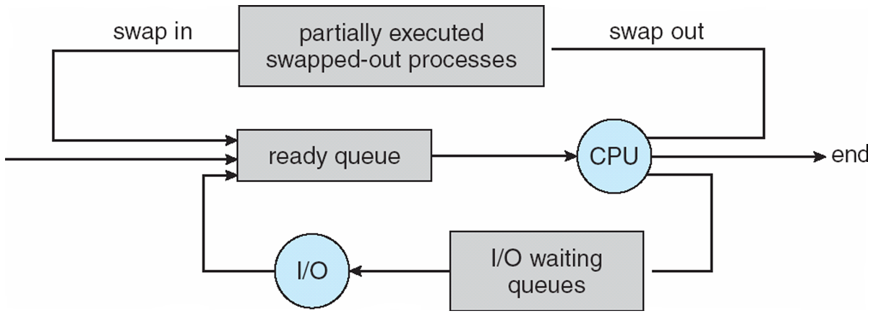
Addition of Medium Term Scheduling
Medium-term scheduler can be added if degree of multiple programming needs to decrease
  Remove process from memory, store on disk, bring back in from disk to continue execution: swapping

Slide 29

CPU Switch From Process to Process

Slide 30
Context Switch
When CPU switches to another process, the system must save the state of the old process and load the saved state for the new process via a context switch
Context of a process represented in the PCB
Context-switch time is overhead; the system does no useful work while switching
  The more complex the OS and the PCB ➔ the longer the context switch

Slide 31
CPU Scheduling

Slide 32
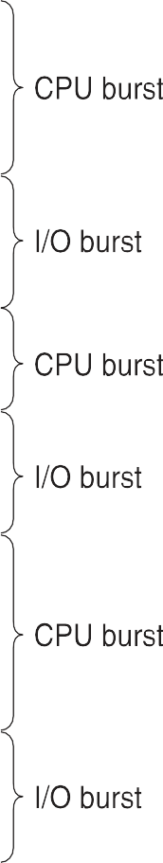


Basic Concepts
Maximum CPU utilization obtained with multiprogramming
CPU–I/O Burst Cycle – Process execution consists of a cycle of CPU execution and I/O wait
CPU burst followed by I/O burst

Slide 33
CPU Scheduler
Short-term scheduler selects from among the processes in ready queue, and allocates the CPU to one of them
  Queue may be ordered in various ways
CPU scheduling decisions may take place when a process:
Switches from running to waiting state
Switches from running to ready state
Switches from waiting to ready
Terminates
Scheduling under 1 and 4 is non-preemptive
All other scheduling is preemptive

Slide 34
Dispatcher
Dispatcher module gives control of the CPU to the process selected by the short-term scheduler; this involves:
  switching context
  switching to user mode
  jumping to the proper location in the user program to restart that
program
Dispatch latency – time it takes for the dispatcher to stop one process and start another running

Slide 35
Scheduling Criteria
CPU utilization – keep the CPU as busy as possible
Throughput – # of processes that complete their execution per time unit
Turnaround time – amount of time to execute a particular process
Waiting time – amount of time a process has been waiting in the ready queue
Response time – amount of time it takes from when a request was submitted until the first response is produced, not output (for time-sharing environment)

Slide 36
Notation
' N' Processes (P1.....Pn)
Arrival Time (AT) = A_{i}
Burst Time (BT) = B
Turnaround Time (TAT) = C_{i} - A_{i}
AvgTAT = 1/n ∑C_{i} - A_{i}
i=1
i
Completion Time (CT) = C_{i}
n
i
WaitingTime (WT) = TAT - BT = C - A − BT
i
i
Avg WT = 1/n ∑C_{i} - A_{i} − B_{i}
i=1
n

Slide 37
Scheduling Algorithm Optimization Criteria
Max CPU utilization
Max throughput
Min turnaround time
Min waiting time
Min response time

Slide 38
Scheduling Algorithms
Classification of scheduling algorithms is given in the table below
CPU / Processor Scheduling Algorithms
Non Preemptive Algorithms |  |  | Preemptive Algorithms
First-Come First-Serve (FCFS) | Shortest Job First (SJF) | Priority Non Preemptive (P-NP) | Shortest Remaining Time First (SRTF) | Priority Preemptive (Pri-P) | Round Robin (RR)
Other classes of CPU scheduling algorithms includes
  Multilevel Queue Scheduling
  Multilevel Feedback Queue scheduling
  Multiple –Processes Scheduling
  Real-Time Scheduling

Slide 39
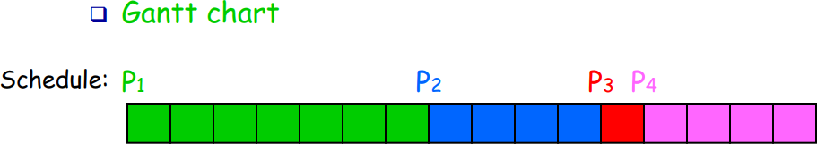
Gantt chart
It is used to represent the scheduling of processes graphically
It is a rectangular time scale diagram with x-axis depicting the timeline
Process- ids of processes allocated the CPU for a particular time periods is indicated in that rectangular slot

Slide 40
First- Come, First-Served (FCFS) Scheduling
Concept - Process that requests the CPU first is allocated the CPU first.
Mode: Non-Preemptive
Criteria: Arrival Time
Working -
  Process requests are kept in ready queue in FIFO order i.e. ready queue is maintained as FIFO queue.
  When a new process enters the queue, its PCB is linked onto the tail/rear of the queue.
  When CPU is free, it is allocated to the process that is at the head / front of the queue.

Slide 41
First- Come, First-Served (FCFS) Scheduling
Consider the following set of processes that arrive at time 0, in the order PI, P2, P3, with CPU-burst time in milliseconds given below (Avg TAT Avg WT)
Process
P₁ P₂ P₃
Burst Time
24
3
3
Gantt chart
P₁ | P₂ | P₃
0
24
27
30

Slide 42



P₁ | P₂ | P₃
0
24
27
30
Turnaround Time (TAT) = C_{i} - A_{i}
AvgTAT = 1/n ∑C_{i} - A_{i}
i=1
WaitingTime (WT) = TAT - BT = C_{i} - A_{i} − BT
Avg WT = 1/n ∑C_{i} - A_{i} − B_{i}
i=1
n
n
Process id | Burst Time (BT) | Arrival Time (AT) | Completion Time (CT) | TAT | WT
PI | 24 | 0 | 24 | 24 | 0
P2 | 3 | 0 | 27 | 27 | 24
P3 | 3 | 0 | 30 | 30 | 27
Avg TAT ?
Average TAT = (24 + 27 + 30)/3 = 81 / 3 = 27 msec.
Average WT = (0 + 24 + 27 ) / 3 = 51/3 = 17 msec.

Slide 43
Example 2
Consider the Example 1 again but with process arriving in the order P2,P3, P1.

Slide 44
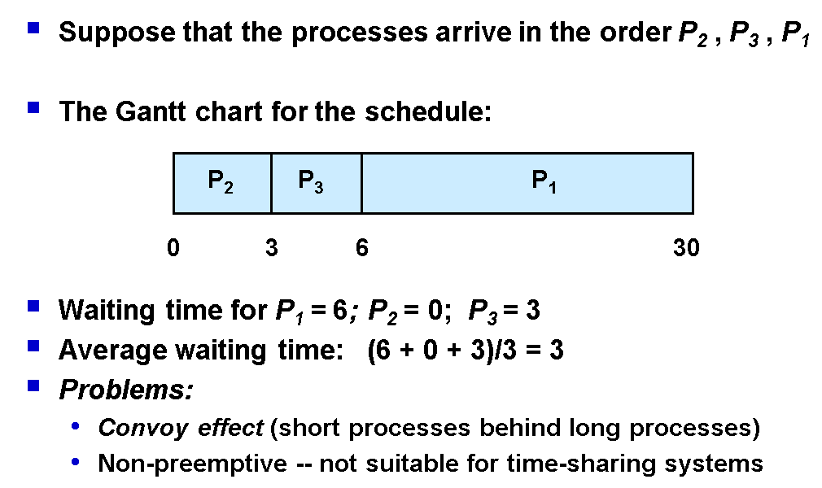
Convoy Effect :All other processes wait for the one big process to get off the CPU

Slide 45
Example 3
Process | Arrival Time | Burst Time
P1 | 0 | 8
P2 | 1 | 4
P3 | 2 | 9
P4 | 3 | 5

Slide 46
Process | Arrival Time | Burst Time
P1 | 0 | 8
P2 | 1 | 4
P3 | 2 | 9
P4 | 3 | 5
Initial Ready Queue
P1
P1
0
8

Slide 47
Process | Arrival Time | Burst Time
P1 | 0 | 8
P2 | 1 | 4
P3 | 2 | 9
P4 | 3 | 5
After 8 ms Ready Queue
P2 P3 P4
P1
P2
0
8
12

Slide 48
Process | Arrival Time | Burst Time
P1 | 0 | 8
P2 | 1 | 4
P3 | 2 | 9
P4 | 3 | 5
Ready Queue
P3 P4
P1
P2
P3
0
8
12
21

Slide 49
Process | Arrival Time | Burst Time
P1 | 0 | 8
P2 | 1 | 4
P3 | 2 | 9
P4 | 3 | 5
Ready Queue
P4
P1
P2
P3
0
8
12
21

Slide 50
Process | Arrival Time | Burst Time
P1 | 0 | 8
P2 | 1 | 4
P3 | 2 | 9
P4 | 3 | 5
Ready Queue
P1
P2
P3
P4
0
8
12
21
26

Slide 51
P1
P2
P3
P4
0
8
12
21
26
Turnaround Time (TAT) = C_{i} - A_{i}
AvgTAT = 1/n ∑C_{i} - A_{i}
i=1
WaitingTime (WT) = TAT - BT = C_{i} - A_{i} − BT
Avg WT = 1/n ∑C_{i} - A_{i} − B_{i}
i=1
n
Process | Arrival Time | Burst Time | Completion Time (CT) | TAT | WT
P1 | 0 | 8 | 8 | 8 | 0
P2 | 1 | 4 | 12 | 11 | 7
P3 | 2 | 9 | 21 | 19 | 10
P4 | 3 | 5 | 26 | 23 | 18
n
Average TAT = (8 + 11 + 19+23)/4 = 61/ 4 = 15.25 msec.
Average WT = (0 + 7+10 + 18) / 4 = 35/4 = 8.75 msec.

Slide 52
First-Come, First-Served (FCFS) Scheduling
Single FIFO ready queue
No-preemptive
  Not suitable for timesharing systems
Simple to implement and understand

Slide 53
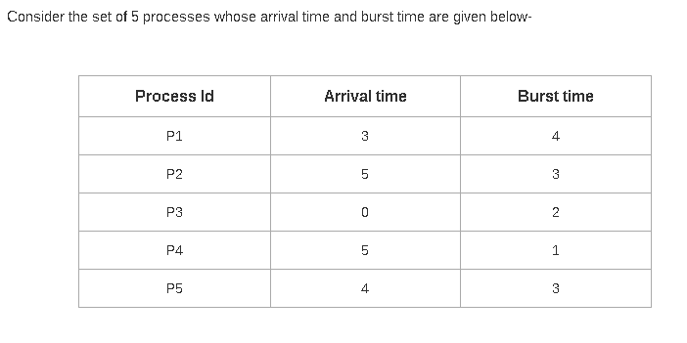

Assignment Questions

Slide 54
Shortest-Job-First (SJF) Scheduling
Concept - Allocate the CPU to the process with the smallest next CPU burst.
Mode :Non-Preemptive
Criteria :Burst Time
Working -
  It associates with each process the length of its next CPU burst.
  The CPU is allocated to the process with the smallest next CPU burst.
  If two processes have the same next CPU bursts, FCFS is used to break the tie.

Slide 55
Shortest-Job-First (SJF) Scheduling
Consider the following set of processes that arrive at time 0, in the order PI, P2, P3, with CPU-burst time in milliseconds given below (Avg TAT Avg WT)
Process
P₁ P₂ P₃
Burst Time 24
3
3
P2
P3
P1
0
3
6
30

Slide 56


P2
Avg TAT ?
Avg WT ?
P3
P1
0
3
6
3
0
Turnaround Time (TAT) = C - A
i i
AvgTAT = 1/n ∑C_{i} - A_{i}
i=1
WaitingTime (WT) = TAT - BT = C_{i} - A_{i} − BT
Avg WT = 1/n ∑C_{i} - A_{i} − B_{i}
i=1
n
n
Process id | Burst Time (BT) | Arrival Time (AT) | Completion Time (CT) | TAT | WT
PI | 24 | 0 | 30 | 30 | 6
P2 | 3 | 0 | 3 | 3 | 0
P3 | 3 | 0 | 6 | 6 | 3
Average TAT = 39 / 3 = 13 msec.
Average WT = 9/ 3 = 3 msec.

Slide 57
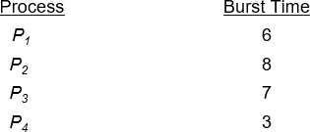
Example of SJF
SJF scheduling chart
P₄ | P₁ | P₃ | P₂
0
3
9
16
24

Slide 58
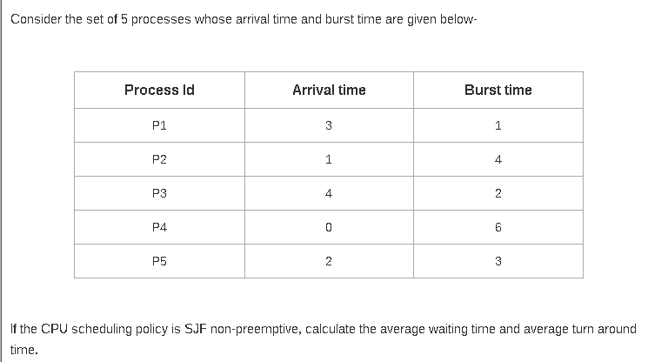
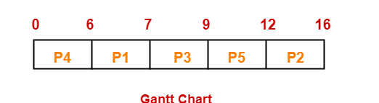

Slide 59
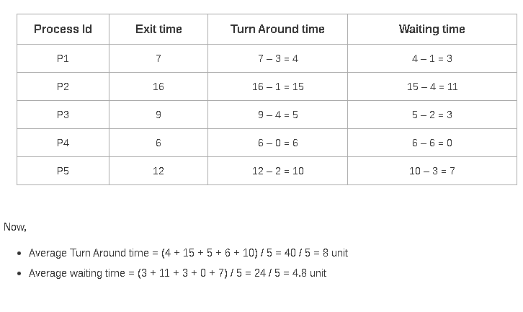

Slide 60
Observations
Also called as shortest next CPU burst scheduling.
It is provably the optimal scheduling algorithm.
It gives the minimum average waiting time for a given set of processes
Knowing the length of the next CPU request is difficult.
It can’t be implemented at short term scheduling level as it is difficult know the length of the next CPU burst.
SJF will result in the maximum Throughput

Slide 61
SJF with Prediction Techniques BT
Prediction Techniques
Static
Dynamic
1. Process size
1. Simple Averaging
2. Process Type
2. Exponential averaging

Slide 62
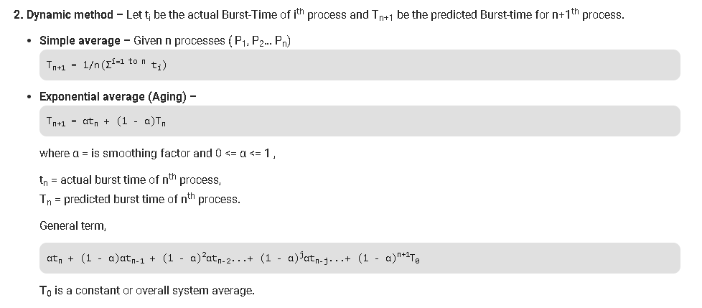

Slide 63
Determining Length of Next CPU Burst
Commonly, α set to ½
Preemptive version called shortest-remaining-time-first

Slide 64
Examples of Exponential Averaging
α =0
  τ_{n+1} = τ_{n}
  Recent history does not count
α =1
  τ_{n+1} = α t_{n}
  Only the actual last CPU burst counts
If we expand the formula, we get:
τ_{n+1} = α t_{n}+(1 - α)α t_{n -1} + …
+(1 - α )^{j} α t_{n -j} + …
+(1 - α )^{n +1} τ₀
Since both α and (1 - α) are less than or equal to 1, each
successive term has less weight than its predecessor

Slide 65

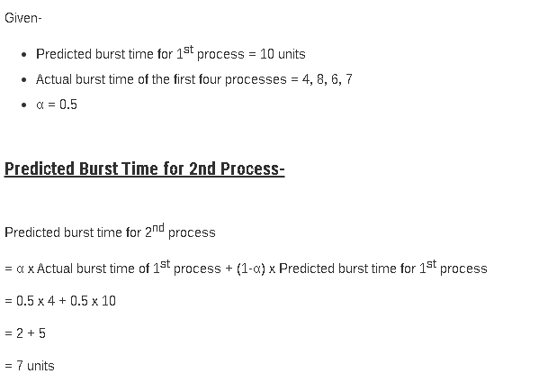

Slide 66
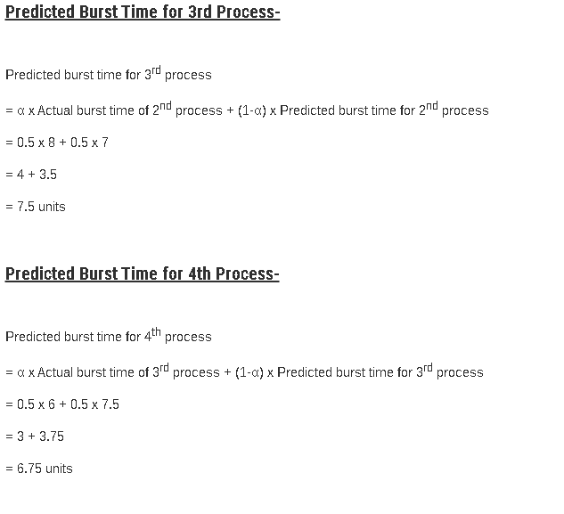

Slide 67
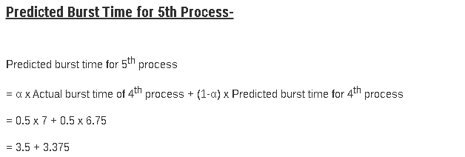

Slide 68


Assignment Questions
Process | Arrival Time | Burst Time
P1 | 0 | 20
P2 | 1 | 1
P3 | 2 | 1
Process | Arrival Time | Burst Time
P1 | 1 | 7
P2 | 2 | 5
P3 | 3 | 1
P4 | 4 | 2
P5 | 5 | 8

Slide 69
Shortest Remaining Time First / Shortest Job First Preemptive Scheduling (SRTF / SJFP)
Concept — Preempt the currently executing process, if the newly arrived process has shorter CPU burst time in comparison to the executing process.
Working -
  Same as SJF except that it can cause preemption when a new process arrives.
    If new arrived process has same CPU burst time as that of the executing process’s remaining CPU burst time,
    the executing process is allowed to continue to avoid context switch overhead.
  Has the overhead of context switch.

Slide 70
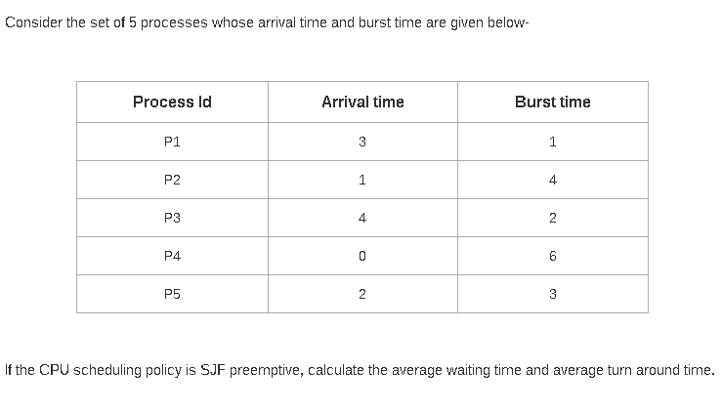
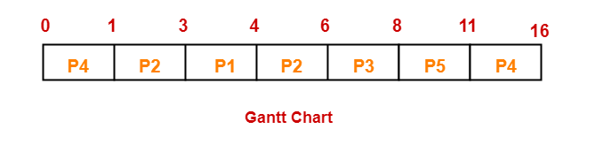

Slide 71
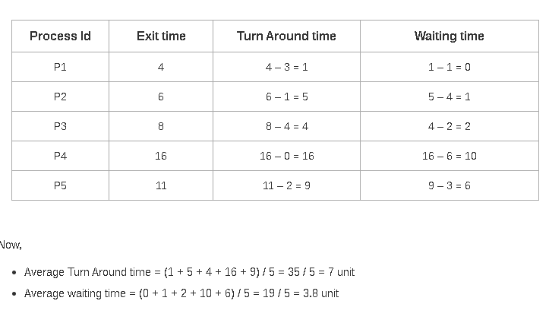

Slide 72
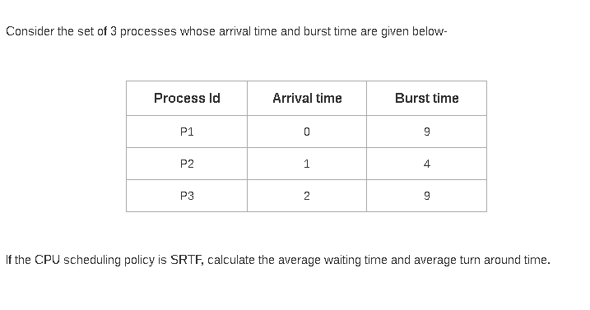
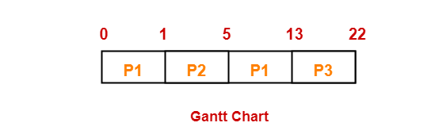

Slide 73
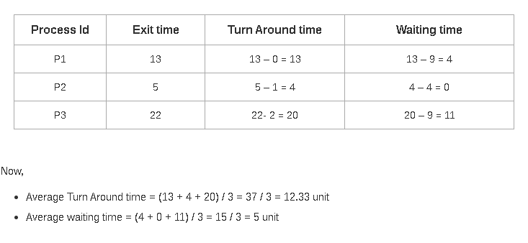

Slide 74
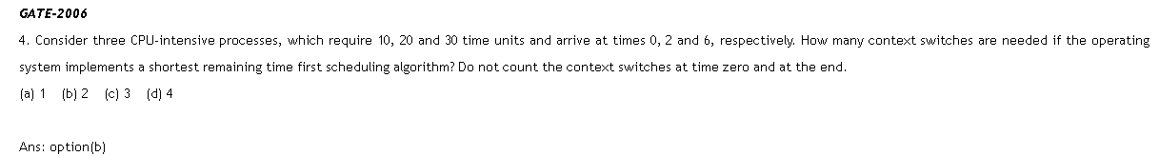

Slide 75
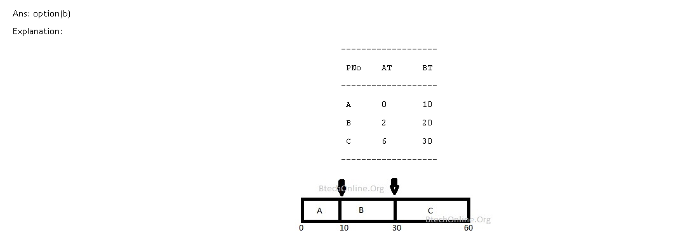

Slide 76
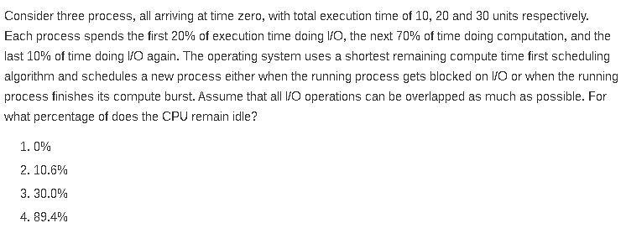

Slide 77
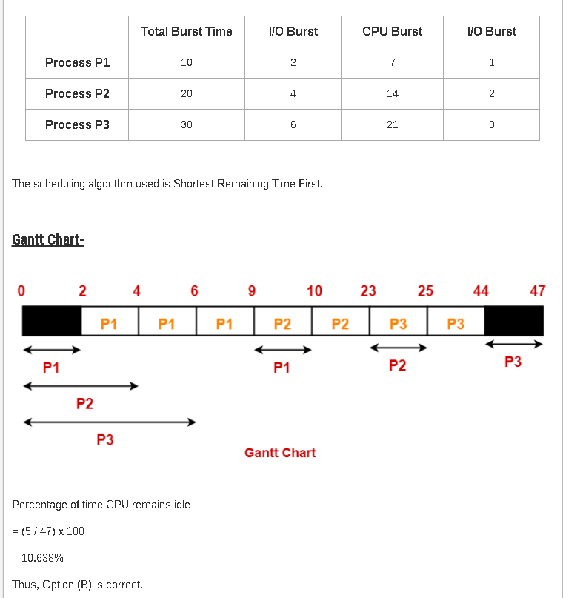

Slide 78
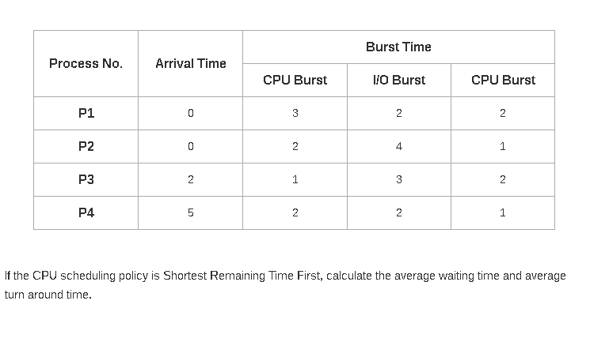

Slide 79
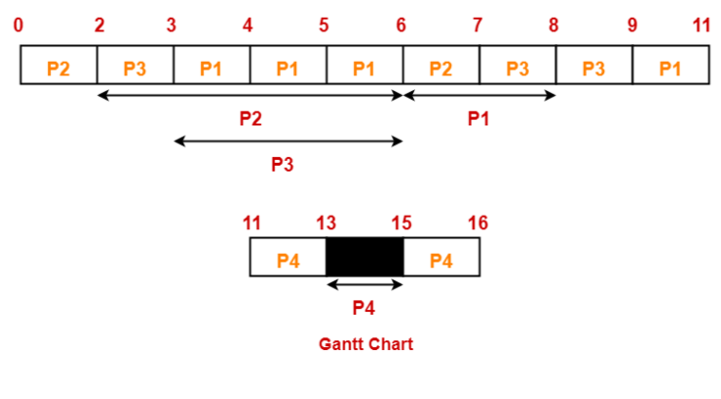

Slide 80
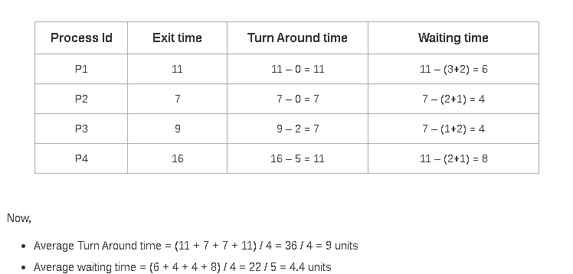

Slide 81
Example of Shortest-remaining-time-first
Now we add the concepts of varying arrival times and preemption to the analysis
Process Arrival Time Burst Time
P₁ |  | 0 |  | 8
P₂ |  | 1 |  | 4
P₃ |  | 2 |  | 9
P₄ |  | 3 |  | 5
Preemptive SJF Gantt Chart
P₁ | P₂ | P₄ | P₁ | P₃
0
1
5
10
17
26

Slide 82
Example 2 (Find ThroughPut)
Process | Arrival Time | Burst Time
P1 | 0 | 7
P2 | 1 | 5
P3 | 2 | 3
P4 | 3 | 1
P5 | 4 | 2
P6 | 5 | 1
Schedulelength(L) = Max(C_{i} ) − Min(A_{i} ) Through Put = N/L

Slide 83
Round Robin (RR)
Each process gets a small unit of CPU time (time quantum q), usually 10-100 milliseconds. After this time has elapsed, the process is preempted and added to the end of the ready queue.
Timer interrupts every quantum to schedule next process
Performance
  q large ⇒ FIFO
  q small ⇒ q must be large with respect to context switch, otherwise overhead is
too high

Slide 84
Round Robin (RR)
Concept — CPU time (in units of time slice/ time quantum) is shared among the requesting processes in a round robin sequence.
Working -
  A small unit of time called time slice / time quantum is defined. It is usually 10 to 100 msecs.
  The ready queue is operated as a circular queue.
  Processes in the ready queue are kept in FIFO order.
  The scheduler picks the first process from the ready queue, at the same time sets a timer to interrupt at the end of the time slice and dispatches the process.
  When the timer goes off, either the executing process completes and releases the CPU or requires more time thus requiring a Context Switch and is added to the tail of the queue.

Slide 85
Example of RR with Time Quantum = 4
Process
P₁ P₂ P₃
The Gantt chart is:
Burst Time 24
3
3
P₁ | P₂ | P₃ | P₁ | P₁ | P₁ | P₁ | P₁
0
4
7
10
14
18
22
26
30
Typically, higher average turnaround than SJF, but better response
q should be large compared to context switch time
q usually 10ms to 100ms, context switch < 10 usec

Slide 86
Example 1
Time Quantum = 2
Process Id | CPU Burst Time | Arrival Time
P1 | 6 | 0
P2 | 2 | 1
P3 | 4 | 2

Slide 87

Process Id | CPU Burst Time | Arrival Time
P1 | 6 | 0
P2 | 2 | 1
P3 | 4 | 2
Queue
P1
At 0
Time Quantum = 2

Slide 88

Process Id | Arrival Time | CPU Burst Time
P1 | 0 | 6
P2 | 1 | 2
P3 | 2 | 4
Queue
4
At 0
Time Quantum = 2
P1
0
2

Slide 89

Queue P2 P3
Process Id | Arrival Time | CPU Burst Time
P1 | 0 | 4
P2 | 1 | 2
P3 | 2 | 4
After 2
Time Quantum = 2
P1
0
2

Slide 90

Queue P3 P1
Process Id | Arrival Time | CPU Burst Time
P1 | 0 | 4
P2 | 1 | 2
P3 | 2 | 4
0
After 4
Time Quantum = 2
P1 P2
0
2
4

Slide 91

Process Id | Arrival Time | CPU Burst Time
P1 | 0 | 4
P2 | 1 | 0
P3 | 2 | 4
Queue
P1
2
After 6
Time Quantum = 2
P1 P2
P3
0
2
4
6

Slide 92
Process Id | Arrival Time | CPU Burst Time
P1 | 0 | 4
P2 | 1 | 0
P3 | 2 | 2
Queue
P3
2
After 6
Time Quantum = 2
P1 P2
P3
P1
0
2
4
6
8

Slide 93
Process Id | Arrival Time | CPU Burst Time
P1 | 0 | 2
P2 | 1 | 0
P3 | 2 | 2
Queue
P3
After 6
Time Quantum = 2
P1 P2
P3
P1
0
2
4
6
8

Slide 94

Process Id | Arrival Time | CPU Burst Time
P1 | 0 | 6
P2 | 1 | 2
P3 | 2 | 4
Queue
Final
Time Quantum = 2
P1 P2
0 2 4
P3
P1
8
P3
P1
12
6
10

Slide 95
Example 2 [ Time Quantum = 3 ]
process - id | CPU Burst Time | Arrival Time
P1 | 5 | 5
P2 | 6 | 4
P3 | 7 | 3
P4 | 9 | 1
P5 | 2 | 2
P6 | 3 | 6

Slide 96
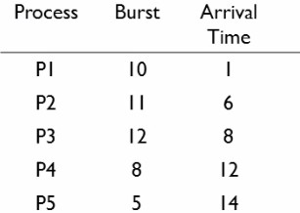
Example 3 [ Time Quantum = 5 ]
Assignment Question

Slide 97
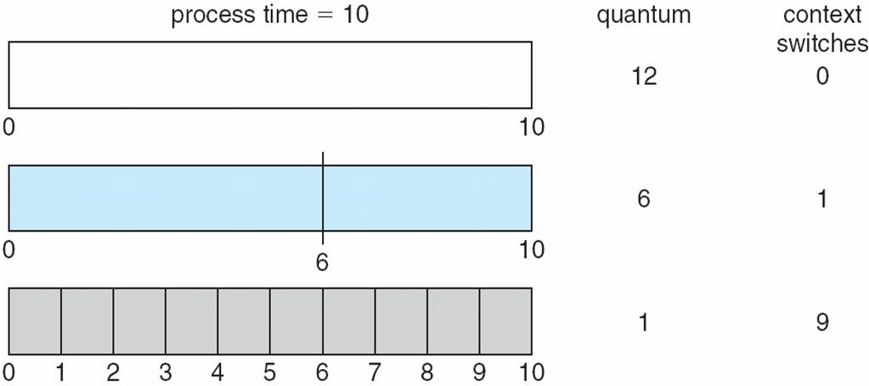
Time Quantum and Context Switch Time

Slide 98
Priority Scheduling
A priority number (integer) is associated with each process
The CPU is allocated to the process with the highest priority (smallest integer ≡ highest priority)
  Preemptive
  Nonpreemptive
Problem ≡ Starvation – low priority processes may never execute
Solution ≡ Aging – as time progresses increase the priority of the process

Slide 99
Priority Scheduling
Concept - Priorities are associated with processes, CPU is allocated to the process with highest priority.
Working
Processes are kept in the ready queue in order of their priorities, whether all processes arrive at the same time or have different times.
The CPU is allocated to the process with the highest priority.
If two processes have the same priority (Equal priority), FCFS is used to break the tie.

Slide 100
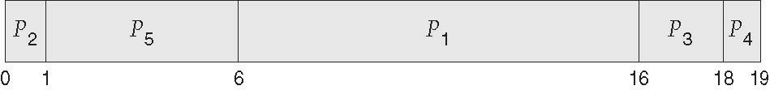
Example of Priority Scheduling
Process Burst Time Priority
P₁ | 10 | 3
P₂ | 1 | 1
P₃ | 2 | 4
P₄ | 1 | 5
P₅ | 5 | 2
Priority scheduling Gantt Chart

Slide 101






Avg TAT ?
Avg WT ?
RT for p5 is ?
Turnaround Time (TAT) = C_{i} - A_{i}
AvgTAT = 1/n ∑C_{i} - A_{i}
i=1
WaitingTime (WT) = TAT - BT = C_{i} - A_{i} − BT
Avg WT = 1/n ∑C_{i} - A_{i} − B_{i}
i=1
n
n
Process id | Burst Time (BT) | Arrival Time (AT) | Completion Time (CT) | TAT | WT | RT
P1 | 10 | 0 | 16 | 16 | 6 | 6
P2 | 1 | 0 | 1 | 1 | 0 | 0
P3 | 2 | 0 | 18 | 18 | 16 | 16
P4 | 1 | 0 | 19 | 19 | 18 | 18
P5 | 5 | 0 | 6 | 6 | 1 | 1
Average TAT = 39 / 3 = 13 msec.
Average WT = 9/ 3 = 3 msec.
Where
ST = Schedule Time

Slide 102
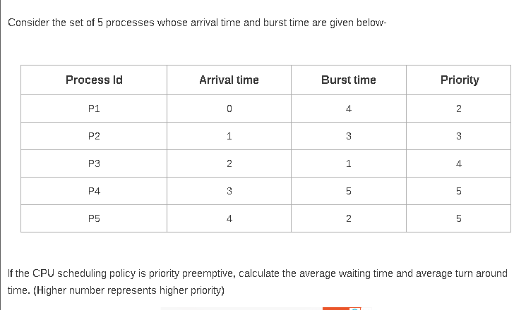

Slide 103
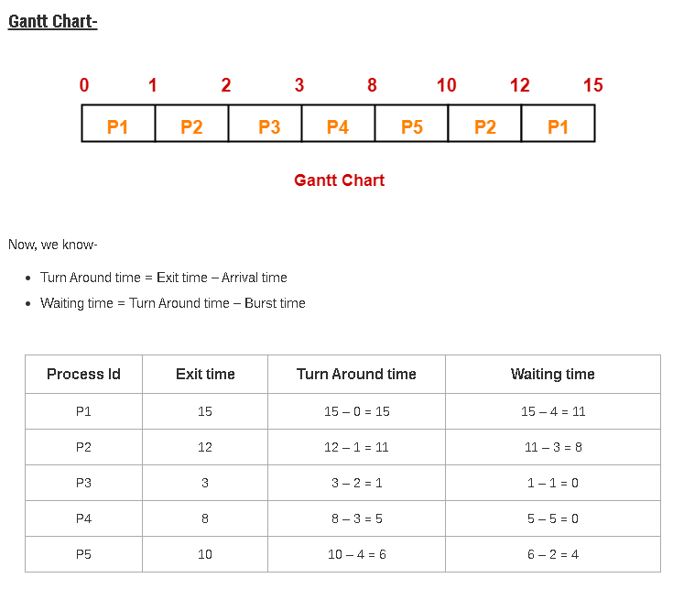

Slide 104
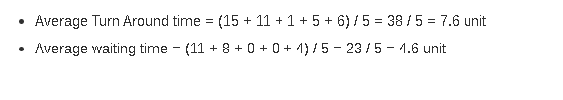

Slide 105
Example 2 (Preemptive)
Pno | Priority | AT | BT
P1 | 2(L) | 0 | 4
P2 | 4 | 1 | 2
P3 | 6 | 2 | 3
P4 | 10 | 3 | 4
P5 | 8 | 4 | 1
P6 | 12 (H) | 5 | 4
P7 | 9 | 6 | 6

Slide 106
Arrival Time
P1 P2 P3 P4 P5 P6 P7
Pno | Priority | AT | BT
P1 | 2(L) | 0 | 4
P2 | 4 | 1 | 2
P3 | 6 | 2 | 3
P4 | 10 | 3 | 4
P5 | 8 | 4 | 1
P6 | 12 (H) | 5 | 4
P7 | 9 | 6 | 6
P1 P2 P3 P4 P5 P6
P1 P2 P3 P4 P5
3
P1 P2 P3 P4
P1 P2 P3
P1 P2
P1
0 |  | 1 |  | 2 |  | 3 |  | 4 |  | 5 |  | 6
P1
0
1

Slide 107
Arrival Time
P1 P2 P3 P4 P5 P6 P7
Pno | Priority | AT | BT
P1 | 2(L) | 0 | 3
P2 | 4 | 1 | 2
P3 | 6 | 2 | 3
P4 | 10 | 3 | 4
P5 | 8 | 4 | 1
P6 | 12 (H) | 5 | 4
P7 | 9 | 6 | 6
P1 P2 P3 P4 P5 P6
P1 P2 P3 P4 P5
P1 P2 P3 P4
1
P1 P2 P3
P1 P2
P1
0 |  | 1 |  | 2 |  | 3 |  | 4 |  | 5 |  | 6
P1
P2
0
1
2

Slide 108
Arrival Time
P1 P2 P3 P4 P5 P6 P7
Pno | Priority | AT | BT
P1 | 2(L) | 0 | 3
P2 | 4 | 1 | 1
P3 | 6 | 2 | 3
P4 | 10 | 3 | 4
P5 | 8 | 4 | 1
P6 | 12 (H) | 5 | 4
P7 | 9 | 6 | 6
P1 P2 P3 P4 P5 P6
P1 P2 P3 P4 P5
P1 P2 P3 P4
P1 P2 P3
P1 P2
P1
2
0 |  | 1 |  | 2 |  | 3 |  | 4 |  | 5 |  | 6
P1
P2
P3
0
1
2
3

Slide 109
Arrival Time
P1 P2 P3 P4 P5 P6 P7
Pno | Priority | AT | BT
P1 | 2(L) | 0 | 3
P2 | 4 | 1 | 1
P3 | 6 | 2 | 2
P4 | 10 | 3 | 4
P5 | 8 | 4 | 1
P6 | 12 (H) | 5 | 4
P7 | 9 | 6 | 6
P1 P2 P3 P4 P5 P6
P1 P2 P3 P4 P5
P1 P2 P3 P4
P1 P2 P3
P1 P2
P1
3
0 |  | 1 |  | 2 |  | 3 |  | 4 |  | 5 |  | 6
P1
P2
P3
P4
0
1
2
3
4

Slide 110
Arrival Time
P1 P2 P3 P4 P5 P6 P7
Pno | Priority | AT | BT
P1 | 2(L) | 0 | 3
P2 | 4 | 1 | 1
P3 | 6 | 2 | 2
P4 | 10 | 3 | 3
P5 | 8 | 4 | 1
P6 | 12 (H) | 5 | 4
P7 | 9 | 6 | 6
P1 P2 P3 P4 P5 P6
P1 P2 P3 P4 P5
P1 P2 P3 P4
P1 P2 P3
P1 P2
P1
2
0 |  | 1 |  | 2 |  | 3 |  | 4 |  | 5 |  | 6
P1
P2
P3
P4
P4
5
0
1
2
3
4

Slide 111
Arrival Time
P1 P2 P3 P4 P5 P6 P7
Pno | Priority | AT | BT
P1 | 2(L) | 0 | 3
P2 | 4 | 1 | 1
P3 | 6 | 2 | 2
P4 | 10 | 3 | 2
P5 | 8 | 4 | 1
P6 | 12 (H) | 5 | 4
P7 | 9 | 6 | 6
P1 P2 P3 P4 P5 P6
P1 P2 P3 P4 P5
P1 P2 P3 P4
P1 P2 P3
P1 P2
P1
0 |  | 1 |  | 2 |  | 3 |  | 4 |  | 5 |  | 6
0
P1
0 1
P2
2
P3
3
P4
4
P4
5
P6
9

Slide 112
Arrival Time
P1 P2 P3 P4 P5 P6
P1 P2 P3 P4 P5 P7
Pno | Priority | AT | BT
P1 | 2(L) | 0 | 3
P2 | 4 | 1 | 1
P3 | 6 | 2 | 2
P4 | 10 | 3 | 2
P5 | 8 | 4 | 1
P6 | 12 (H) | 5 | 0
P7 | 9 | 6 | 6
P1 P2 P3 P4 P5
P1 P2 P3 P4
P1 P2 P3
P1 P2
P1
0
0 |  | 1 |  | 2 |  | 3 |  | 4 |  | 5 |  | 6
P1
0 1
P2
2
P3
3
P4
4
P4
5
P6
9
P4
11

Slide 113
Pno | Priority | AT | BT
P1 | 2(L) | 0 | 3
P2 | 4 | 1 | 1
P3 | 6 | 2 | 2
P4 | 10 | 3 | 0
P5 | 8 | 4 | 1
P6 | 12 (H) | 5 | 0
P7 | 9 | 6 | 6
Arrival Time
P1 P2 P3 P4 P5 P6
P1 P2 P3 P5 P7
P1 P2 P3 P4 P5
P1 P2 P3 P4
P1 P2 P3
P1 P2
P1
0 |  | 1 |  | 2 |  | 3 |  | 4 |  | 5 |  | 6
0
P1
0 1
P2
2
P3
3
P4
4
P4
5
P6
9
P4 P7
11 17

Slide 114
Pno | Priority | AT | BT
P1 | 2(L) | 0 | 3
P2 | 4 | 1 | 1
P3 | 6 | 2 | 2
P4 | 10 | 3 | 0
P5 | 8 | 4 | 1
P6 | 12 (H) | 5 | 0
P7 | 9 | 6 | 0
Arrival Time
P1 P2 P3 P4 P5 P6
P1 P2 P3 P5
P1 P2 P3 P4 P5
P1 P2 P3 P4
P1 P2 P3
P1 P2
P1
0 |  | 1 |  | 2 |  | 3 |  | 4 |  | 5 |  | 6
0
P1
0 1
P2
2
P3
3
P4
4
P4
5
P6
9
P4 P7
11 17
P5
18

Slide 115
Pno | Priority | AT | BT
P1 | 2(L) | 0 | 3
P2 | 4 | 1 | 1
P3 | 6 | 2 | 2
P4 | 10 | 3 | 0
P5 | 8 | 4 | 0
P6 | 12 (H) | 5 | 0
P7 | 9 | 6 | 0
Arrival Time
P1 P2 P3 P4 P5 P6
P1 P2 P3 P4 P5
P1 P2 P3
P1 P2 P3 P4
P1 P2 P3
P1 P2
P1
0
0 |  | 1 |  | 2 |  | 3 |  | 4 |  | 5 |  | 6
P1
0 1
P2
2
P3
3
P4
4
P4
5
P6
9
P4 P7
11 17
P5
P3
18
20

Slide 116
Pno | Priority | AT | BT
P1 | 2(L) | 0 | 3
P2 | 4 | 1 | 1
P3 | 6 | 2 | 0
P4 | 10 | 3 | 0
P5 | 8 | 4 | 0
P6 | 12 (H) | 5 | 0
P7 | 9 | 6 | 0
Arrival Time
P1 P2 P3 P4 P5 P6
P1 P2 P3 P4 P5
P1 P2
P1 P2 P3 P4
0
P1 P2 P3
P1 P2
P1
0 |  | 1 |  | 2 |  | 3 |  | 4 |  | 5 |  | 6
P1
0 1
P2
2
P3
3
P4
4
P4
5
P6
9
P4 P7
11 17
P5
P3
P2
18
20
21

Slide 117
Pno | Priority | AT | BT
P1 | 2(L) | 0 | 3
P2 | 4 | 1 | 0
P3 | 6 | 2 | 0
P4 | 10 | 3 | 0
P5 | 8 | 4 | 0
P6 | 12 (H) | 5 | 0
P7 | 9 | 6 | 0
Arrival Time
P1 P2 P3 P4 P5 P6
P1 P2 P3 P4 P5
0
P1 P2 P3 P4
P1
P1 P2 P3
P1 P2
P1
0 |  | 1 |  | 2 |  | 3 |  | 4 |  | 5 |  | 6
P1
0 1
P2
2
P3
3
P4
4
P4
5
P6
9
P4 P7
11 17
P5
18
P3
20
P2
21
P1
24

Slide 118
P1
P2
P3
P4
P4
P6
P4
P7
0
1
2
3
4
5
9
11
17
P5
P3
P2
P1
18
20
21
24
Process id | Burst Time (BT) | Arrival Time (AT) | Completion Time (CT) | TAT | WT | RT
P1 | 4 | 0 | 24 | 24 | 20 | 0
P2 | 2 | 1 | 21 | 20 | 18 | 0
P3 | 3 | 2 | 20 | 18 | 15 | 0
P4 | 4 | 3 | 11 | 8 | 4 | 0
P5 | 1 | 4 | 18 | 14 | 13 | 13
P6 | 4 | 5 | 9 | 4 | 0 | 0
P7 | 6 | 6 | 17 | 11 | 5 | 5
Average TAT = 14.14 msec. Average WT = 10.71 msec.
Throughput =7/24 =0.29msec

Slide 119
Example 4
Pno | Priority | AT | CPU | I/O | CPU
P1 | 2 | 0 | 1 | 5 | 3
P2 | 3(L) | 2 | 3 | 3 | 1
P3 | 1(H) | 3 | 2 | 3 | 1

Slide 120
Interprocess Communication
Processes within a system may be independent or cooperating
Cooperating process can affect or be affected by other processes, including sharing data
Reasons for cooperating processes:
  Information sharing
  Computation speedup
  Modularity
  Convenience
Cooperating processes need interprocess communication (IPC)
Two models of IPC
  Shared memory
  Message passing

Slide 121
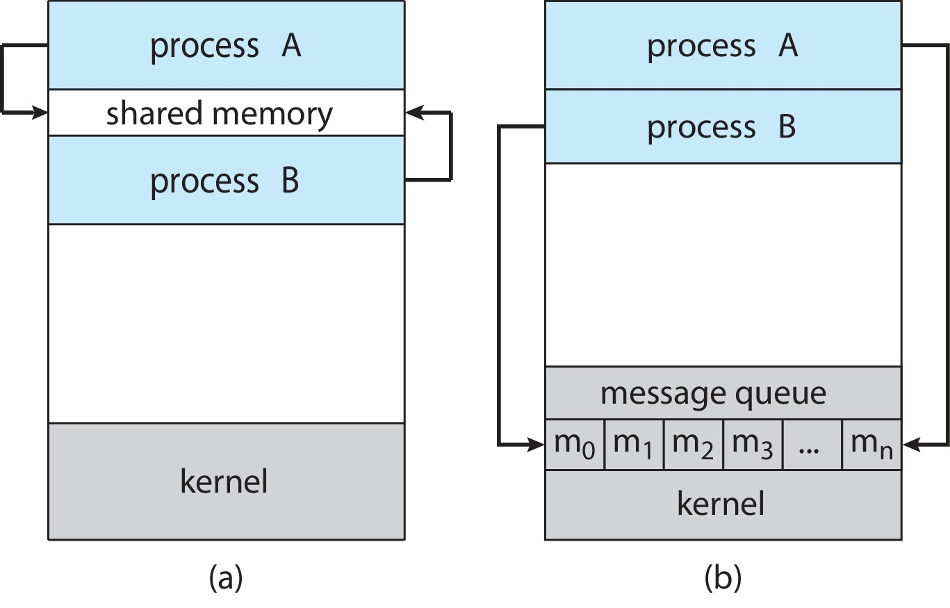
Communications Models
(a) Shared memory. (b) Message passing.

Slide 122
Producer-Consumer Problem
Paradigm for cooperating processes:
  producer process produces information that is consumed by a consumer process
Two variations:
  unbounded-buffer places no practical limit on the size of the buffer:
    Producer never waits
    Consumer waits if there is no buffer to consume
  bounded-buffer assumes that there is a fixed buffer size
    Producer must wait if all buffers are full
    Consumer waits if there is no buffer to consume

Slide 123
IPC – Shared Memory
An area of memory shared among the processes that wish to communicate
The communication is under the control of the users processes not the operating system.
Major issues is to provide mechanism that will allow the user processes to synchronize their actions when they access shared memory.

Slide 124
Bounded-Buffer – Shared-Memory Solution
Shared data
      #define BUFFER_SIZE 10
      typedef struct {
      . . .
      } item;
      item buffer[BUFFER_SIZE];
      int in = 0;
      int out = 0;
Solution is correct, but can only use BUFFER_SIZE-1 elements

Slide 125
Producer Process – Shared Memory
item next_produced;
while (true) {
/* produce an item in next produced */
while (((in + 1) % BUFFER_SIZE) == out)
; /* do nothing */
buffer[in] = next_produced;
in = (in + 1) % BUFFER_SIZE;
}

Slide 126
Consumer Process – Shared Memory
item next_consumed;
while (true) {
while (in == out)
; /* do nothing */
next_consumed = buffer[out];
out = (out + 1) % BUFFER_SIZE;
/* consume the item in next consumed */
}

Slide 127
What about Filling all the Buffers?
Suppose that we wanted to provide a solution to the consumer-producer problem that fills all the buffers.
We can do so by having an integer counter that keeps track of the number of full buffers.
Initially, counter is set to 0.
The integer counter is incremented by the producer after it produces a new buffer.
The integer counter is and is decremented by the consumer after it consumes a buffer.

Slide 128
Linux IPC Mechanisms
Pipes: Unidirectional communication channels between related processes (parent-child). Data written to one end is read from the other.
FIFOs (Named Pipes): Similar to pipes but are named files in the filesystem, enabling communication between unrelated processes.
Message Queues: Allow processes to exchange messages in a structured manner. Messages can be prioritized and retrieved based on type.
Shared Memory: Provides a region of memory that multiple processes can access directly, offering high-speed data exchange. Requires explicit synchronization mechanisms (e.g., semaphores, mutexes) to prevent race conditions.

Slide 129
Linux IPC Mechanisms
Semaphores:
Synchronization primitives used to control access to shared resources, preventing race conditions in shared memory or other critical sections.
Sockets:
Enable communication between processes on the same or different machines, supporting various network protocols (e.g., TCP, UDP).
Signals:
Software interrupts used to notify processes of events or request specific actions.

Slide 130
Remote Procedure Call (RPC)
high-level IPC mechanism that allows a program to execute a procedure (function)in a different address space
RPC framework handles the underlying network communication, data serialization, and deserialization.
RPC Exception Handling:
RPC systems provide mechanisms for handling errors and exceptions that occur during remote procedure execution. This typically involves:
  Return codes
  Exception Propagation
  Timeout and retire

Slide 131
Security Issues in IPC and RPC
Data Tampering:
Unauthorized processes could modify data being exchanged through IPC mechanisms ike shared memory or message queues if not properly secured.
Denial of Service (DoS):
  Malicious processes could flood IPC channels or RPC servers with requests, consuming resources and preventing legitimate communication.
Unauthorized Access:
  Without proper authentication and authorization, unauthorized processes or remote clients could access sensitive data or execute unauthorized operations.
Buffer Overflows:
  Vulnerabilities in message parsing or data handling can lead to buffer overflows, potentially allowing malicious code execution.
Time-of-Check to Time-of-Use (TOCTTOU) vulnerabilities:
  In shared memory or file-based IPC, a race condition can occur where a security check is performed on a resource, but the resource&#39;s state changes before it is used, leading to a vulnerability.
Insecure Deserialization:
  In RPC, if data is deserialized without proper validation, it can lead to remote codeexecution vulnerabilities.

