Slide 1
Unit-3
Memory Management: Memory view of a process, Process memory usage requirements, virtual and physical memory related system calls (mmap, munmap, sbrk, mprotect). Address translation mechanisms --- static mapping, segmentation, paging, page faults, page replacement algorithms, page sharing, read/write permissions, swapping.
Secondary Memory Management: Disk structure, disk scheduling, disk management, buffering, swapspace management

Slide 2
Memory view of a process
A process's memory view, or virtual address space, is a logical representation of memory that the operating system provides to each process.
This virtual space is distinct from the physical memory (RAM) and offers several benefits, including isolation between processes and simplified memory management.

Slide 3
Memory view of a process
The virtual address space typically includes:
  Text Segment: Contains the executable instructions of the program. It is usually read-only and shared among multiple instances of the same program.
  Data Segment: Contains global and static variables initialized by the program
  BSS (Block Started by Symbol) Segment: Contains uninitialized global and static variables.
  Heap: Used for dynamic memory allocation during runtime (e.g., using malloc or new). It grows upwards from a lower address.
  Stack: Used for local variables, function call information, and return addresses. It grows downwards from a higher address.
  Memory-Mapped Files/Anonymous Mappings: Regions used for mapping files into memory or for anonymous memory allocations (e.g., shared memory).

Slide 4
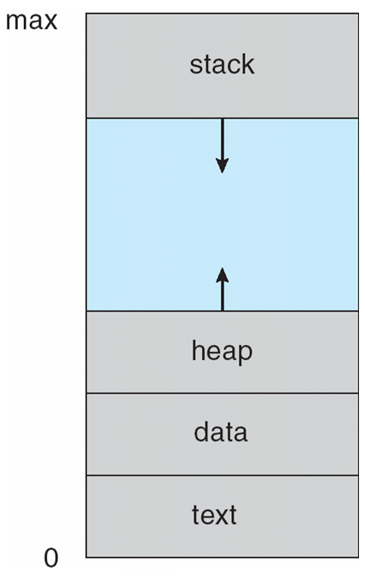

Slide 5
Process Memory Usage Requirements
Processes require memory for various purposes:
  Code Execution: To store the program's instructions.
  Data Storage: For global, static, and dynamically allocated data.
  Function Calls: To manage function call stacks and local variables.
  I/O Buffers: For temporary storage during input/output operations.
  Shared Memory: For inter-process communication.

Slide 6
Virtual and Physical Memory Related System Calls
Operating systems provide system calls for managing virtual and physical memory:
  mmap() (Memory Map): Maps files or devices into memory, or creates anonymous memory regions. It allows direct access to file contents as if they were in memory, enabling efficient I/O and shared memory.
  munmap() (Unmap Memory):Unmaps memory regions previously mapped by mmap(), releasing the associated virtual and physical memory resources.

Slide 7
Virtual and Physical Memory Related System Calls
  sbrk() (Change Data Segment Size):Used to adjust the program's data segment size (heap). It increases or decreases the program's break value, which marks the end of the data segment. While historically common for heap management, mmap() is often preferred for more flexible memory allocation in modern systems.
  mprotect() (Memory Protect):Changes the protection attributes of memory pages within a process's virtual address space (e.g., read, write, execute permissions). This allows for fine-grained control over memory access and can be used for security or performance optimizations.

Slide 8
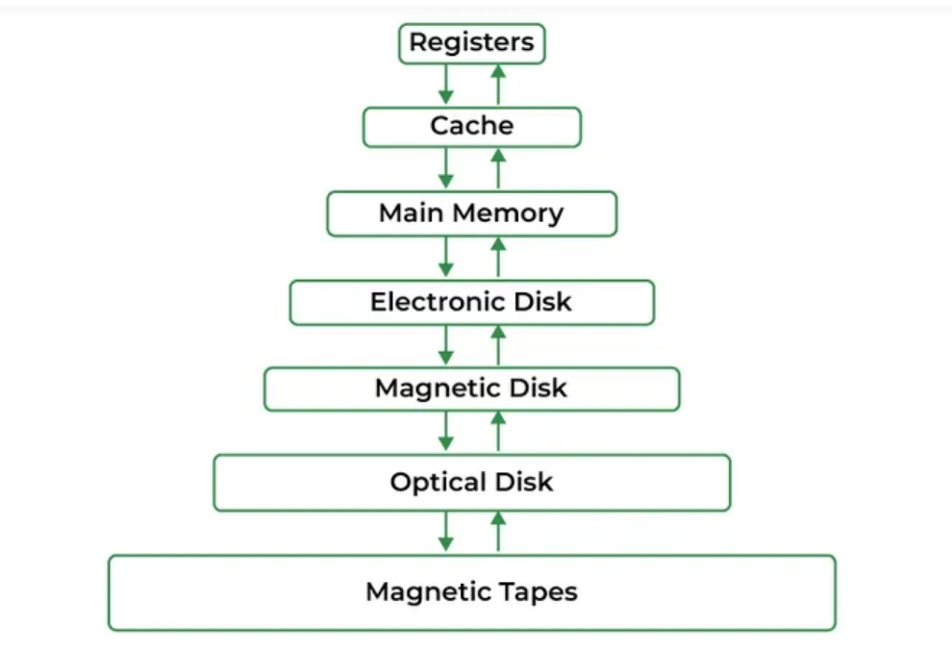
Memory Management in Operating System
critical aspect of operating systems that ensures efficient use of the computer's memory resources.
It controls how memory is allocated and deallocated to processes, which is key to both performance and stability

Slide 9
Why Memory Management is Required?
Allocate and de-allocate memory before and after process execution.
To keep track of used memory space by processes.
To minimize fragmentation issues.
To proper utilization of main memory.
To maintain data integrity while executing of process.

Slide 10
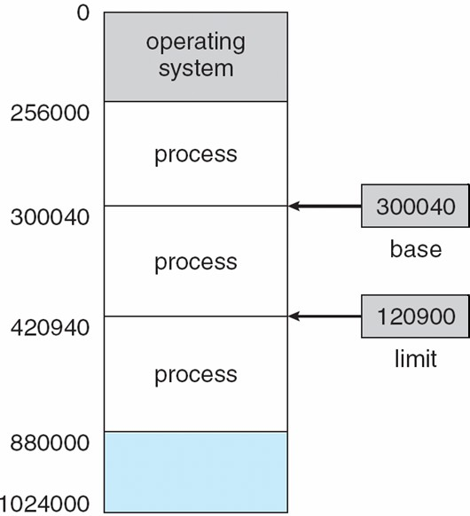
Background
Multiple processes resides in memory
Protection of memory required to ensure correct operation
Protect OS
Protect user processes

Slide 11
Base and Limit Registers
A pair of base and limit registers define the logical address space

Slide 12
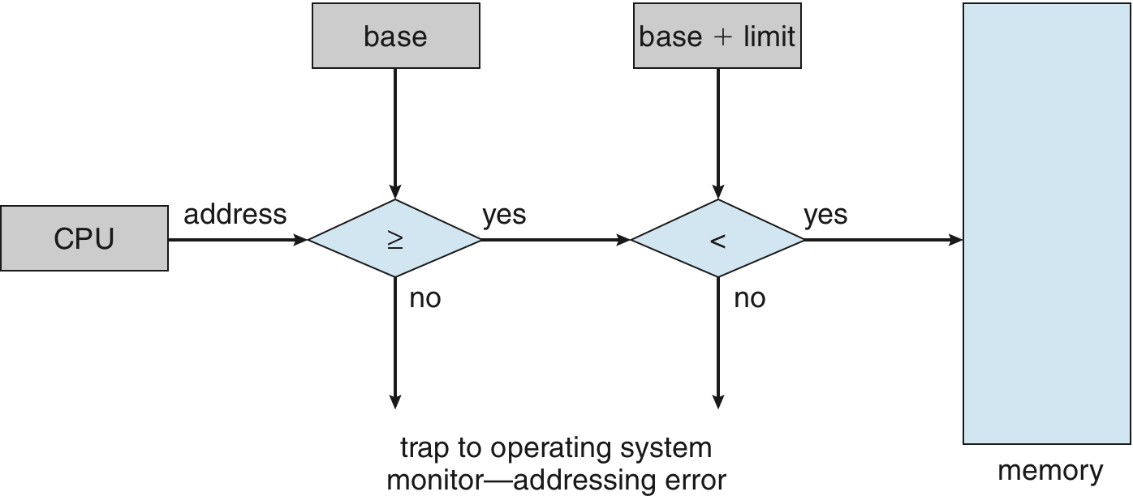
Hardware Address Protection with Base and Limit Registers
OS loads the base & limit reg.
Privileged instruction

Slide 13
Address Binding
Process resides in main memory
Associate each data element with memory address
Further, addresses represented in different ways at different stages of a program’s life
  Source code addresses usually symbolic
  Compiled code addresses bind to relocatable addresses
    i.e. “14 bytes from beginning of this module”
  Linker or loader will bind relocatable addresses to absolute addresses
    i.e. 74014

Slide 14
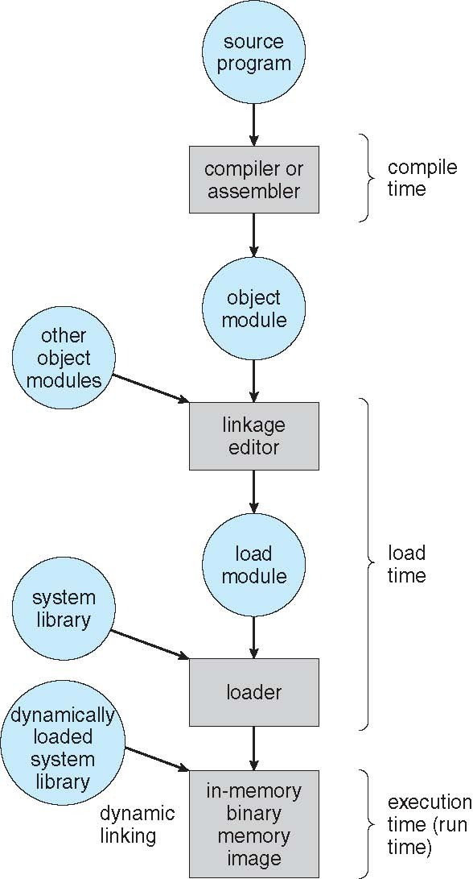
Multistep Processing of a User Program

Slide 15
Binding of Instructions and Data to Memory
Address binding of instructions and data to memory addresses can happen at three different stages
  Compile time: If memory location known a priori, absolute code can be generated; must recompile code if starting location changes
  Load time: Must generate relocatable code if memory location is not known at compile time
  Execution time: If the process can be moved during its execution from one memory segment to another
    Binding delayed until run time
    Need hardware support for address maps (e.g., base and limit registers)

Slide 16

Logical vs. Physical Address Space
Logical address – generated by the CPU; also referred to as virtual address
CPU
Physical address – address seen by the memory unit
Logical and physical addresses are the same in compile-time and load-time address-binding schemes;
logical (virtual) and physical addresses differ in execution-time address-binding scheme
Logical address space is the set of all logical addresses generated by a program
Physical address space is the set of all physical addresses generated by a program

Slide 17
Memory-Management Unit (MMU)
Hardware device that at run time maps virtual to physical address
Many methods possible
To start, consider simple scheme where the value in the relocation register is added to every address generated by a user process at the time it is sent to memory
  relocation register
  MS-DOS on Intel 80x86 used 4 relocation registers
The user program deals with logical addresses (0 to max); it never sees the real physical addresses (R to R+max)
  Say the logical address 25
  Execution-time binding occurs when reference is made to location in memory
  Logical address bound to physical addresses

Slide 18
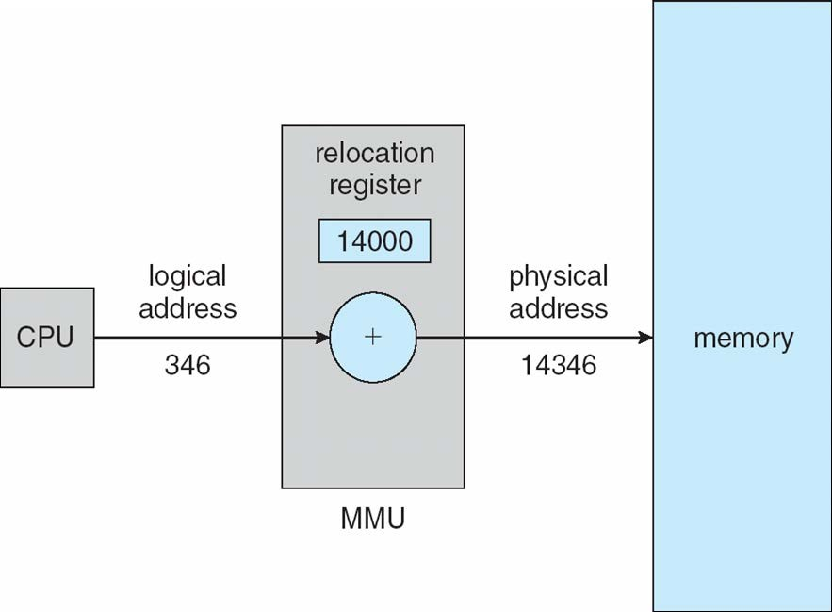
Dynamic relocation using a relocation register
14000
Relocatable code

Slide 19
Contiguous Allocation
Multiple processes resides in memory

Slide 20
Contiguous Allocation
Main memory usually divided into two partitions:
  Resident operating system, usually held in low memory
  User processes then held in high memory
  Each process contained in single contiguous section of memory

Slide 21
Contiguous Allocation (Cont.)
Multiple-partition allocation
  Divide memory into several Fixed size partition
  Each partition stores one process
  Degree of multiprogramming limited by number of partitions
  If a partition is free, load process from job queue
  MFT (IBM OS/360)

Slide 22
Contiguous Allocation (Cont.)
Multiple-partition allocation
  Variable partition scheme
  Hole – block of available memory; holes of various size are scattered throughout memory
  Keeps a table of free memory
  When a process arrives, it is allocated memory from a hole large enough to accommodate it
  Process exiting frees its partition, adjacent free partitions combined
  Operating system maintains information about:
a) allocated partitions b) free partitions (hole)
OS
OS
process 5
process 8
process 2
OS
process 5
process 2
OS
process 5
process 9
process 2
OS
process 5
process 9
process 10
process 2
Hole

Slide 23
Dynamic Storage-Allocation Problem
How to satisfy a request of size n from a list of free holes? Dynamic storage allocation problem
First-fit: Allocate the first hole that is big enough
Best-fit: Allocate the smallest hole that is big enough; must search entire list, unless ordered by size
  Produces the smallest leftover hole
Worst-fit: Allocate the largest hole; must also search entire list
  Produces the largest leftover hole

Slide 24
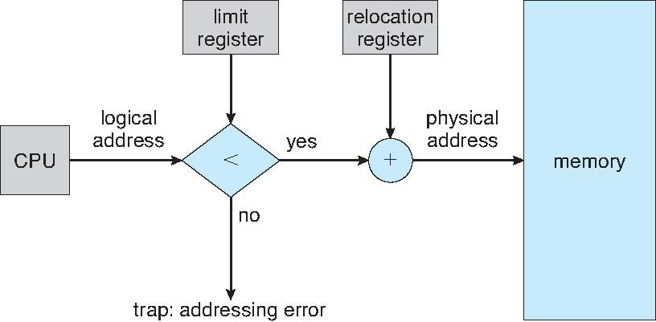
Hardware Support for Relocation and Limit Registers
Relocation registers used to protect user processes from each other, and from changing operating-system code and data
  Relocation register contains value of smallest physical address
  Limit register contains range of logical addresses – each logical address must be less than the limit register
  Context switch
  MMU maps logical address dynamically

Slide 25
Fragmentation
Processes loaded and removed from memory
  Memory is broken into little pieces
External Fragmentation – total memory space exists to satisfy a request, but it is not contiguous
First fit analysis reveals that given N blocks allocated, 0.5 N blocks lost to fragmentation
  1/3 may be unusable -> 50-percent rule

Slide 26
Fragmentation (Cont.)
Reduce external fragmentation by compaction
  Shuffle memory contents to place all free memory together in one large block
  Compaction is possible only if relocation is dynamic, and is done at execution time
    Change relocation reg.
  Cost
Internal Fragmentation – allocated memory may be slightly larger than requested memory; this size difference is memory internal to a partition, but not being used

Slide 27
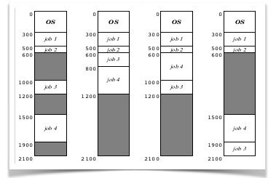

Slide 28
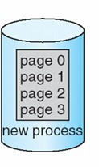
Paging
Physical address space of a process can be noncontiguous;
  process allocates physical memory whenever the latter is available
Divide physical memory into fixed-sized blocks called frames
  Size is power of 2, between 512 bytes and 16 Mbytes
Divide logical memory into blocks of same size called pages
  To run a program of size N pages, need to find N free frames and load program
Backing store likewise split into pages
Set up a page table to translate logical to physical addresses
System keeps track of all free frames

Slide 29

Paging Model of Logical and Physical Memory
page table to translate logical to physical addresses

Slide 30
Address Translation Scheme
Address generated by CPU is divided into:
  Page number (p) – used as an index into a page table
    which contains base address of each page in physical memory
  Page offset (d) – offset within a page
    combined with base address to define the physical memory address that is sent to the memory unit
offset
page
p
m - n n
– For given logical address space 2^{m} and page size 2^{n}
age number | page offset
p | d

Slide 31
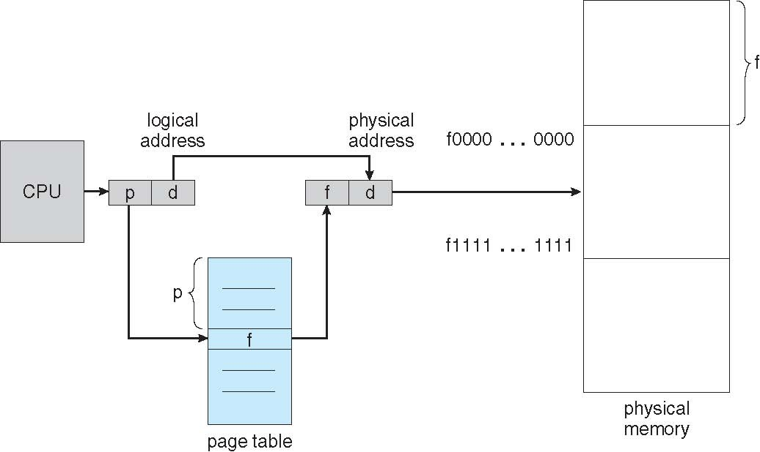
Paging Hardware

Slide 32
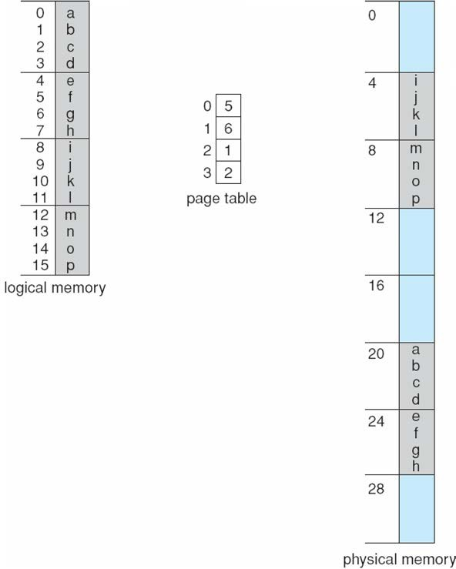
Paging Example
Logical address 0 (0*4+0)
Physical address: (5*4+0)=20
Logical address = 16 Page size=4
Physical memory=32
Logical address 3 (0*4+3)
Physical address: (5*4+0)=23
Logical address 4 (1*4+0)
Physical address: (6*4+0)=24
User’s view
Run time address binding
Logical address 13 (3*4+1)
Physical address: (2*4+1)
n=2 and m=4 32-byte memory and 4-byte pages

Slide 33
Implementation of Page Table
For each process, Page table is kept in main memory
Page-table base register (PTBR) points to the page table
Page-table length register (PTLR) indicates size of the page table
In this scheme every data/instruction access requires two memory accesses
– One for the page table and one for the data / instruction
The two memory access problem can be solved by the use of a special fast-lookup hardware cache called associative memory or translation look-aside buffers (TLBs)

Slide 34
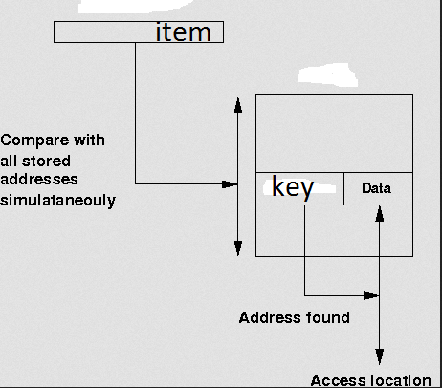
Associative memory

Slide 35
Associative Memory
Associative memory – parallel search
Page # | Frame #
Address translation (p, d)
  If p is in associative register, get frame # out
  Otherwise get frame # from page table in memory

Slide 36
Implementation of Page Table
For each process, Page table is kept in main memory
Page-table base register (PTBR) points to the page table
Page-table length register (PTLR) indicates size of the page table
In this scheme every data/instruction access requires two memory accesses
  One for the page table and one for the data / instruction
The two memory access problem can be solved by the use of a special fast-lookup hardware cache called associative memory or translation look-aside buffers (TLBs)
TLBs typically small (64 to 1,024 entries)
On a TLB miss, value is loaded into the TLB for faster access next time
  Replacement policies must be considered (LRU)
  Some entries can be wired down for permanent fast access
Some TLBs store address-space identifiers (ASIDs) in each TLB entry – uniquely identifies each process (PID) to provide address-space protection for that process
  Otherwise need to flush at every context switch

Slide 37

Paging Hardware With TLB

Slide 38
Effective Access Time
Associative Lookup = ε time unit
  Can be < 10% of memory access time
Hit ratio = α
  Hit ratio – percentage of times that a page number is found in the associative registers; ratio related to size of TLB
Consider α = 80%, ε = 20ns for TLB search, 100ns for memory access
Effective Access Time (EAT)
EAT = (100 + ε) α + (200 + ε)(1 – α)
Consider α = 80%, ε = 20ns for TLB search, 100ns for memory access
– EAT = 0.80 x 120 + 0.20 x 220 = 140ns
Consider better hit ratio -> α = 98%, ε = 20ns for TLB search, 100ns for memory access
– EAT = 0.98 x 120 + 0.02 x 220 = 122ns

Slide 39
Memory Protection
Memory protection implemented by associating protection bit with each frame to indicate if read-only or read-write access is allowed
  Can also add more bits to indicate page execute-only, and so on
Valid-invalid bit attached to each entry in the page table:
  “valid” indicates that the associated page is in the process’ logical address space, and is thus a legal page
  “invalid” indicates that the page is not in the process’ logical address space
  Or use PTLR
Any violations result in a trap to the kernel

Slide 40
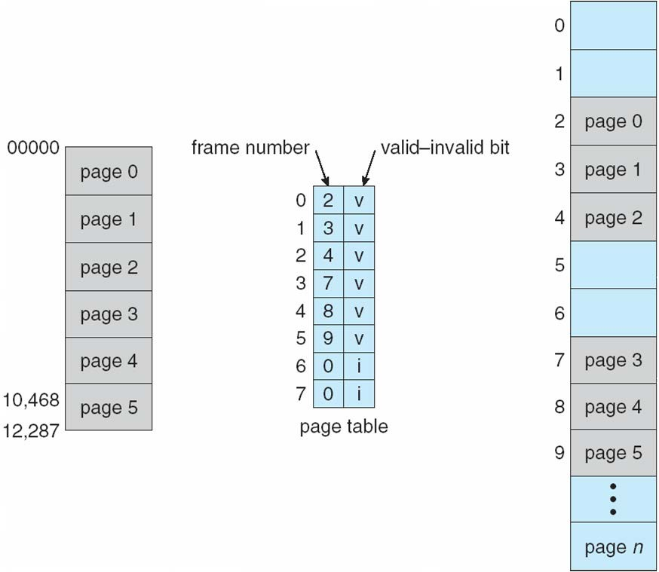
Valid (v) or Invalid (i) Bit In A Page Table
14 bit address space (0 to 16383) Page size 2KB
Process P1 uses only 0 to 10468
P2
Page 0
Page 1
Page 2
Page 3
P1
Internal fragmentation
Use of PTLR (length)

Slide 41
Shared Pages Example
System with 40 users
  Use common text editor
Text editor contains 150KB code 50KB data (page size 50KB)
  8000KB!
Shared code
  One copy of read-only (reentrant) code shared among processes (i.e., text editors, compilers, window systems)
    Code never changes during execution
Only one copy of the editor in the memory
Total memory consumption
– 40*50+150=2150KB

Slide 42
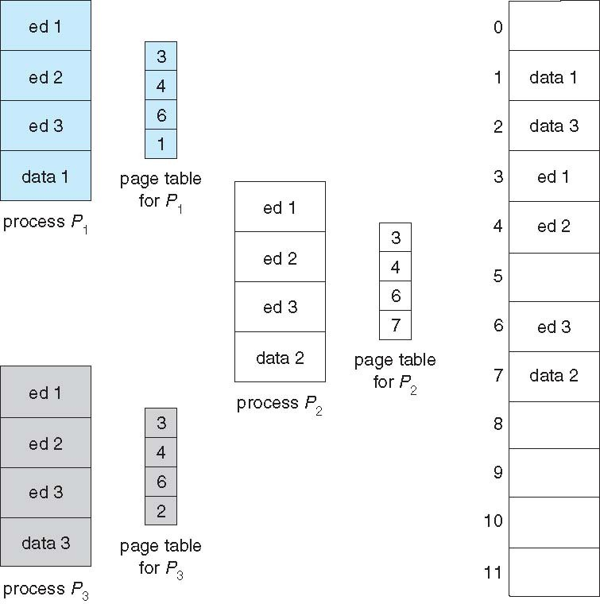
Shared Pages Example

Slide 43
Data share: example
writer.c
reader .c
int main()
{
int main()
{
int shmid,f,key=3,i,pid; char *ptr;
int shmid,f,key=3,i,pid; char *ptr;
shmid=shmget((key_t)key,100,IPC_CREAT|0666); ptr=shmat(shmid,NULL,0);
printf("shmid=%d ptr=%u\n",shmid, ptr); strcpy(ptr,"hello");
i=shmdt((char*)ptr);
shmid=shmget((key_t)key,100,IPC_CREAT|0666); ptr=shmat(shmid,NULL,0);
printf("shmid=%d ptr=%u\n",shmid, ptr); printf("\nstr %s\n",ptr);
}
}
ptr
Shared memory

Slide 44
Segmentation
Memory-management scheme that supports user view of memory
A program is a collection of segments
– A segment is a logical unit such as:
Compiler generates the
main program procedure function method object
local variables, global variables common block
stack
symbol table arrays
segments
Loader assign the seg#

Slide 45
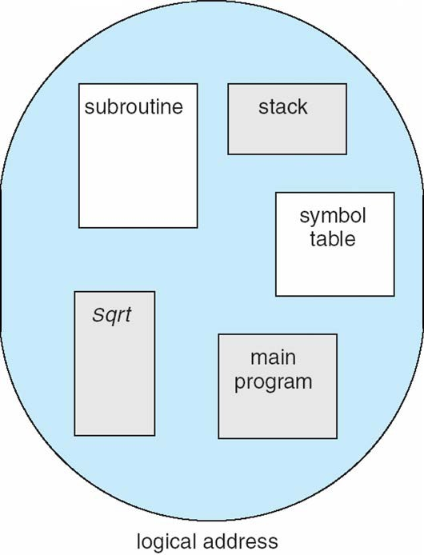
User’s View of a Program
User specifies each address by two quantities
Segment name
Segment offset
Logical address contains the tuple
<segment#, offset>
Variable size segments without order
Length=> purpose of the program
Elements are identified by offset

Slide 46
Logical View of Segmentation
Logical address
<segment-number, offset>
1
4
2
3
1
2
3
4
Logical address space
user space physical memory space
Long term scheduler finds and allocates memory for all segments of a program
Variable size partition scheme

Slide 47
Segmentation Architecture
Logical address consists of a two tuple:
<segment-number, offset>
Segment table – maps two-dimensional logical address to physical address;
Each table entry has:
  base – contains the starting physical address where the segments reside in memory
  limit – specifies the length of the segment
Segment-table base register (STBR) points to the segment table’s location in memory
Segment-table length register (STLR) indicates number of segments used by a program;
segment number s is legal if s < STLR

Slide 48
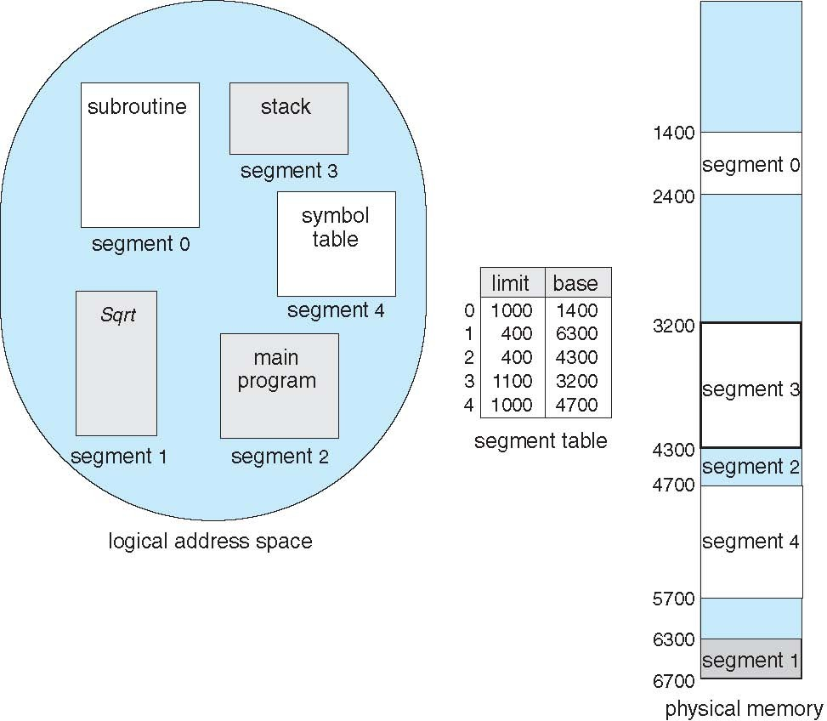
Example of Segmentation

Slide 49
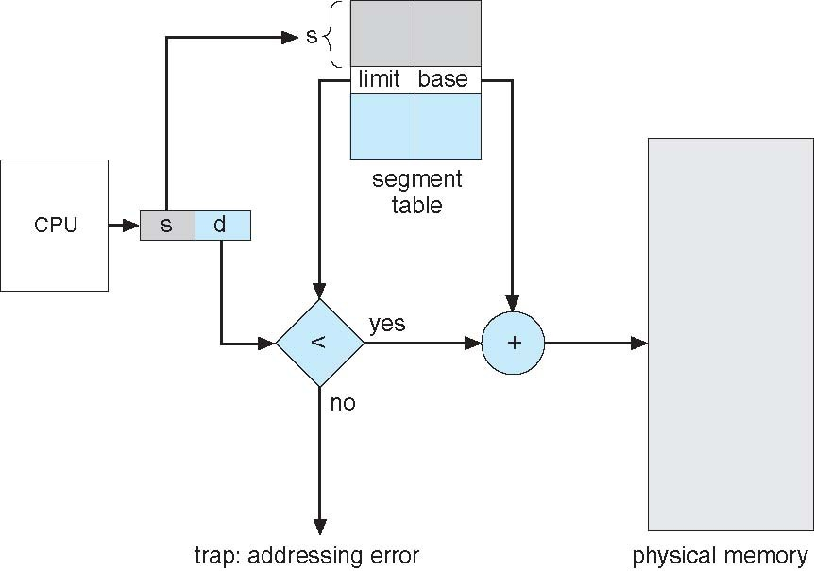
Segmentation Hardware

Slide 50
Example of Segmentation

Slide 51
Segmentation Architecture
Protection
Protection bits associated with segments
  With each entry in segment table associate:
    validation bit = 0 ⇒ illegal segment
    read/write/execute privileges
Code sharing occurs at segment level
Since segments vary in length, memory allocation is a dynamic storage-allocation problem
  Long term scheduler
  First fit, best fit etc
Fragmentation

Slide 52
Segmentation with Paging
Key idea:
Segments are splitted into multiple pages
Each page is loaded into frames in the memory

Slide 53
Segmentation with Paging
Supports segmentation with paging
  Each segment can be 4 GB
  Up to 16 K segments per process
  <selector(16), offset (32)>
  Divided into two partitions
    First partition of up to 8 K segments are private to process (kept in local descriptor table LDT)
    Second partition of up to 8K segments shared among all processes (kept in
global descriptor table GDT)
CPU generates logical address (six Segment Reg.)
  Given to segmentation unit
    Which produces linear addresses
  Physical address 32 bits
S(13) | G(1) | P(2)
– Linear address given to paging unit
Intel 80386
Which generates physical address in main memory
Paging units form equivalent of MMU
Pages sizes can be 4 KB
IBM OS/2

Slide 54
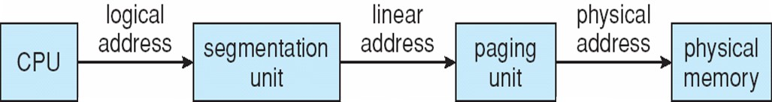
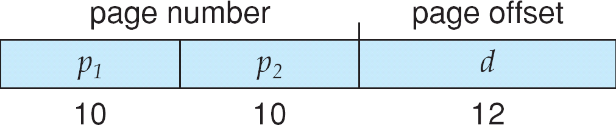
Logical to Physical Address Translation in Pentium
Page table=2²⁰ entries

Slide 55
Background
Code needs to be in memory to execute, but entire program rarely used
  Error code, unusual routines, large data structures
Entire program code not needed at same time
Consider ability to execute partially-loaded program
  Program no longer constrained by limits of physical memory
  programs could be larger than physical memory
  More processes can be accommodated

Slide 56
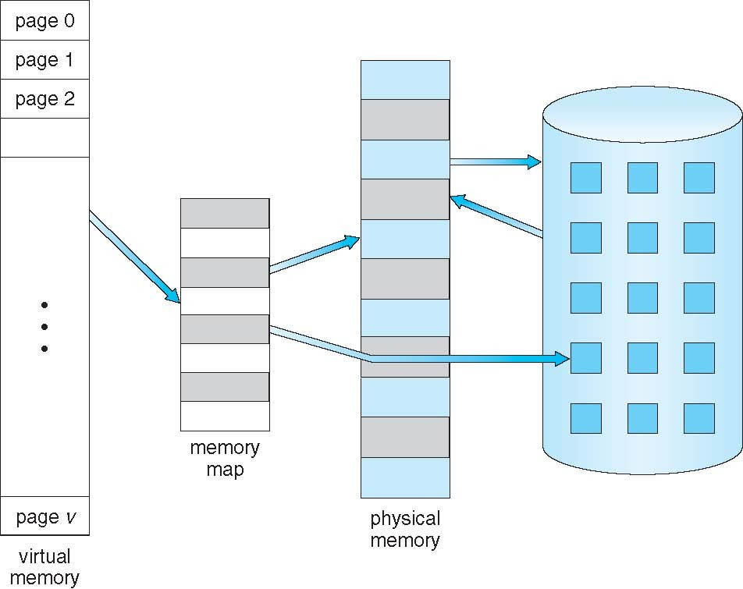
Virtual Memory That is Larger Than Physical Memory
Large virtual space
Small memory

Slide 57
Classical paging
Process P1 arrives
Requires n pages => n frames must be available
Allocate n frames to the process P1
Create page table for P1
Allocate < n frames

Slide 58
Background
Virtual memory – separation of user logical memory from physical memory
  Extremely large logical space is available to programmer
  Concentrate on the problem
Only part of the program needs to be in memory for execution
  Logical address space can therefore be much larger than physical address space
  Starts with address 0, allocates contiguous logical memory
  Physical memory
    Collection of frame
Virtual memory can be implemented via:
  Demand paging
  Demand segmentation

Slide 59
Demand Paging
Bring a page into memory only when it is needed
Lazy swapper – never swaps a page into memory unless page will be needed
  Swapper that deals with pages is a pager
Less I/O needed, no unnecessary I/O
  Less memory needed
  More users
Page is needed ⇒ reference to it
  invalid reference ⇒ abort
  not-in-memory ⇒ bring to memory
Valid address information is available in PCB

Slide 60
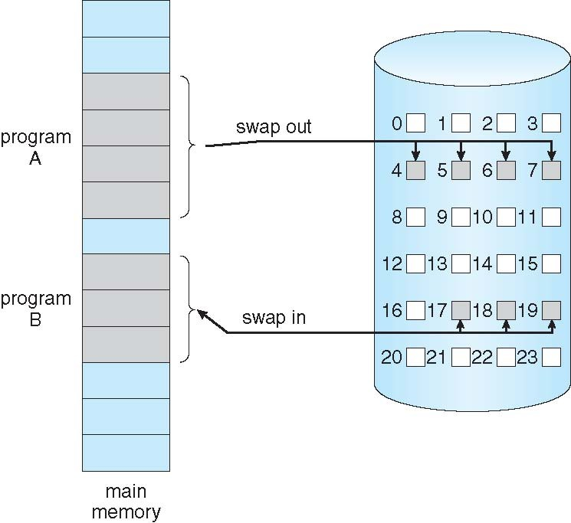
Transfer of a Paged Memory to Contiguous Disk Space
When we want to execute a process, swap in
Instead of swap in entire process, load page
Pager

Slide 61
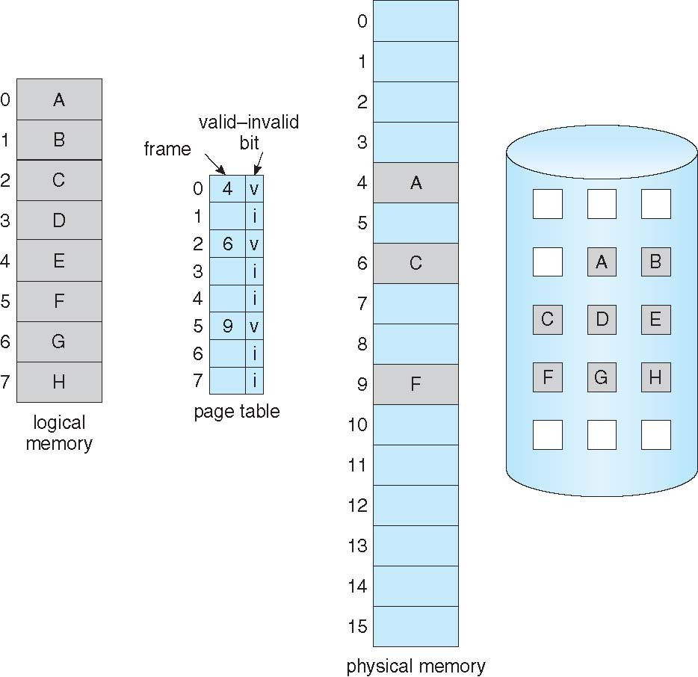
Page Table When Some Pages Are Not in Main Memory
Pager loads few necessary pages in memory

Slide 62
Valid-Invalid Bit
With each page table entry a valid–invalid bit is associated (v ⇒ in-memory – memory resident, i ⇒ not-in-memory)
Initially valid–invalid bit is set to i on all entries
Example of a page table snapshot:
Frame # valid-invalid bit
v v v
v
i
page table
….
i
Disk address
During address translation, if valid–invalid bit in page table entry is i ⇒ page fault

Slide 63
Page Fault
If the page in not in memory, first reference to that page will trap to operating system:
page fault
Operating system looks at PCB to decide:
  Invalid reference ⇒ abort
  Just not in memory (load the page)
Get empty frame
Swap page into frame via scheduled disk operation
Reset page table to indicate page now in memory Set validation bit = v
Restart the instruction that caused the page fault

Slide 64
What Happens if There is no Free Frame?
Example
  40 frames in memory
  8 processes each needs 10 pages
  5 of them never used
Two options
  Run 4 processes (10 pages)
  Run 8 processes (5 pages)
Increase the degree of multiprogramming
– Over allocating memory
Page fault
– No free frame
– Terminate? swap out? replace the page?
Page replacement – find some page in memory, not really in use, page it out
– Performance – want an algorithm which will result in minimum number of page faults
Same page may be brought into memory several times

Slide 65
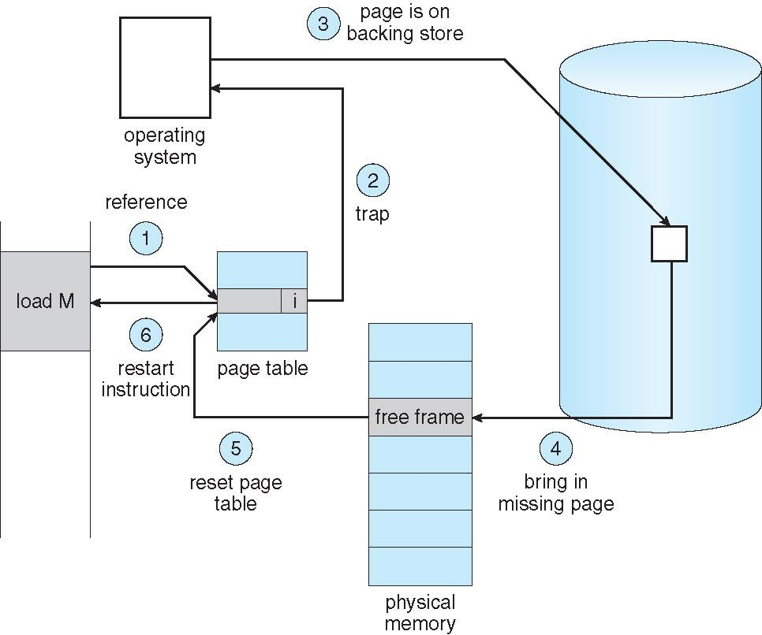
Steps in Handling a Page Fault
Check PCB

Slide 66
Pure Demand Paging
Extreme case – start process with no pages in memory
  OS sets instruction pointer to first instruction of process, non- memory-resident -> page fault
  Swap in that page
  Pure demand paging
Actually, a given instruction could access multiple pages (instruction + data) -> multiple page faults
  Pain decreased because of locality of reference
Hardware support needed for demand paging
  Page table with valid / invalid bit
  Secondary memory (swap device with swap space)
  Instruction restart after page fault

Slide 67
Performance of Demand Paging
Demand paging affects the performance of the computer systems
Page Fault Rate 0 ≤ p ≤ 1
  if p = 0 no page faults
  if p = 1, every reference is a fault
Effective Access Time (EAT)
EAT = (1 – p) x memory access
+ p (page fault overhead
+ swap page out
+ swap page in
+ restart overhead
)

Slide 68

Demand Paging Example
Memory access time = 200 nanoseconds
Average page-fault service time = 8 milliseconds
EAT = (1 – p) x 200 + p (8 milliseconds)
= (1 – p ) x 200 + p x 8,000,000
= 200 + p x 7,999,800
If one access out of 1,000 causes a page fault, then EAT = 8.2 microseconds.
This is a slowdown by a factor of 40!!
If want performance degradation < 10 percent
– 220 > 200 + 7,999,800 x p
20 > 7,999,800 x p
– p < .0000025
– < one page fault in every 400,000 memory accesses
Better utilization of swap space
Swap space

Slide 69
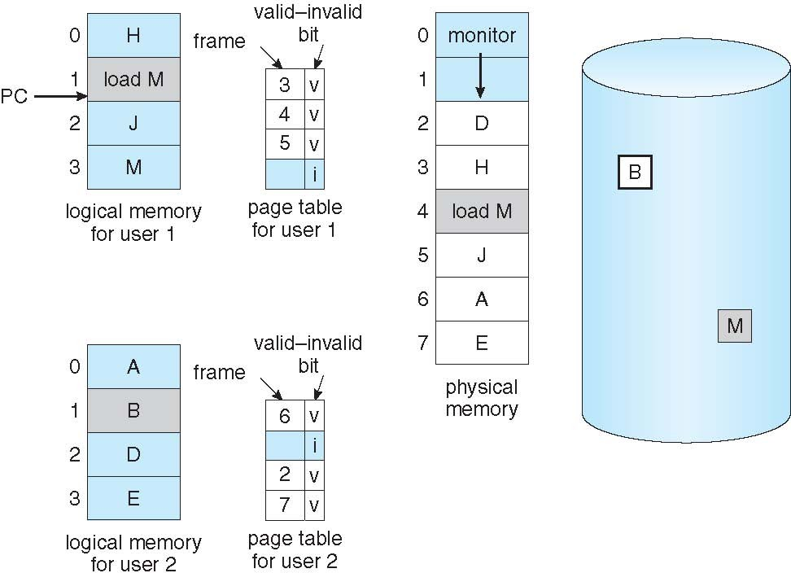
Need For Page Replacement
P1
K
P2

Slide 70
Need For Page Replacement
P1
K
P2
PC

Slide 71
Basic Page Replacement
Find the location of the desired page on disk
Find a free frame:
  If there is a free frame, use it
  If there is no free frame, use a page replacement algorithm to select a victim frame (of that process)
- Write victim frame to disk
Bring the desired page into the (newly) free frame; update the page and frame tables
Continue the process by restarting the instruction that caused the trap
Note now potentially 2 page transfers for page fault – increasing Effective memory access time

Slide 72
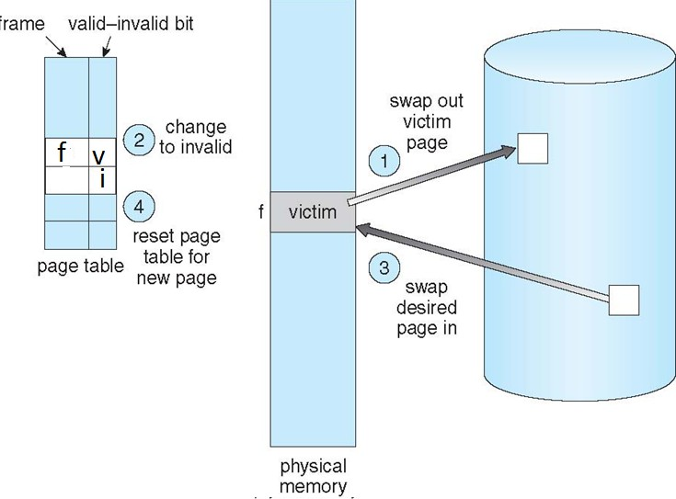
Page Replacement
5
6
5
6

Slide 73

Page Replacement
5
6
5
6

Slide 74
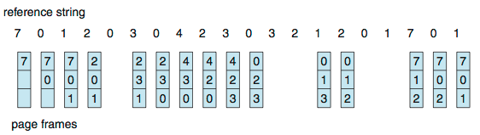
First-In-First-Out (FIFO) Algorithm
Reference string: 7,0,1,2,0,3,0,4,2,3,0,3,0,3,2,1,2,0,1,7,0,1
3 frames (3 pages can be in memory at a time per process)
Can vary by reference string: consider 1,2,3,4,1,2,5,1,2,3,4,5
  Adding more frames can cause more page faults!
    Belady’s Anomaly
15 page faults

Slide 75
Bélády’s anomaly is the name given to the phenomenon where increasing the number of page frames results in an increase in the number of page faults for a given memory access pattern.

Slide 76
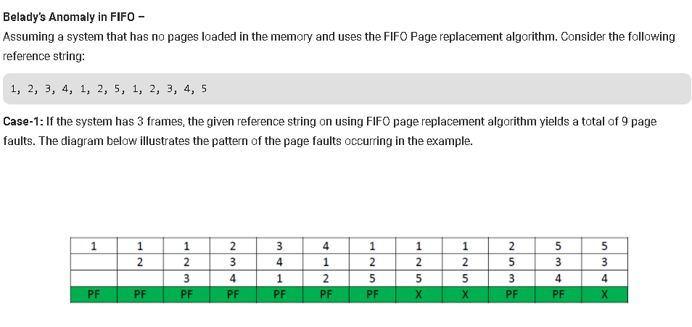

Slide 77
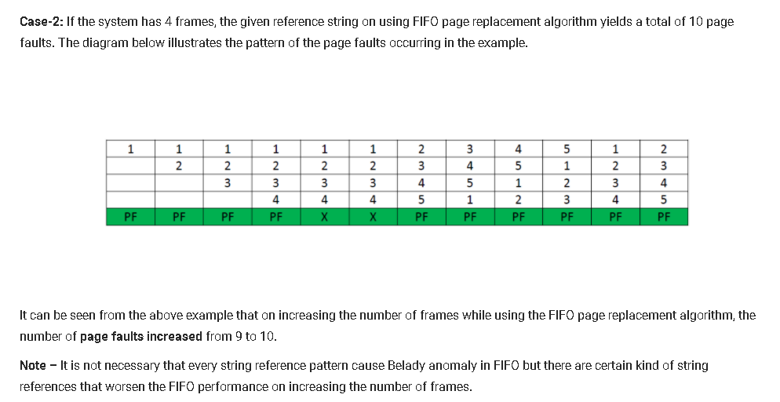

Slide 78
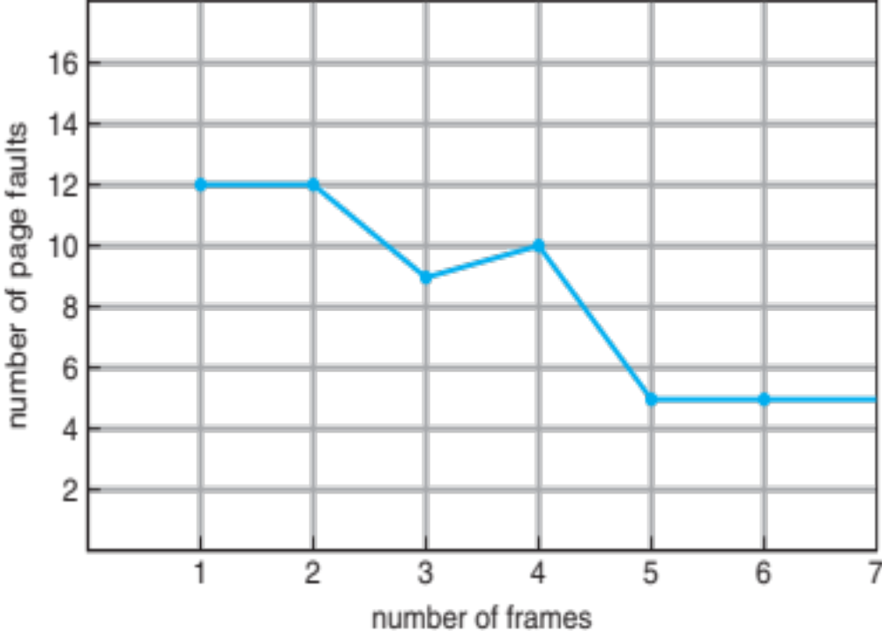
FIFO Illustrating Belady’s Anomaly

Slide 79
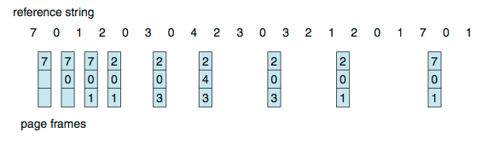
Optimal Algorithm
Replace page that will not be used for longest period of time
  9 is optimal for the example
Used for measuring how well your algorithm performs

Slide 80
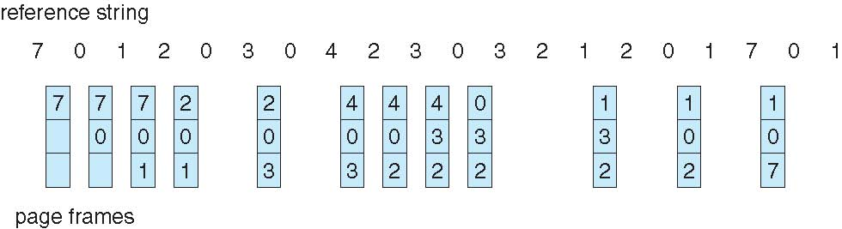
Least Recently Used (LRU) Algorithm
Use past knowledge rather than future
Replace page that has not been used in the most amount of time
Associate time of last use with each page
12 faults – better than FIFO but worse than OPT
Generally good algorithm and frequently used

Slide 81
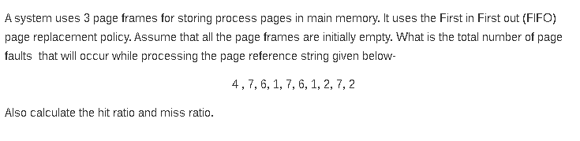

Slide 82
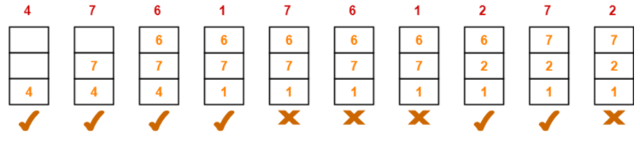
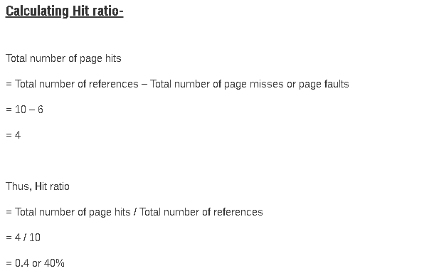

Slide 83
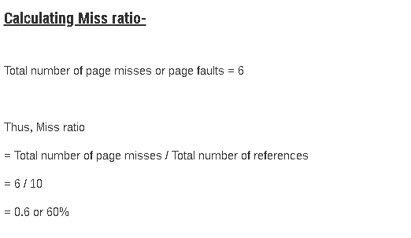

Slide 84
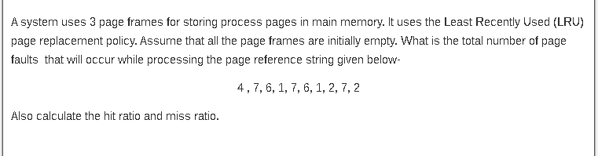

Slide 85
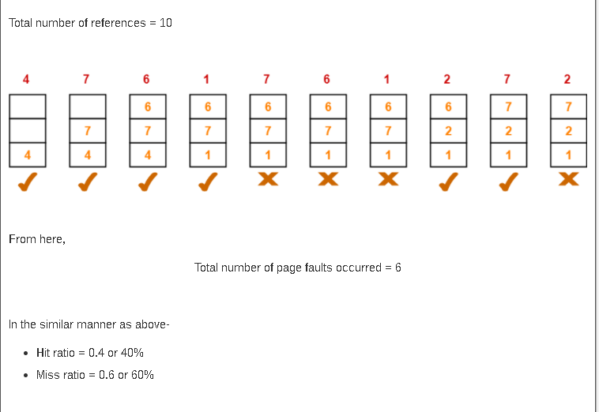

Slide 86
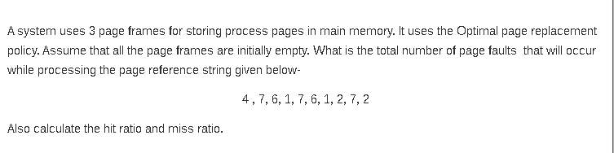

Slide 87
