Slide 1
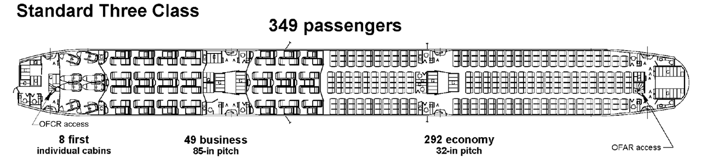
Problem Statement
Passengers bring media content on personal portable devices onto airplane, and it is desirable to “cast” onto seat back displays.
Considering that 2.4 & 5 GHz Wi-Fi on airplane is congested, desirable to leverage alternate technology that is/will be supported in COTS portable devices.
Develop wireless casting solution that
supports high resolution (4K) video bandwidth
scales to 400+ passenger devices in close proximity.
Boeing 777-9

Slide 2
802.11ad – Wi-Gig

Slide 3
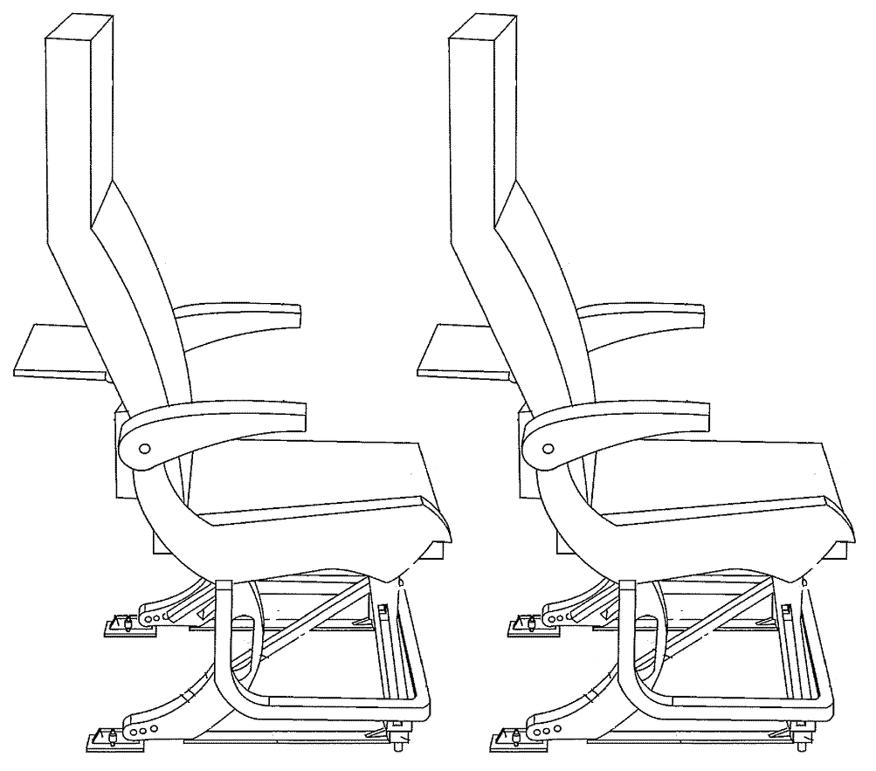
Simulation Scenario – 100 & 400 Seats
Parameter | Details
Tx Power | 10 dbm (average allowed level in Japan, Korea, Australia, and US for portable devices)
Tx. Channel Gain | 15 dBi
Channel Bandwidth | 1760 Mhz channel bandwidth
Transmitter frequency | 60 Ghz carriers
Rx Channel Gain | 15 dBi
# of Channels | Channels 1 to 6
# of Tx Antennas per cell | 1
# of Rx Antennas per cell | 1
MCS | MCS 1 to 9
PDSU Size | 4096 bytes
Number of cells in [x,y] directions | 10 X 10 for testing 100 seats 40 X 10 for testing 400 seats
Dimensions of a cell (m) | 0.86 x 0.43 x 2 (Pitch, width, height)
# of Antenna Elements in Tx and Rx | [3,2]
Parameter | Details
Position of Tx in a cell | Two positions for 100 seats – 0.125 X0.15X 0.85 (Tray) & 0.125 X 0.43 X 0.50 (Lap) For 400 seats the Tx position is considered as 0.125 X0.15X 0.85
Position of Rx in a cell | 0.25 X 0 X 1
Orientation of Tx Antenna | [0; 0; 0] degrees
Orientation of Rx Antenna | [0; 270; 0] degrees
Beamforming | True
Pitch 0.86m
Eye level
1m
0.38m
0.43m
Each cell has an access point (AP) on the seat back display and one station (STA) for the user’s device.
APs and STAs are randomly 'dropped' within the scenario.
For each pair of nodes, the large-scale path loss is calculated.
One or more 'transmission events' is performed.
Average PER and Data Rate is calculated for different channel allocation
Notes:
3

Slide 4
Key Takeaways from 802.11ad Study
Considering the simulations performed and observations made, we find the following key takeaways from the study made for 802.11ad while testing for 400 seats in a cabin environment -
When the Tx is placed in the food tray, MCS 2 (π/2-BPSK modulation) would be able to transmit 4K Video with good through put and PER <= 10% in all channels for 400 seats
When Tx is placed in the Lap position, MCS 2 would still be able to transmit 4K Video with good throughput and PER <=10%. Higher MCS such as MCS 6 and above shall experience PER > 10% in this condition.
Modulation schemes 7 and above may not be suitable for transmitting 4K videos in cabin environment for 400 seats as they may experience > 10% PER in the conditions specified.

Slide 5
802.11ax - Wi-Fi 6E

Slide 6
Simulations for choice of Phone Transmission Power
Bandwidth (MHz) | Stream data rate (Mb/s) 16 QAM ) | Stream data rate (Mb/s) 256 QAM
20 | 33 | 98
40 | 65 | 195
80 | 136 | 408
Takeaway: iPhones & iPads have TxPower in the range of 9 to 14 dBm
Most mobile phones: 11 dBm
https://www.cisco.com/c/dam/en/us/td/docs/wireless/controller/technotes/8-6/Enterprise_Best_Practices_for_iOS_devices_and_Mac_computers_on_Cisco_Wireless_LAN.pdf
https://metis.fi/en/2017/10/txpower/
Notes:
Who changes cBW

Slide 7
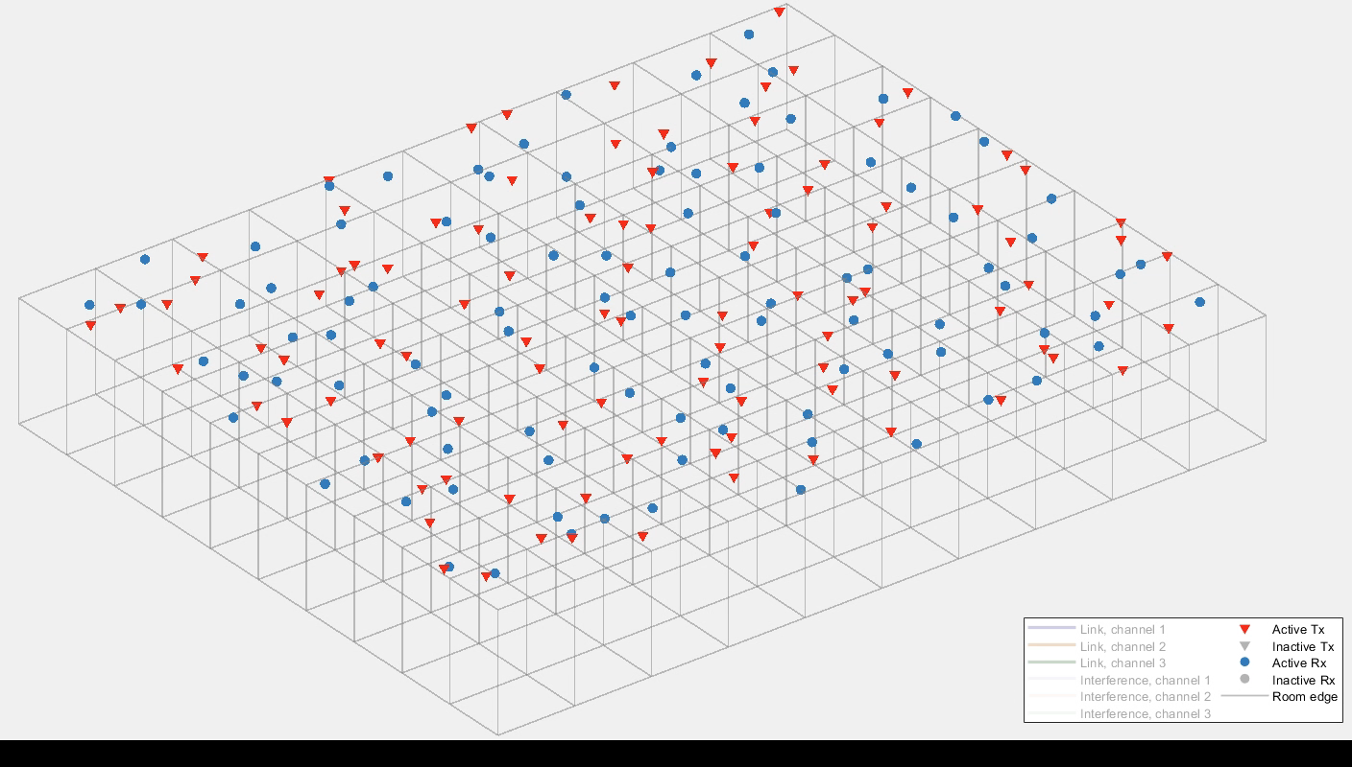
Tx-Rx Link and Interference
100 seats

Slide 8
Simulation 1: PER estimation
Objective
To understand the effect of various parameters on PER across seats.
3 channels to be allocated and SINR threshold kept high so that more nodes are simultaneously active.
Algorithm
Assign channels randomly.
Nodes with SINR above threshold are deemed active.
Packet drops are recorded.
Go back to step 1; Stop after pre assigned iterations (1000 say)

Slide 9
Changing Transmission Power [3 channels]
 | Rx antenna gain: 3dBi
 | Tx power: 7 dBm |  |  |  |  |  |  |  |  |  | Tx power: 9 dBm |  |  |  |  |  |  |  |  |  | Tx power: 11 dBm
MCS 1 | 0.37 | 0.58 | 0.55 | 0.58 | 0.54 | 0.62 | 0.6 | 0.55 | 0.49 | 0.41 | 0.31 | 0.43 | 0.48 | 0.46 | 0.59 | 0.43 | 0.48 | 0.49 | 0.41 | 0.4 | 0.28 | 0.32 | 0.42 | 0.33 | 0.38 | 0.52 | 0.41 | 0.29 | 0.38 | 0.24
MCS 2 | 0.51 | 0.66 | 0.71 | 0.7 | 0.68 | 0.72 | 0.61 | 0.59 | 0.57 | 0.51 | 0.57 | 0.61 | 0.44 | 0.49 | 0.65 | 0.58 | 0.67 | 0.58 | 0.7 | 0.46 | 0.49 | 0.48 | 0.48 | 0.59 | 0.38 | 0.42 | 0.53 | 0.47 | 0.43 | 0.4
MCS 3 | 0.54 | 0.68 | 0.73 | 0.78 | 0.73 | 0.78 | 0.88 | 0.77 | 0.72 | 0.73 | 0.55 | 0.69 | 0.7 | 0.77 | 0.69 | 0.78 | 0.75 | 0.69 | 0.61 | 0.6 | 0.48 | 0.56 | 0.65 | 0.62 | 0.59 | 0.62 | 0.57 | 0.59 | 0.62 | 0.51
MCS 4 | 0.77 | 0.77 | 0.9 | 0.76 | 0.92 | 0.88 | 0.88 | 0.82 | 0.87 | 0.87 | 0.68 | 0.85 | 0.81 | 0.83 | 0.79 | 0.77 | 0.84 | 0.83 | 0.75 | 0.71 | 0.65 | 0.7 | 0.84 | 0.71 | 0.86 | 0.79 | 0.77 | 0.84 | 0.68 | 0.66
MCS 5 | 0.87 | 0.88 | 0.96 | 0.96 | 0.95 | 0.95 | 0.93 | 0.91 | 0.92 | 0.92 | 0.83 | 0.88 | 0.89 | 0.88 | 0.93 | 0.97 | 0.87 | 0.91 | 0.91 | 0.84 | 0.79 | 0.81 | 0.82 | 0.76 | 0.91 | 0.85 | 0.89 | 0.87 | 0.78 | 0.78
MCS 6 | 0.94 | 0.98 | 0.95 | 0.98 | 0.93 | 0.95 | 0.99 | 1 | 0.9 | 0.9 | 0.82 | 0.92 | 0.97 | 0.98 | 0.91 | 0.97 | 0.91 | 0.95 | 0.96 | 0.92 | 0.81 | 0.85 | 0.9 | 0.93 | 0.91 | 0.85 | 0.92 | 0.9 | 0.8 | 0.85
MCS 7 | 0.94 | 0.98 | 0.98 | 0.97 | 0.93 | 0.97 | 0.96 | 0.99 | 0.97 | 0.9 | 0.86 | 0.91 | 0.93 | 0.93 | 0.95 | 0.91 | 0.96 | 0.96 | 0.92 | 0.82 | 0.8 | 0.91 | 0.86 | 0.9 | 0.87 | 0.91 | 0.91 | 0.93 | 0.9 | 0.86
MCS 8 | 0.97 | 0.92 | 1 | 0.99 | 1 | 1 | 0.99 | 1 | 0.99 | 0.97 | 0.94 | 0.94 | 0.98 | 0.97 | 1 | 0.96 | 0.95 | 0.96 | 0.99 | 0.98 | 0.95 | 0.97 | 0.97 | 0.98 | 0.96 | 0.96 | 0.97 | 0.96 | 0.9 | 0.9
MCS 9 | 0.96 | 0.99 | 1 | 1 | 1 | 0.97 | 0.99 | 0.99 | 0.99 | 0.99 | 0.99 | 0.98 | 0.97 | 1 | 0.99 | 1 | 1 | 0.99 | 1 | 0.94 | 0.91 | 0.95 | 1 | 0.98 | 0.99 | 0.99 | 0.97 | 0.92 | 0.95 | 0.92
MCS 10 | 0.98 | 0.99 | 1 | 1 | 1 | 1 | 1 | 1 | 1 | 1 | 0.99 | 1 | 0.99 | 1 | 1 | 1 | 1 | 1 | 0.96 | 1 | 0.98 | 0.98 | 0.99 | 0.98 | 1 | 1 | 0.99 | 1 | 0.97 | 0.94
Window Seats
Window seats have lower PERs. As transmission power increases, PER drops

Slide 10
Changing Receiver Antenna Gain [3 channels]
 | Tx power:11 dBm
 | Rx antenna gain: 3 dBi |  |  |  |  |  |  |  |  |  | Rx antenna gain: 6 dBi |  |  |  |  |  |  |  |  |  | Rx antenna gain: 9 dBi
MCS 1 | 0.28 | 0.32 | 0.42 | 0.33 | 0.38 | 0.52 | 0.41 | 0.29 | 0.38 | 0.24 | 0.21 | 0.24 | 0.28 | 0.26 | 0.24 | 0.32 | 0.4 | 0.24 | 0.26 | 0.17 | 0.09 | 0.16 | 0.26 | 0.13 | 0.28 | 0.16 | 0.2 | 0.23 | 0.16 | 0.2
MCS 2 | 0.49 | 0.48 | 0.48 | 0.59 | 0.38 | 0.42 | 0.53 | 0.47 | 0.43 | 0.4 | 0.28 | 0.33 | 0.32 | 0.53 | 0.33 | 0.4 | 0.49 | 0.28 | 0.25 | 0.42 | 0.21 | 0.21 | 0.27 | 0.3 | 0.31 | 0.4 | 0.34 | 0.37 | 0.16 | 0.22
MCS 3 | 0.48 | 0.56 | 0.65 | 0.62 | 0.59 | 0.62 | 0.57 | 0.59 | 0.62 | 0.51 | 0.41 | 0.47 | 0.42 | 0.46 | 0.62 | 0.5 | 0.51 | 0.55 | 0.33 | 0.33 | 0.3 | 0.3 | 0.34 | 0.36 | 0.41 | 0.33 | 0.31 | 0.39 | 0.33 | 0.29
MCS 4 | 0.65 | 0.7 | 0.84 | 0.71 | 0.86 | 0.79 | 0.77 | 0.84 | 0.68 | 0.66 | 0.47 | 0.55 | 0.67 | 0.71 | 0.67 | 0.63 | 0.61 | 0.66 | 0.58 | 0.51 | 0.39 | 0.48 | 0.52 | 0.52 | 0.56 | 0.52 | 0.49 | 0.49 | 0.4 | 0.4
MCS 5 | 0.79 | 0.81 | 0.82 | 0.76 | 0.91 | 0.85 | 0.89 | 0.87 | 0.78 | 0.78 | 0.66 | 0.75 | 0.69 | 0.87 | 0.8 | 0.84 | 0.83 | 0.73 | 0.78 | 0.71 | 0.54 | 0.66 | 0.57 | 0.59 | 0.66 | 0.65 | 0.66 | 0.66 | 0.63 | 0.48
MCS 6 | 0.81 | 0.85 | 0.9 | 0.93 | 0.91 | 0.85 | 0.92 | 0.9 | 0.8 | 0.85 | 0.64 | 0.7 | 0.73 | 0.76 | 0.79 | 0.9 | 0.83 | 0.79 | 0.73 | 0.75 | 0.65 | 0.68 | 0.64 | 0.75 | 0.75 | 0.72 | 0.66 | 0.57 | 0.71 | 0.66
MCS 7 | 0.8 | 0.91 | 0.86 | 0.9 | 0.87 | 0.91 | 0.91 | 0.93 | 0.9 | 0.86 | 0.79 | 0.75 | 0.87 | 0.78 | 0.79 | 0.92 | 0.81 | 0.91 | 0.81 | 0.74 | 0.72 | 0.63 | 0.76 | 0.75 | 0.85 | 0.75 | 0.82 | 0.8 | 0.66 | 0.65
MCS 8 | 0.95 | 0.97 | 0.97 | 0.98 | 0.96 | 0.96 | 0.97 | 0.96 | 0.9 | 0.9 | 0.82 | 0.91 | 0.85 | 0.9 | 0.93 | 0.92 | 0.97 | 0.93 | 0.91 | 0.88 | 0.78 | 0.81 | 0.89 | 0.83 | 0.8 | 0.97 | 0.89 | 0.92 | 0.83 | 0.73
MCS 9 | 0.91 | 0.95 | 1 | 0.98 | 0.99 | 0.99 | 0.97 | 0.92 | 0.95 | 0.92 | 0.92 | 0.94 | 0.94 | 0.92 | 0.99 | 0.95 | 0.92 | 0.94 | 0.93 | 0.93 | 0.8 | 0.74 | 0.84 | 0.83 | 0.93 | 0.91 | 0.95 | 0.9 | 0.78 | 0.81
MCS 10 | 0.98 | 0.98 | 0.99 | 0.98 | 1 | 1 | 0.99 | 1 | 0.97 | 0.94 | 0.93 | 0.97 | 1 | 0.98 | 0.98 | 1 | 0.96 | 0.99 | 0.97 | 0.94 | 0.87 | 0.87 | 0.87 | 0.93 | 0.92 | 0.99 | 0.96 | 0.97 | 0.93 | 0.85
Window Seats
Window seats have lower PERs. As receiver antenna gain increases, PER drops

Slide 11
Simulation 2: AP Channel Allocation– Distributed algorithm
Objective:
59 non overlapping 20MHz channels are used to simulate the events inside the cabin.
All the Wi-Fi nodes are active simultaneously and we aim for a channel matrix which gives the lowest PER.
Simulation Starts
All seats are allocated channels randomly.
Flag counter= number of seats
Channel matrix set
SINR calculated
Seats experiencing SINR greater than 25db raise a flag
Channel matrix is calibrated and used for PER calculation
Number of raised flags==0
True
False
Simulation Ends
Number of raised flags < Flag counter
Random channel is allocated to each flagged seat
False
True
Flag counter denotes the total number of seats that have to be assigned a channel
Flag counter= number of raised flags
Channel matrix updated

Slide 12
Extending the simulation to 400 seats
27 | 11 | 35 | 7 | 17 | 6 | 19 | 40 | 33 | 42
18 | 56 | 25 | 33 | 5 | 51 | 41 | 36 | 8 | 31
24 | 57 | 43 | 1 | 58 | 32 | 13 | 11 | 27 | 38
45 | 10 | 40 | 47 | 48 | 34 | 39 | 9 | 29 | 21
4 | 37 | 8 | 42 | 23 | 24 | 56 | 16 | 22 | 37
51 | 16 | 32 | 14 | 12 | 30 | 20 | 52 | 48 | 34
54 | 26 | 22 | 17 | 45 | 55 | 5 | 40 | 41 | 49
59 | 1 | 50 | 39 | 9 | 53 | 10 | 4 | 2 | 8
47 | 40 | 19 | 57 | 54 | 37 | 15 | 47 | 56 | 38
38 | 2 | 52 | 28 | 51 | 3 | 43 | 31 | 33 | 58
39 | 11 | 24 | 29 | 6 | 41 | 32 | 18 | 23 | 21
37 | 20 | 12 | 13 | 1 | 35 | 49 | 30 | 9 | 19
50 | 18 | 33 | 27 | 23 | 25 | 2 | 57 | 15 | 51
28 | 14 | 8 | 9 | 52 | 28 | 54 | 17 | 50 | 14
35 | 46 | 21 | 32 | 37 | 58 | 34 | 6 | 10 | 48
38 | 13 | 53 | 19 | 22 | 47 | 51 | 18 | 38 | 39
15 | 25 | 4 | 59 | 55 | 41 | 33 | 24 | 44 | 36
37 | 1 | 10 | 23 | 39 | 31 | 11 | 32 | 28 | 8
45 | 57 | 12 | 56 | 40 | 42 | 43 | 26 | 45 | 5
17 | 9 | 54 | 46 | 21 | 29 | 52 | 54 | 13 | 47
39 | 26 | 15 | 38 | 49 | 36 | 2 | 14 | 19 | 31
55 | 5 | 28 | 27 | 50 | 35 | 48 | 30 | 18 | 55
29 | 19 | 47 | 59 | 57 | 3 | 58 | 8 | 56 | 38
8 | 17 | 20 | 22 | 7 | 43 | 33 | 37 | 15 | 17
6 | 46 | 24 | 41 | 34 | 52 | 40 | 4 | 46 | 39
28 | 58 | 23 | 44 | 48 | 28 | 16 | 6 | 54 | 9
9 | 49 | 11 | 53 | 29 | 25 | 56 | 43 | 31 | 47
56 | 40 | 50 | 27 | 30 | 19 | 5 | 36 | 24 | 59
5 | 57 | 4 | 14 | 33 | 32 | 18 | 3 | 2 | 21
8 | 45 | 12 | 15 | 46 | 6 | 51 | 10 | 7 | 4
37 | 34 | 41 | 13 | 49 | 9 | 38 | 27 | 42 | 20
17 | 6 | 58 | 2 | 47 | 55 | 50 | 52 | 37 | 23
7 | 44 | 10 | 3 | 1 | 4 | 8 | 57 | 48 | 15
19 | 29 | 51 | 36 | 56 | 35 | 46 | 12 | 31 | 56
20 | 52 | 59 | 30 | 53 | 22 | 7 | 5 | 28 | 44
45 | 25 | 21 | 54 | 15 | 26 | 39 | 42 | 55 | 45
18 | 38 | 24 | 4 | 32 | 51 | 9 | 2 | 19 | 6
36 | 40 | 23 | 17 | 49 | 1 | 29 | 58 | 41 | 40
5 | 10 | 2 | 37 | 45 | 13 | 3 | 21 | 27 | 15
43 | 51 | 47 | 44 | 16 | 42 | 10 | 35 | 22 | 48
0 | 0 | 0 | 0 | 0 | 0 | 0 | 0 | 0 | 0
0 | 0 | 0 | 0 | 0 | 0 | 0 | 0 | 0 | 0
0 | 0 | 0 | 0 | 0 | 0 | 0 | 0 | 0 | 0
0 | 0 | 0 | 0 | 0 | 0 | 0 | 0 | 0 | 0
0 | 0 | 0 | 0 | 0 | 0 | 0 | 0 | 0 | 0
0 | 0 | 0 | 0 | 0 | 0 | 0 | 0 | 0 | 0
0 | 0 | 0 | 0 | 0 | 0 | 0 | 0 | 0 | 0
0 | 0 | 0 | 0 | 0 | 0 | 0 | 0 | 0 | 0
0 | 0 | 0 | 0 | 0 | 0 | 0 | 0 | 0 | 0
0 | 0 | 0 | 0 | 0 | 0 | 0 | 0 | 0 | 0
0 | 0 | 0 | 0 | 0 | 0 | 0 | 0 | 0 | 0
0 | 0 | 0 | 0 | 0 | 0 | 0 | 0 | 0 | 0
0 | 0 | 0 | 0 | 0 | 0 | 0 | 0 | 0 | 0
0 | 0 | 0 | 0 | 0 | 0 | 0 | 0 | 0 | 0
0 | 0 | 0 | 0 | 0 | 0 | 0 | 0 | 0 | 0
0 | 0 | 0 | 0 | 0 | 0 | 0 | 0 | 0 | 0
0 | 0 | 0 | 0 | 0 | 0 | 0 | 0 | 0 | 0
0 | 0 | 0 | 0 | 0 | 0 | 0 | 0 | 0 | 0
0 | 0 | 0 | 0 | 0 | 0 | 0 | 0 | 0 | 0
0 | 0 | 0 | 0 | 0 | 0 | 0 | 0 | 0 | 0
0 | 0 | 0 | 0 | 0 | 0 | 0 | 0 | 0 | 0
0 | 0 | 0 | 0 | 0 | 0 | 0 | 0 | 0 | 0
0 | 0 | 0 | 0 | 0 | 0 | 0 | 0 | 0 | 0
0 | 0 | 0 | 0 | 0 | 0 | 0 | 0 | 0 | 0
0 | 0 | 0 | 0 | 0 | 0 | 0 | 0 | 0 | 0
0 | 0 | 0 | 0 | 0 | 0 | 0 | 0 | 0 | 0
0 | 0 | 0 | 0 | 0 | 0 | 0 | 0 | 0 | 0
0 | 0 | 0 | 0 | 0 | 0 | 0 | 0 | 0 | 0
0 | 0 | 0 | 0 | 0 | 0 | 0 | 0 | 0 | 0
0 | 0 | 0 | 0 | 0 | 0 | 0 | 0 | 0 | 0
0 | 0 | 0 | 0 | 0 | 0 | 0 | 0 | 0 | 0
0 | 0 | 0 | 0 | 0 | 0 | 0 | 0 | 0 | 0
0 | 0 | 0 | 0 | 0 | 0 | 0 | 0 | 0 | 0
0 | 0 | 0 | 0 | 0 | 0 | 0 | 0 | 0 | 0
0 | 0 | 0 | 0 | 0 | 0 | 0 | 0 | 0 | 0
0 | 0 | 0 | 0 | 0 | 0 | 0 | 0 | 0 | 0
0 | 0 | 0 | 0 | 0 | 0 | 0 | 0 | 0 | 0
0 | 0 | 0 | 0 | 0 | 0 | 0 | 0 | 0 | 0
0 | 0 | 0 | 0 | 0 | 0 | 0 | 0 | 0 | 0
0 | 0 | 0 | 0 | 0 | 0 | 0 | 0 | 0 | 0
Takeaway: Channel allocation converges to PER 0 across all 400 seats
With independent access points, the channel allocation procedure will repeat every time the usage scenario changes.
By using WLAN controllers the allocation procedure will need to run only once as after that, all the APs can be set to suitable channels.
Virtual WLAN controllers like OpenWISP, Chillispot could be used to automate several aspects of network deployment and management.
Rows
MCS: 4
Tx power: 7 dBm
Rx gain: 3 dBi
Channel Matrix
Packet error rate per seat

