Slide 1


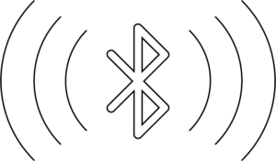
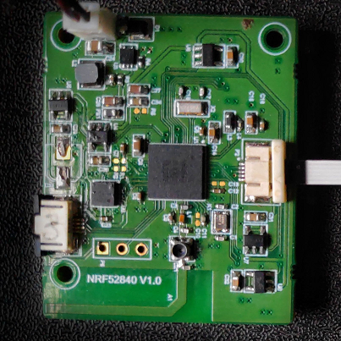

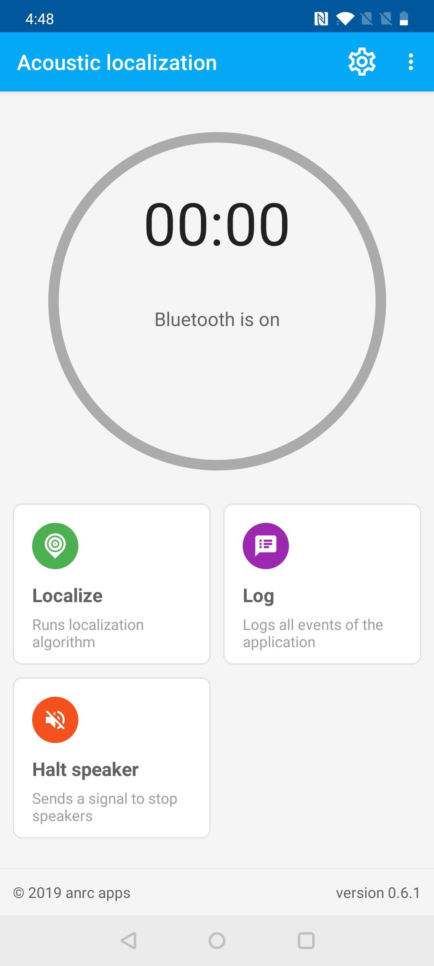
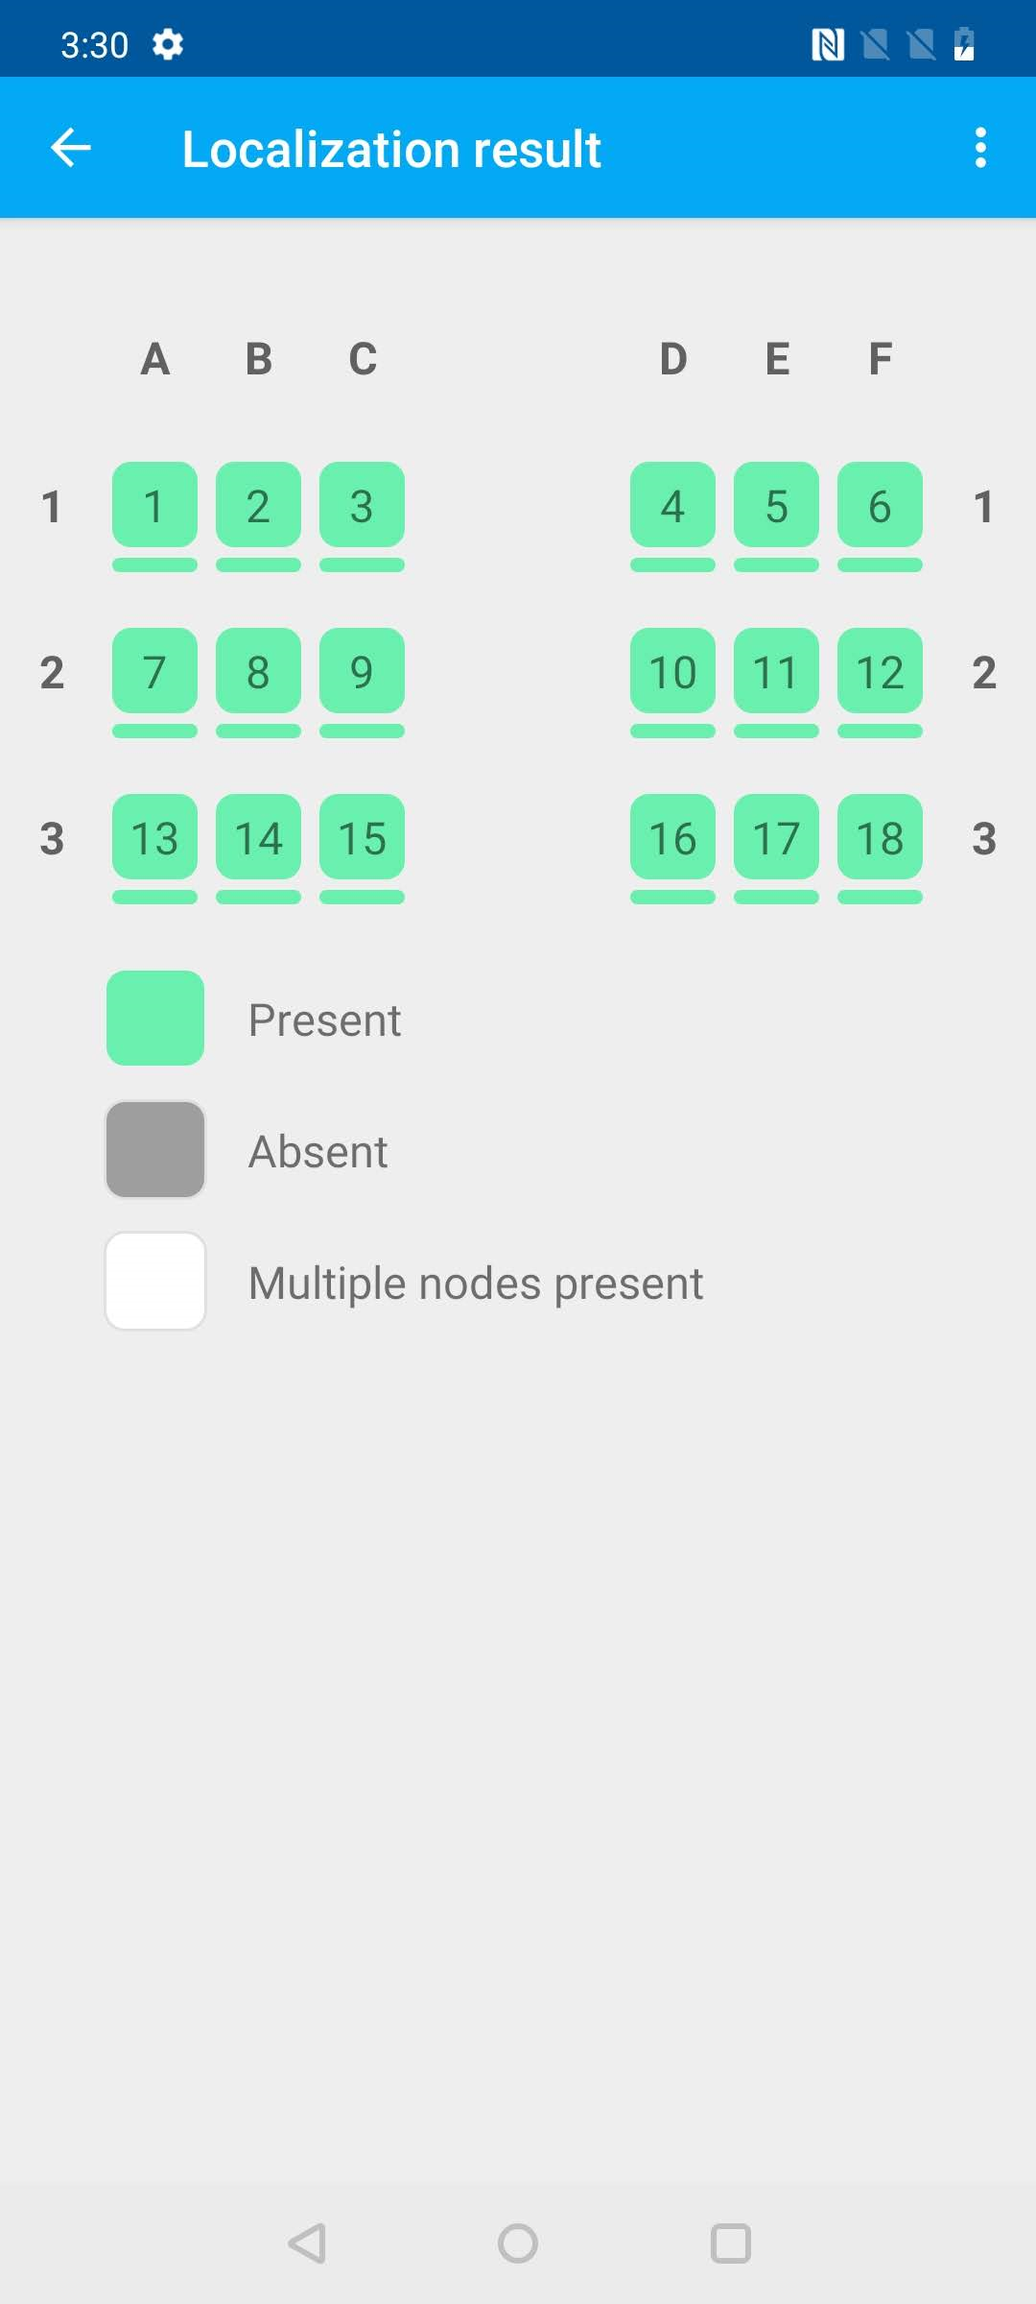

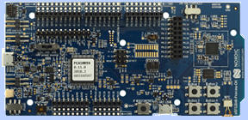
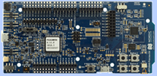
Aircraft Cabin
TDoA1, 2, 3 at 3A
3F
3E
3D
3C
3B
3A
TDoA1, 2, 3 at 2C
2F
2E
2D
2C
2B
2A
1F
1E
1D
1C
1B
1A
Localization Algorithm
3rd beep
Start Signal
2nd beep
4th beep
Wake-up beep & 1st beep
Speaker Controller

