Slide 1
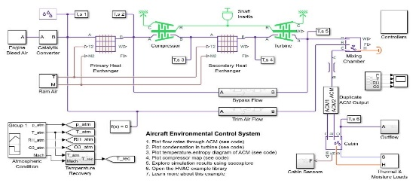
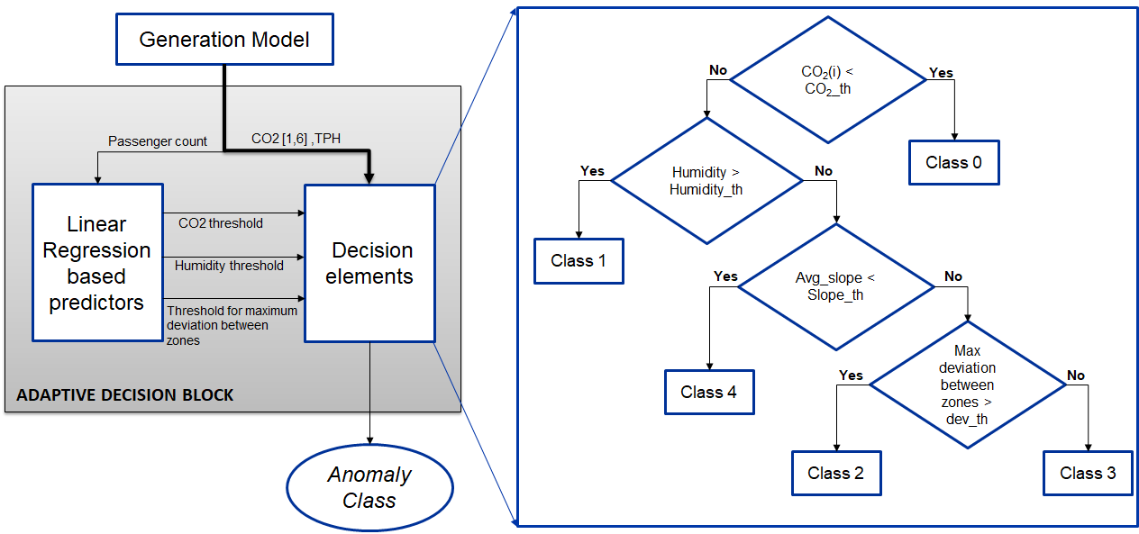
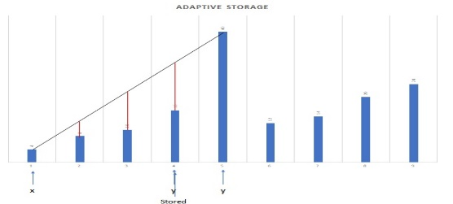
AIOT data management - Overview
Storage Space
Data generation model
Adaptive decision block and severity predictor
Adaptive Storage
CO2 across zones
TPH
Passenger Count
Anomaly class
Severity
Anomaly Class | Description
0 | NO anomaly
1 | Ventilation efficiency
2 | Independent source
3 | Fuming event
4 | Event after anomaly
Severity | Indicator
0 | Low
1 | Medium
2 | High

Slide 2
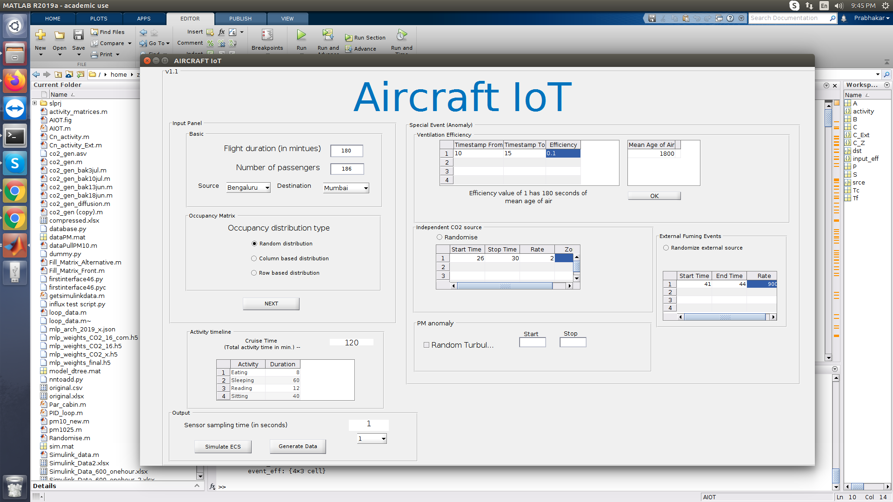
Data generation model
Notes:
Cabin ECS system using Simulink
Flight conditions, passenger count, diffusion model written using MATLAB
Cabin divided into 6 zones

Slide 3
Example - Class 2 anomaly in zone 2 for 50% occupancy
Anomaly:
Independent source of CO₂ in Zone 2

Slide 4
Anomaly & severity level prediction
Input Features
Adaptive Decision Block
Anomaly Class
Severity Level
Predictor
Input Features:
CO2 across zones [1:6]
Rate of change of CO2 [1:6]
Humidity
Passenger Count
(total features: 14)
Anomaly Class | Description
0 | NO anomaly
1 | Ventilation efficiency
2 | Independent source
3 | Fuming event
4 | Event after anomaly
Severity level | Description
0 | Low severity
1 | Intermediate Severity
2 | High Severity

Slide 5
Adaptive decision block
Generation Model
CO₂(i) < CO₂_th
i is the Zone Number
CO₂(i) : CO₂(1),…, CO₂(6),
No
Yes
Passenger count
CO2 [1,6] ,Humidity
Humidity > Humidity_th
Class 0
Yes
No
Linear Regression based predictors
CO2 threshold
Decision elements
Humidity threshold
Avg_slope < Slope_th
Class 1
Threshold for maximum
deviation between zones
Yes
No
Max deviation between zones > dev_th
Class 4
Yes
No
ADAPTIVE DECISION BLOCK
Anomaly Class | Description
0 | NO anomaly
1 | Ventilation efficiency
2 | Independent source
3 | Fuming event
4 | Event after anomaly
Anomaly Class
Class 2
Class 3
Notes:
A transparent method of anomaly detection was desired for the controller
Few Algorithms like linear classifiers, logistic regression, decision trees were tried, but the anomaly predictions were noisy.
An adaptive decision block was designed. It can accurately predict the anomalies.
Linear regression was used to predict thresholds for making decision block
Anomaly detection done by the decision block

Slide 6
Adaptive Storage using Linear Interpolation
Class 4
Severity 1
Class 2
Severity 1
Class 2
Severity 0
Class 4
Severity 0
Class 0
Class 0
Notes:
Time series data divided into windows based on anomaly class and severity

Slide 7
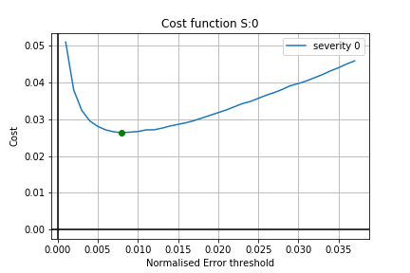
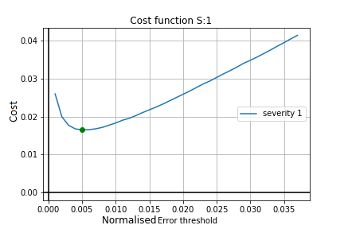
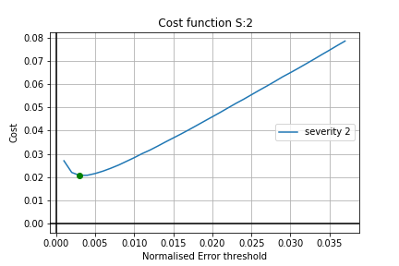
Designing a Cost Function
Cost Function:
Cost = (1-A).(Normalized Error threshold)+(A).(Normalized Storage Space)
Severity 0
Severity 1
Severity 2
Notes:
There is an inverse relationship between error threshold and storage space consumed
Larger errors allow us to consume less space but reduce reconstruction accuracy
An optimum error threshold needs to be chosen depending upon available storage space and severity of data.
This optimization is done using cost functions over windows (batches) of time series data

Slide 8
Data management implementation in TICK stack
Data Generation Model
Influx DB (Temporary Database)
Influx DB (Final Database)
Chronograf (Reconstruction and visualization)
CO2 across zones
TPH
Passenger Count
Query data for defined window size
Points to be stored
Kapacitor (batch process) Adaptive Storage Algorithm

Slide 9
TICK stack results
Generated Data
10800 Data Points
Final file size with InfluxDB’s compression
70488 bytes
File size in InfluxDB before compression
166,290 bytes
Generated Data
10800 Data Points
Adaptive Storage
282 Data Points Stored
Final file size with InfluxDB’s compression
2367 bytes
File size in InfluxDB before compression
4819 bytes
Reduction in Storage Space = 96.64%

Slide 10
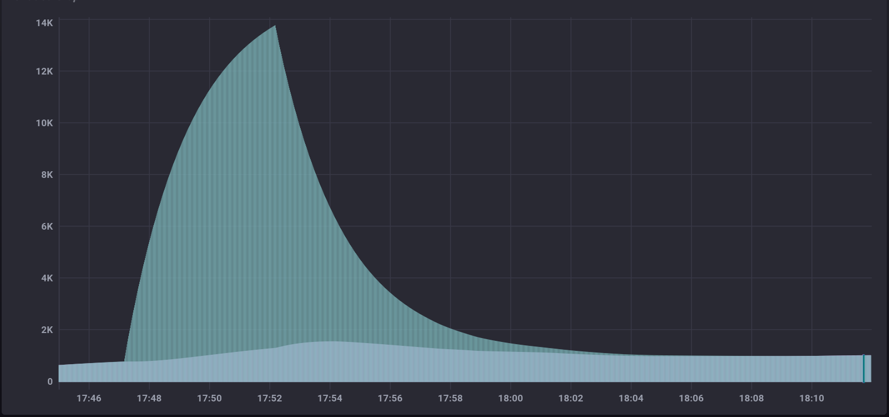
Generated data at zones 1 & 3
Data Generation Model
CO₂ across zones
TPH
Passenger count
Influx DB (Temporary Database)
Influx DB (Final Database)
Chronograf (Reconstruction and visualization)
Zone 3 (anomalous)
Query data for defined window size
Points to be stored
Kapacitor (batch process) Adaptive Storage Algorithm
CO2 (ppm)
Zone 1
Time

Slide 11
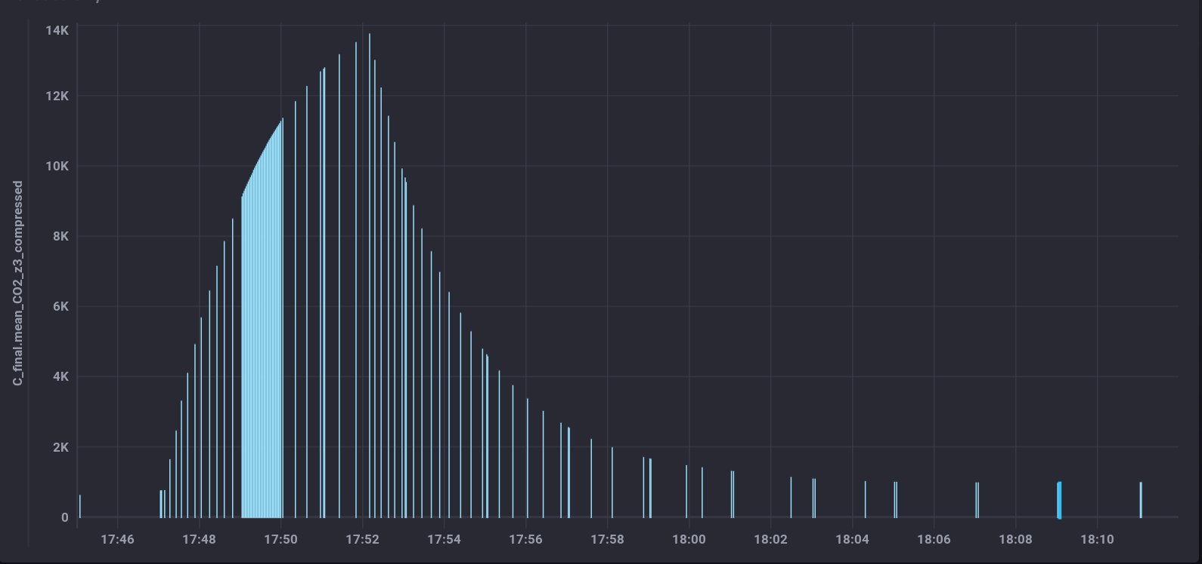
Adaptively stored data at zone 3 (anomalous)
Data Generation Model
CO₂ across zones
TPH
Passenger count
Influx DB (Temporary Database)
Influx DB (Final Database)
Chronograf (Reconstruction and visualization)
Query data for defined window size
Points to be stored
Kapacitor (batch process) Adaptive Storage Algorithm
CO2 (ppm)
Time

Slide 12
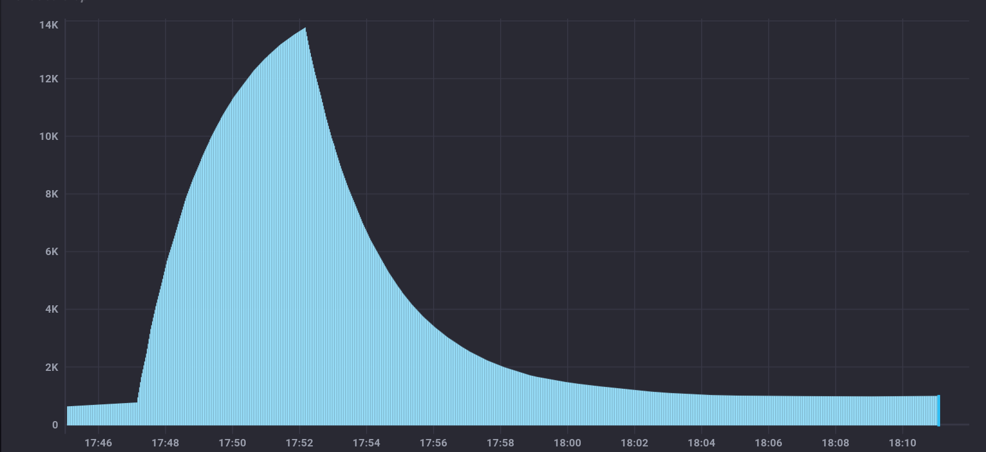
Reconstructed data
Data Generation Model
CO₂ across zones
TPH
Passenger count
Influx DB (Temporary Database)
Influx DB (Final Database)
Chronograf (Reconstruction and visualization)
Query data for defined window size
Points to be stored
Kapacitor (batch process) Adaptive Storage Algorithm
CO2 (ppm)
Time

Slide 13
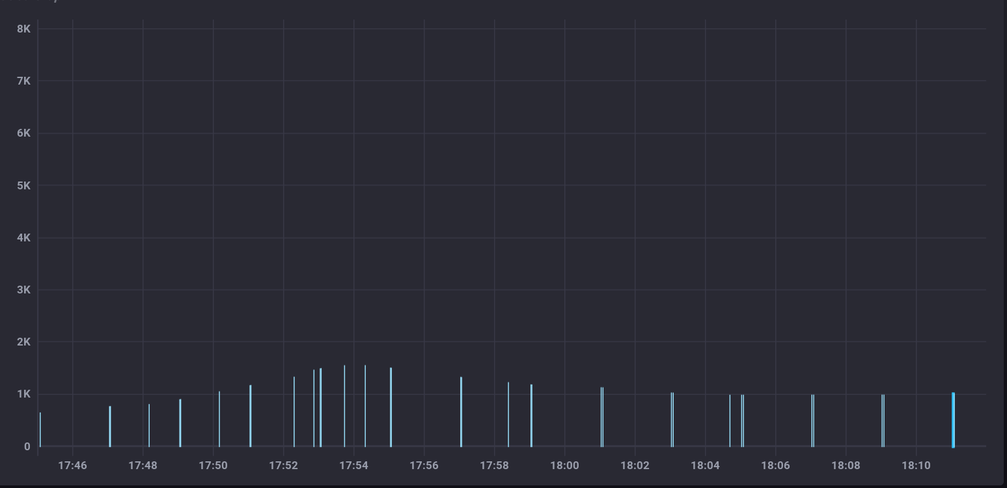
Adaptively stored data at zone 1 (Non-anomalous)
Data Generation Model
CO₂ across zones
TPH
Passenger count
Influx DB (Temporary Database)
Influx DB (Final Database)
Chronograf (Reconstruction and visualization)
Query data for defined window size
Points to be stored
Kapacitor (batch process) Adaptive Storage Algorithm
CO2 (ppm)
Time

Slide 14
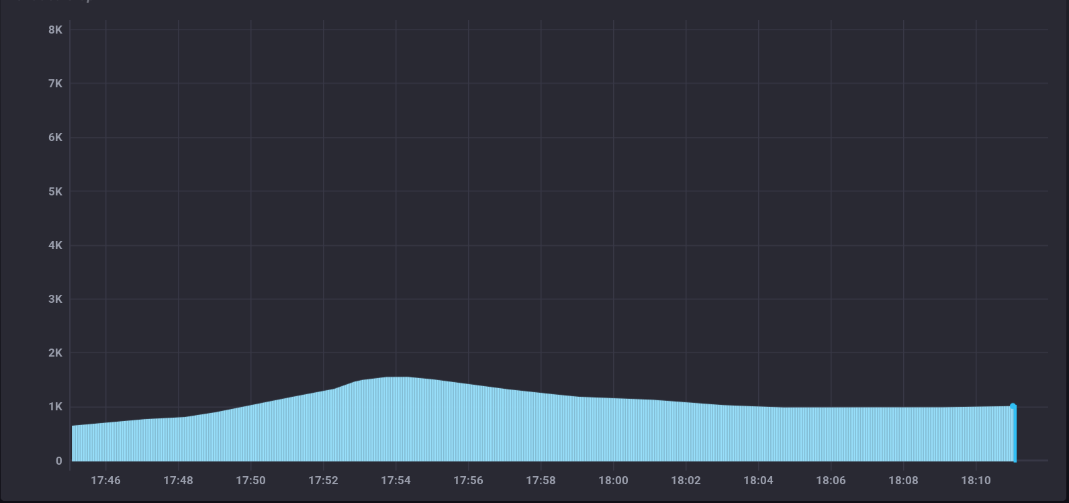
Reconstructed data
Data Generation Model
CO₂ across zones
TPH
Passenger count
Influx DB (Temporary Database)
Influx DB (Final Database)
Chronograf (Reconstruction and visualization)
Query data for defined window size
Points to be stored
Kapacitor (batch process) Adaptive Storage Algorithm
CO2 (ppm)
Time

