Slide 1
Objective
Modeling and simulation of physical and MAC layers of IEEE WLANs
Standards considered: 802.11n & 802.11ac at 2.4 GHz and 5 GHz

Slide 2
Outline
Scenarios and performance metrics
Throughput results: 802.11n and 802.11ac
Methodology and details
Plan for 2021

Slide 3
Performance Metrics and Modeling Scenarios
Performance metrics
Throughput
Latency
Packet error rate
Range
Models with simulation parameters
Scenario 1: Aircraft stationary at different distances from an access point
Focus on standardized channel models for which verification is possible
Scenario 2: Aircraft in motion towards gate with single access point
Scenario 3: Aircraft in motion in taxi way covering multiple access points

Slide 4
Throughput vs. Distance Plots
802.11n:
802.11ac:
EIRP (dBm) | Noise Figure (dB) | BW (MHz) | No. of spatial streams
18 vs. 20 | 11 | 20 | 2
18 | 11 vs. 16 | 40 | 1
18 | 11 | 20 vs. 40 | 3
EIRP (dBm) | Noise Figure (dB) | BW (MHz) | No. of spatial streams
18 | 11 | 20 vs. 40 vs. 80 vs. 160 | 4, 2

Slide 5
Throughput Results for IEEE 802.11n
EIRP: 18 & 20 dBm
Noise figures: 11, 13.5, 16 dB
Bandwidth: 20 & 40 MHz for 11n, and 20, 40, 80 & 160 MHz for 11ac
1x1, 2x2, 3x3 & 4x4 antenna configurations
Spatial streams: 1, 2, 3 & 4

Slide 6
Effect of EIRP [BW 20 MHz, 2 Spatial Streams]
EIRP (dBm) | 18 vs. 20
Noise figure (dB) | 11
BW (MHz) | 20
No. of spatial streams | 2
As EIRP increases, range increases

Slide 7
Effect of Noise Figure [BW 40 MHz, 1 Spatial Stream]
EIRP (dBm) | 18
Noise figure (dB) | 11 vs. 16
BW (MHz) | 40
No. of spatial streams | 1
As noise figure increases, range decreases

Slide 8
Effect of Bandwidth [3 Spatial Streams]
EIRP (dBm) | 18
Noise figure (dB) | 11
BW (MHz) | 20 vs. 40
No. of spatial streams | 3
As channel bandwidth increases, throughput increases & range decreases

Slide 9
Throughput Results for IEEE 802.11ac

Slide 10
Effect of Bandwidth [MCS 0, 4 spatial streams]
MCS 0
EIRP (dBm) | 20
Noise Figure (dB) | 11
BW (MHz) | 20 vs. 40 vs. 80 vs. 160
No. of spatial streams | 4
As channel bandwidth increases, throughput increases & range decreases

Slide 11
Effect of Bandwidth [MCS 2, 2 spatial streams]
MCS 2
EIRP (dBm) | 20
Noise Figure (dB) | 11
BW (MHz) | 20 vs. 40 vs. 80 vs. 160
No. of spatial streams | 2
As channel bandwidth increases, throughput increases & range decreases

Slide 12
Methodology

Slide 13
Technical Details: Four Step Approach
Step 1: Obtain PER vs. SNR plots for different MCSs
Validate the simulation results by comparing it with results in standard documents
Step 2: Obtain PER vs. distance plots for different EIRPs and noise floors
Step 3: Develop rate adaptation algorithm and benchmark
Step 4: Extend to Scenarios 2 and 3
PER
PER vs. distance
For different EIRP
For different Noise Floor
EIRP
MCS
SNR
Noise Floor
Throughput
Throughput vs. distance
For different EIRP
For different Noise Floor
Channel Model
Distance

Slide 14
Plots Generated and Verification Approach
PER and throughput for different SNRs obtained for all MCSs
For 802.11n and 802.11ac
Channel Models B, C, and D
PER vs. SNR curves validated with those in “Next Generation Wireless LANs,” E. Perahia and R. Stacey, Cambridge Univ. Press

Slide 15
Changing Channel Model
Can control breakpoint distance (d_{BP})
Results shown were for d_{BP} = 50 m
Need to figure out how to change power delay profile

Slide 16

Transmit Receive Chain Simulation for an MCS
MCS
SNR
Every packet
Transmitter
Channel
Receiver
Packet Waveform Generation
Packet Detect
Frequency correction
Time sync
Demodulation
Channel estimation
Data Decoding
Channel model
AWGN
PSDU
PSDU
Bit comparison
PER
Each module corresponds to a function in MATLAB

Slide 17
Throughput Calculation
Distance Pathloss
MCS
Rate
EIRP
SNR
PER
Throughput
Noise Floor
Given a distance, EIRP, noise floor, the SNR is calculated
PER is obtained using the data generated for different MCS
Throughput is calculated using the rate and PER

Slide 18
Plots Coming Up
Validation plots: PER vs. SNR for 802.11n, Model D
Outstanding issue

Slide 19
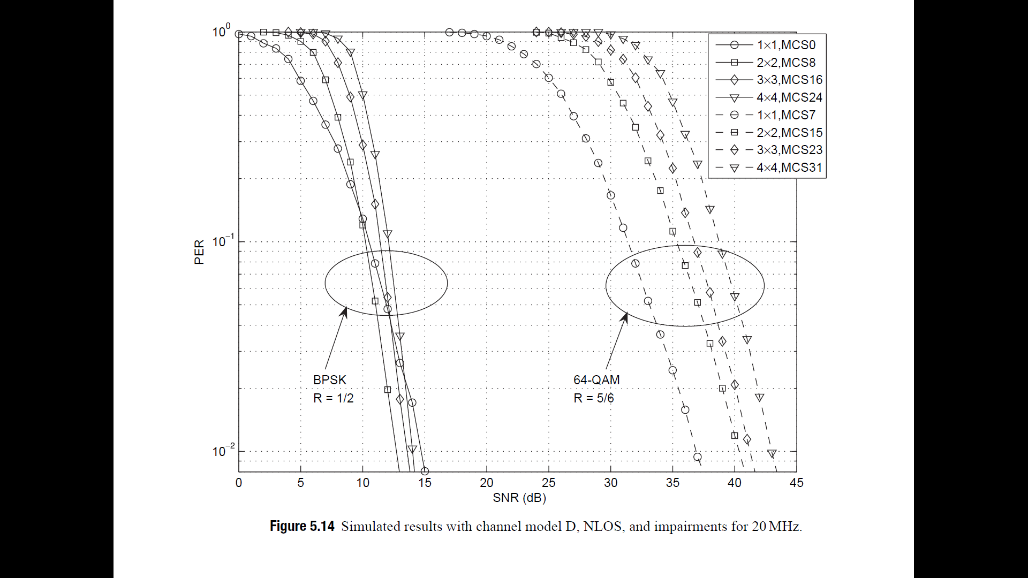
Validation: PER vs. SNR: Model D, 802.11n
SNR (dB) at which PER is 10%:
Reference: 10, 11, 12, 13, 32, 35, 37, 38
Simulation: 10, 10, 11, 11, 32, 36, 37, 39

Slide 20
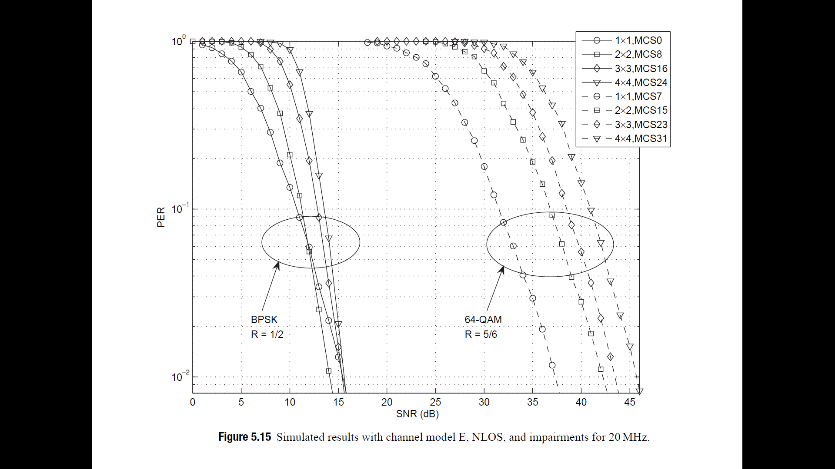
Outstanding Issue: Error Floor
PER exhibits error floors for higher MCSs in Models E & F in both 11n & 11ac
Occurs only for highly dispersive channel models
PER vs. SNR; Model-E; 802.11n

Slide 21
Rate Adaptation Algorithms

Slide 22
Rate Adaptation Algorithms
Goal: Choose rate, number of spatial streams and bandwidth
Several algorithms available in literature
Minstrel: Default in Linux.
MiRA (MIMO – Aware Rate Adaptation)
RAMAS (Rate Adaptation for Multi-Antenna Systems)
Damysus
Few algorithms require modifications or special signalling

Slide 23
Minstrel: A Closer Look
Initial rate selection
Organize rates in groups
MCS 0 to 9 - 1 spatial stream 20 MHz; MCS 0 to 9 - 1 spatial stream 40 MHz; ...
Same for 2, 3 & 4 spatial streams
Remove/trim groups not supported by the AP
Optional: From each group, pick rates compatible with initial signal budget
Compute the transmission time for each selected rate
Transmit at the rate with the smallest transmission time

Slide 24
Picking Good Rates that Change with Conditions
At regular intervals (e.g., 100 ms), enter a sampling period
During a sampling period, pick a random rate in a group
Try the rate, within the max retry limit for this group (e.g., 3)
If the rate results in a higher throughput than the previous rate, rank the rate up
Repeat until the end of the sampling period
Retain 3 rates:
Highest throughput
Second highest throughput
Highest probability (least loss/retries)

Slide 25
Retry Chain: When Transmission Fails
For each rate, a max retry count is defined
Count is affected by the historical throughput for that rate
Retry time is assigned (percentage of maximum of 79.2 ms)
Number of retries depends on the data rate
Retry more of those rates that have been highly successful in the past
79.2 ms
high
Retry time calculation:
throughput
low
Retry chain logic

Slide 26
Summary
Throughput vs. distance plots obtained for models B, C, D, E & F
Based on PER vs. SNR data obtained for all models
MATLAB issue: Error floors for highly dispersive channel models (E and F)
Rate adaptation algorithms survey initiated
Minstrel: Default benchmark

