Slide 1

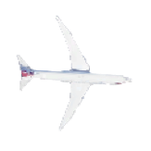
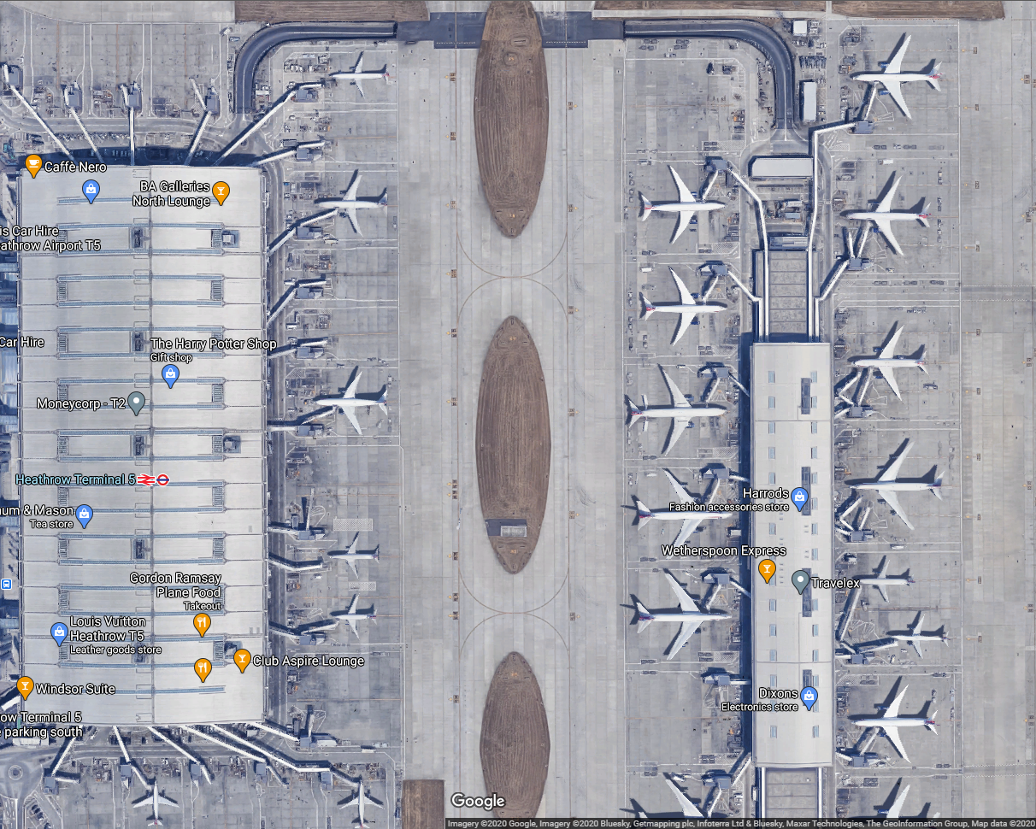




A
Wi-Fi Stations at Terminals/Gates
B
Scenario 1 Stationary Aircrafts
350m
Scenario 2 Moving aircraft
A
B
Courtesy: Google Maps

