Slide 1
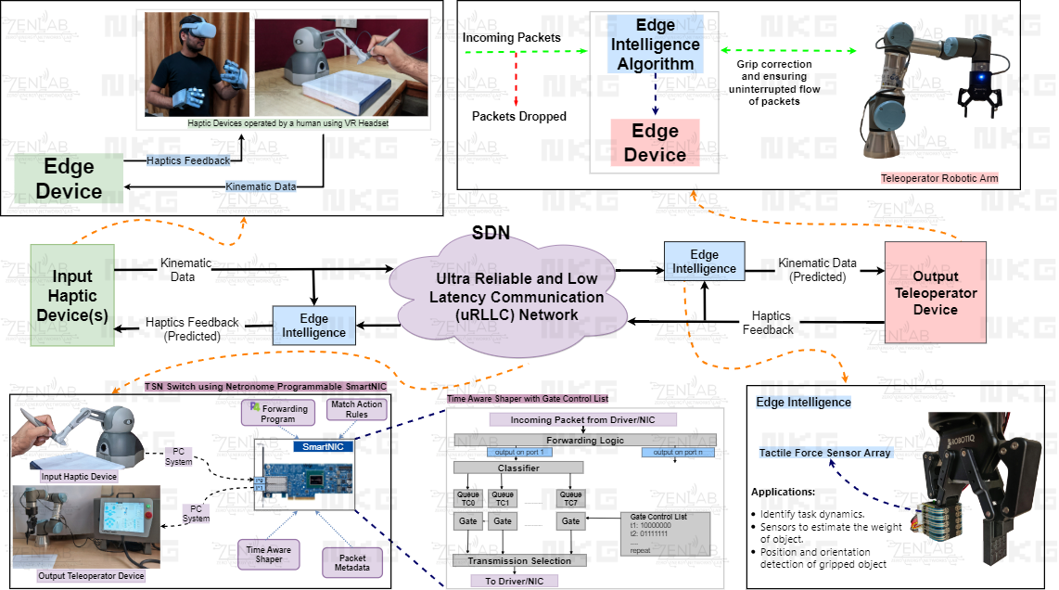

Slide 2
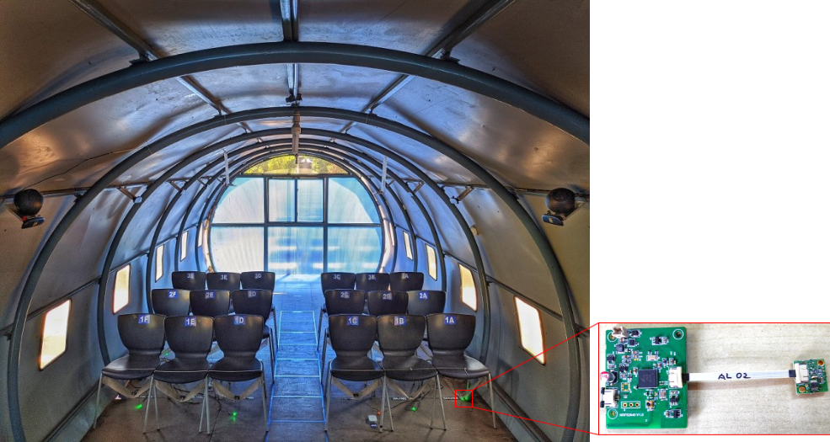

Slide 3
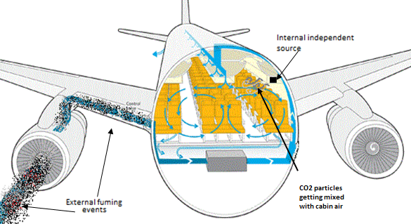
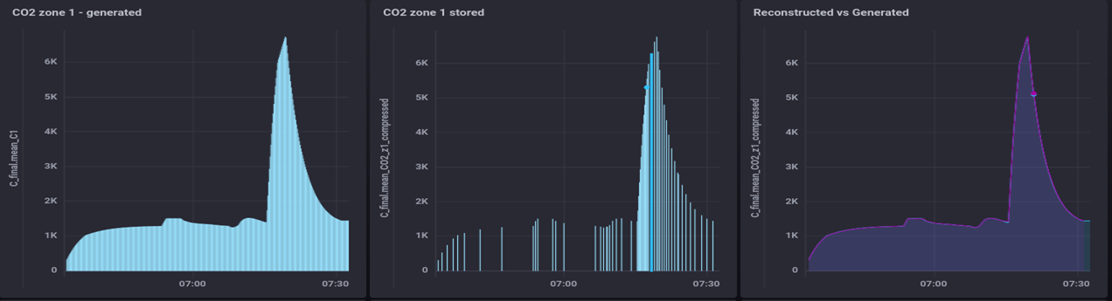

Slide 4
PER
EIRP
MCS
Distance Pathloss
MCS
SNR
Rate
Noise Floor
EIRP
SNR
PER
Throughput
Throughput
Channel Model
Distance
Noise Floor

Slide 5
