Slide 1

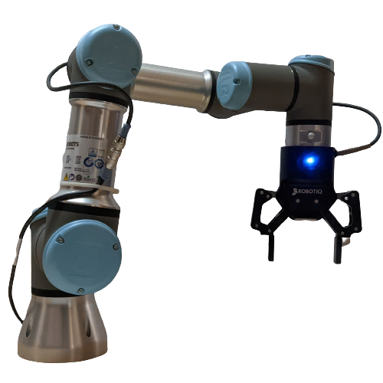
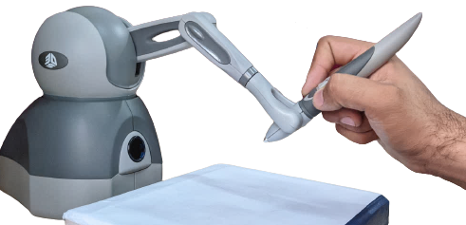

Edge Switch 1
Network
Edge Switch 2
tremor suppression
grip monitoring &
pose correction
Host 1
Host 2
Haptic Device
(Human operated)
Robotic Arm (Teleoperator)

