Slide 1
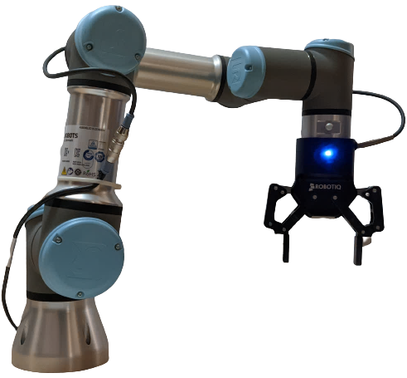
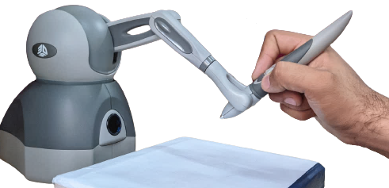


Host 1
Host 2
Network
Gripper, Robotic Arm (Teleoperator)
Haptic Device
(Human operated)
Edge Switch 1
Edge Switch 2
tremor suppression
grip monitoring &
pose correction

