Slide 1
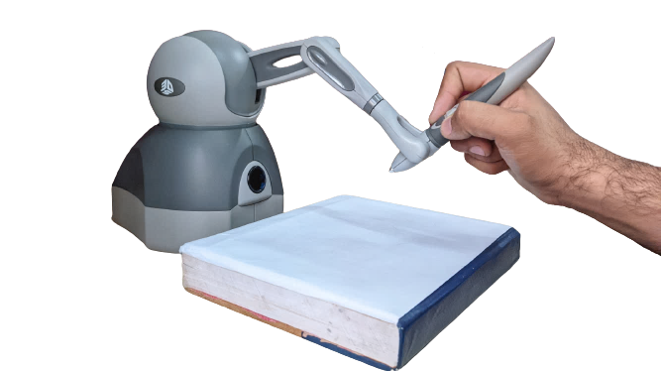

Geomagic Touch – OpenHaptics Toolkit
Get coordinates joint angles, velocity
Send coordinates joint angles, velocity
Virtual environment
or
Real hardware
OpenHaptics Toolkit
Geomagic Touch
Set force
Force feedback

