Slide 1
Tremor suppression - Results
Task | No. of packets transmitted | No. of packets discarded | Average data rate (kbps) | Traffic reduction (%)
Spiral | 813 | 14182 | 55 | 94.58
Straight line | 250 | 4718 | 51 | 94.97
Hold steady | 5 | 9950 | 0.5 | 99.95
Traffic reduction due to tremor suppression for different tasks
Threshold (mm) | No. of packets transmitted | No. of packets discarded | Average data rate (kbps) | Traffic reduction (%) | Drawing length (mm)
None | 14992 | 0 | 1015 | 0.0 | 600
0.1 | 2299 | 12621 | 156 | 84.6 | 507
0.2 | 1586 | 13399 | 107 | 89.4 | 522
0.5 | 813 | 14182 | 55 | 94.6 | 527
1 | 423 | 14494 | 29 | 97.2 | 506
2 | 226 | 14714 | 15 | 98.5 | 512
Effect of different thresholds in drawing a spiral

Slide 2
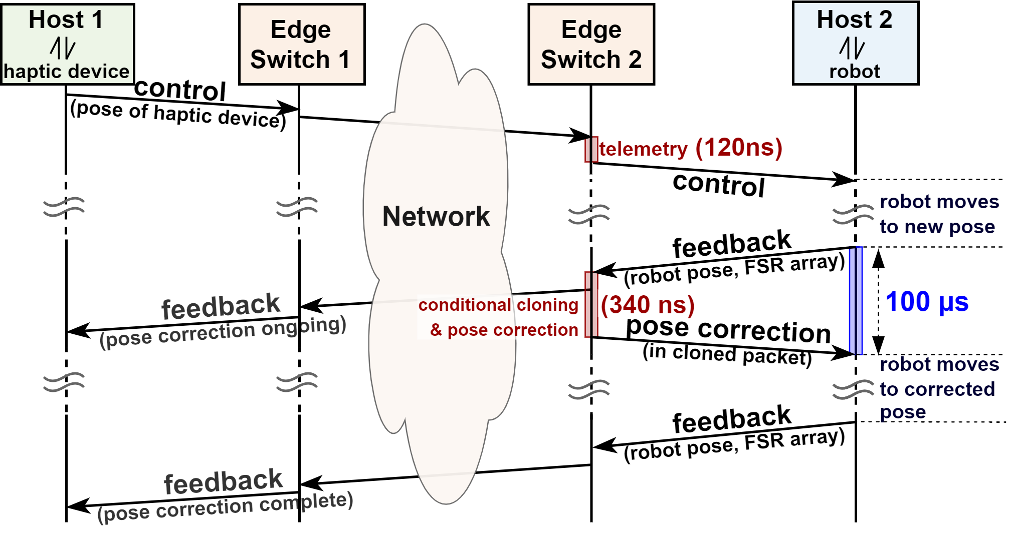
Pose correction - Results
Figure 5: Automatic pose correction - packet flow and latency measurements

