Slide 1
Application Architecture

Slide 2
S.No | Ver.No. | Author | Section(s) affected | Change(s) made | Approved date | Approved by
1 | 1.0 | Suruthi V Razeena Nilufar M Nithishkumar T | All | Initial

Slide 3
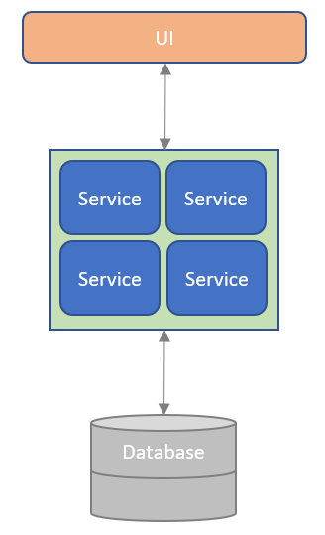


Monolithic Architecture
A Software Model where all the functionalities of an application are combined into a single, unified package and deployed on a server.
One executable that encapsulates the entire application functionality.
Features :
Single codebase - All modules are developed and maintained in unified project structure
Unified Deployment – Entire application is built and deployed as a single package
Tightly Coupled components – All modules are interdependent
Shared Resources - Single Database
Various Companies have evolved from monolithic architecture to microservices due to its scalability but still some major companies use monolithic architecture for its simplicity.
Major Companies still using Monolithic

Slide 4





Microservices Architecture
Microservice Architecture is a software development architecture model wherein a large, complex application is decomposed into a collection of loosely coupled, independently deployable, and domain-driven services, each encapsulating a specific functionality.
Features:
Small, independent, loosely coupled services
Decentralized data management – Separate Databases
Each service runs in its own process
Communicates via lightweight protocols (REST, Messaging)
Independent deployability
Scalable and resilient services
Major Companies migrating towards microservices architecture

Slide 5
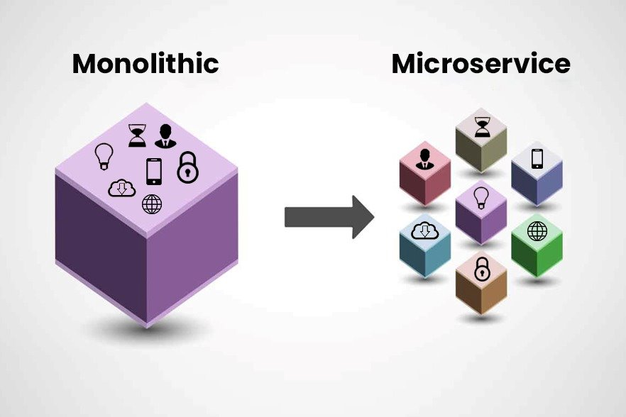

Why migrating from Monolith to Microservices ?
IMPROVED SCALABILITY
Entire application must scale together
Scale individual components independently
FASTER DEPLOYMENT
Any small change requires full redeployment
Deploy services independently with minimal downtime
FAULT ISOLATION
A failure in one module can crash the whole app
EASIER MAINTANABILITY
Codebase becomes large and tightly coupled over time
Modular structure allows easier updates and debugging
Failure is contained within the specific service
Monolithic
Microservices

Slide 6



Microservices Implementation Guide : E-Commerce
Step 1: Design Microservices
Break down the monolithic e-commerce system into microservices based on business domains.
Tools:
Architecture diagram tools (e.g., Lucidchart, Draw.io)
Example:
Lucidchart
Draw.io
E-Commerce
User
service
Manages customer accounts, registration, login.
Product
service
Lists products, categories,
pricing.
Order
service
Creates orders, tracks order status.
Payment
service
Handles payment processing.
Inventory
Service
Tracks product stock.
Shipping
service
Manages delivery and tracking.

Slide 7
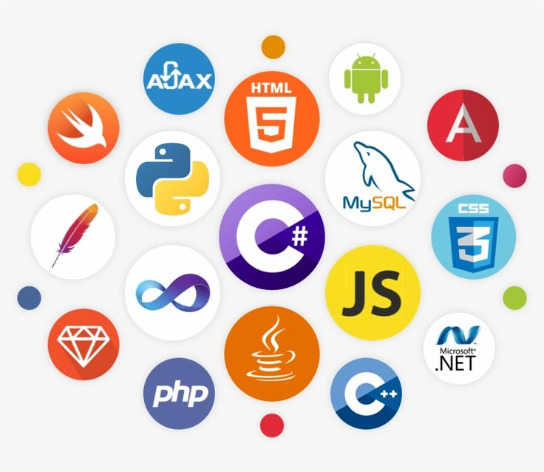
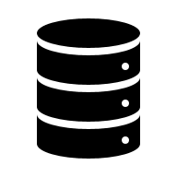
Microservices Implementation Guide : E-Commerce
Step 2: Choose Language, Framework, Server & Data Base
Each service owns its Language, framework, Server & data store.
Tools:
Languages: Java (Spring Boot), Node.js (Express), Python (FastAPI), Go, .NET Core
Frameworks: Spring Boot, Express.js, FastAPI, Flask
Databases: PostgreSQL, MongoDB, Redis, Cassandra
Example:
E-Commerce
User
service
Java + Spring Boot
Tomcat (8081)
Product
service
Node.js + Express
Node HTTP (8082)
Order
service
Python + FastAPI
Uvicorn (8083)
Payment
service
Go
Go HTTP (8084)
Inventory
Service
.NET Core
Kestrel (8085)
Shipping
service
Java + Spring Boot
Tomcat (8086)
PostgreSQL
MongoDB
PostgreSQL
Redis
Cassandra
PostgreSQL

Slide 8
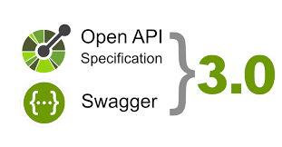
Microservices Implementation Guide : E-Commerce
Step 3: Define APIs
Document and define RESTful APIs
Tools:
Swagger/OpenAPI, API Blueprint
Example:
Services | API Endpoints
Product-service | - GET /products - GET /products/{id}
Order-service | - POST /orders - GET /orders/user/{userId}
Payment-service | - POST /payments - GET /payments/status/{paymentId}
Inventory-service | - GET /inventory/{productId} - PATCH /inventory/update
Shipping-service | - GET /shipping/{orderId} - POST /shipping/schedule

Slide 9
Microservices Implementation Guide : E-Commerce
Step 4 : Communication Between Services
Connect services synchronously or asynchronously.
Tools:
REST, gRPC, Kafka, RabbitMQ
Example:
Synchronous Communication
(Request-Response)
One service directly calls another service’s endpoint
Asynchronous Communication
(Event Based – Message Broker (Intermediater))
One service publishes an event, others subscribe
Kafka (Event)
Subscribe
REST API Call
(HTTP)
Order Service
{
"event": "OrderPlaced",
"orderId": "789",
"userId": "101"
}
Inventory
service
Order
Service
Product
Service
Payment
Service
REST API Call
(HTTP)
REST API Call
(HTTP)
Inventory
Service
Payment
Service
Shipping
service

Slide 10

Microservices Implementation Guide : E-Commerce
Step 5 : Implement Service Discovery
In a microservices architecture, services should not hardcode IP addresses or ports when calling each other. Instead, use service discovery (via registry or DNS) to dynamically resolve service names.
Tools:
Eureka, Consul
Example:
Service | Discovers and Calls | Example API Call
order-service | user-service | GET http://user-service/users/{userId}
order-service | product-service | GET http://product-service/products/{productId}
order-service | payment-service | POST http://payment-service/payments
payment-service | order-service | GET http://order-service/orders/{orderId}
inventory-service | order-service | GET http://order-service/orders/{orderId}
shipping-service | order-service | GET http://order-service/orders/{orderId}

Slide 11
Microservices Implementation Guide : E-Commerce
Step 6 : Containerization & Orchestration
Containerization is the process of packaging each microservice with its dependencies to ensure it runs consistently across environments. Orchestration is the method of managing, deploying, scaling, load-balancing and monitoring these containerized microservices in distributed environments.
Tools:
Containerization : Docker
Orchestration : Kubernetes, Docker Swarm
Example:
Containerization ( Docker )
Orchestration ( Kubernetes )
Auto-scaling = More users → More service instances
Ser-1
Lib
DB
Ser-1
Lib
DB
Ser-1
Lib
DB
Ser-1
Lib
DB
Ser-3
Lib
DB
Ser-3
Lib
DB
Ser-2
Lib
DB
Ser-1
Lib
DB
Ser-4
Lib
DB
Ser-2
Lib
DB
Docker Engine
Docker Engine
OS
OS
Hardware
Hardware

Slide 12



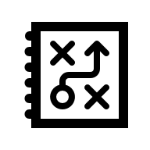
Microservices Implementation Guide : E-Commerce
Step 7: API Gateway
The API Gateway acts as a single entry point for all external client requests. It routes requests to the appropriate microservices internally, hiding service details. handles routing, rate limiting, authentication.
Tools:
Kong, NGINX, Zuul, AWS API Gateway
Example:
Kong API Gate
Way
Route to user ser
User Service
/api/users
/api/orders
Route to order ser
Order Service
/api/Payment
Client
Auth
Routing
Payment Service
Route to payment ser

Slide 13
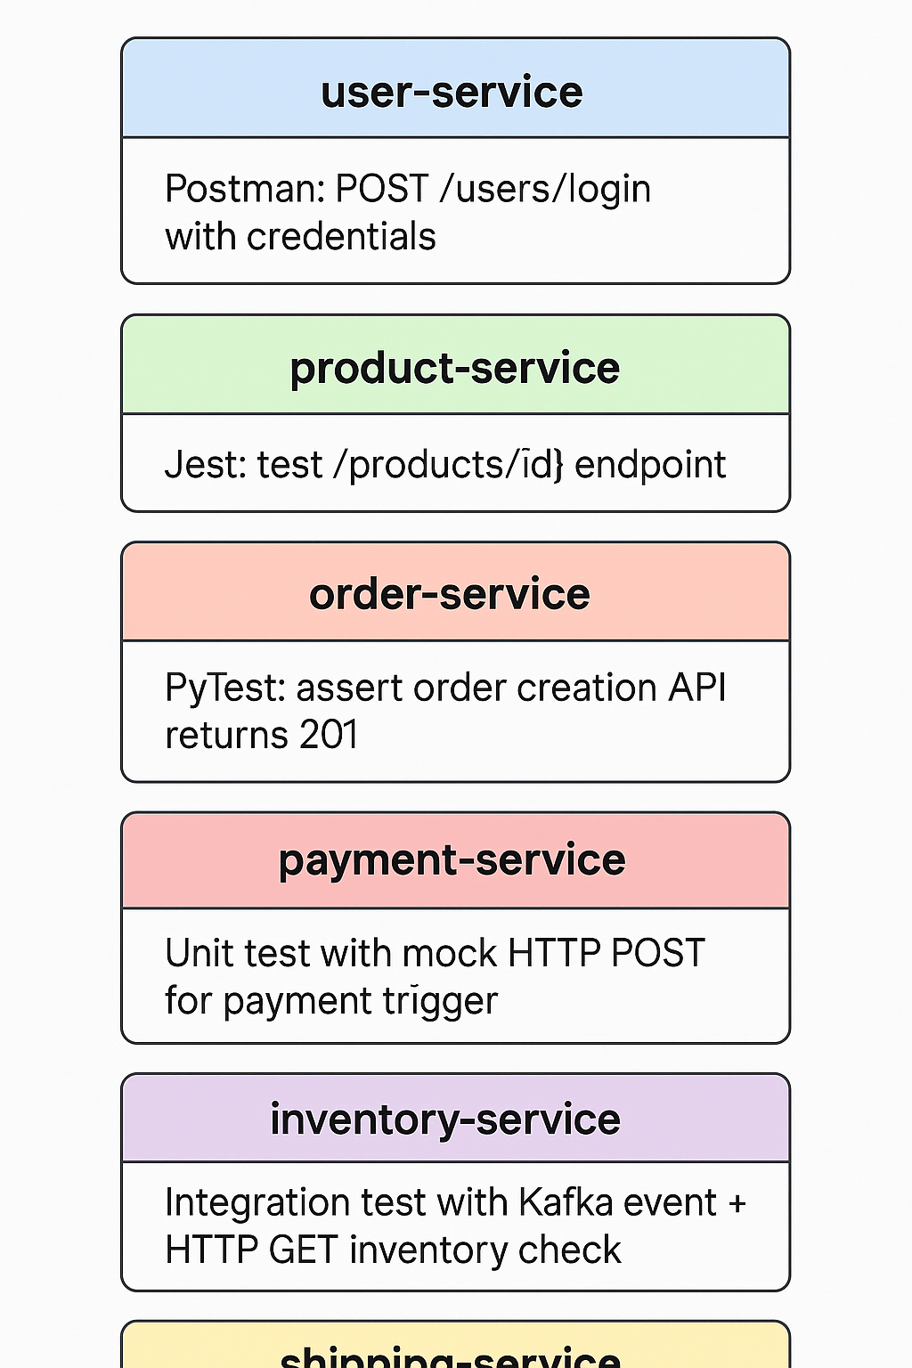




Microservices Implementation Guide : E-Commerce
Step 8 : Testing
Test API endpoints and business logic.
Tools:
Postman, JUnit, PyTest, Jest
Example :

Slide 14
Microservices without a Network
It is a type of microservice design where each service can run independently on a local device
These services do not rely on a continuous network connection to communicate with central/cloud systems.
They store/process requests locally, and when connectivity is restored, they sync data back to the cloud or other services.
Low Latency, Real-Time Decisions
Decisions are made instantly on-device, without waiting for cloud responses.
Crucial for industrial machines, robotics, vehicles and medical devices.
Works Even Without Internet
System keeps functioning even when offline.
Eventual Consistency is Acceptable
Not every system needs real-time synchronization.
It’s okay if data is synced after minutes or hours, as long as it is not lost.
Edge Computing Compatibility
Processing is done near the data source (edge)→ reduces bandwidth usage to cloud.
Scalable solution for large deployments of field devices.

Slide 15
Modular Monolithic Architecture
A single codebase split into clearly defined modules (e.g., user module, billing module).
Deployment: All modules are deployed together as one application.
Local Setup: Simple to run with a single command (npm start, mvn spring-boot:run, etc.)
Modules
Have clear boundaries
Communicate via function calls
Benefits
Easier to develop, test, and debug
Faster local development cycle
Cleaner internal architecture
Easier to refactor or transition to microservices later
Challenges
Limited scalability (can’t scale modules independently)
Entire app must be redeployed for any change
E-Commerce
User service
Product service
Order service
Payment service
Inventory service
Shipping service

Slide 16
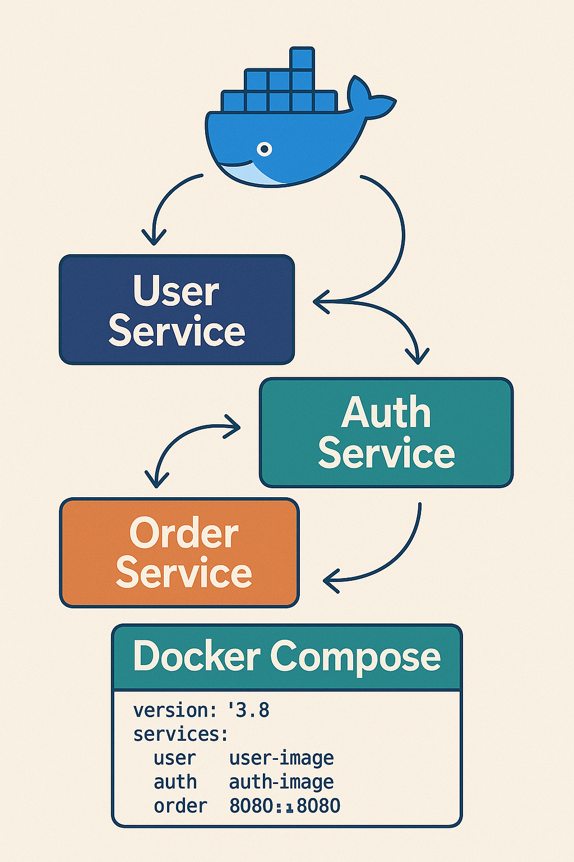
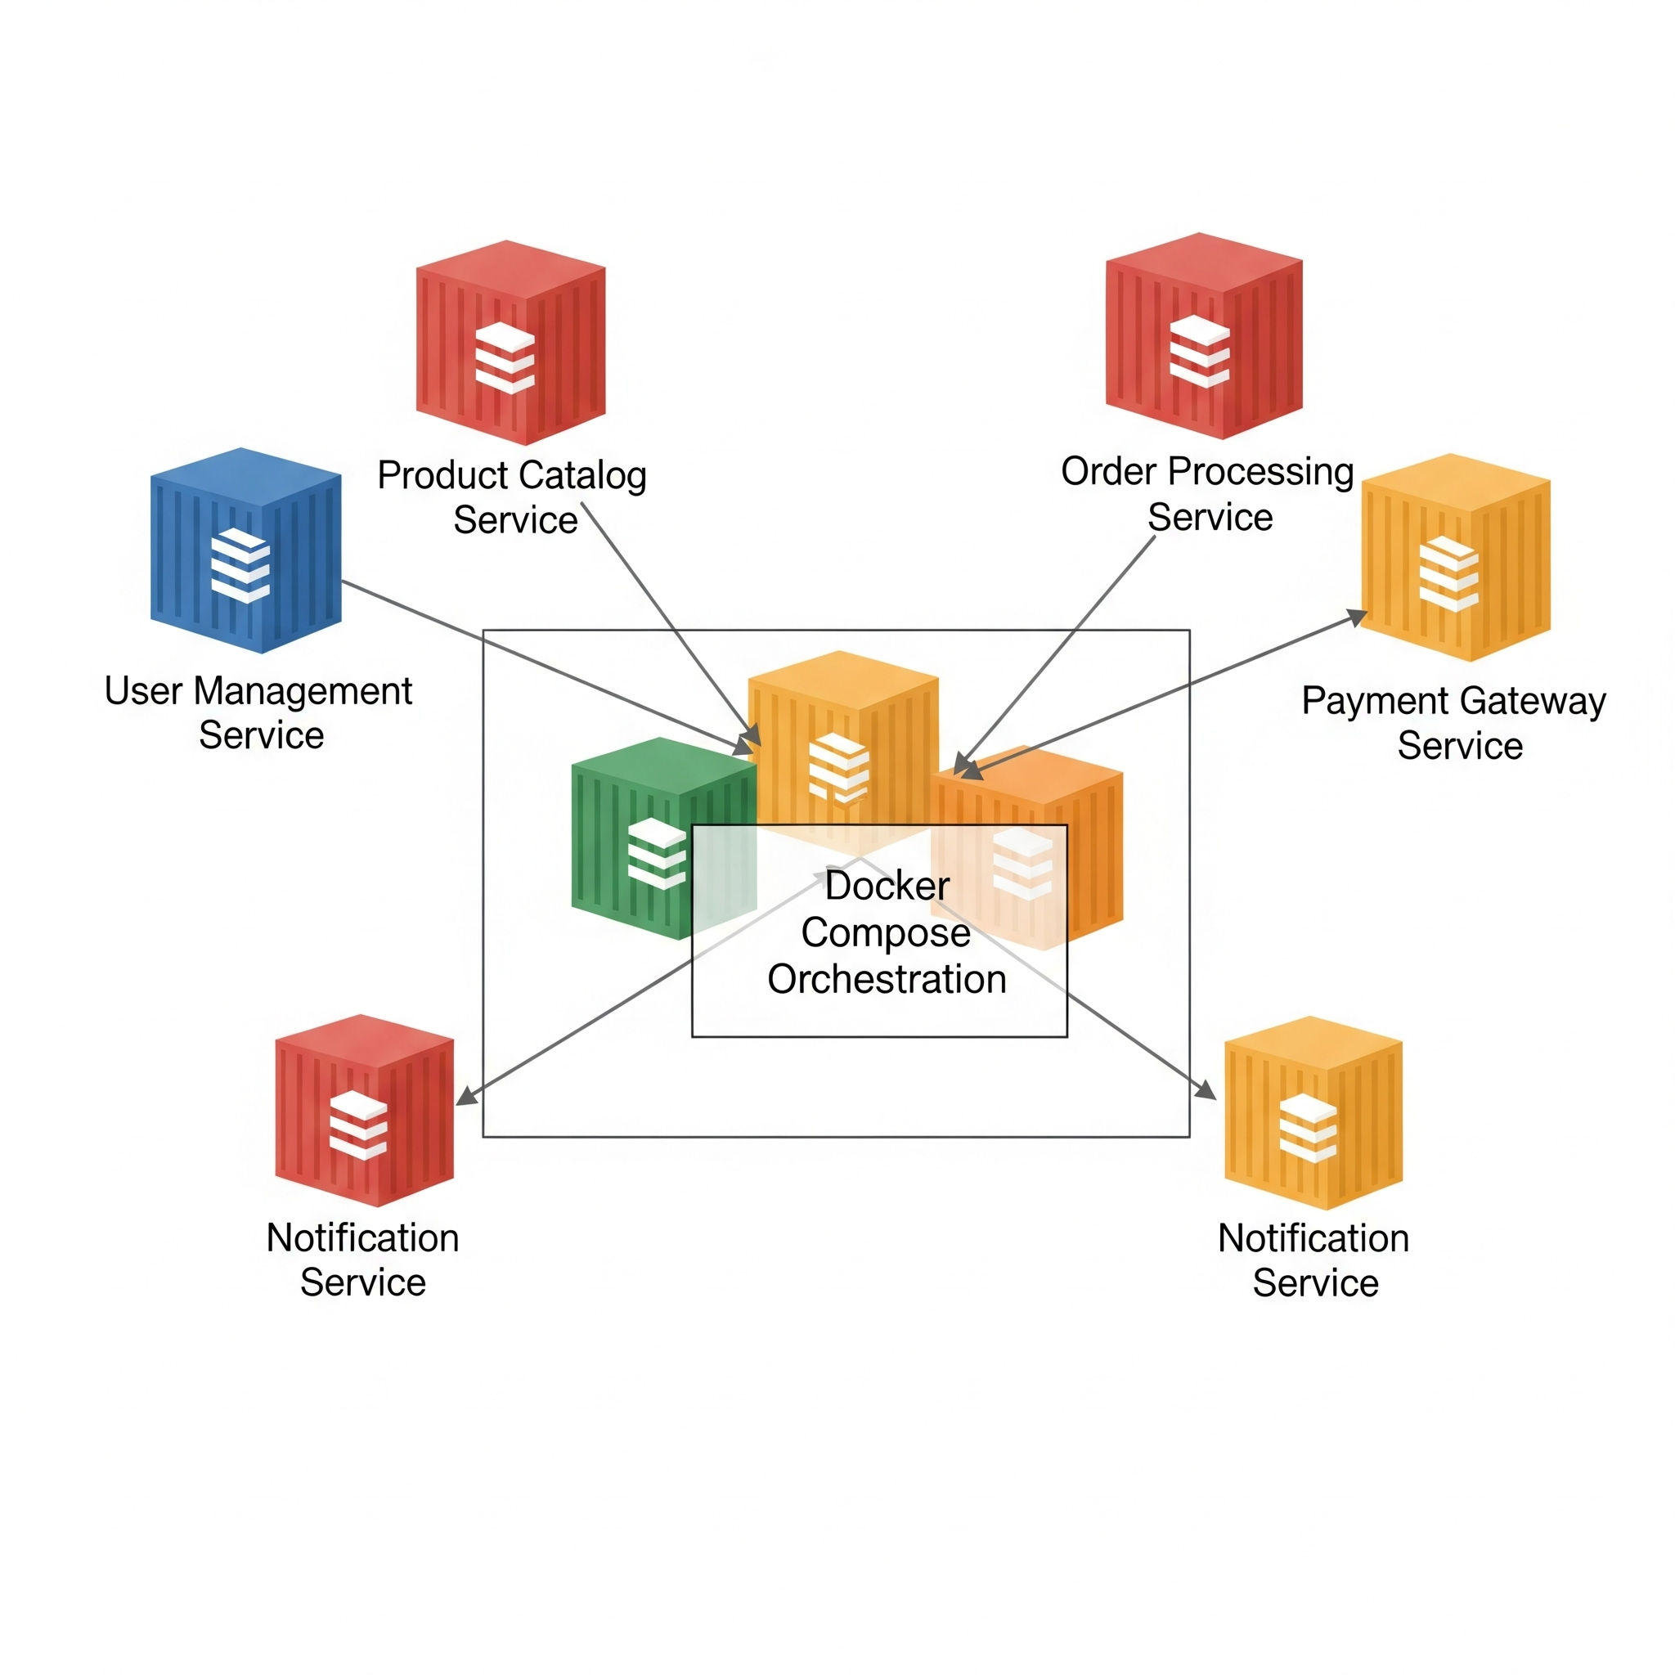
Microservices with Docker Compose
Each feature or component is developed as a separate service (e.g., user service, order service, auth service).
Local Setup:Use Docker Compose to run all services together in separate containers.
Communication: Services interact via HTTP/gRPC/message queues, just like in production.
Tools Needed:
Docker & Docker Compose
Individual repos (or folders) for each service
Benefits:
Realistic simulation of a distributed system
Test service dependencies and interactions locally
Easier to isolate and scale individual components
Challenges:
High setup complexity (networking, configs)
Difficult debugging across multiple containers
Slower startup times

Slide 17
Comparision of Architectures
Features | Monolithic | Modular Monolith | Microservices | Microservices Local Host
Deployment Unit | One single application | One application (internally divided into modules) | Many independent deployable services | Many independent services capable of running without connectivity
Codebase | Single codebase | Single codebase, logically modular | Multiple separate codebases | Multiple separate codebases
Technology Flexibility | Usually one tech stack | Usually one tech stack | Different services can use different technologies | Same flexibility as microservices
Data Sharing | Shared DB | Shared or modular schema | Separate DB per service | Separate local DB/cache per service; later sync
Communication | Function calls | Internal module calls | APIs, Events | APIs on localhost

Slide 18
Comparision of Architectures
Features | Monolithic | Modular Monolith | Microservices | Microservices Local Host
Failure Isolation | Low – one bug can crash entire app | Medium – module isolation only | High – service failure usually isolated | High, but added logic needed for offline mode
Team Structure | One team | One team with module ownership | Small team per service | Same as microservices
Scalability | Scale entire app only | Limited horizontal/partial scaling | Scale each service individually | Independently scalable, works even without connectivity
Maintainability | Degrades as app grows | Good due to modularity | Better – independent codebases | Good – but sync adds complexity
Example | A small college management system or inventory app | E-commerce platform with domains as modules | Amazon / Flipkart backend (authenticate, catalog, order, payment, notification services) | POS terminals, delivery agent apps, oil-rig systems

Slide 19

References
What is microservice & Its tools's functionalities
Microservices & its tools's usage explanation within 60 min
Microservice Architecture - Middleware Blog
How to migrate from monolithic to microservice & its need

Slide 21
BACKUP SLIDES
For Reference

Slide 22
Microservices using Docker Compose
Step-1: Plan Your Microservices
Break your application into small, independent services, each with a clear business capability.
Define APIs (usually REST or gRPC) through which they will communicate.
Step2: Choose Your Tech Stack
Component | Options (Examples)
Programming | Java, Python, Node.js, Go, .NET
API Protocol | REST (JSON), gRPC, GraphQL
Databases | Local MySQL, PostgreSQL, MongoDB, Redis
Service Discovery | Eureka, Consul (optional locally)
Local Container | Docker
API Gateway | Nginx / Kong / Spring Cloud Gateway (optional)
Orchestration | Docker Compose (local) / Kubernetes (advanced)

Slide 23
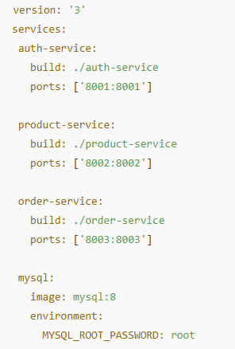
Microservices using Docker Compose
Step 3: Create Each Service as an Independent Project
Each service should contain:
Its own codebase.
Its own Dockerfile (if using Docker).
Its own configuration (port, DB connection, etc.)
Step 4Run Services Locally with Docker Compose (Recommended)
Build a docker-compose.yml file which
Specifies all services + ports
Adds infrastructure (DB, RabbitMQ, Eureka, API-Gateway etc.)
Inside container, services communicate using DNS name http://auth-service:8001
Outside (developer testing), use http://localhost:8001
Run all Services together

Slide 24
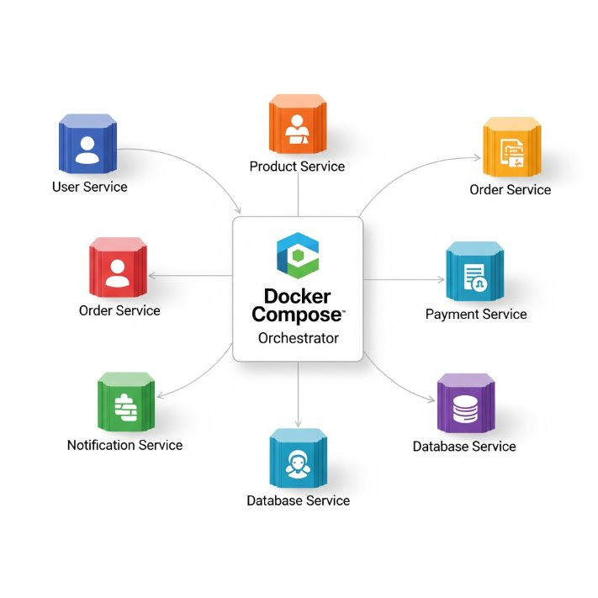
Heading – Subheading 1 (Sub heading 2)

