Slide 1
Household Electricity Analytics
4 years · 1 household · 2,075,259 minutes of power data
Big Data course project — Streamlit dashboard · pandas/Plotly analytics · HDFS/Hive/Spark batch pipeline
Python 3.13 · UCI Individual Household Electric Power Consumption (CC BY 4.0) · November 2026
VINNAKOTA NITHISH KUMAR JOSHI (2300049053)
Dept. of Electronics and Communication Engineering
Guide: K. PRAVALLIKA · Koneru Lakshmaiah Education Foundation (Deemed to be University)

Slide 2
Objectives
What this project set out to demonstrate
Apply the full Big Data lifecycle to a real 2M-row sensor dataset: ingest → validate → clean → analyze → visualize → export
Answer concrete consumption questions: when is power used, how much, and where it goes
Keep the pipeline dataset-agnostic — demonstrated on a second dataset (UCI Online Retail, 541,909 rows)
Express the same analysis in course tooling: HDFS · Hive · Pig · Spark
Guarantee quality with automation: 185 pytest tests + headless UI walk, honest tested-vs-provided reporting
Household Electricity Analytics · Big Data course project
2

Slide 3
Datasets
Both from the UCI Machine Learning Repository — CC BY 4.0
Primary — Individual Household Electric Power Consumption
Secondary — Online Retail
2,075,259 rows × 9 columns · 130 MB ';'-separated text
One reading per minute · 2006-12-16 → 2010-11-26
99.12 % complete · missing values stored as '?'
Global active/reactive power, voltage, current, 3 sub-meters
Citation: Hébrail, Bérard, Temam del Rio — UCI dataset 235
541,909 rows × 8 columns · UK e-commerce 2010–2011
Loads in ≈ 15 s from the bundled .xlsx (openpyxl)
Proves the pipeline is dataset-agnostic: filters, search, stats and charts work on any tabular data
Citation: Chen, Sain, Guo — UCI dataset 352
Household Electricity Analytics · Big Data course project
3

Slide 4
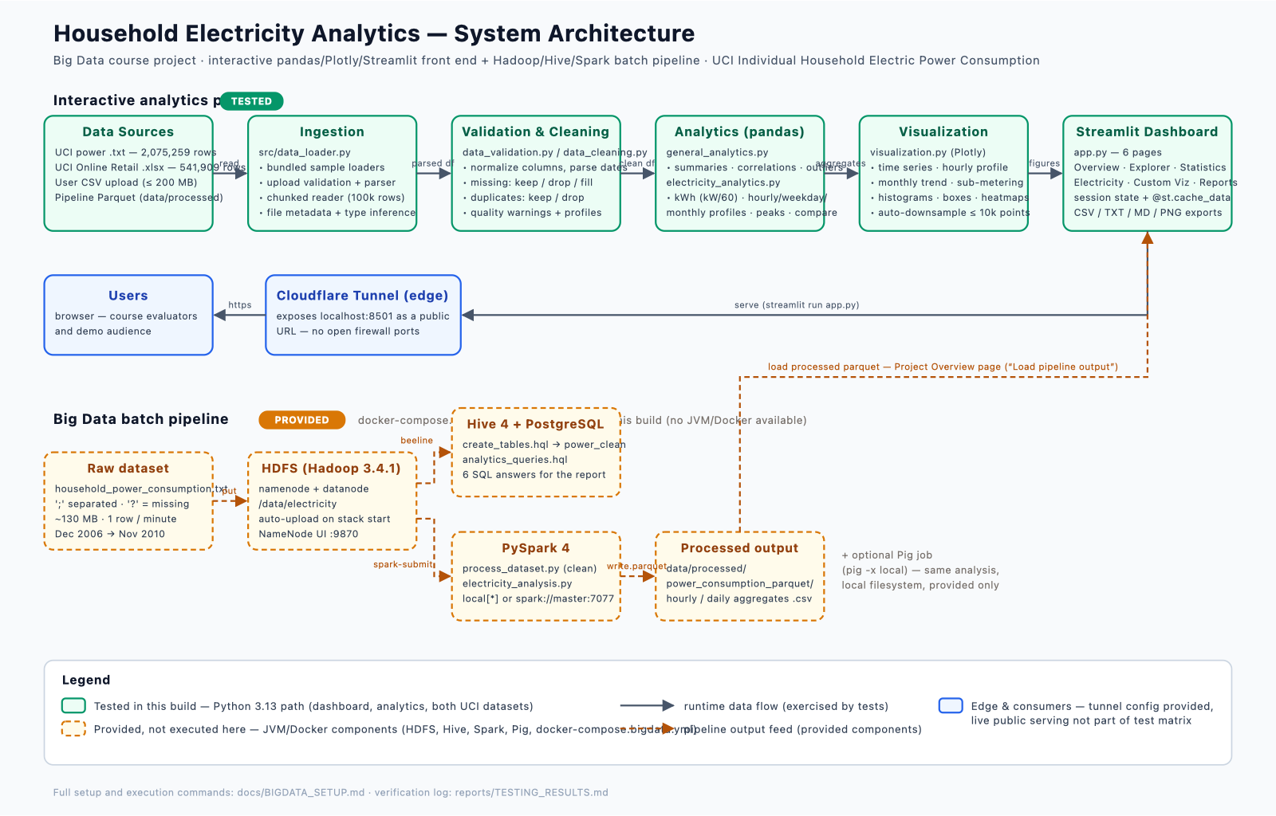
System Architecture
Interactive path (tested) + batch pipeline (provided) + tunnel edge
Household Electricity Analytics · Big Data course project
4

Slide 5
Pipeline & Cleaning Policies
src/ modules — every step explicit and logged
Bundled samples · CSV upload ≤ 200 MB validated · chunked reader (100k rows) · Spark-produced Parquet
1 · Load
Completeness %, memory footprint, column-type inference, quality warnings surfaced on the Overview page
2 · Validate
Missing: keep / drop / fill mean-median-mode · duplicates: keep / drop · every action recorded in a cleaning log
3 · Clean
Documented energy assumption: kWh = kW / 60 (meter writes exactly one row per minute)
4 · Analyze
Plotly charts (≤ 10k points auto-downsampled) · CSV · TXT stats/quality · Markdown report · PNG
5 · Visualize & export
Household Electricity Analytics · Big Data course project
5

Slide 6
Dashboard Tour — 6 Pages
One Streamlit script (app.py), shared session state, cached analytics
📊 Project Overview
🔍 Data Explorer
KPIs, quality warnings, pipeline explainer, Parquet loader
Date/category filters, text search, cleaning controls, 500-row previews
📈 Statistical Analysis
⚡ Electricity Analysis
Numeric summaries, categorical frequencies, correlations, IQR outliers
Trends, hourly/weekday/monthly profiles, sub-metering, peaks, period comparison
🎨 Custom Visualization
📥 Reports & Downloads
Any column pair with recommended chart types
Filtered CSV, stats/quality TXT, consolidated Markdown, chart PNG
Household Electricity Analytics · Big Data course project
6

Slide 7
Key Findings
Computed on the full 2,075,259-row dataset by this project's own code
1.092 kW
37,283.7 kWh
20:00
72.7 %
average active power
total energy over ≈ 4 years
peak hour (1.899 kW avg)
of metered load = climate circuit
Evening-driven usage: 20:00 peak vs 04:00 overnight low (0.444 kW)
Saturday heaviest weekday (1.248 kW avg) · Thursday lightest (0.982 kW)
Winter-dominated: top-3 months = Dec 2007 (1,210 kWh) · Jan 2007 (1,150) · Jan 2008 (1,086)
Largest days: 2006-12-23 (79.6 kWh) · 2007-02-03 · 2006-12-26
Sub-metering shares: climate/heating 72.7 % · laundry 14.6 % · kitchen 12.6 %
Household Electricity Analytics · Big Data course project
7

Slide 8
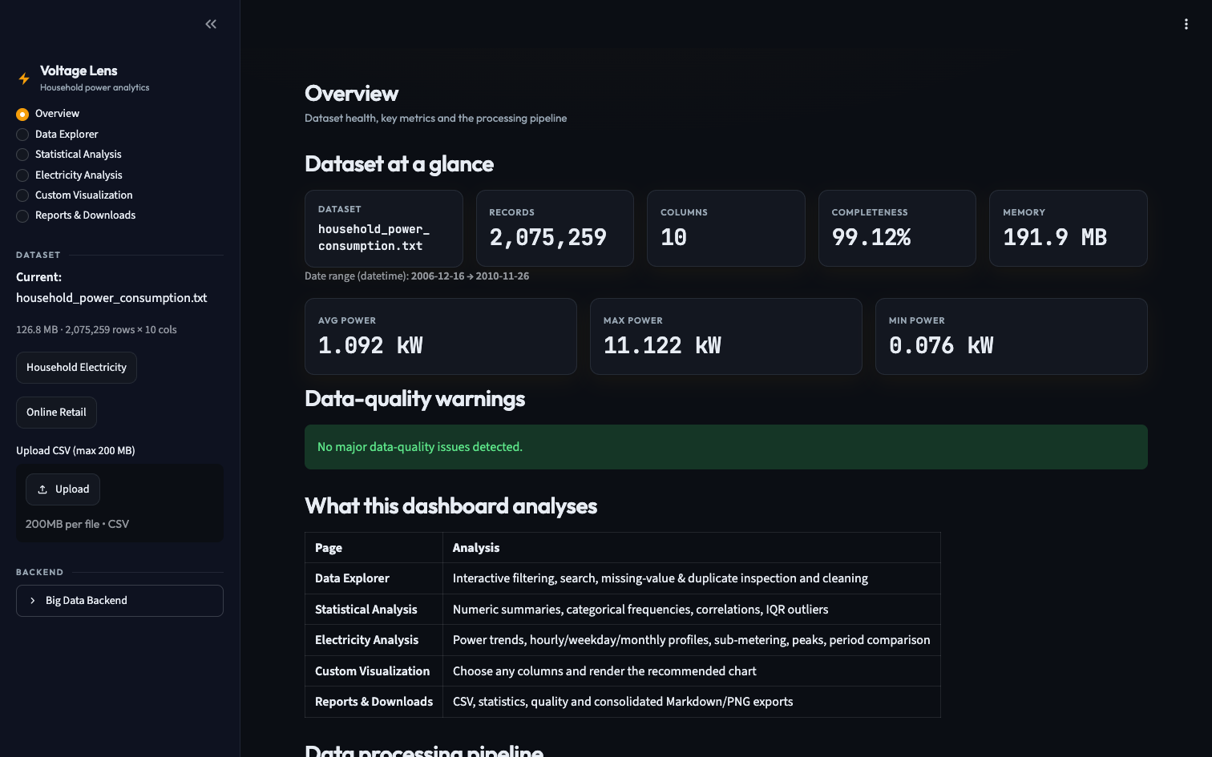
Dashboard Evidence — Overview KPIs
The full sample loads in one click — 2,075,259 rows, 99.12 % complete
▪ Dataset at a glance: 2,075,259 records · 10 columns · 191.9 MB in memory
▪ Power KPIs: avg 1.092 kW · max 11.122 kW · min 0.076 kW
▪ Data-quality panel reports completeness and warnings before any analysis
Household Electricity Analytics · Big Data course project
8

Slide 9
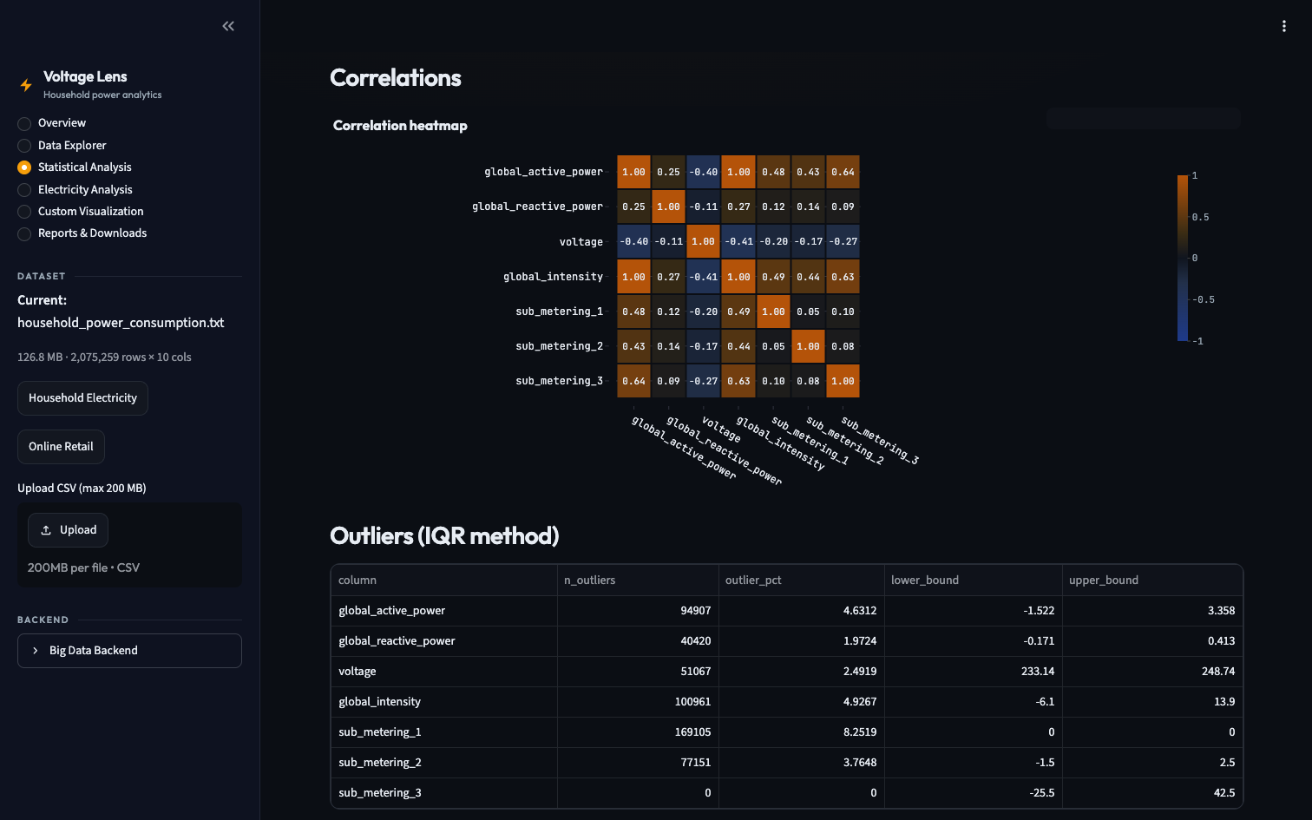
Dashboard Evidence — Correlation Heatmap
Power ≈ current (+0.999) with a load-driven voltage dip (−0.40)
▪ corr(active power, intensity) ≈ +0.9989 — the physics check passes
▪ corr(active power, voltage) ≈ −0.40 — heavier loads pull the supply down
▪ IQR scan below: 94,907 outlier minutes (4.63 %) above the 3.358 kW fence
Household Electricity Analytics · Big Data course project
9

Slide 10
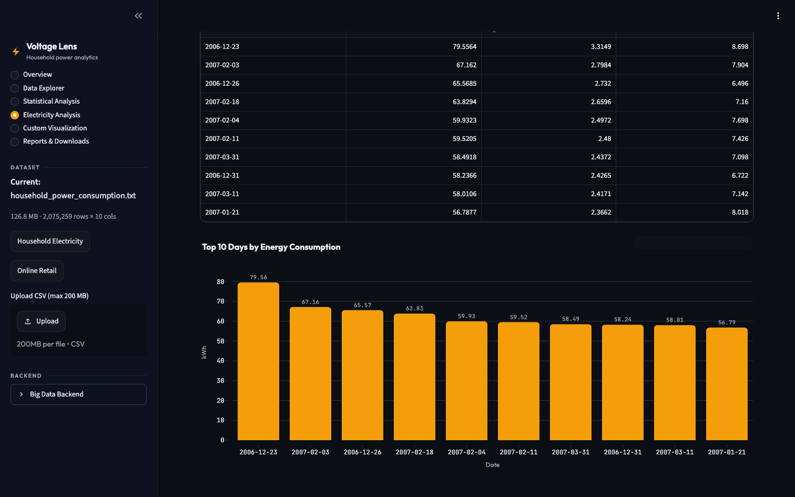
Dashboard Evidence — Peak Days
Every top-consumption day is mid-winter, led by 79.56 kWh on 2006-12-23
▪ Heaviest day: 2006-12-23 — 79.56 kWh at 3.31 kW average, 8.70 kW peak
▪ All top-10 days fall in Dec–Feb — the winter-heating signature
▪ Table and chart render from one cached computation — no drift between views
Household Electricity Analytics · Big Data course project
10

Slide 11
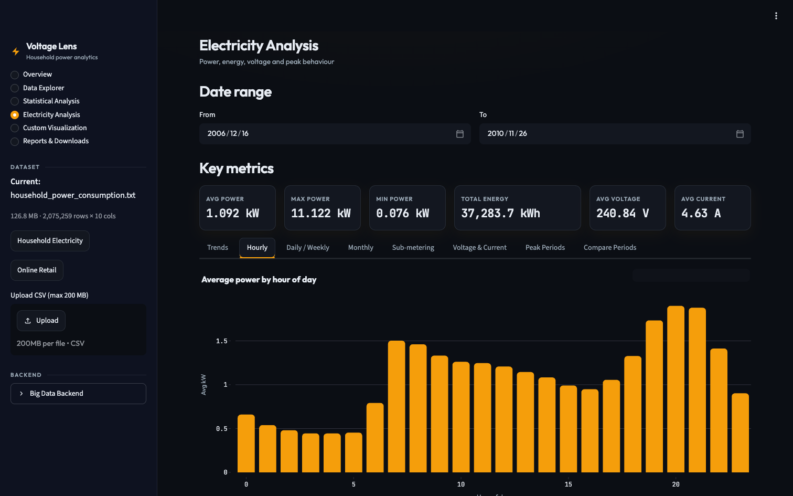
Dashboard Evidence — Hourly Profile
Consumption peaks at 20:00 (1.899 kW) and bottoms out at 04:00 (0.444 kW)
▪ Evening cooking/heating window drives a 4.3× swing across the day
▪ Key metrics row: 37,283.7 kWh total · 240.84 V · 4.63 A — all live
▪ Every bar is a full-dataset group-by, rendered in the page re-run budget
Household Electricity Analytics · Big Data course project
11

Slide 12
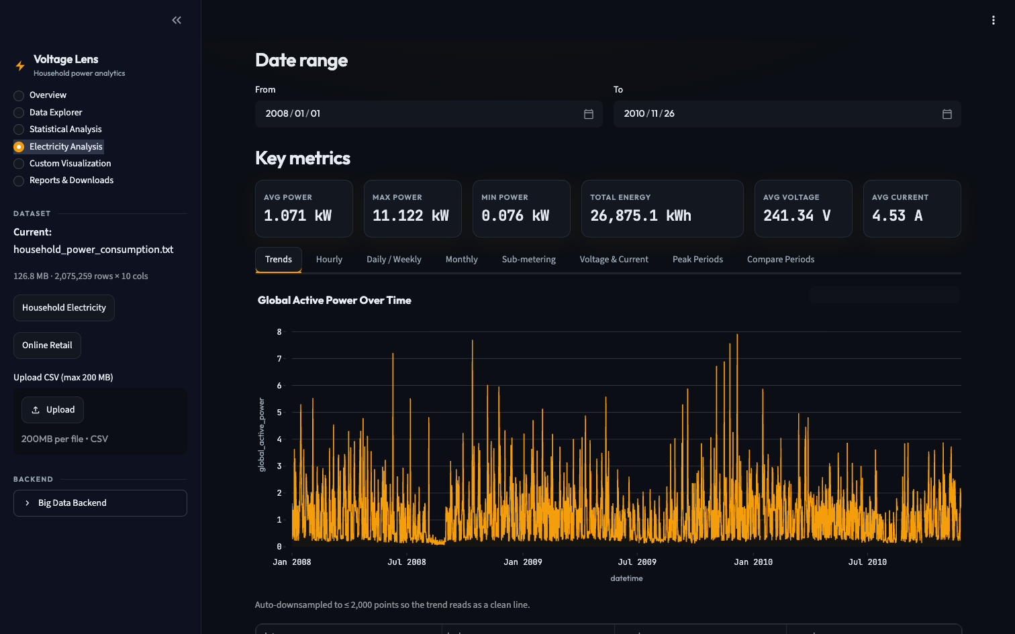
Dashboard Evidence — Live Filtering
A date filter recomputes KPIs live — 26,875.1 kWh for 2008–2010
▪ Filter 2008-01-01 → 2010-11-26: avg 1.071 kW · 241.34 V · 4.53 A
▪ Trend chart redraws auto-downsampled to ≤ 2,000 points
▪ A verified Reset restores the full 2,075,259-row dataset and original range
Household Electricity Analytics · Big Data course project
12

Slide 13
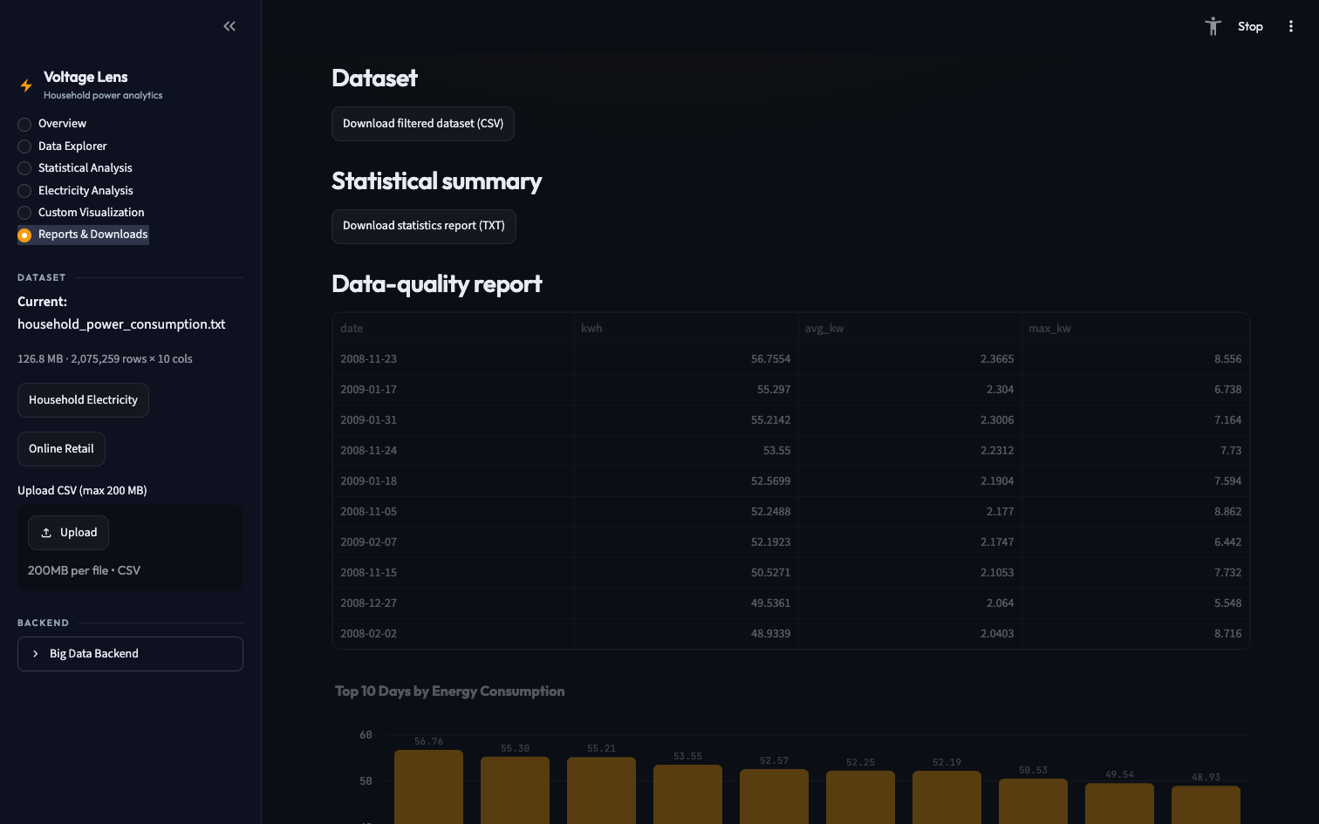
Dashboard Evidence — Reports & Downloads
Filtered CSV, TXT statistics, quality report, Markdown and PNG — one page
▪ Downloads built in memory — nothing is written to server disk
▪ Consolidated Markdown report embeds the top-10 table and chart
▪ PNG export via the optional kaleido engine (verified byte output)
Household Electricity Analytics · Big Data course project
13

Slide 14
Big Data Backend
Scripted end-to-end — honest execution status
Tool
Role in this project
Status
HDFS 3.4.1
raw file stored in /data/electricity, auto-uploaded at stack start
provided — not executed here
Hive 4 + PostgreSQL
external table → typed Parquet power_clean + 6 SQL analytics queries
provided — not executed here
PySpark 4
clean → Parquet + hourly/daily aggregates; profiles/peaks/correlations job
✅ verified — local mode, full dataset (36 s + 10 s; matches pandas)
Apache Pig (optional)
same hourly/daily analysis in Pig Latin, local filesystem
provided — not executed here
Docker Compose
one-command orchestration of the whole stack
provided — not executed here
Design choice: the dashboard consumes only flat Parquet/CSV outputs → the interactive path works without a cluster.
Household Electricity Analytics · Big Data course project
14

Slide 15
Testing & Verification
Full matrix in reports/TESTING_RESULTS.md — every number reproducible
pytest
185 passed, 0 failed (1.22 s) — all 7 src modules + integration test
Headless AppTest walk
all 6 pages rendered with the real 2.07M-row sample · 0 exceptions · 0 error blocks
Live server boot
streamlit run + health endpoint → HTTP 200
Dataset loads
electricity raw read ≈ 0.4 s · full analytics chain ≈ 3.8 s · retail .xlsx ≈ 15 s
JVM/Docker components
HDFS · Hive · Pig not executed here (provided scripts, rerun via docs/BIGDATA_SETUP.md); Spark verified in local mode — 36 s + 10 s on the full 2.07M rows, aggregates match pandas exactly
Household Electricity Analytics · Big Data course project
15

Slide 16
Live Demo Plan
8 steps — the exact evaluation walkthrough
1
Open the app — streamlit run app.py
2
Load the electricity sample (2,075,259 rows)
3
Show the processing pipeline on the Overview page
4
Statistical Analysis — summaries, correlations, outliers
5
Graphs & peaks — 20:00 hourly peak, top-10 days, sub-metering
6
Filter in the Data Explorer — date range + cleaning strategies
7
Download filtered CSV + consolidated Markdown report
8
Explain the backend — HDFS → Hive/Spark → Parquet → dashboard
Household Electricity Analytics · Big Data course project
16

Slide 17
Conclusions
End-to-end Big Data product: 2.07M messy rows → reproducible insight in seconds
Measured story: ~1.1 kW continuous draw · evenings + weekends + winter · ¾ of metered load is the climate circuit
Engineering quality: cached analytics, bounded rendering, 185 green tests
Distributed layer fully scripted; provided-vs-tested status documented honestly
Everything reproducible: README.md · docs/BIGDATA_SETUP.md · reports/TESTING_RESULTS.md
References — UCI ML Repository datasets 235 & 352 (CC BY 4.0) · Apache Hadoop/Hive/Spark/Pig documentation · Streamlit, Plotly & pandas documentation · Full citations: reports/ATTRIBUTION.md
Household Electricity Analytics · Big Data course project
17

