Slide 1
NITHISHKUMAR MV
Final Project
01/04/2024 Annual Review

Slide 2
Generative Adversarial Network (GAN) for Handwritten Digit Generation
Create a Generative Adversarial Network (GAN) that can produce images of handwritten digits similar to those found in the MNIST dataset.
01/04/2024 Annual Review

Slide 3


AGENDA
Problem Statement
Project Overview
End Users
Solution and Value Proposition
Unique Aspects of the Solution
Modelling
Results
01/04/2024 Annual Review

Slide 4

PROBLEM STATEMENT
The aim of the is to produce handwritten digits like those present in MNIST dataset using Generative Adversarial Network(GAN). MNIST comprises 28x28 grayscale images of handwritten digits ranging from 0 to 9.
01/04/2024 Annual Review

Slide 5

PROJECT OVERVIEW
Acquiring data, designing the model, training, evaluating, and deploying are some of the major processes in the project. To construct and train the GAN architecture, it makes use of deep learning frameworks like TensorFlow and Keras. The project also places a strong emphasis on optimisation and experimentation to produce the best outcomes.
01/04/2024 Annual Review

Slide 6

WHO ARE THE END USERS?
Researchers and developers who are studying GANs, image generation, or handwriting recognition.
Educators who teach deep learning, GANs, or image generation can use the tool.
Developers or engineers working on applications that require handwritten digits, such as optical character recognition (OCR).
01/04/2024 Annual Review

Slide 7

SOLUTION AND ITS VALUE PROPOSITION
Using TensorFlow/Keras, create a GAN architecture with a discriminator network and a generator.
Construct a neural network that has several layers of activation layers (such as ReLU and Tanh) and fully connected (Dense) layers.
Make modifications to the layer sizes, depth of the network, and normalisation methods.
Create a neural network with a binary classification output that shares architectural decisions with the generator.
Use activation functions to create probability scores and introduce non-linearity, such as Sigmoid and Leaky ReLU.
01/04/2024 Annual Review

Slide 8

THE WOW IN SOLUTION
Innovative Network Architectures: Exploring varied architectural designs for both the generator and discriminator networks to ensure the creation of realistic and diverse digit images.
Performance Optimization: Conducting thorough experimentation and hyperparameter tuning to maximize the GAN model's performance, resulting in improved image quality and stability.
01/04/2024 Annual Review
‹#›

Slide 9
MODELLING
Generator Network Design: Design the architecture of the generator network, experimenting with various layer sizes, depths, and activation functions like ReLU and Tanh to generate realistic digit images.
Discriminator Network Design: Develop the discriminator network architecture, exploring different layer configurations and activation functions such as Sigmoid and Leaky ReLU to distinguish between real and generated images.
Hyperparameter Tuning: Conduct extensive experimentation and hyperparameter tuning to optimize the GAN model's performance, focusing on parameters like learning rate, batch size, and network depth.
Training: Train the GAN model on the MNIST dataset, iteratively updating the generator and discriminator networks to enhance image generation quality and stability.
Evaluation: Evaluate the trained GAN model's performance by analyzing generated digit images and assessing their realism and diversity.
01/04/2024 Annual Review
‹#›

Slide 10
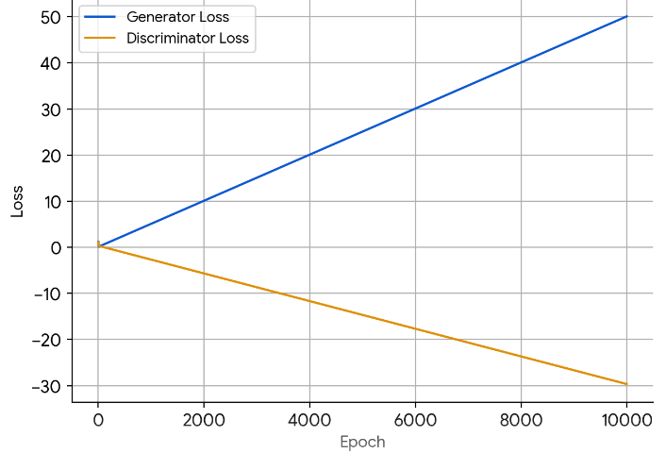
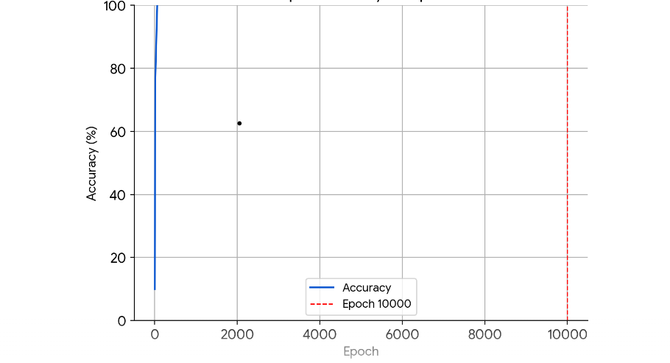
RESULTS
01/04/2024 Annual Review
‹#›

Slide 11
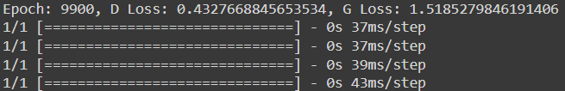
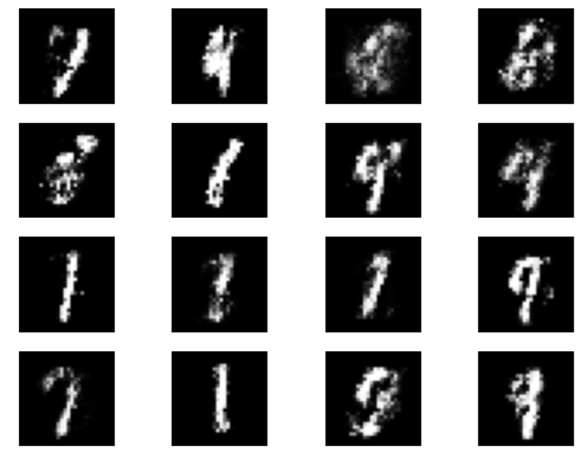
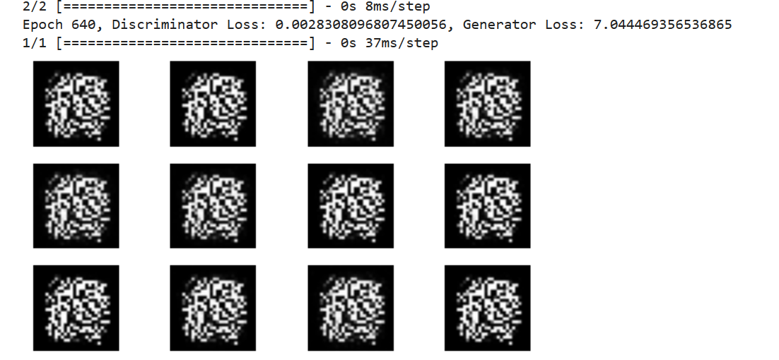
RESULTS
Demo Link
01/04/2024 Annual Review
‹#›

Slide 12
CONCLUSION
In summary, our Generative Adversarial Network (GAN) has shown remarkable progress in generating lifelike handwritten digit images akin to the MNIST dataset. By exploring diverse network architectures and fine-tuning parameters, we've achieved superior image quality and stability. The detailed documentation ensures easy deployment and accessibility, promising broader applications in image generation and beyond.
01/04/2024 Annual Review
‹#›

Slide 13
REFERENCES
https://www.tensorflow.org/
https://keras.io/
https://numpy.org/
https://matplotlib.org/
scikit-learn: machine learning in Python — scikit-learn 1.4.1 documentation
MNIST handwritten digit database, Yann LeCun, Corinna Cortes and Chris Burges
https://www.techtarget.com/searchenterpriseai/definition/generative-adversarial-network-GAN
01/04/2024 Annual Review
‹#›

