Slide 1

Your Company’s Intelligent Meetup Organizer!

Slide 2
Remote collaboration pain-points

Slide 3
Live demo

Slide 4
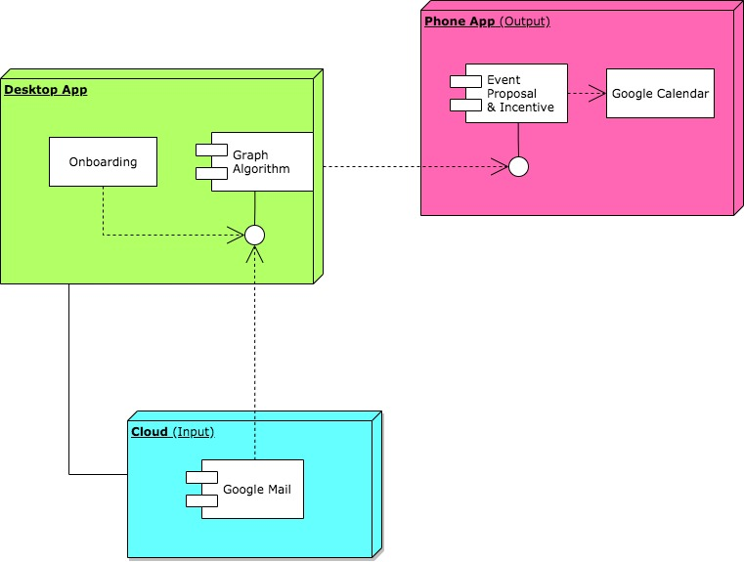
The Architecture!

Slide 5
BUILD INFO
Django
APIs

Slide 6

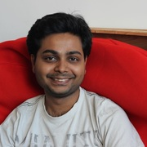


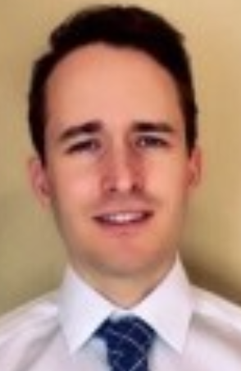
Team INCLUDOO
Jiayao
Yu
Nithish
Raghunandanan
Marcel
Engelmann
Tim
Weiland
Jeremy
Huffman
UX/UI,
Data
Engineering
ML,
Software Development
UX,
Frontend Development
Backend, Frontend,
Mobile
Hardware,
Electronics

