Slide 1
Vision Creator
Noisy Document Image → OCR → Adaptive Huffman Compression
Two-stage microservice pipeline · 99.1% OCR accuracy · 100% lossless · <4 ms end-to-end
99.10%
3.55 ms
0 / 100
OCR Accuracy
End-to-end p50
Lossless Fails

Slide 2
What Makes This Innovative
Not one component — the composition and specific design choices
DENOISER DESIGN
TRAINING STRATEGY
Median + DnCNN Cascade
Blind Denoising via Random σ
Median filter kills S&P noise in microseconds (no gradient, no inference), leaving DnCNN to focus purely on Gaussian residual. Division of labour — not redundancy — is what achieves +8.4 dB PSNR with sub-millisecond denoiser latency.
DnCNN trains with σ sampled from U[5,55]/255 per image — 3M unique noisy pairs from 60k images across 50 epochs. The model generalises to unseen noise levels without a separate model per profile.
COMPRESSION ALGORITHM
ENGINEERING DETAIL
Adaptive Huffman (FGK) — Streaming
The compressed_bits Field
Standard Huffman requires a full pre-pass before it can start encoding — a hard latency floor. FGK builds the tree character-by-character, enabling compression to begin before the full string is ready. Real streaming capability.
Most Huffman implementations silently corrupt on bitstreams not divisible by 8. Encoding the exact bit count alongside the hex payload tells the decoder where real bits end and zero-padding begins — what makes decompression provably lossless.

Slide 3
Real-World Usefulness
Where this architecture solves genuine problems — and where it stops
🏥
Edge Document Digitisation
Honest Limits
Hospitals, government offices, logistics — scanning paper forms in real time. <4 ms/image means thousands of documents/second. GPU-intensive OCR scales independently from CPU-only compression.
⚠ MNIST ≠ Real Documents
Digits only, balanced classes, clean backgrounds. Production needs full alphabets, mixed fonts, skew, multi-column layouts — substantially harder. Accuracy numbers here don't transfer directly.
📡
Bandwidth-Constrained Transmission
OCR'd text from remote field devices (rural healthcare IoT, warehouse scanners) compressed before transmission over metered links. ~1.7× ratio with sub-millisecond latency, no zlib licensing.
⚠ Synthetic Noise ≠ Real Scanner Noise
📚
Historical Document Archival
Gaussian and salt-and-pepper are idealised models. Actual degradation includes ink bleed, coffee stains, scanner artefacts, and paper texture — DnCNN would need domain fine-tuning.
Libraries digitising degraded or stained records. +8.4 dB PSNR recovery can turn a 90% baseline accuracy into >99% on documents where naive OCR fails entirely — old census records, wartime correspondence.
🔒
⚠ Compression Breaks on Short Output
On-Device Privacy-Preserving OCR
For single-character OCR output, the FGK compressed form is larger than the raw input. Tree state overhead dominates until strings are ~10+ characters long.
OCRNet (1.7 MB) + DnCNN (2.2 MB) run entirely locally — no raw image leaves the device. Critical for legal, medical, or any privacy-sensitive content.
Verdict: Well-engineered proof of concept with a real architectural idea — needs domain adaptation and full character set to deploy on production documents.

Slide 4
Pipeline Architecture
Two decoupled FastAPI microservices connected over HTTP
Stage 1 — OCR Microservice
Stage 2 — Compression Microservice
port 8000
port 8001
Median Filter
FGK Adaptive Huffman
Kills salt-and-pepper spikes (3×3 kernel, PIL space)
No zlib/gzip — pure Python, zero stdlib compression
▶
DnCNN
POST /compress
17-layer residual net · predicts & subtracts noise map
HTTP
Returns hex bitstream + ratio + entropy + efficiency
OCRNet CNN
POST /decompress
Conv(32)→BN→Pool → Conv(64)→BN→Pool → FC(128)→FC(10)
Requires compressed_bits to strip padding · 100% lossless

Slide 5
OCR Accuracy Results
10,000 validation images per noise profile · Device: CUDA · Gate: ≥95%
Per-Digit Accuracy
Digit | Clean | S&P | Gauss
0 | 99.7% | 99.6% | 99.7%
1 | 99.7% | 100.0% | 99.8%
2 | 99.7% | 99.3% | 99.5%
3 | 99.6% | 99.6% | 99.6%
4 | 99.4% | 99.2% | 99.0%
5 | 99.4% | 98.9% | 99.2%
6 | 98.7% | 98.7% | 98.9%
7 | 99.2% | 98.8% | 98.6%
8 | 99.7% | 99.1% | 99.8%
9 | 99.1% | 98.3% | 98.5%
Gate: 95% ──────────────────
✓ All profiles cleared the 95% gate — Clean: 99.44% S&P: 99.17% Gaussian: 99.27%

Slide 6
OCR Service Latency Benchmark
100 sequential requests · 28×28 synthetic digit PNG · Hardware: GPU (CUDA)
POST /ocr — Server total_ms
Denoiser (Median + DnCNN)
Client Round-Trip (RTT)
End-to-end inside the server
Inside server total_ms
Full HTTP request latency
Mean
1.14 ms
Mean
0.72 ms
Mean
1.97 ms
Median
1.13 ms
Median
0.72 ms
Median
1.93 ms
P95
1.16 ms
P95
0.73 ms
P95
2.07 ms
P99
1.20 ms
P99
0.76 ms
P99
2.26 ms
Min
1.12 ms
Min
0.70 ms
Min
1.92 ms
Max
2.06 ms
Max
1.35 ms
Max
3.32 ms
Batch (8 imgs/req) — mean per image: 1.07 ms p95: 1.11 ms p99: 1.16 ms batch total mean: 8.55 ms

Slide 7
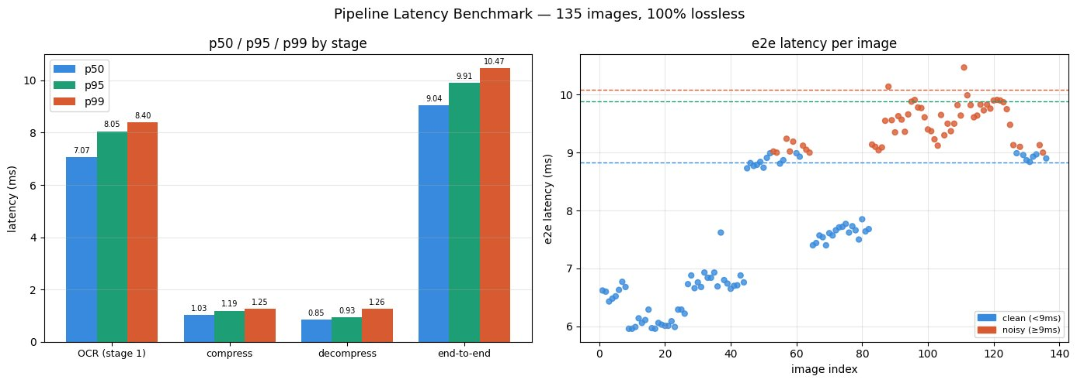
End-to-End Pipeline Benchmark
135 images · 100% lossless · p50/p95/p99 per stage + per-image e2e scatter
7.07 ms
1.03 ms
9.04 ms
10.47 ms
OCR p50
Compress p50
E2E p50
E2E p99

Slide 8
Denoising Pipeline: Median + DnCNN
Two-stage denoiser runs before OCRNet — classical then learned
PSNR Improvement
DnCNN Architecture (17 layers)
Layer 1
Conv(1→64, 3×3) + ReLU
No BN — preserves pixel signal
Layers 2–16
Conv(64→64, 3×3) + BN + ReLU
15 residual middle layers
Layer 17
Conv(64→1, 3×3)
Outputs noise residual map
Output
clamp(input − residual, 0, 1)
Residual subtraction
Loss
MSE(denoised, clean_target)
Blind denoising: σ ~ U[5,55]/255
Init
Orthogonal weights + const BN
Prevents gradient collapse
← Gate: 28 dB
Receptive
1 + 16×2 = 33 pixels
Justifies depth of 17 layers

Slide 9
Stage 2: Adaptive Huffman Compression
FGK algorithm · pure Python · zero zlib/gzip/bz2 dependencies
How FGK Works
Compression Metrics (Sample Inputs)
Initialise
Input | Ratio | Entropy | Efficiency
aaaa | 3.20× | 0.000 | 1.000
abcd | 1.14× | 2.000 | 0.870
mississippi | 1.69× | 2.845 | 0.912
hello world | 1.52× | 3.096 | 0.885
quick brown fox | 1.49× | 4.087 | 0.910
1
Start with a single NYT (Not Yet Transmitted) node
2
New symbol
Split NYT into new leaf + new NYT; emit 8-bit raw code
3
Known symbol
Walk tree from root to leaf; emit path bits
4
Update tree
Increment freq → swap siblings to maintain sibling property
5
Decode mirror
Decoder runs same FGK algorithm in parallel — no pre-pass
✓ assert decompress(compress(text)) == text — 0/100 lossless failures

Slide 10
Results Summary
OCR Accuracy Gate
99.44% / 99.17% / 99.27%
Clean / Salt-and-Pepper / Gaussian — all cleared 95%
End-to-End Latency (100-run bench)
p50: 3.55 ms · p99: 5.54 ms
Stage 1: 2.28 ms · Compress: 0.65 ms · Decompress: 0.62 ms
Lossless Decompression
0 failures in 100 runs
compressed_bits field strips zero-padding; FGK decode mirrors encoder exactly
Denoiser PSNR Gain
+8.4 dB (21.4 → 29.8 dB)
Median: +6.5 dB · DnCNN on top: +1.9 dB · Gate: 28 dB ✓

Slide 11
Thank You
LLMS were used to give slide templates and content were made by the presenter

