Slide 1

Using Existing CCTV Network For Crowd Management, Crime Prevention And Work Monitoring Using AI and ML
PROBLEM STATEMENT : SIH1349
TEAM NAME : TECH TITANS
TEAM LEADER NAME : B LAKSHMI BHAVANI

Slide 2

CHALLENGES FACED BY INDIAN RAILWAY
Crowd management
Crime Prevention
work monitoring
cleanliness

Slide 3
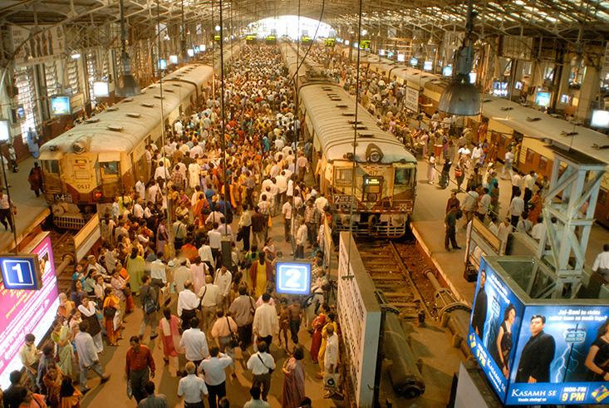
02
01
CROWD MANAGEMENT
It is one of the biggest challenges faced by Indian Railways which leads lo delays amd discomfort for passengers
To address this , we are implementing an AI algorithms that analyze real time data from CCTV cameras
These cameras can help to predict peak crowd times and allocate staff and resources accordingly

Slide 4

02
CRIME PREVENTION
Crime prevention is also a crucial concern
By utilizing AI powered CCTV Systems capable of identifying suspicious behaviour or objects .
These AI systems sends immediate alerts to security personnel when it detects something suspicious
This enhances the decrease in the crime rate and passenger saftey

Slide 5

03
Work monitoring
Efficient work monitoring is another key aspect.
Maintainance workers missing critical tasks this leads to inefficenit tracking system.
This will impact the over all saftey and reliability of the railway network.
Equipping them with IOT devices that track the workers task and provide real time progress updates .This ensures that maintainance activities are completed efficiently.

Slide 6

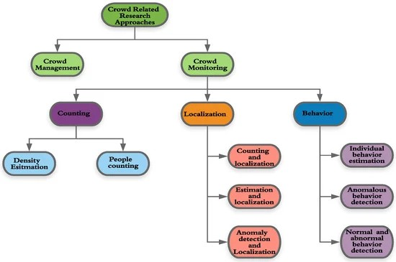
IDEA AND APPROACH

Slide 7

DETECTING THROUGH CCTV FOOTAGE

Slide 8

FIRMWARE
It is a software program on a harware device which performs the functions given in input/output
Here the permanent software is programmed into a read-only memory.(i.e ROM)

Slide 9
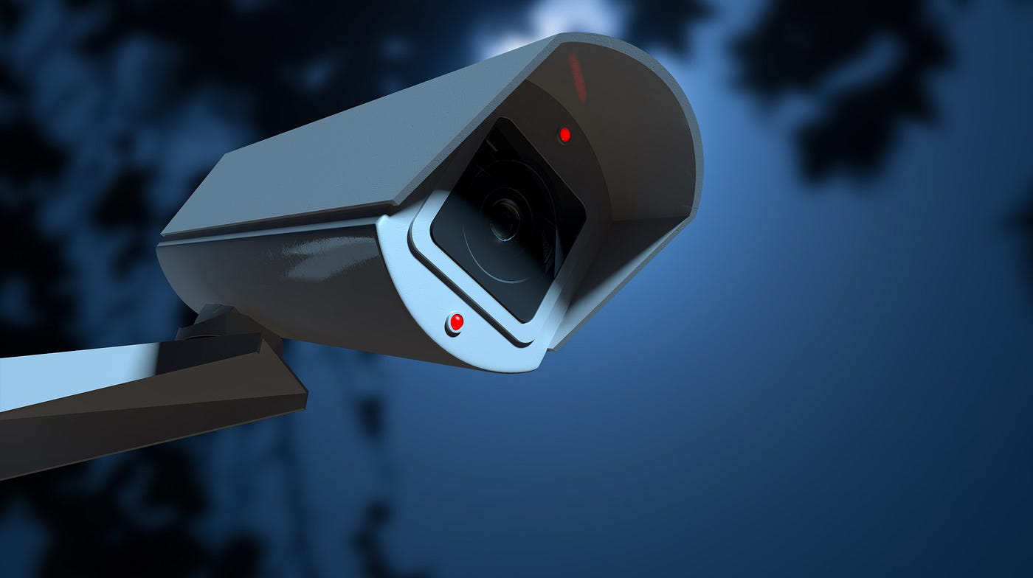
To update the firmware of a CCTV camera, you need to follow below steps:
Check your camera’s menu to see if there is a new firmware update.
Format a memory card.
Download the firmware update as a zip file.
Copy the downloaded firmware over to the memory card.
Insert the firmware-loaded memory card into the camera.

Slide 10

THANK YOU

