Slide 1
Design and Analysis of Algorithms
-Introduction

Slide 2
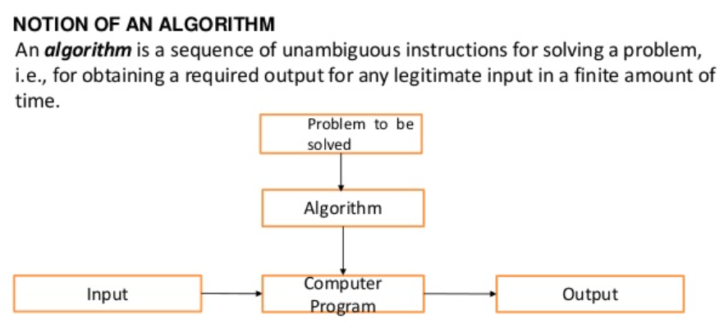
Introduction to Algorithm

Slide 3
Goals of Algorithm Study
To develop framework for instructing computer to perform tasks
To introduce notion of algorithm as means of specifying how to solve a problem
To introduce and appreciate approaches for defining and solving very complex tasks in terms of simpler tasks;

Slide 4
Algorithm - Definition
An algorithm for solving a problem
“a finite sequence of unambiguous, executable steps or instructions, which, if followed would ultimately terminate and give the solution of the problem”.
Note the keywords:
Finite set of steps;
Unambiguous;
Executable;
Terminates;

Slide 5
Algorithm/Pseudocode – find the max in an array
Algorithm
Set the temporary maximum equal to the first integer in the sequence.
Compare the next integer in the sequence to the temporary maximum, and set the larger one to be temporary maximum.
Repeat the previous step if there are more integers in the sequence.
Stop when there are no integers left in the sequence. The temporary maximum at this point is the maximum in the sequence.
Instead of using a particular computer language, we use a form of pseudocode.

Slide 6
Algorithm - Example
Problem: What is the largest integer?
INPUT: All the integers { … -2, -1, 0, 1, 2, … }
OUTPUT: The largest integer
Algorithm:
Arrange all the integers in a list in decreasing order;
MAX = first number in the list;
Print out MAX;
WHY is the above NOT an Algorithm?
(Hint: How many integers are there?)

Slide 7
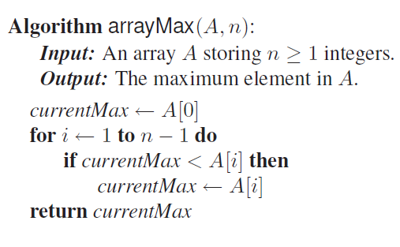
Example - ArrayMax

Slide 8
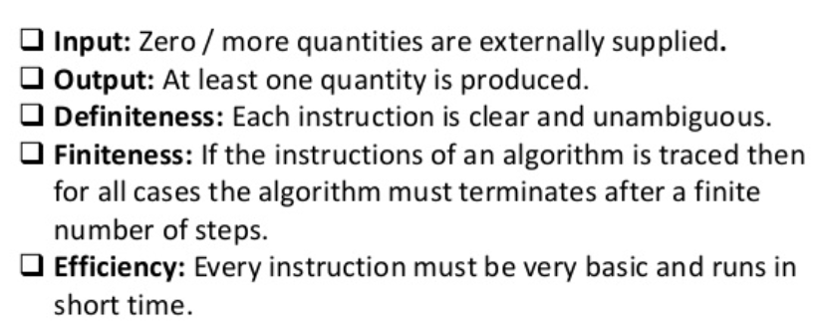
Characteristics of an Algorithm

Slide 9
Fundamentals of Algorithmic Problem Solving
Understand the problem
Design an algorithm and proper data structures
Analyze the algorithm
Code the algorithm

Slide 10
Important Problem Types
Sorting
Searching
String processing (e.g. string matching)
Graph problems (e.g. graph coloring problem)
Combinatorial problems (e.g. maximizes a cost)
Geometric problems (e.g. convex hull problem)
Numerical problems (e.g. solving equations )

Slide 11
Some Algorithm Types
Algorithm types include:
Simple recursive algorithms
Brute force algorithms
Divide and conquer algorithms
Greedy algorithms
Dynamic programming algorithms
Backtracking algorithms
Branch and bound algorithms
Randomized algorithms

Slide 12
Types of Algorithm Analysis
Time complexity: the time required to solve a problem of a specified size
The time complexity is expressed in terms of the number of operations used by the algorithm.
Space complexity: the computer memory required to solve a problem of a specified size.
Analysis Types
Worst case analysis: the largest number of operations needed to solve the given problem using this algorithm.
Average case analysis: the average number of operations used to solve the problem over all inputs.
Best case analysis: the minimum number of operations used to solve the problem over all inputs.

Slide 13
Fundamentals of the Analysis of the Algorithm
Implementation and Empirical Analysis
Challenge in empirical analysis:
Develop a correct and complete implementation.
Determine the nature of the input data and other factors influencing on the experiment. Typically, There are three choices: actual data, random data, or perverse data.
Compare implementations independent to programmers, machines, compilers, or other related systems.
Consider performance characteristics of algorithms, especially for those whose running time is big.
Can we analyze algorithms that haven’t run yet?

Slide 14
Empirical Algorithm Analysis
Results of an experimental study on the running time of an algorithm.
A dot with coordinates (n, t) indicates that on an input of size n, the running time of the algorithm is t milliseconds (ms).

Slide 15
Random Access Machine Model (RAM)
Experimental analysis is valuable, but it has its limitations
To analyze a particular algorithm without performing experiments on its running time, we can use RAM model
A set of high-level primitive operations that are largely independent from the programming language used can be identified and analyzed
Primitive operations include the following:
Assigning a value to a variable
Calling a method
Performing an arithmetic operation (for example, adding two numbers)
Comparing two numbers
Indexing into an array
Following an object reference
Returning from a method.

Slide 16
Example - ArrayMax
1+1
1 (init)+ [1(cond)+ 1(if-check)+1(array)+1(array)+1(assign)+2 (incr+assign)] (n-1) + 1(false cond) + 1(return)
T(n)=7(n-1)+5 = 7n-2 => worst case
T(n)=5n => best case
This is called recurrence equation

Slide 17
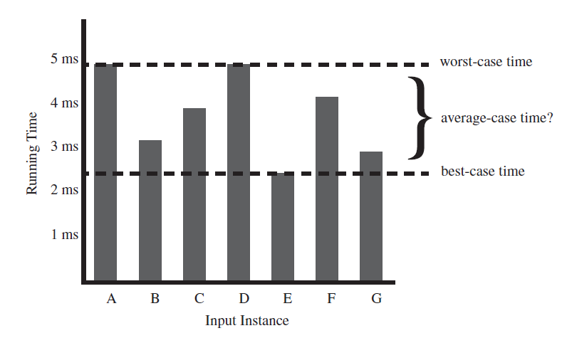
Best case and Worst case

Slide 18
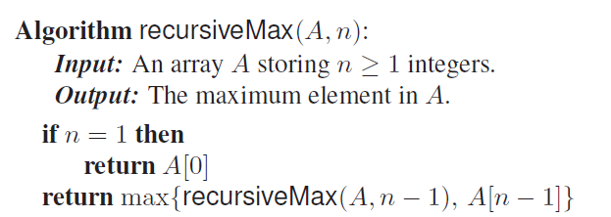
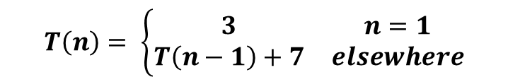
Analyzing Recursive algorithms
1
1 + 1
1+1+1+1+1+1
$$T\left(n\right)= \left\{\begin{matrix}3 & n=1 \\ T\left(n−1\right)+7 & elsewhere\end{matrix}\right.$$
This is called recurrence relation

Slide 19
Try Yourself!!
Write a Pseudocode to find the sum of first N natural numbers. Using the RAM model, find the recurrence equation
Write a Pseudocode/Algorithm to find the factorial of a given number.
For the above examples, try the recursive procedure too..
Try to find the above examples for varying ‘n’s values and plot it using python plot function

Slide 20
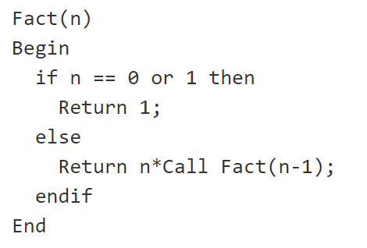
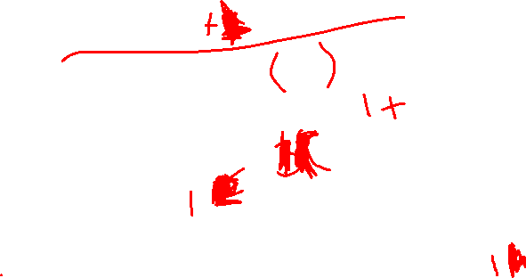
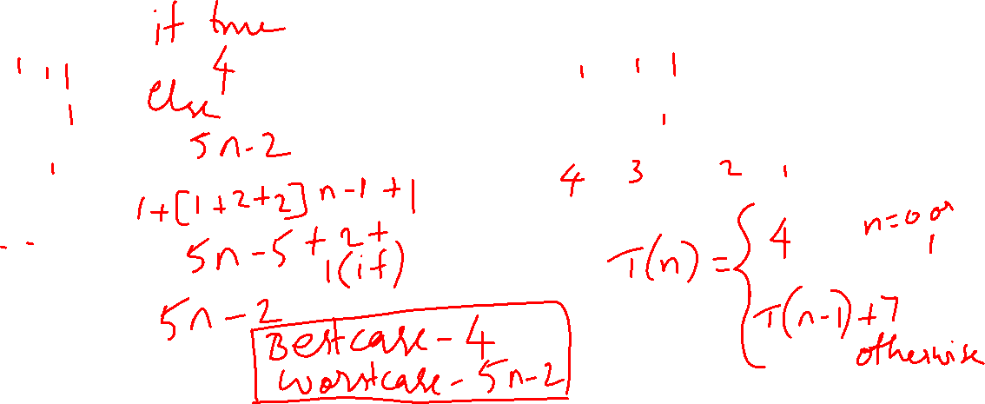
Example – factorial of a number
Iterative version
Recursive version
Fact(n)
Begin
if n==0 or 1 then
return 1
else
f=1
for i in 2 to n do
f=f*I
end for
end if
End

Slide 21
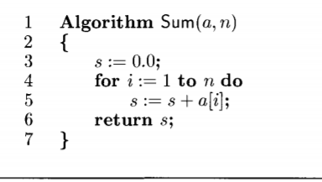
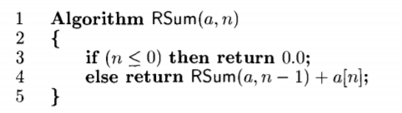
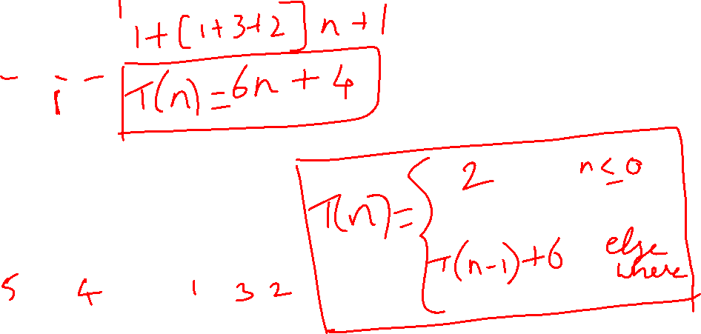
Few examples

Slide 22
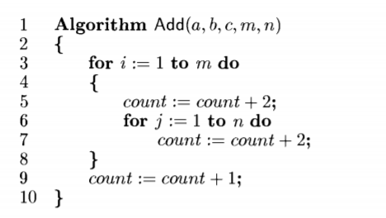
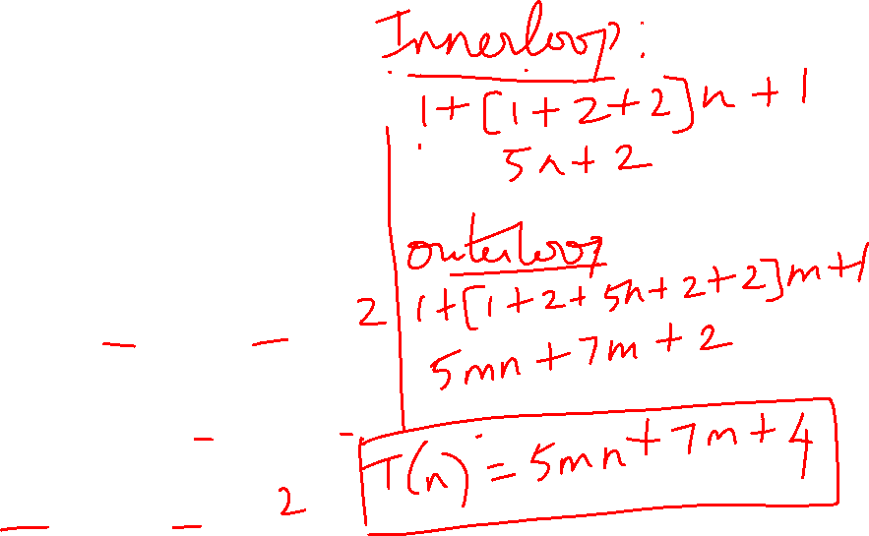
Few examples

Slide 23
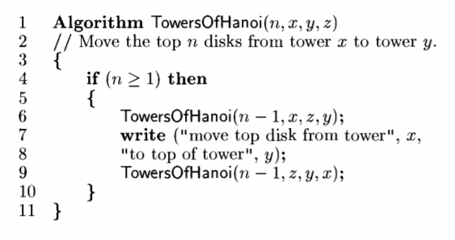
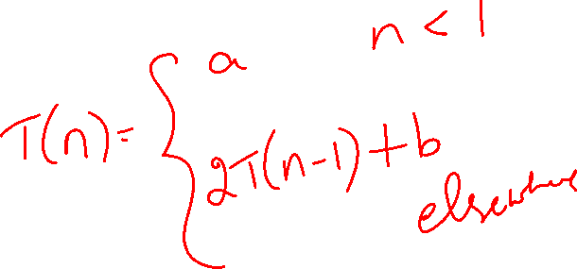
Generic Notations - Examples

Slide 24
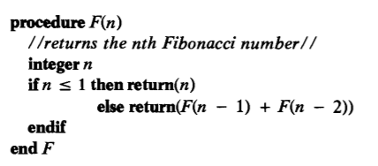
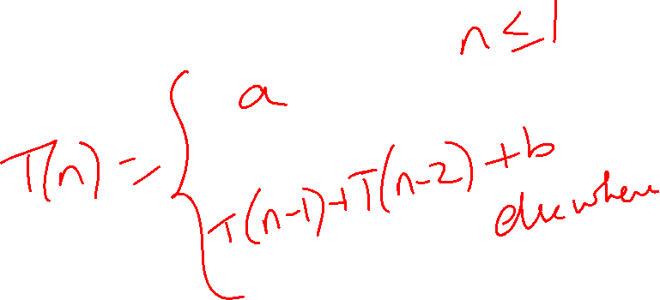
Generic Notations - Examples

Slide 25
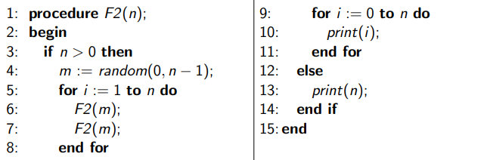

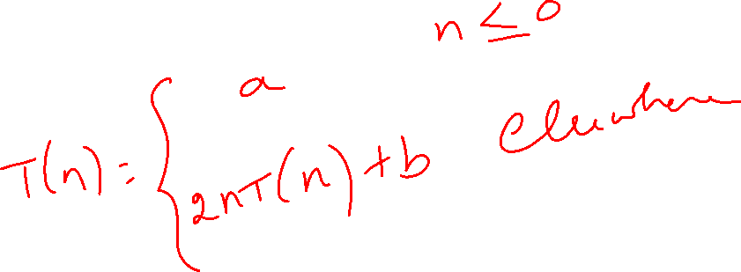
Generic Notations - Examples

Slide 26
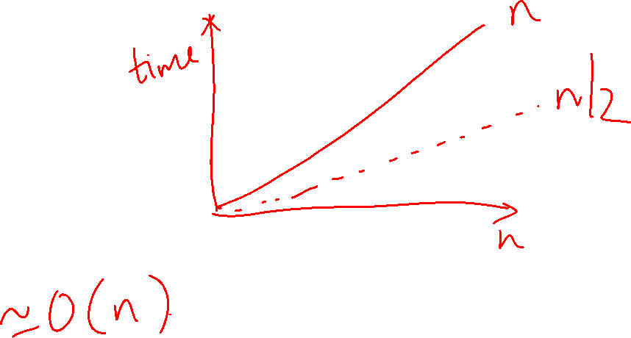
Algorithm Efficiency
Linear Loops
for (i = 0; i < 1000; i++)
application code
T (n) = n
for (i = 0; i < 1000; i += 2)
application code
T (n) = n / 2
If you were to plot either of these loop examples, you would get a straight line. For that reason they are known as linear loops.

Slide 27
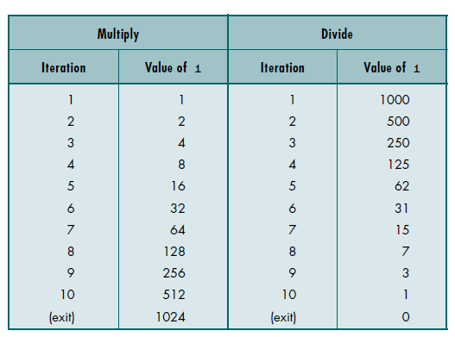
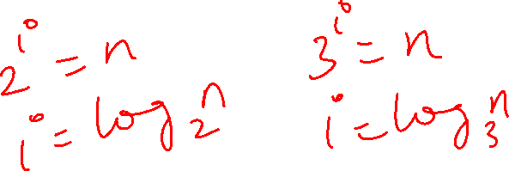
Algorithm Efficiency
Logarithmic Loops
Multiply Loops
for ( i=1; i<1000; i*=2)
application code
Divide Loops
for ( i=1000; i>0; i/=2)
application code
T (n) = logn

Slide 28

Algorithm Efficiency
Linear Logarithmic
T (n) = 10log10
T (n) = nlogn

Slide 29



Algorithm Efficiency
Quadratic
Dependent Quadratic
T (n) = n²
1 + 2 + 3 + … + 9 + 10 = 55
T (n) = n²

Slide 30
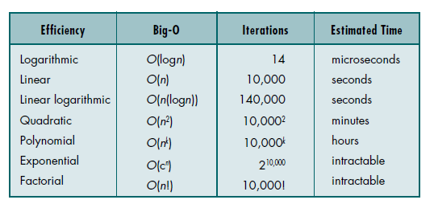
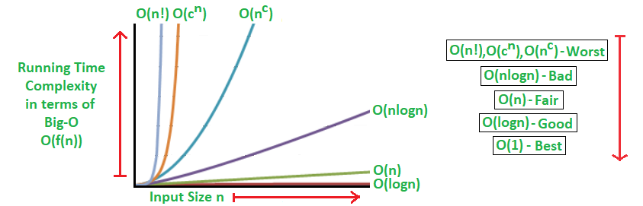
Algorithm Efficiency – Overall comparison
Assuming n=10000

Slide 31
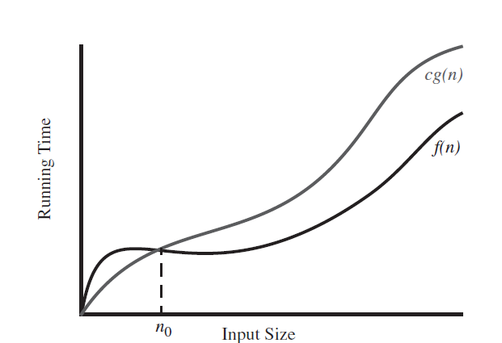
Asymptotic Notations - The “Big-Oh” Notation
Let f(n) and g(n) be functions mapping nonnegative integers to real numbers. We say that f(n) is O(g(n)) if there is a real constant c > 0 and an integer constant n₀ ≥ 1 such that f(n) ≤ cg(n) for every integer n ≥ n₀.
This definition is often pronounced as “f(n) is big-Oh of g(n)” or “f(n) is order g(n).”
Example: 7n − 2 is O(n).

Slide 32
Examples
Example 1: 7n − 2 is O(n)
We need a real constant c > 0 and an integer constant n0 ≥ 1 such that 7n − 2 ≤ cn for every integer n ≥ n0. It is easy to see that a possible choice is c = 7and n0 = 1, but there are other possibilities as well.
Example 2: 20n³ + 10n log n + 5 is O(n³)
Example 3: 3 log n + log logn is O(log n)
3 log n + loglogn ≤ 4 log n, for n ≥ 2. Note that log log n is not even defined for n = 1, but log logn < log n, for n ≥ 2. That is why we use n ≥ 2.
Example 4: 2¹⁰⁰ is O(1)
Example 5: 5n log n + 2n is O(n log n)

Slide 33
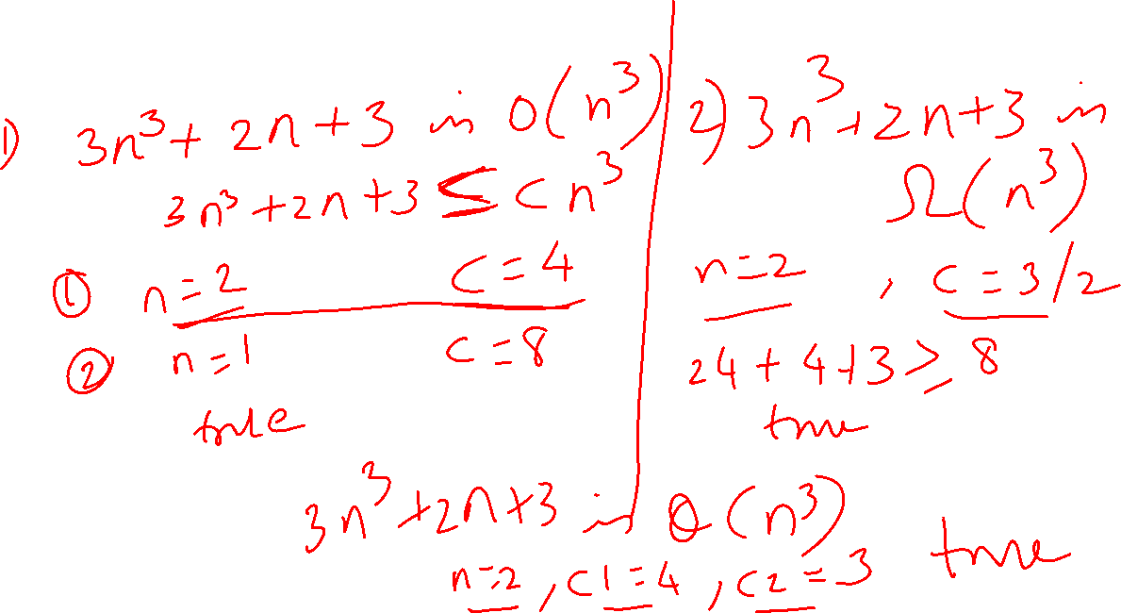
Examples

Slide 34
Big – O - theorem
Let d(n), e(n), f(n), and g(n) be functions mapping nonnegative integers to nonnegative reals.
1. If d(n) is O(f(n)), then ad(n) is O(f(n)), for any constant a > 0.
2. If d(n) is O(f(n)) and e(n) is O(g(n)), then d(n)+e(n) is O(f(n)+g(n)).
3. If d(n) is O(f(n)) and e(n) is O(g(n)), then d(n)e(n) is O(f(n)g(n)).
4. If d(n) is O(f(n)) and f(n) is O(g(n)), then d(n) is O(g(n)).
5. If f(n) is a polynomial of degree d (that is, f(n) = a₀ +a₁n+・ ・ ・+a_{d}n^{d}),
then f(n) is O(n^{d}).
6. n^{x} is O(a^{n}) for any fixed x > 0 and a > 1.
7. log n^{x} is O(log n) for any fixed x > 0.
8. log^{x} n is O(n^{y}) for any fixed constants x > 0 and y > 0.

Slide 35
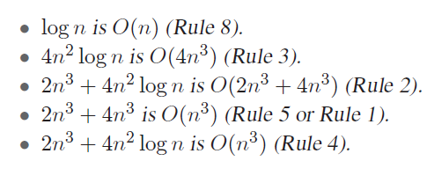
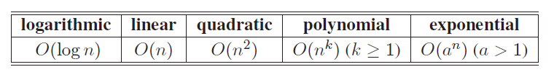
Example
Prove by theorem : 2n³ + 4n² log n is O(n³).

Slide 36
Big-Omega and Big-Theta
Let f(n) and g(n) be functions mapping integers to real numbers. We say that f(n) is Ω(g(n)) (pronounced “f(n) is big-Omega of g(n)”) if g(n) is O(f(n)); that is, there is a real constant c > 0 and an integer constant n₀ ≥ 1 such that f(n) ≥ cg(n), for n ≥ n₀. This definition allows us to say asymptotically that one function is greater than or equal to another, up to a constant factor.
Likewise, we say that f(n) is Θ(g(n)) (pronounced “f(n) is big-Theta of g(n)”) if f(n) is O(g(n)) and f(n) is Ω(g(n)); that is, there are real constants c’ > 0 and c’’ > 0, and an integer constant n₀ ≥ 1 such that c’g(n) ≤ f(n) ≤ c’’g(n), for n ≥ n₀.

Slide 37
Examples
Example 1: 3 log n + log logn is Ω(log n)
Proof: 3 log n + log logn ≥ 3 log n, for n ≥ 2.
Example 2: 3 log n + log logn is Θ(log n)
Proof: 3 log n + loglogn ≤ 4 log n, for n ≥ 2. Note that log log n is not even defined for n = 1, but log logn < log n, for n ≥ 2. That is why we use n ≥ 2.
Proof: 3 log n + log logn ≥ 3 log n, for n ≥ 2.

Slide 38
Little-Oh and Little-Omega
Let f(n) and g(n) be functions mapping integers to real numbers. We say that f(n) is o(g(n)) (pronounced “f(n) is little-oh of g(n)”) if, for any constant c > 0, there is a constant n₀ ≥ 1 such that f(n) < cg(n) for n ≥ n₀.
Likewise, we say that f(n) is ω(g(n)) (pronounced “f(n) is little-omega of g(n)”) if g(n) is o(f(n)), that is, if, for any constant c > 0, there is a constant n₀ ≥ 1 such that f(n) > cg(n) for n ≥ n₀.

Slide 39
Examples
x²∈O(x²)
x²∉o(x²)
x²∈o(x³)
The following are true for Big-O, but would not be true if you used little-o:
x² ∈ O(x²)
x² ∈ O(x² + x)
x² ∈ O(200 * x²)
The following are true for little-o:
x² ∈ o(x³)
x² ∈ o(x!)
ln(x) ∈ o(x)
For example, the function f(n) = 3n is:
in O(n²), o(n²), and O(n)
not in O(lg n), o(lg n), or o(n)

Slide 40
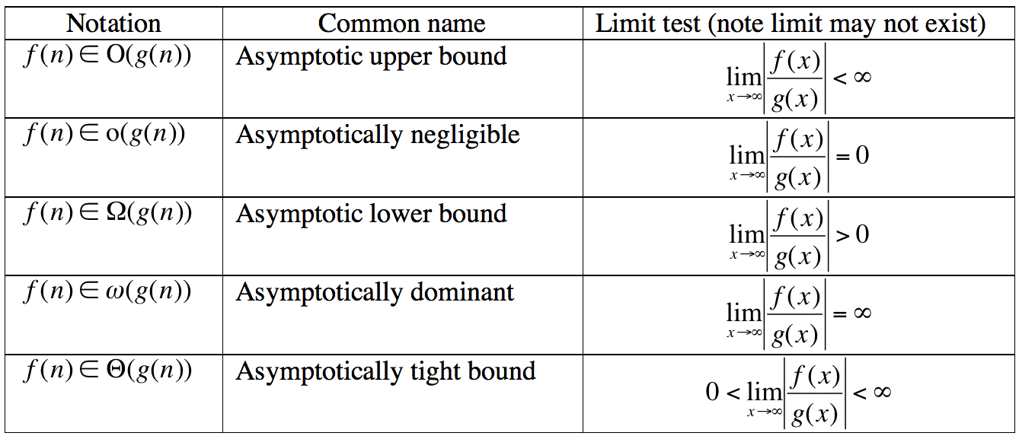
Limit Theorem

Slide 41
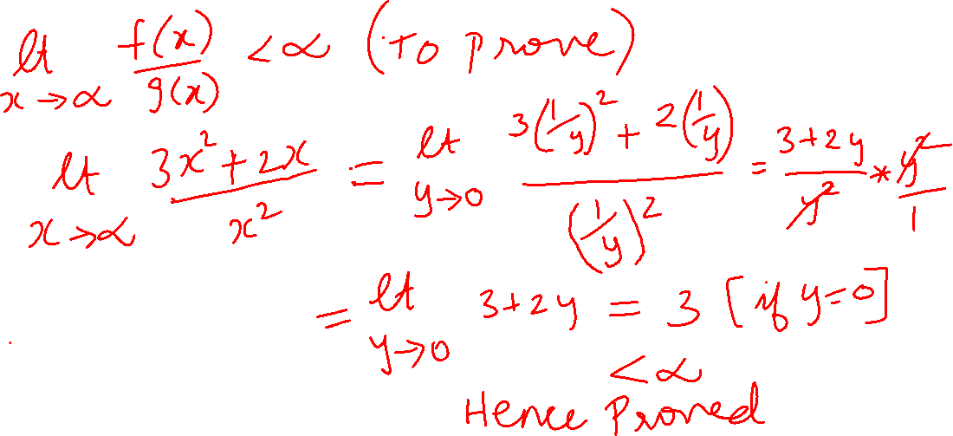
Prove using limit theorem
Example 1: 3n²+2n is O(n²)

Slide 42
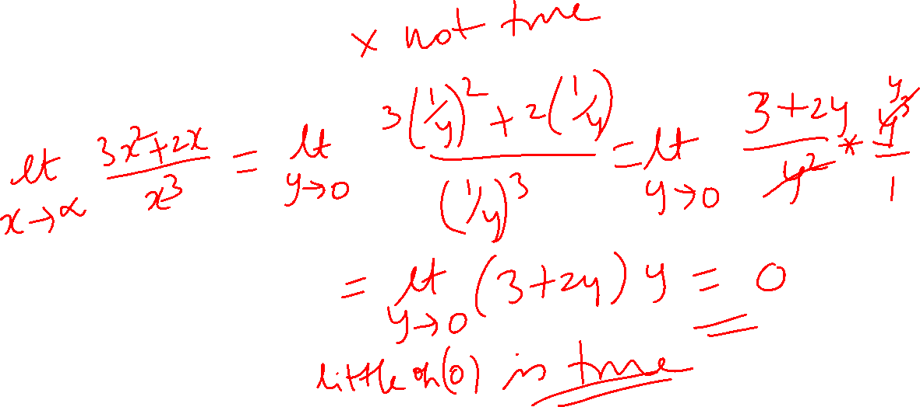
Prove using limit theorem
Example 2: 3n²+2n is o(n²)
Example 3: 3n²+2n is o(n³)

Slide 43
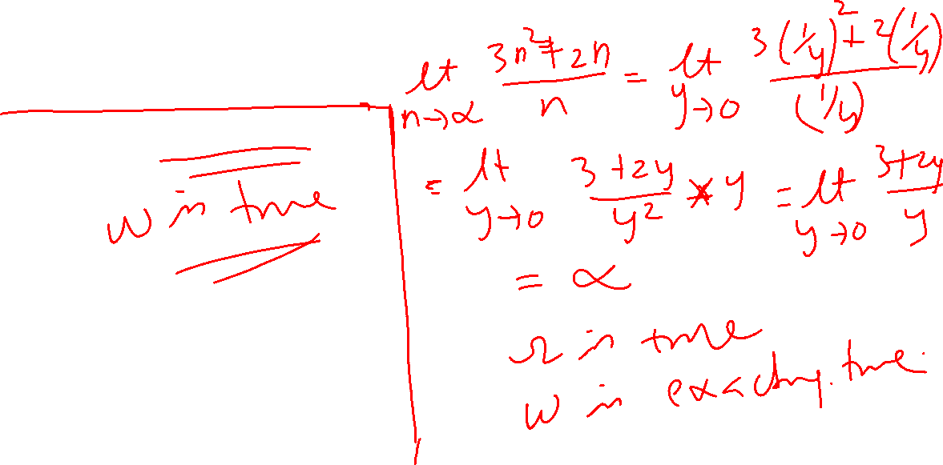
Prove using limit theorem
Example 4: 3n²+2n is Ω(n)
Example 5: 3n²+2n is ω(n)

Slide 44
Asymptotically tight notation
Theta, commonly written as Θ, is an Asymptotic Notation to denote the asymptotically tight bound on the growth rate of runtime of an algorithm.
For example, if f(n) is O(g(n)), and f(n) is O(h(n)) and if g(n) is O(h(n)) then g(n) is called the asymptotically tight notation.

Slide 45
Asymptotically tight notation
So for log(n) we could say: log(n) is O(n^n) since log(n) grows asymptotically no faster than n^n log(n) is O(n) since log(n) grows asymptotically no faster than n log(n) is O(log(n)) since log(n) grows asymptotically no faster than log(n) We went from loose upper bounds to a tight upper bound
log(n) is Ω(1) since log(n) grows asymptotically no slower than 1 log(n) is Ω(log(log(n))) since log(n) grows asymptotically no slower than log(log(n)) log(n) is Ω(log(n)) since log(n) grows asymptotically no slower than log(n) We went from loose lower bounds to a tight lower bound
Since we have log(n) is O(log(n)) and Ω(log(n)) we can say that log(n) is Θ(log(n)).

Slide 46
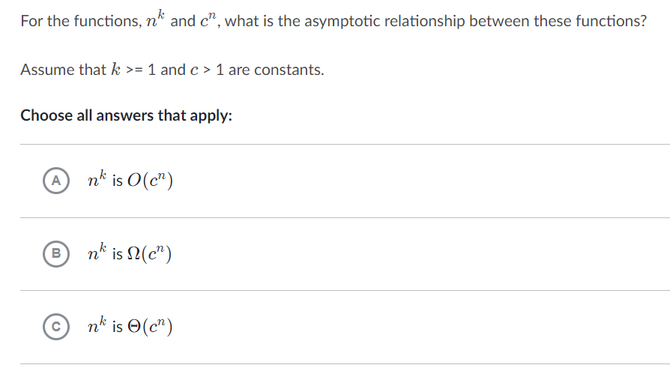


Slide 47
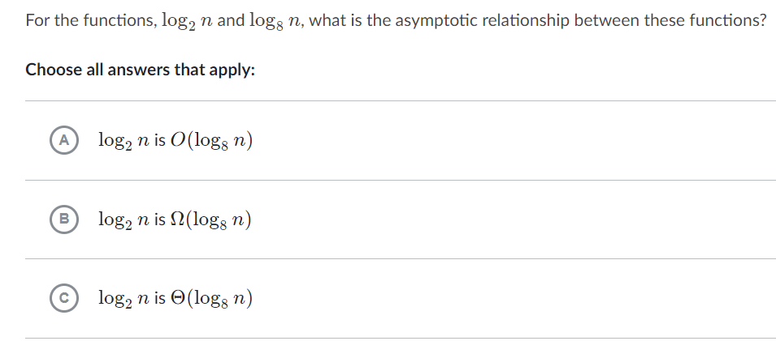

Slide 48
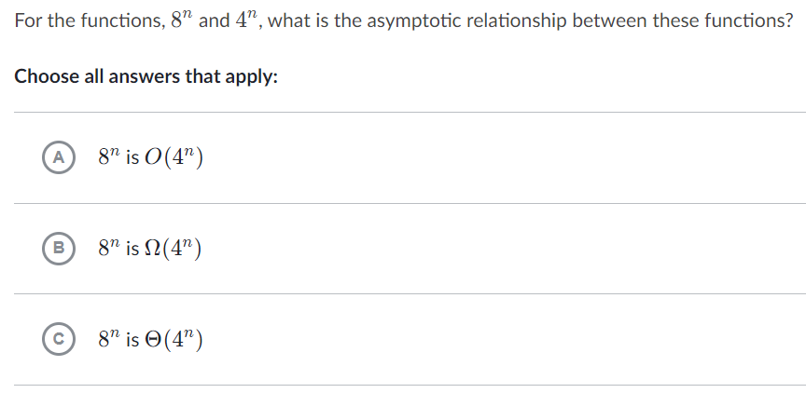

Slide 49
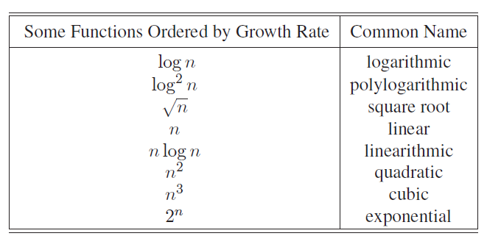
Ordering functions by growth rate

Slide 50
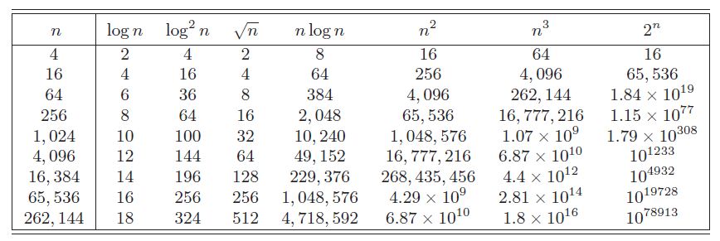

Ordering functions by growth rate
Note the point at which the function sqrt(n) dominates log² n.

Slide 51
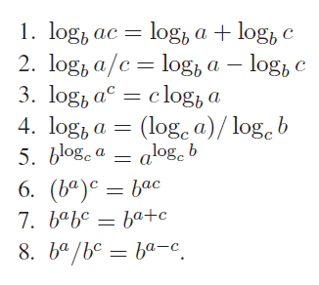
Logarithmic and Exponent properties
Let a, b, and c be positive real numbers. We have

Slide 52


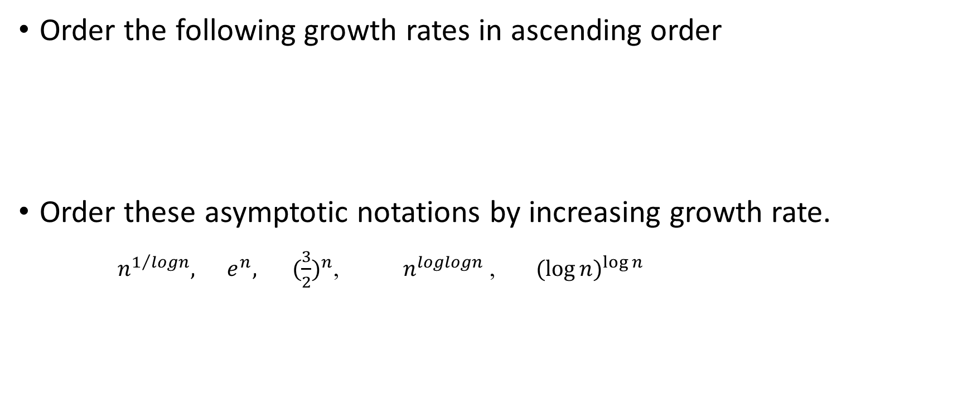
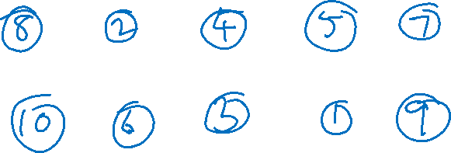
Try yourself!!
Order the following growth rates in ascending order
Order these asymptotic notations by increasing growth rate.
$n^{1/{logn}}, e^{n}, { (\frac{3}{2})}^{n}$, $n^{loglogn}$ , ${(\log{n)}}^{\log{n}}$

Slide 53
Solving Recurrences
An equation or inequality that describes a function in terms of its value on smaller inputs.
T(n) = T(n-1) + n
Recurrences arise when an algorithm contains recursive calls to itself
What is the actual running time of the algorithm?
Need to solve the recurrence
Find an explicit formula of the expression
Bound the recurrence by an expression that involves n

Slide 54
Example Recurrences
T(n) = T(n-1) + n Θ(n²)
Recursive algorithm that loops through the input to eliminate one item
T(n) = T(n/2) + c Θ(lgn)
Recursive algorithm that halves the input in one step
T(n) = T(n/2) + n Θ(n)
Recursive algorithm that halves the input but must examine every item in the input
T(n) = 2T(n/2) + 1 Θ(n)
Recursive algorithm that splits the input into 2 halves and does a constant amount of other work

Slide 55
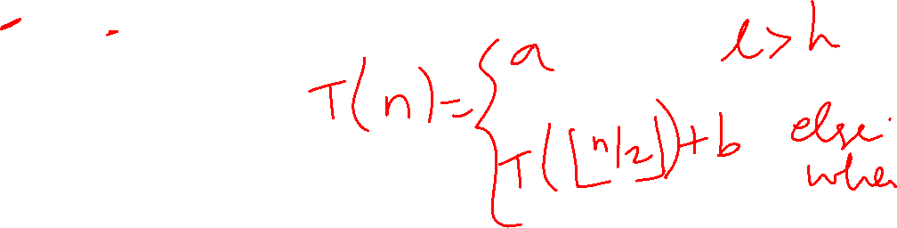
Recurrent Algorithms - BINARY-SEARCH
for an ordered array A, finds if x is in the array A[lo…hi]
Alg.: BINARY-SEARCH (A, lo, hi, x)
if (lo > hi)
return FALSE
mid ← ⎣(lo+hi)/2⎦
if x = A[mid]
return TRUE
if ( x < A[mid] )
BINARY-SEARCH (A, lo, mid-1, x)
if ( x > A[mid] )
BINARY-SEARCH (A, mid+1, hi, x)
1
2
3
4
5
6
7
8
2
3
5
7
9
10
11
12
mid
lo
hi

Slide 56
Example
A[8] = {1, 2, 3, 4, 5, 7, 9, 11}
lo = 1 hi = 8 x = 7
1
2
3
4
5
6
7
8
1
2
3
4
5
7
9
11
mid = 4, lo = 5, hi = 8
5
6
7
8
1
2
3
4
5
7
9
11
mid = 6, A[mid] = x Found!

Slide 57
Another Example
A[8] = {1, 2, 3, 4, 5, 7, 9, 11}
lo = 1 hi = 8 x = 6
1
2
3
4
5
6
7
8
1
2
3
4
5
7
9
11
mid = 4, lo = 5, hi = 8
low
high
1
2
3
4
5
7
9
11
mid = 6, A[6] = 7, lo = 5, hi = 5
low
high
1
2
3
4
5
7
9
11
mid = 5, A[5] = 5, lo = 6, hi = 5
NOT FOUND!
1
2
3
4
5
7
9
11
high
low

Slide 58

Analysis of BINARY-SEARCH
Alg.: BINARY-SEARCH (A, lo, hi, x)
if (lo > hi)
return FALSE
mid ← ⎣(lo+hi)/2⎦
if x = A[mid]
return TRUE
if ( x < A[mid] )
BINARY-SEARCH (A, lo, mid-1, x)
if ( x > A[mid] )
BINARY-SEARCH (A, mid+1, hi, x)
T(n) = c +
T(n) – running time for an array of size n
constant time: c₁
constant time: c₂
constant time: c₃
same problem of size n/2
same problem of size n/2
T(n/2)

Slide 59
Methods for Solving Recurrences
Iteration method (or) Iterative substitution method
Substitution method (or) Guess and test method
Recursion tree method
Master method

Slide 60
The Iteration Method
Convert the recurrence into a summation and try to bound it using known series
Iterate the recurrence until the initial condition is reached.
Use back-substitution to express the recurrence in terms of n and the initial (boundary) condition.

Slide 61
The Iteration Method – Example 1
Example: T(n) = c + T(n/2)
T(n) = c + T(n/2)
= c + c + T(n/4)
= c + c + c + T(n/8)
Assume n = 2^{k}
T(n) = c + c + … + c + T(1)
= clgn + T(1)
= Θ(lgn)
T(n/2) = c + T(n/4)
T(n/4) = c + T(n/8)
k times

Slide 62
Iteration Method – Example 2
Example: T(n) = n + 2T(n/2)
T(n) = n + 2T(n/2)
= n + 2(n/2 + 2T(n/4))
= n + n + 4T(n/4)
= n + n + 4(n/4 + 2T(n/8))
= n + n + n + 8T(n/8)
… = in + 2^{i}T(n/2^{i})
= kn + 2^{k}T(1)
= nlgn + nT(1) = Θ(nlgn)
Assume: n = 2^{k}
T(n/2) = n/2 + 2T(n/4)

Slide 63
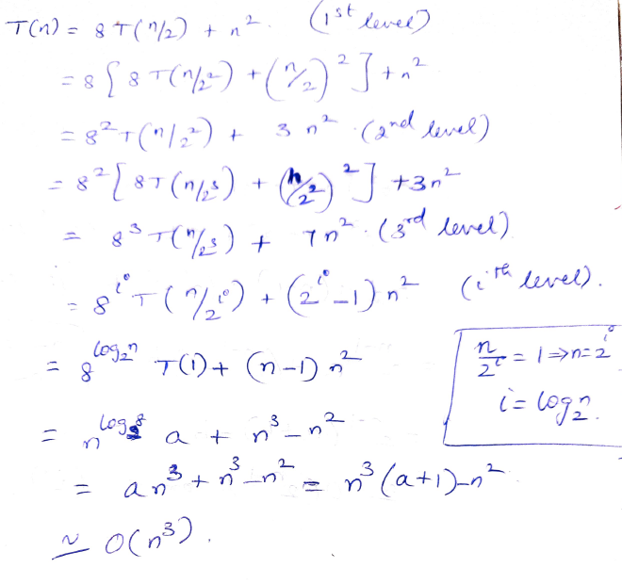
Iteration Method – Example 3
T(n) = 8T(n/2) + n²

Slide 64
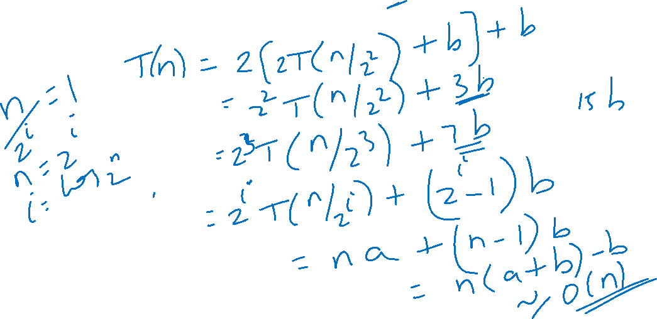
Iteration Method – Example 4
T(n) = 2T(n/2) + b

Slide 65
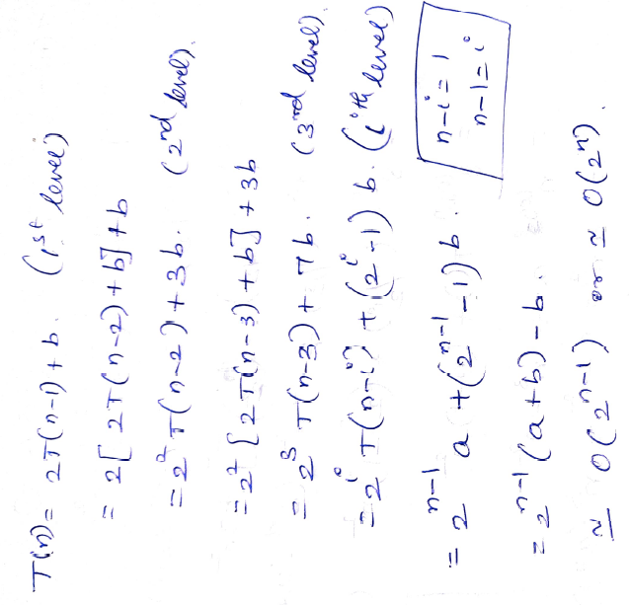
Iteration Method – Example 5
T(n) = 2T(n-1) + b (Tower of Hanoi)

Slide 66
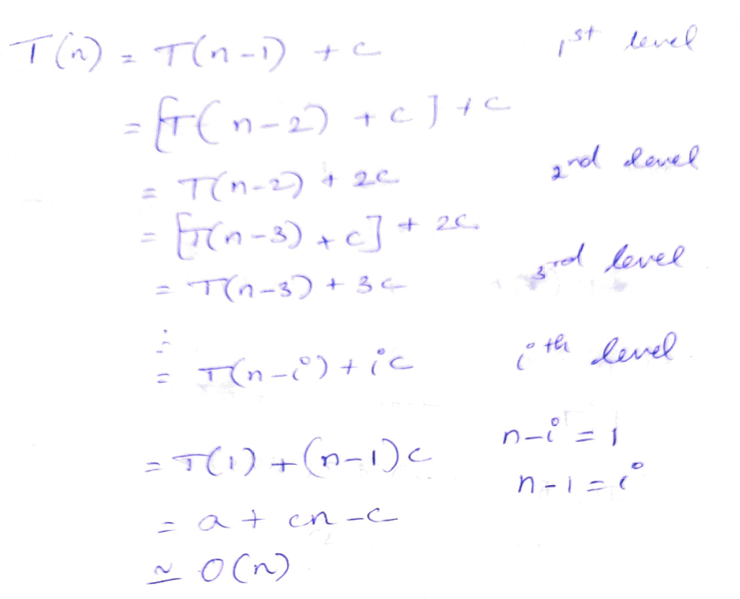
Iteration Method – Example 6

Slide 67
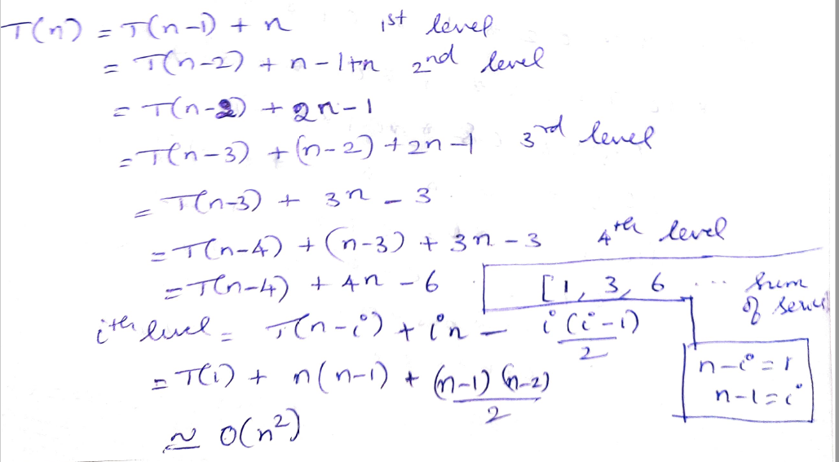
Iteration Method – Example 7

Slide 68
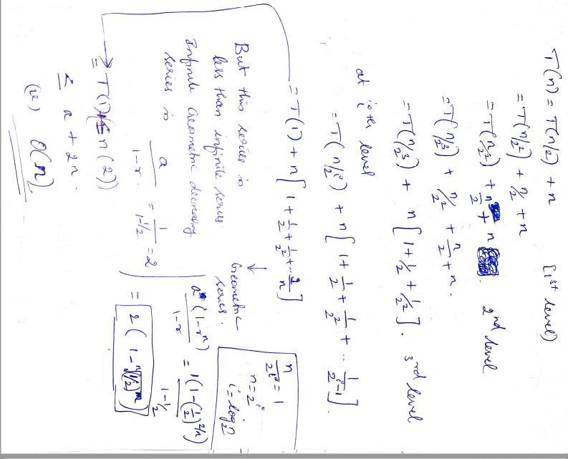
Iteration Method – Example 8

Slide 69
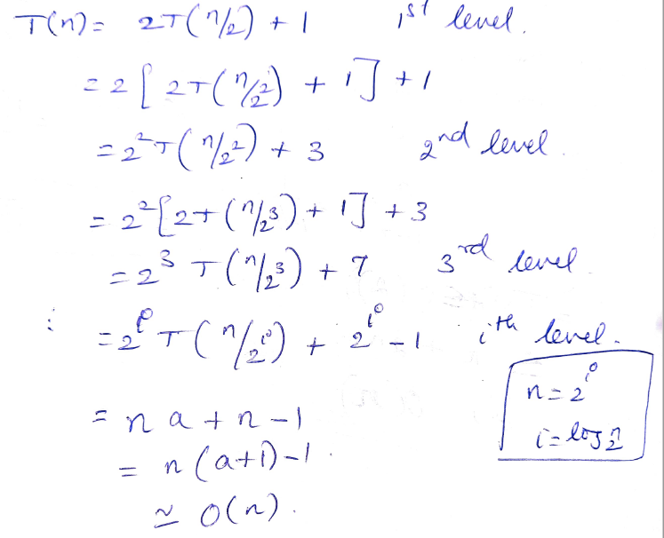
Iteration Method – Example 9

Slide 70
The substitution method
Guess a solution
Use induction to prove that the solution works

Slide 71
Substitution method
Guess a solution
T(n) = O(g(n))
Induction goal: apply the definition of the asymptotic notation
T(n) ≤ d g(n), for some d > 0 and n ≥ n₀
Induction hypothesis: T(k) ≤ d g(k) for all k < n
Prove the induction goal
Use the induction hypothesis to find some values of the constants d and n₀ for which the induction goal holds
(strong induction)

Slide 72
Example: Binary Search
T(n) = c + T(n/2)
Guess: T(n) = O(lgn)
Induction goal: T(n) ≤ d lgn, for some d and n ≥ n₀
Induction hypothesis: T(n/2) ≤ d lg(n/2)
Proof of induction goal:
T(n) = T(n/2) + c ≤ d lg(n/2) + c
= d lgn – d + c ≤ d lgn
if: – d + c ≤ 0, d ≥ c
Base case?

Slide 73
Example 2
T(n) = T(n-1) + n
Guess: T(n) = O(n²)
Induction goal: T(n) ≤ c n², for some c and n ≥ n₀
Induction hypothesis: T(n-1) ≤ c(n-1)² for all k < n
Proof of induction goal:
T(n) = T(n-1) + n ≤ c (n-1)² + n
= cn² – (2cn – c - n) ≤ cn²
if: 2cn – c – n ≥ 0 ⇔ c ≥ n/(2n-1) ⇔ c ≥ 1/(2 – 1/n)
For n ≥ 1 ⇒ 2 – 1/n ≥ 1 ⇒ any c ≥ 1 will work

Slide 74
Example 3
T(n) = 2T(n/2) + n
Guess: T(n) = O(nlgn)
Induction goal: T(n) ≤ cn lgn, for some c and n ≥ n₀
Induction hypothesis: T(n/2) ≤ cn/2 lg(n/2)
Proof of induction goal:
T(n) = 2T(n/2) + n ≤ 2c (n/2)lg(n/2) + n
= cn lgn – cn + n ≤ cn lgn
if: - cn + n ≤ 0 ⇒ c ≥ 1
Base case?

Slide 75
Example 4
T(n) = 2T(n/2) + bnlogn
First Guess: T(n) <=cnlogn
Better Guess: T(n) <=cnlog²n
But there is no way that we can make this last line less than or equal to cn log n for n ≥ 2. Thus, this first guess was not sufficient
provided c ≥ b

Slide 76
The recursion-tree method
Convert the recurrence into a tree:
Each node represents the cost incurred at various levels of recursion
Sum up the costs of all levels
Used to “guess” a solution for the recurrence

Slide 77
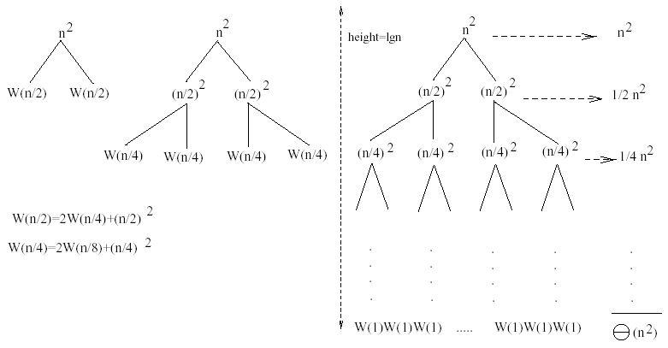
Example 1
W(n) = 2W(n/2) + n²
Subproblem size at level i is: n/2^{i}
Subproblem size hits 1 when 1 = n/2^{i} ⇒ i = lgn
Cost of the problem at level i = (n/2^{i})² No. of nodes at level i = 2^{i}
Total cost:
⇒ W(n) = O(n²)
(n)

Slide 78

Example 2
E.g.: T(n) = 3T(n/4) + cn²
Subproblem size at level i is: n/4^{i}
Subproblem size hits 1 when 1 = n/4^{i} ⇒ i = log₄n
Cost of a node at level i = c(n/4^{i})²
Number of nodes at level i = 3^{i} ⇒ last level has 3^{log}₄^{n} = n^{log}₄³ nodes
Total cost:
⇒ T(n) = O(n²)

Slide 79
Example 2 - Substitution
T(n) = 3T(n/4) + cn²
Guess: T(n) = O(n²)
Induction goal: T(n) ≤ dn², for some d and n ≥ n₀
Induction hypothesis: T(n/4) ≤ d (n/4)²
Proof of induction goal:
T(n) = 3T(n/4) + cn²
≤ 3d (n/4)² + cn²
= (3/16) d n² + cn²
≤ d n² if: d ≥ (16/13)c
Therefore: T(n) = O(n²)

Slide 80

Example 3 (simpler proof)
W(n) = W(n/3) + W(2n/3) + n
The longest path from the root to a leaf is: n → (2/3)n → (2/3)² n → … → 1
Subproblem size hits 1 when 1 = (2/3)^{i}n ⇔ i=log_{3/2}n
Cost of the problem at level i = n
Total cost:
⇒ W(n) = O(nlgn)

Slide 81
Example 3
W(n) = W(n/3) + W(2n/3) + n
The longest path from the root to a leaf is: n → (2/3)n → (2/3)² n → … → 1
Subproblem size hits 1 when 1 = (2/3)^{i}n ⇔ i=log_{3/2}n
Cost of the problem at level i = n
Total cost:
⇒ W(n) = O(nlgn)

Slide 82
Example 3 - Substitution
W(n) = W(n/3) + W(2n/3) + O(n)
Guess: W(n) = O(nlgn)
Induction goal: W(n) ≤ dnlgn, for some d and n ≥ n₀
Induction hypothesis: W(k) ≤ d klgk for any K < n (n/3, 2n/3)
Proof of induction goal:
Try it out as an exercise!!
T(n) = O(nlgn)

Slide 83
Example of recursion tree
Solve T(n) = T(n/4) + T(n/2) + n²:

Slide 84
Example of recursion tree
Solve T(n) = T(n/4) + T(n/2) + n²:
T(n)

Slide 85
Example of recursion tree
Solve T(n) = T(n/4) + T(n/2) + n²:
n²
T(n/4)
T(n/2)

Slide 86
Example of recursion tree
Solve T(n) = T(n/4) + T(n/2) + n²:
n²
(n/4)²
(n/2)²
T(n/16)
T(n/8)
T(n/8)
T(n/4)

Slide 87
Example of recursion tree
Solve T(n) = T(n/4) + T(n/2) + n²:
n²
(n/4)²
(n/2)²
(n/16)²
(n/8)²
(n/8)²
(n/4)²
…
Θ(1)

Slide 88
Example of recursion tree
Solve T(n) = T(n/4) + T(n/2) + n²:
n²
(n/4)²
(n/2)²
(n/16)²
(n/8)²
(n/8)²
(n/4)²
…
Θ(1)

Slide 89
Example of recursion tree
Solve T(n) = T(n/4) + T(n/2) + n²:
n²
(n/4)²
(n/2)²
(n/16)²
(n/8)²
(n/8)²
(n/4)²
…
Θ(1)

Slide 90
Example of recursion tree
Solve T(n) = T(n/4) + T(n/2) + n²:
n²
(n/4)²
(n/2)²
(n/16)²
(n/8)²
(n/8)²
(n/4)²
…
…
Θ(1)

Slide 91
Example of recursion tree
Solve T(n) = T(n/4) + T(n/2) + n²:
n²
(n/4)²
(n/2)²
(n/16)²
(n/8)²
(n/8)²
(n/4)²
…
…
Θ(1)
Total =
= Θ(n²)
geometric series

Slide 92
Appendix: geometric series
for x ≠ 1
for |x| < 1

Slide 93
Master’s method
“Cookbook” for solving recurrences of the form:
where, a ≥ 1, b > 1, and f(n) > 0
Idea: compare f(n) with n^{log}_{b}ª
f(n) is asymptotically smaller or larger than n^{log}_{b}ª by a polynomial factor n^{ε}
f(n) is asymptotically equal with n^{log}_{b}ª

Slide 94
Master’s method
“Cookbook” for solving recurrences of the form:
where, a ≥ 1, b > 1, and f(n) > 0
Case 1: if f(n) = O(n^{log}_{b}^{a -ε}) for some ε > 0, then: T(n) = Θ(n^{log}_{b}ª)
Case 2: if f(n) = Θ(n^{log}_{b}ª), then: T(n) = Θ(n^{log}_{b}ª lgn)
Case 3: if f(n) = Ω(n^{log}_{b}^{a +ε}) for some ε > 0, and if
af(n/b) ≤ cf(n) for some c < 1 and all sufficiently large n, then:
T(n) = Θ(f(n))
regularity condition

Slide 95

Examples
T(n) = 2T(n/2) + n
a = 2, b = 2, log₂2 = 1
Compare n^{log}₂² with f(n) = n
⇒ f(n) = Θ(n) ⇒ Case 2
⇒ T(n) = Θ(nlgn)

Slide 96
Examples
T(n) = 2T(n/2) + n²
a = 2, b = 2, log₂2 = 1
Compare n with f(n) = n²
⇒ f(n) = Ω(n^{1+ε}) Case 3 ⇒ verify regularity cond.
a f(n/b) ≤ c f(n)
⇔ 2 n²/4 ≤ c n² ⇒ c = ½ is a solution (c<1)
⇒ T(n) = Θ(n²)

Slide 97
Examples (cont.)
T(n) = 2T(n/2) +
a = 2, b = 2, log₂2 = 1
Compare n with f(n) = n^{1/2}
⇒ f(n) = O(n^{1-ε}) Case 1
⇒ T(n) = Θ(n)

Slide 98
Examples
Ex. T(n) = 4T(n/2) + n
a = 4, b = 2 ⇒ n^{logba} = n²; f (n) = n.
CASE 1: f (n) = O(n^{2 – ε}) for ε = 1.
∴ T(n) = Θ(n²).
Ex. T(n) = 4T(n/2) + n²
a = 4, b = 2 ⇒ n^{logba} = n²; f (n) = n².
CASE 2: f (n) = Θ(n²lg⁰n), that is, k = 0.
∴ T(n) = Θ(n²lg n).

Slide 99
Examples
Ex. T(n) = 4T(n/2) + n³
a = 4, b = 2 ⇒ n^{logba} = n²; f (n) = n³.
CASE 3: f (n) = Ω(n^{2 + ε}) for ε = 1
and 4(cn/2)³ ≤ cn³ (reg. cond.) for c = 1/2.
∴ T(n) = Θ(n³).
Ex. T(n) = 4T(n/2) + n²/lg n
a = 4, b = 2 ⇒ n^{logba} = n²; f (n) = n²/lg n.
Master method does not apply. In particular, for every constant ε > 0, we have n^{ε} = ω(lg n).

Slide 100


Examples
T(n) = 3T(n/4) + nlgn
a = 3, b = 4, log₄3 = 0.793
Compare n^{0.793} with f(n) = nlgn
f(n) = Ω(n^{log}₄^{3+ε}) Case 3
Check regularity condition:
3∗(n/4)lg(n/4) ≤ (3/4)nlgn = c ∗f(n), c=3/4
⇒T(n) = Θ(nlgn)

Slide 101


Examples
T(n) = 2T(n/2) + nlgn
a = 2, b = 2, log₂2 = 1
Compare n with f(n) = nlgn
seems like case 3 should apply
f(n) must be polynomially larger by a factor of n^{ε}
In this case it is only larger by a factor of lgn
So which rule??

Slide 102
Changing variables
T(n) = 2T( ) + lgn
Rename: m = lgn ⇒ n = 2^{m}
T (2^{m}) = 2T(2^{m/2}) + m
Rename: S(m) = T(2^{m})
S(m) = 2S(m/2) + m ⇒ S(m) = O(mlgm) (demonstrated before)
T(n) = T(2^{m}) = S(m) = O(mlgm)=O(lgnlglgn)
Idea: transform the recurrence to one that you have seen before

