Slide 1
Graphs
Motivation and Terminology
Representations
Traversals
Three Problems

Slide 2
Graphs
A graph G consists of a set of vertices V together with a set E of vertex pairs or edges.
G = (V,E) [in some texts they use G(V,E)].
We also use V and E to represent # of nodes and edges
Graphs are important because any binary relation is a graph, so graphs can be used to represent essentially any relationship.

Slide 3
Graph Interpretations
The vertices could represent rooms in a house, and the edges could indicate which of those rooms are connected to each other.
Sometimes a using a graph will be an easy simplification for a problem.
Living Room Den Bedroom
Kitchen Hallway Bath
Living Den
Room
Hall
Bed
Kitchen Bath
Apartment Blueprint
Notes:
Our question might be, how can I get from the Kitchen to the bathroom while going through the fewest other rooms?

Slide 4
More interpretations
Vertices are cities and edges are the roads connecting them.
Edges are the components in a circuit and vertices are junctions where they connect.
Vertices are software packages and edges indicate those that can interact.
Edges are phone conversations and vertices are the households being connected.

Slide 5
Friendship Graphs
A
B
C
D
E
F
Each vertex represents a person, and each edge indicates that the two people are friends.

Slide 6
Graph Terminology
Directed and undirected graphs
A graph is said to be undirected if edge (x, y) always implies (y, x). Otherwise it is said to be directed. Often called an arc.
Loops, multiedges, and simple graphs
An edge of the form (x, x) is said to be a loop. If x was y’s friend several times over, we can model this relationship using multiedges. A graph is said to be simple if it contains no loops or multiedges.
Weighted edges
A graph is said to be weighted if each edge has an associated numerical attribute. In an unweighted graph, all edges are assumed to be of equal weight.

Slide 7
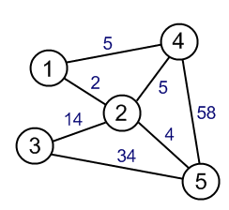
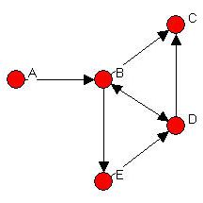
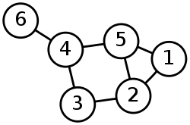
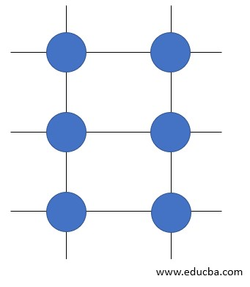
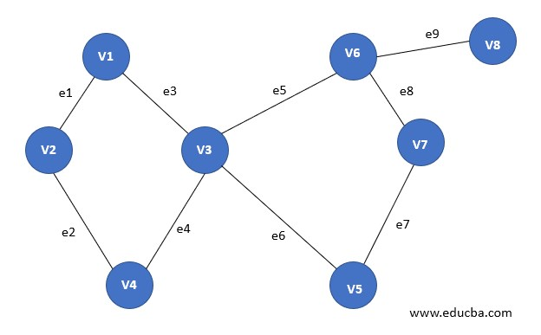

Kinds of Graphs
Weighted Undirected graph
Undirected graph
Directed graph
Finite graph
Trivial graph
Infinite graph

Slide 8
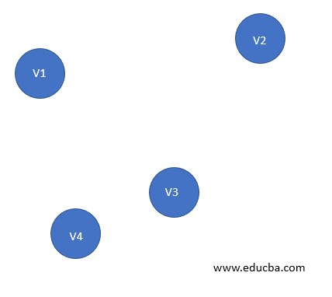
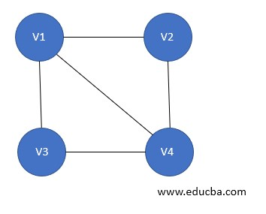
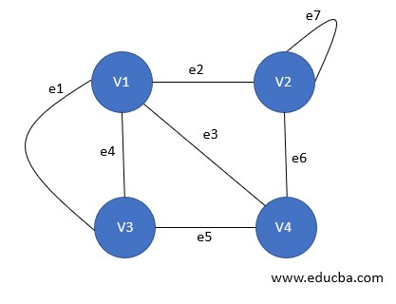
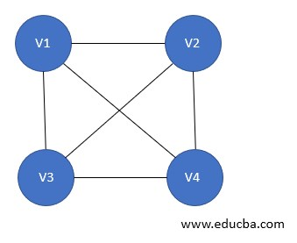
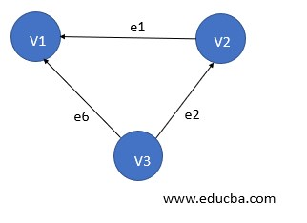
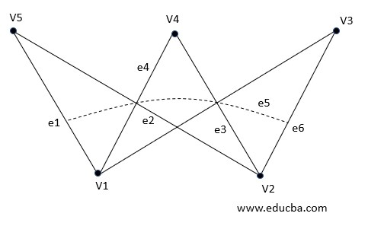
Kinds of Graphs
Simple graph
Parallel graph
Null graph
Complete graph
Bipartite graph
Directed Acyclic graph

Slide 9
Terminology continued...
Paths
A path is any sequence of edges that connect two vertices. A simple path never goes through any vertex more than once. The shortest path is the minimum number edges needed to connect two vertices.
Connectivity
The “six degrees of separation” theory argues that there is always a short path between any two people in the world. A graph is connected if there a path between any two vertices. A directed graph is strongly connected if there is always a directed path between vertices. Any subgraph that is connected can be referred to as a connected component.

Slide 10
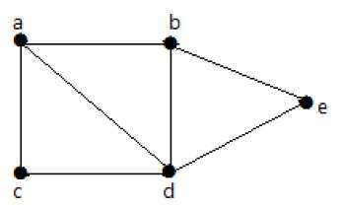
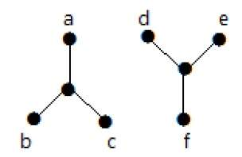
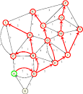
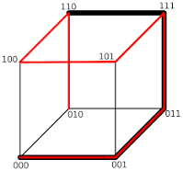
Path and Connectivity
Disconnected graph
Connected graph
Path in a graph
Path in a graph

Slide 11
Still More Terminology...
Degree and graph types
The degree of a vertex is the number of edges connected to it. The most popular person will have a vertex of the highest degree. Remote hermits may have degree-zero vertices. In dense graphs, most vertices have high degree. In sparse graphs, most vertices have low degree. In a regular graph, all vertices have exactly the same degree. Degree can be Indegree and/or Outdegree.
Clique
A graph is called complete if every pair of vertices is connected by an edge. A clique is a sub-graph that is complete.

Slide 12
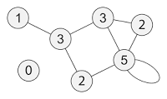
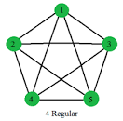
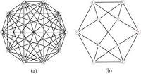
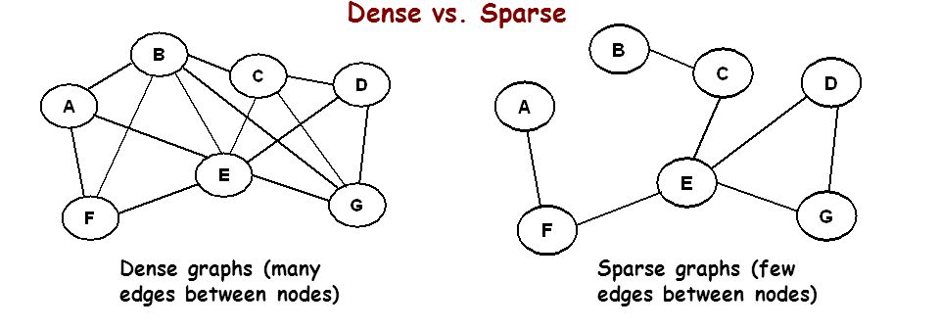
Degree
Graph with varying degree
Regular Graph (with same degree)

Slide 13
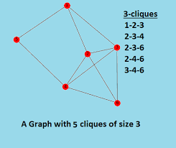
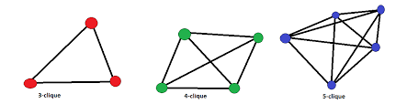
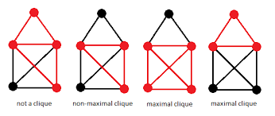
Clique

Slide 14
Yet More Terminology...
Cycles and Dags
A cycle is a path where the last vertex is adjacent to the first. A cycle in which no vertex is repeated is said to be a simple cycle. The shortest cycle in a graph determines the graph’s girth. A simple cycle that passes through every vertex is said to be a Hamiltonian cycle. An undirected graph with no cycles is a tree if it is connected, or a forest if it is not. A directed graph with no directed cycles is said to be a directed acyclic graph (or a DAG)

Slide 15
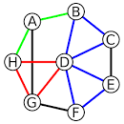
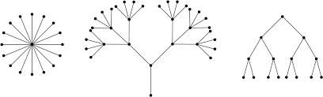
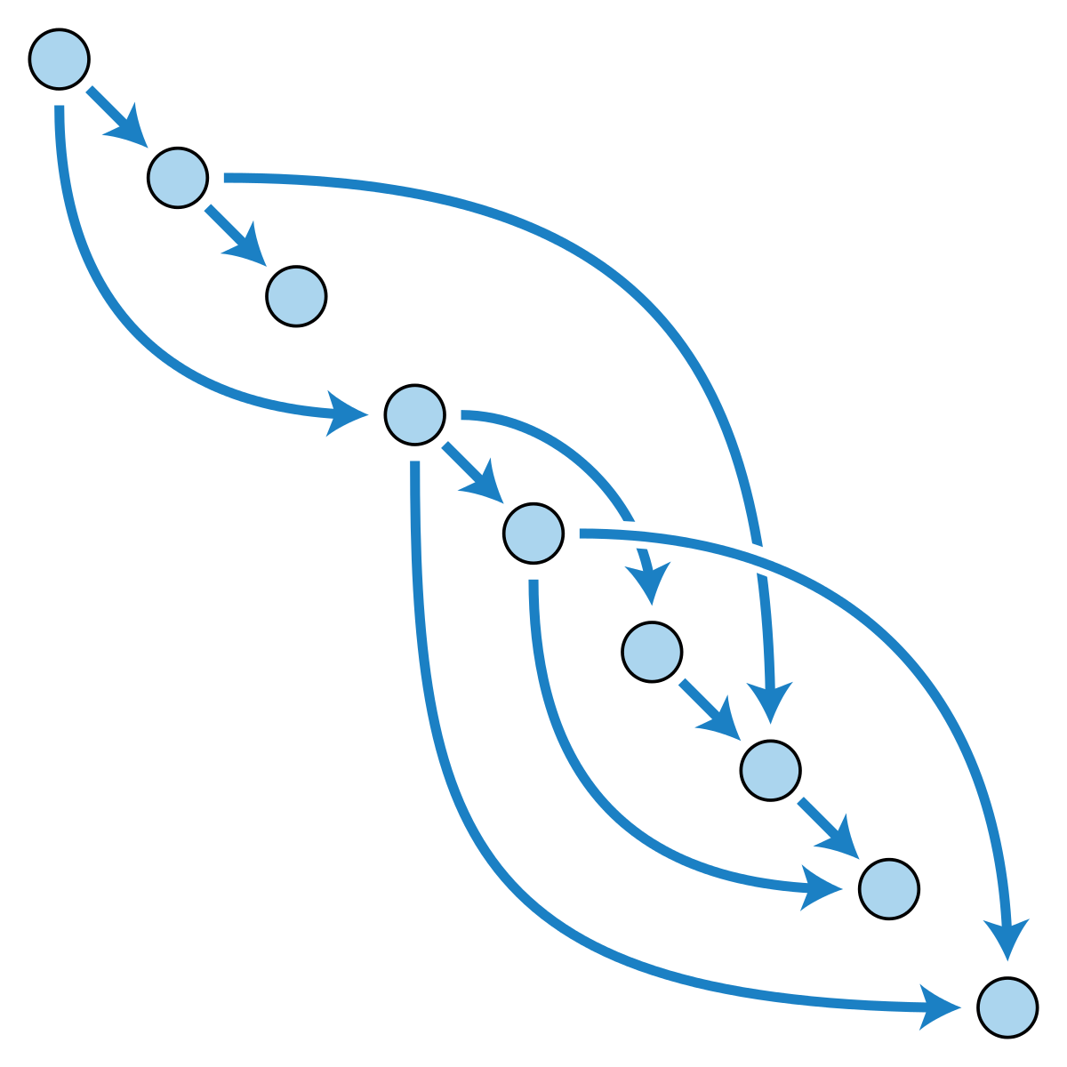
Cycles and DAGs
Trees in a Forest
Graph with cycles
DAG

Slide 16
Graphs
Graph G = (V, E)
V = set of vertices
E = set of edges ⊆ (V×V)
Types of graphs
Undirected: edge (u, v) = (v, u); for all v, (v, v) ∉ E (No self loops.)
Directed: (u, v) is edge from u to v, denoted as u → v. Self loops are allowed (also called as digraph)
Weighted: each edge has an associated weight, given by a weight function w : E → R.
Dense: |E| ≈ |V|².
Sparse: |E| << |V|².
|E| = O(|V|²)

Slide 17
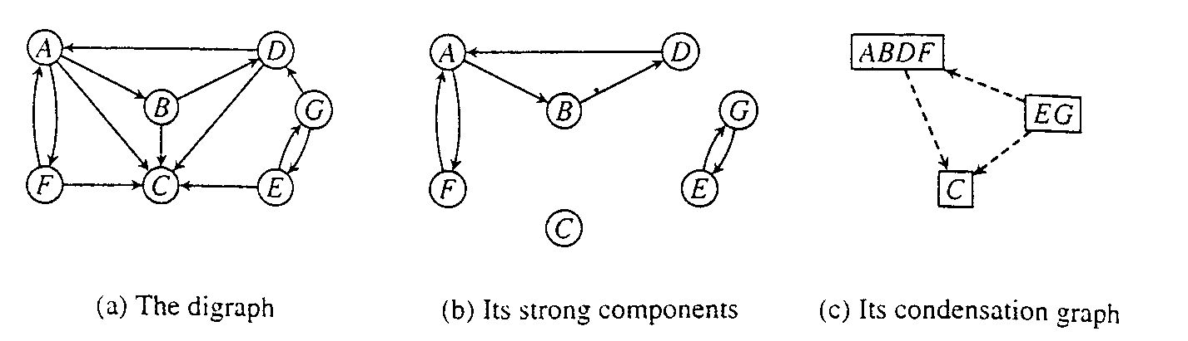
Strongly Connected Components of a Digraph
Strongly connected:
A directed graph is strongly connected if and only if, for each pair of vertices v and w, there is a path from v to w.
Strongly connected component:
A strongly connected component of a digraph G is a maximal strongly connected subgraph of G.

Slide 18
Strongly connected Components and Equivalence Relations
Strongly Connected Components may be defined in terms of an equivalence relation, S, on the vertices
vSw iff there is a path from v to w and
a path from w to v
Then, a strongly connected component consists of one equivalence class, C, along with all edges vw such that v and w are in C.

Slide 19
Condensation graph
The strongly connected components of a digraph can each be collapsed to a single vertex yielding a new digraph that has no cycles.
Condensation graph:
Let S₁,S₂,...S_{p} be the strong components of G.
The condensation graph of G denoted as G↓, is the digraph G↓ = (V',E'),
where V' has p elements s₁,s₂,...s_{p} and
s_{i}s_{j} is in E' if and only if i≠j and
there is an edge in E from some vertex in S_{i} to some vertex in S_{j}.

Slide 20
Condensation graph and its strongly connected components
Condensation Graph is acyclic.

Slide 21
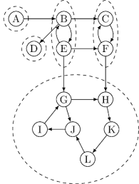
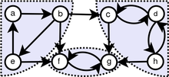
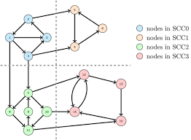
Examples
Graph with strongly connected components marked

Slide 22
Bi-connected components of an Undirected graph
Problem:
If any one vertex (and the edges incident upon it) are removed from a connected graph,
is the remaining subgraph still connected?
Biconnected graph: (No separation edge and separation vertex)
A connected undirected graph G is said to be biconnected if it remains connected after removal of any one vertex and the edges that are incident upon that vertex. Separation edge is also called cut edge and separation vertex is called cut vertex.
Biconnected component:
A biconnected component of a undirected graph is a maximal biconnected subgraph, that is, a biconnected subgraph not contained in any larger biconnected subgraph.
Articulation point:
A vertex v is an articulation point for an undirected graph G if there are distinct vertices w and x (distinct from v also) such that v is in every path from w to x.

Slide 23
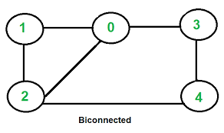
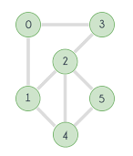
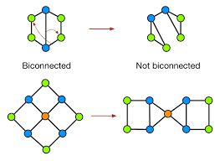
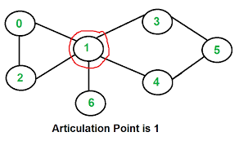
Bi-connected graph
Not a biconnected graph

Slide 24
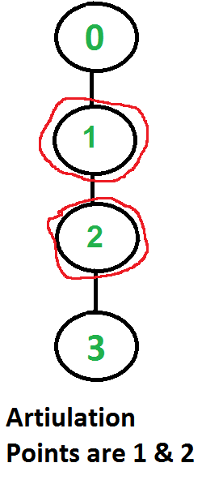
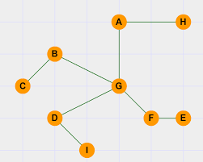
Articulation point
An articulation point of a graph is a vertex v such that when we remove v and all edges incident upon v , we break a connected component of the graph into two or more pieces.
A connected graph with no articulation points is said to be biconnected.

Slide 25
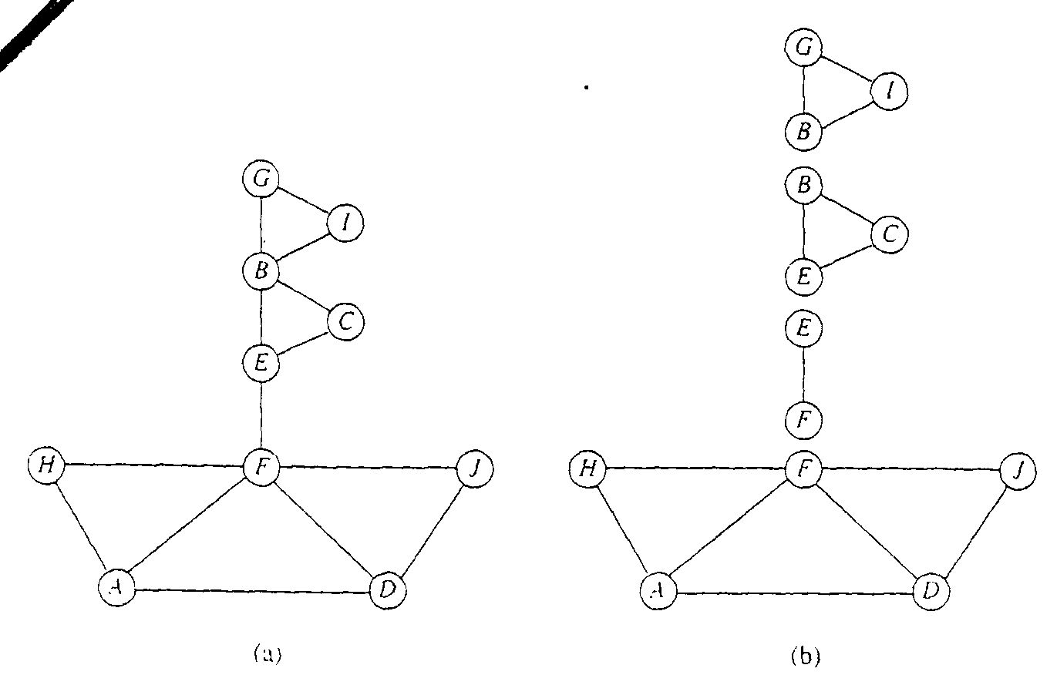
Bi-connected components, e.g.
Some vertices are in more than one component (which vertices are these?)

Slide 26
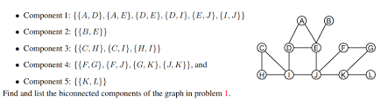
Example

Slide 27
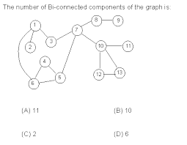
Example
1. {10-12, 12-13, 10-13}
2. {10-11}
3. {8-9}
4. {7-8}
5. {1-2}
6. {1-3, 1-6, 3-7, 5-7, 4-5,5-6, 4-6, }

Slide 28
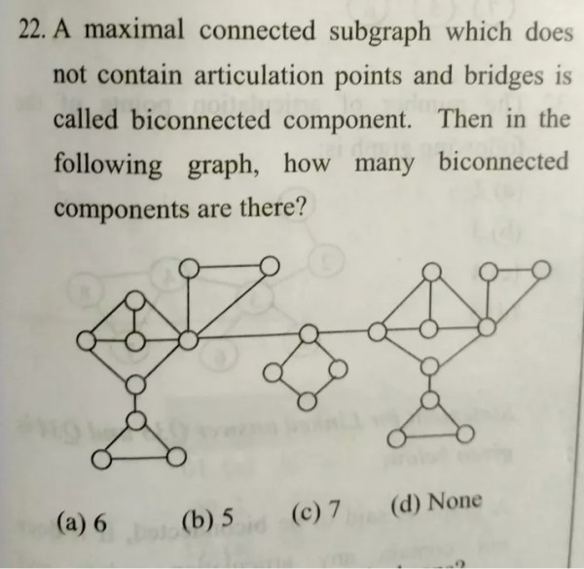
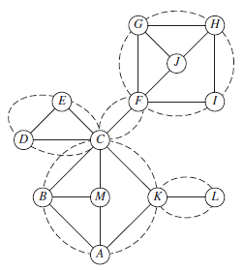
Example

Slide 29
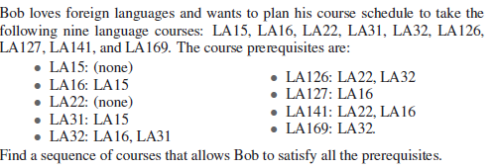
Exercises
Draw a directed graph, having as its eight vertices the strings ’ape’, ’ate’, ’eat’, ’era’, ’pea’, ’rap’, ’rat’, and ’tea’, and including an edge from word x to word y whenever the last two letters of x are the same as the first two letters of y; for instance, you should include an edge from ’ape’ to ’pea’.
Consider the vertices 1 to 10. An edge is created iff the sum of two vertices are divisible by 4. Draw the graph and find the total number of edges.

Slide 30
Exercises
Is the graph connected? If not identify the connected components.

Slide 31
Graphs
Motivation and Terminology
Representations
Traversals
Three Problems

Slide 32
Adjacency Matrix
1
2
3
4
5

Slide 33
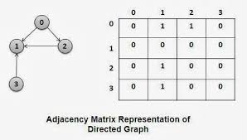
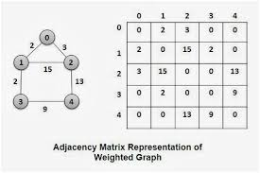
Adjacency Matrix

Slide 34
Adjacency List
1
2
1
2
3
4
5
2 3 4
1 4
3
4
1 4 5
1 2 3 5
5
3 4

Slide 35
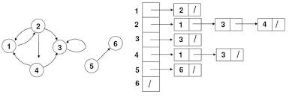
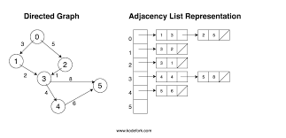
Adjacency List

Slide 36
Tradeoffs Between Adjacency Lists and Adjacency Matrices
Comparison Winner (for worst case)
Faster to test if (x, y) exists? matrices: Θ(1) vs. Θ(V)
Faster to find vertex degree? lists: Θ(1) vs. Θ(V)
Less memory on sparse graphs? lists: Θ(V+E) vs. Θ(V²)
Less memory on dense graphs? matrices: (small win)
Edge insertion or deletion? matrices: Θ(1) vs. Θ(V)
Faster to traverse the graph? lists: Θ(E+V) vs. Θ(V²)
Better for most problems? lists
Notes:
Assume size is kept in the lists.

Slide 37
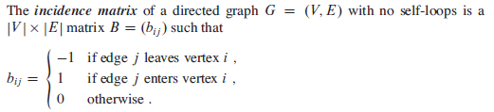
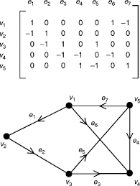
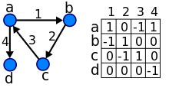
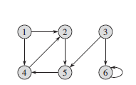
Incidence matrix
1
-1
←Try for this…

Slide 38
Graph Squaring
The square of a directed graph G = (V, E) is the graph G² = (V, E²), such that (x, y) ∈ E² iff, for some z, both (x, z) and (z, y) ∈ E ; i.e., there is a path of exactly two edges.
Try yourself….
Give efficient algorithms to square a graph on both adjacency lists and matrices.

Slide 39
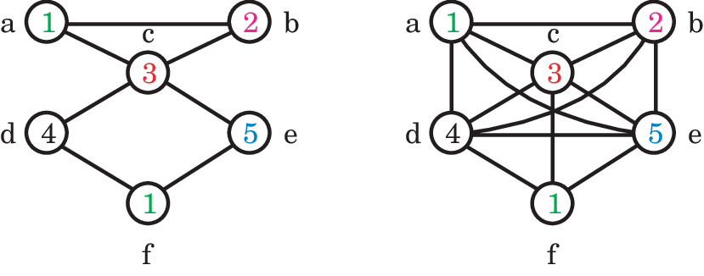
Example

Slide 40
G² with Adjacency Matrices
To discover whether there is an edge (x, y) in E², we do the following.
For each possible intermediate vertex z, we check whether (x, z) and (z, y) exist in O(1); if so for any z, mark (x,y) in E².
Since there are O(V) intermediate vertices to check, and O(V²) pairs of vertices to ask about, this takes O(V³) time.

Slide 41
G² with Adjacency Lists
We use an adjacency matrix as temporary storage.
For each edge (x, z), we run through all the edges (z,y) from z in O(V) time, updating the adjacency matrix for edge (x,y). We convert back to adjacency lists at the end.
It takes O(VE) to construct the edges, and O(V²) to initialize and read the adjacency matrix, for a total of O((V+E)V). Since E+1 ≥ V (unless the graph is disconnected), this is usually simplified to O(VE), and is faster than the previous algorithm on sparse graphs.
Notes:
E ranges between O(V) and O(V²)

Slide 42

Exercises
Write the adjacency matrix, incidence matrix and adjacency list representation of this graph

Slide 43
Graphs
Motivation and Terminology
Representations
Traversals
Three Problems

Slide 44
Traversing a Graph
One of the most fundamental graph problems is to traverse every edge and vertex in a graph. Applications include:
Printing out the contents of each edge and vertex.
Counting the number of edges.
Identifying connected components of a graph.
For correctness, we must do the traversal in a systematic way so that we don't miss anything.
For efficiency, we must make sure we visit each edge at most twice.

Slide 45
Marking Vertices
The idea in graph traversal is that we mark each vertex when we first visit it, and keep track of what is not yet completely explored.
For each vertex, we maintain two flags:
discovered - have we encountered this vertex before?
explored - have we finished exploring this vertex?
We must maintain a structure containing all the vertices we have discovered but not yet completely explored.
Initially, only a single start vertex is set to be discovered.
Notes:
To completely explore a vertex, we look at each edge going out of it. For each edge which goes to an undiscovered vertex, we mark it discovered and add it to the list of work to do.
Note that regardless of what order we fetch the next vertex to explore, each edge is considered exactly twice, when each of its endpoints are explored.

Slide 46
Correctness of Graph Traversal
Every edge and vertex in the connected component is eventually visited.
Suppose not, i.e. there exists a vertex which was unvisited whose neighbor was visited. This neighbor will eventually be explored so we would visit it….

Slide 47
Traversal Orders
The order we explore the vertices depends upon the data structure used to hold the discovered vertices yet to be fully explored:
Queue - by storing the vertices in a first-in, first out (FIFO) queue, we explore the oldest unexplored vertices first. Thus we radiate out slowly from the starting vertex, defining a so-called breadth-first search.
Stack - by storing the vertices in a last-in, first-out (LIFO) stack, we explore the vertices by constantly visiting a new neighbor if one is available; we back up only when surrounded by previously discovered vertices. This defines a so-called depth-first search.

Slide 48
BFS(G,s)
1. for each vertex u in V[G] – {s}
2 do color[u] ← white
3 d[u] ← ∝
4 π[u] ← nil
5 color[s] ← gray
6 d[s] ← 0
7 π[s] ← nil
8 Q ← Φ
9 enqueue(Q,s)
10 while Q ≠ Φ
11 do u ← dequeue(Q)
12 for each v in Adj[u]
13 do if color[v] = white
14 then color[v] ← gray
15 d[v] ← d[u] + 1
16 π[v] ← u
17 enqueue(Q,v)
18 color[u] ← black
white: undiscovered
gray: discovered
black: finished
Q: a queue of discovered vertices
color[v]: color of v
d[v]: distance from s to v
π[u]: predecessor of v

Slide 49
Example (BFS)
r
s
t
u
∞
0
∞
∞
∞
∞
∞
∞
v
w
x
y
Q: s
0
Order of visit:
s

Slide 50
Example (BFS)
r
s
t
u
1
0
∞
∞
∞
1
∞
∞
v
w
x
y
Q: w r
1 1
Order of visit:
s, w, r

Slide 51
Example (BFS)
r
s
t
u
1
0
2
∞
∞
1
2
∞
v
w
x
y
Q: r t x
1 2 2
Order of visit:
s, w, r, t, x

Slide 52
Example (BFS)
r
s
t
u
1
0
2
∞
2
1
2
∞
v
w
x
y
Q: t x v
2 2 2
Order of visit:
s, w, r, t, x, v

Slide 53
Example (BFS)
r
s
t
u
1
0
2
3
2
1
2
∞
v
w
x
y
Q: x v u
2 2 3
Order of visit:
s, w, r, t, x, v, u

Slide 54
Example (BFS)
r
s
t
u
1
0
2
3
2
1
2
3
v
w
x
y
Q: v u y
2 3 3
Order of visit:
s, w, r, t, x, v, u, y

Slide 55
Example (BFS)
r
s
t
u
1
0
2
3
2
1
2
3
v
w
x
y
Q: u y
3 3
Order of visit:
s, w, r, t, x, v, u, y

Slide 56
Example (BFS)
r
s
t
u
1
0
2
3
2
1
2
3
v
w
x
y
Q: y
3
Order of visit:
s, w, r, t, x, v, u, y

Slide 57
Example (BFS)
r
s
t
u
1
0
2
3
2
1
2
3
v
w
x
y
Q: ∅
Order of visit:
s, w, r, t, x, v, u, y

Slide 58
Example (BFS)
r
s
t
u
T
T
1
0
2
3
T
T
T
C
C
2
1
2
3
T
T
v
w
x
y
BF Tree
BFS traversal:
s, w, r, t, x, v, u, y

Slide 59
Analysis of BFS
Initialization takes O(V).
Traversal Loop
After initialization, each vertex is enqueued and dequeued at most once, and each operation takes O(1). So, total time for queuing is O(V).
The adjacency list of each vertex is scanned at most once. The sum of lengths of all adjacency lists is Θ(E).
Summing up over all vertices => total running time of BFS is O(V+E), linear in the size of the adjacency list representation of graph.

Slide 60


BFS- Example 2

Slide 61


BFS- Example 2

Slide 62

BFS- Example 2
BFS tree
C
C
BFS traversal:
1, 2, 5, 3, 6, 4, 7

Slide 63
BFS- Example 2

Slide 64
Exercise- Find the BFS tree and the traversal
D
G
B
J
H
E
K
C
I
A
F
L

Slide 65
Depth-first Search (DFS)
Explore edges out of the most recently discovered vertex v.
When all edges of v have been explored, backtrack to explore other edges leaving the vertex from which v was discovered (its predecessor).
“Search as deep as possible first.”
Continue until all vertices reachable from the original source are discovered.
If any undiscovered vertices remain, then one of them is chosen as a new source and search is repeated from that source.

Slide 66
Depth-first Search
Input: G = (V, E), directed or undirected. No source vertex given!
Output:
2 timestamps on each vertex. Integers between 1 and 2|V|.
d[v] = discovery time (v turns from white to gray)
f [v] = finishing time (v turns from gray to black)
π[v] : predecessor of v = u, such that v was discovered during the scan of u’s adjacency list.
Uses the same coloring scheme for vertices as BFS.

Slide 67
Pseudo-code
DFS(G)
1. for each vertex u ∈ V[G]
2. do color[u] ← white
3. π[u] ← NIL
4. time ← 0
5. for each vertex u ∈ V[G]
6. do if color[u] = white
7. then DFS-Visit(u)
DFS-Visit(u)
color[u] ← GRAY ∇ White vertex u has been discovered
time ← time + 1
d[u] ← time
for each v ∈ Adj[u]
do if color[v] = WHITE
then π[v] ← u
DFS-Visit(v)
color[u] ← BLACK ∇ Blacken u; it is finished.
f[u] ← time ← time + 1
Uses a global timestamp time.

Slide 68
Example (DFS)
u
v
w
1/
x
y
z

Slide 69
Example (DFS)
u
v
w
1/
2/
x
y
z

Slide 70
Example (DFS)
u
v
w
1/
2/
3/
x
y
z

Slide 71
Example (DFS)
u
v
w
1/
2/
4/
3/
x
y
z

Slide 72
Example (DFS)
u
v
w
1/
2/
B
4/
3/
x
y
z

Slide 73
Example (DFS)
u
v
w
1/
2/
B
4/5
3/
x
y
z

Slide 74
Example (DFS)
u
v
w
1/
2/
B
4/5
3/6
x
y
z

Slide 75
Example (DFS)
u
v
w
1/
2/7
B
4/5
3/6
x
y
z

Slide 76
Example (DFS)
u
v
w
1/
2/7
F
B
4/5
3/6
x
y
z

Slide 77
Example (DFS)
u
v
w
1/8
2/7
F
B
4/5
3/6
x
y
z

Slide 78
Example (DFS)
u
v
w
1/8
2/7
9/
F
B
4/5
3/6
x
y
z

Slide 79
Example (DFS)
u
v
w
1/8
2/7
9/
F
B
C
4/5
3/6
x
y
z

Slide 80
Example (DFS)
u
v
w
1/8
2/7
9/
F
B
C
4/5
3/6
10/
x
y
z

Slide 81
Example (DFS)
u
v
w
1/8
2/7
9/
F
B
C
4/5
3/6
10/
B
x
y
z

Slide 82
Example (DFS)
u
v
w
1/8
2/7
9/
F
B
C
4/5
3/6
10/11
B
x
y
z

Slide 83
Example (DFS)
u
v
w
1/8
2/7
9/12
F
B
C
4/5
3/6
10/11
B
x
y
z
DFS traversal:
u, v, y, x, w, z

Slide 84
Analysis of DFS
Loops on lines 1-2 & 5-7 take Θ(V) time, excluding time to execute DFS-Visit.
DFS-Visit is called once for each white vertex v∈V when it’s painted gray the first time. Lines 3-6 of DFS-Visit is executed |Adj[v]| times. The total cost of executing DFS-Visit is ∑_{v∈V}|Adj[v]| = Θ(E)
Total running time of DFS is Θ(V+E).

Slide 85

DFS – Example 2
DFS traversal:
1
DFS traversal:
1, 2,
DFS traversal:
1, 2, 6

Slide 86

DFS – Example 2
DFS traversal:
1, 2, 6
DFS traversal:
1, 2, 6, 4
DFS traversal:
1, 2, 6, 4

Slide 87

DFS – Example 2
DFS traversal:
1, 2, 6, 4
DFS traversal:
1, 2, 6, 4, 5
DFS traversal:
1, 2, 6, 4, 5

Slide 88

DFS – Example 2
DFS traversal:
1, 2, 6, 4, 5, 3
DFS traversal:
1, 2, 6, 4, 5, 3, 7
DFS traversal:
1, 2, 6, 4, 5, 3, 7

Slide 89

DFS – Example 2
DFS traversal:
1, 2, 6, 4, 5, 3, 7

Slide 90
DFS – Example 2
DFS traversal:
1, 2, 6, 4, 5, 3, 7

Slide 91

Example 3 – Identify the edges
S, 1, 2, 3, 4, 5, 6, 7

Slide 92
Exercise – Perform DFS
D
G
B
J
H
E
K
C
I
A
F
L

Slide 93
Directed Graph DFS trees
Things are a bit more complicated
Forward edges (ancestor to descendant)
Cross Edges
Not from an ancestor to a descendant
Parenthesis structure still holds
The discovery and finishing times of nodes in a DFS tree have a parenthesis structure
Can create a forest of DFS trees

Slide 94
Classification of Edges
Tree edge: in the depth-first forest. Found by exploring (u, v).
Back edge: (u, v), where u is a descendant of v (in the depth-first tree).
Forward edge: (u, v), where v is a descendant of u, but not a tree edge.
Cross edge: any other edge. Can go between vertices in same depth-first tree or in different depth-first trees.
In DFS of an undirected graph, we get only tree and back edges. No forward or cross edges.

Slide 95

Exercises

Slide 96
Graphs
Motivation and Terminology
Representations
Traversals
Three Problems

Slide 97


Bipartite Graph?
Give an efficient algorithm to determine if a graph is bipartite. (Bipartite means that the graph can be colored with 2 colors such that all edges connect vertices of different colors. )
A graph is bipartite if:
Vertices can be split into two sets $V_{1}$and $V_{2}$
Every edge (if it exists) goes between the two sets
There is no requirement that every possible cross-edge must exist
No edges between the same sets
A graph is complete bipartite if:
It is bipartite and
Every vertex in $V_{1}$is connected to every vertex in $V_{2}$

Slide 98
Cycle?
Give an O(V) algorithm to determine if an undirected graph contains a cycle.
Note: Full traversal by BFS and DFS both take O(V+E) time.

Slide 99
Topological Sorting?
A directed acyclic graph (DAG) is a directed graph with no directed cycles.
A topological sort is an ordering of nodes where all edges go from left to right.
How can BFS or DFS help us topologically sort a directed graph (or determine the graph is not a DAG)?
A
B
C
A
C
F
B
D
E
D
E
F

Slide 100
DAGs and Topological Ordering
D
E
A directed acyclic graph (DAG) is a digraph that has no directed cycles
A topological ordering of a digraph is a numbering
v₁ , …, v_{n}
of the vertices such that for every edge (v_{i} , v_{j}), we have i < j
Example: in a task scheduling digraph, a topological ordering a task sequence that satisfies the precedence constraints
Theorem
A digraph admits a topological ordering if and only if it is a DAG
B
C
A
DAG G
v₄
v₅
D
E
v₂
B
v₃
v₁
C
Topological ordering of G
A

Slide 101

Example 1 – Topological Ordering

Slide 102


Example 1

Slide 103

Example 1

Slide 104

Example 1

Slide 105

Algorithm

Slide 106

Algorithm

Slide 107

Example 2 - Topological Sort
C
G
A
B
D
E
F
H

Slide 108




Example 2 - Topological Sort

Slide 109


Example 2 - Topological Sort

Slide 110


Example 2 - Topological Sort

Slide 111


Example 2 - Topological Sort

Slide 112


Example 2 - Topological Sort

Slide 113
Example 2 - Topological Sort (Alternate Way)
C
G
A
B
D
E
F
H

Slide 114
Topological Sort: DFS
C
dfs(A)
G
A
B
D
E
F
H

Slide 115
Topological Sort: DFS
C
dfs(A)
dfs(D)
G
A
B
D
E
F
H

Slide 116
Topological Sort: DFS
C
dfs(A)
dfs(D)
dfs(E)
G
A
B
D
E
F
H

Slide 117
Topological Sort: DFS
C
dfs(A)
dfs(D)
dfs(E)
dfs(F)
G
A
B
D
E
F
H

Slide 118
Topological Sort: DFS
C
dfs(A)
dfs(D)
dfs(E)
dfs(F)
dfs(H)
G
A
B
D
E
F
H

Slide 119
Topological Sort: DFS
C
dfs(A)
dfs(D)
dfs(E)
dfs(F)
G
A
B
D
E
F
H
7

Slide 120
Topological Sort: DFS
C
dfs(A)
dfs(D)
dfs(E)
G
A
B
D
E
F
6
H
7

Slide 121
Topological Sort: DFS
C
dfs(A)
dfs(D)
G
A
B
D
E
5
F
6
H
7

Slide 122
Topological Sort: DFS
C
dfs(A)
dfs(D)
G
A
B
D
E
5
F
6
H
7

Slide 123
Topological Sort: DFS
C
dfs(A)
G
A
B
D
E
4
5
F
6
H
7

Slide 124
Topological Sort: DFS
C
dfs(A)
G
A
B
D
E
4
5
F
6
H
7

Slide 125
Topological Sort: DFS
C
G
A
3
B
D
E
4
5
F
6
H
7

Slide 126
Topological Sort: DFS
C
dfs(B)
G
A
3
B
D
E
4
5
F
6
H
7

Slide 127
Topological Sort: DFS
C
dfs(B)
G
A
3
B
D
E
4
5
F
6
H
7

Slide 128
Topological Sort: DFS
C
G
A
3
B
2
D
E
4
5
F
6
H
7

Slide 129
Topological Sort: DFS
C
dfs(C)
G
A
3
B
2
D
E
4
5
F
6
H
7

Slide 130
Topological Sort: DFS
C
dfs(C)
G
A
3
B
2
D
E
4
5
F
6
H
7

Slide 131
Topological Sort: DFS
C
dfs(C)
G
A
3
B
2
D
E
4
5
F
6
H
7

Slide 132
Topological Sort: DFS
C
dfs(C)
G
A
3
B
2
D
E
4
5
F
6
H
7

Slide 133
Topological Sort: DFS
C
dfs(C)
dfs(G)
G
A
3
B
2
D
E
4
5
F
6
H
7

Slide 134
Topological Sort: DFS
C
dfs(C)
G
1
A
3
B
2
D
E
4
5
F
6
H
7

Slide 135
Topological Sort: DFS
0
C
G
1
A
3
B
2
D
E
4
5
F
6
H
7

Slide 136
Topological Sort: DFS
0
C
G
1
A
3
B
2
D
E
4
5
F
6
H
7
Topological order: C G B A D E F H

Slide 137


Exercise – Find the Topological order

