Slide 1
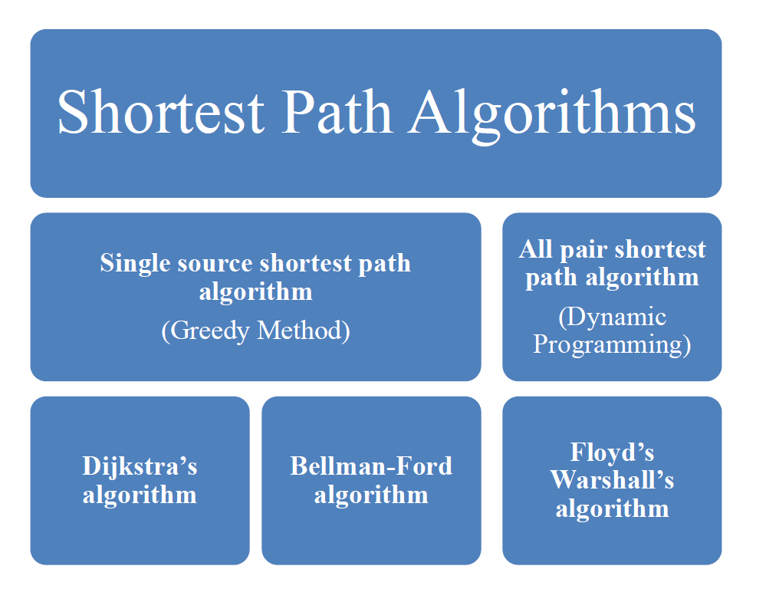
DAG Algorithm

Slide 2
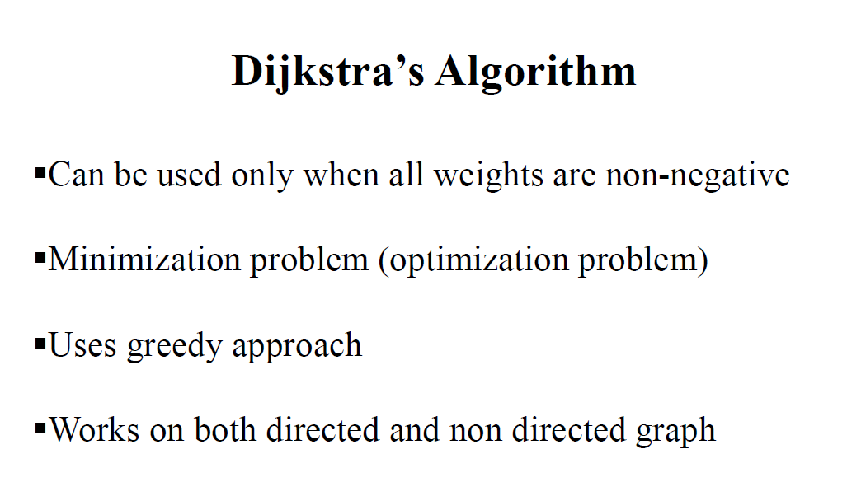
Can be used only when the graph do not have a negative weight cycle
Undirected graphs

Slide 3
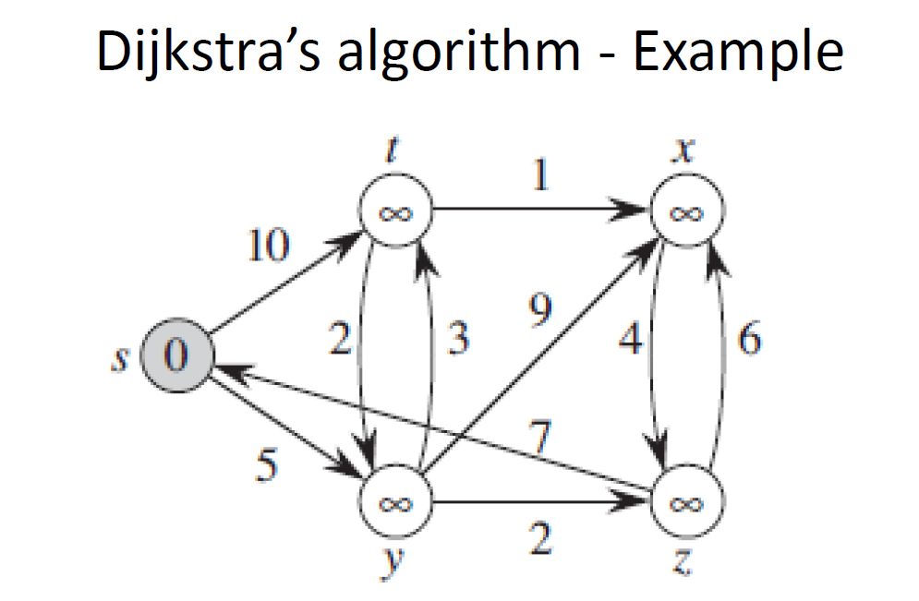

Slide 4
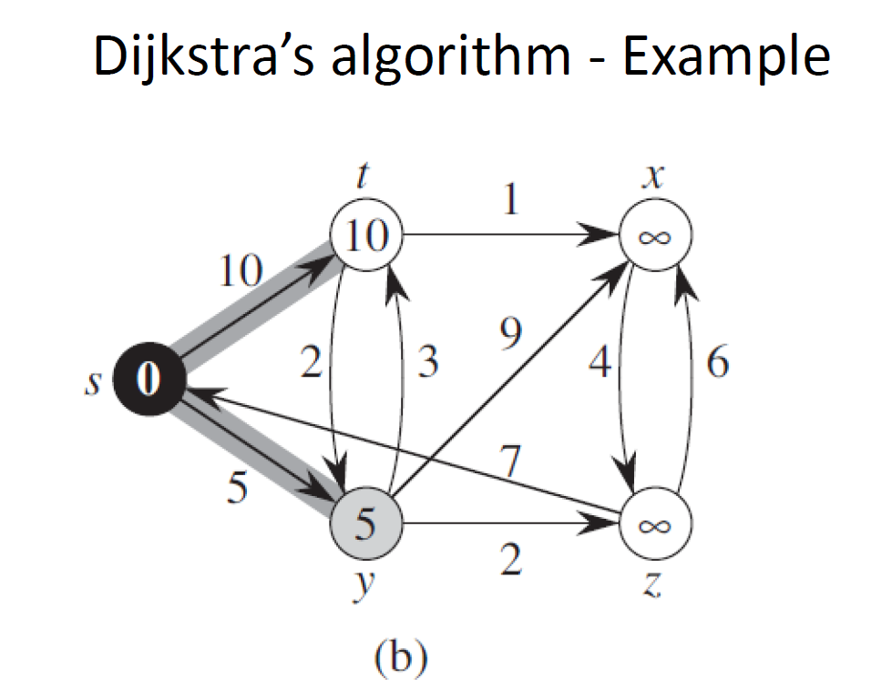

Slide 5
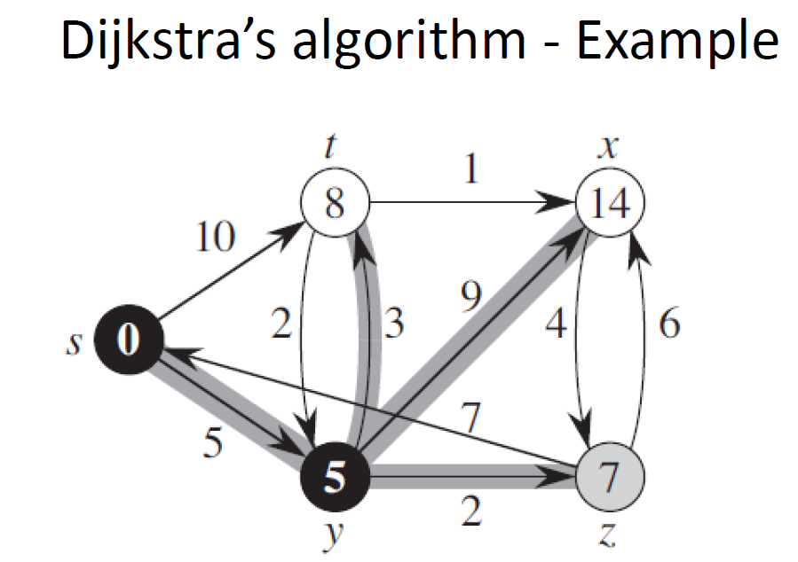

Slide 6
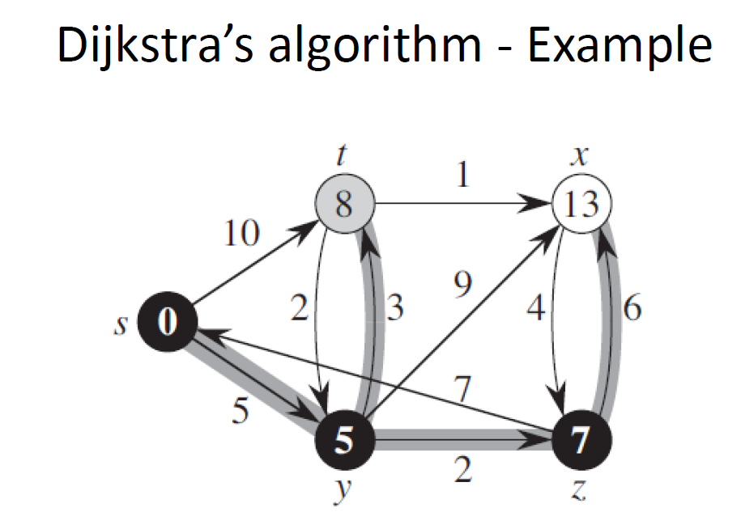

Slide 7
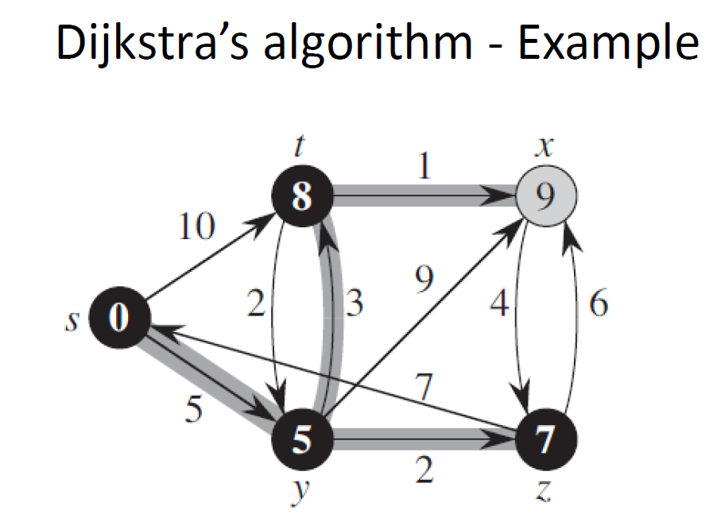

Slide 8
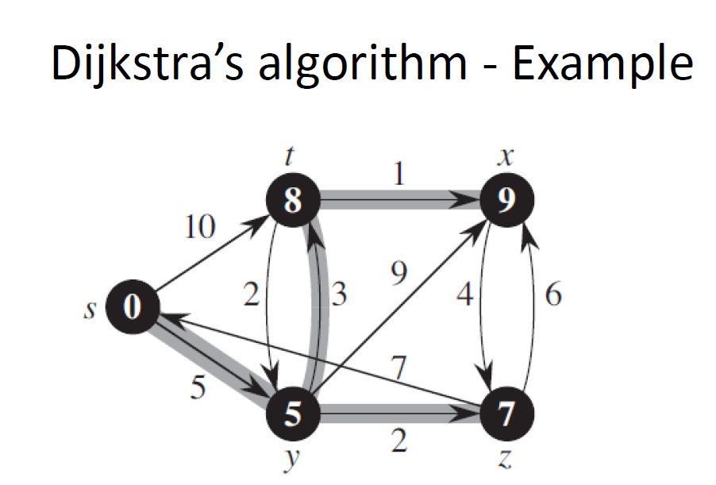

Slide 9
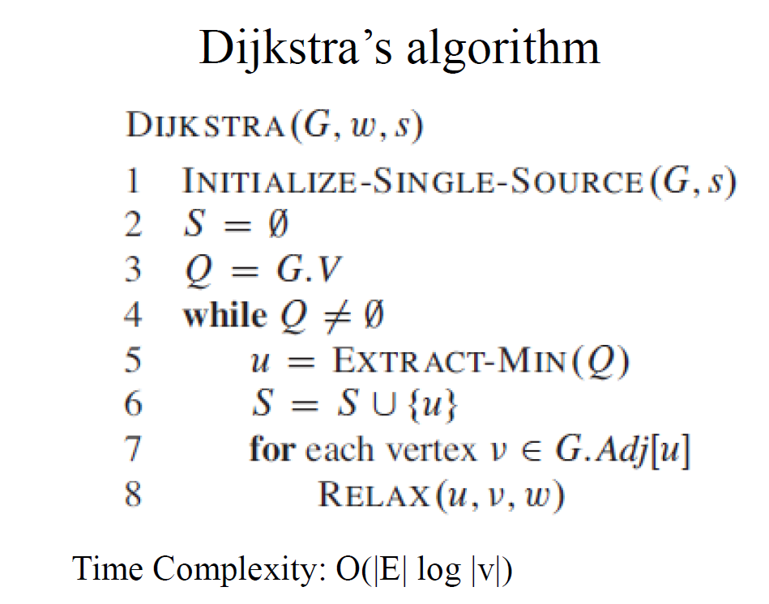

Slide 10
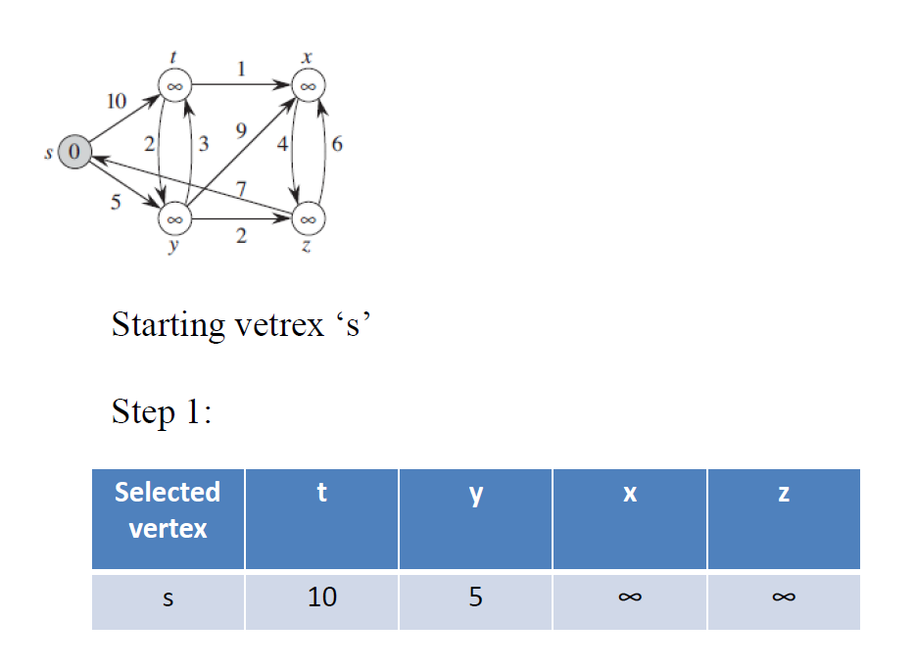

Slide 11
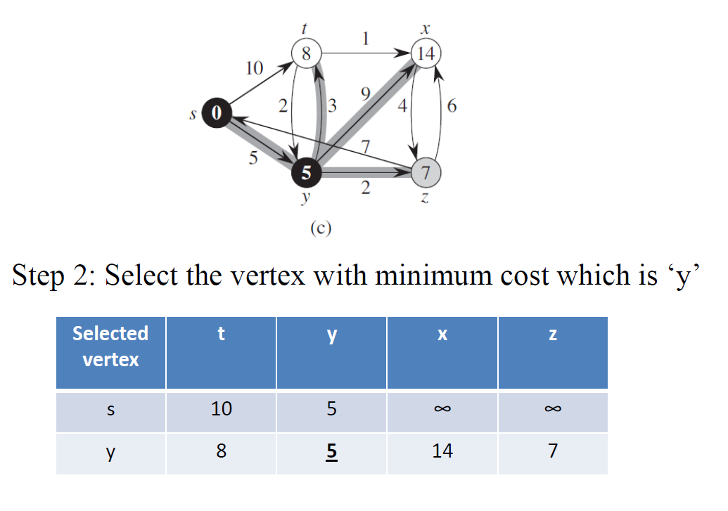

Slide 12
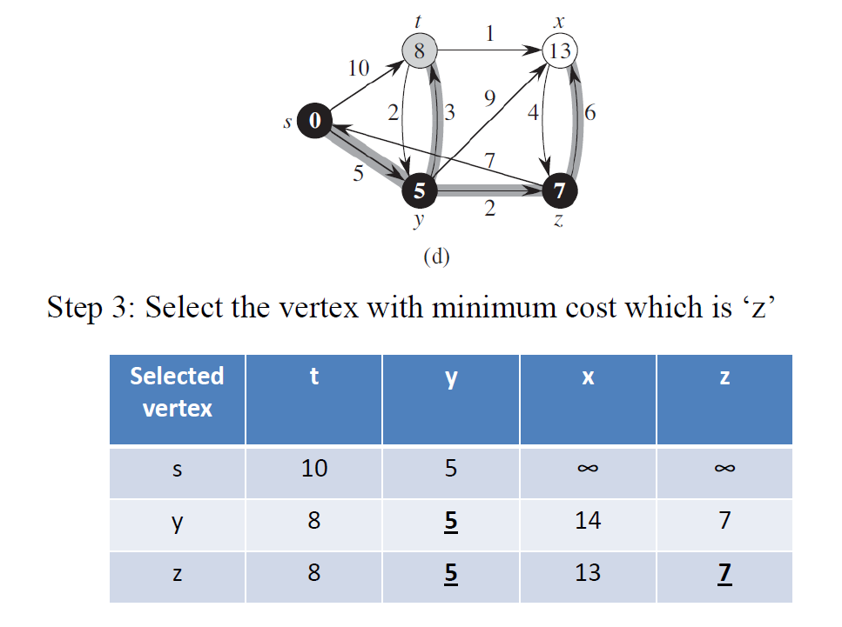

Slide 13
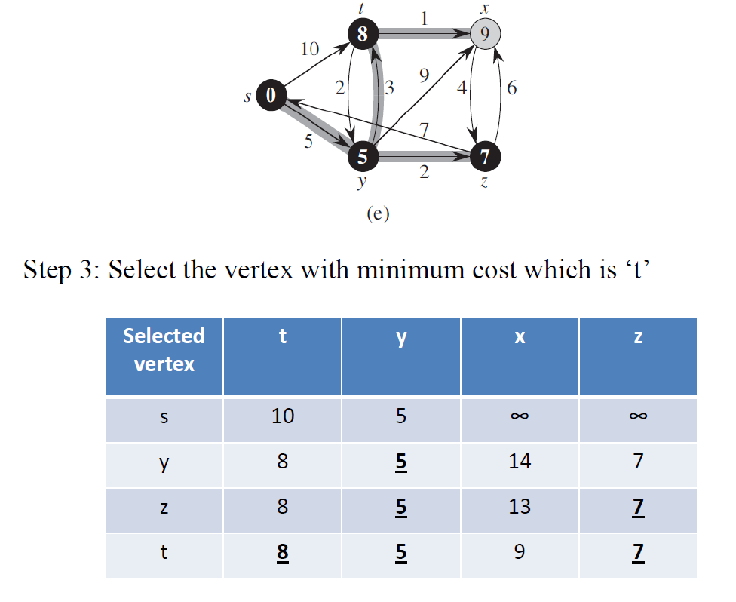

Slide 14
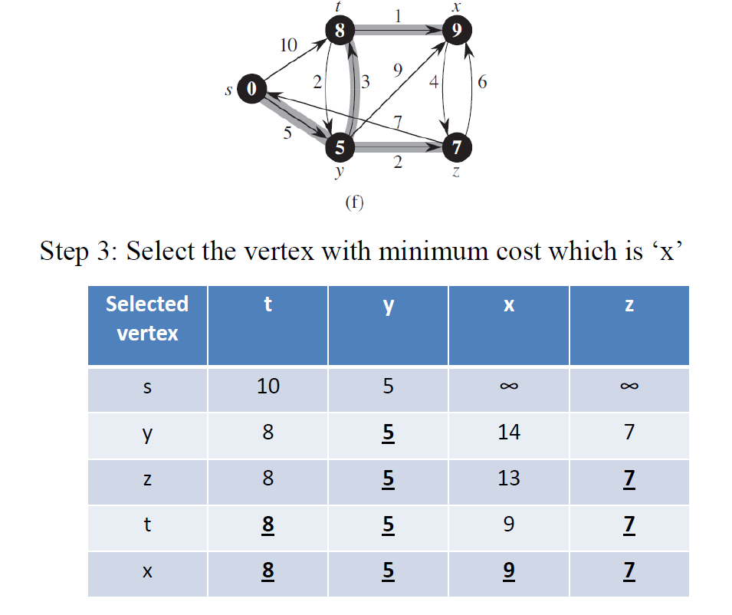

Slide 15
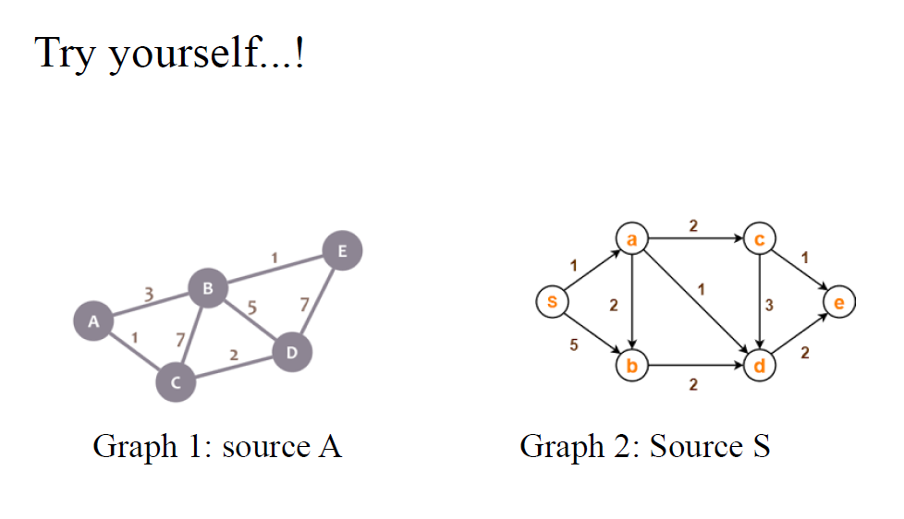
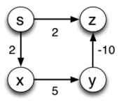

Slide 16


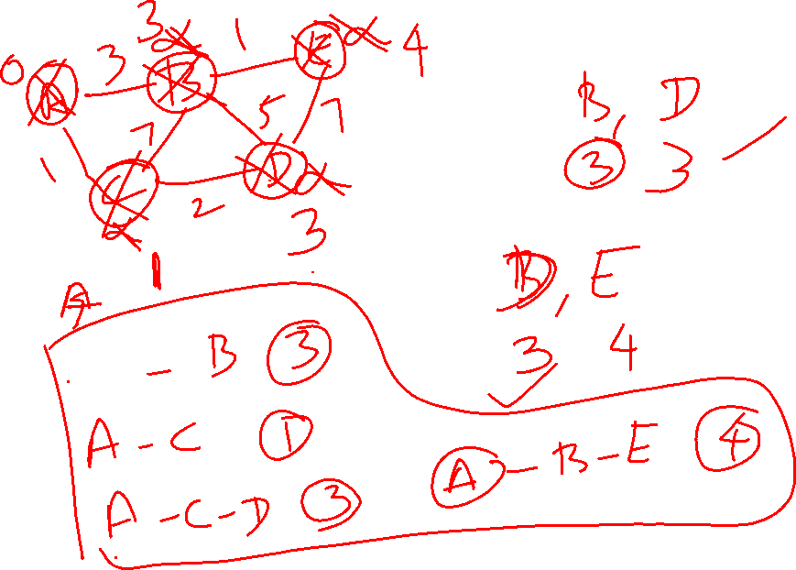


Slide 17
Bellman Ford Algorithm
Single source shortest path algorithm.
Bellman Ford algorithm works for negative weighted graphs.
Principle of this algorithm is, go on relaxing all the edges (n-1) times where ‘n’ is number of edges.
Relaxation – updating process
If (d[u] + c(u,v) < d[v])
d[v] = d[u] + c(u,v)

Slide 18
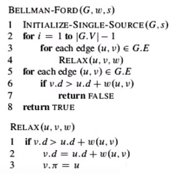

Slide 19
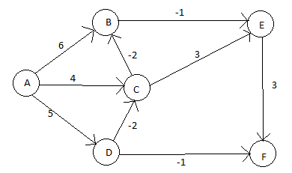
Example 1: Find the shortest path from A to all other vertices.

Slide 20
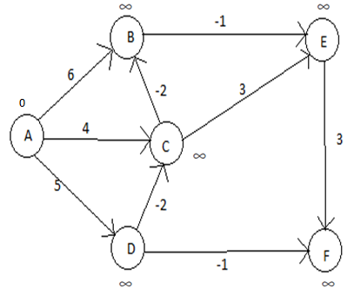
Step 1: Initialization

Slide 21
Step 2: List all the edges present in the graph.
Edges: (AB), (AC), (AD), (BE), (CB), (CE), (DC), (DF), (EF)

Slide 22
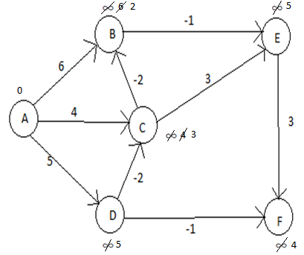
Step 3: Relaxation
1st Iteration: (AB), (AC), (AD), (BE), (CB), (CE), (DC), (DF), (EF)

Slide 23
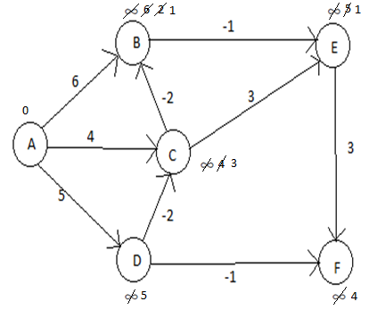
2nd Iteration : (AB), (AC), (AD), (BE), (CB), (CE), (DC), (DF), (EF)

Slide 24
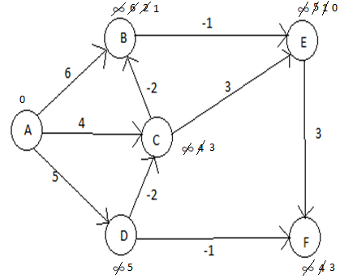
3rd Iteration : (AB), (AC), (AD), (BE), (CB), (CE), (DC), (DF), (EF)

Slide 25
4th Iteration: (AB), (AC), (AD), (BE), (CB), (CE), (DC), (DF), (EF)

Slide 26
Observation:
Though we are suppose to do five iterations here, we observed that
there is no update in the 4th iteration. Hence we stop here, however
the algorithm continues till (n-1) iterations.
Disadvantage:
The disadvantage of Bellman Ford algorithm is, it will not work when
there is a negative edge cycle present in the graph.
But a variation of the algorithm works for n-1 cycles and still if the cost
changes, concludes that the graph leads to a negative weight cycle.

Slide 27
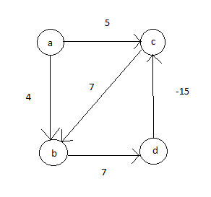
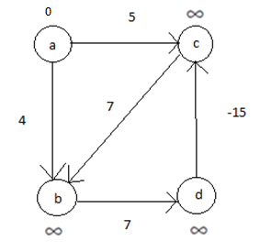
Example 2:
Step 1: Initialization

Slide 28
Step 2: List all the edges present in the graph.
Edges: (ab), (ac), (bd), (cb), (dc)

Slide 29
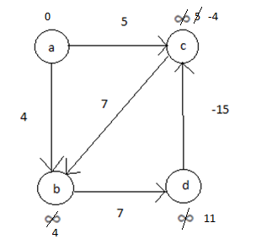
Step 3: Relaxation.
1st Iteration: (ab), (ac), (bd), (cb), (dc)

Slide 30
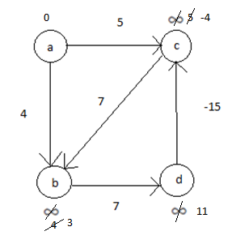
2nd Iteration: (ab), (ac), (bd), (cb), (dc)

Slide 31
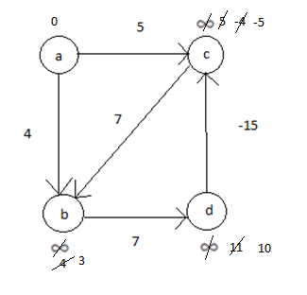
3rd Iteration: (ab), (ac), (bd), (cb), (dc)
According to algorithm, from a we have found shortest path to all other nodes, but continue for one more iteration...

Slide 32
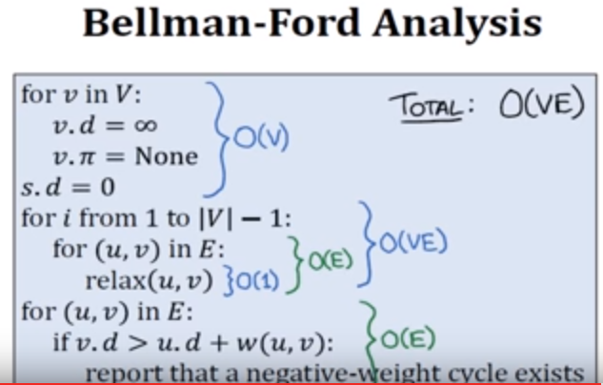

Slide 33
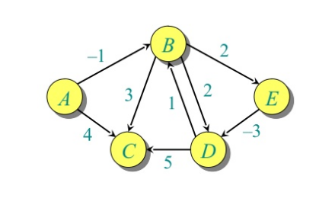
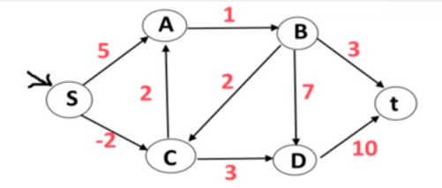
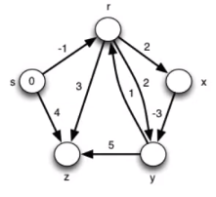
Try it yourself..!

Slide 34
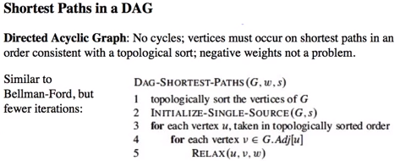
DAG Algorithm

Slide 35
Single-Source Shortest Paths in DAGs
Runs in linear time: Θ(V+E)
topological sort: Θ(V+E)
initialization: Θ(V+E)
for-loop: Θ(V+E)
each vertex processed exactly once
=> each edge processed exactly once: Θ(V+E)

Slide 36
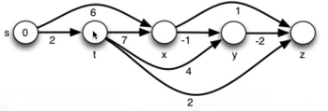
Example 1

Slide 37
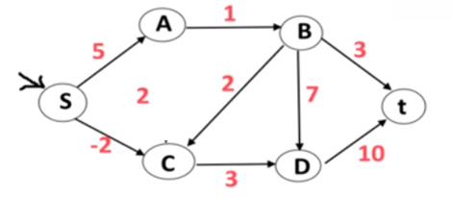
Example 2

Slide 38
All Pair Shortest Path Algorithm
Shortest path between every pair of vertices.
Floyd-Warshall algorithm.
Dynamic programming approach.
Input: Weighted graph without negative cycles.

Slide 39
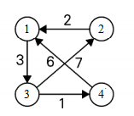
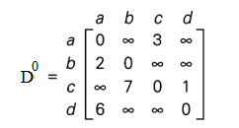
Example 1:
Step 1: Write the adjacency matrix of the graph.

Slide 40
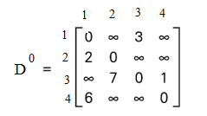

Step 2: To write the D¹ matrix keep 1st row, 1st column unaltered and use the below formula to fill the other values of matrix.
D ^{k} [i,j] ← min [ D^{k-1}[i,j], D^{k-1}[i,k] + D^{k-1}[k,j] ] where k varies from 1 to n which is the number of vertices.
D ^{k} [i,j] ← min [ D^{k-1}[i,j], D^{k-1}[i,k] + D^{k-1}[k,j] ]
D¹[2,3] ← min [ D¹⁻¹[2,3], D¹⁻¹[2,1] + D¹⁻¹[1,3] ]
min [ ∞, 5] = 5
Similarly find the other values of matrix which is D¹

Slide 41
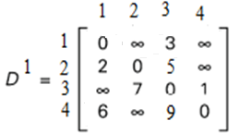

Step 3: To write the D² matrix keep 2nd row, 2nd column unaltered and use the below formula to fill the other values of matrix.
D ^{k} [i,j] ← min [ D^{k-1}[i,j], D^{k-1}[i,k] + D^{k-1}[k,j] ]
D²[3,1] ← min [ D²⁻¹[3,1], D²⁻¹[3,2] + D²⁻¹[2,1] ]
min [ ∞, 9] = 9

Slide 42


Step 3: To write the D³ matrix keep 3nd row, 3nd column unaltered and use the below formula to fill the other values of matrix.
D ^{k} [i,j] ← min [ D^{k-1}[i,j], D^{k-1}[i,k] + D^{k-1}[k,j] ]
D³[1,2] ← min [ D³⁻¹[1,2], D³⁻¹[1,3] + D³⁻¹[3,2] ]
min [ ∞, 10] = 10

Slide 43


Step 4: To write the D⁴ matrix keep 4th row, 4th column unaltered and use the below formula to fill the other values of matrix.
D ^{k} [i,j] ← min [ D^{k-1}[i,j], D^{k-1}[i,k] + D^{k-1}[k,j] ]
D⁴[3,1] ← min [ D⁴⁻¹[3,1], D⁴⁻¹[3,4] + D⁴⁻¹[4,1] ]
min [ 9, 7] = 7

Slide 44
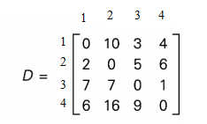
When the value of k =4, algorithm will stop working since there are only 4 vertices.

Slide 45
Example
2
4
3
1 2 3 4 5
1
2
3
4
5
0 | 3 | 8 | ∞ | -4
∞ | 0 | ∞ | 1 | 7
∞ | 4 | 0 | ∞ | ∞
2 | ∞ | -5 | 0 | ∞
∞ | ∞ | ∞ | 6 | 0
1
8
3
2
-4
1
-5
7
5
4
6

Slide 46
Example
2
4
3
1 2 3 4 5
1
2
3
4
5
0 | 3 | 8 | ∞ | -4
∞ | 0 | ∞ | 1 | 7
∞ | 4 | 0 | ∞ | ∞
2 | 5 | -5 | 0 | -2
∞ | ∞ | ∞ | 6 | 0
1
8
3
2
-4
1
-5
7
5
4
6

Slide 47
Example
2
4
3
1 2 3 4 5
1
2
3
4
5
0 | 3 | 8 | 4 | -4
∞ | 0 | ∞ | 1 | 7
∞ | 4 | 0 | 5 | 11
2 | 5 | -5 | 0 | -2
∞ | ∞ | ∞ | 6 | 0
1
8
3
2
-4
1
-5
7
5
4
6

Slide 48
Example
2
4
3
1 2 3 4 5
1
2
3
4
5
0 | 3 | 8 | 4 | -4
∞ | 0 | ∞ | 1 | 7
∞ | 4 | 0 | 5 | 11
2 | -1 | -5 | 0 | -2
∞ | ∞ | ∞ | 6 | 0
1
8
3
2
-4
1
-5
7
5
4
6

Slide 49
Example
2
4
3
1 2 3 4 5
1
2
3
4
5
0 | 3 | -1 | 4 | -4
3 | 0 | -4 | 1 | -1
7 | 4 | 0 | 5 | 3
2 | -1 | -5 | 0 | -2
8 | 5 | 1 | 6 | 0
1
8
3
2
-4
1
-5
7
5
4
6

Slide 50
Example
2
4
3
1 2 3 4 5
1
2
3
4
5
0 | 1 | -3 | 2 | -4
3 | 0 | -4 | 1 | -1
7 | 4 | 0 | 5 | 3
2 | -1 | -5 | 0 | -2
8 | 5 | 1 | 6 | 0
1
8
3
2
-4
1
-5
7
5
4
6

Slide 51
Algorithm Floyd Warshall
for i← 1 to n do
for j← 1 to n do
if (i==j) then
D[i,j] ← 0
else if ((v_{i}, v_{j}) is an edge in graph) then
D[i,j] ← W[i,j]
else
D[i,j] ← ∞
end for
end for
for k← 1 to n do
for i← 1 to n do
for j← 1 to n do
D ^{k} [i,j] ← min [ D^{k-1}[i,j], D^{k-1}[i,k] + D^{k-1}[k,j] ]
end for
end for
end for
Complexity: T(n) = O(n²) + O(n³) = O(n³)

Slide 52
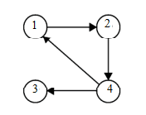
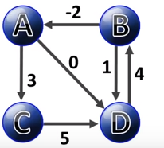
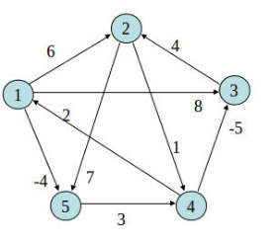
Example 2: Try yourself..!
Example 3: Try yourself..!
1
1
8
4
2
4
2
1
3

