Slide 1
Backtracking

Slide 2
Backtracking
Suppose you have to make a series of decisions, among various choices, where
– You don’t have enough information to know what to choose
– Each decision leads to a new set of choices
– Some sequence of choices (possibly more than one) may be a
solution to your problem
Backtracking is a methodical way of trying out various sequences of decisions, until you find one that “works”
Solutions to many combinatorial optimization problems include exhaustive search and Backtracking can be used to reduce the cost involved

Slide 3
Example
Problem:
Find out all 3-bit binary numbers for which the sum of the 1's is greater than or equal to 2.
The only way to solve this problem is to check all the possibilities:
(000, 001, 010, ....,111)
The 8 possibilities are called the search space of the problem. They can be organized into a tree generally called as state space tree.

Slide 4
State space tree
A rooted tree where each level represents a choice in the solution space that depends on
the level above and
any possible solution is represented by some path starting out at the root and ending at a leaf
Root represents state where no partial solution has been made
A leaf represents the state where all choices making up a solution have been made
A node in a state-space tree is promising if it corresponds to a partial solution that may still lead to a complete solution otherwise it is called nonpromising

Slide 5
Coming back to the example…
Problem:
Find out all 3-bit binary numbers for which the sum of the 1's is greater than or equal to 2.
The only way to solve this problem is to check all the possibilities:
(000, 001, 010, ....,111)
The 8 possibilities are called the search space of the problem. They can be organized into a tree generally called as state space tree.

Slide 6
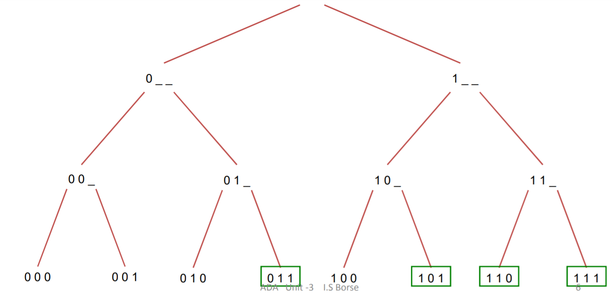
Example – state space tree

Slide 7
Backtracking - relook
For some problems, the only way to solve is to check all possibilities.
Backtracking is a systematic way to go through all the possible configurations of a search space.
Backtracking is easily implemented with recursion because:
The run-time stack takes care of keeping track of the choices that got us to a given point.
Upon failure we can get to the previous choice simply by returning a failure code from the recursive call.
Optimized Backtracking:
It help us to reduce the search space and hence get a solution faster.
The idea is to avoid those paths that may not lead to solutions as early as possible by finding contradictions so that we can backtrack immediately without the need to build a hopeless solution vector.

Slide 8
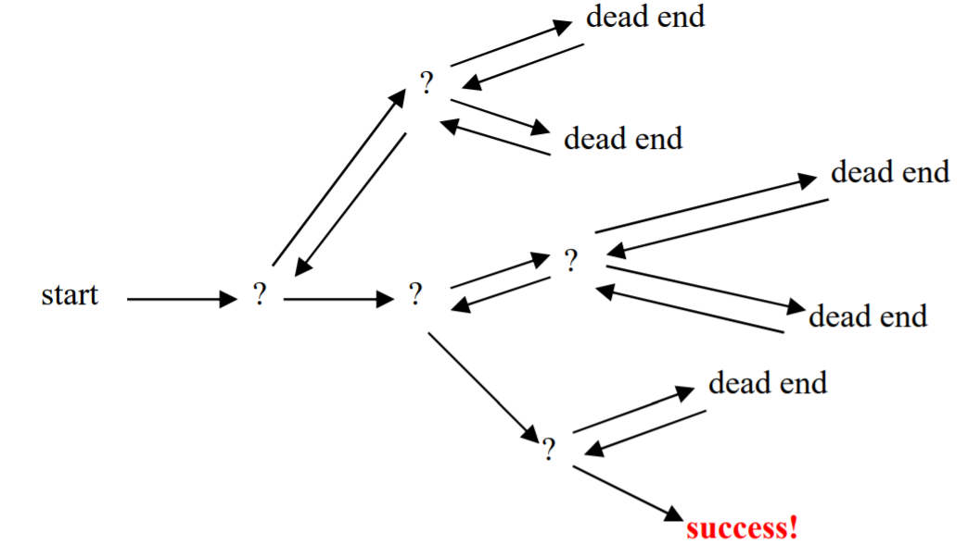
Backtracking Examples
Solving a Maze
N Queen’s problem
Sudoku solving
Map coloring etc.

Slide 9
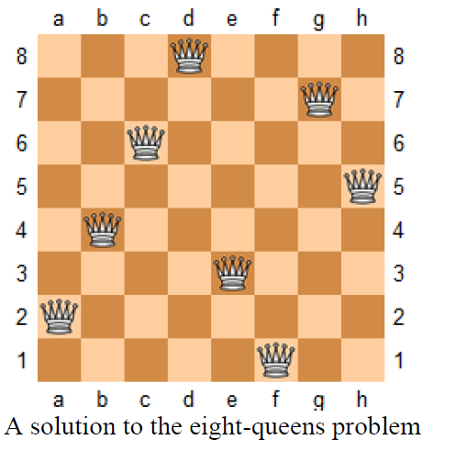
N-Queen’s problem
Given: n-queens and an nxn chess board
Find: A way to place all n queens on the board s.t. no queens are attacking each other (i.e.)
No two queens on the same row or column or diagonal
If n=1, trivial case
No solution for n=2 or 3

Slide 10
Solution to 4-queens problem
 | Q1 | Q2 | Q3 | Q4
1
2
3
4
Start in the leftmost column
If all queens are placed
return true
3) Try all rows in the current column. Do
following for every tried row.
a) If the queen can be placed safely in
this row then mark this [row, column]
as part of the solution and
recursively check if placing queen
here leads to a solution.
b) If placing the queen in [row, column]
leads to a solution then return true.
c) If placing queen doesn't lead to a
solution then unmark this [row,
column] (Backtrack) and go to step (a)
to try other rows.
4) If all rows have been tried and nothing
worked, return false to trigger backtracking.
Efficient version is:
After placing the first Queen in the first cell, leave the current column and first row in the next column and proceed
After placing the 2nd Queen, leave the current column and first 2 rows in the next column
Repeat the same till you have a solution or backtrack to the previous placement and change the position
Repeat until you return a true or a false

Slide 11
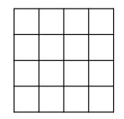
4-queens problem -state space tree
Root
Q
Q
 | Q
Q
 | Q
Not possible, so backtrack to the previous successful placement and change the Queen to the next possible position and continue

Slide 12
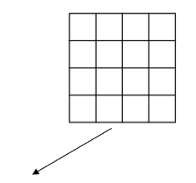
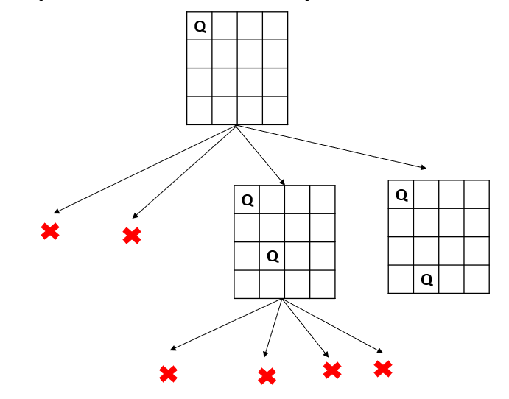
4-queens problem-state space tree --contd
Not possible, so backtrack to the previous successful placement and change the Queen to the next possible position and continue
Q
 |  | Q
 | Q
Not possible, so backtrack to the previous successful placement and change the Queen to the next possible position and continue

Slide 13
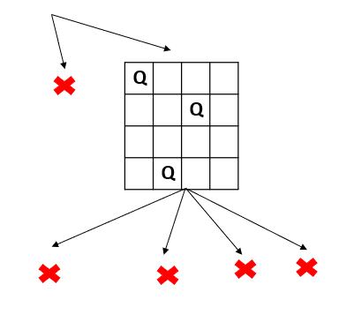
4-queens problem-state space tree --contd
Q
Q
 | Q

Slide 14
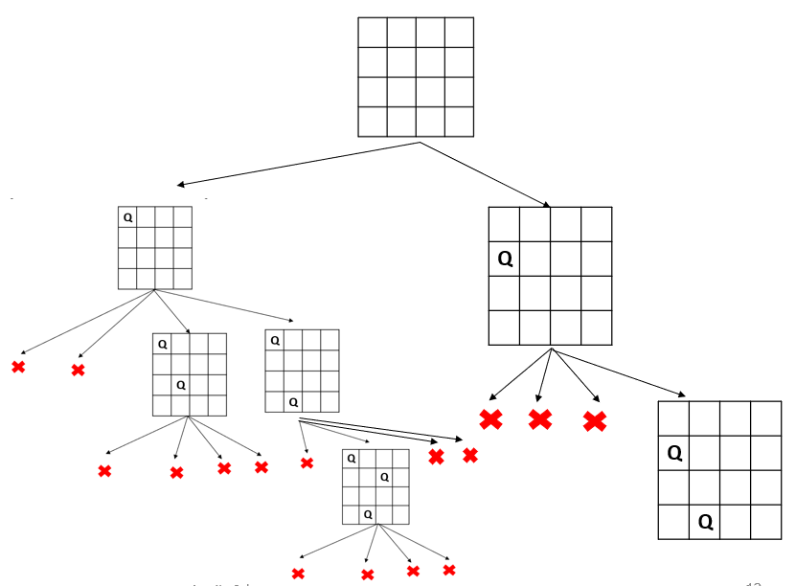
4-queens problem-state space tree --contd
 |  | Q
Q
 | Q
 |  | Q
Q
 |  |  | Q
 | Q
One Possible Final Solution

Slide 15
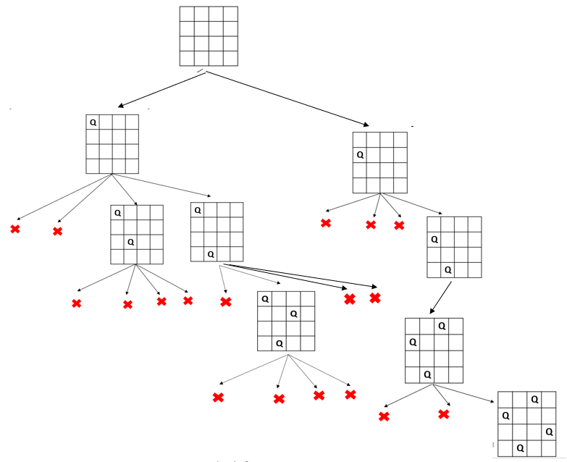
4-queens problem - final state space tree

Slide 16
2-Queens Problem
Q
Q
No Solution

Slide 17
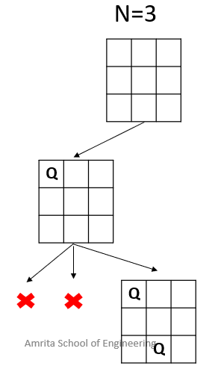
3-Queens Problem
Q
Q
Q
 | Q
Q
Q
 | Q
No Solution

Slide 18
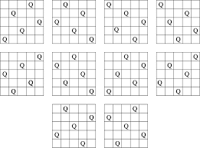
5-Queens problem
Find the solution to place 5 queens on a 5X5 chessboard
There are many solutions
Depends on where the first queen is placed

Slide 19
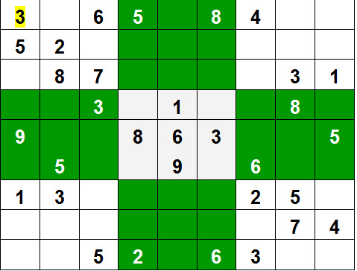
Sudoku

Slide 20
Sudoku Solving - 9x9 grid
Find row, column of an unassigned cell
If there is none, return true
For digits from 1 to 9
If there is no conflict for digit at row, col
assign digit to row, col and recursively try filling in the rest of the grid
b) If recursion successful, return true
c) else, remove digit and try another
If all digits have been tried and nothing worked, return false

Slide 21
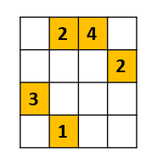
Example – 4x4 puzzle
Find the missed entries using backtracking approach

Slide 22
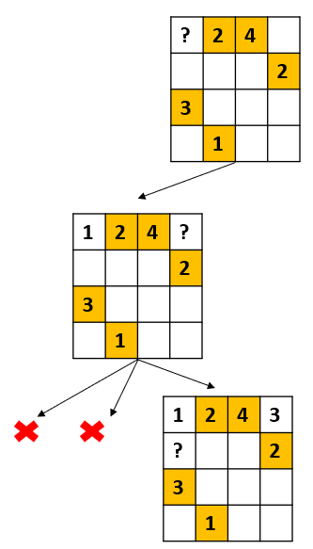
Example – 4x4 puzzle
? | 2 | 4
 |  |  | 2
3
 | 1
1 | 2 | 4 | ?
 |  |  | 2
3
 | 1
1 | 2 | 4 | 3
4 | ? |  | 2
3
 | 1
1 | 2 | 4 | 3
? |  |  | 2
3
 | 1
1 | 2 | 4 | 3
4 | 3 | ? | 2
3
 | 1

Slide 23
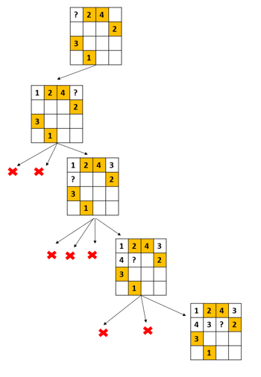
Example – 4x4 puzzle
1 | 2 | 4 | 3
4 | 3 | ? | 2
3
 | 1
1 | 2 | 4 | 3
4 | 3 | 1 | 2
3 | ?
 | 1
1 | 2 | 4 | 3
4 | 3 | 1 | 2
3 | 4 | ?
 | 1

Slide 24
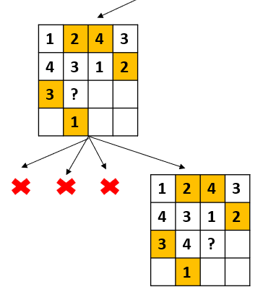
Example – 4x4 puzzle
1 | 2 | 4 | 3
4 | 3 | 1 | 2
3 | 4 | ?
 | 1
1 | 2 | 4 | 3
4 | 3 | 1 | 2
3 | 4 | 2 | ?
 | 1
1 | 2 | 4 | 3
4 | 3 | 1 | 2
3 | 4 | 2 | 1
? | 1
1 | 2 | 4 | 3
4 | 3 | 1 | 2
3 | 4 | 2 | 1
2 | 1 | ?

Slide 25
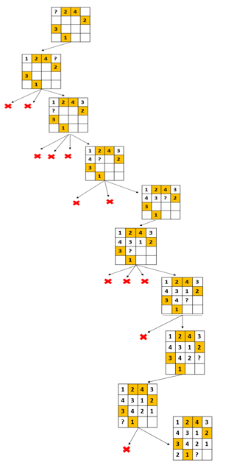
Example – 4x4 puzzle
1 | 2 | 4 | 3
4 | 3 | 1 | 2
3 | 4 | 2 | 1
2 | 1 | ?
1 | 2 | 4 | 3
4 | 3 | 1 | 2
3 | 4 | 2 | 1
2 | 1 | 3 | ?
1 | 2 | 4 | 3
4 | 3 | 1 | 2
3 | 4 | 2 | 1
2 | 1 | 3 | 4
Final Solution

Slide 26
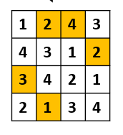
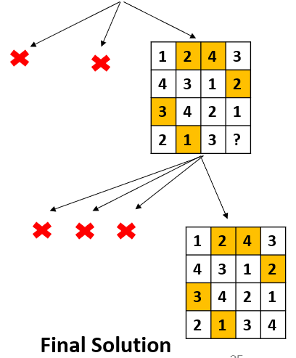
Example – 4x4 puzzle

Slide 27
Example – 4x4 puzzle – complete state space tree
This example does not involve backtracking. But a bigger grid may have backtracking strategy applied

Slide 28
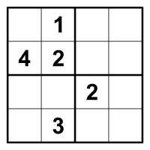
Sudoku – Example 2
Solve the following puzzle and show the complete state space tree

Slide 29
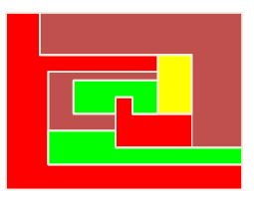
Map/Graph coloring
You wish to color a map with not more than four colors (say..)
– red, yellow, green, brown
Adjacent countries/nodes must be in different colors
You don’t have enough information to choose colors
Each choice leads to another set of choices
One or more sequences of choices may (or may not) lead to a solution
Many coloring problems can be solved with backtracking

Slide 30
Graph Coloring problem - defined
Finding all ways to color an undirected graph using at most m different colors, so that no two adjacent vertices are the same color.
Usually the m-Coloring problem consider as a unique problem for each value of m.
Assign colors to the vertices of a graph so that no adjacent vertices share the same color
– Vertices i, j are adjacent if there is an edge from vertex i to vertex j.
Find all m-colorings of a graph
– Find all ways to color a graph with at most m colors.
– m is called chromatic number

Slide 31
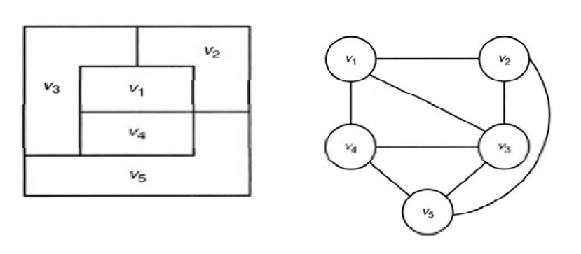
Map to a Graph

Slide 32
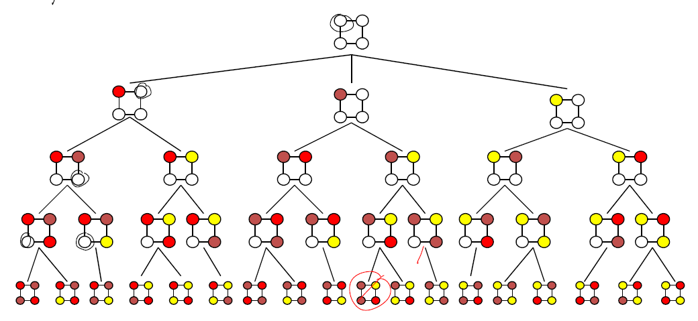
Graph Coloring – Example (state space tree)
Use 3 colors - red, yellow, brown and find all the possible colorings

Slide 33
Hamiltonian Cycle/Path
Hamiltonian cycle (HC): is a cycle which passes once and exactly once through every vertex of G and returns to starting position
Hamiltonian path: is a path which passes once and exactly once through every vertex of G (G can be digraph).
A graph is Hamiltonian iff a Hamiltonian cycle(HC) exists.
This problem can be solved using backtracking approach

Slide 34
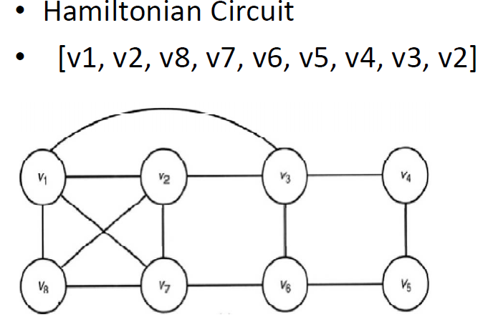
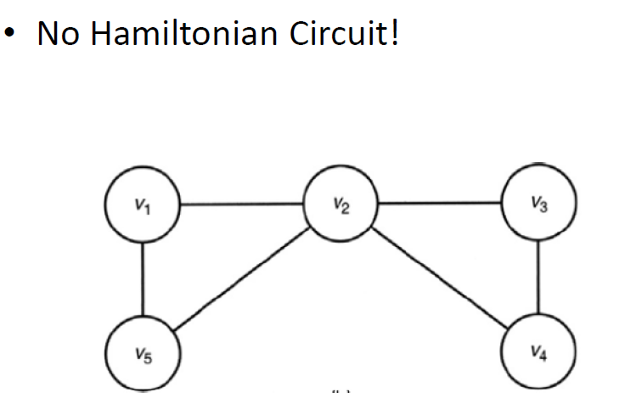
Example
v1]

Slide 35
Complexity
N-Queen’s problem - O(n^{n}) or O(n!)
Sudoku problem - O(n^{m}) where n is the number of possibilities for each square (i.e., 9 in classic Sudoku) and m is the number of spaces that are blank
Solving a Maze (rat in maze) – O(2^n²) – n is the size of the maze
Graph coloring problem - O(nm^{n})
//where n=no. of vertex, m=no. of color used

