Slide 1
Chapter 6: Synchronization Tools

Slide 2
Outline
Background
The Critical-Section Problem
Peterson’s Solution
Hardware Support for Synchronization
Mutex Locks
Semaphores
Monitors
Liveness
Evaluation

Slide 3
Objectives
Describe the critical-section problem and illustrate a race condition
Illustrate hardware solutions to the critical-section problem using memory barriers, compare-and-swap operations, and atomic variables
Demonstrate how mutex locks, semaphores, monitors, and condition variables can be used to solve the critical section problem
Evaluate tools that solve the critical-section problem in low-, Moderate-, and high-contention scenarios

Slide 4
Background
Processes can execute concurrently
May be interrupted at any time, partially completing execution
Concurrent access to shared data may result in data inconsistency
Maintaining data consistency requires mechanisms to ensure the orderly execution of cooperating processes
We illustrated in chapter 4 the problem when we considered the Bounded Buffer problem with use of a counter that is updated concurrently by the producer and consumer,. Which lead to race condition.
Notes:
CPU Scheduling decides: Which process gets the CPU?
But in real systems, multiple processes:
Run concurrently
Share resources (memory, files, variables)
This leads to problems like:
Data inconsistency
Unexpected results
So we need Synchronization.-Process synchronization is a technique to coordinate multiple processes so that they can safely share resources without conflicts.

Slide 5
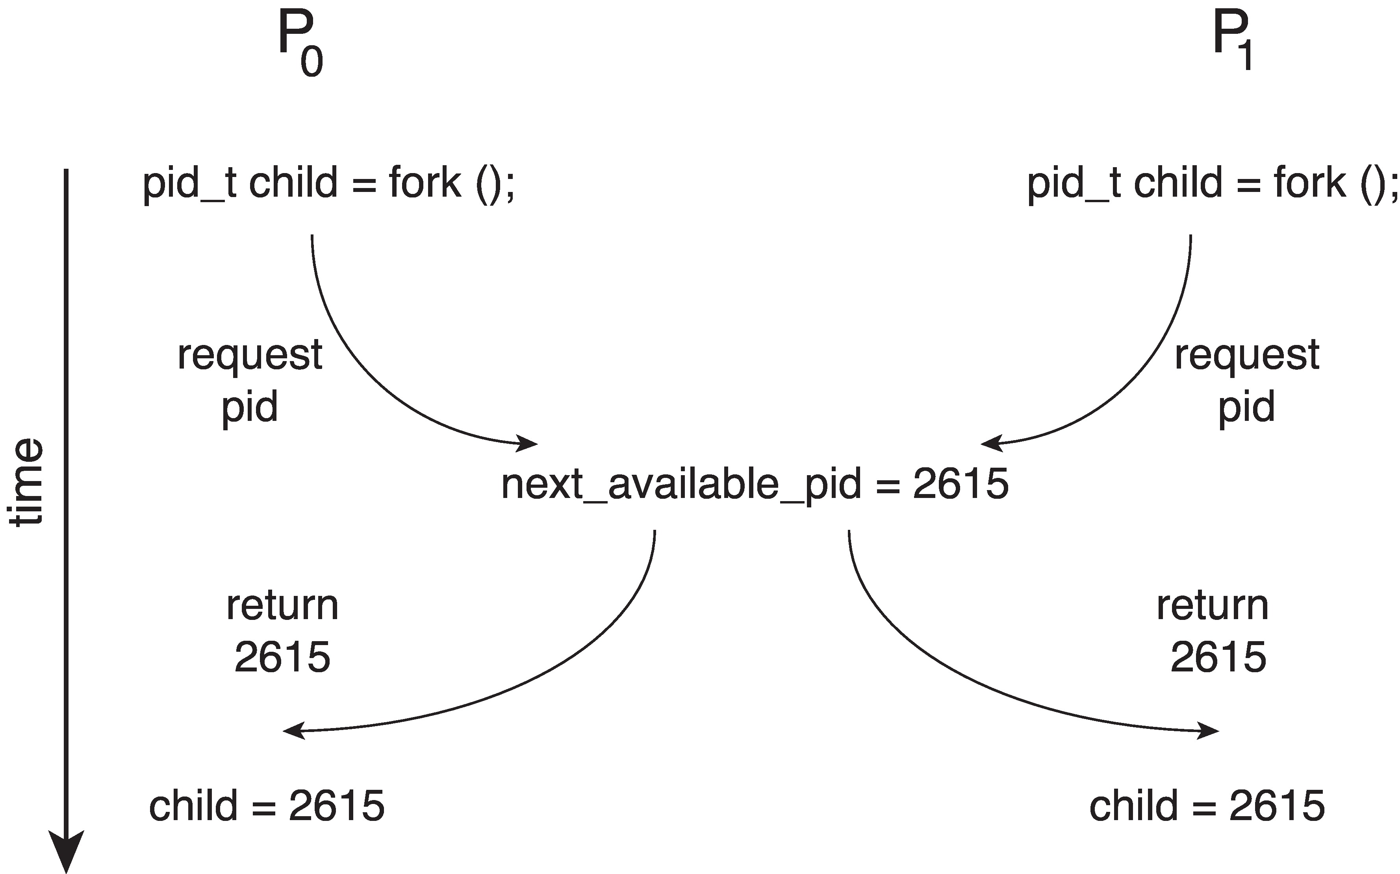
Race Condition
Processes P₀ and P₁ are creating child processes using the fork() system call
Race condition on kernel variable next_available_pid which represents the next available process identifier (pid)
Unless there is a mechanism to prevent P₀ and P₁ from accessing the variable next_available_pid the same pid could be assigned to two different processes!
Notes:
Race condition- Occurs when multiple processes access and modify shared data simultaneously, and the final result depends on the order of execution.
The final result depends on which process runs first
If properly ordered → correct result
If interleaved → incorrect result

Slide 6
Critical Section Problem
Consider system of n processes {p₀, p₁, … p_{n-1}}
Each process has critical section segment of code
Process may be changing common variables, updating table, writing file, etc.
When one process in critical section, no other may be in its critical section
Critical section problem is to design protocol to solve this
Each process must ask permission to enter critical section in entry section, may follow critical section with exit section, then remainder section
Notes:
Each process has a critical section:
Part of code where shared resources are accessed

Slide 7
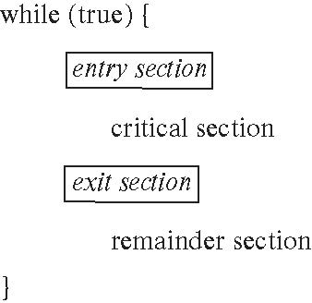
Critical Section
General structure of process P_{i}
Notes:
Structure of a process:
Entry Section
Critical Section
Exit Section
Remainder Section

Slide 8
Critical-Section Problem (Cont.)
Requirements for solution to critical-section problem
Mutual Exclusion - If process P_{i} is executing in its critical section, then no other processes can be executing in their critical sections
Progress - If no process is executing in its critical section and there exist some processes that wish to enter their critical section, then the selection of the process that will enter the critical section next cannot be postponed indefinitely
Bounded Waiting - A bound must exist on the number of times that other processes are allowed to enter their critical sections after a process has made a request to enter its critical section and before that request is granted
Assume that each process executes at a nonzero speed
No assumption concerning relative speed of the n processes
Notes:
To solve synchronization issues, we must satisfy:
Mutual Exclusion-Only one process in critical section at a time
Progress- If no process is inside, others should not wait unnecessarily
Bounded Waiting- No process should wait forever (no starvation)

Slide 9
Interrupt-based Solution
Entry section: disable interrupts
Exit section: enable interrupts
disable_interrupts();
pid = next_available_pid;
next_available_pid++;
enable_interrupts();
Not suitable for multi core systems- single core systems-lock and unlock
Only interrupts in that particular core only.
Will this solve the problem?
What if the critical section is code that runs for an hour?
Can some processes starve – never enter their critical section.
What if there are two CPUs?
Notes:
Prevent context switching while a process is executing the critical section.-Disabling interrupts, Enabling interrupts
Not suitable for multiprocessor systems- Disabling interrupts on one CPU doesn’t stop others
What if the critical section is code that runs for an hour?
If a critical section is long, disabling interrupts makes the system unresponsive, halts scheduling, and is therefore impractical; hence interrupt-based solutions are suitable only for short critical sections.
processes can starve if synchronization mechanisms do not ensure bounded waiting, causing some processes to wait indefinitely.
In multiprocessor systems, disabling interrupts is insufficient for synchronization because other CPUs can still access shared data concurrently.

Slide 10
Software Solution 1
Two process solution
Assume that the load and store machine-language instructions are atomic; that is, cannot be interrupted
The two processes share one variable:
int turn;
The variable turn indicates whose turn it is to enter the critical section
initially, the value of turn is set to i

Slide 11
Algorithm for Process P_{i and Pj}
while (true){
while (turn = = j);
/* critical section */
turn = j;
/* remainder section */
}
while (true){
while (turn = = i);
/* critical section */
turn = i;
/* remainder section */
}
Notes:
Turn=j
Pi runs turn==j-> Since turn = j → condition TRUE → Pi waits
When Pj finishes and sets: turn = i
Now condition FALSE → Pi exits loop → enters critical section.

Slide 12
Correctness of the Software Solution
Mutual exclusion is preserved
P_{i} enters critical section only if:
turn = i
and turn cannot be both 0 and 1 at the same time
What about the Progress requirement?
If no process is in the critical section and some processes want to enter, then one of them should be allowed to enter immediately.
Since turn is still j → Pi keeps waiting But Pj is not even trying to enter.
So the critical section is empty, but Pi still cannot enter.
What about the Bounded-waiting requirement?
After a process requests entry into the critical section, there must be a limit on how many times other processes enter before it gets a turn.
Pi → Pj → Pi → Pj → Pi → Pj
If Pi wants to enter, it will get the turn after at most one entry of Pj.
Notes:
turn = j Pj is in remainder section (not interested) Pi wants to enter critical section
a process can enter the critical section only when it is its turn, not when the critical section is free.
So even if the other process does not want to enter, the current process still has to wait for its turn.
This violates Progress. Satisifies bounded waiting

Slide 13
Peterson’s Solution
Two process solution
Assume that the load and store machine-language instructions are atomic; that is, cannot be interrupted
The two processes share two variables:
int turn;
boolean flag[2]
The variable turn indicates whose turn it is to enter the critical section
The flag array is used to indicate if a process is ready to enter the critical section.
flag[i] = true implies that process P_{i} is ready!
To solve the Progress problem in Software solution ->Pi waits only if Pj actually wants to enter.

Slide 14
Algorithm for Process P_{i}
Algorithm for Process P_{j}
while (true){
flag[i] = true;
turn = j;
while (flag[j] && turn = = j);
/* critical section */
flag[i] = false;
/* remainder section */
}
while (true){
flag[j] = true;
turn = i;
while (flag[i] && turn = = i);
/* critical section */
flag[j] = false;
/* remainder section */
}
Notes:
Pi flag = true
Pj flag = true
Pi turn = j
Pj turn = i ← last turn assignment
Pi enters CS
Pi exits CS
Pj enters CS

Slide 15
Correctness of Peterson’s Solution
Provable that the three CS requirement are met:
1. Mutual exclusion is preserved
P_{i} enters CS only if:
either flag[j] = false or turn = i
2. Progress requirement is satisfied
3. Bounded-waiting requirement is met

Slide 16
Peterson’s Solution and Modern Architecture
Although useful for demonstrating an algorithm, Peterson’s Solution is not guaranteed to work on modern architectures.
To improve performance, processors and/or compilers may reorder operations that have no dependencies
Understanding why it will not work is useful for better understanding race conditions.
For single-threaded this is ok as the result will always be the same.
For multithreaded the reordering may produce inconsistent or unexpected results!

Slide 17
Modern Architecture Example
Two threads share the data: boolean flag = false; int x = 0;
Thread 1 performs while (!flag); print x
Thread 2 performs x = 100; flag = true
What is the expected output?
100

Slide 18
Modern Architecture Example (Cont.)
However, since the variables flag and x are independent of each other, the instructions:
flag = true; x = 100;
for Thread 2 may be reordered
If this occurs, the output may be 0!

Slide 19
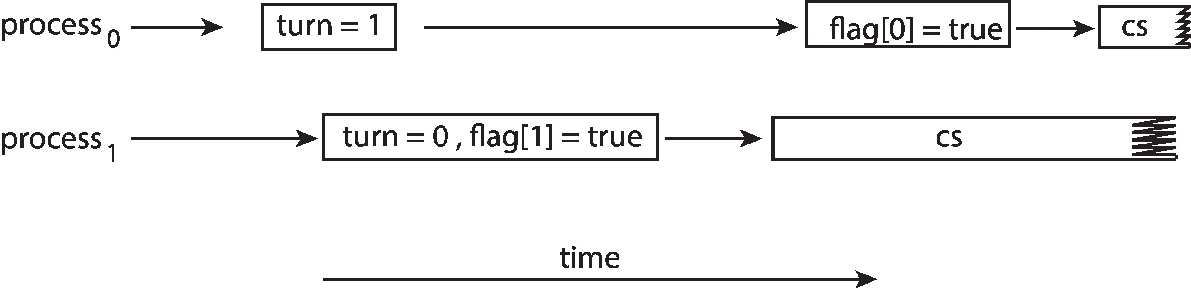
Peterson’s Solution Revisited
The effects of instruction reordering in Peterson’s Solution
This allows both processes to be in their critical section at the same time!
To ensure that Peterson’s solution will work correctly on modern computer architecture we must use Memory Barrier.
A memory barrier is a synchronization instruction that prevents the CPU and compiler from reordering memory operations across the barrier, ensuring correct execution order in multithreaded programs.

Slide 20
Synchronization Hardware
Many systems provide hardware support for implementing the critical section code.
Uniprocessors – could disable interrupts
Currently running code would execute without preemption
Generally too inefficient on multiprocessor systems
Operating systems using this not broadly scalable
We will look at three forms of hardware support: 1. Hardware instructions 2. Atomic variables

Slide 21
Hardware Instructions
Special hardware instructions that allow us to either test-and-modify the content of a word, or to swap the contents of two words atomically (uninterruptedly.)
Test-and-Set instruction
Compare-and-Swap instruction

Slide 22
The test_and_set Instruction
Definition
boolean test_and_set (boolean *target)
{
boolean rv = *target;
*target = true;
return rv:
}
Properties
Executed atomically
Returns the original value of passed parameter
Set the new value of passed parameter to true
Notes:
Test and set algorithm uses a boolean variable 'lock' which is initially initialized to false. This lock variable determines the entry of the process inside the critical section of the code

Slide 23
Solution Using test_and_set()
Shared boolean variable lock, initialized to false
Solution:
do { while (test_and_set(&lock))
; /* do nothing */
/* critical section */
lock = false;
/* remainder section */
} while (true);
Does it solve the critical-section problem?
Definition
boolean test_and_set (boolean *target)
{
boolean rv = *target;
*target = true;
return rv:
}
Properties
Executed atomically
Returns the original value of passed parameter
Set the new value of passed parameter to true
Notes:
Mutual exclusion and progress satisfied.
However, after the first process, any process can go in. There is no queue maintained,
so any new process that finds the lock to be false again can enter. So bounded waiting is not ensured.

Slide 24
The compare_and_swap Instruction
Definition
int compare_and_swap(int *value, int expected, int new_value)
{
int temp = *value;
if (*value == expected)
*value = new_value;
return temp;
}
Properties
Executed atomically
Returns the original value of passed parameter value
Set the variable value the value of the passed parameter new_value but only if *value == expected is true. That is, the swap takes place only under this condition.
Notes:
Swap algorithm is a lot like the TestAndSet algorithm. Instead of directly setting lock to true in the swap function, key is set to true and then swapped with lock.

Slide 25
Solution using compare_and_swap
Shared integer lock initialized to 0;
Solution:
while (true){ while (compare_and_swap(&lock, 0, 1) != 0)
; /* do nothing */
/* critical section */
lock = 0;
/* remainder section */
}
Does it solve the critical-section problem?
int compare_and_swap(int *value, int expected, int new_value)
{
int temp = *value;
if (*value == expected)
*value = new_value;
return temp;
}
Notes:
bounded waiting is not ensured in Swap algorithm
Test-and-Set always sets the lock variable, whereas Compare-and-Swap updates the lock only if it matches the expected value.

Slide 26
Bounded-waiting with compare-and-swap
while (true) { waiting[i] = true; key = 1; while (waiting[i] && key == 1)
key = compare_and_swap(&lock,0,1);/* key -to know when lock is acquired
waiting[i] = false;
/* critical section */
j = (i + 1) % n; /* start from the next process
while ((j != i) && !waiting[j]) /* Keep moving to next process until: find a process that is waiting and come back to the same process i
j = (j + 1) % n;
if (j == i) /* no other process is waiting- any one access the lock
lock = 0;
else
waiting[j] = false;
/* remainder section */
}
Notes:
bounded waiting Compare-and-Swap algorithm ensures mutual exclusion by using an atomic CAS instruction to acquire the lock and a waiting array to pass the lock to the next waiting process in circular order, thereby preventing starvation and ensuring bounded waiting.

Slide 27
Mutex Locks
Previous solutions are complicated and generally inaccessible to application programmers
OS designers build software tools to solve critical section problem
Simplest is mutex lock
Boolean variable indicating if lock is available or not
Protect a critical section by
First acquire() a lock
Then release() the lock
Calls to acquire() and release() must be atomic
Usually implemented via hardware atomic instructions such as compare-and-swap.
But this solution requires busy waiting
This lock therefore called a spinlock

Slide 28
Solution to CS Problem Using Mutex Locks
while (true) {
acquire lock
critical section
release lock
remainder section
}

Slide 29
Semaphore
Synchronization tool that provides more sophisticated ways (than Mutex locks) for processes to synchronize their activities.
Semaphore S – integer variable
Non-negative integer variable shared between the threads
Can only be accessed via two indivisible (atomic) operations
wait() and signal()
Originally called P() and V()
Definition of the wait() operation
wait(S) {
while (S <= 0)
; // busy wait
S--;
}
Definition of the signal() operation
signal(S) {
S++;
}
Notes:
Hardware based solution are difficult for developers
Software based solutions
Waiting for entering into CS
Signal -> signal the other process that they can enter into CS
One process is modifying the semaphore value no other process can modify it

Slide 30
Semaphore (Cont.)
Counting semaphore – integer value can range over an unrestricted domain-multiple instances of the resources.
Binary semaphore – integer value can range only between 0 and 1
Same as a mutex lock
Can implement a counting semaphore S as a binary semaphore
With semaphores we can solve various synchronization problems

Slide 31
Semaphore Usage Example
Solution to the CS Problem
Create a semaphore “mutex” initialized to 1
wait(mutex);
CS
signal(mutex);
Consider P₁ and P₂ that with two statements S₁ and S₂ and the requirement that S₁ to happen before S₂
Create a semaphore “synch” initialized to 0
P1:
S₁;
signal(synch);
P2:
wait(synch);
S₂;

Slide 32
Shared data: semaphore mutex; //initially mutex = 1 
Process Pi:
Do
{ wait(mutex);
critical section
signal(mutex);
remainder section } while (1)
signal(S) {
S++;
}
wait(S) {
while (S <= 0)
; // busy wait
S--;
}

Slide 33
Semaphore Implementation
Must guarantee that no two processes can execute the wait() and signal() on the same semaphore at the same time
Thus, the implementation becomes the critical section problem where the wait and signal code are placed in the critical section
Could now have busy waiting in critical section implementation
But implementation code is short
Little busy waiting if critical section rarely occupied
Note that applications may spend lots of time in critical sections and therefore this is not a good solution
Notes:
Limitation-busy waiting-waste CPU cycles-looping inside while loop-wasting CPU-Spinlock semaphore.

Slide 34
Semaphore Implementation with no Busy waiting
With each semaphore there is an associated waiting queue
Each entry in a waiting queue has two data items:
Value (of type integer)
Pointer to next record in the list
Two operations:
block – place the process invoking the operation on the appropriate waiting queue
wakeup – remove one of processes in the waiting queue and place it in the ready queue
Notes:
Process can block itself and put in a waiting queue instead of busy waiting- Control is transferred to cpu scheduler –selects other process for execution.

Slide 35
Implementation with no Busy waiting (Cont.)
Waiting queue
typedef struct {
int value;
struct process *list;
} semaphore;

Slide 36
Implementation with no Busy waiting (Cont.)
wait(semaphore *S) {
S->value--;
if (S->value < 0) { add this process to S->list;
block();
}
}
signal(semaphore *S) {
S->value++;
if (S->value <= 0) { remove a process P from S->list;
wakeup(P);
}
}

Slide 37
Problems with Semaphores
Incorrect use of semaphore operations:
signal(mutex) …. wait(mutex)
wait(mutex) … wait(mutex)
Omitting of wait (mutex) and/or signal (mutex)
These – and others – are examples of what can occur when semaphores and other synchronization tools are used incorrectly.
Notes:
Multiple processes execute the critical section simultaneously Data inconsistency (e.g., wrong shared variable updates)
The process is waiting for a lock it already holds.
Process enters critical section without acquiring lock
Process acquires lock but never releases it-> No other process can enter the critical section.

Slide 38
Liveness
Processes may have to wait indefinitely while trying to acquire a synchronization tool such as a mutex lock or semaphore.
Waiting indefinitely violates the progress and bounded-waiting criteria discussed at the beginning of this chapter.
Liveness refers to a set of properties that a system must satisfy to ensure processes make progress.
Indefinite waiting is an example of a liveness failure.

Slide 39
Liveness
Deadlock – two or more processes are waiting indefinitely for an event that can be caused by only one of the waiting processes
Let S and Q be two semaphores initialized to 1
P₀ P₁
wait(S); wait(Q);
wait(Q); wait(S);
... ...
signal(S); signal(Q);
signal(Q); signal(S);
Consider if P₀ executes wait(S) and P₁ wait(Q). When P₀ executes wait(Q), it must wait until P₁ executes signal(Q)
However, P₁ is waiting until P₀ execute signal(S).
Since these signal() operations will never be executed, P₀ and P₁ are deadlocked.

Slide 40
Liveness
Other forms of deadlock:
Starvation – indefinite blocking
A process may never be removed from the semaphore queue in which it is suspended
Notes:
Deadlock → All processes blocked Starvation → One process blocked forever

Slide 41
Monitors
A high-level abstraction that provides a convenient and effective mechanism for process synchronization
Abstract data type, internal variables only accessible by code within the procedure
Only one process may be active within the monitor at a time
Semaphore is a low-level synchronization mechanism where the programmer manually controls access using wait and signal operations, whereas a monitor is a high-level synchronization construct that provides automatic mutual exclusion and encapsulates shared data and procedures.
Pseudocode syntax of a monitor:
monitor monitor-name
{
// shared variable declarations
procedure P1 (…) { …. }
procedure P2 (…) { …. }
procedure Pn (…) {……}
initialization code (…) { … }
}
Notes:
To avoid errors in semaphores->monitor
Set of Programmer designed operations->mutual exclusion will happen
Process is programmed wrongly->semaphore ->leads to erros

Slide 42
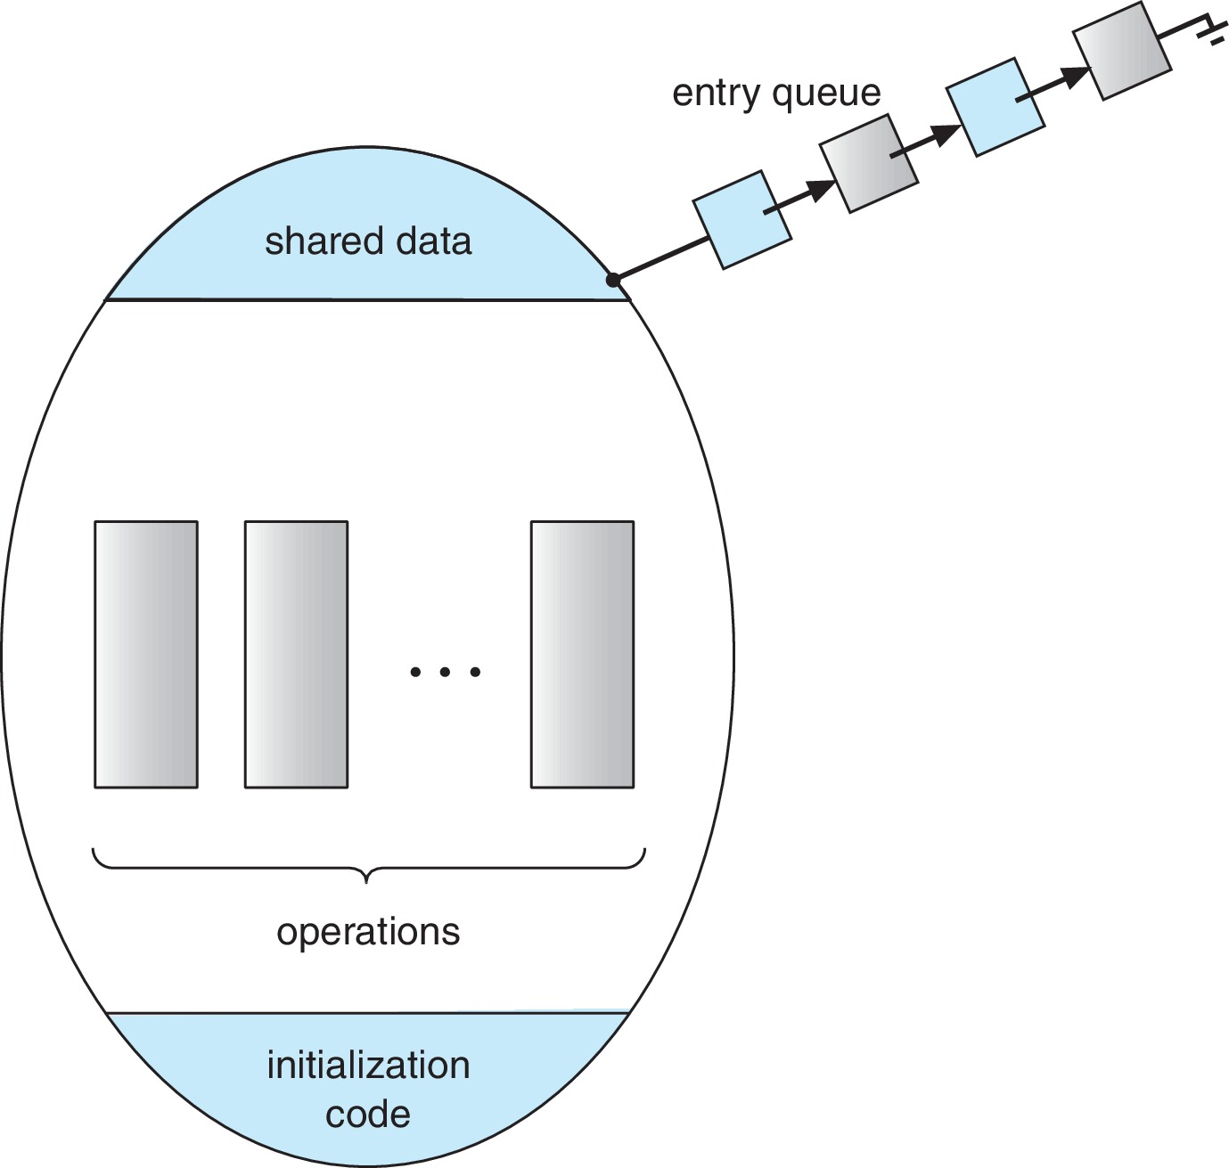
Schematic view of a Monitor
A procedure defined within a monitor can access only those variables declared locally within the monitor and its formal parameters
The local variables of a monitor can be accessed by only the local procedures
The monitor construct ensures that only one process at a time can be active within the monitor.
Notes:
A monitor has its own private variables Only the functions (procedures) inside the monitor can access those variables
Variables inside the monitor are completely protected Only monitor’s internal functions can use them
At any time, only one process/thread can execute inside the monitor Others must wait outside

Slide 43
Monitor Implementation Using Semaphores
Variables
semaphore mutex
mutex = 1
Each procedure P is replaced by
wait(mutex);
…
body of P;
…
signal(mutex);
Mutual exclusion within a monitor is ensured

Slide 44
Condition Variables
condition x, y;
Two operations are allowed on a condition variable:
x.wait() – a process that invokes the operation is suspended until x.signal()
x.signal() – resumes one of processes (if any) that invoked x.wait()
If no x.wait() on the variable, then it has no effect on the variable

Slide 45
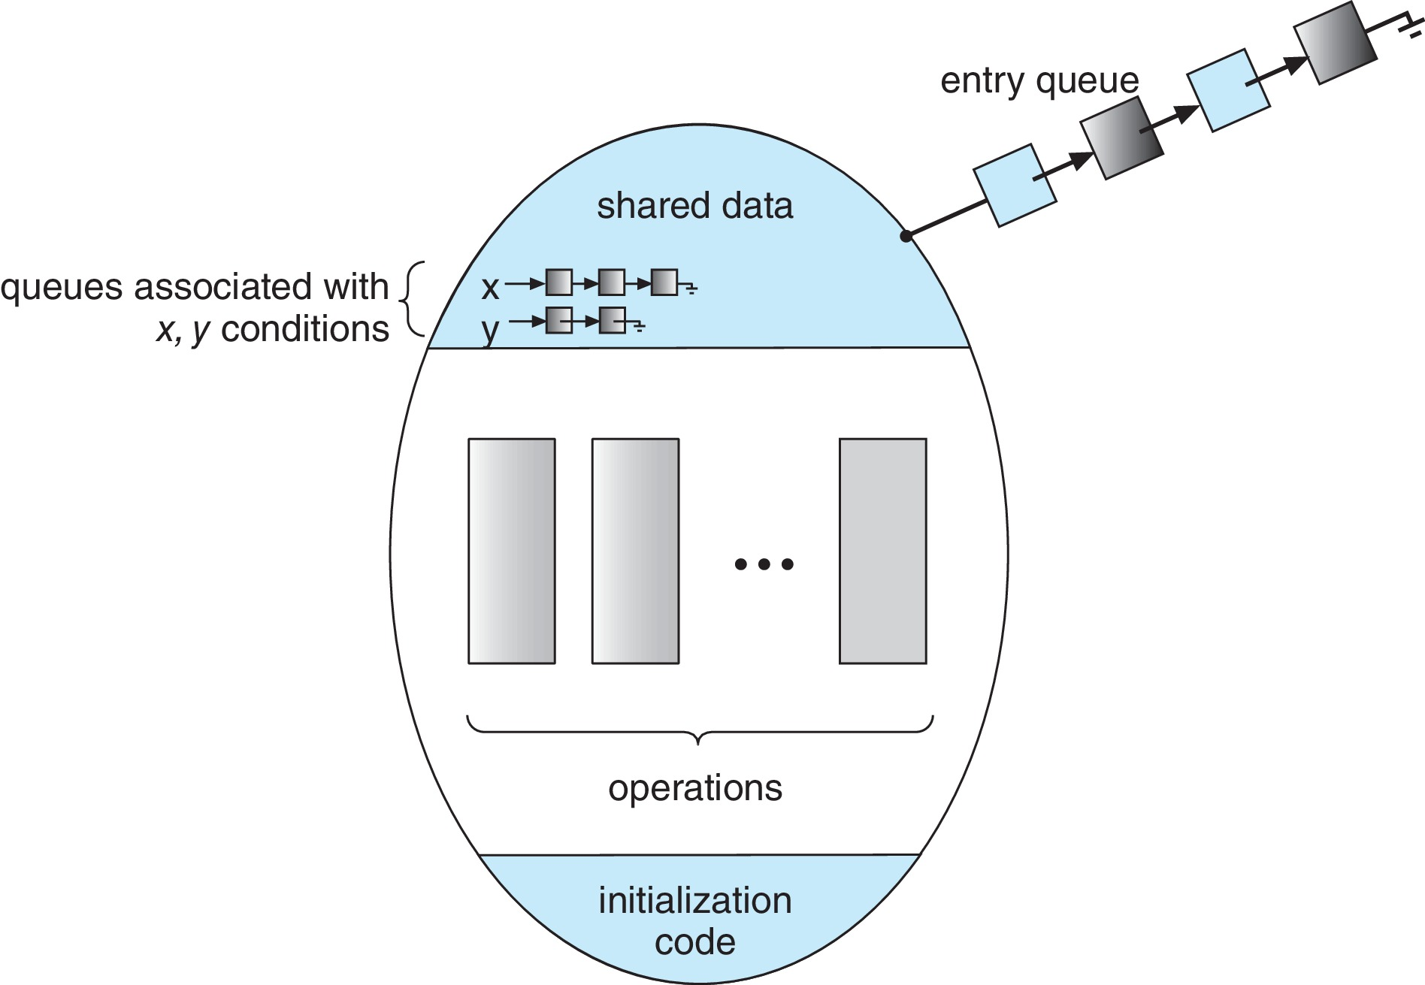
Monitor with Condition Variables
When two processes attempt to access a monitor, only one process can execute inside the monitor at a time while the other waits in the entry queue.
2. If the running process executes wait(), it is suspended and placed in a condition queue, allowing the waiting process to enter the monitor.
3. When signal() is executed, the waiting process is resumed and allowed to continue execution inside the monitor.
Notes:
P1 enters monitor
P2 waits in entry queue
P1 finds buffer empty → wait(notEmpty)
P1 goes to condition queue
Monitor becomes free
P2 enters monitor
P2 produces item → signal(notEmpty)
P1 wakes up and enters monitor again

Slide 46
Usage of Condition Variable Example
Consider P₁ and P₂ that that need to execute two statements S₁ and S₂ and the requirement that S₁ to happen before S₂
Create a monitor with two procedures F₁ and F₂ that are invoked by P₁ and P₂ respectively
One condition variable “x” initialized to 0
One Boolean variable “done”
F1:
S₁;
done = true;
x.signal();
F2:
if done = false
x.wait()
S₂;
Notes:
A shared variable → done
A condition variable → x
Two functions → F1 and F2
S1 and S2 are statements (critical operations)
Goal: F2 should execute S2 only after F1 finishes S1
P2 Executes First- P2 → wait P1 → S1 P2 → S2
Case 2: P1 Executes First

Slide 47
Usage:
acquire
...
release
Incorrect use of monitor operations
release() … acquire()
acquire() … acquire())
Omitting of acquire() and/or release()
Monitors eliminate these errors because mutual exclusion is handled automatically, unlike manual acquire() and release() operations.

Slide 48
End of Chapter 6

