Slide 1
Chapter 7: Synchronization Examples

Slide 2
Outline
Explain the bounded-buffer synchronization problem
Explain the readers-writers synchronization problem
Explain and dining-philosophers synchronization problems
Describe the tools used by Linux and Windows to solve synchronization problems.
Illustrate how POSIX and Java can be used to solve process synchronization problems

Slide 3
Classical Problems of Synchronization
Classical problems used to test newly-proposed synchronization schemes
Bounded-Buffer Problem
Readers and Writers Problem
Dining-Philosophers Problem

Slide 4
Bounded-Buffer Problem
n buffers, each can hold one item
Semaphore mutex initialized to the value 1
Semaphore full initialized to the value 0
Semaphore empty initialized to the value n

Slide 5
Bounded Buffer Problem (Cont.)
The structure of the producer process
while (true) {
... /* produce an item in next_produced */
...
wait(empty);
wait(mutex);
... /* add next produced to the buffer */
...
signal(mutex);
signal(full);
}

Slide 6
Bounded Buffer Problem (Cont.)
The structure of the consumer process
while (true) {
wait(full);
wait(mutex);
... /* remove an item from buffer to next_consumed */
...
signal(mutex);
signal(empty);
... /* consume the item in next consumed */
... }

Slide 7
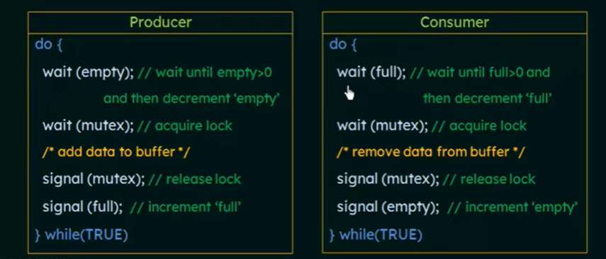
Notes:
n buffers, each can hold one item, Semaphore mutex initialized to the value 1, Semaphore full initialized to the value 0, Semaphore empty initialized to the value n
wait(S) {
while (S <= 0)
; // busy wait
S--;
}
signal(S) {
S++;
}

Slide 8
Readers-Writers Problem
A data set is shared among a number of concurrent processes
Readers – only read the data set; they do not perform any updates
Writers – can both read and write( read and modify)
Problem – allow multiple readers to read at the same time
Only one single writer can access the shared data at the same time
Several variations of how readers and writers are considered – all involve some form of priorities
Notes:
Dataset shared among different processes.
If a writer and some other thread(reader or writer) access the dataset simultaneously, problems arise
When one writer is writing-no other writers are allowed to write and no other reader is allowed to read.-r/w problem

Slide 9
Readers-Writers Problem (Cont.)
Shared Data
Data set
Semaphore rw_mutex initialized to 1
Semaphore mutex initialized to 1
Integer read_count initialized to 0
Notes:
2 semaphores and integer variable
Rw_mutex- common to reader and writer
Mutex- readcount variable is updated
Read_count- how many processes are currently reading the object

Slide 10
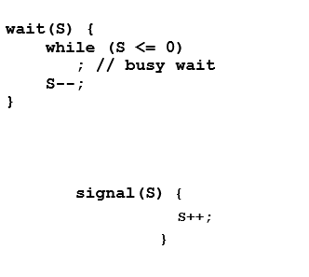
Readers-Writers Problem (Cont.)
The structure of a writer process
while (true) { wait(rw_mutex);
... /* writing is performed */
...
signal(rw_mutex);
}
Notes:
Rw-Mutesx –no other process can access reader or writer

Slide 11
Readers-Writers Problem (Cont.)
The structure of a reader process
while (true){ wait(mutex); read_count++; //no of readers increased by 1 if (read_count == 1) /* first reader */
wait(rw_mutex); // no writer can enter if one reader is there.
signal(mutex); // other reader can enter
... /* reading is performed */
...
wait(mutex); read_count--; // reader wants to leave if (read_count == 0) /* last reader */
signal(rw_mutex); // writer can enter
signal(mutex); // reader leaves
}
Notes:
Mutex is acquired such that no 2 reader process access the variable at same time.
Priority to the reader- if atleast one reader is present- shouldnot allow the writer to write it.

Slide 12
Readers-Writers Problem Variations
The solution in previous slide can result in a situation where a writer process never writes. It is referred to as the “First reader-writer” problem.
The “Second reader-writer” problem is a variation the first reader-writer problem that state:
Once a writer is ready to write, no “newly arrived reader” is allowed to read.
Both the first and second may result in starvation. leading to even more variations
Problem is solved on some systems by kernel providing reader-writer locks
Notes:
If readers keep arriving continuously, a writer may never get a chance to write. This is called writer starvation.
If writers keep arriving, readers may never get access. This leads to reader starvation.
Soultion- Modern operating systems solve this using Reader–Writer Locks provided by the kernel.- FIFO queue, Fairness balanced lock

Slide 13
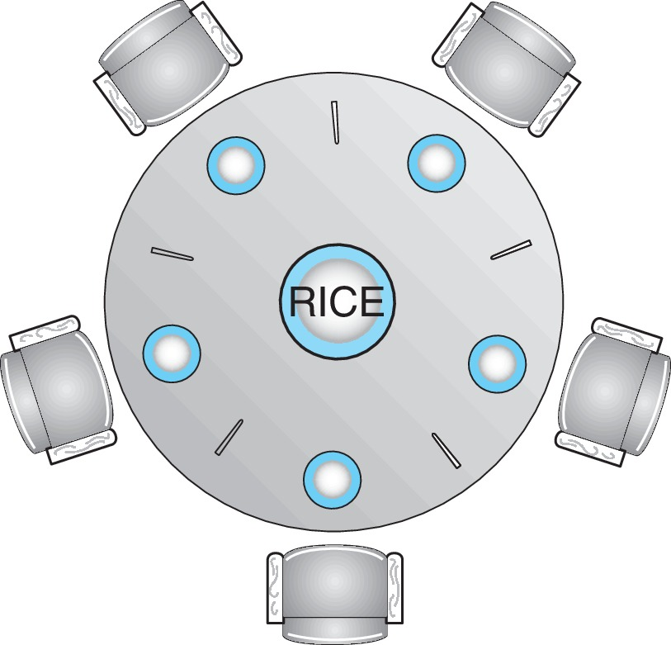
Dining-Philosophers Problem
N philosophers’ sit at a round table with a bowel of rice in the middle.
They spend their lives alternating thinking and eating.
They do not interact with their neighbors.
Occasionally try to pick up 2 chopsticks (one at a time) to eat from bowl
Need both to eat, then release both when done
In the case of 5 philosophers, the shared data
Bowl of rice (data set)
Semaphore chopstick [5] initialized to 1

Slide 14
Dining-Philosophers Problem Algorithm
Semaphore Solution
The structure of Philosopher i :
while (true){
wait (chopstick[i] );
wait (chopStick[ (i + 1) % 5] );
/* eat for awhile */
signal (chopstick[i] );
signal (chopstick[ (i + 1) % 5] );
/* think for awhile */
}
What is the problem with this algorithm?
Notes:
All 5 philosophers simultaneously pick up their left chopstick
So each holds one chopstick
Then each tries to pick up the right chopstick
But the right chopstick is already held by their neighbor- Everyone is waiting forever- This is a classic circular wait condition

Slide 15
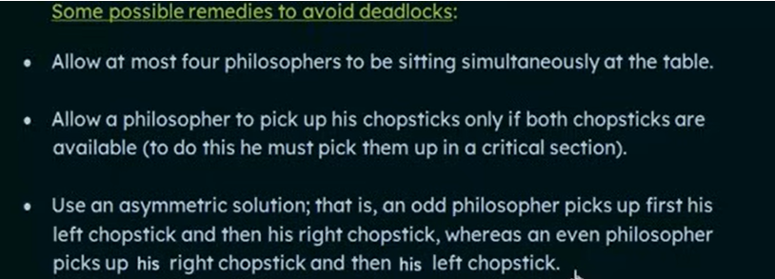

Slide 16
Monitor Solution to Dining Philosophers
monitor DiningPhilosophers
{
enum {THINKING; HUNGRY, EATING} state [5];
condition self [5];
void pickup (int i) {
state[i] = HUNGRY;
test(i);
if (state[i] != EATING) self[i].wait;
}
void putdown (int i) {
state[i] = THINKING;
// test left and right neighbors
test((i + 4) % 5);
test((i + 1) % 5);
}

Slide 17
Solution to Dining Philosophers (Cont.)
void test (int i) {
if ((state[(i + 4) % 5] != EATING) &&
(state[i] == HUNGRY) &&
(state[(i + 1) % 5] != EATING) ) {
state[i] = EATING ;
self[i].signal () ;
}
}
initialization_code() {
for (int i = 0; i < 5; i++)
state[i] = THINKING;
}
}

Slide 18
Solution to Dining Philosophers (Cont.)
Each philosopher “i” invokes the operations pickup() and putdown() in the following sequence:
DiningPhilosophers.pickup(i);
/** EAT **/
DiningPhilosophers.putdown(i);
No deadlock, but starvation is possible

Slide 19
Kernel Synchronization - Windows
Uses interrupt masks to protect access to global resources on uniprocessor systems
Uses spinlocks on multiprocessor systems
Spinlocking-thread will never be preempted
Also provides dispatcher objects user-land which may act mutexes, semaphores, events, and timers
Events
An event acts much like a condition variable
Timers notify one or more thread when time expired
Dispatcher objects either signaled-state (object available) or non-signaled state (thread will block)

Slide 20
End of Chapter 7

