Slide 1
Chapter 8: Deadlocks

Slide 2
Outline
System Model
Deadlock Characterization
Methods for Handling Deadlocks
Deadlock Prevention
Deadlock Avoidance
Deadlock Detection
Recovery from Deadlock

Slide 3
Chapter Objectives
Illustrate how deadlock can occur when mutex locks are used
Define the four necessary conditions that characterize deadlock
Identify a deadlock situation in a resource allocation graph
Evaluate the four different approaches for preventing deadlocks
Apply the banker’s algorithm for deadlock avoidance
Apply the deadlock detection algorithm
Evaluate approaches for recovering from deadlock

Slide 4
System Model
System consists of resources
Resource types R₁, R₂, . . ., R_{m}
CPU cycles, memory space, I/O devices
Each resource type R_{i} has W_{i} instances.
Each process utilizes a resource as follows:
request
use
release

Slide 5
Deadlock with Semaphores
Data:
A semaphore S₁ initialized to 1
A semaphore S₂ initialized to 1
Two threads T₁ and T₂
T₁:
wait(s₁)
wait(s₂)
T₂:
wait(s₂)
wait(s₁)

Slide 6
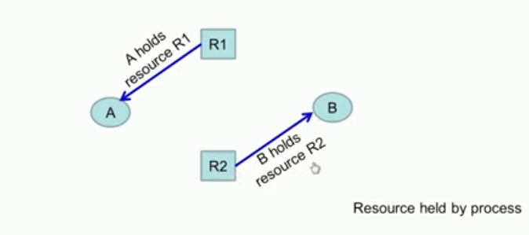
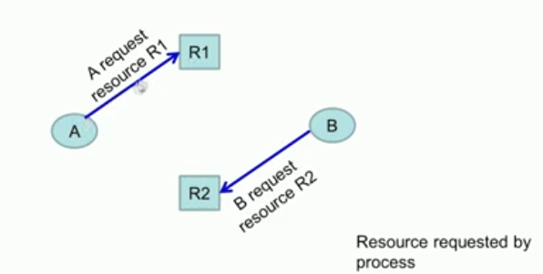
Resource Allocation Graphs

Slide 7

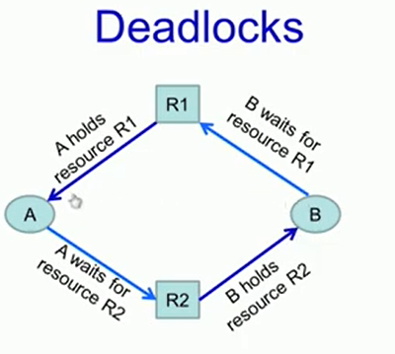
Notes:
Deadlock-

Slide 8
Resource-Allocation Graph
A set of vertices V and a set of edges E.
V is partitioned into two types:
T = {T₁, T₂, …, T_{n}}, the set consisting of all the threads in the system.
R = {R₁, R₂, …, R_{m}}, the set consisting of all resource types in the system
request edge – directed edge T_{i} → R_{j}
assignment edge – directed edge R_{j} → T_{i}
Notes:
RAG-directed graphs- used to model resource allocations

Slide 9
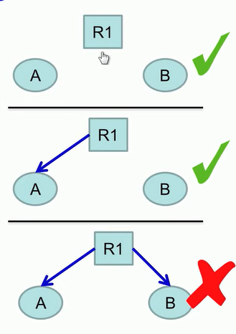
Deadlock Characterization
Deadlock can arise if four conditions hold simultaneously.
Mutual exclusion: only one thread at a time can use a resource
Notes:
Conditions for resource deadlocks- Each resource is currently available or not assigned to a process

Slide 10
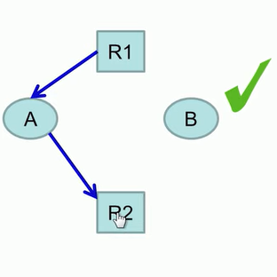
Deadlock Characterization
Deadlock can arise if four conditions hold simultaneously.
Mutual exclusion: only one thread at a time can use a resource
Hold and wait: a thread holding at least one resource is waiting to acquire additional resources held by other threads

Slide 11
Deadlock Characterization
Deadlock can arise if four conditions hold simultaneously.
Mutual exclusion: only one thread at a time can use a resource
Hold and wait: a thread holding at least one resource is waiting to acquire additional resources held by other threads
No preemption: a resource can be released only voluntarily by the thread holding it, after that thread has completed its task

Slide 12
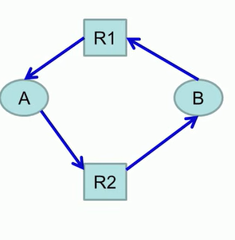
Deadlock Characterization
Deadlock can arise if four conditions hold simultaneously.
Mutual exclusion: only one thread at a time can use a resource
Hold and wait: a thread holding at least one resource is waiting to acquire additional resources held by other threads
No preemption: a resource can be released only voluntarily by the thread holding it, after that thread has completed its task
Circular wait: there exists a set {T₀, T₁, …, T_{n}} of waiting threads such that T₀ is waiting for a resource that is held by T₁, T₁ is waiting for a resource that is held by T₂, …, T_{n–1} is waiting for a resource that is held by T_{n}, and T_{n} is waiting for a resource that is held by T₀.
Notes:
All these conditions occurs then deadlock happens- ordering of the resources and requests-deadlocks

Slide 13
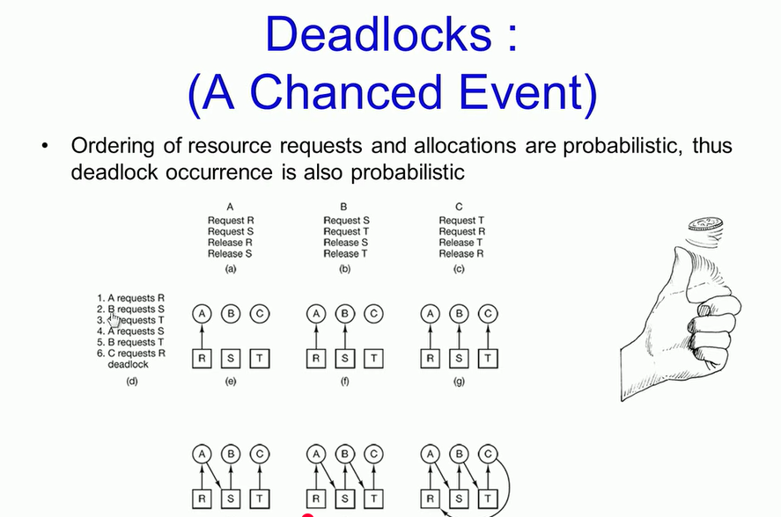

Slide 14
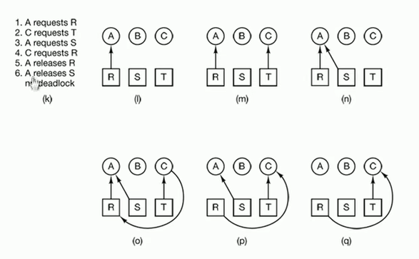

Slide 15
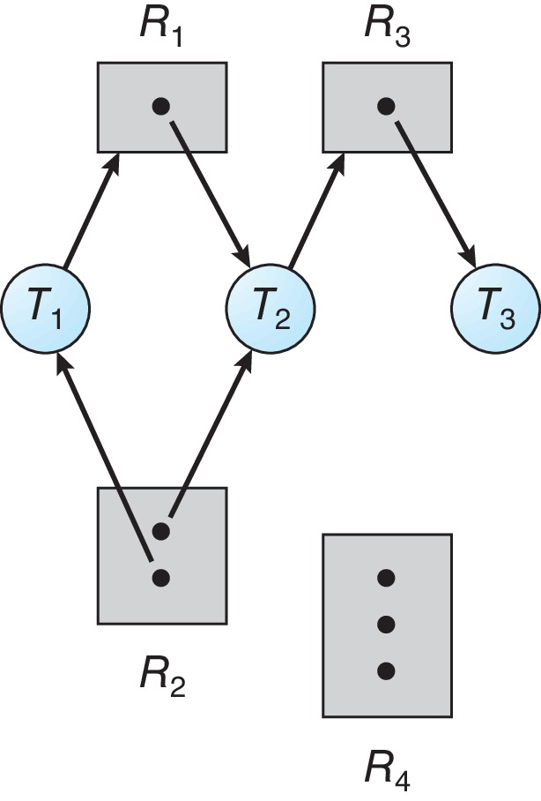
Resource Allocation Graph Example
One instance of R₁
Two instances of R₂
One instance of R₃
Three instance of R₄
T₁ holds one instance of R₂ and is waiting for an instance of R₁
T₂ holds one instance of R₁, one instance of R₂, and is waiting for an instance of R₃
T₃ is holds one instance of R₃

Slide 16
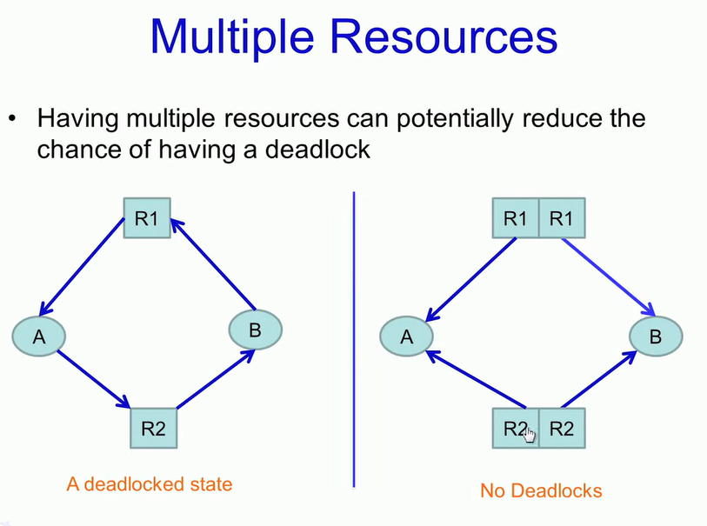

Slide 17
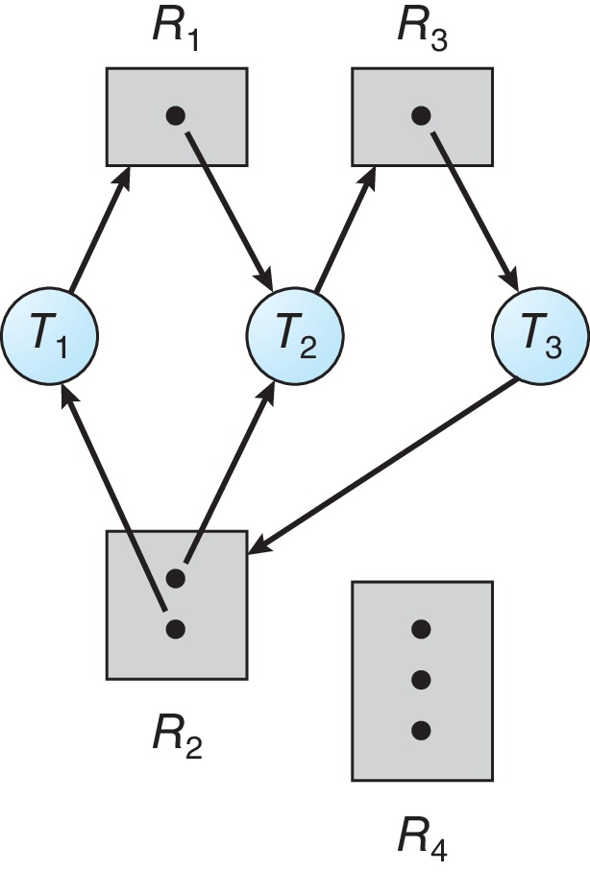
Resource Allocation Graph with a Deadlock

Slide 18
Resource Allocation Graph with a Deadlock
T1->R1->T2->R3->T3->R2->T1
P2->R3->P3->R2->P2
T1 and T2 are in a circular wait where both are waiting for resources held by the other, this creates a deadlock condition.

Slide 19

Graph with a Cycle But no Deadlock

Slide 20
Graph with a Cycle But no Deadlock
T₁ → R₁ → T₃ → R₂ → T₁
There is no circular wait condition.
Some transactions (T3​ and T4​) do not have dependencies on other resources.
Transactions will eventually complete and release resources, allowing other transactions to proceed.

Slide 21
Basic Facts
If graph contains no cycles ⇒ no deadlock
If graph contains a cycle ⇒
if only one instance per resource type, then deadlock
if several instances per resource type, possibility of deadlock

Slide 22
Methods for Handling Deadlocks
Ensure that the system will never enter a deadlock state:
Deadlock prevention
Deadlock avoidance
Allow the system to enter a deadlock state and then recover
Ignore the problem and pretend that deadlocks never occur in the system.

Slide 23
Deadlock Prevention
Invalidate one of the four necessary conditions for deadlock:
Mutual Exclusion – not required for sharable resources (e.g., read-only files); must hold for non-sharable resources
Hold and Wait – must guarantee that whenever a thread requests a resource, it does not hold any other resources
Require threads to request and be allocated all its resources before it begins execution or allow thread to request resources only when the thread has none allocated to it.
Low resource utilization; starvation possible
Notes:
Allow multiple processes to use a resource simultaneously. Example: Read-only files can be shared.-ME

Slide 24
Deadlock Prevention (Cont.)
No Preemption:
If a process that is holding some resources requests another resource that cannot be immediately allocated to it, then all resources currently being held are released
Preempted resources are added to the list of resources for which the thread is waiting
Thread will be restarted only when it can regain its old resources, as well as the new ones that it is requesting
Circular Wait:
Impose a total ordering of all resource types, and require that each thread requests resources in an increasing order of enumeration

Slide 25
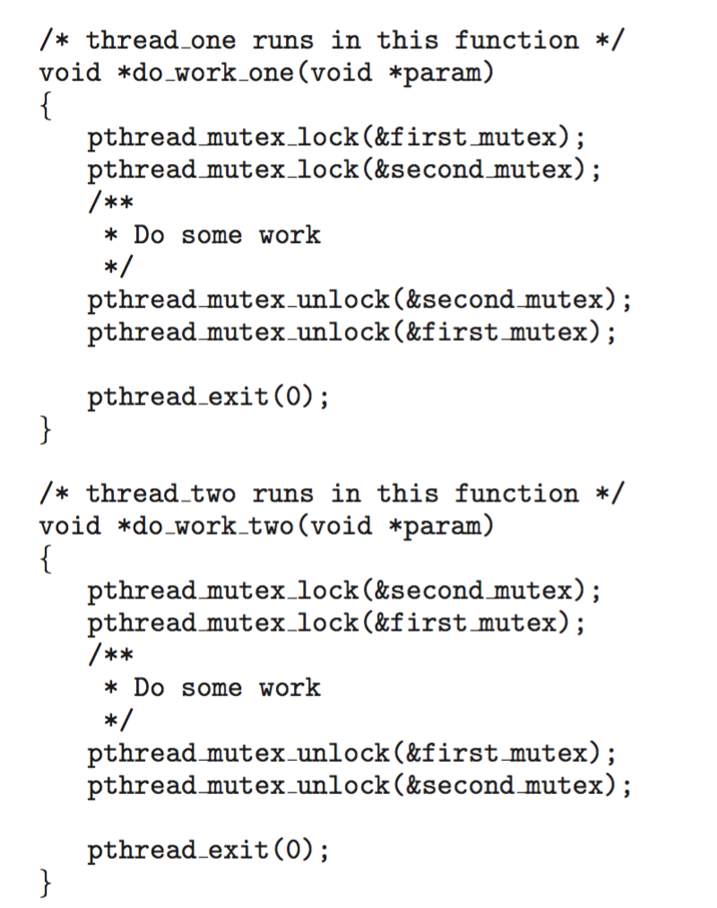
Circular Wait
Invalidating the circular wait condition is most common.
Simply assign each resource (i.e., mutex locks) a unique number.
Resources must be acquired in order.
If: first_mutex = 1 second_mutex = 5 code for thread_two could not be written as follows:

Slide 26
Deadlock Avoidance
Requires that the system has some additional a priori information available
Simplest and most useful model requires that each thread declare the maximum number of resources of each type that it may need
The deadlock-avoidance algorithm dynamically examines the resource-allocation state to ensure that there can never be a circular-wait condition
Resource-allocation state is defined by the number of available and allocated resources, and the maximum demands of the processes

Slide 27
Safe State
When a thread requests an available resource, system must decide if immediate allocation leaves the system in a safe state
System is in safe state if there exists a sequence <T₁, T₂, …, T_{n}> of ALL the threads in the systems such that for each T_{i}, the resources that T_{i} can still request can be satisfied by currently available resources + resources held by all the T_{j}, with j < I
That is:
If T_{i} resource needs are not immediately available, then T_{i} can wait until all T_{j} have finished
When T_{j} is finished, T_{i} can obtain needed resources, execute, return allocated resources, and terminate
When T_{i} terminates, T_{i +1} can obtain its needed resources, and so on

Slide 28
Basic Facts
If a system is in safe state ⇒ no deadlocks
If a system is in unsafe state ⇒ possibility of deadlock
Avoidance ⇒ ensure that a system will never enter an unsafe state.

Slide 29
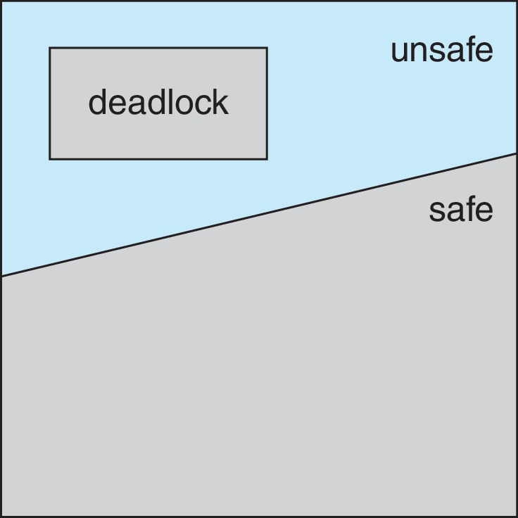
Safe, Unsafe, Deadlock State

Slide 30
Avoidance Algorithms
Single instance of a resource type
Use a resource-allocation graph
Multiple instances of a resource type
Use the Banker’s Algorithm

Slide 31
Resource-Allocation Graph Scheme
Claim edge T_{i} → R_{j} indicated that process T_{j} may request resource R_{j}; represented by a dashed line
Claim edge converts to request edge when a thread requests a resource
Request edge converted to an assignment edge when the resource is allocated to the thread
When a resource is released by a thread, assignment edge reconverts to a claim edge
Resources must be claimed a priori in the system

Slide 32
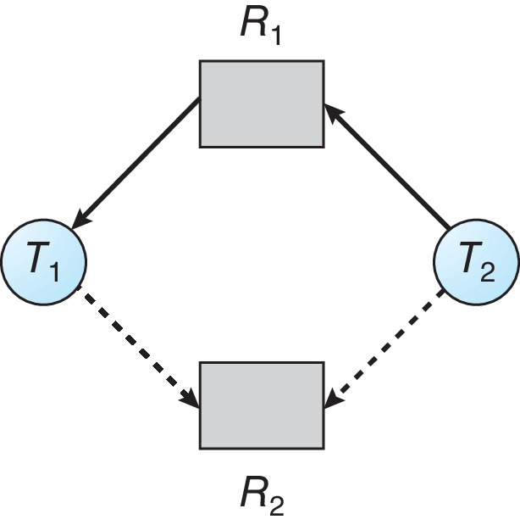
Resource-Allocation Graph

Slide 33
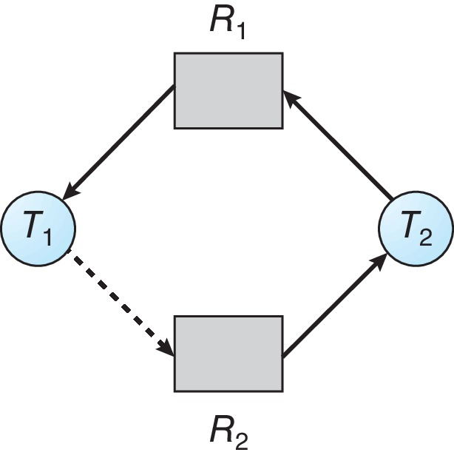
Unsafe State In Resource-Allocation Graph

Slide 34
Resource-Allocation Graph Algorithm
Suppose that thread T_{i} requests a resource R_{j}
The request can be granted only if converting the request edge to an assignment edge does not result in the formation of a cycle in the resource allocation graph

Slide 35
Consider a system with three processes P1, P2, and P3 and two resource types R1 and R2, each having a single instance.
For the given Resource Allocation Graph:
Process P1 is holding resource R1
Process P2 is holding resource R2
Process P3 is requesting both R1 and R2

Slide 36
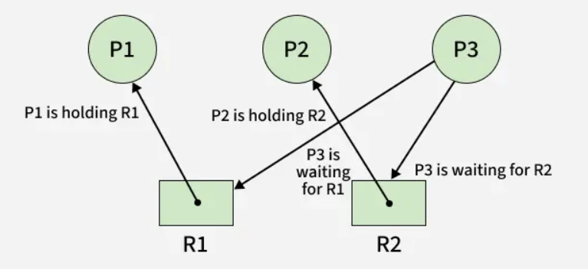

Slide 37
In a system, the following state of processes and resources are given: R1→ P1, P1→ R2, P2→ R3, R2→ P2, R3→ P3, P3→ R4, P4→ R3, R4→ P4, P4→ R1, R1→ P5.
Draw Resource Allocation Graph for the system and check for deadlock condition.
R1→ P1→ R2→ P2→ R3→ P3→ R4→ P4→ R3→ P3→ R4→ P4→ R1
R3→ P3→ R4→ P4→ R3

Slide 38
Cycles in the resource allocation graph include:
R1→ P1→ R2→ P2→ R3→ P3→ R4→ P4→ R3→ P3→ R4→ P4→ R1 This cycle has more than one instances of the resource R3 and R4, so it’s not necessarily deadlocked.
R3→ P3→ R4→ P4→ R3
This cycle has only one instances of the resources R3 and R4, so it might be deadlocked.

Slide 39
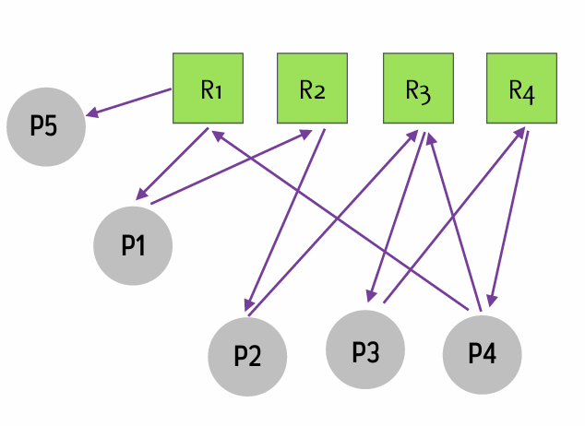
R1→ P1→ R2→ P2→ R3→ P3→ R4→ P4→ R3→ P3→ R4→ P4→ R1

Slide 40
Consider the following Resource Allocation Graph:
P1 → R1 (P1 is holding R1)
P2 → R2 (P2 is holding R2)
P3 → R3 (P3 is holding R3)
P1 → R2 (P1 is requesting R2)
P2 → R3 (P2 is requesting R3)
P3 → R1 (P3 is requesting R1)
Draw the RAG for this scenario.
Identify if a deadlock exists.

Slide 41
There is a cycle P1 → R2 → P2 → R3 → P3 → R1 → P1.
A cycle in the RAG indicates a deadlock.

Slide 42
Banker’s Algorithm
Multiple instances of resources
Each thread must a priori claim maximum use
When a thread requests a resource, it may have to wait
When a thread gets all its resources it must return them in a finite amount of time

Slide 43
While implementing or working with Bankers algorithm in OS, it is quite important to keep a track of three things:
How many resources of each type, a process can request for and it is denoted by the [MAX] array.
How many resources of each type, a process is currently holding or allocated and it is denoted by [ALLOCATION] array.
How many resources of each type are currently available within the system and it is denoted by the [AVAILABLE] array.

Slide 44
The following data structures are needed to implement the Bankers Algorithm in OS:
Available Resources Array: An array that stores the current number of available resources of each type.
Maximum Need Matrix: A matrix that stores the maximum number of resources of each type required by each process.
Allocation Matrix: A matrix that stores the number of resources of each type currently allocated to each process.
Need Matrix: A matrix that stores the remaining resources of each type required by each process (calculated as the difference between the Maximum Need and Allocation matrices).

Slide 45
1. Available
It is a 1-D array of size ‘m’ indicating the number of available resources of each type.
Available[ j ] = k means there are ‘k’ instances of resource type Rj
2. Max
It is a 2-d array of size ‘n*m’ that defines the maximum demand of each process in a system.
Max[ i, j ] = k means process Pi may request at most ‘k’ instances of resource type Rj.

Slide 46
3. Allocation
It is a 2-d array of size ‘n*m’ that defines the number of resources of each type currently allocated to each process.
Allocation[ i, j ] = k means process Pi is currently allocated ‘k’ instances of resource type Rj
4. Need
It is a 2-d array of size ‘n*m’ that indicates the remaining resource need of each process.
Need [ i, j ] = k means process Pi currently needs ‘k’ instances of resource type Rj
Need [ i, j ] = Max [ i, j ] – Allocation [ i, j ]

Slide 47
Data Structures for the Banker’s Algorithm
Let n = number of processes, and m = number of resources types.
Available: Vector of length m. If available [j] = k, there are k instances of resource type R_{j} available
Max: n x m matrix. If Max [i,j] = k, then process T_{i} may request at most k instances of resource type R_{j}
Allocation: n x m matrix. If Allocation[i,j] = k then T_{i} is currently allocated k instances of R_{j}
Need: n x m matrix. If Need[i,j] = k, then T_{i} may need k more instances of R_{j} to complete its task
Need [i,j] = Max[i,j] – Allocation [i,j]

Slide 48
Safety Algorithm
Let Work and Finish be vectors of length m and n, respectively. Initialize:
Work = Available
Finish [i] = false for i = 0, 1, …, n- 1
Find an i such that both:
(a) Finish [i] = false
(b) Need_{i} ≤ Work
If no such i exists, go to step 4
Work = Work + Allocation_{i} Finish[i] = true go to step 2
If Finish [i] == true for all i, then the system is in a safe state
Notes:
Used to check whether the system is in a safe state
Allocation matrix shows how many resources are currently given to each process.
Max matrix shows the maximum resources each process may need to complete its execution.
Need[i] represents the remaining resources that process i still requires to complete its execution.
Work means current available resources during checking

Slide 49
Processes: P0, P1, P2
Resource types: A, B
Available = [3, 2]
Allocation
P0 → [1, 0] P1 → [1, 1] P2 → [1, 2]
Need
P0 → [1, 2] P1 → [1, 1] P2 → [2, 0]
Work = Available = [3, 2] Finish = [false, false, false]
P0: Need = [1,2] ≤ [3,2]
P1: Need = [1,1] ≤ [3,2]
P2: Need = [2,0] ≤ [3,2]
Select P0
Work = Work + Allocation
[P0] = [3,2] + [1,0] = [4,2]
Finish = [true, false, false]

Slide 50
Allocation matrix
Process | A | B | C
P0 | 0 | 1 | 0
P1 | 2 | 0 | 0
P2 | 3 | 0 | 2
P3 | 2 | 1 | 1
P4 | 0 | 0 | 2
Max Matrix
Process | A | B | C
P0 | 7 | 5 | 3
P1 | 3 | 2 | 2
P2 | 9 | 0 | 2
P3 | 2 | 2 | 2
P4 | 4 | 3 | 3
Available is 3 3 2

Slide 51
Resource-Request Algorithm for Process P_{i}
Request_{i} = request vector for process T_{i}. If Request_{i} [j] = k then process T_{i} wants k instances of resource type R_{j}
If Request_{i} ≤ Need_{i} go to step 2. Otherwise, raise error condition, since process has exceeded its maximum claim
If Request_{i} ≤ Available, go to step 3. Otherwise T_{i} must wait, since resources are not available
Pretend to allocate requested resources to T_{i} by modifying the state as follows:
Available = Available – Request_{i};
Allocation_{i} = Allocation_{i} + Request_{i};
Need_{i} = Need_{i} – Request_{i};
If safe ⇒ the resources are allocated to T_{i}
If unsafe ⇒ T_{i} must wait, and the old resource-allocation state is restored
Notes:
To decide whether a new resource request can be granted.
Need=max-allocation

Slide 52
Steps in Resource request algorithm :
Step-1: If Request[i,j]<= Need[i,j] then it means the process is requesting for resources less than or eqaul its need for execution.If Request[i,j]>Need[i,j] then an error flag can be raised stating that process is requesting for resources beyond its need.If Request[i,j]<= Need[i,j] then proceed to step2.
Step-2: If Request[i.j]<=Available[i,j] then it means the requested resources are availble in the sytem and can be allocated to the process.If Request[i.j]<Available[i,j] then proceed to step-3 else the process has to wait for the available resource to be greater than equal to the requested resources.
Step-3 - Now, if Request[i.j]<Available[i,j] then resource are allocated to the process Pi and the Available[i,j],Allocation[i,j]and Need[i,j] will updated as given below:
Available[i,j]=Available[i,j]-Request[i,j]
Allocation[i,j]=Allocation[i,j]+Request[i,j]
Need[i,j]=Need[i,j]-Request[i,j]

Slide 53
Example of Banker’s Algorithm
5 threads T₀ through T₄;
3 resource types:
A (10 instances), B (5instances), and C (7 instances)
Snapshot at time T₀:
Allocation Max Available
A B C A B C A B C
T₀ 0 1 0 7 5 3 3 3 2
T₁ 2 0 0 3 2 2
T₂ 3 0 2 9 0 2
T₃ 2 1 1 2 2 2
T₄ 0 0 2 4 3 3

Slide 54
Example (Cont.)
The content of the matrix Need is defined to be Max – Allocation
Need
A B C
T₀ 7 4 3
T₁ 1 2 2
T₂ 6 0 0
T₃ 0 1 1
T₄ 4 3 1
Notes:
The system is in a safe state since the sequence < T₁, T₃, T₄, T₂, T₀> satisfies safety criteria

Slide 55
Example: P₁ Request (1,0,2)
Check that Request ≤ Available (that is, (1,0,2) ≤ (3,3,2) ⇒ true
Allocation Need Available
A B C A B C A B C
T₀ 0 1 0 7 4 3 2 3 0
T₁ 3 0 2 0 2 0
T₂ 3 0 2 6 0 0
T₃ 2 1 1 0 1 1
T₄ 0 0 2 4 3 1
Executing safety algorithm shows that sequence < T₁, T₃, T₄, T₀, T₂> satisfies safety requirement
Can request for (3,3,0) by T₄ be granted?
Can request for (0,2,0) by T₀ be granted?
Notes:
T4 → (3,3,0) Not Granted Request > Available
T0 → (0,2,0) Not Granted Leads to unsafe state- tentatively allocate and check safety.-

Slide 56
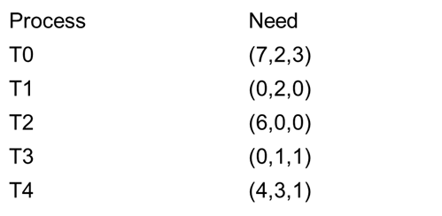
Available = (2,3,0) − (0,2,0) = (2,1,0)
T0 Allocation = (0,1,0) + (0,2,0) = (0,3,0)
T0 Need = (7,4,3) − (0,2,0) = (7,2,3)
Work = (2,1,0)
Now check if any process can finish (Need ≤ Work)

Slide 57
Because after allocating:
Available resources become too low: (2,1,0)
No process has its Need ≤ Available
So no process can complete and release resources
This causes a deadlock risk, hence:
Request by T4 (3,3,0) → Cannot be granted (insufficient resources)
Request by T0 (0,2,0) → Cannot be granted (leads to unsafe state)

Slide 58
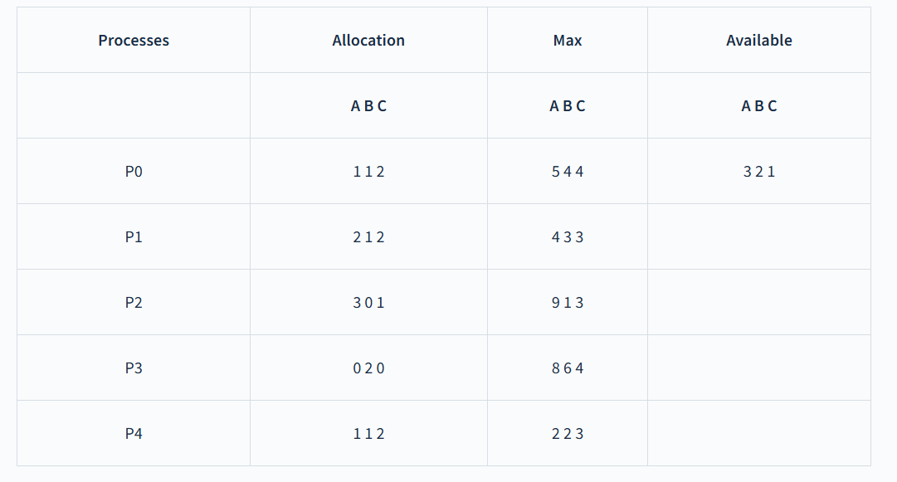
Calculate the need matrix? Q.2 Is the system in a safe state?

Slide 59
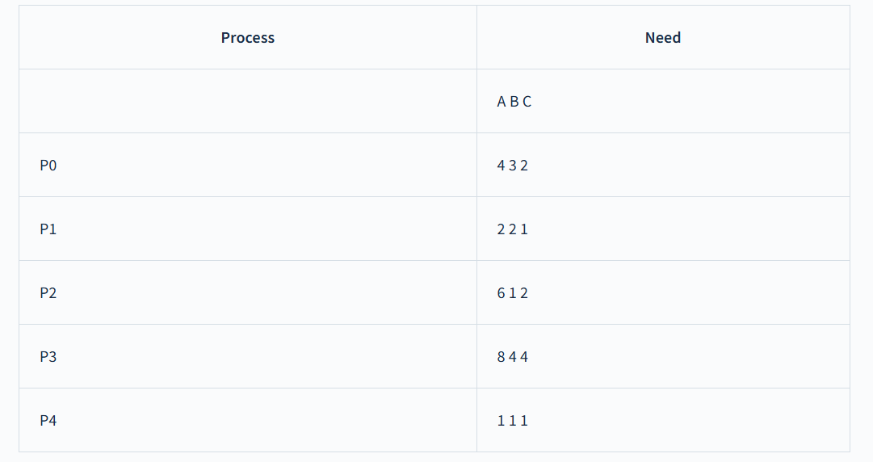

Q.1 Calculate the need matrix? Q.2 Is the system in a safe state?
We can easily calculate the entries of need matrix using the formula: $\left(Need\right)i=\left(Max\right)i−\left(Allocation\right)i$

Slide 60
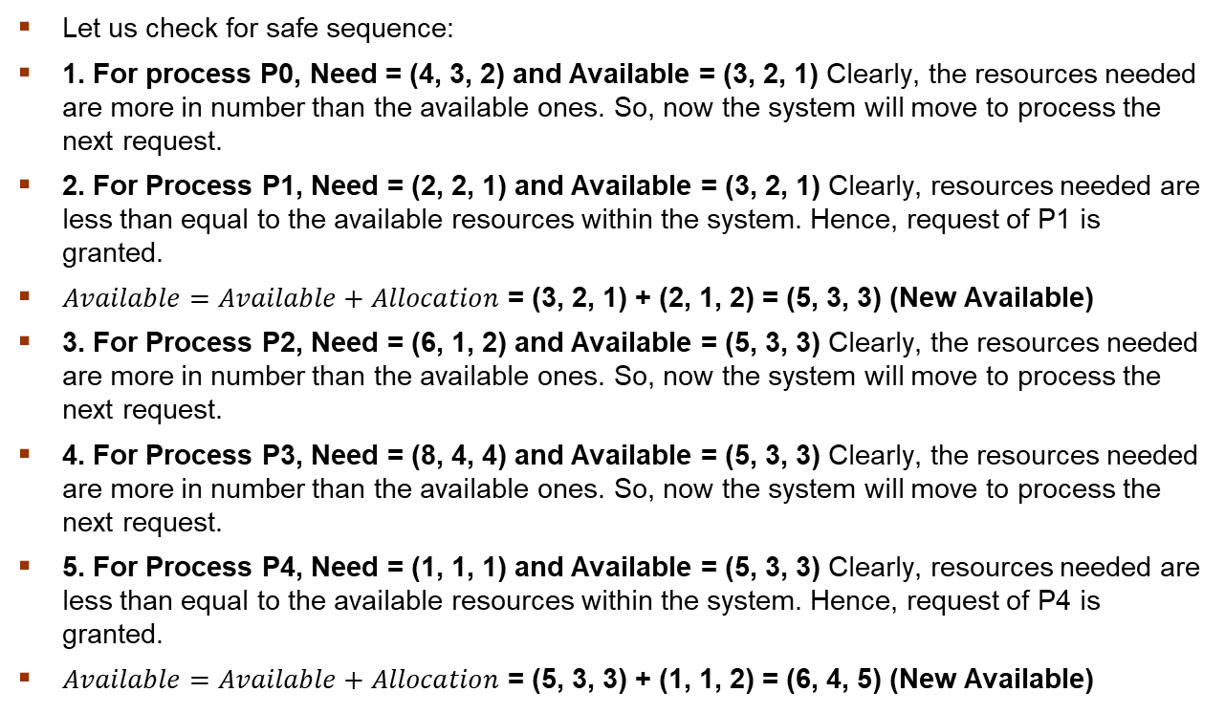
Let us check for safe sequence:
1. For process P0, Need = (4, 3, 2) and Available = (3, 2, 1) Clearly, the resources needed are more in number than the available ones. So, now the system will move to process the next request.
2. For Process P1, Need = (2, 2, 1) and Available = (3, 2, 1) Clearly, resources needed are less than equal to the available resources within the system. Hence, request of P1 is granted.
$Available=Available+Allocation$ = (3, 2, 1) + (2, 1, 2) = (5, 3, 3) (New Available)
3. For Process P2, Need = (6, 1, 2) and Available = (5, 3, 3) Clearly, the resources needed are more in number than the available ones. So, now the system will move to process the next request.
4. For Process P3, Need = (8, 4, 4) and Available = (5, 3, 3) Clearly, the resources needed are more in number than the available ones. So, now the system will move to process the next request.
5. For Process P4, Need = (1, 1, 1) and Available = (5, 3, 3) Clearly, resources needed are less than equal to the available resources within the system. Hence, request of P4 is granted.
$Available=Available+Allocation$ = (5, 3, 3) + (1, 1, 2) = (6, 4, 5) (New Available)

Slide 61
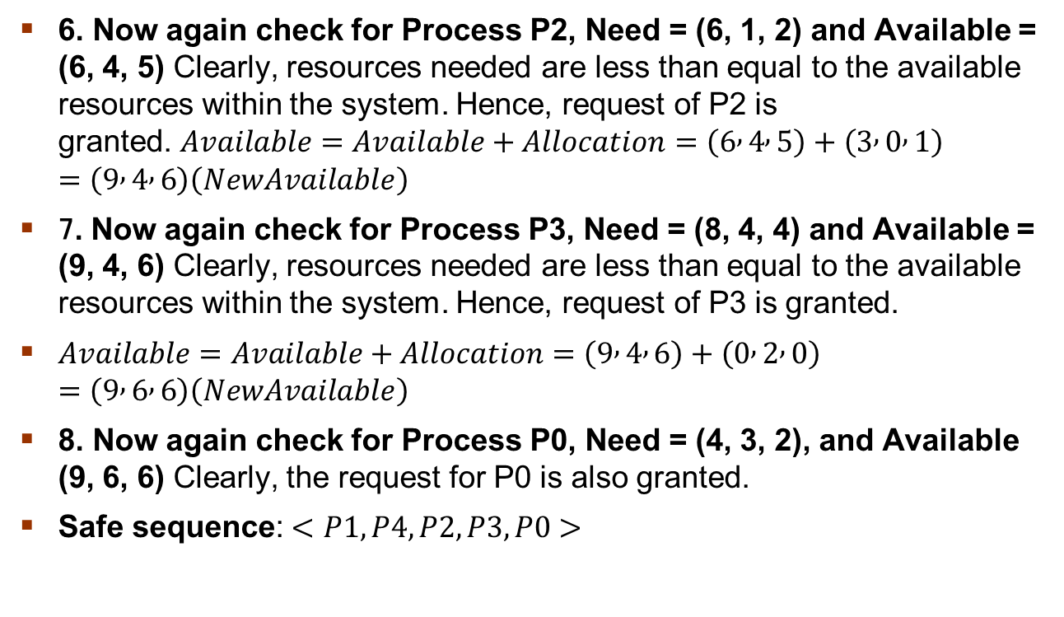
6. Now again check for Process P2, Need = (6, 1, 2) and Available = (6, 4, 5) Clearly, resources needed are less than equal to the available resources within the system. Hence, request of P2 is granted. $Available=Available+Allocation$ $=\left(6 , 4 , 5\right)+\left(3 , 0 , 1\right)=\left(9 , 4 , 6\right)\left(NewAvailable\right)$
7. Now again check for Process P3, Need = (8, 4, 4) and Available = (9, 4, 6) Clearly, resources needed are less than equal to the available resources within the system. Hence, request of P3 is granted.
$Available=Available+Allocation$ $=\left(9 , 4 , 6\right)+\left(0 , 2 , 0\right)=\left(9 , 6 , 6\right)\left(NewAvailable\right)$
8. Now again check for Process P0, Need = (4, 3, 2), and Available (9, 6, 6) Clearly, the request for P0 is also granted.
Safe sequence: $<P1,P4,P2,P3,P0>$

Slide 62
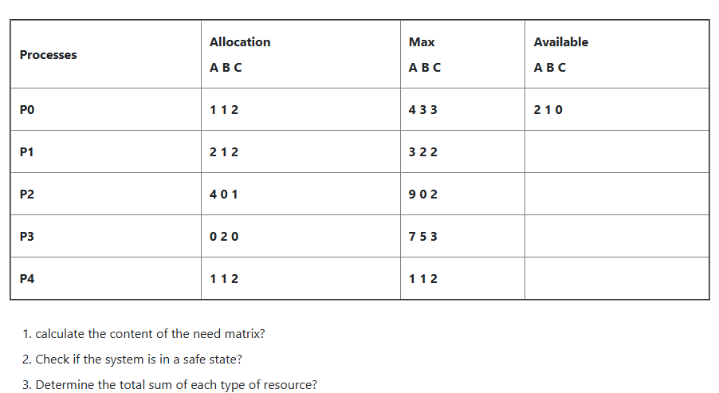

Slide 63
Safe sequence: < P1, P4, P2, P3, P0>
The total amount of resources will be calculated by the following formula:
The total amount of resources= sum of columns of allocation + Available
= [8 5 7] + [2 1 0] = [10 6 7]

Slide 64
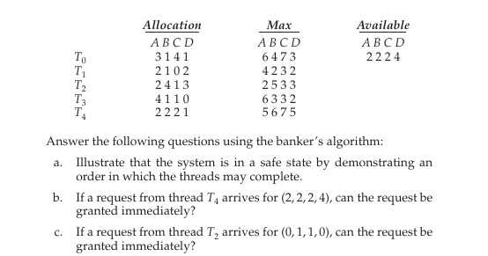
Notes:
⟨ T2, T1, T3, T0, T4 ⟩

Slide 65
Deadlock Detection
Allow system to enter deadlock state
Detection algorithm
Recovery scheme
Notes:
Deadlock detection is the process of identifying when processes are stuck waiting for resources held by other processes.
Recovery is the method of resolving the deadlock to allow the system to continue functioning.
Detection is done using techniques like Resource Allocation Graphs (RAG) or Wait-for Graphs.
Once a deadlock is detected, recovery methods include process termination, resource preemption, or process rollback.

Slide 66
Single Instance of Each Resource Type
Maintain wait-for graph
Nodes are threads
T_{i} → T_{j} if T_{i} is waiting for T_{j}
Periodically invoke an algorithm that searches for a cycle in the graph. If there is a cycle, there exists a deadlock
An algorithm to detect a cycle in a graph requires an order of n² operations, where n is the number of vertices in the graph
Notes:
Deadlock detection is a mechanism in operating systems used to identify whether a set of processes is stuck in a deadlock state.
It analyzes resource allocation and process dependencies to detect cycles and determine if processes are waiting indefinitely for resources.
In this case for Deadlock detection, we can run an algorithm to check for the cycle in the Resource Allocation Graph. The presence of a cycle in the graph is a sufficient condition for deadlock.

Slide 67
A Wait-For Graph is a simplified graph used for deadlock detection in systems where each resource has only one instance.
Nodes → Processes (T0, T1, …)
Edges (Pi → Pj) → Process Pi is waiting for a resource held by Pj
Assume:
T0 is waiting for a resource held by T1
T1 is waiting for a resource held by T2
T2 is waiting for a resource held by T0
Wait-For Graph:
T0 → T1 → T2 → T0

Slide 68
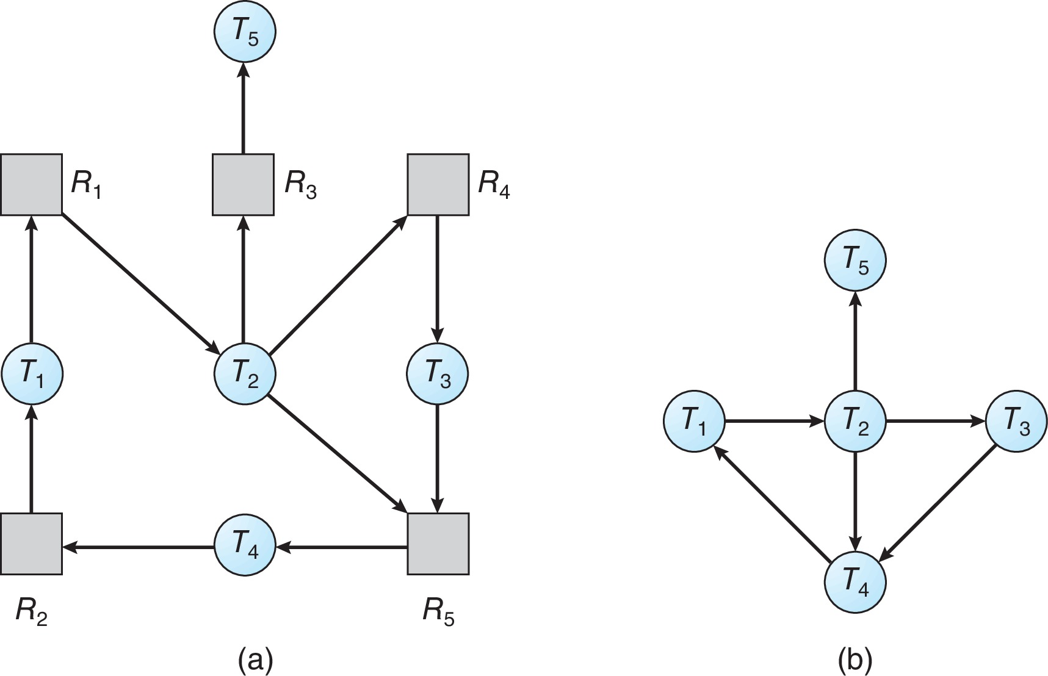
Resource-Allocation Graph and Wait-for Graph
Resource-Allocation Graph
Corresponding wait-for graph

Slide 69
Several Instances of a Resource Type
Available: A vector of length m indicates the number of available resources of each type
Allocation: An n x m matrix defines the number of resources of each type currently allocated to each thread.
Request: An n x m matrix indicates the current request of each thread. If Request [i][j] = k, then thread T_{i} is requesting k more instances of resource type R_{j}.

Slide 70
Why Max and Need are NOT required in Deadlock Detection
In deadlock detection, we are only asking:
“Given the current situation, is there a deadlock right now?”
We do NOT care about future demands.
So we only need:
Allocation → what each process already has
Request → what each process is currently waiting for
Available → what is free now
That’s enough to check:
Can any process finish with the resources currently available?
If no process can proceed → deadlock exists
Notes:
IN bankers algorithm->Maximum demand (Max) of each process
Remaining need (Need = Max − Allocation)
This allows the system to:
Predict future behavior
Ensure a safe sequence exists

Slide 71
Detection Algorithm
Let Work and Finish be vectors of length m and n, respectively Initialize:
Work = Available
For i = 1,2, …, n, if Allocation_{i} ≠ 0, then Finish[i] = false; otherwise, Finish[i] = true
Find an index i such that both:
Finish[i] == false
Request_{i} ≤ Work
If no such i exists, go to step 4

Slide 72
Detection Algorithm (Cont.)
Work = Work + Allocation_{i} Finish[i] = true go to step 2
If Finish[i] == false, for some i, 1 ≤ i ≤ n, then the system is in deadlock state. Moreover, if Finish[i] == false, then T_{i} is deadlocked
Algorithm requires an order of O(m x n²) operations to detect whether the system is in deadlocked state

Slide 73
Example of Detection Algorithm
Five threads T₀ through T₄; three resource types A (7 instances), B (2 instances), and C (6 instances)
Snapshot at time T₀:
Allocation Request Available
A B C A B C A B C
T₀ 0 1 0 0 0 0 0 0 0
T₁ 2 0 0 2 0 2
T₂ 3 0 3 0 0 0
T₃ 2 1 1 1 0 0
T₄ 0 0 2 0 0 2
Sequence <T₀, T₂, T₃, T₁, T₄> will result in Finish[i] = true for all i

Slide 74
In this, Work = [0, 0, 0] &
Finish = [false, false, false, false, false]
i=0 is selected as both Finish[0] = false and [0, 0, 0]<=[0, 0, 0].
Work =[0, 0, 0]+[0, 1, 0] =>[0, 1, 0] &
Finish = [true, false, false, false, false].
i=2 is selected as both Finish[2] = false and [0, 0, 0]<=[0, 1, 0].
Work =[0, 1, 0]+[3, 0, 3] =>[3, 1, 3] &
Finish = [true, false, true, false, false].
i=1 is selected as both Finish[1] = false and [2, 0, 2]<=[3, 1, 3].
Work =[3, 1, 3]+[2, 0, 0] =>[5, 1, 3] &
Finish = [true, true, true, false, false].
i=3 is selected as both Finish[3] = false and [1, 0, 0]<=[5, 1, 3].
Work =[5, 1, 3]+[2, 1, 1] =>[7, 2, 4] &
Finish = [true, true, true, true, false].
i=4 is selected as both Finish[4] = false and [0, 0, 2]<=[7, 2, 4].
Work =[7, 2, 4]+[0, 0, 2] =>[7, 2, 6] &
Finish = [true, true, true, true, true].

Slide 75
Example (Cont.)
T₂ requests an additional instance of type C
Request
A B C
T₀ 0 0 0
T₁ 2 0 2
T₂ 0 0 1
T₃ 1 0 0
T₄ 0 0 2
Notes:
After granting T2’s additional request, only T0 can complete. The remaining processes cannot satisfy their requests with available resources, leading to a deadlock involving T1, T2, T3, and T4.

Slide 76
Example (Cont.)
T₂ requests an additional instance of type C
Request
A B C
T₀ 0 0 0
T₁ 2 0 2
T₂ 0 0 1
T₃ 1 0 0
T₄ 0 0 2
State of system?
Can reclaim resources held by thread T₀, but insufficient resources to fulfill other processes; requests
Deadlock exists, consisting of processes T₁, T₂, T₃, and T₄
Notes:
After granting T2’s additional request, only T0 can complete. The remaining processes cannot satisfy their requests with available resources, leading to a deadlock involving T1, T2, T3, and T4.

Slide 77
Detection-Algorithm Usage
When, and how often, to invoke depends on:
How often a deadlock is likely to occur?
How many processes will need to be rolled back?
one for each disjoint cycle
If detection algorithm is invoked arbitrarily, there may be many cycles in the resource graph and so we would not be able to tell which of the many deadlocked threads “caused” the deadlock.

Slide 78
Recovery from Deadlock: Process Termination
Abort all deadlocked threads
Abort one process at a time until the deadlock cycle is eliminated
In which order should we choose to abort?
Priority of the thread
How long has the thread computed, and how much longer to completion
Resources that the thread has used
Resources that the thread needs to complete
How many threads will need to be terminated
Is the thread interactive or batch?

Slide 79
Recovery from Deadlock: Resource Preemption
Selecting a victim – minimize cost
Rollback – return to some safe state, restart the thread for that state
Starvation – same thread may always be picked as victim, include number of rollback in cost factor

Slide 80
End of Chapter 8

