Slide 1
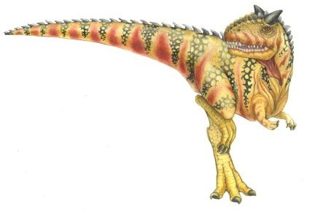
Chapter 8: Main Memory
Operating System Concepts – 9th Edition
Silberschatz, Galvin and Gagne ©2013

Slide 2
Chapter 8: Memory Management
Background
Swapping
Contiguous Memory Allocation
Segmentation
Paging
Structure of the Page Table
Example: The Intel 32 and 64-bit Architectures
Example: ARM Architecture

Slide 3
Objectives
To increase CPU utilization and response speed:
Several processes must be kept in main memory
 We must share memory
How to manage main memory resource…?
To provide a detailed description of various ways of organizing memory hardware
To discuss various memory-management techniques, including paging and segmentation
To provide a detailed description of the Intel Pentium, which supports both pure segmentation and segmentation with paging

Slide 4
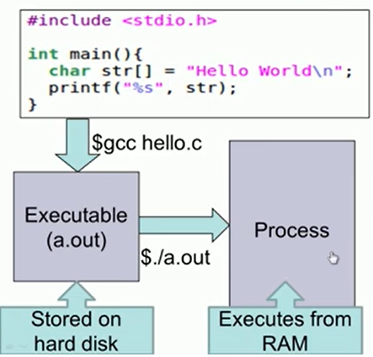

Slide 5
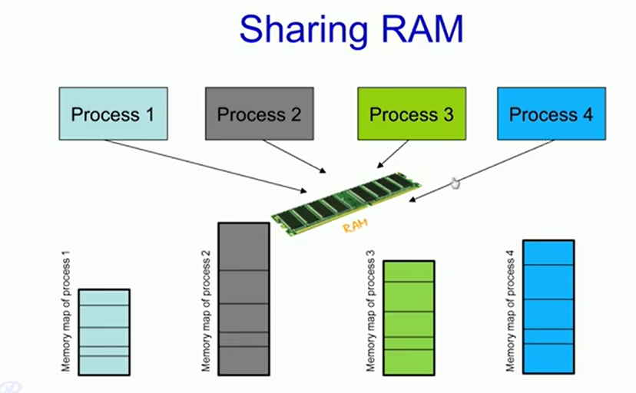

Slide 6
Background
Program must be brought (from disk) into memory and placed within a process for it to be run
Given current value of EIP register, then Fetch-and-Execute cycle
Fetch next instruction from memory
Decode the new instruction
If necessary: fetch operands (data) from memory
Execute the instruction
EIP = address of next instruction
If necessary: save results (new data) to memory
Main memory and registers are the only storage that the CPU can access directly
There are no machine instructions taking disk addresses as arguments
Memory unit only sees a stream of
addresses and read requests, or, address + data and write requests
Registers are accessed within one tick of the CPU clock; very fast memories
Main memory access can take many CPU clock ticks, causing a stall
Cache sits between main memory and CPU registers; solution to stall issue
Protection of memory required to ensure correct operation; hardware-level

Slide 7
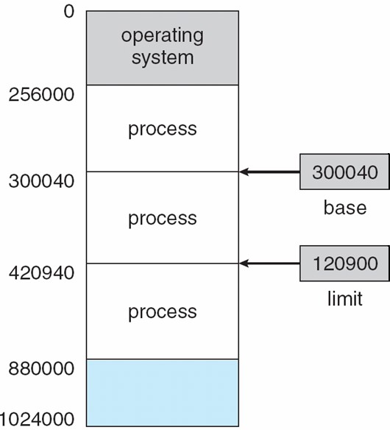
Base and Limit Registers
For each process, the base and limit registers define its logical address space
 To protect processes from each; each process has its own memory space
Base register holds the smallest legal physical memory address
Limit register specifies the size of the range of accessible addresses
CPU must check every memory access generated in user mode to be sure it is between base and limit for that user; to protect a process’s memory space

Slide 8



Hardware Address Protection
Base and limit registers loaded only by the OS through a privileged instruction
To prevent users from changing these registers’ contents
OS has unrestricted access to OS memory and user memory
Load users’ programs into users’ memory, … etc
Access and modify system-calls’ parameter, … etc

Slide 9
Logical vs. Physical Address Space
The concept of a logical address space that is bound to a separate physical address space is central to proper memory management
Logical address – generated by the CPU;
 Also referred to as virtual address
Physical address – address seen by the memory-management unit in its
memory-address register
The compile-time and load-time address-binding schemes generate identical logical and physical addresses;
The execution-time address-binding scheme results in differing logical and physical addresses; hence, we refer to logical address as virtual address
Logical address space is the set of all logical addresses generated by a
program
Physical address space is the set of all physical addresses corresponding to these logical addresses

Slide 10
Address Binding
Processes on disk waiting to be brought into memory for execution form an input queue
Addresses represented in different ways at different stages of a program’s life.
Addresses in source codes are symbolic. They are names of variable
Compilers bind symbolic addresses to relocatable addresses
i.e. “14 bytes from beginning of this module”
Linkers or loaders will bind relocatable addresses to absolute addresses
i.e. 74014
Each binding is a mapping from one address space to another

Slide 11
Binding of Instructions and Data to Memory
Address binding of instructions and data to memory addresses can happen at three different stages
Compile time: If memory location is known a priori at compile time, absolute
code can be generated; must recompile code if starting location changes
If a process will reside at location L then its compile code will start at L
Source code should be re-compiled if L changes
Load time: Compiler must generate relocatable code if memory location of the process is not known at compile time
That is, final binding is delayed until load time
Execution time: Binding delayed until run time if the process can be moved
during its execution from one memory segment to another
Need hardware support for address maps (e.g., base and limit registers)

Slide 12
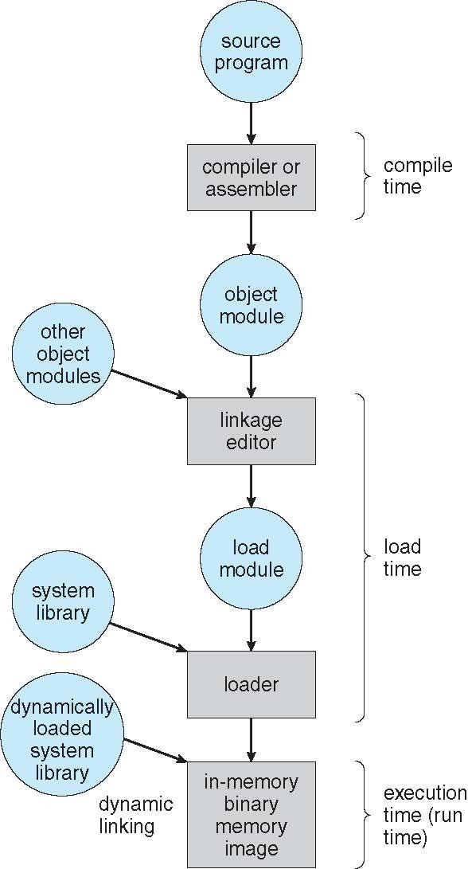
Multistep Processing of a User Program

Slide 13
Memory-Management Unit (MMU)
MMU is the hardware that does virtual-to-physical addr mappings at run-time
Many possible mapping method; covered in the rest of this chapter
Example: a simple a MMU scheme which adds the value in the base register to every address generated by a user process at the time it is sent to memory
 Generalizes the base-register scheme described in Slide-6
Base register now called relocation register
MS-DOS on Intel 80x86 used 4 relocation registers: EBX, BX, BH, BL
The user program deals with logical addresses; it never sees the real physical addresses
Execution-time binding occurs when reference is made to location in memory
 See Slide-8
Logical address mapped to physical addresses before use
Logical addresses: in range
Physical addresses: in range
0 to
R + 0 to
max
R + max
– For a base value R in the relocation register

Slide 14
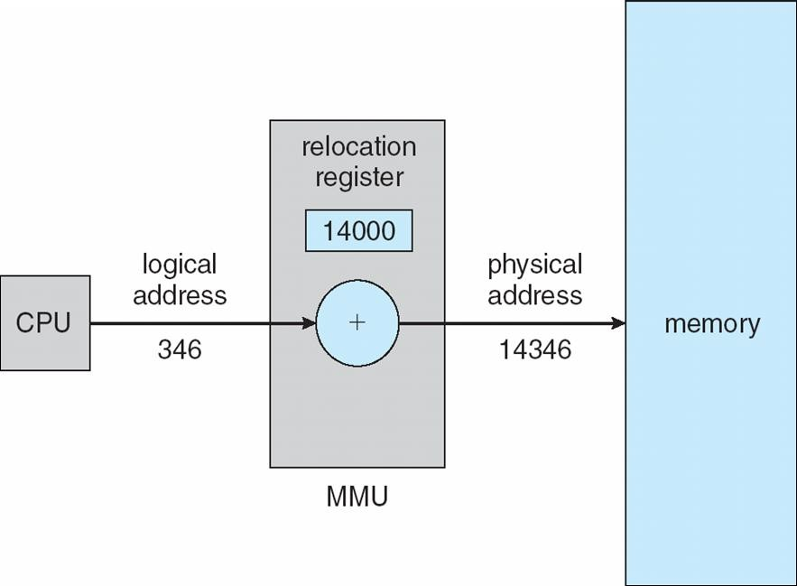
Dynamic relocation using a relocation register (Dynamic Loading)
A user routine is not loaded until it is called Loading is delayed until run-time
Better memory-space utilization; unused routine is never loaded
All routines kept on disk in relocatable
load format
Useful when large amounts of code are needed to handle infrequently occurring cases. Loaded program portion is much smaller than total program
No special support from the operating system is required
Implemented through program design
OS can help users by providing libraries to implement dynamic loading

Slide 15
Dynamic Linking
Static linking – system libraries and program code combined by the loader into the binary program image (the final executable file)
Dynamic linking – the linking is postponed until execution-time
The executing program (the running process)
Small piece of code, the stub, indicates how to locate the appropriate memory- resident library routine, or, how to load the library if routine is not already present
Operating system checks if the needed routine is in the process’s memory space
If not in address space, then load the library routine; when stub is executed
Stub replaces itself with the address of the routine and executes the routine
Dynamic linking is particularly useful for [large] system libraries
Very useful also for shared libraries with different version numbers
Consider applicability to patching system libraries
Versioning may be needed

Slide 16
Contiguous Allocation
Main memory must support both OS and user processes
Limited memory resource; thus, must allocate efficiently
Main memory is usually divided into two partitions:
Resident OS usually placed in low memory together with the interrupt vector
User processes then held in high memory
Each process is contained in a single contiguous section of memory
Contiguous memory allocation is one early method
Each process is placed contiguous to each other in memory

Slide 17
Contiguous Allocation - Memory Protection
We can protect a process’s memory by combining ideas in Slide-5 and Slide-11
Relocation registers is used to protect user processes from each other, and from changing operating-system code and data.
For each process:
Relocation register contains value of smallest physical address; Slide-11
Limit register contains its range of logical addresses
Each logical address must be less than the limit register value; Slide-5
MMU maps logical addresses dynamically
By adding logical address to relocation value; see Slide-22
Dispatcher always loads these two registers with their correct values
All logical addresses are checked against these two registers
Thus, protecting both each OS and each user program and data
This relocation-register protection scheme allows actions such as kernel code being transient and kernel changing size dynamically
Unused kernel code and data need not be in memory until needed
Example: un-used device driver code need not be kept in memory

Slide 18
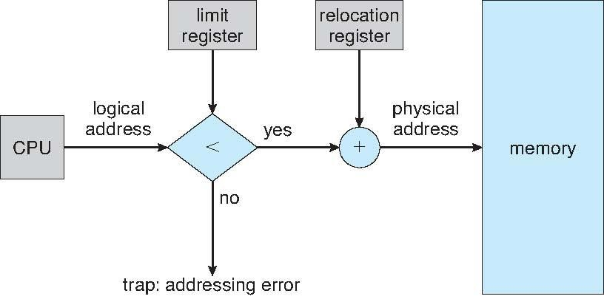
Hardware Support for Relocation and Limit Registers

Slide 19
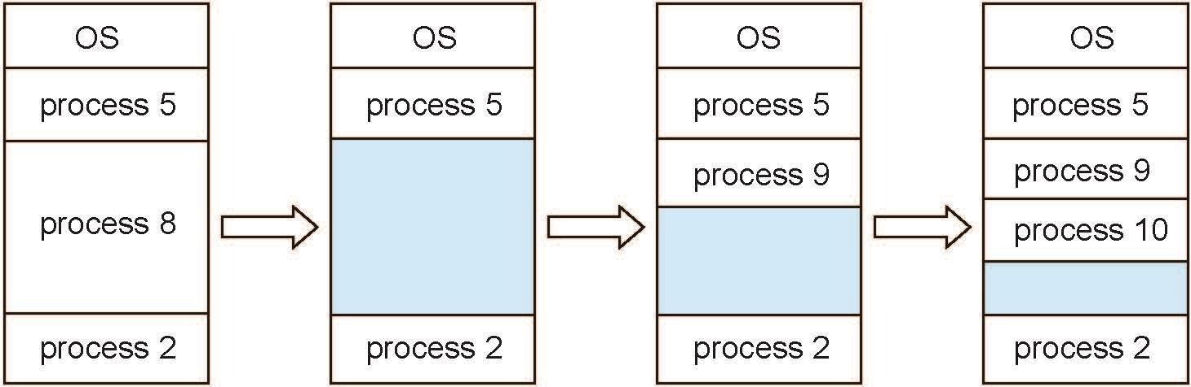
Multiple-Partition Allocation
Multiple-partition allocation: divide memory into many fixed-sized partitions
One process in each partition. Degree of multiprogramming limited by # of partitions
Fixed-sized partitioning is simple but limited due to size and number of partitions
Better: use variable-partition sizes for efficiency (sized to a given process’ needs)
Hole – block of free memory; variable-sized holes scattered throughout memory
Operating system maintains information about: a) allocated partitions, and b) holes
Job scheduling algorithm considers holes and memory need of each process
Allocate memory to a new process from a hole large enough to accommodate it
Terminating processes free their partition; adjacent free partitions are combined

Slide 20
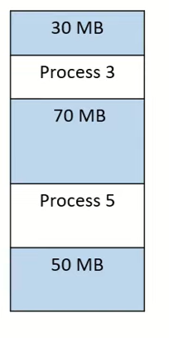
Dynamic Storage-Allocation Problem
How to satisfy a request of size n from a list of free holes?
First-fit: Allocate the first hole that is big enough
Best-fit: Allocate the smallest hole that is big enough;
must search entirelist, unless ordered by size
Produces the smallest leftover hole
Worst-fit: Allocate the largest hole; must search entire list,
unless ordered by size
Produces the largest leftover hole
– Which may be more useful than the smaller leftover hole from a best-fit approach; see Slide-25
First-fit and best-fit better than worst-fit in terms of speed and storage utilization
First-fit is generally the fastest

Slide 21
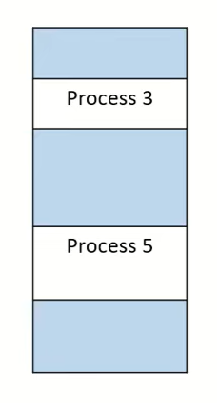
Fragmentation
External Fragmentation – total memory space exists to satisfy a request, but it is not contiguous
Free memory space is broken into pieces as processes are
loaded and removed from memory
Both, first-fit and best-fit strategies suffer from external
fragmentation
Statistical analysis of first-fit reveals that given N allocated blocks, 0.5N blocks will be lost to fragmentation
 That is, 1/3 of memory may be unusable -> 50-percent rule
Internal Fragmentation – allocated memory may be slightly larger than requested memory; this size difference is memory internal to a partition, but not being used.Example: a process requests 18,462 bytes and is allocated memory hole of 18,464 bytes; we are then left with a hole of 2 bytes

Slide 22
Fragmentation
Reduce external fragmentation by compaction
Shuffle memory contents to place all free memory together in one large block
Compaction is possible only if address relocation is dynamic, and is done at
execution time
I/O problem
Latch job in memory while it is involved in I/O
Do I/O only into OS buffers
Compaction can be very expensive in terms of time
All processes are moved toward one end of memory
Other solutions to external fragmentation problems: Segmentation and Paging
Permit the logical address space of each process to be non-contiguous
Process can be allocated physical memory wherever it is available
Now consider that backing store has same fragmentation problems
As processes are swapped in and out. Also true for any storage device

Slide 23
A system is using a dynamic partitioning memory allocation scheme. At a given point in time, the memory is divided into 10 blocks as shown below:
Block No. | 1 | 2 | 3 | 4 | 5 | 6 | 7 | 8 | 9 | 10
Size (MB) | 40 | 50 | P1 | 60 | P2 | P3 | 26 | P4 | 20 | P5
The system receives the following sequence of memory requests:
16 MB
30 MB
20 MB
50 MB
Apply the following placement algorithms:
First Fit
Best Fit
Worst Fit
Which placement algorithm results in the most efficient memory utilization (i.e., minimum fragmentation)? Justify your answer.

Slide 24
Consider six memory partitions of size 200 KB, 400 KB, 600 KB, 500 KB, 300 KB and 250 KB. These partitions need to be allocated to four processes of sizes 357 KB, 210 KB, 468 KB and 491 KB in that order.
Perform the allocation of processes using-
First Fit Algorithm
Best Fit Algorithm
Worst Fit Algorithm

Slide 25
Paging
Physical address space of a process can be non-contiguous; process is allocated physical memory whenever the latter is available
Avoids external fragmentation and the need for compaction
Avoids problem of varying sized memory chunks
Paging
Divide physical memory into fixed-sized blocks called frames
 Block size is a power of 2; between 512 bytes and 1 Gbytes
Divide logical memory into blocks of same size as the frames called pages
The page size (like the frame size) is defined by the hardware; see Slide-29
Divide backing store into [clusters of] blocks of same size as the frames
Keep track of all free frames
To run a program of size N pages, need to find N free frames and load program
Set up a page table to translate logical to physical addresses
Still have Internal fragmentation

Slide 26
Address Translation Scheme
Each address generated by CPU is divided into two parts:
Page number (p) – used as an index into a page table
Page table contains the base address of each page in physical memory
Page offset (d) – combined with the base address to define the physical memory address that is sent to the memory unit
If the logical address space is 2^{m} and the page size is 2^{n}
The binary representation of the logical address has m bits, such that
The m – n leftmost bits designate the page number p
» p is index into the page table
The rightmost n bits designate the page offset d
» d is displacement within the page
page number | page offset
p | d
m -n
n
Notes:
Page number identifies the page
Offset exact location within the page

Slide 27
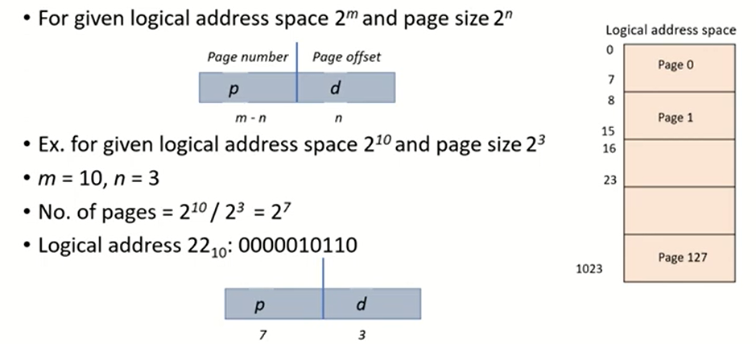

Slide 28
A logical address (or virtual address) generated by the CPU is divided into:
Page number (p): identifies which page the address refers to.
Page offset (d): the offset within that page.
The logical address space is assumed to be of size 2^m.
Page size is 2^n.
Number of pages = 2^m / 2^n = 2^{m-n}
Logical address space: 2^{10} → needs 10 bits to represent.
Page size: 2^3 → 3 bits for offset.
So,
m=10
n=3
m−n=7 → 7 bits for page number
Total number of pages = 2^7 = 128

Slide 29
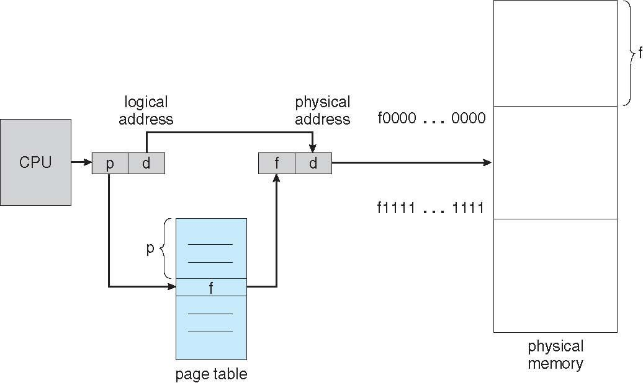
Paging Hardware

Slide 30

Paging Model of Logical and Physical Memory

Slide 31
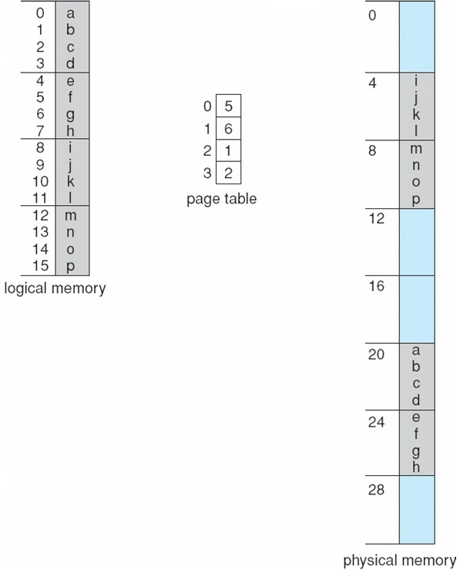
Paging Example
Example: n = 2 and m = 4 and using a 32-byte memory (8 pages) with 4-byte pages
Logical address 0 is page p=0, offset d=0; Page 0 is in frame f=5;
[ (f × m) + d ]
 Thus logical address 0 maps to physical address 20 [= (5 × 4) + 0];

Slide 32
Suppose logical address space of 32 pages of 2048 words. There are 64 frames in the main memory. Calculate the size of logical address and physical address along with the page no and offset value.

Slide 33
Number of pages = 32
So, number of bits to represent the page number =
2^5=32=5 bits
Page size = 2048 words
So, number of bits to represent the offset =
2^11=2048=11 bits
Therefore:
Logical Address = Page Number (5 bits) + Offset (11 bits) = 16 bits
Number of frames = 64
So, number of bits to represent the frame number =
2^6=64=6 bits
Offset is the same as page size = 2048 → 11 bits
Therefore:
Physical Address = Frame Number (6 bits) + Offset (11 bits) = 17 bits

Slide 34
Paging
There is no external fragmentation when using paging scheme
Internal fragmentation is possible. Calculating internal fragmentation
Page size = 2,048 bytes
Process size = 72,766 bytes
Process has 35 pages + 1,086 bytes; thus, 36 frames required
Internal fragmentation of 2,048 - 1,086 = 962 bytes of un-used memory
Worst case fragmentation is when 1 frame contains only 1 byte of used mem
Average fragmentation is about 1-half page size per process
So: are small page sizes more desirable?
Not necessarily; each page-table entry takes memory to track (overhead)
Large frame sizes better when transferring data to/from disk; efficient disk I/O
Page size: 4KB ~ 8KB but growing over time, and researching variable page size
Solaris supports two page sizes – 8 KB and 4 MB; fixed multiple page sizes
Process view and physical memory now very different
By implementation process can only access its own memory

Slide 35
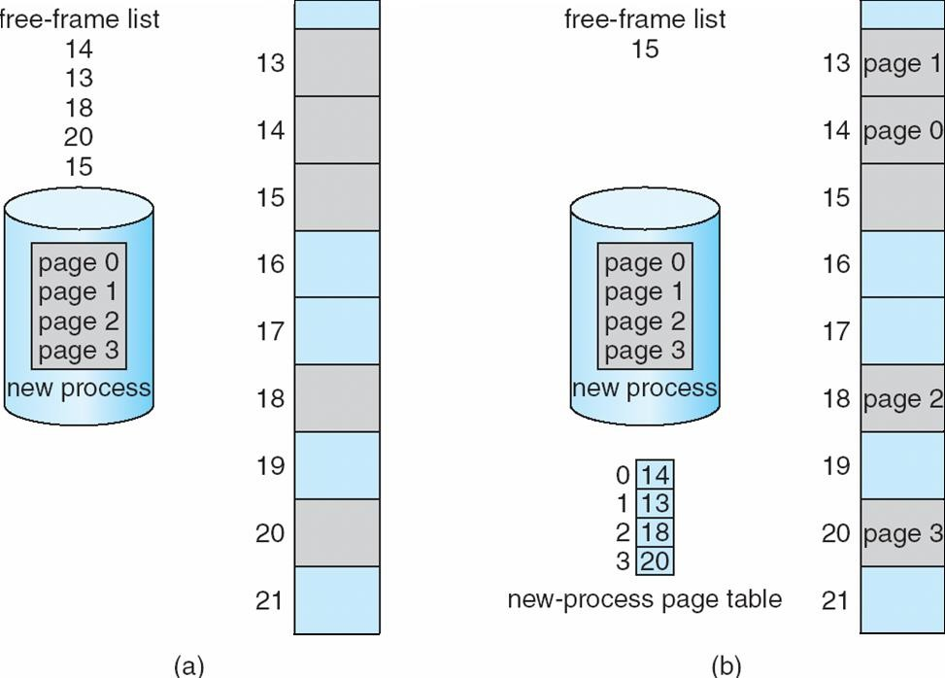
Free Frames
Before allocation
After allocation

Slide 36
Implementation of Page Table
Process’s page table is kept in main memory
Page-table base register (PTBR) points to the page table
Page-table length register (PTLR) indicates size of the page table
Both, PTBR and PTLR are also stored in the process’s PCB
In this scheme every access to data or instruction requires two memory accesses
First: access the page table using PTBR value to retrieve its frame number
Second: access the actual memory location given the frame number
 This is a serious time overhead that needs to reduced
The two-memory-access problem can be solved by the use of a special fast- lookup hardware cache called associative memory or translation look-aside buffers (TLBs)

Slide 37
Associative Memory - TLB
Associative memory – parallel search
Page #
Frame #
Address translation give (p, d)
If p is in associative memory, then retrieve the corresponding frame #
Otherwise retrieve the corresponding frame # from the page table in memory
 This is a TLB miss; the page # and frame # are then added to the TLB for future references

Slide 38

Paging Hardware With TLB

Slide 39
Implementation of Page Table
TLBs are typically small (64 to 1,024 entries)
On a TLB miss, new entry (p, f) is loaded into the TLB for faster access next time
Replacement policies must be considered; if TLB is already full. Examples:
LRU – Least Recently Used replacement algorithm
RR – Round Robin replacement algorithm
Random replacement algorithm
Some entries can be wired down for permanent fast access
Cannot be removed by any replacement algorithm
Some TLBs store address-space identifiers (ASIDs) in each TLB entry
Uniquely identifies each process and is used to provide address-space protection for that process
Otherwise need to flush the current TLB at every context switch

Slide 40
Effective Access Time is the average time it takes to access a memory location with the presence of TLB.
The TLB stores recent translations of virtual memory to physical memory addresses, speeding up the address translation process
EAT = (m + ε)α + (2m + ε)(1 – α)
(m + ε) → Time for TLB hit: search TLB and access memory.
(2m + ε) → Time for TLB miss: search TLB (fails), then go to page table (memory access), then go to actual memory (another access).

Slide 41
Effective Memory-Access Time
Associative Lookup Time = ε time units
Can be < 10% of memory access time
Hit ratio = α
Hit ratio – percentage of times that a page number is found in the associative
registers; ratio related to number of associative registers
Consider hit ratio α, TLB search time ε, and memory access time m
Effective Access Time (EAT)
EAT = (m + ε)α + (2m + ε)(1 – α)
= 2m + ε – mα
■
Consider α = 80%, ε = 20ns for TLB search, m = 100ns for memory access
EAT = 0.80 × (100 + 20) + 0.20 × (200 + 20) = 140ns (40% slowdown)
Consider more realistic hit ratio α = 99%, ε = 20ns for TLB search, m = 100ns for memory access
EAT = 0.99 × (100 + 20) + 0.01 × (200 + 20) = 121ns (21% slowdown)

Slide 42
Memory Protection
Memory protection implemented by associating protection bit with each frame to indicate if read-only or read-write access is allowed
Can also add more bits to indicate frame protection as
 execute-only, read-write, or read-only,
Or, add separate protection bit for each kind of access
Valid-invalid bit attached to each entry in the page table:
“valid” indicates that the associated page is in the process’s logical address space, and is thus a legal page
OS sets this bit for each for page to allow/disallow access to its frame
“invalid” indicates that the page is not in the process’ logical address space
Or use page-table length register (PTLR); see Slide-34
Any violations result in a trap to the kernel

Slide 43
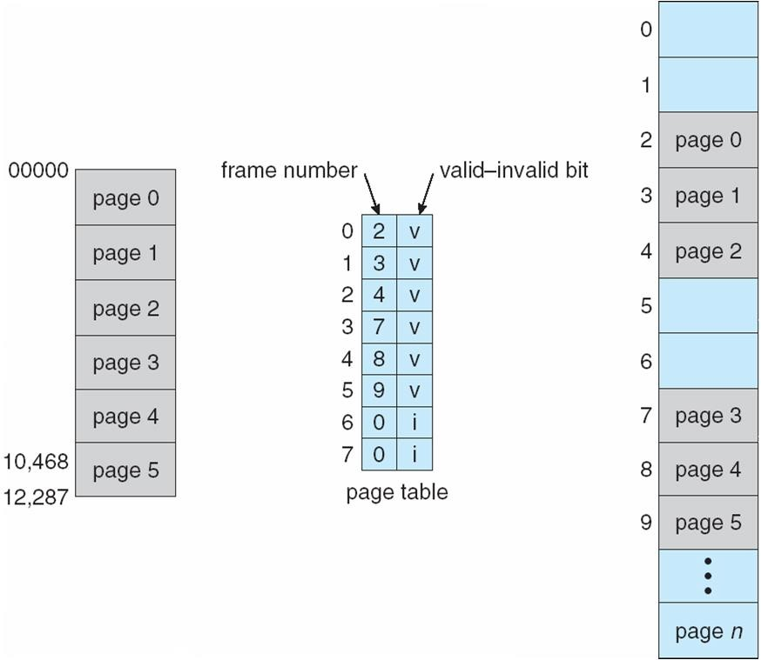
Valid (v) or Invalid (i) Bit In A Page Table

Slide 44
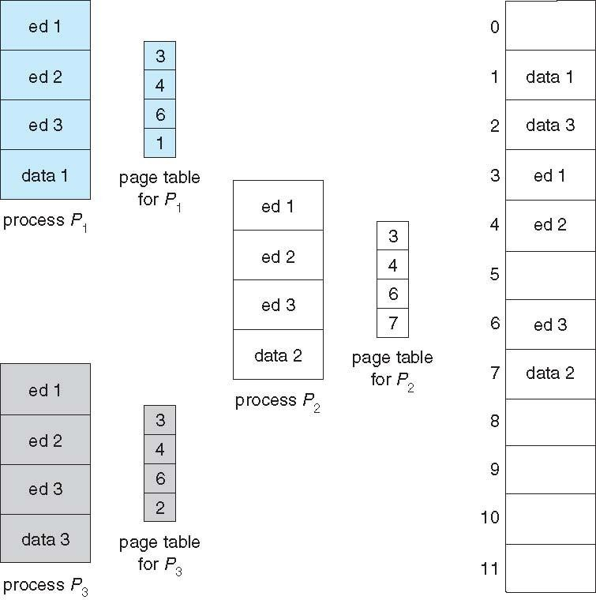
Shared Pages Example

Slide 45
Structure of the Page Table
Memory structures for paging can get huge using straight-forward methods
Consider a 32-bit logical address space as on modern computers
Page size of 4 KB (2¹²)
Page table would have 1 million entries (2³² / 2¹²); number of pages
If each entry is 4 bytes
Then each process may need up to 4 MB of physical address space to store its page table alone
Very costly to store in main memory
Do not want to allocate the page table contiguously in main memory
Solutions:
Hierarchical Paging
Hashed Page Tables
Inverted Page Tables

Slide 46
Swapping
A process can be swapped temporarily out of memory to a backing store, and then brought back into memory for continued execution
Total physical memory space of processes can exceed physical memory
Hence, swapping increases the degree of multiprogramming
Backing store – fast disk large enough to accommodate copies of all memory images for all users; must provide direct access to these memory images
System maintains a ready queue of ready-to-run processes which have memory images on the backing store or in memory. Standard swapping method:
Dispatcher called when the CPU scheduler selects a process P from queue
If P is not in the ready queue and not enough free space in memory for P
Swap in P from backing store and swap out some Q from memory
Reload registers and transfer control to P; i.e. P is now in running state
The context-switch time in standard swapping is fairly high; see Slide-16
Roll out, roll in – swapping variant used for priority-based scheduling algorithms; lower-priority process is swapped out so higher-priority process can be loaded and executed
Also, see medium-term scheduler in Chap-3

Slide 47
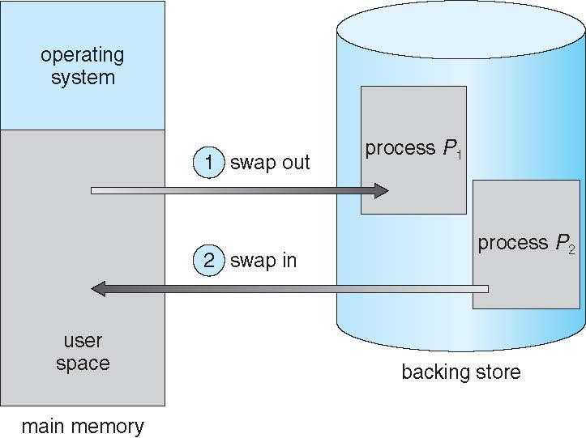
Schematic View of Swapping
(Swapping of two processes using a disk as a backing store)

Slide 48
Consider a single level paging scheme with a TLB. Assume no page fault occurs. It takes 30 ns to search the TLB and 100 ns to access the physical memory. If TLB hit ratio is 70%, the effective memory access time is _______ msec.
Suppose
TLB (Translation Lookaside Buffer) lookup time = 5 nanoseconds
Memory access time = 100 nanoseconds
Effective Access Time (EAT) = 125 nanoseconds
Assuming that accessing a page involves a TLB lookup followed by one memory access in case of a hit, and a TLB lookup plus two memory accesses in case of a miss, calculate the TLB hit ratio.

Slide 49
Context Switch Time including Swapping
Context-switch time in swapping is very high
Assume swapping 100MB to backing store with a transfer rate of 50MB/sec
Swap out time of a process is 2000 ms (= 2 seconds)
Swap in time of a same sized process is also 2000 ms
Total context-switch swapping component time is 4000ms (= 4 seconds)
We have ignored other components of context-switch time and ignored other disk performance aspect. But, the major part of swap time is transfer time
Total transfer time is directly proportional to the amount of memory swapped
We can reduce if we know exactly how much memory a process is using
Process with dynamic memory requirements will issue system-calls to inform OS of memory use via request_memory() and release_memory()

Slide 50
Context Switch Time and Swapping
Other constraints as well on swapping
Does the swapped out process need to swap back in to same physical addresses?
Depends on address binding method
A process must be completely idle before being swapped out; not just waiting
Consider pending I/O to/from process memory space
We can’t swap out the process since I/O would occur to wrong process
Solutions:
Never swap out a process with pending I/O
Or, always transfer I/O operations to kernel space, then to I/O device
» Known as double buffering, adds overhead

Slide 51
Modified Standard Swapping
Standard swapping not used in modern operating systems
But modified version are common
Idea: swap only when free memory is extremely low
Modified versions of swapping are found on many systems
UNIX, Linux, and Windows
Swapping normally disabled
Started only if amount of free memory falls below a threshold amount
Disabled again once amount of free memory increases beyond some threshold

Slide 52
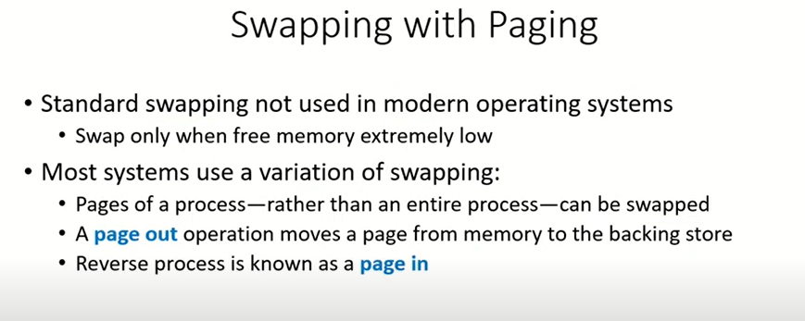

Slide 53
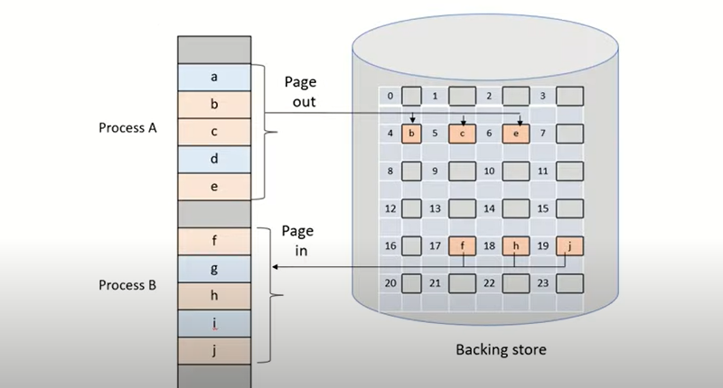

Slide 54
End of Chapter 8
Operating System Concepts – 9th Edition
Silberschatz, Galvin and Gagne ©2013

