Slide 1
23ECE205 Digital Electronics and Systems III Semester B. Tech. ( CSE) Amrita School of Engineering, Bengaluru Lecture

Slide 2
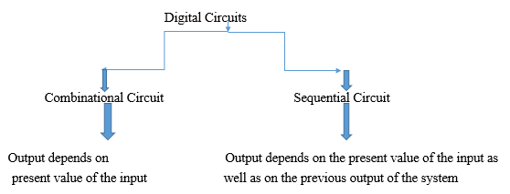
Combinational Circuit and Sequential Circuit
Sequential circuits include storage elements that store the values of the previous state of the system. The contents of the storage elements are said to represent the state of the circuit.

Slide 3
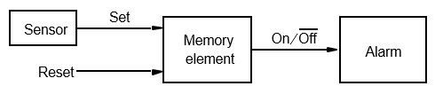
Control of an Alarm System
The alarm mechanism responds to the control input On/Off’ . It is turned on when On/Off’ = 1, and it is off when On/Off’ = 0. The desired operation is that the alarm turns on when the sensor generates a positive voltage signal, Set, in response to some undesirable event. Once the alarm is triggered, it must remain active even if the sensor output goes back to zero. The alarm is turned off manually by means of a Reset input. The circuit requires a memory element to remember that the alarm has to be active until the Reset signal arrives.

Slide 4
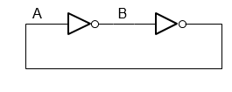
A Simple Memory Element
If we assume that A = 0, then B = 1. The circuit will maintain these values indefinitely. If we assume that A = 1, then B = 0, and the circuit will remain in this second state indefinitely. Thus, the circuit has two possible states. This circuit is not useful, because it lacks some practical means for changing its state.

Slide 5
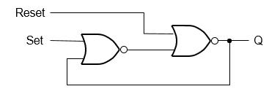
A Memory Element with NOR gates
Set (S) | Reset (R) | Q | Remarks
0 | 0 | Q | Previous State
0 | 1 | 0 | Reset State
1 | 0 | 1 | Set State
1 | 1 | 0 | But this is invalid state which will be discussed soon

Slide 6
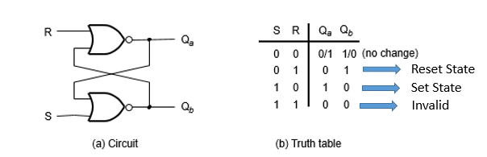
A Latch built with NOR gates
Required: Qa and Qb are complement of each other

Slide 7
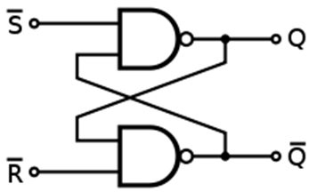
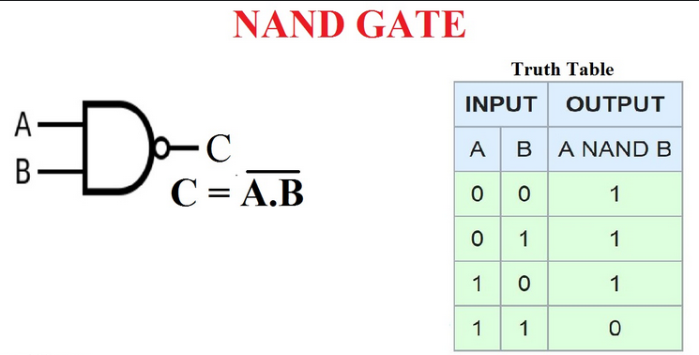
A Latch built with NAND gates
The next state Q can be written as either Q(n+1) or Q(t+1) or Q+ different authors follow different notations
The next state Q’ can be written as either Q’(n+1) or Q’(t+1) or Q’+
S | R | S’ | R’ | Q | Q’ | Remarks
0 | 0 | 1 | 1 | Q | Q’ | Same Previous value
0 | 1 | 1 | 0 | 0 | 1 | Reset State
1 | 0 | 0 | 1 | 1 | 0 | Set State
1 | 1 | 0 | 0 | 1 | 1 | Not Allowed
S
Q
Symbol of SR Latch
R
Q’

Slide 8
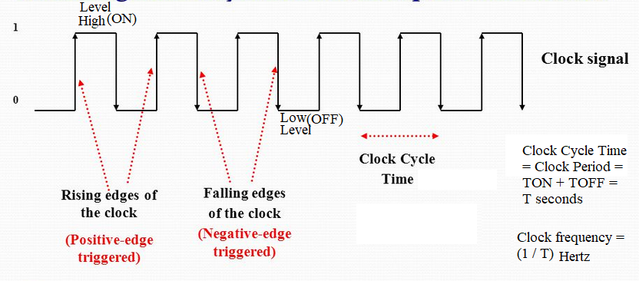
Clock
A clock is that which continuously alternates between 0 and 1. i.e. it is continuous train of pulses
The time it takes the clock to change from 1 to 0 and back to 1 (or vice versa) is called the clock period or clock cycle time.
i.e. Cycle time of a clock is the sum of its high duration and its low duration. The length of the time the clock is high before changing states is it high duration and the length of the time the clock is low before changing states is it low duration
The clock frequency is the inverse of the clock period. The unit of measurement for frequency is the Hertz
Clocks are often used to synchronize circuits

Slide 9
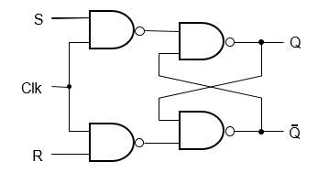
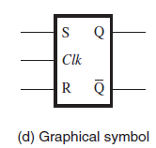
Gated SR Latch with NAND gates
Clk | S | R | Q(t+1) | Q’(t+1) | Remarks
0 | x | x | Q(t) | Q’(t) | No change. Same as that of the previous state
1 | 0 | 0 | Q(t) | Q’(t) | No change. Same as that of the previous state
1 | 0 | 1 | 0 | 1 | Reset state
1 | 1 | 0 | 1 | 0 | Set state
1 | 1 | 1 | 1 | 1 | Invalid

Slide 10
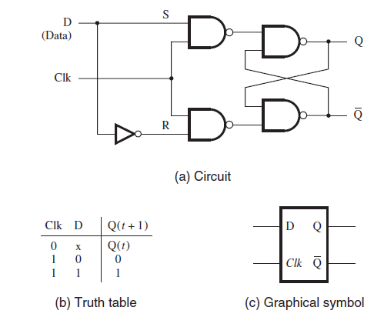
Gated D (Data) Latch
Clk | D | Q | Q’ | Remarks
0 | x | Q | Q’ | No change. Same as that of the previous state
1 | 0 | 0 | 1 | Q will be same as that of D input
1 | 1 | 1 | 0 | Q will be same as that of D input

Slide 11
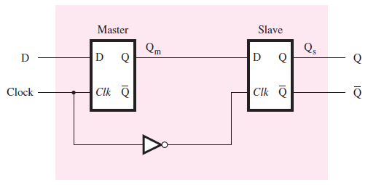
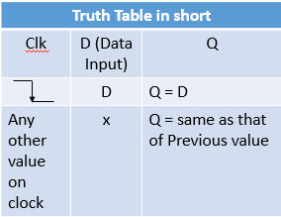
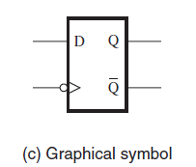
Master Slave D Flip Flop (Negative Edge Triggered D Flip Flop)
Truth Table in a descriptive manner
Clk |  | D | Qm | Qs = Q | Remarks
1 | -ve edge on Clk | 1 | 1 | Previous output = Q | At negative edge, whatever is value of D data input the same value will appear on Q
0 |  | x | 1 | 1
1 | -ve edge on Clk | 0 | 0 | Previous output = Q | At negative edge, whatever is value of D data input the same value will appear on Q
0 |  | x | 0 | 0
x |  | x | Qm | Q | At any other value other than negative edge trigger on the clock, the same previous value of Q will continue on Q
Clk

Slide 12
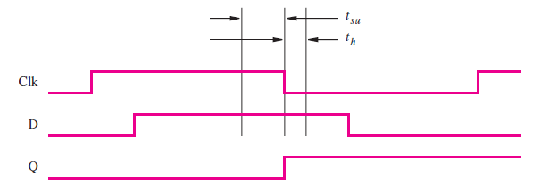
Set Up Time and Hold Time
Set Up Time (tsu): The minimum time that the D signal must be stable prior to the negative edge (or positive edge based on what type of flipflop) of the Clk signal is called the setup time, tsu, of the latch.
Hold Time (th): The minimum time that the D signal must remain stable after the negative edge (or positive edge based on what type of flipflop) of the Clk signal is called the hold time, th, of the latch.
Typical values for tsu = 3 ns and th = 2 ns.
If Set up time and Hold time are not adhered then the circuit will enter in Metastable state.

Slide 13
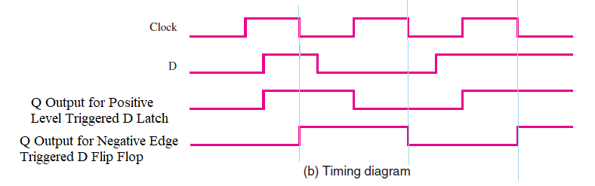
Timing Diagram Showing Difference between D Latch and D Flip Flop Working

Slide 14
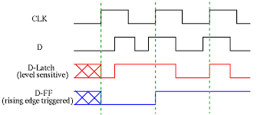
Analyze this Waveform: Exercise

Slide 15
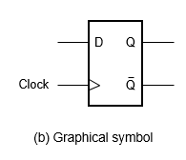
A Positive-Edge-Triggered D flip-flop.

Slide 16
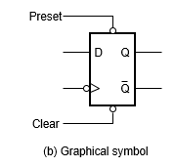
Master-Slave D flip-flop with Clear and Preset
Preset | Clear | D Input | Q Output | Remarks
0 | 0 | Don’t Care | Don’t Care | Invalid
0 | 1 | Don’t Care | 1 | Preset Condition
1 | 0 | Don’t Care | 0 | Clear or Reset Condition
1 | 1 | Whatever Valid value on D Input | Q = D Valid Output on Q | Regular or Normal Functionality of D Flip flop begins
We have assumed Low Level Active Preset and Clear here.
* Practically, these may be Low level or High level active

Slide 17
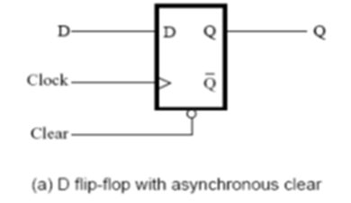
Asynchronous Clear
If the Clear Signal is considered to be Asynchronous signal, then that means the Clear signal will not wait for clock (positive edge as per the diagram here), and Q will made zero (0) immediately without waiting for the clock’s required edge. That is Clear signal is not synchronized with Clock signal.
If the Clear Signal is considered to be Synchronous signal, then that means the Clear signal will wait clock till immediate positive edge (positive edge as per the diagram here) occurs on the clock and then Q will be made zero (0). That is Clear signal is synchronized with Clock signal.

Slide 18
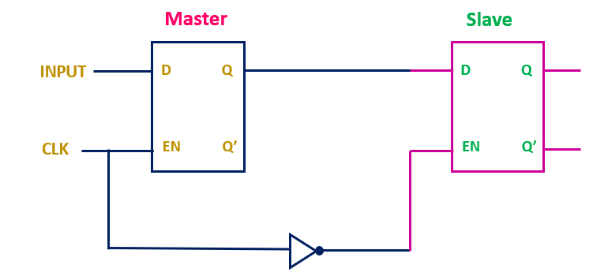

Slide 19
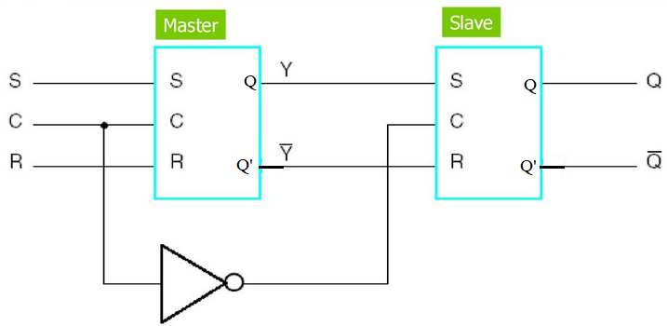
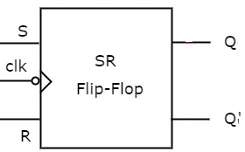
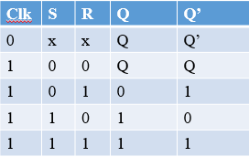
Master Slave SR Flip Flop
C = Clock = Clk
C = Clk = Clock | S | R | Q | Q’ | Remarks
Negative edge on C | 0 | 0 | Q | Q’ | Same as that of the previous value
Negative edge on C | 0 | 1 | 0 | 1 | Reset state
Negative edge on C | 1 | 0 | 1 | 0 | Set state
Negative edge on C | 1 | 1 | 1 | 1 | Invalid or Undefined
Any other value on C other than negative edge on the C | x | x | Q | Q’ | Same as that of the previous value

Slide 20
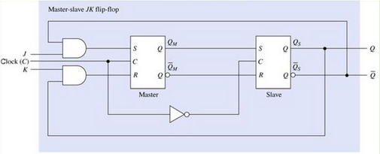
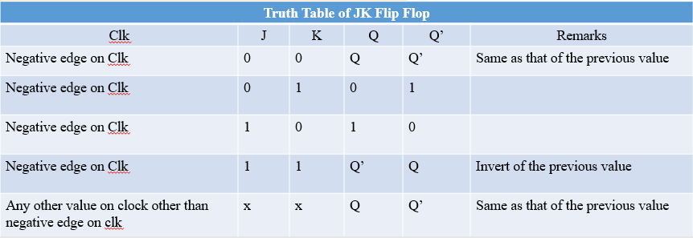
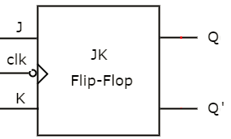
J K Flipflop (Master Slave)
Clock = C = Clk

Slide 21
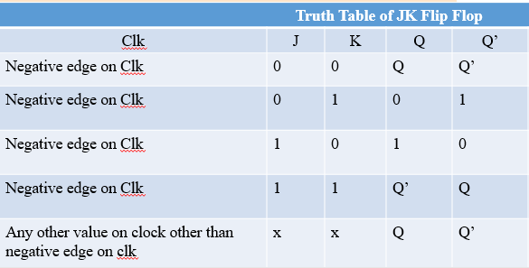
J K Flipflop (Master Slave)
When clk = 1 Mater Latch is active and when clk = 0 Slave latch is active.
a) When J = 0 and K = 0, Master Latch input S = R = 0 therefore QM and QM’ will be same as that of the previous value. Therefore, based on previous value on QM = 0/1 and QM’ = 1/0, the output QS = 0/1 and QS’ = 1/0.
b) When J = 0 and K = 1, Master Latch input S = 0 and R can not be defined hence we assume
Case i) If we assume at this time Q = 0 and Q’ = 1, then R = 0 hence QM and QM’ will have the same previous value QM = 0 and QM’ = 1. This causes the QS and QS’ to be 0 and 1 respectively (same as previous).
Case ii) If we assume at this time Q = 1 and Q’ = 0, then R = 1 hence QM and QM’ will have the value as QM = 0 and QM’ = 1. This causes the QS and QS’ to be 0 and 1 respectively.
Hence, we conclude that when J = 0 and K = 1, then Q = 0 and Q’ = 1
c) When J = 1 and K = 0, Master Latch input R = 0 and S can not be defined hence we assume
Case i) If we assume at this time Q = 0 and Q’ = 1, then S = 1 hence QM = 1 and QM’ = 0. This causes the QS and QS’ to be 1 and 0 respectively.
Case ii) If we assume at this time Q = 1 and Q’ = 0, then S = 0 hence QM and QM’ will have the same previous value QM = 1 and QM’ = 0. This causes the QS and QS’ to be 1 and 0 respectively (same as previous).
Hence, we conclude that when J = 1 and K = 0, then Q = 1 and Q’ = 0
d) When J = 1 and K = 1, Master Latch input S and R inputs can not be defined hence we assume
Case i) If we assume at this time Q = 0 and Q’ = 1, then S = 1 and R = 0, hence QM = 1 and QM’ = 0. This causes the QS and QS’ to be 1 and 0 respectively.
Case ii) If we assume at this time Q = 1 and Q’ = 0, then S = 0 and R = 1, hence QM = 0 and QM’ = 1. This causes the QS and QS’ to be 0 and 1 respectively.
Hence, we conclude that when J = 1 and K = 1, then Q and Q’ toggles with respect to the previous value and hence it is a valid output and removes the drawback of the Master Slave SR flipflop where for S=R= 1, the output is invalid as discussed before.

Slide 22
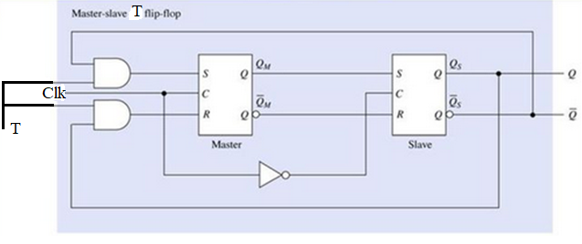
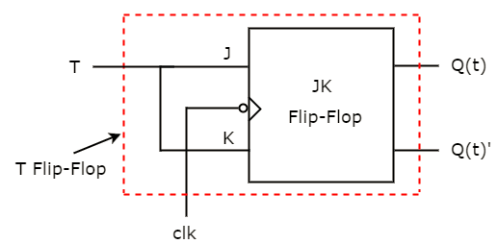
T (Toggle) Flip Flop
C = Clk = Clock | T | Q | Q’ | Remarks
Negative edge on C | 0 | Q | Q’ | Same as that of the previous value
Negative edge on C | 1 | Q’ | Q | Toggles i. e. Invert of the previous value
Any other value on C other than negative edge on the C | x | Q | Q’ | Same as that of the previous value

Slide 23
Summary of Truth Table of SR, JK, D and T flipflops
Characteristic Table
Characteristic Equation
Excitation Table
Characteristic Table = State Table Function Table = Truth Table

Slide 24
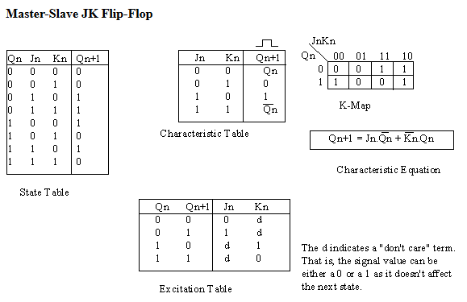

Slide 25
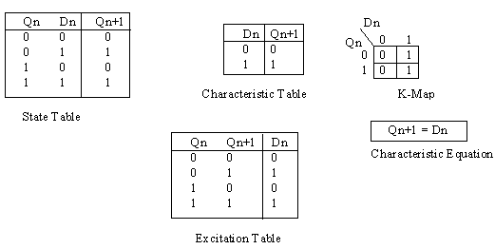
As an exercise, derive the state table, K-map, and excitation table for an SR flip-flop from the characteristic table.

Slide 26
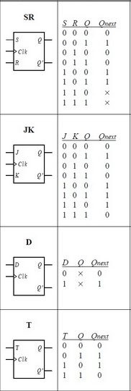
 | SR = 00 | SR = 01 | SR = 11 | SR = 10
Q = 0 | 0 | 0 | x | 1
Q = 1 | 1 | 0 | x | 1
Characteristic Equation for SR ff = Qnext = Q+ = S + R’Q
 | JK = 00 | JK = 01 | JK = 11 | JK = 10
Q = 0 | 0 | 0 | 1 | 1
Q = 1 | 1 | 0 | 0 | 1
Characteristic Equation for JK ff = Qnext = Q+ = JQ’ + K’Q
 | D = 0 | D = 1
Q = 0 | 0 | 1
Q = 1 | 0 | 1
Characteristic Equation for D ff = Qnext = Q+ = D
 | T = 0 | T = 1
Q = 0 | 0 | 1
Q = 1 | 1 | 0
Characteristic Equation for T ff = Qnext = Q+ = T’Q + TQ’
= T ⊕ Q

Slide 27
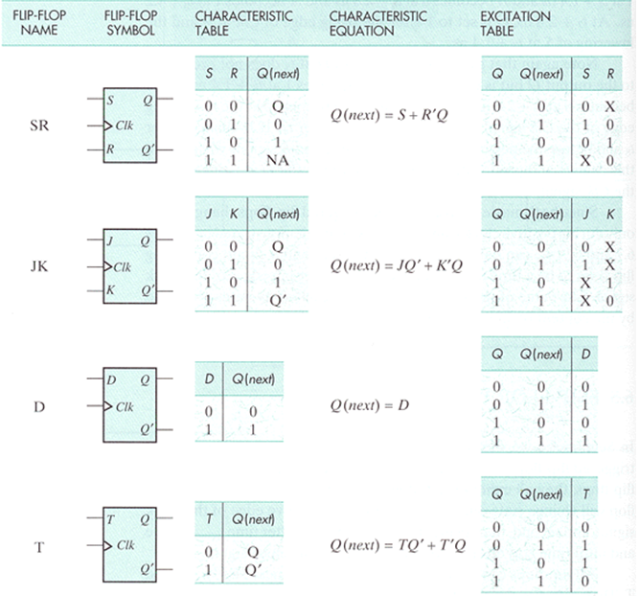
hi
Characteristic Table = State Table Function Table = Truth Table

