Slide 1

Database Management Systems
Chapter 1
Introduction to DBMS

Slide 2
Introduction to DBMS
Saya
Rs.40
BL002
Dosa
DBMS
CSE202
3
4
CSE
IT01

Slide 3
Introduction to DBMS
DBMS stands for Database Management System.
DBMS = Database + Management System.
Database is a collection of data
Management System is a set of programs to store & retrieve those data.
Thus, DBMS is a collection of inter-related data and set of programs to store & access those data in an easy and effective manner.

Slide 4
What is the need of DBMS?
Storage: Acquires less space as the redundant data (duplicate data)
has been removed before storage.
Example: A person having 2 accounts and the details
Fast Retrieval of data: Faster retrieval of data through queries

Slide 5
Purpose of Database Systems
Managing Data
To manage the data.
Consider a University that keeps the data of students, teachers, courses, books etc.
For all the above , we need a Database Management System.
Add new data
Store data
Delete data
Retrieve data
Update data

Slide 6
Few Applications of DBMS
Airlines: reservations, schedules, etc
Telecom: calls made, customer details, network usage, etc
Universities: registration, results, grades, etc
Sales: products, purchases, customers, etc
Banking: all transactions etc
Education sector: staff ,student & course details, registration, etc
Online shopping: product details, billing, shipping, etc

Slide 7
DBMS vs File System

Slide 8
Drawbacks of File system
Data redundancy: Refers to the duplication of data.
Ex: Students registers for 2 courses, the details of that student has to be saved in two files, this will take more storage than needed. Data redundancy often leads to higher storage costs and poor access time.
Data inconsistency: Data redundancy leads to data inconsistency.
Ex: Considering the student in the above example, if the student requests to change his address. If the address is changed at one place and not on all the records then this can lead to data inconsistency.
Data Isolation: Data are scattered in various files and files may be in different formats, writing new application programs to retrieve the appropriate data is difficult.
Dependency on application programs: Changing files would lead to change in application programs.

Slide 9
Drawbacks of File system
Atomicity issues: All the operations in a transaction executes or none.
Ex: Fund transfer across accounts involves debit and credit operations, incase after debit, system fails. It is difficult to achieve atomicity in file processing systems.
Data Security: Unauthorized access should be avoided.
Ex: A student in a college should not be able to see the payroll details of the teachers, such kind of security constraints are difficult to apply in file processing systems.

Slide 10
Advantages of DBMS over file system
No redundant data: Redundancy removed by data normalization. No data duplication saves storage and improves access time.
Data Consistency and Integrity: Since data normalization takes care of the data redundancy, data inconsistency is checked
Data Security: It is easier to apply access constraints in database systems so that only authorized user is able to access the data.
Privacy: Limited access means privacy of data.
Easy access to data – Database systems manages data in such a way so that the data is easily accessible with fast response times.
Easy recovery: Since database systems keeps the backup of data, it is easier to do a full recovery of data in case of a failure.
Flexible: Database systems are more flexible than file processing systems.

Slide 11
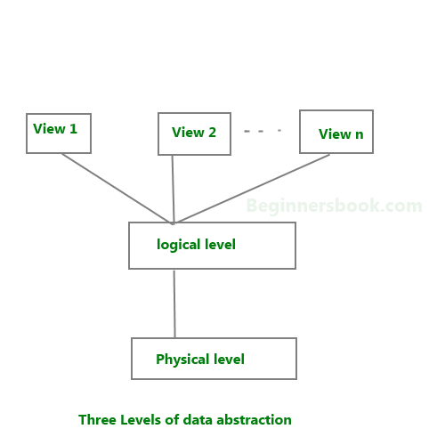
Data Abstraction in DBMS
We have three levels of abstraction:
Physical level: Lowest level of data abstraction.
It describes how data is actually stored in database.
Logical level: Describes what data is stored in database.
View level: Highest level of data abstraction. Describes the user interaction with database system.

Slide 12
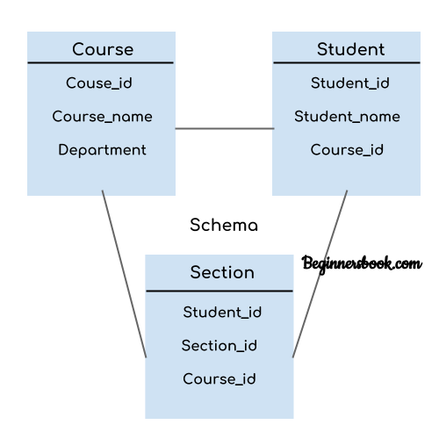
Schema
Design of a database is called the schema.
Schema is of three types:
Physical schema
Logical schema
View schema
For example: In the diagram, we have a schema showing the relationship between three tables: Course, Student and Section. It does not show the data present in those tables. Schema is only a structural view(design) of a DB

Slide 13
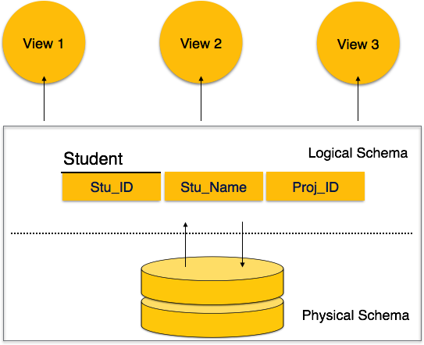
Types of Schema
View schema: Design of database at view level
Describes end user interaction with database systems
Logical schema: Design of database at logical level
Programmers and database administrators work at this level, which describes the table structure , how attributes/columns are interrelated, however the internal details such as implementation of data structure is hidden at this level (available at physical level).
Physical schema : The design of a database at physical level
How the data stored in blocks of storage is described at this level.

Slide 14
Instance of a DB
Definition
The data stored in database at a particular moment of time.
For example, lets say we have a single table student in the database, today the table has 100 records, so today the instance of the database has 100 records. Lets say we are going to add another 100 records in this table by tomorrow so the instance of database tomorrow will have 200 records in table. In short, at a particular moment the data stored in database is called the instance, that changes over time when we add or delete data from the database.

Slide 15


Question?????
Is it schema that changes frequently or is it instance?????

Slide 16
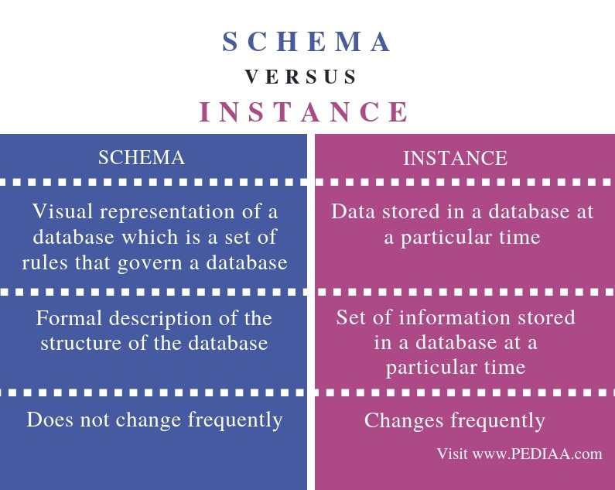
Difference between schema and instance

Slide 17
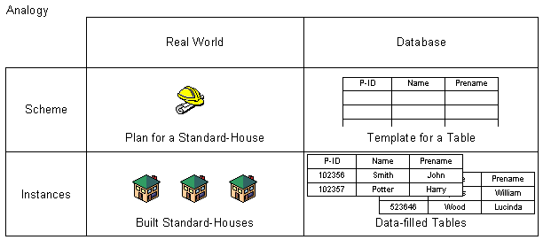
Difference between schema and instance

Slide 18
Data Independence
What is Data Independence ???????
Property of DBMS that helps you to change the Database schema at one level of a
database system without requiring to change the schema at the next higher level.

Slide 19
Data Independence
Why Data Independence ???????
A database system normally contains a lot of data in addition to users’ data.
Stores data about data, known as metadata, to locate and retrieve data easily.
It is rather difficult to modify or update a set of metadata once it is stored in the database.
But as a DBMS expands, it needs to change over time to satisfy the requirements of the users. If the entire data is dependent, it would become a tedious and highly complex job.

Slide 20
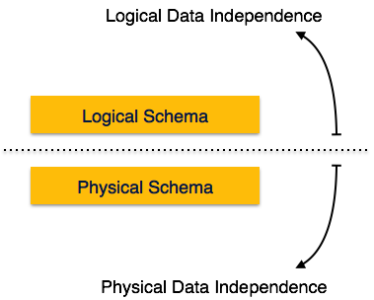
Data Independence

Slide 21
Data Independence
Physical Data Independence
- AUMS – accommodated data for say 1000 students…. X units of memory
2016 –AUMS - accommodates data for say 3000 students….. X+Y units of memory

Slide 22
Data Independence
Logical Data Independence
Student(RegNo, name, marks1, marks 2, total, addr, fee)
Note: Total is defined as marks1 + marks 2
Admin: RegNo (R),
name(R), addr(R ),
fee (R & W)
Stud:
RegNo (R),
name (R),
marks1 (R),
marks2 (R ),
total (R),
addr(R & W),
fee (R)
Teacher:
RegNo (R),
name (R),
marks1 (R),
marks2 (R ),
total (R),
addr(R )
Note: Total is later defined as marks1 + marks 2 + 5

Slide 23
Data Independence
Physical Data Independence
All the schemas are logical, and the actual data is stored in bit format on the disk.
The ability to change the physical data without impacting the schema at the logical level.
For example, in case we want to change or upgrade the storage system itself − suppose we want to replace hard-disks with SSD − it should not have any impact on the logical data or schemas. Or
may be we increase the memory capacity of the hard disk, and this is no way requires an explicit change in the logical level
Logical Data Independence
Logical data is data about database, that is, it stores information about how data is managed inside.
Logical data independence is a kind of mechanism, which liberalizes itself from actual data stored on the disk. If we do some changes on table format, it should not change the data residing on the disk.
The ability to change the logical data without impacting the schema at the view level
For example, a table (relation) stored in the database and all its constraints, applied on that relation. Or
We enforce a constraint in the logical level

Slide 24
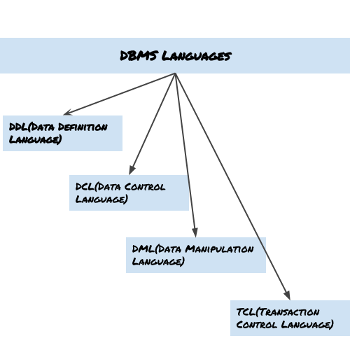
DBMS Languages

Slide 25
DBMS Languages
Data Definition Language (DDL)
DDL is used for specifying the database schema.
It is used for creating tables, schema, indexes, constraints etc. in database.
To create the database instance – CREATE
To alter the structure of database – ALTER
To drop the structure of database – DROP
To delete tables in a database instance – TRUNCATE

Slide 26
DBMS Languages
Data Manipulation Language (DML)
DML is used for accessing and manipulating data in a database.
The following operations on database comes under DML:
To read records from table(s) – SELECT
To insert record(s) into the table(s) – INSERT
Update the data in table(s) – UPDATE
Delete all the records from the table – DELETE

Slide 27
DBMS Languages
Data Control language (DCL)
DCL is used for granting and revoking user access on a database –
To grant access to user – GRANT
To revoke access from user – REVOKE

Slide 28
DBMS Languages
Transaction Control Language(TCL)
The changes in the database that we made using DML commands are either performed or rolled back using TCL.
To persist the changes made by DML commands in database – COMMIT
To rollback the changes made to the database – ROLLBACK

Slide 29
DBMS Architecture

Slide 30
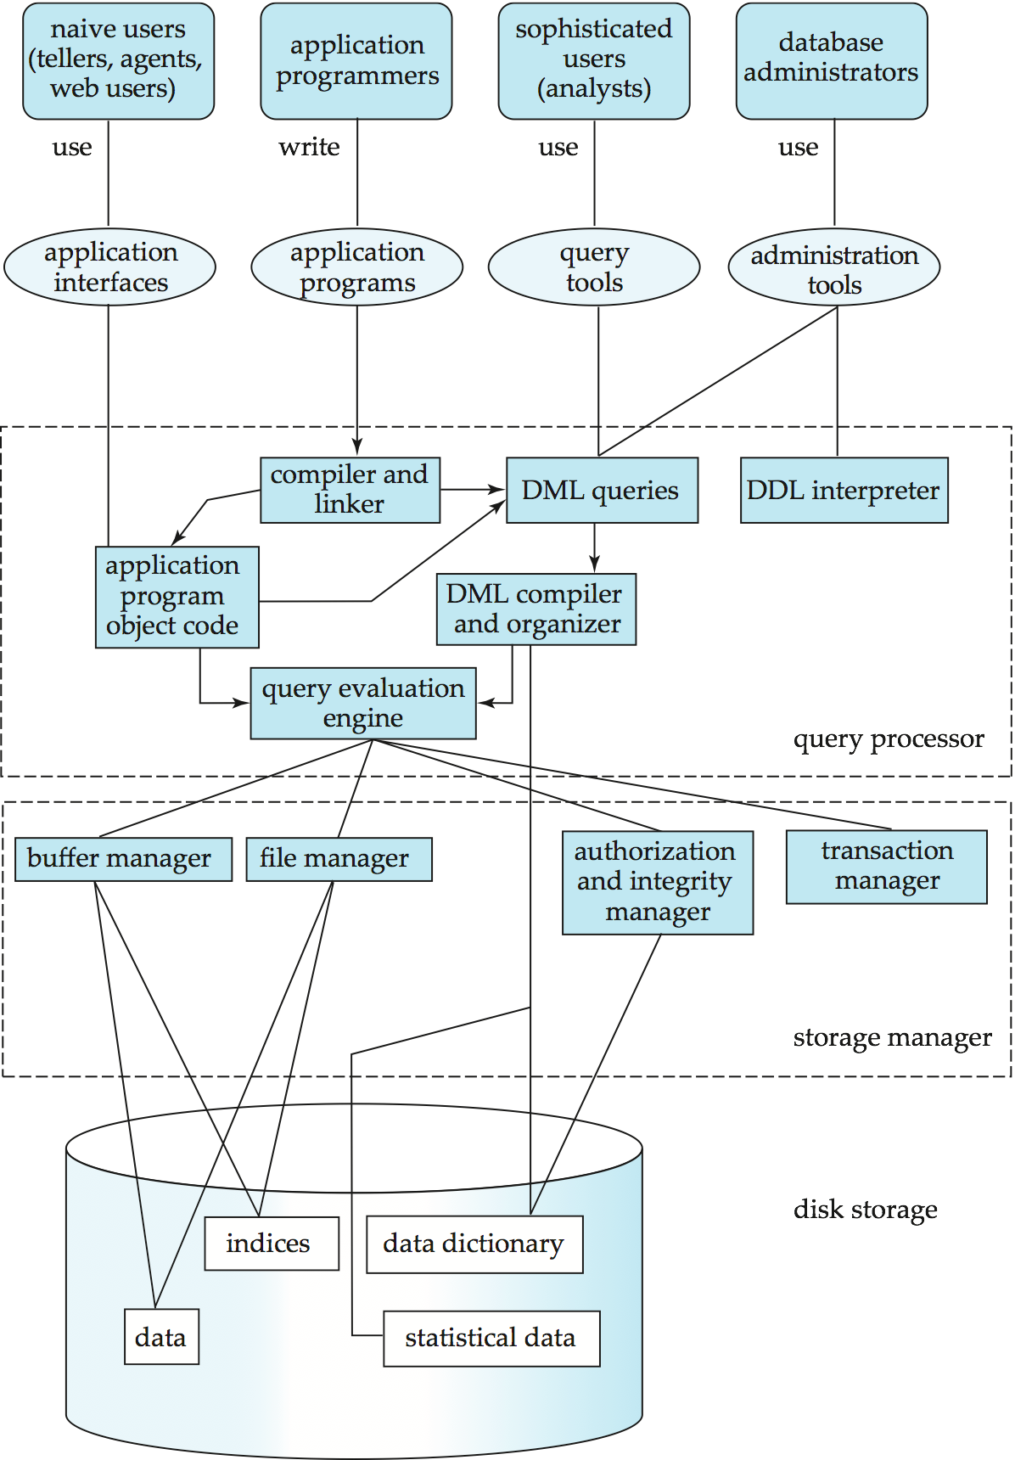
DBMS
Architecture

Slide 31
Database Architecture has following components
1. Database Users
2. Query Processor
Storage Manager
Disk Storage

Slide 32
Database Architecture has following components
1. Database Users
2. Query Processor
Storage Manager
Disk Storage

Slide 33
Database Users
Naive Users
Application Programmers
Sophisticated Users
Specialized Users

Slide 34

Database Users
Naive or parametric end users
Users who basically make up the database end users.
The main job function revolves basically around constantly querying and updating the database
These users need to learn very little about the facilities provided by the DBMS they basically have to understand the users’ interfaces of the standard transaction designed and implemented for their use.
The following tasks are basically performed by Naive end users:
The person who is working in the bank will basically tell us the account balance and post-withdrawal and deposits.
Reservation clerks for airlines, railway, hotels, and car rental companies basically check availability for a given request and make the reservation.

Slide 35

Database Users
Application Programmer
They are the developers who interact with the database by means of DML queries. These DML queries are written in the application programs like C, C++, JAVA, Pascal etc. These queries are converted into object code to communicate with the database.
For example, writing a C program to generate the report of employees who are working in particular department will involve a query to fetch the data from database. It will include a embedded SQL query in the C Program.

Slide 36
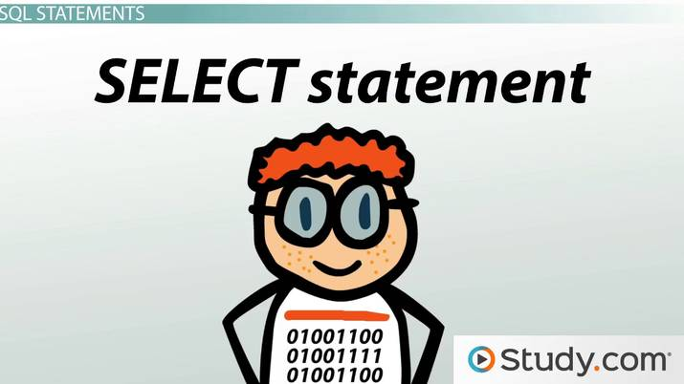
Database Users
Sophisticated User
They are database developers, who write SQL queries to select/insert/delete/update data.
They do not use any application or programs to request the database. They directly interact with the database by means of query language like SQL. These users will be scientists, engineers, analysts who thoroughly study SQL and DBMS to apply the concepts in their requirement.

Slide 37
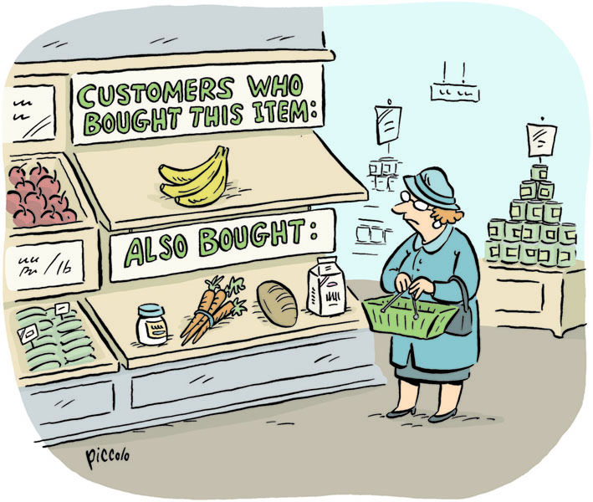
Database Users
Specialized User
These are also sophisticated users, but they write special database application programs that do not fit the traditional data processing framework

Slide 38

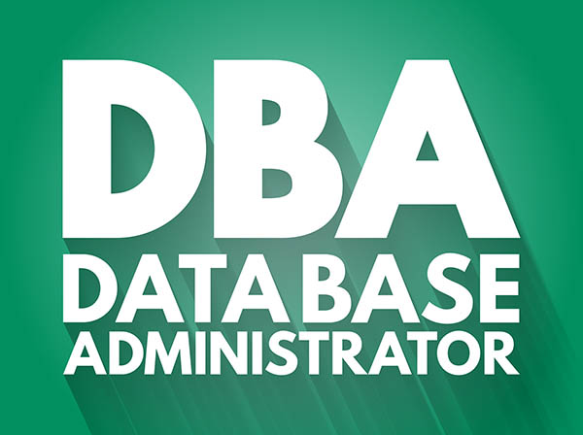
Database Users : DBA
A person who has central control over the system is called a database administrator (DBA).
Functions of a DBA include:
Schema definition and modification
Storage structure and access-method definition
Granting of authorization for data access
Routine maintenance
Periodically backing up the database
Ensuring that enough free disk space is available for normal
operations, and upgrading disk space as required
Monitoring jobs running on the database

Slide 39
Database Architecture has following components
1. Database Users
2. Query Processor
Storage Manager
Disk Storage

Slide 40
Query Processor
  DDL interpreter -- interprets DDL statements and instructions generated and records the definitions in the data dictionary.
  DML compiler -- translates DML statements in a query language into an evaluation plan consisting of instructions that the query evaluation engine understands. The DML compiler performs query optimization; that is, it picks the lowest cost evaluation plan.
  Query evaluation engine -- executes low-level from among the various alternatives.

Slide 41
Database Architecture has following components
1. Database Users
2. Query Processor
Storage Manager
Disk Storage

Slide 42
Storage Manager
A program module that provides the interface between
the low-level data stored in the database and
the application programs and
the queries submitted to the system.

Slide 43
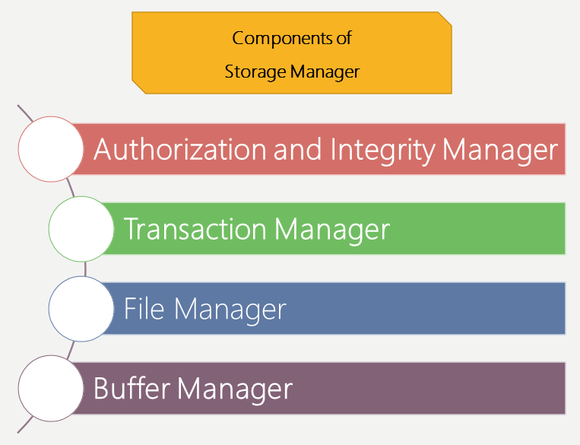
Storage Manager
It tests the integrity constraints and checks the authorization of users to access data.
It ensures that no kind of change will be brought to the database until a transaction has been completed totally.
It manages the allocation of space on disk storage and the data structures used to represent information stored on disk.
It decides which data is in need to be cached in main memory and then fetch it up in main memory. This is very important as it defines the speed in which the database can be used

Slide 44
Database Architecture has following components
1. Database Users
2. Query Processor
Storage Manager
Disk Storage

Slide 45
Components
Data: Actual physical files of the users
Data Dictionary: contains metadata
Indices: For faster access of data
Statistical Data: Data for Analytical purpose (OLAP )
Disk Storage

Slide 46
  End of Chapter 1

