Slide 1

Database Management Systems
Chapter 2
Entity Relationship Diagram

Slide 2
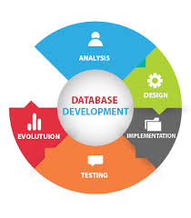

Slide 3
What is an Entity Relationship Diagram (ER Diagram) ?
An ER diagram shows the relationship among entities & relationships.
ER diagram shows the complete logical structure of a database.
Components of the ER Diagram
This model is based on three basic concepts:
Entities
Attributes
Relationships

Slide 4
Why use ER Diagrams?
ER Diagram is allowed you to communicate with the logical structure of the database to users
Provide a preview of how all your tables should connect, what fields are going to be on each table
ER diagrams are translatable into relational tables which allows you to build databases quickly
The database designer gains a better understanding of the information to be contained in the database with the help of ER diagram

Slide 5
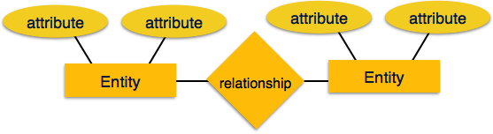
ER Diagram : Basic Skeleton
What is an Entity……?????
What is Relationship…….?????
What is an Attribute…….?????

Slide 6
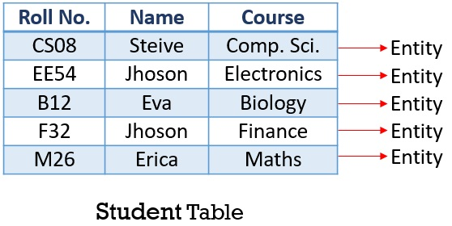
Attributes
Student
Entity Set

Slide 7
Entity:
Entity is any real world object with well defined property.
An Entity can be a thing, person, place, unit, object or any item about which the data should be captured and stored in the form of properties and tables.
Entity without properties is not an entity.

Slide 8
Examples of Entities:
Person: Employee, Student, Patient
Place: Store, Building
Object: Machine, product, and Car
Event: Sale, Registration, Renewal
Concept: Account, Course

Slide 9
Entity:
Table / Table Name -----> Entity
Column -----> Attributes
Connection between tables -----> Relationship

Slide 10
Example
University database, we have entities : Students, Courses, and Lecturers.
Students entity can have attributes : Rollno, Name and Sem.
Course entity can have attributes : CourseCode, CourseName and Credit.
Lecturer entity can have attributes: Id, lec_Name and Area_of_Spl
They might have relationships with Courses and Lecturers.
(Student registers for a course taught by lecturer.)
(registers and taught are relationships)

Slide 11
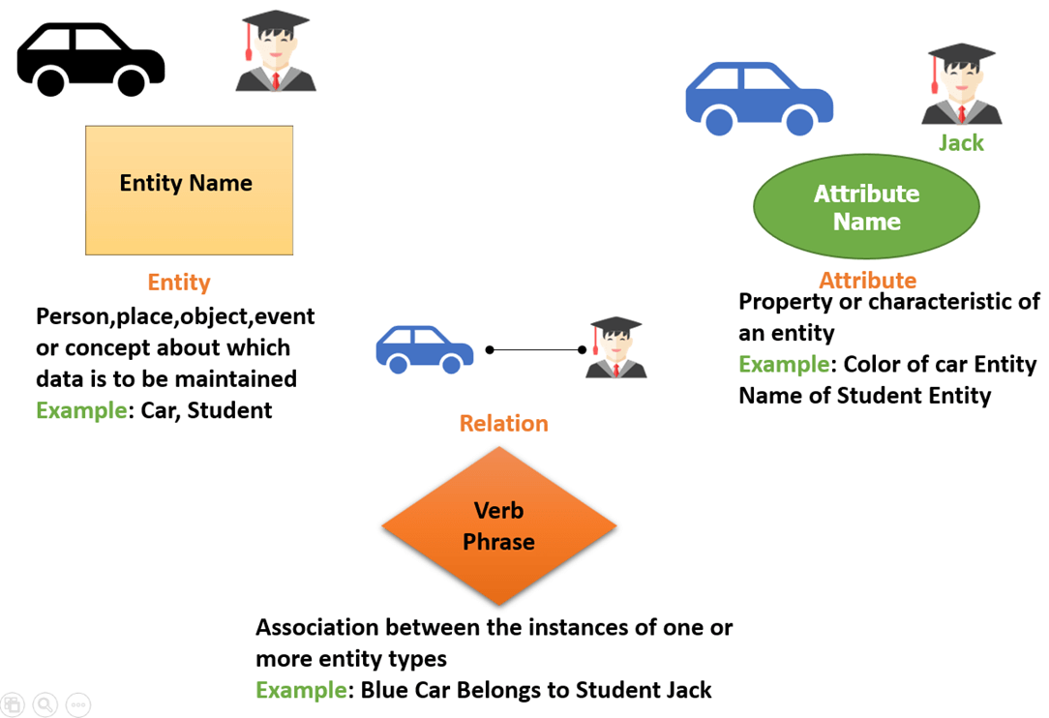

Slide 12
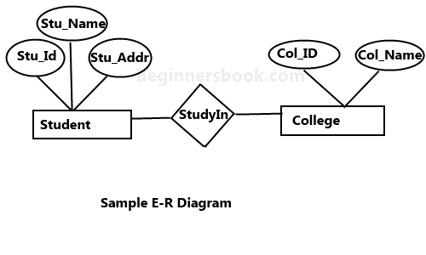
Example:
Two Entities: Student and College and their relationship.
Student entity has attributes such as Stu_Id, Stu_Name & Stu_Addr and
College entity has attributes such as Col_ID & Col_Name.
The relationship between Student and College is that the students study in colleges.

Slide 13






Rectangle: Represents Entity sets.
Ellipses: Attributes
Diamonds: Relationship Set
Double Ellipses: Multivalued Attributes
Dashed Ellipses: Derived Attribute
Double Rectangles: Weak Entity Sets

Slide 14
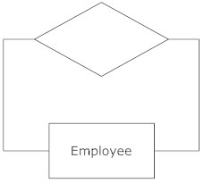
Lines: They link attributes to Entity Sets & Entity sets to Relationship Set / Partial participation of an entity in a relationship
Double Lines: Total participation of an entity in a relationship
Cardinality: specifies how many instances of an entity relate to one instance of another entity.
1:1 , 1:M / M:1, M:N
In some cases, entities can be self-linked. For example, employees can supervise other employees.

Slide 15
Ellipse with name underlined (dashed): Discriminator
Ellipse with name underlined (solid): Primary Key
Connected Ellipses: Composite Attribute

Slide 16
Attributes:
There are four types of attributes:
Key attribute-uniquely identifies each row in a table
Stud(regno, name, ph. No, dob, age)
2. Composite attribute ----- simple
3. Multivalued attribute ------single valued/atomic
4. Derived attribute----stored
1 | A | 100
2 | A | 101,102

Slide 17
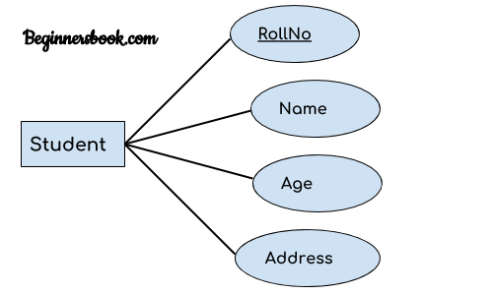
1. Key attribute:
A key attribute can uniquely identify an entity from an entity set.
For example, student roll number can uniquely identify a student from a set of students.
Key attribute is represented by oval same as other attributes however the text of key attribute is underlined.

Slide 18
2. Composite attribute:
An attribute that is a combination of other attributes is known as composite attribute.
For example, In student entity, the student address is a composite attribute as an address is composed of other attributes such as pin code, state, country.
Pin code
State
Country

Slide 19
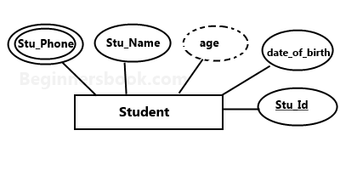
3. Multivalued attribute:
An attribute that can hold multiple values is known as multivalued attribute.
It is represented with double ovals in an ER Diagram.
For example – A person can have more than one phone numbers so the phone number attribute is multivalued.

Slide 20
4. Derived attribute:
A derived attribute is one whose value is dynamic and derived from another attribute. It is represented by dashed oval in an ER Diagram.
For example – Person age is a derived attribute as it changes over time and can be derived from another attribute (Date of birth).

Slide 21
Mapping Cardinality / Cardinality Ratio / Cardinality :
Specifies how many instances of an entity relate to how many instance of another entity.
There are four types of Mapping Cardinalities:
1. One to One
2. One to Many
3. Many to One
4. Many to Many

Slide 22
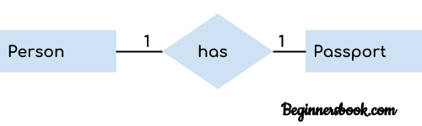
One to One (1 : 1):
When a single instance of an entity is associated with a single instance of another entity then it is called one to one relationship.
For example, a person has only one passport and a passport is given to one person
Person(p1,p2,p3) pass(w1,w2) p1-w1 p3-w2 p2
→1:1
←1:1

Slide 23
One to One (1 : 1):
Person→Passport 1:1
Person← Passport 1:1
Aadhar No | Name
A1 | AAA
A2 | BBB
A3 | CCC
PP No
P1
P2

Slide 24
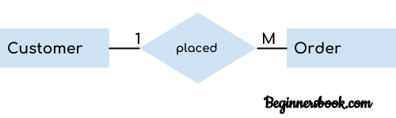
One to Many ( 1: M)
When a single instance of an entity is associated with more than one instances of another entity then it is called one to many relationship.
For example – a customer can place many orders but a order cannot be placed by many customers.
Cust(c1,c2) Ord(o1,o2,o3) →c1:o1,o2 c2:o3 1:m
← o1: C1, o2: c1, o3:c2 1 :1

Slide 25
One to Many (1 : M):
Cust→Order 1:M
Cust← Order 1:1
1:M
C No | Name
C1 | AAA
C2 | BBB
C3 | CCC
Order No
O1
O2
O3

Slide 26
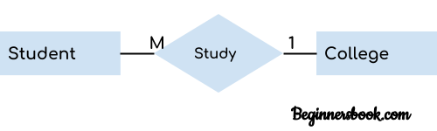
Many to One ( M: 1)
When more than one instances of an entity is associated with a single instance of another entity then it is called many to one relationship.
For example – many students can study in a single college but a student cannot study in many colleges at the same time.

Slide 27
Many to One ( M: 1)
Stud→Coll 1:1
Stud← Coll M:1
M:1
S1-c1 s2-c1 s3-c3 1:1 c1-s1,s2 c2-s3 c3- 1:M
Reg No | Name
S1 | AAA
S2 | BBB
S3 | CCC
Coll Code
c1
c2
c3

Slide 28
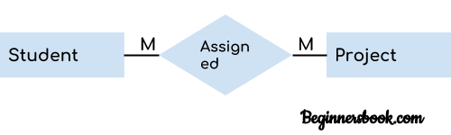
Many to Many ( M: N)
When more than one instances of an entity is associated with more than one instances of another entity then it is called many to many relationship.
For example, a can be assigned to many projects and a project can be assigned to many students.

Slide 29
Many to Many ( M: N)
Stud→Project 1:M
Stud← Project M:1
M: M / M:N
S1- P1,P2 S2 - P1 S3 - P2, P3
Reg No | Name
S1 | AAA
S2 | BBB
S3 | CCC
Pjt Code
P1
P2
P3

Slide 30
Many to Many ( M: N)
Stud→course 1:M
Stud← course M:1
M: M / M:N
S1-DB,OOPs S2-DB S3- Oops, PR 1:M(1 stud reg multiple courses)
DB-s1,s2 Oops-s1,s3 PR –S3 1:M(1 course is reg by multiple stud)
Reg No | Name
S1 | AAA
S2 | BBB
S3 | CCC
course
DB
OOPs
PR

Slide 31
Participation Constraints :
Specifies if all the instances or only few of the instances of an entity are participating in a relationship.
There are two types of Participation:
Total Participation
2. Partial Participation

Slide 32
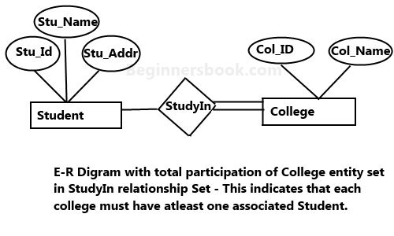
Total Participation
A Total participation of an entity set represents that each instance in entity must participate in the relationship
For example: In the below diagram each college must have at-least one associated Student

Slide 33
Total Participation
A Total participation of an entity set represents that each instance in entity must participate in the relationship
For example: In the below diagram each Passport must belong to a person, hence total participation

Slide 34
Partial Participation
A Partial participation of an entity set represents that only few or none of the instances participate in the relationship.
For example: In the below diagram every person may not have a Passport, hence partial participation

Slide 35
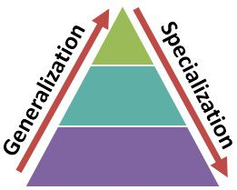
Specialization and Generalization:
Specialization and Generalization are fundamental concepts in database modeling that are useful for establishing superclass-subclass relationships.
They are extended ER features

Slide 36
Specialization :
Specialization is a top-down approach in which a higher-level entity is divided into multiple specialized lower-level entities.
In addition to sharing the attributes of the higher-level entity, these lower-level entities have specific attributes of their own.
Specialization is usually used to find subsets of an entity that has a few different or additional attributes.

Slide 37
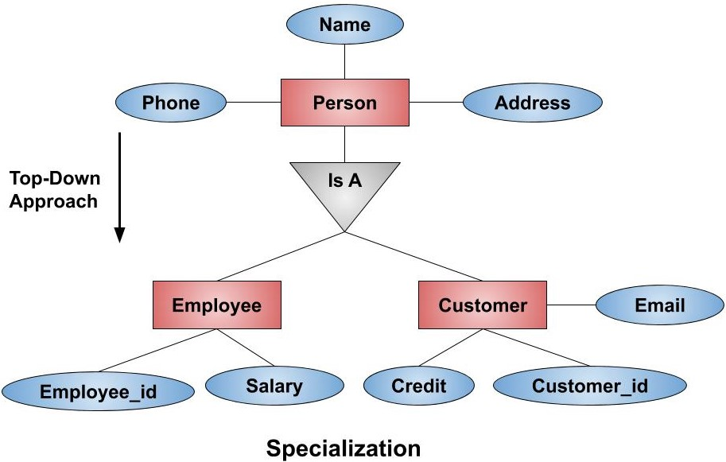
Specialization :
Person : Name, Phone, Address,
Emp:Eid, sal,
Cust :email, cid, credit
A, 100, AA,e1,20k,1@, null, null
B, 101, BA,null,null,2@,c1,5k

Slide 38
Generalization:
Generalization
Generalization is a bottom-up approach in which multiple lower-level entities are combined to form a single higher-level entity.
Generalization is usually used to find common attributes among entities to form a generalized entity. It can also be thought of as the opposite of specialization.
The following enhanced entity relationship diagram expresses entities in a hierarchical database to demonstrate generalization:

Slide 39
Generalization :
Cust:
Name
Phone
Address
Credit
Email
cid
Emp:
Name
Ph
Address
Eid
Sal
Bottom –up Approach
Generalization

Slide 40
Constraints on Generalization / Specialization:
Condition based Vs User Defined
Overlapping Vs Disjoint

Slide 41
disjoint entities
PAN No
Mobile No
Employee
The lower level entities will not have any instances overlapping. i.e., the instance can belong to only one of the lower entities
An employee can either be a part time employee or full time employee
IS A
Full Time Employee
Part Time Employee
Salary
No. of Hours
Emp: PAN_No, Mob_No,
FT:month_Sal,
PT:NoH 80-FTE 20 PTE total=100

Slide 42
overlapping entities
Adhar card No
Mobile No
Person
Name
The lower level entities may have overlapping instances.
A teacher may be doing her part time degree in the same university
IS A
Teacher
Student
Salary
Eno
Reg No
Credits Earned
Teachers: 30 stud: 50 teacher who is a stud: 5 =75

Slide 43
condition based entities
Exp
ENo
Degree
Faculty
Name
IS A
The lower level entities are decided based on degree and experience
Lecturer
Professor
No. of theory
No. of labs
No. of Research Scholars

Slide 44
user defined entities
Name
RegNo
Sem
Student
Branch
IS A
No. of events conducted
The lower level entities have no well defined criteria
Executive members
Secretary of the club
No. of events volunteered
Exec_Id
Sec_Id

Slide 45
Participation Constraints on Generalization / Specialization:
Total Participation
Partial Participation

Slide 46
Total Participation
PAN No
Mobile No
Employee
Emp = 100
PT=20
FT =80
All Entities from higher level entity will participate in any of the lower level entitites
IS A
Full Time Employee
Part Time Employee
Salary
No. of Hours

Slide 47
Partial Participation
PAN No
Mobile No
Person
Person-30
Emp-10
Cust-15
All Entities from higher level entity may not participate in any of the lower level entities.
Ex: I may have details of all people in a locality of a departmental store. Some of whom may be customer of the store, few may be employees of that store
IS A
Employee
Customer
Salary
Order No.

Slide 48
Steps for constructing an ERD:
Identify the entities. The first step in making an ERD is to identify all of the entities. An entity is nothing more than a rectangle with a description of something that your system store information about. This could be a customer, a manager, an invoice, a schedule, etc.
Univ has many depts. Which employ teachers and each faculty teaches courses. Subjects are reg by stud
Identify and describe relationships. Look at two entities, are they related? How are the entities related? Draw an action diamond between the two entities on the line you just added. In the diamond write a brief description of how they are related.
Cardinality: Specify the mapping cardinalities between the entities in relationship , also specify the participation constraints.
Add attributes. Any key attributes of entities should be added using oval-shaped symbols.
Complete the diagram. Continue to connect the entities with lines, and adding diamonds to describe each relationship until all relationships have been described. Each of your entities may not have any relationships, some may have multiple relationships. That is okay.

Slide 49
How to Draw a complete ER Diagram?????

Slide 50
Tips for Effective ER Diagrams
Make sure that each entity only appears once per diagram.
Name every entity, relationship, and attribute on your diagram.
Examine relationships between entities closely. Are they necessary?
Are there any relationships missing? Eliminate any redundant relationships.
Don't connect relationships to each other.

Slide 51
How do we identify Entities ?????
Noun Phrase Approach

Slide 52
Case Study 1:
In a University, there are multiple departments each of which is headed by a staff. There are multiple staffs employed in each department. There are various courses offered by the department taught by teachers of the respective department. Students register for various courses.
(Assumption : Teachers teach only one course)
Draw the ERD
University (Ucode, Uname, location) X
Department
Staff
Teachers X
Course
Student

Slide 53
In a University, there are multiple departments each of which is headed by a staff.
Cse-dr.s
ECE-dr. n
There are multiple staffs employed in each department.
-> 1:m
<- 1:1
There are various courses offered by the department taught by teachers of the respective department. Adb,ip,ncp,ss
h
Students register for various courses. (Assumption : Teachers teach only one course)
1
1
Dept
Headed by
Staff
1
m
Dept
Has
Staff
1
o
m
Dept
offers
Course
o
1
staff
m
teaches
Course
o
n
stud
m
registers
Course

Slide 54
Dname
Dept
Ccode
Dloc
course
Cname
Credit
Fname
Name
Name
Lname
Stud
Staff
RegNo
Sid
Ph No
Ph No
Age
DoB

Slide 55
Dname
1
has
Fname
m
Name
Dept
Lname
Dloc
Staff
Sid
1
1
1
Headed by
Ph No
offers
m
teaches
m
Ccode
1
Name
Cname
Course
registers
Stud
m
RegNo
n
Credit
Ph No
grade
DoB
Age

Slide 56
Course registered by stud………………….grade—registers
Course and stud…..r/t m:n
stud entity with grade attr….. X
Course entity with grade attr……X
stud
Code | cname
C1 | Db
c2 | OS
C3 | PR
Reg | Ccode | grade
1 | C1 | A+
1 | C2 | B
2 | C1 | A
Reg | Name
1 | A
2 | b
3 | A

Slide 57
Weak Entity, Discriminator and Identifying Relationship.
The entity sets which do not have sufficient attributes to form a primary key are known as weak entity sets and the entity sets which have a primary key are known as strong entity sets.
As the weak entities do not have any primary key, they cannot be identified on their own, so they depend on some other entity (known as owner entity/ strong entity). The weak entities have total participation constraint (existence dependency) in its identifying relationship with owner identity. Weak entity types have partial keys.
Partial Keys are set of attributes with the help of which the tuples/records of the weak entities can be distinguished and identified.

Slide 58
A1
B1
- - -
Strong Entity
Identifying Relationship
Weak Entity
B2
A2
B3
Partial Key in the weak Entity is discriminator.
Entity on which weak Entity is dependent on is Strong Entity / Owner Entity.
To uniquely identify records in a weak Entity:
Primary Key of the Owner Entity + Discriminator of the Weak Entity.
Relationship between Weak Entity and Owner Entity is Identifying Relationship.

Slide 59
CampusCode
RollNo
- - - - -
Relationship
ship
Campus
ship
Has
Stud
Name
CampusLoc
Sem
Roll No | Name | Sem
01 | A | 5
02 | A | 3
01 | B | 5
03 | C | 3
CampusCode | CampusLoc
CBR | Ettimadai
BL | Bengaluru
Primary Key of the strong entity: Campus Code
Discriminator : Roll No
To uniquely identifying record /row of a weak entity : (CampusCode, RollNo)

Slide 60
CampusCode
SlNo
- - - - -
Relationship
ship
Campus
ship
Has
Stud
Name
CampusLoc
Sem
Sl No | Name | Sem
01 | Adi | 5
02 | A | 3
01 | Abhi | 5
02 | C | 3
CampusCode | CampusLoc
CBR | Ettimadai
BL | Bengaluru
Discriminator
CBR01 (campuscode,Slno)
BLR01

Slide 61
Case Study 2:
In a city, there are multiple univ, each of which has multiple library
Assume in a (Amrita) University, there are multiple libraries and each library has many student members. A student may be a member in multiple libraries.
Each library has its own set of books. Within the library, these books are identified by a unique number.
Students can borrow multiple books from subscribed library.
Students can also borrow books through inter library loan ie., in case the book is unavailable in his/her subscribed library, the subscribed library avails from the other library in which the student is not a member.
Draw the ERD
Strong Entity BRANCH Weak Entity PK? Discriminator?
Strong Entity GENRE Weak Entity ? PK? Discriminator?
Strong Entity LIBRARY Weak Entity BOOK PK LibCode Discriminator BookNo

Slide 62
Library : LibCode,LibLoc
L1, GndFlr
L2 , FirstFlr
Book: Bno, Title
B1, DB
B2, OS
B1, PR
B2, OS
L2,B2----- (pk of lib , Discriminator of Book)

Slide 63
Case Study 2:
University X
Library (LibNo, LibLoc)
Student(RegNo,Name,Sem)
Books (ISBN, Title, Author, price)
Draw the ERD

Slide 64
Loans
book
from
1
m
L1: B1, B2, B3, B4 Srini(B5)
L2: B1, B2, B5 ---sree(B3), raj(B4)
LibNo
Library
LibLoc
1
1
m
loans
Is a member
has
1
n
bNo
- - -
m
Name
Book
borrows
Stud
bname
m
RegNo
1
AuthorName
Ph No

Slide 65
Case Study 3:
Assume in a city, there are multiple banks and each bank has many branches. Each branch has multiple customers.
Customers have various types of accounts.
Customers can also avail different types of loans from the respective branches.
One customer can have multiple accounts and can avail multiple loans.
Draw the ERD
DLB---B1, B2
SBI----B1, B2, B3

Slide 66
Case Study 4:
Given below are entities, connect them appropriately with necessary relationship and relationship constraints including mapping cardinalities and participation constraints.
Complete the ERD with Attributes for each entity and key attributes if any.

Slide 67
Mapping ER Diagram to Relational Model

Slide 68
Dname
1
has
Fname
m
Name
Dept
Lname
Dloc
Staff
Sid
1
1
1
Headed by
Ph No
offers
m
teaches
m
Ccode
1
Name
Cname
Course
registers
Stud
m
RegNo
n
Credit
Ph No
grade
DoB
Age

Slide 69
Mapping Strong Entity
Dname
Dept(dname, dloc)
Dept
Dloc
Ccode
course
Cname
Course(Ccode, Cname, Credit)
Credit

Slide 70
Name
Stud( Regno, Name, DoB, Phno)
1, A, 22 sept, 100
2, B, 22 Aug, (101,102)
Stud( Regno, Name, DoB, Phno1, phno2)
1, A, 22 sept, 100, null
2, B, 22 Aug, 101,102
Stud( Regno, Name, DoB, Phno)
1, A, 22 sept, 100
2, B, 22 Aug, 101
2, B, 22 Aug, 102
Stud(Regno, Name, Dob)
1, A, 22 sept
2, B, 22 Aug
Stud_ph(Regno, phno)
1, 100
2, 101
2, 102
Stud
RegNo
Ph No
DoB
Age

Slide 71
Staff (Sid, Fname, Lname)
Staff_ph(Sid, phno)
Fname
Name
Lname
Staff
Sid
Ph No

Slide 72
Mapping 1:1 relationship
1
1
Dept
Headed by
Staff
Dept (dname, dloc, sid )……. Dname is the pk and sid is the fk
Staff( sid, fname, lname )……… sid is the pk
Cse, GF, S1
ECE, FF, S2
S1 , Dr. S.Lakshmi, Mahi
S2, Dr. Naveen, Kumar

Slide 73
Mapping 1:m relationship (the m side entity will have fk)
1
m
Dept
Has
Staff
Staff (sid,fname, lname, dname)……..sid is the pk, dname is the fk
Dept (dname, dloc)………...dname is the pk

Slide 74
Mapping 1:m relationship (the m side entity will have fk)
1
m
Dept
Has
Staff
Dept(dname,dloc) dname is the pk Staff(sid, fname,lname, dname ) sid is the pk and dname is the fk
o
Dept
offers
Course
1
m
Dept(dname,dloc) dname is the pk Course(ccode,cname,credit, dname) code is the pk and dname is the fk
m
o
1
staff
teaches
Course
Staff(sid, fname,lname, code ) sid is the pk and code is the fk Course(ccode,cname,credit) code is the pk

Slide 75
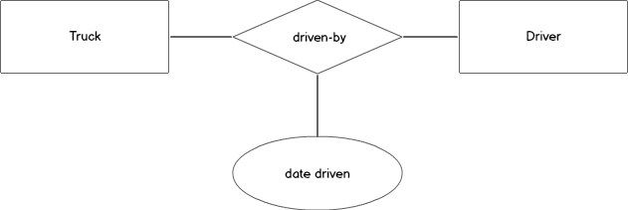
Descriptive Attribute
Assume Truck(TruckNo, ModelNo, Year) Driver(LicNo, Name, DoJ)
The travel agency has to keep track of which driver drove which truck and when(i.e., date).
If you attach date driven attribute with Truck , then it is incorrect, because one single truck is driven many times and you cannot have multiple values in a single cell, nor can you have multiple rows with same truckNo (violation of Pk) so you cannot attach with Truck
How about attaching datedriven attribute with driver, this is also incorrect, becasr the driver drives can drive different trucks at different times , as in the case above you cannot have mulriple rows with same LicNo(violation of pk) andalso one cell cannot accommodate more than one date. So you cannot attach date driven to Driver.
Therefore the attribute is better attached as an attribute describing the relationship between the two entities and they are called descriptive attributes.

Slide 76
Mapping m:n relationship ( a new table is created with only key attributes of both the tables and descriptive attribute if any )
m
o
n
stud
registers
Course
grade
Stud( RegNo, name, Dob)….reg no is the pk
Course(ccode,cname,credit) ….ccode is the pk
Stud_course(ccode,Regno,grade)…..regno is the fk, ccode is another fk
C1,S1, A
C2,S1, B
vaishak O DB

Slide 77
Mapping m:n relationship ( a new table is created with only key attributes of both the tables and descriptive attribute if any )
1
o
n
stud
registers
Course
Stud(regno,name,dob)
Pk=regno
Course(ccode,cname, credit,regno)
Pk=ccode
Fk=regno
Stud_ph(regno,phno)
Fk=regno
Pk=(regno,phno)

Slide 78
Mapping m:n relationship ( a new table is created with only key attributes of both the tables and descriptive attribute if any )
m
o
n
stud
registers
Course
grade
stud( RegNo, Name, DoB) Course(ccode, cname, credit)
Stud_Reg( RegNo, ccode, grade) this table depicts the relationship between stud and course
RegNo is a fk, ccode is a fk, grade is a descriptive attribute, (Regno,ccode) is a pk

Slide 79
Mapping Weak entity
Relationship between strong entity and weak entity – IDENTIFYING RELATIONSHIP
m
o
1
A
r
B
A(a1,a2)
Discriminator =a1
Pk of the weak entity= pk of the strong entity + discriminator of the w.e
Pk of A=(b1,a1)
B(b1,b2)
Pk=b1
Mapping:
A(b1,a1,a2)
Discriminator=a1
FK=b1
PK=a1,b1
B(b1,b2)
PK=b1

Slide 80
Mapping Weak entity
m
o
1
A
r
B
Let A(a1, a2, a3) a1 is a discriminator and B (b1, b2,b3) b1 is pk
While we map the above, we have
B (b1, b2,b3) b1 is pk
A( b1, a1, a2, a3) b1 is fk, a1 is discriminator, (a1,b1 ) is the pk

Slide 81
Tables after mapping
Dept(dname, dloc)
Course(Ccode, Cname, Credit)
Stud(RegNo, Name, DoB)
Stud_phNo (RegNo, PhNo)
staff( Sid, Fname, Lname )
Staff_Ph (Sid, PhNo)
Dept(dname,dloc, sid)
Staff(sid, fname,lname, dname )
Course(ccode,cname,credit, dname)
Staff(sid, fname,lname, ccode )
Stud_Reg( RegNo, ccode, grade)

Slide 82
Tables after mapping
Dept(dname, dloc)
Course(Ccode, Cname, Credit)
Stud(RegNo, Name, DoB)
Stud_phNo (RegNo, PhNo)
staff( Sid, Fname, Lname )
Staff_Ph (Sid, PhNo)
Dept(dname,dloc, sid)
Staff(sid, fname,lname, dname )
Course(ccode,cname,credit, dname)
Staff(sid, fname,lname, ccode )
Stud_Reg( RegNo, ccode, grade)

Slide 83
Tables after mapping
Tables after filtering
Dept-1,7
Course -2,9
Staff-5,6,8,10
Stud -3,4,11
Dept(dname, dloc)
9 Course(ccode,cname,credit, dname)
Combine 8 and 10 =12 Staff(sid, fname,lname, dname,ccode )
6 Staff_phNo(Sid, PhNo)
3 Stud(RegNo, Name, DoB)………………….
4 Stud_phNo (RegNo, PhNo)
11 Stud_Reg( RegNo, ccode, grade)
Dept(dname, dloc)
Course(Ccode, Cname, Credit)
Stud(RegNo, Name, DoB)
Stud_phNo (RegNo, PhNo)
staff( Sid, Fname, Lname )
Staff_phNo(Sid, PhNo)
Dept(dname,dloc, sid)
Staff(sid, fname,lname, dname )
Course(ccode,cname,credit, dname)
Staff(sid, fname,lname, ccode )
Stud_Reg( RegNo, ccode, grade)
Staff(sid, fname,lname, dname,ccode )

Slide 84
Tables after mapping
Tables after filtering
Dept-1,7
Course -2,9
Staff-5,6,8,10
Stud -3,4,11
1 Dept(dname, dloc)…………..(3)
9 Course(ccode,cname,credit, dname) ………………(4)
Combine 8 and 10 =12 Staff(sid, fname,lname, dname,ccode ) ……………(6)
6 Staff_phNo(Sid, PhNo)………………..(7)
3 Stud(RegNo, Name, DoB)……………………no FK…….(1)
4 Stud_phNo (RegNo, PhNo)…………..(2)
Stud_Reg( RegNo, ccode, grade) ……………….(5)
Modify table 1 using ALTER ADD command and add a column sid , accordingly 1 becomes Dept(dname, dloc, sid)

Slide 85
Tables after mapping
Tables after filtering
Dept(dname, dloc)
Course(Ccode, Cname, Credit)
Stud(RegNo, Name, DoB)
Stud_phNo (RegNo, PhNo)
staff( Sid, Fname, Lname )
Staff (Sid, PhNo)
Dept(dname,dloc, sid)
Staff(sid, fname,lname, dname )
Course(ccode,cname,credit, dname)
Staff(sid, fname,lname, ccode )
Stud_Reg( RegNo, ccode, grade)
Dept(dname, dloc)
Stud(RegNo, Name, DoB)
Stud_phNo (RegNo, PhNo)
Staff (Sid, PhNo)
Course(ccode,cname,credit,dname)
Staff(sid, fname,lname, dname,ccode) //combining 8 & 10
Stud_Reg( RegNo, ccode, grade)

Slide 86
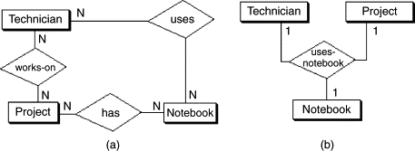
Ternary Relationship :

Slide 87
Mapping Generalization/Specialization :
Employee(Employeeid, salary, Name,Phone, Address)
Customer (Customer_id, Email, Credit, Name, Phone, Address)

Slide 88
Mapping Generalization/Specialization :
Employee(Employeeid, salary, Name, Address)
Customer (Customer_id, Email, Credit, Name, Address)
Emp_ph (Employeeid,phone)
Cust_ph(Customer_id,phone)

Slide 89
Aggregation
In aggregation, the relationship between two entities is treated as a single entity. In aggregation, relationship with its corresponding entities is aggregated into a higher level entity.
EMP WORKS FOR PROJECT
Manages
Manager

Slide 90
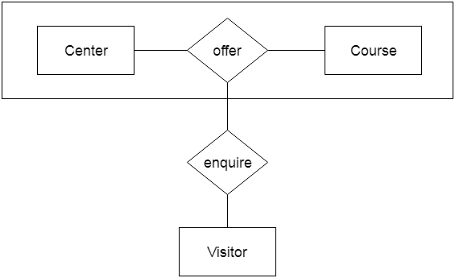
For example: Center entity offers the Course entity act as a single entity in the relationship which is in a relationship with another entity visitor. In the real world, if a visitor visits a coaching center then he will never enquire about the Course only or just about the Center instead he will enquiry about both.
Center(only attributes of Center)
Course (Only attributes of course)
Visitor(Only attributes of visitor)
Center_course(pks of center and course)
Enquire(pks of center, course, visitor,date)
Date

Slide 91
For example: Center entity offers the Course entity act as a single entity in the relationship which is in a relationship with another entity visitor. In the real world, if a visitor visits a coaching center then he will never enquire about the Course only or just about the Center instead he will enquiry about both.
Center(only attributes of Center)
Course (Only attributes of course)
Vsitor(Only attributes of visitor)
Center_course(pks of center and course)
Enquire(pks of center, course, visitor,date)
Date

Slide 92
Thank you

