Slide 1

Database Management Systems
Chapter 4
Functional Dependency

Slide 2
What is Functional Dependency
A relationship between attributes of a table dependent on each other.
Introduced by E. F. Codd.
It helps in preventing data redundancy and gets to know about bad designs.

Slide 3
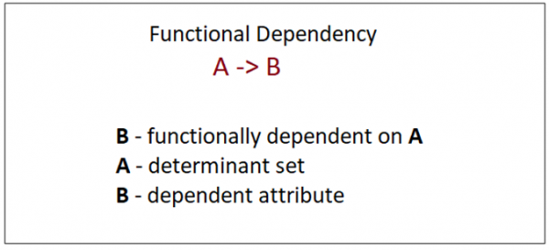
What is Functional Dependency
Let us consider P is a relation with attributes A and B.
Functional Dependency is represented by -> (arrow sign)
A→B

Slide 4
stud
RegNo | Name | Ph | City | State
1 | A | 123 | Blr | Kar
2 | A | 234 | Mys | Kar
3 | B | 345 | Ch | TN
4 | C | 456 | Tvm | Kl
5 | D | 567 | Tcr | Kl
6 | E | 678 | Blr | Kar
LHS-->RHS
FDs
RegNo→Name-v
RegNo→ Ph-v
RegNo→City-v
RegNo→State-v
City→state-v
State→City- I
Name →State--V
Name→RegNo--I
Ph→RegNo--V
Ph→Name—V
Name→Ph--I

Slide 5
Armstrong Axioms / Inference Rules / IRs
Reflexitivity Rule:
if Y ⊆ X , then X→Y regno,city→ city and regno,city→regno
Transitive Rule:
if X→Y and Y→Z , then X→Z
Augmentation Rule
if X→Y, then XA→YA
Union Rule ( Applied only to the RHS)
if X→Y and X→Z then X→YZ
X→ Y and Z→Y then XZ→Y NOT UNION RULE(INCORRECT)
Decomposition Rule
if X→YZ then X→Y and X→Z
Pseudo transitivity Rule
if X→Y and YZ→W then XZ→W

Slide 6
Closure of a Functional Dependency
The Closure Of Functional Dependency means the complete set of all possible attributes that can be functionally derived from given functional dependency using the inference rules known as Armstrong’s Rules.

Slide 7
Closure of a Functional Dependency
If “F” is a functional dependency then closure of functional dependency can be denoted using “F⁺”.
Given some FDs, new set of FDs can be implied by applying inference rules.

Slide 8
example
Given: A→B, A→D , DE→F, G→D and B→ C, find the closure of the given FDs
Sol:A→B and A→D then A→BD (union)
A→B and B—C then A→ C(trans)
A→D and DE→F then AE→F (P T)
F⁺ ⁼ : A→B, A→D , DE→F, G→D , B→ C, A→BD, A→C, AE→F….

Slide 9
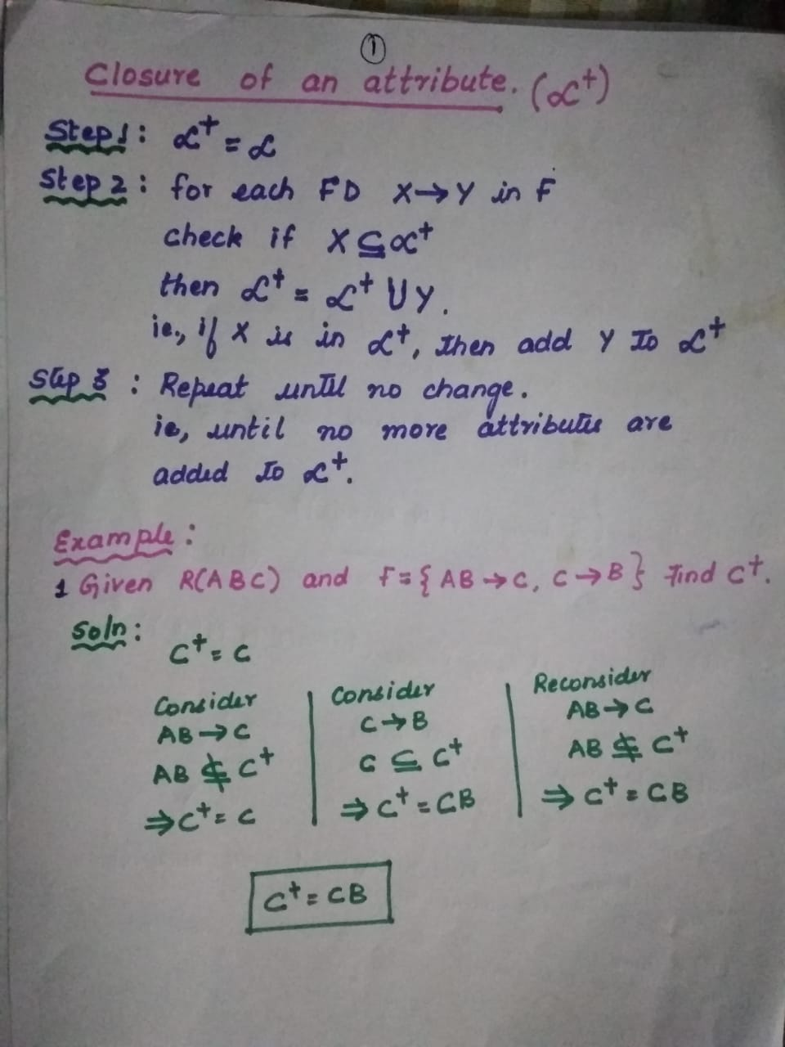

Slide 10
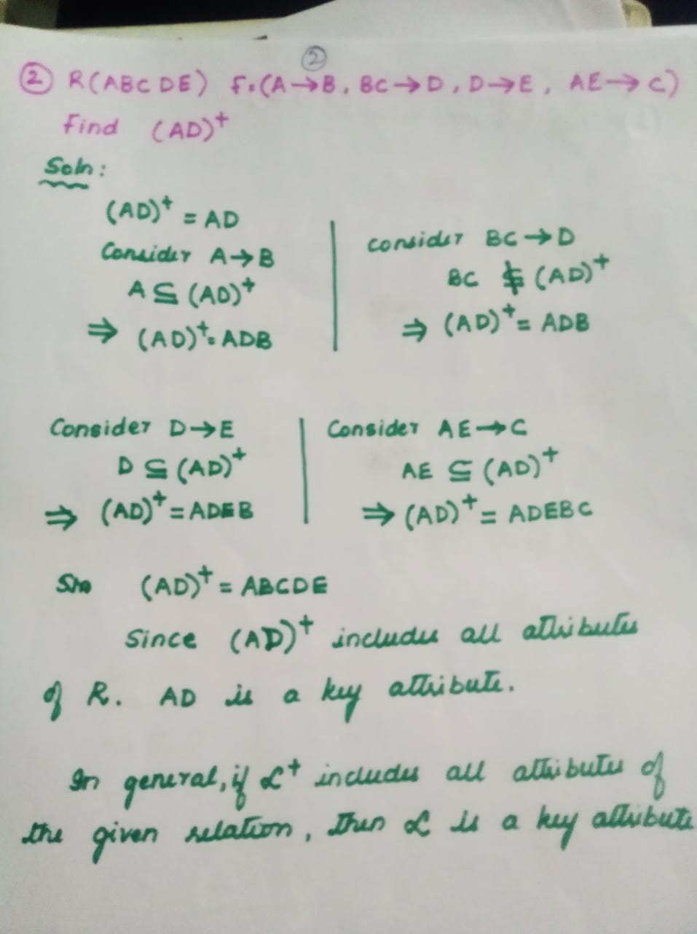

Slide 11
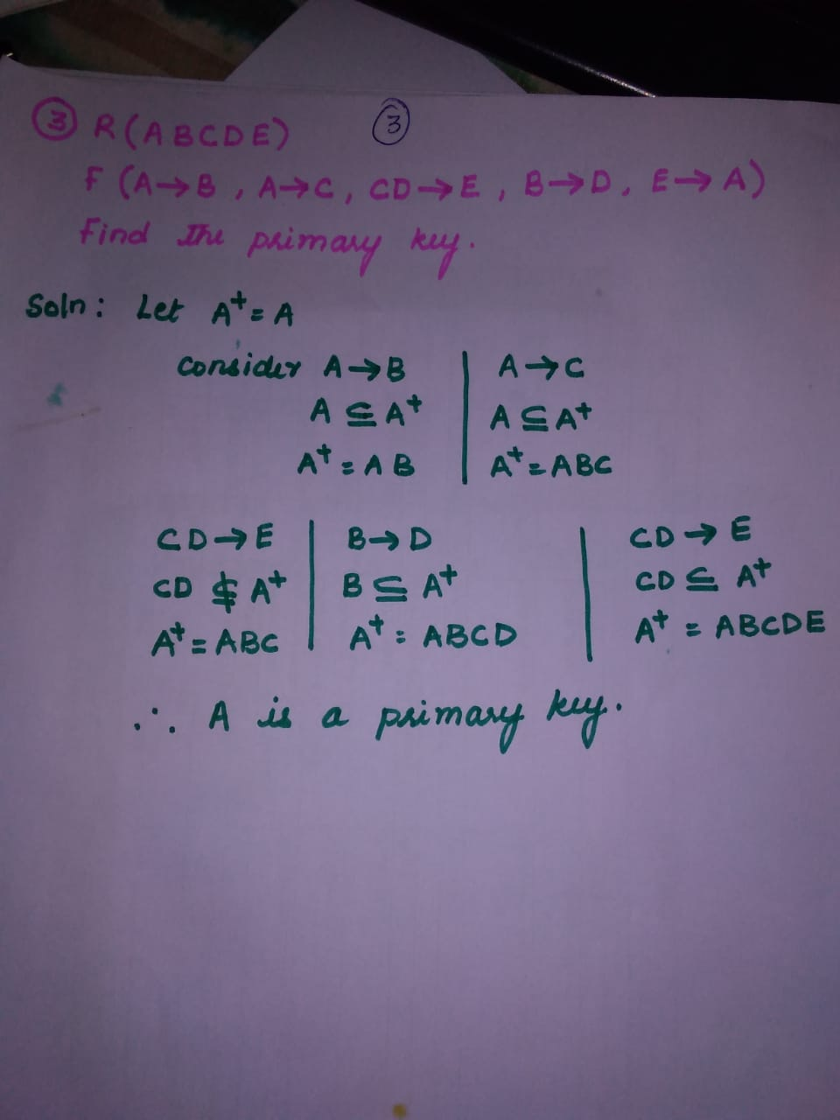

Slide 12
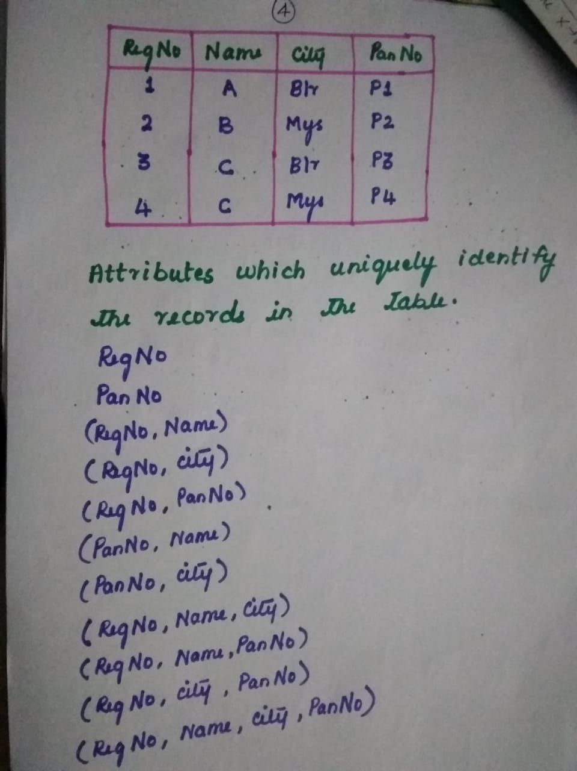

Slide 13
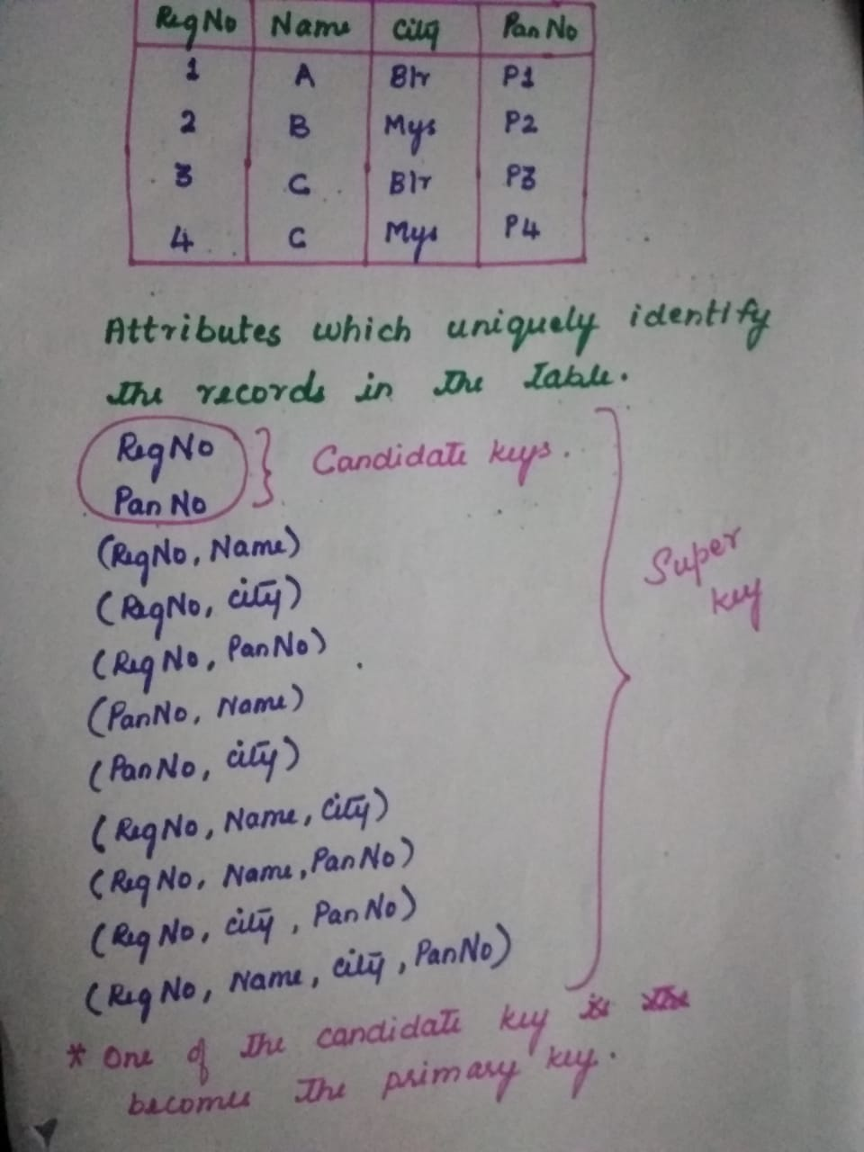

Slide 14
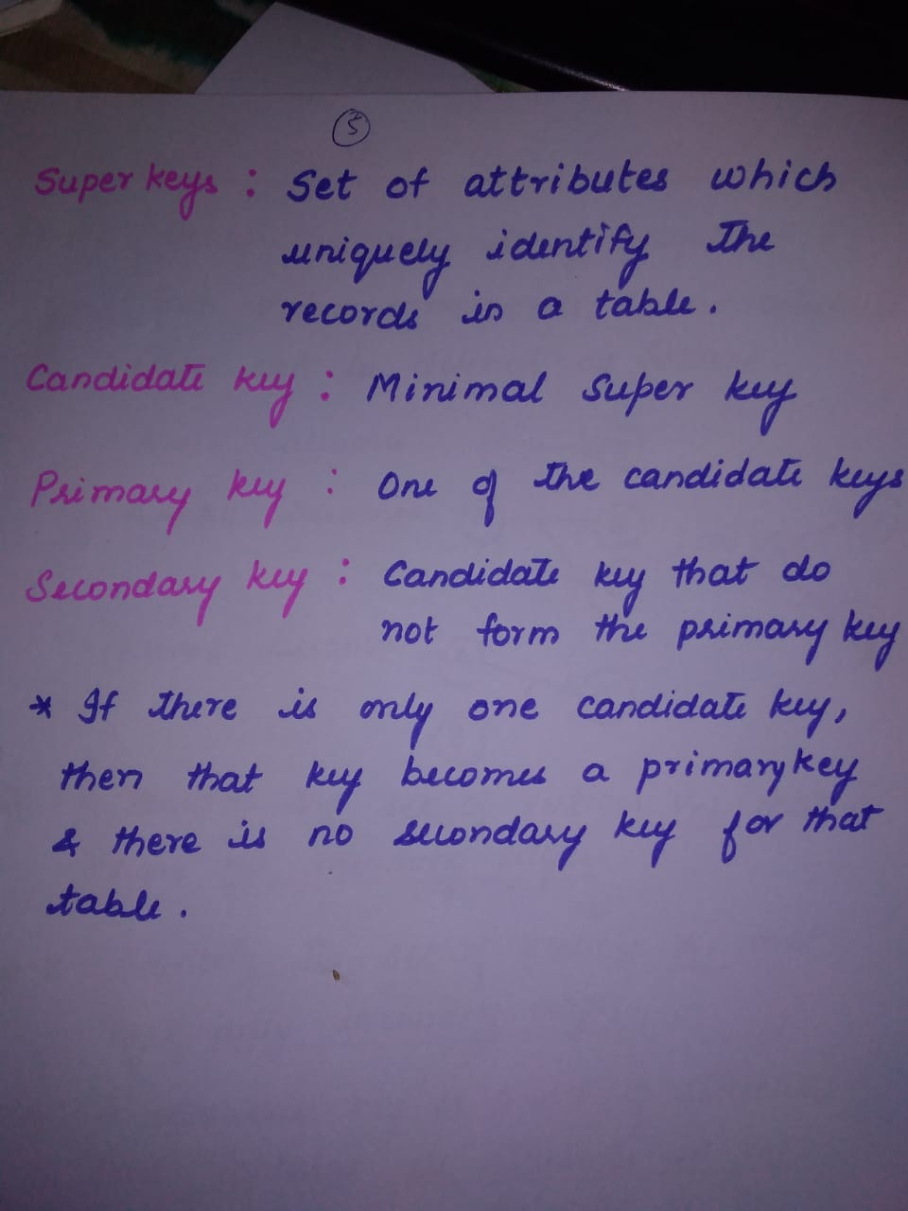

Slide 15
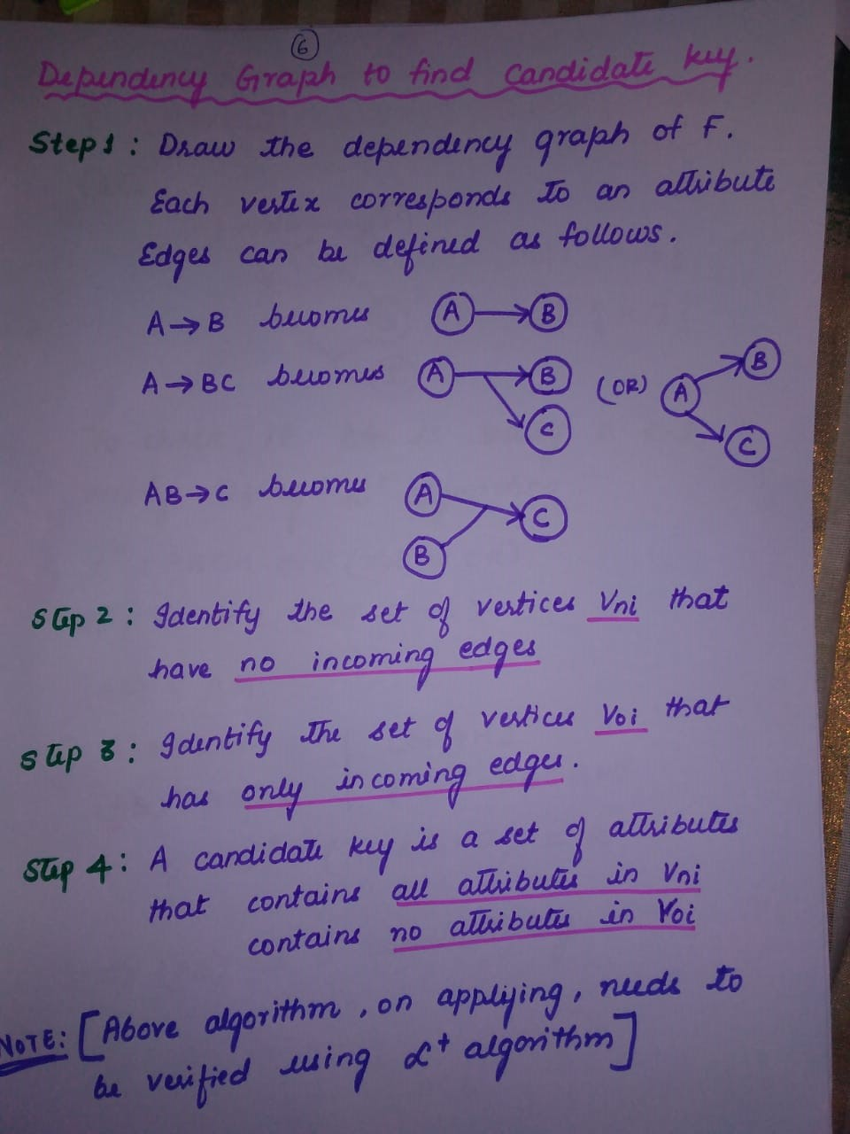

Slide 16
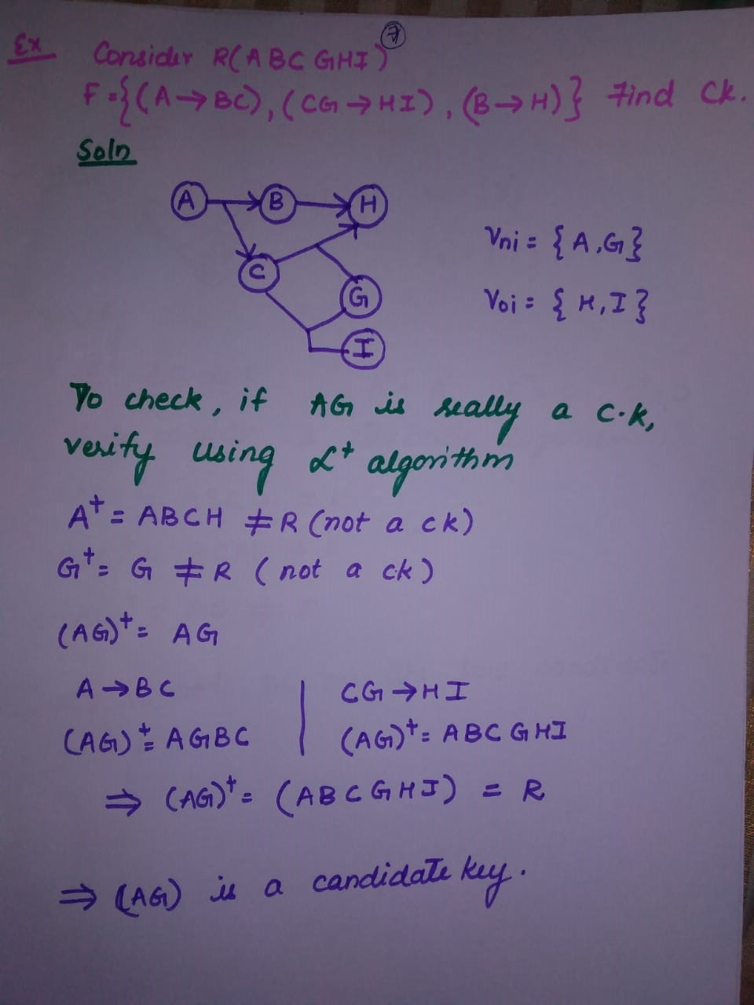

Slide 17
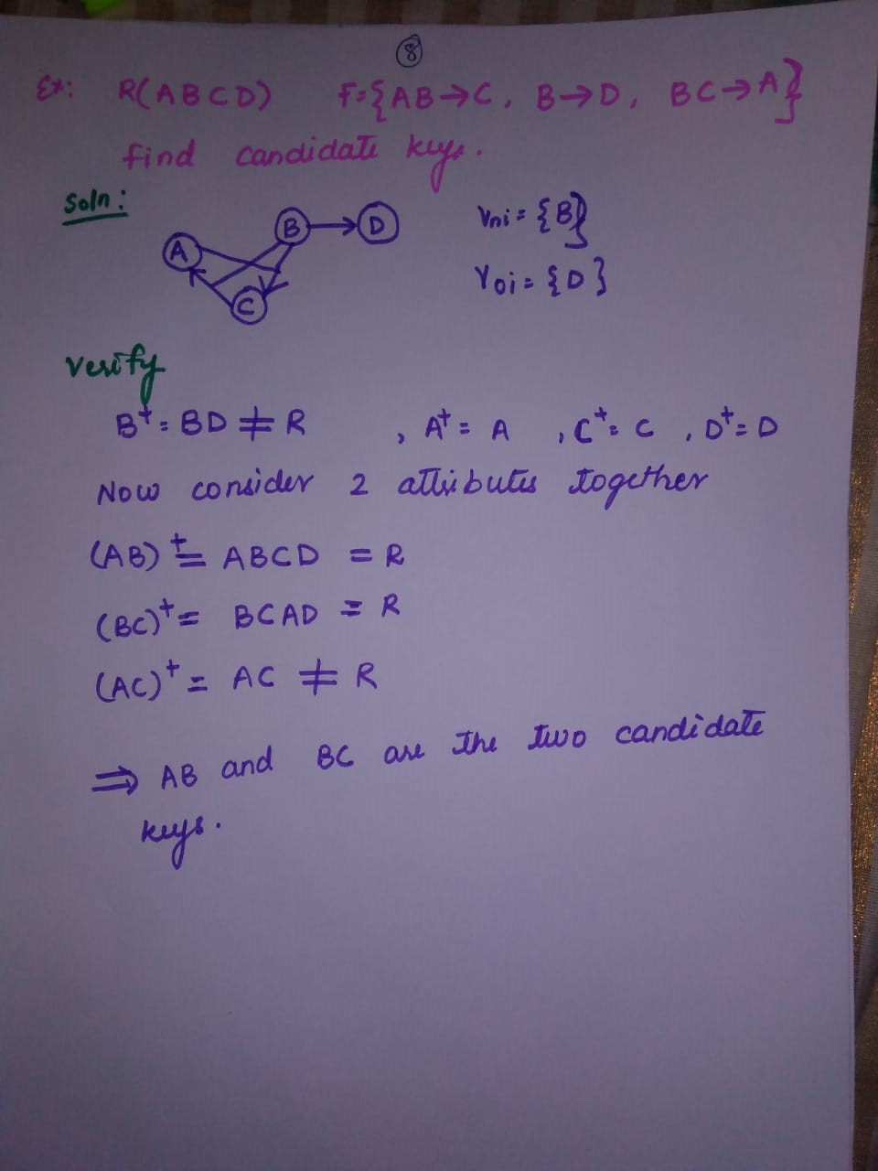

Slide 18
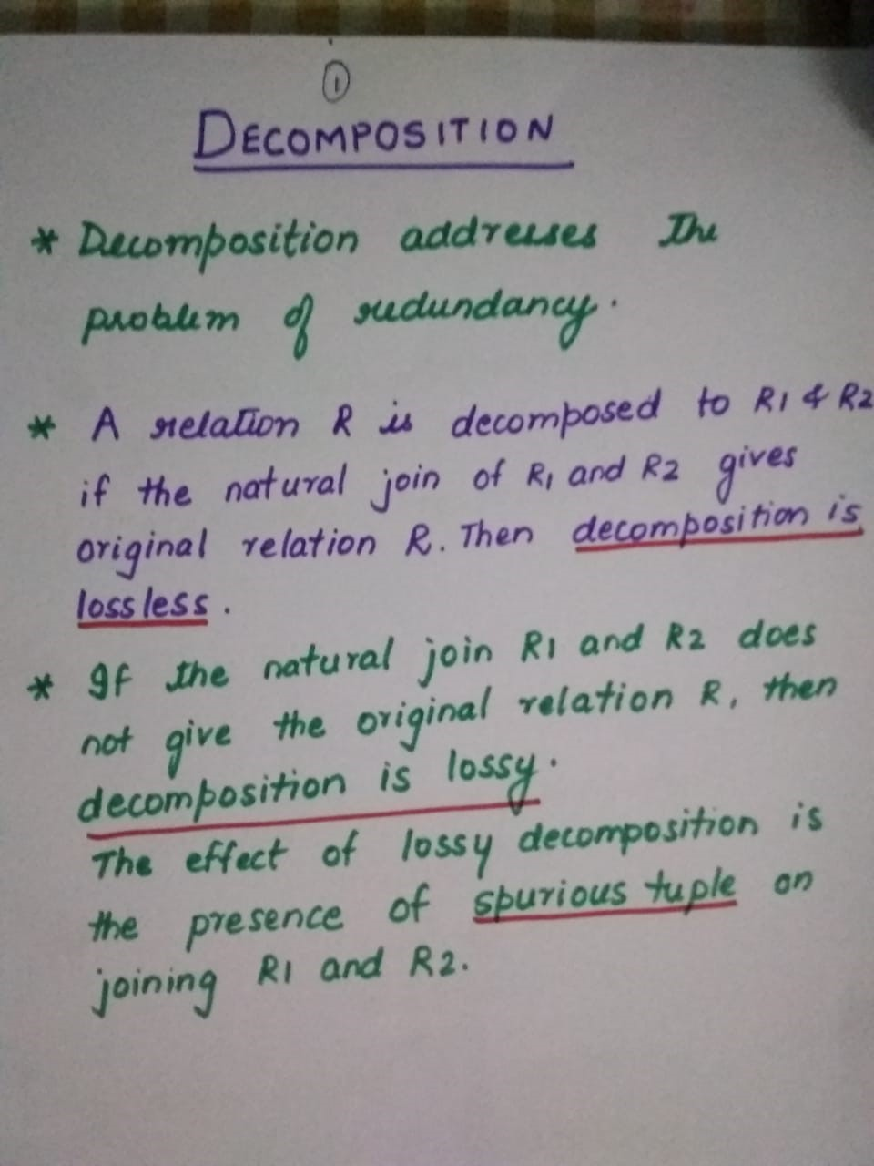

Slide 19
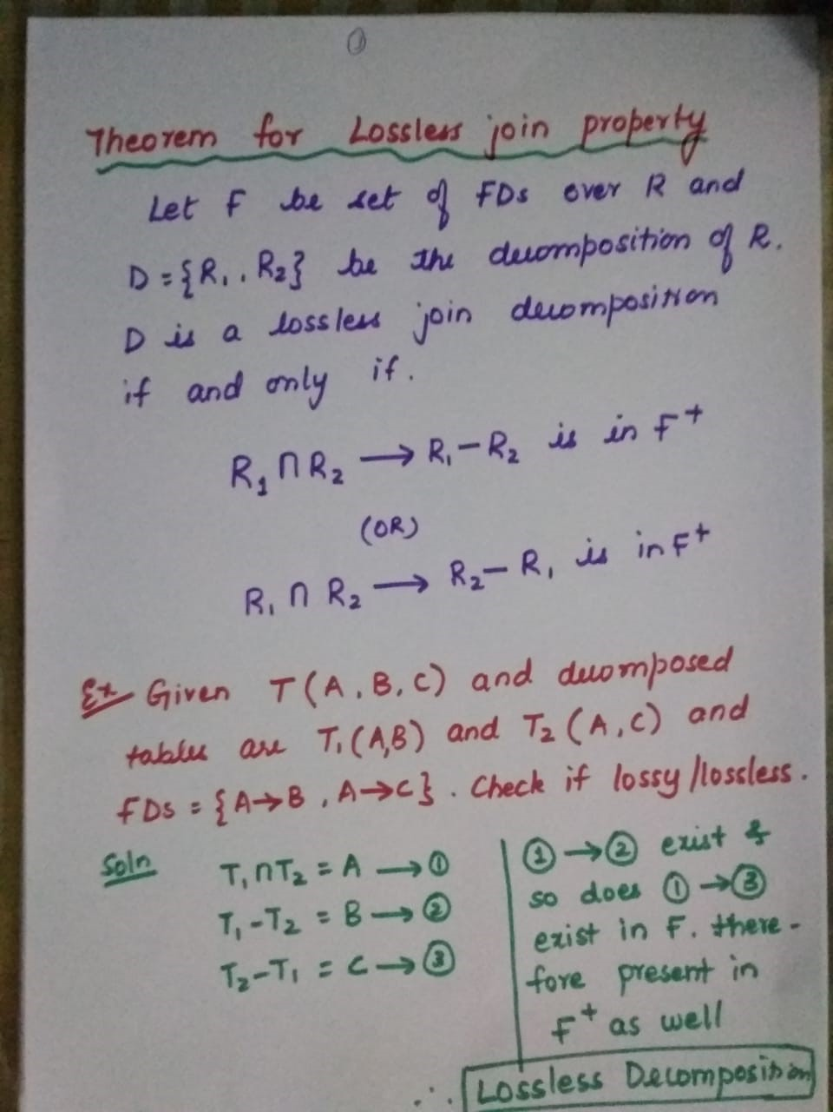

Slide 20
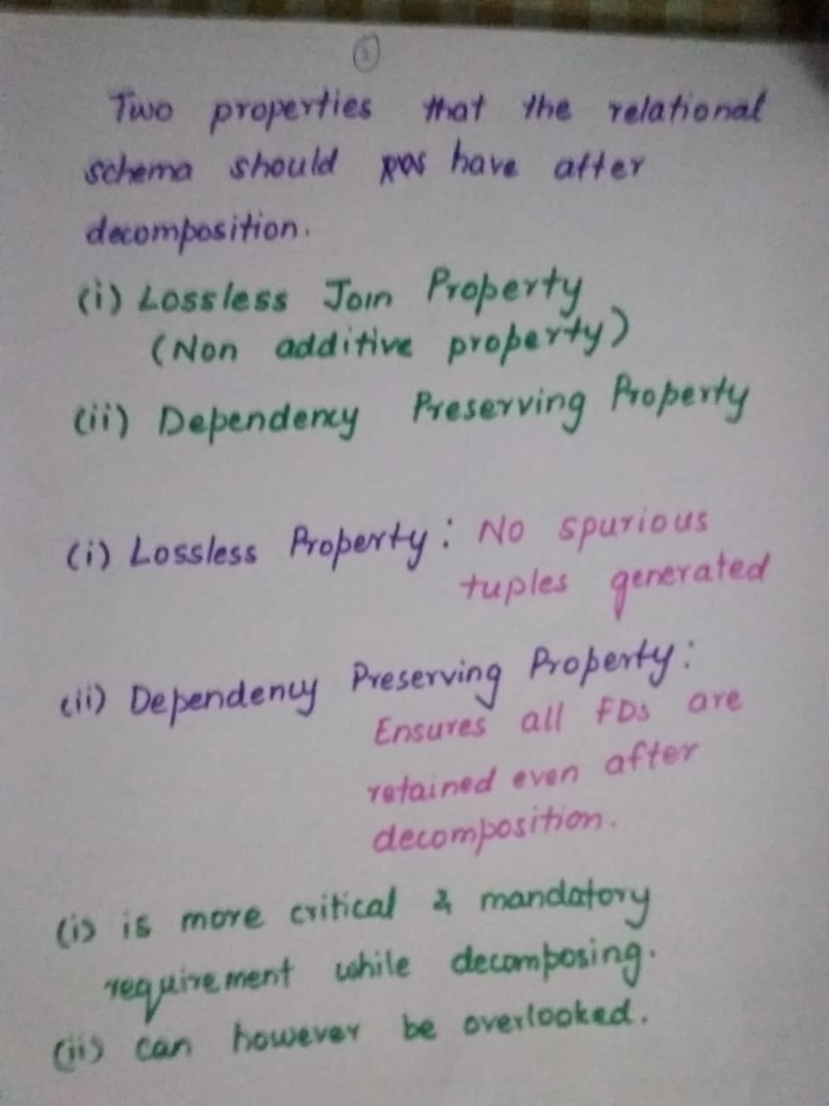

Slide 21
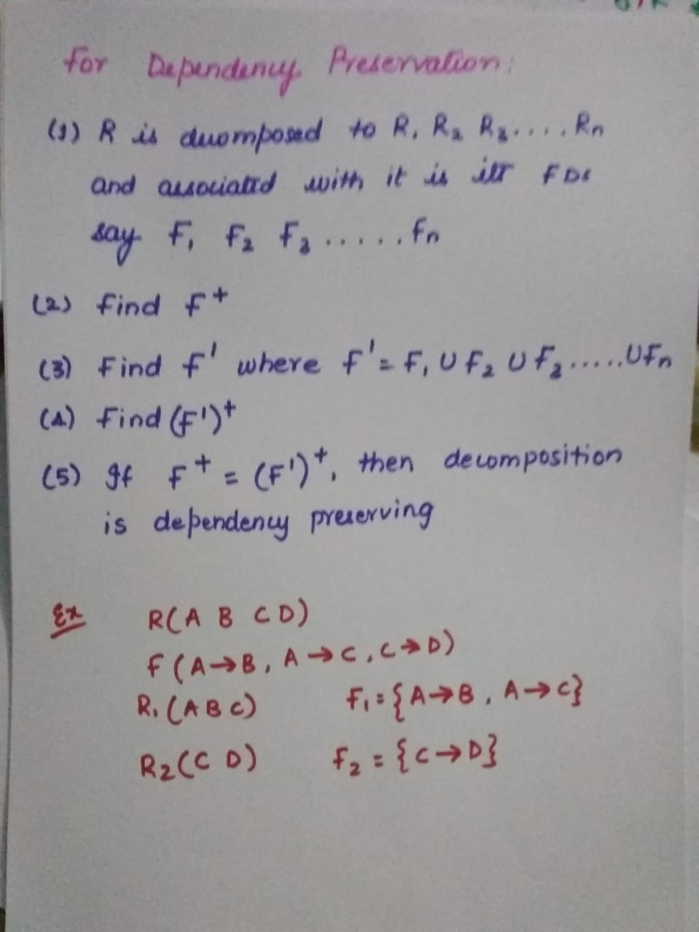

Slide 22
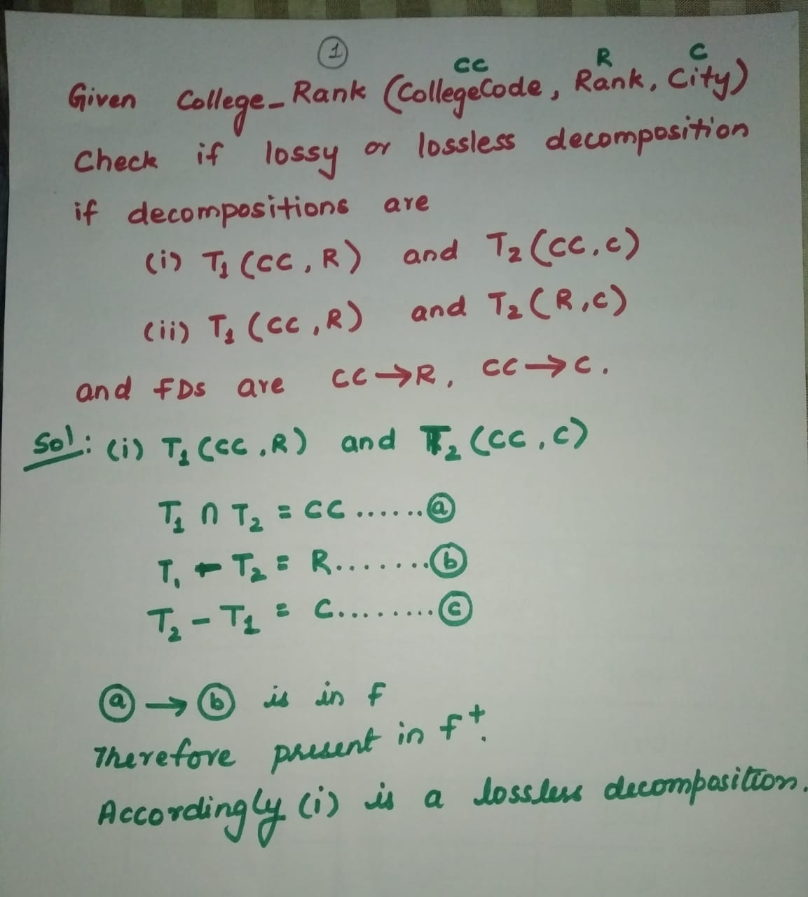

Slide 23
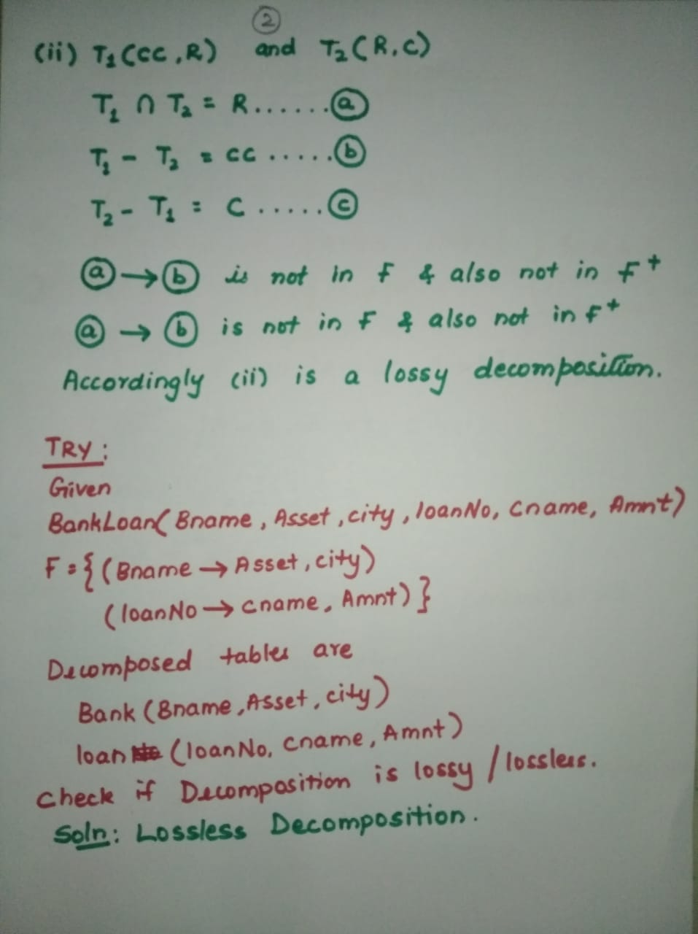
Loan( Bname, LoanNo, cname, Amnt)

Slide 24
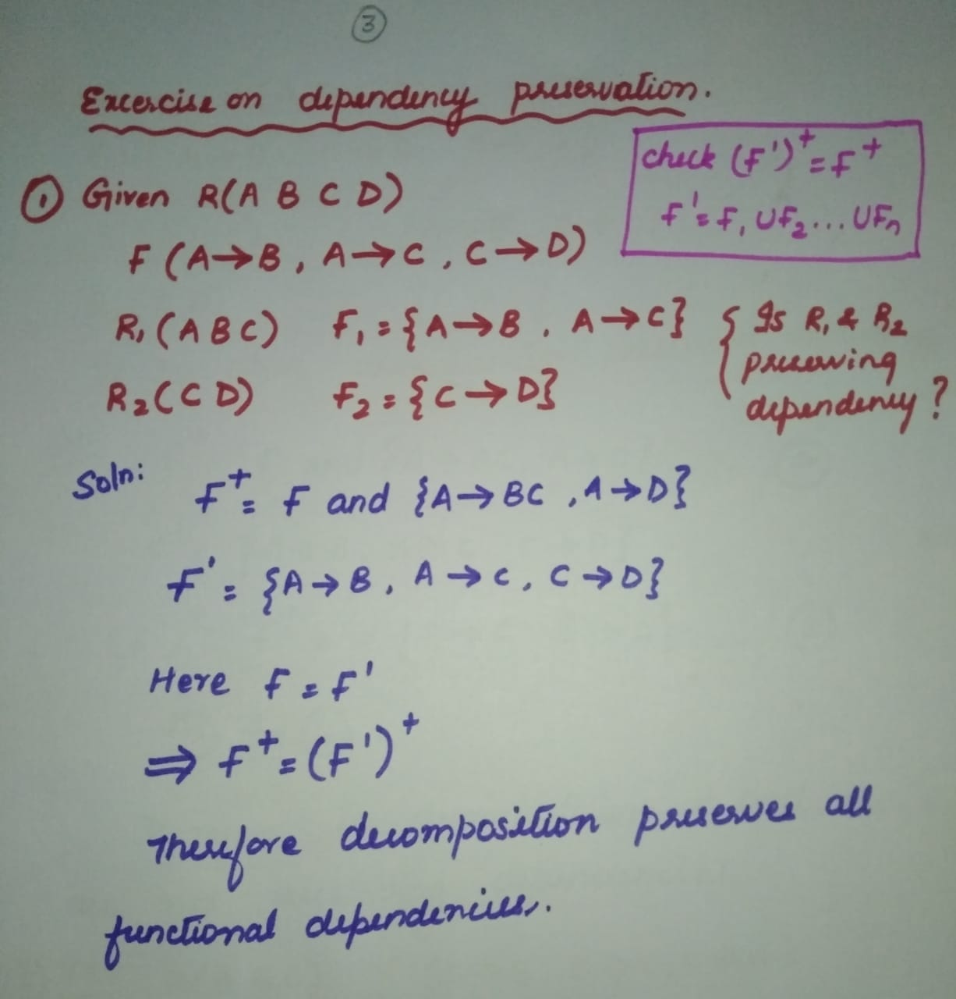

Slide 25
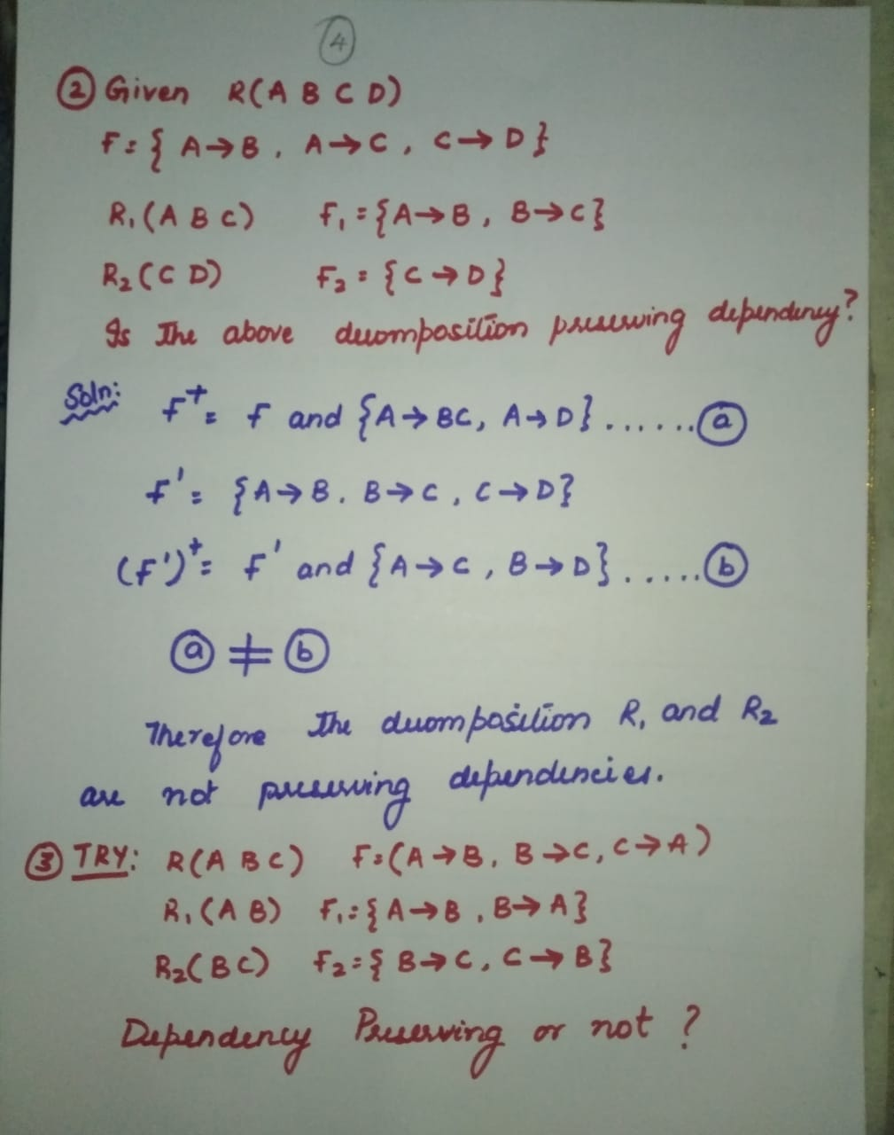

Slide 26
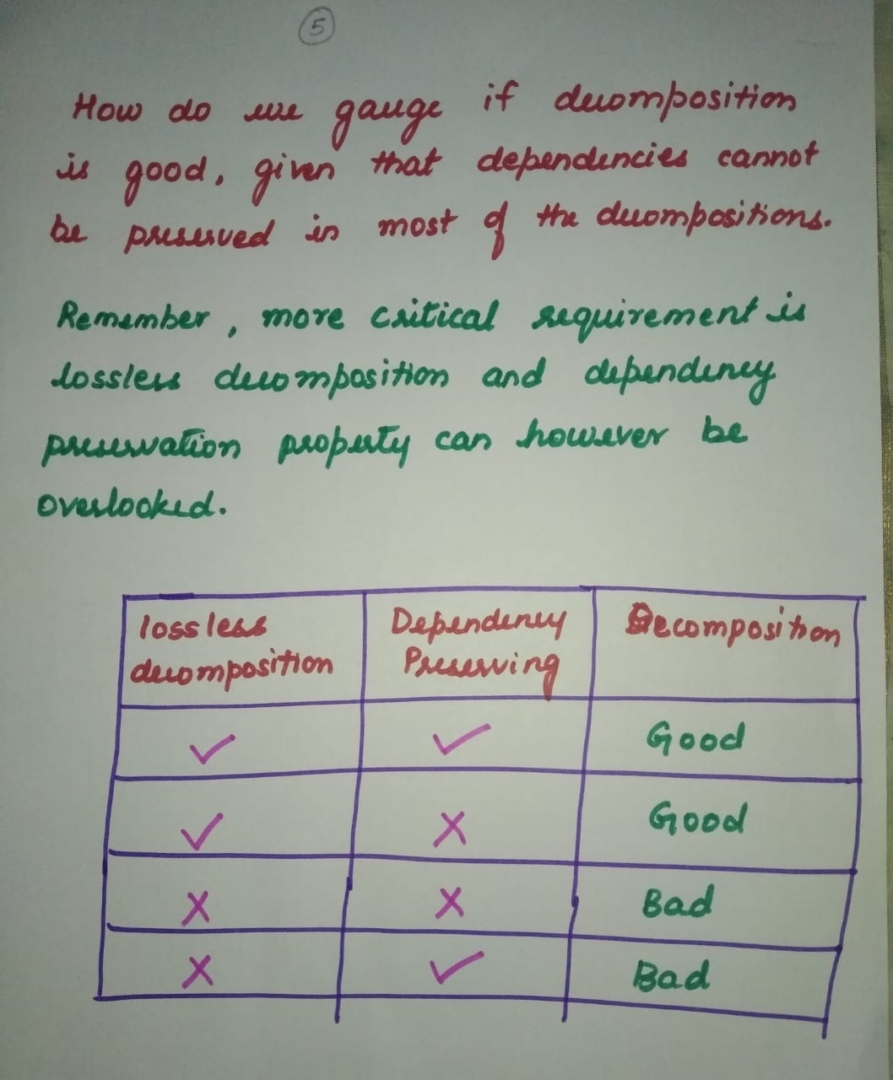

Slide 27
NORMALIZATION
Normalization is the process of minimizing redundancy from a relation or set of relations.
Redundancy in relation may cause insertion, deletion and update anomalies. So, it helps to minimize the redundancy in relations.
Normal forms are used to eliminate or reduce redundancy in database tables.

Slide 28
1NF---- atomic attribute/ functional dependency
2NF----- partial dependency
3NF-----Transitive dependency
BCNF(Boyce Codd Normal Form)----special of 3NF
4NF----- multivalued dependency
5NF------ Join dependency

Slide 29
Normalization is the process of splitting relations into well structured relations that allow users to insert, delete, and update tuples/rows/records efficiently.
Without normalization many problems can occur when trying to load an integrated conceptual model (undecomposed relations) into the DBMS. These problems arise from relations that are generated directly from user views, and are called anomalies. There are three types of anomalies: update, deletion and insertion anomalies.

Slide 30
Anomalies
Insertion
Deletion
Update

Slide 31
Insertion Anomaly
An insertion anomaly is the inability to add data to the database due to absence of other data.
For example, assume if a new employee is hired but not immediately assigned to any dept then this employee could not be entered into the database or insert with null value in dept column. This results in database’ inconsistencies .
Emp_dept( eno, ename, sal, gender, dname, dloc)
1, A, 20k, M ,CSE, GF
2, D, 30K, M, null, null
3, B, 40K, F, CSE, GF
4, C, 40K, F, CSE, GF

Slide 32
Insertion Anomaly solution
Emp_dept( eno, ename, sal, gender, dname, dloc)
1, A, 20k, M ,CSE, GF
2, D, 30K, M, null, null
3, B, 40K, F, CSE, GF
4, C, 40K, F, CSE, GF
Emp(eno, ename, sal, gender, dname)
1, A, 20k, M ,CSE
2, D, 30K, M, null (No. of null values can be considerably reduced)
3, B, 40K, F, CSE
4, C, 40K, F, CSE
Dept(dname, dloc)
1. CSE GF
2. PHY FF

Slide 33
2. Deletion Anomaly
A deletion anomaly is the unintended loss of data due to deletion of other data.
For example, if the emp B resigns and the record is deleted from the table below, then employee B and Dept PHY would cease to exist (because B is the only employee of PHY).
This results in database inconsistencies and is an example of how combining information that does not really belong together into one table can cause problems.
Emp_dept( eno, ename, sal, gender, dname, dloc)
1, A, 20k, M ,CSE, GF
2, B, 30K, M, PHY, TF
3, C, 40K, F, CSE, GF
4, D, 40K, F, CSE, GF

Slide 34
Deletion Anomaly Solution
Emp_dept( eno, ename, sal, gender, dname, dloc)
1, A, 20k, M ,CSE, GF
2, B, 30K, M, phy, FF
3, C, 40K, F, CSE, GF
4, D, 40K, F, CSE, GF
Emp(eno, ename, sal, gender, dname)
1, A, 20k, M ,CSE
2, B, 30K, M, phy (even if removed phy exists in dept table)
3, C, 40K, F, CSE
4, D, 40K, F, CSE
Dept(dname, dloc)
1. cse GF
2. phy ff

Slide 35
3. Update Anomaly
An update anomaly is a data inconsistency that results from data redundancy and a partial update.
For example, the location of CSE in multiple places have different values(inconsistent). Therefore it is better to decompose the table
Emp_dept( eno, ename, sal, gender, dname, dloc)
1, A, 20k, M ,CSE, FF
2, B, 30K, M, PHY, TF
3, C, 40K, F, CSE, FF
4, D, 40K, F, CSE, GF

Slide 36
Update Anomaly solution
Emp_dept( eno, ename, sal, gender, dname, dloc)
1, A, 20k, M ,CSE, GF
2, A, 30K, M, phy, FF
3, B, 40K, F, CSE, GF
4, C, 40K, F, CSE, GF
Emp(eno, ename, sal, gender, dname)
1, A, 20k, M ,CSE
2, A, 30K, M, PHY
3, B, 40K, F, CSE
4, C, 40K, F, CSE
Dept(dname, dloc) (loc of the dept is stored only in this table)
1. CSE GF
2. PHY FF

Slide 37
Update Anomaly
Acc_Cust
Accno | Bal | Custid | Custname | city
A1 | 10k | C1 | A | Mys
A2 | 35k | C2 | B | Mys
A3 | 56k | C1 | A | Blr
A4 | 78k | C3 | C | Mlr
A5 | 34k | C4 | D | Mys
Cust c1 blr– mys
Update acc_cust set city=‘mys’ where accno=‘A1’;

Slide 38
Accno | Bal | Custid
A1 | 10k | C1
A2 | 35k | C2
A3 | 56k | C1
A4 | 78k | C3
A5 | 34k | C4
Cust c1 blr– mys
Update cust set city=‘mys’ where custid=‘c1’;
Custid | Custname | city
C1 | A | Mys
C2 | B | Mys
C3 | C | Mlr
C4 | D | Mys

Slide 39
First Normal Form (1 NF )
Guideline : All the attributes should be atomic in nature.
Atomic attribute = single valued attribute
Emp(eno, ename, sal, phno) phno=mva
Is Emp in 1NF??? NO
Emp(eno, ename, sal,phno)
1, A, 10, 100
1, A, 10, 101
2, B, 20, 102
Emp(eno, ename, sal, phno1, phno2)
Emp(eno, ename, sal) & emp_ph(eno, phno)
1, 100
1, 101

Slide 40
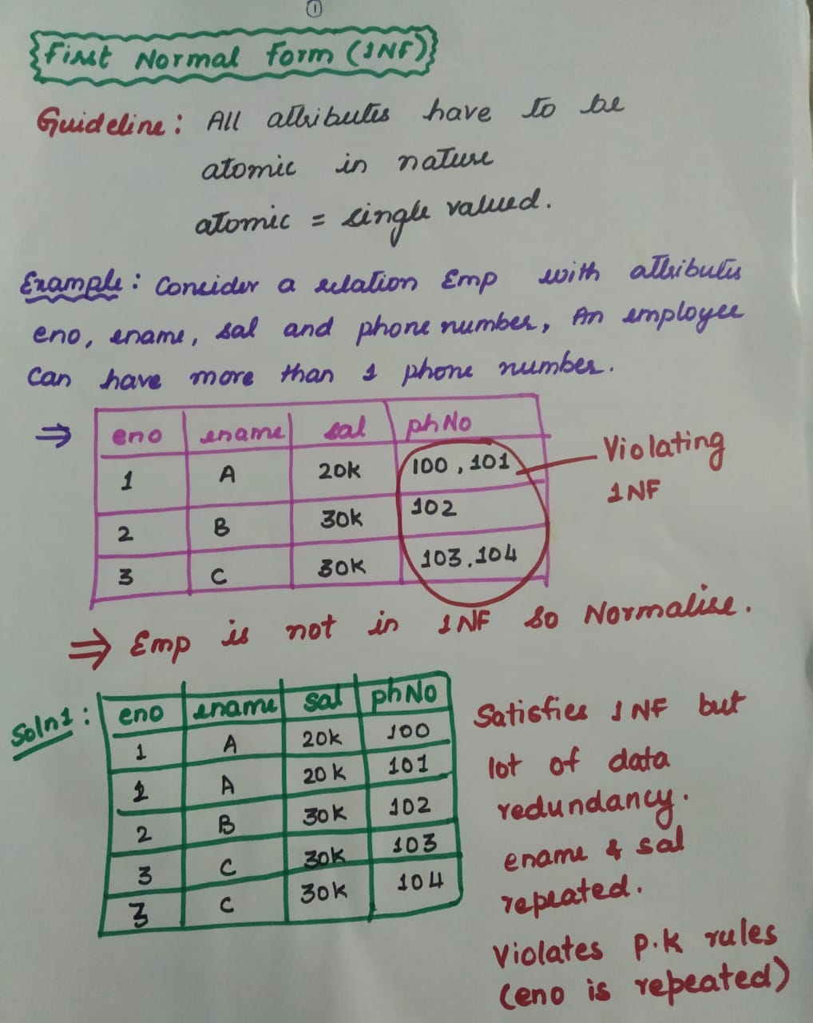

Slide 41
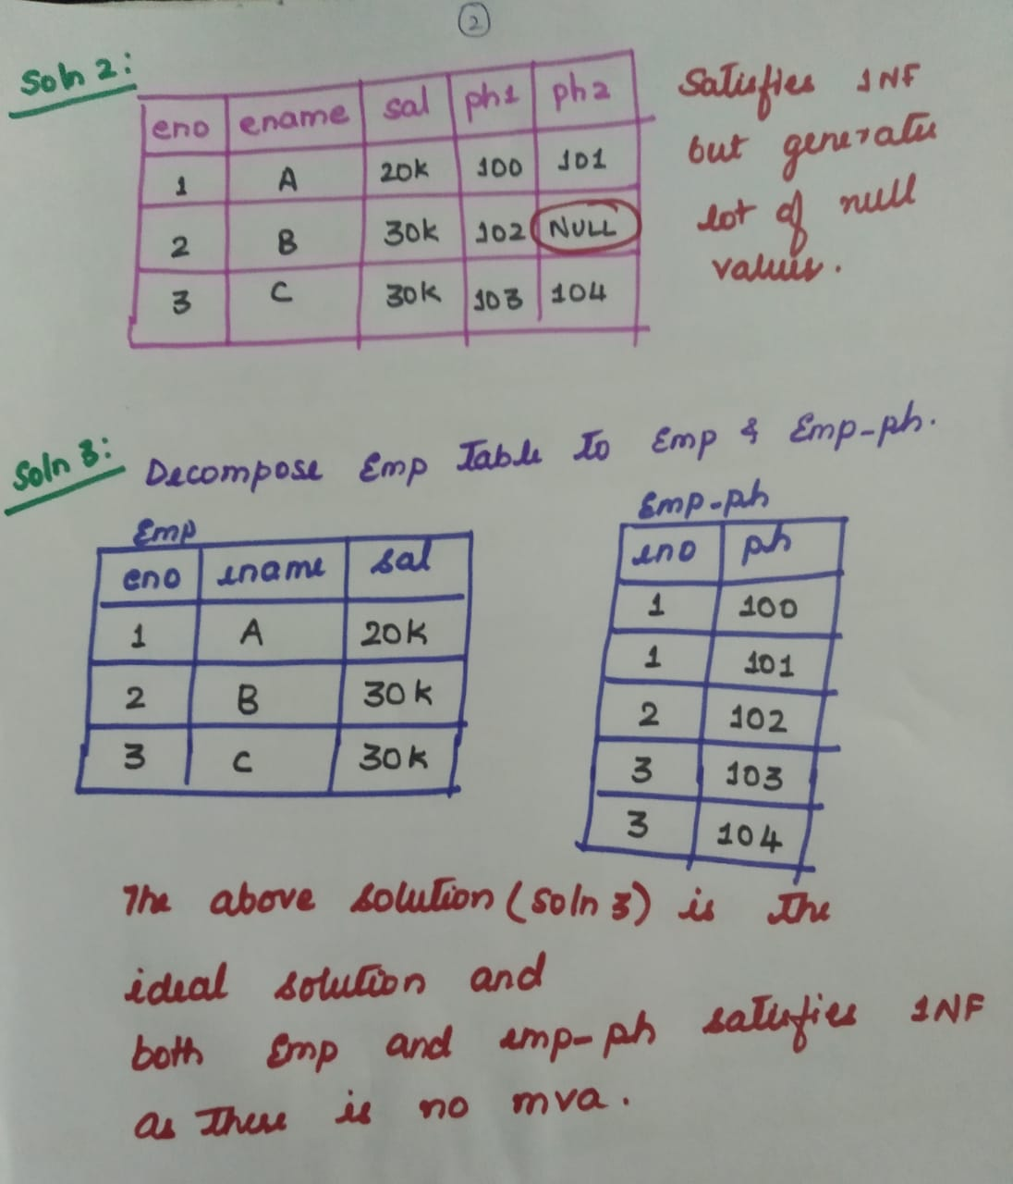

Slide 42
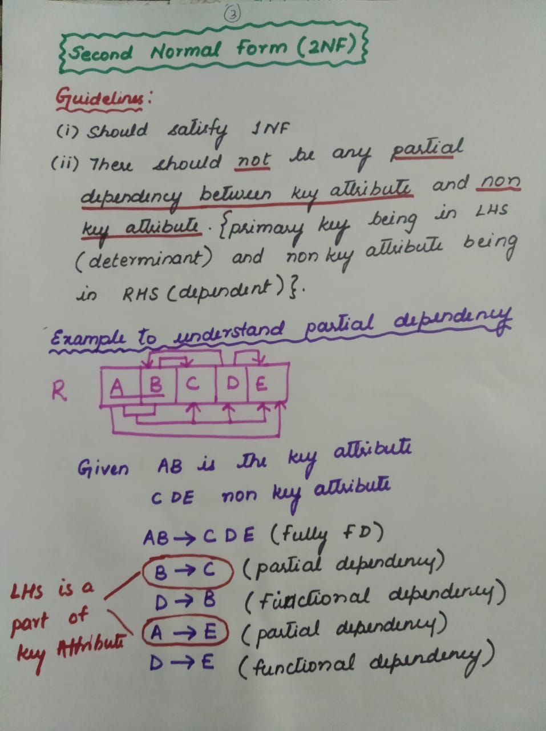

Slide 43
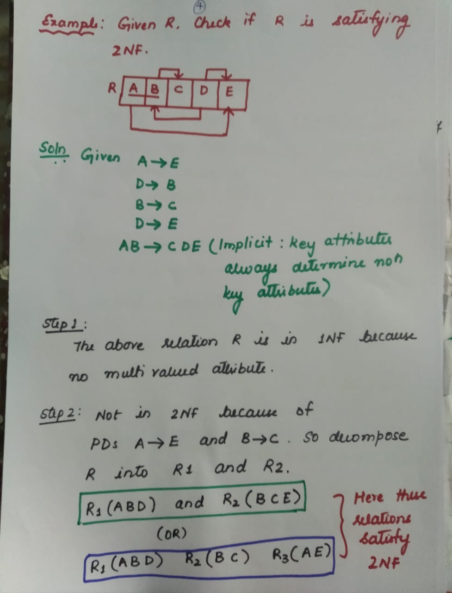
GREEN:
R1 int R2= B
R2-R1=C,E
B→C,E
BLUE:
R1 int R2= B
R2-R1= C
B→C
R1 int R3 =A
R3-R1 =E
A→E

Slide 44
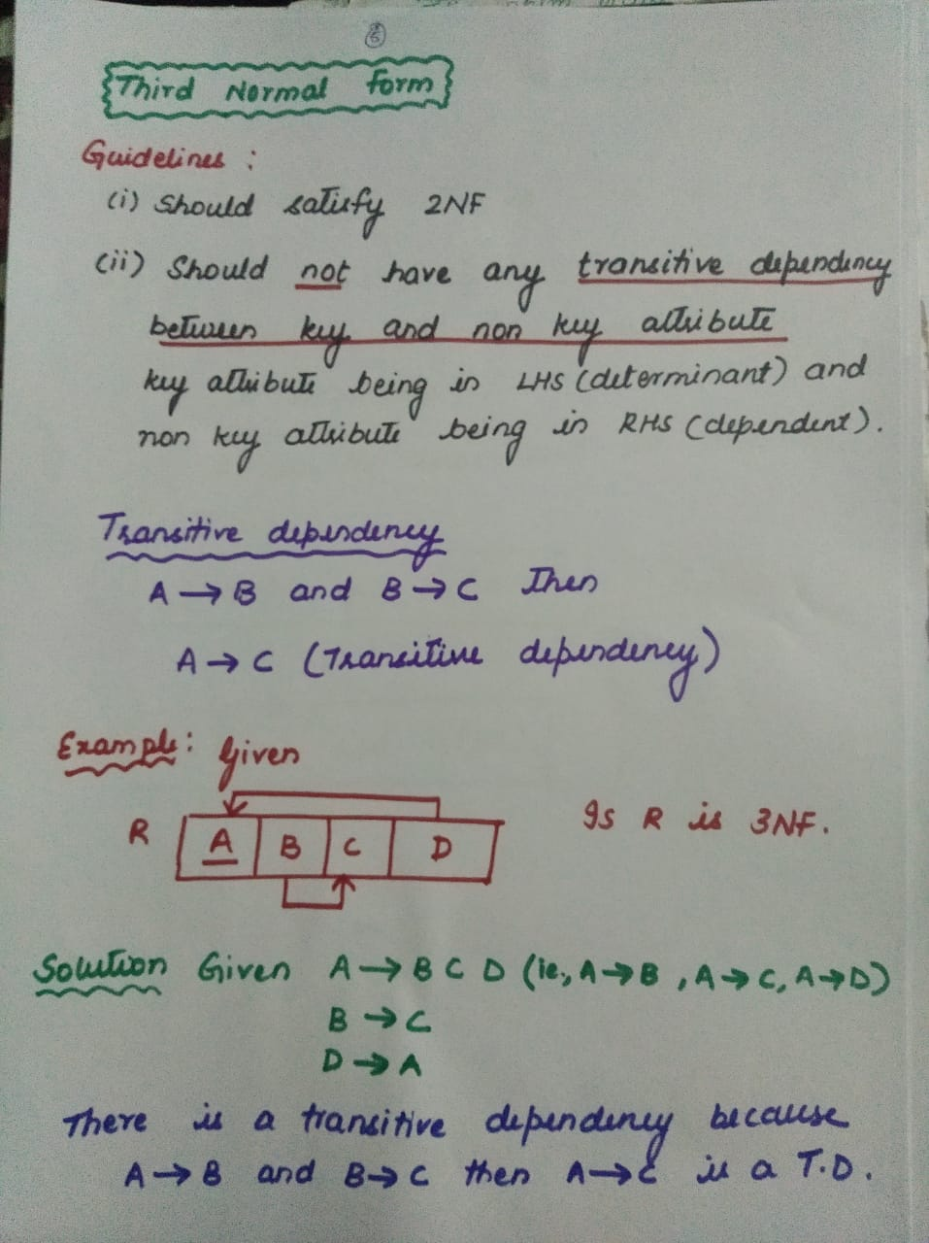

Slide 45
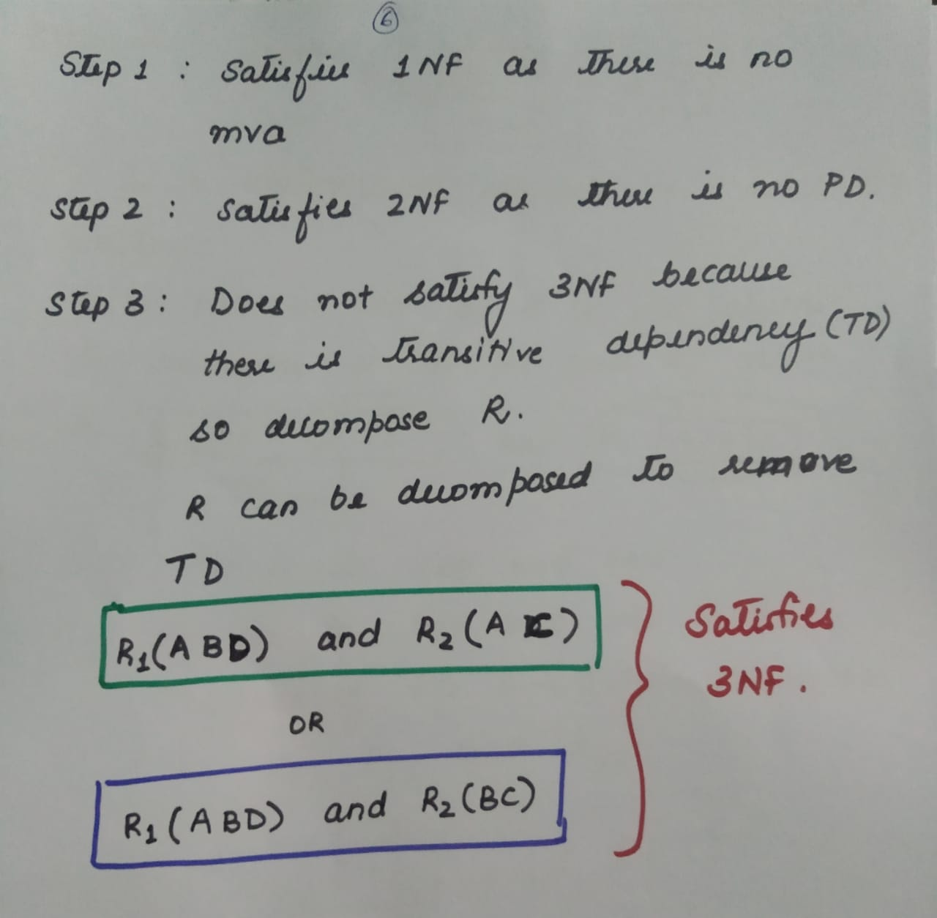

Slide 46
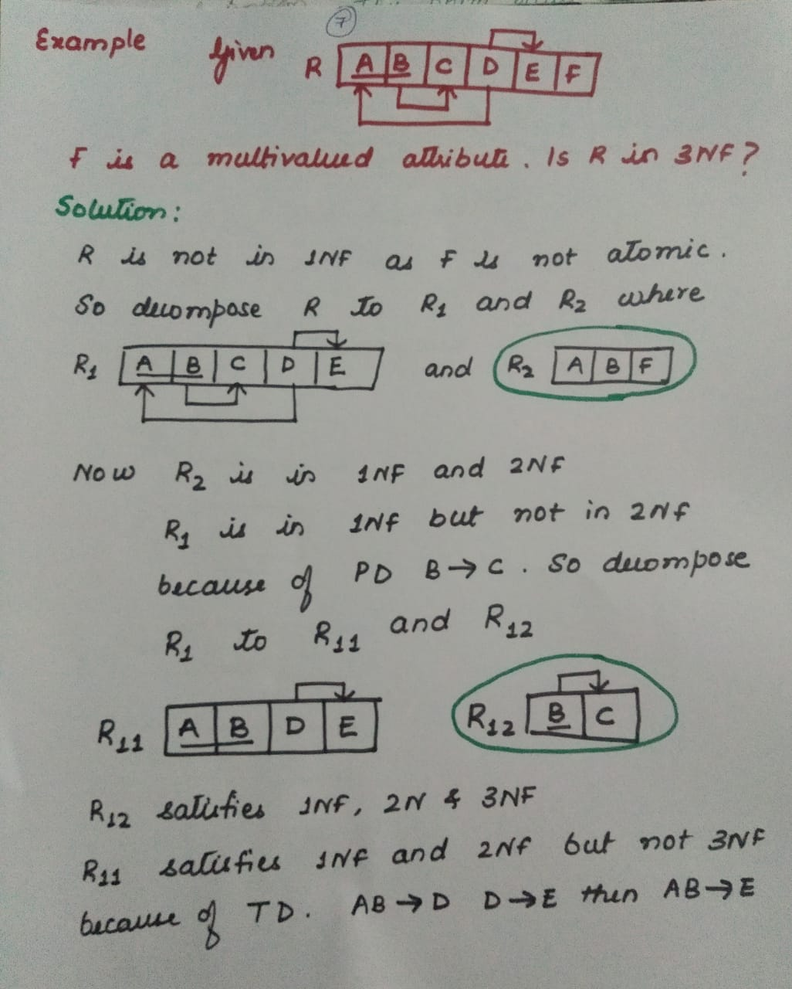

Slide 47
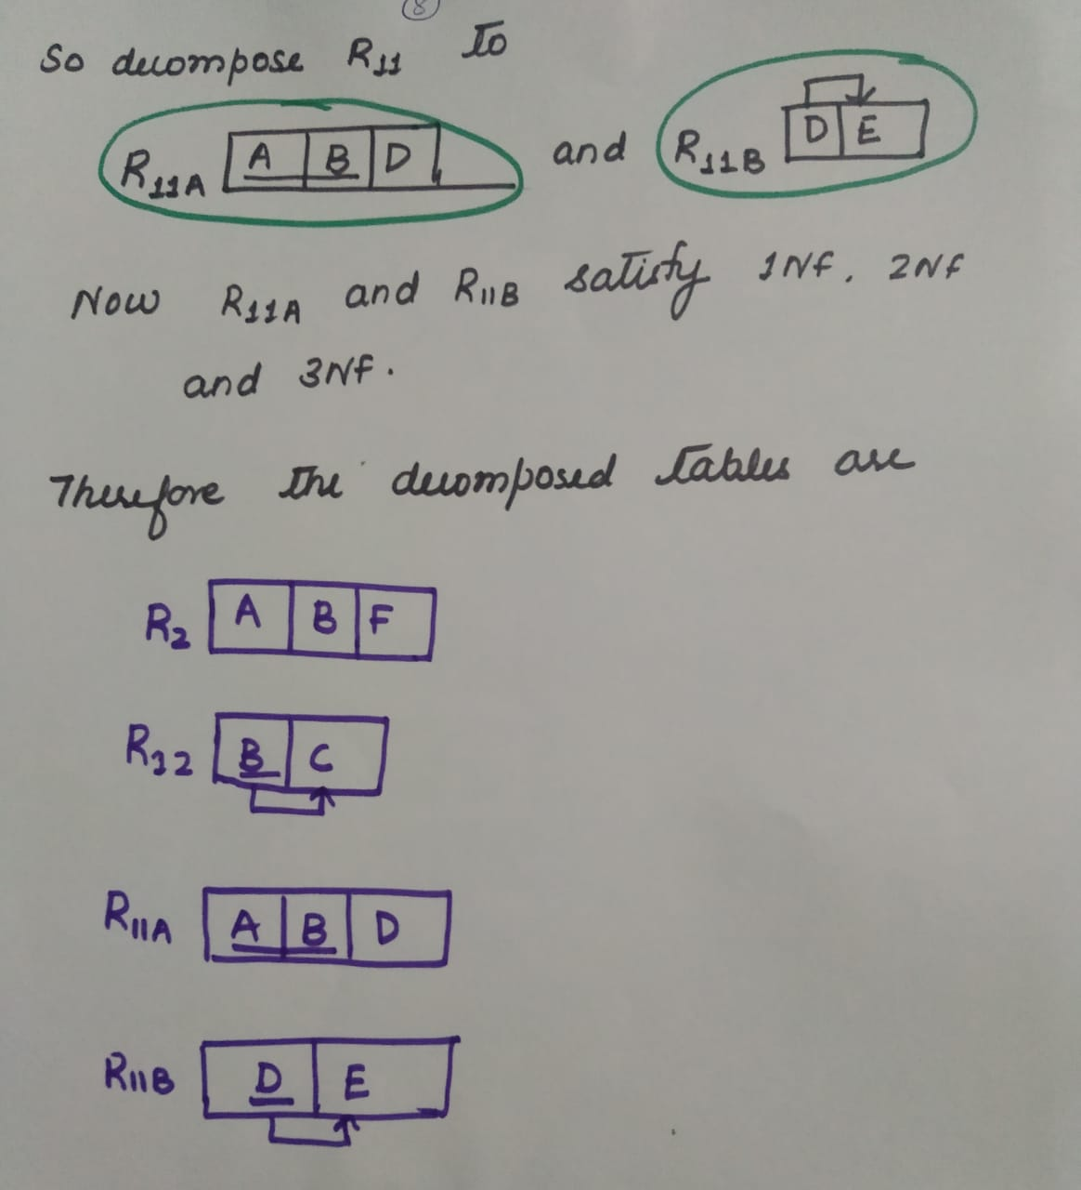

Slide 48
Why remove Partial dependency & transitive dependency from a table……..?????
ccode | RegNo | Sname | Cname | Credit | Grade | Ph
C1 | R1 | Arun | DB | 3 | A | 123
C2 | R1 | Arun | CN | 4 | B | 123
C3 | R1 | Arun | OS | 4 | A | 123
C1 | R2 | Elsa | DB | 3 | A | 456
C2 | R2 | Elsa | CN | 4 | C | 456
Dependencies: { (ccode→cname), //PD
(ccode→credit), //PD
(regNo→sname), //PD
(regNo→ph), //PD
(ccode, regNo→Grade) //FFD
}
Is the above table
in 2NF ??

Slide 49
Why remove Partial dependency & transitive dependency from a table……..?????
ccode | RegNo | Sname | Cname | Credit | Grade | Ph
C1 | R1 | Arun | DB | 3 | A | 123
C2 | R1 | Arun | CN | 4 | B | 123
C3 | R1 | Arun | OS | 4 | A | 123
C1 | R2 | Elsa | DB | 3 | A | 456
C2 | R2 | Elsa | CN | 4 | C | 456
when decomposed :
R1( ccode, RegNo, Grade)
R2(ccode, cname, credit)
R3(regNo, sname, Ph)

Slide 50
ccode | RegNo | Sname | Cname | Credit | Grade | Ph
C1 | R1 | Arun | DB | 3 | A | 123
C2 | R1 | Arun | CN | 4 | B | 234
C3 | R1 | Arun | OS | 4 | A | 345
C1 | R2 | Elsa | DB | 3 | A | 456
C2 | R2 | Elsa | CN | 4 | C | 567
ccode | RegNo | Grade
C1 | R1 | A
C2 | R1 | B
C3 | R1 | A
C1 | R2 | A
C2 | R2 | C
ccode | Cname | Credit
C1 | DB | 3
C2 | CN | 4
C3 | OS | 4
RegNo | Sname | Ph
R1 | Arun | 123
R2 | Elsa | 456

Slide 51
Why remove Partial dependency & transitive dependency from a table……..?????
Pan_No. | Name | City | State
P1 | Arun | Blr | Kar
P2 | Ben | Blr | Kar
P3 | Cathy | Mys | Kar
P4 | Dennis | Tvm | Kl
P5 | Elsa | Tvm | Kl
Dependencies: { (Pan_No→ Name), (Pan_No→ City), (Pan_No→ State) , (city→state) }

Slide 52
Why remove Partial dependency & transitive dependency from a table……..?????
Pan_No. | Name | City | State
P1 | Arun | Blr | Kar
P2 | Ben | Blr | Kar
P3 | Cathy | Mys | Kar
P4 | Dennis | Tvm | Kl
P5 | Elsa | Tvm | Kl
Dependencies: { (Pan_No→ Name),
(Pan_No→ City),
(Pan_No→ State) ,
(city→state)
}
Transitive dependency is ( Pan_No→State )
Because of Pan_No→ city and city→state
Is the given relation in 3NF ?????

Slide 53
Pan_No. | Name | City | State
P1 | Arun | Blr | Kar
P2 | Ben | Blr | Kar
P3 | Cathy | Blr | Kar
P4 | Dennis | Tvm | Kl
P5 | Elsa | Tvm | Kl
The decomposed tables :
Pan_No. | Name | City
P1 | Arun | Blr
P2 | Ben | Blr
P3 | Cathy | Blr
P4 | Dennis | Tvm
P5 | Elsa | Tvm
City | State
Blr | Kar
Tvm | Kl

Slide 54
Alternative Definition for 3NF
Any one of the three conditions should be satisfied for a Table/ Relation to be in 3 N. For all the FDs X→Y in R,
X→Y should be a trivial dependency.
X should be a super key.
Y should be a prime attribute (each element of Y is part of some candidate key).
X→Y is a trivial functional dependency if Y is a subset of X
Ex: sno, dno→sno

Slide 55
BCNF(Boyce Codd Normal Form) / 3.5 NF
Any one of the two conditions should be satisfied for a Table/ Relation satisfy BCNF.
X→Y should be a trivial dependency.
X should be a super key.
X -> Y is a trivial functional dependency if Y is a subset of X

