Slide 1
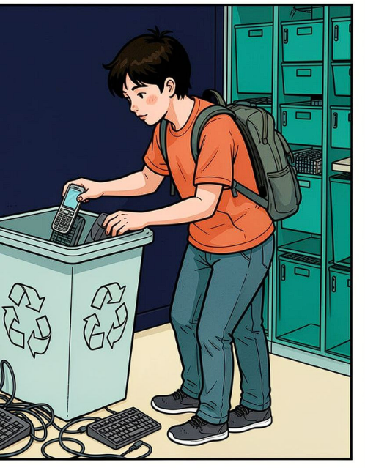
CAPSTONE 48 · AI & DATA SCIENCE
E-Waste in India:
Understand. Reduce. Recycle.
Verified facts, clear risks, and practical student action.
S Nithiya Dharshini · AI&DS · Dhanalakshmi College of Engineering
Notes:
Introduce the project as a short, evidence-led guide for students. The deck moves from the scale of e-waste to its risks, then to actions students can take and the verification process behind the three infographics.

Slide 2
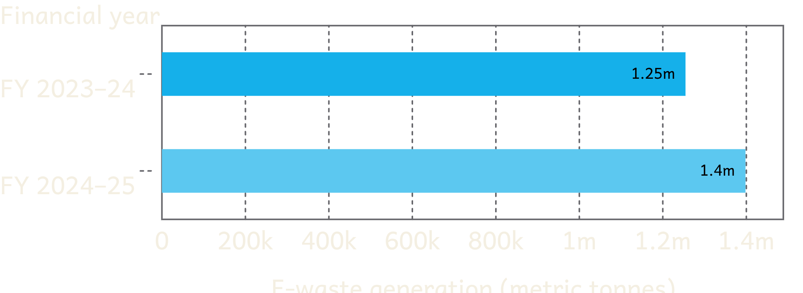
India’s reported e-waste generation is rising
Increase: about 143,669 metric tonnes in one financial year.
FY 2023–24
1,254,286.55 metric tonnes
FY 2024–25
1,397,955.59 metric tonnes
Source: Government of India, Press Information Bureau, 24 July 2025 — https://www.pib.gov.in/PressReleasePage.aspx?PRID=2147876&lang=2&reg=3
Important: these are generation estimates, not collection or recycling rates.
Notes:
Point to the two bars and read the values exactly. Emphasise the distinction: the figures describe estimated generation, not how much was collected or recycled.

Slide 3
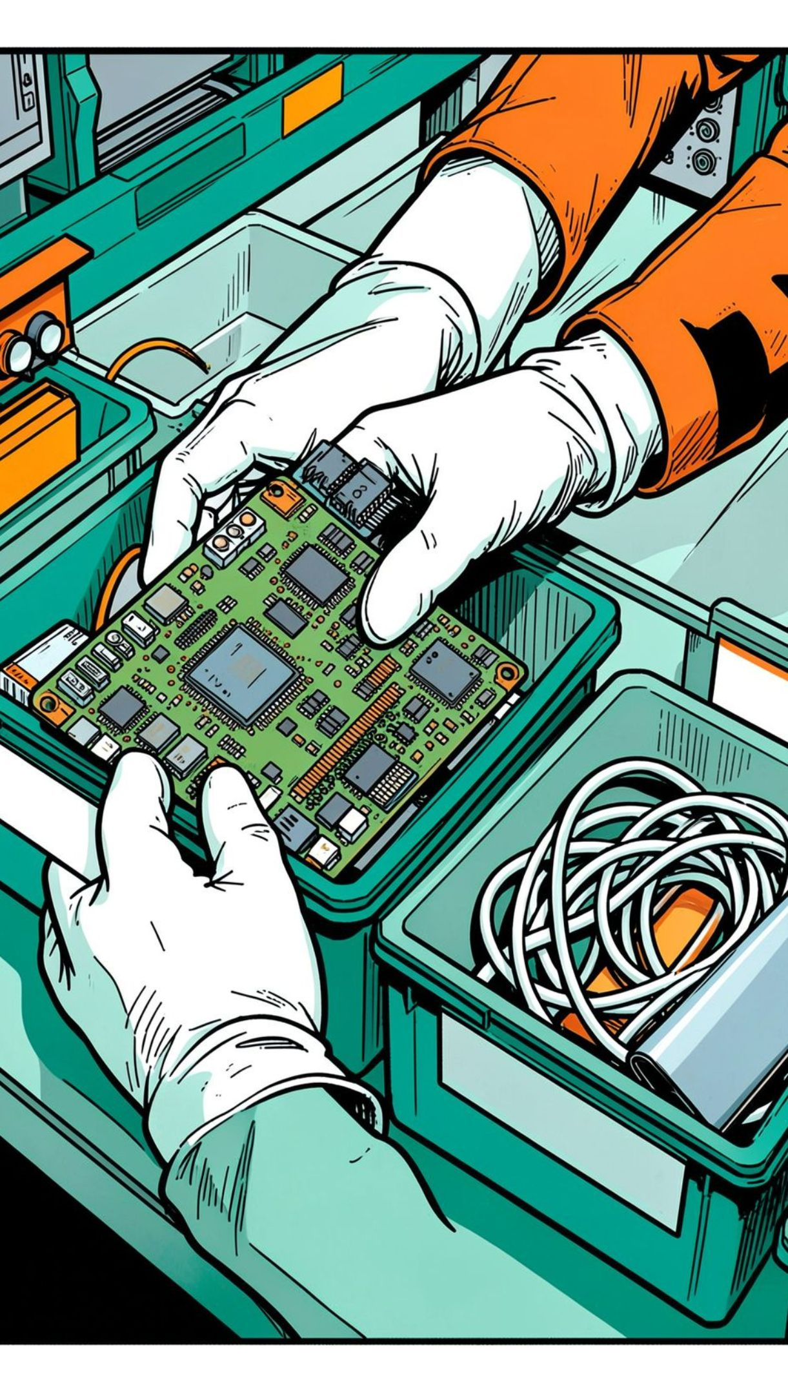
WHY IT MATTERS
Unsafe handling turns old electronics into a wider risk
Improper disposal → Wider exposure: Improper processing may contaminate soil, water, and air; informal dismantling and burning can expose workers and nearby communities to hazardous substances.
Responsible recovery: Electronics contain valuable materials. Responsible collection and recycling help reduce environmental harm and preserve recoverable resources.
Use cautious, evidence-based language; no disease statistics or unsupported numerical claims.
3
Notes:
Use cautious language. The point is the pathway from unsafe handling to broader environmental and health risk, followed by the practical alternative: responsible collection and recycling.

Slide 4
Six actions students can take now
01
Keep e-waste separate from regular household waste.
02
Repair, reuse, or donate working devices where appropriate.
03
Delete personal data and securely reset devices before handover.
04
Use authorised collection centres or registered recyclers.
05
Never burn electronics or dismantle hazardous components at home.
06
Encourage campus e-waste collection and awareness activities.
Reference: Central Pollution Control Board e-waste portal — https://www.eprewaste.cpcb.gov.in/
4
Notes:
Read the six actions as a checklist. The first five change how a device is handled; the sixth moves the habit from one student to the campus community.

Slide 5
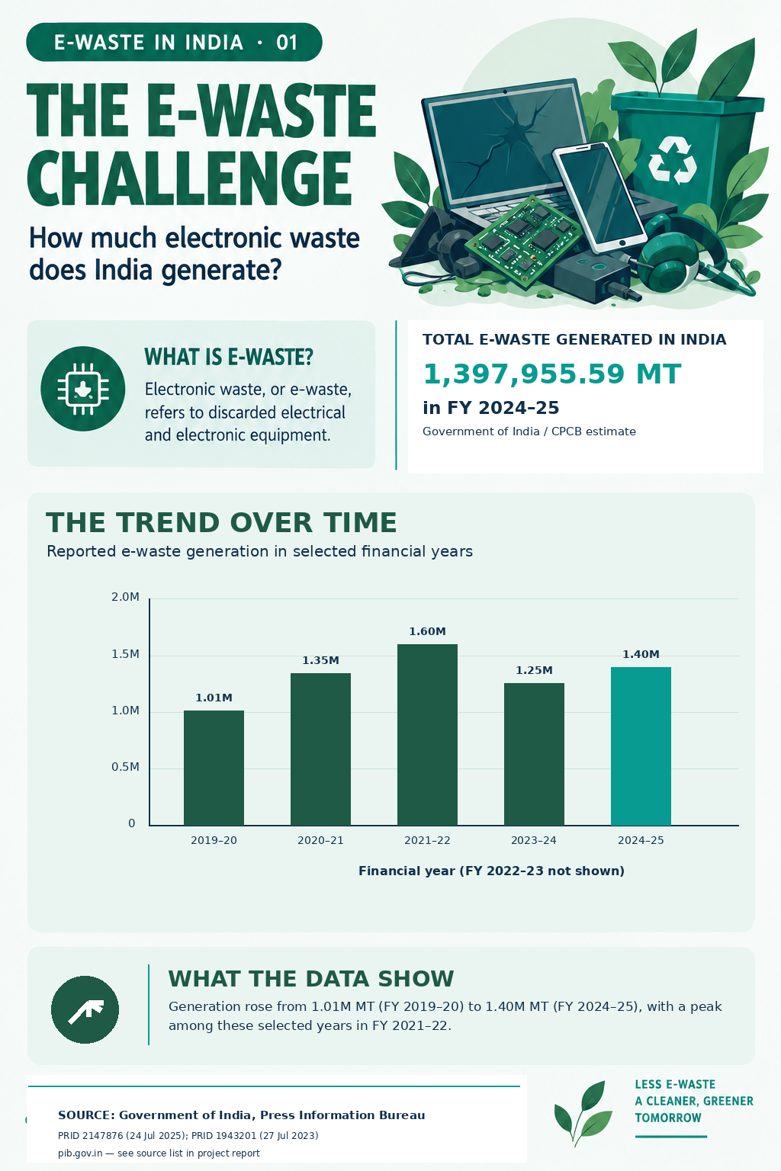
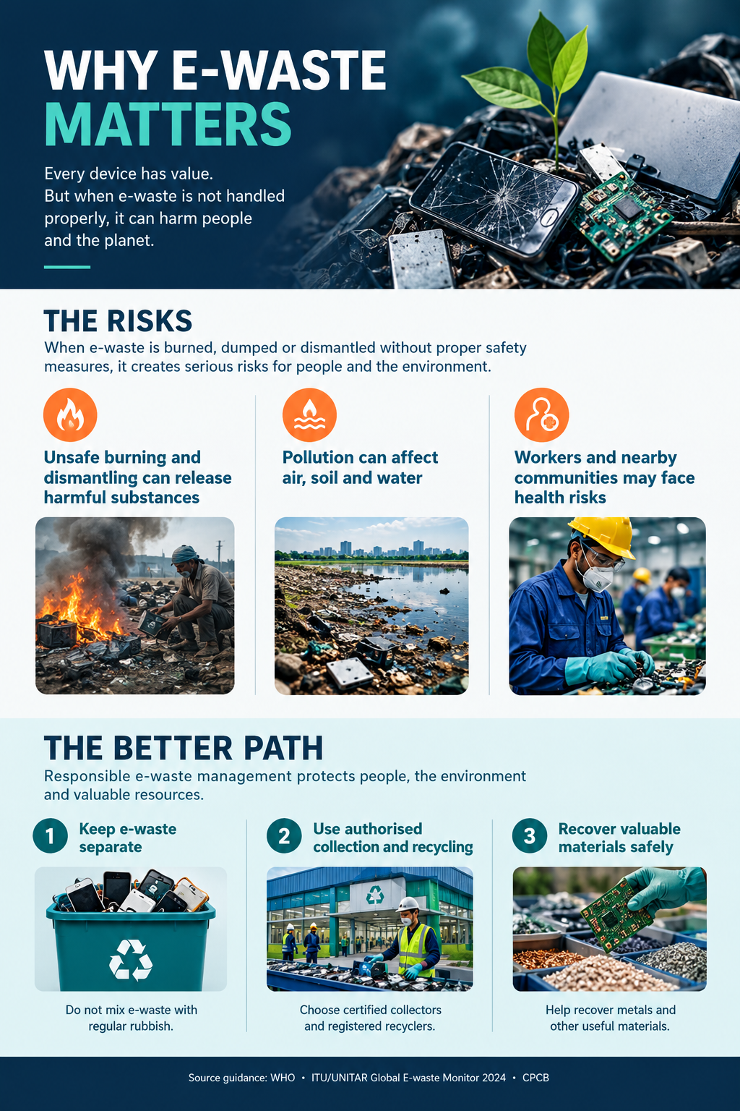
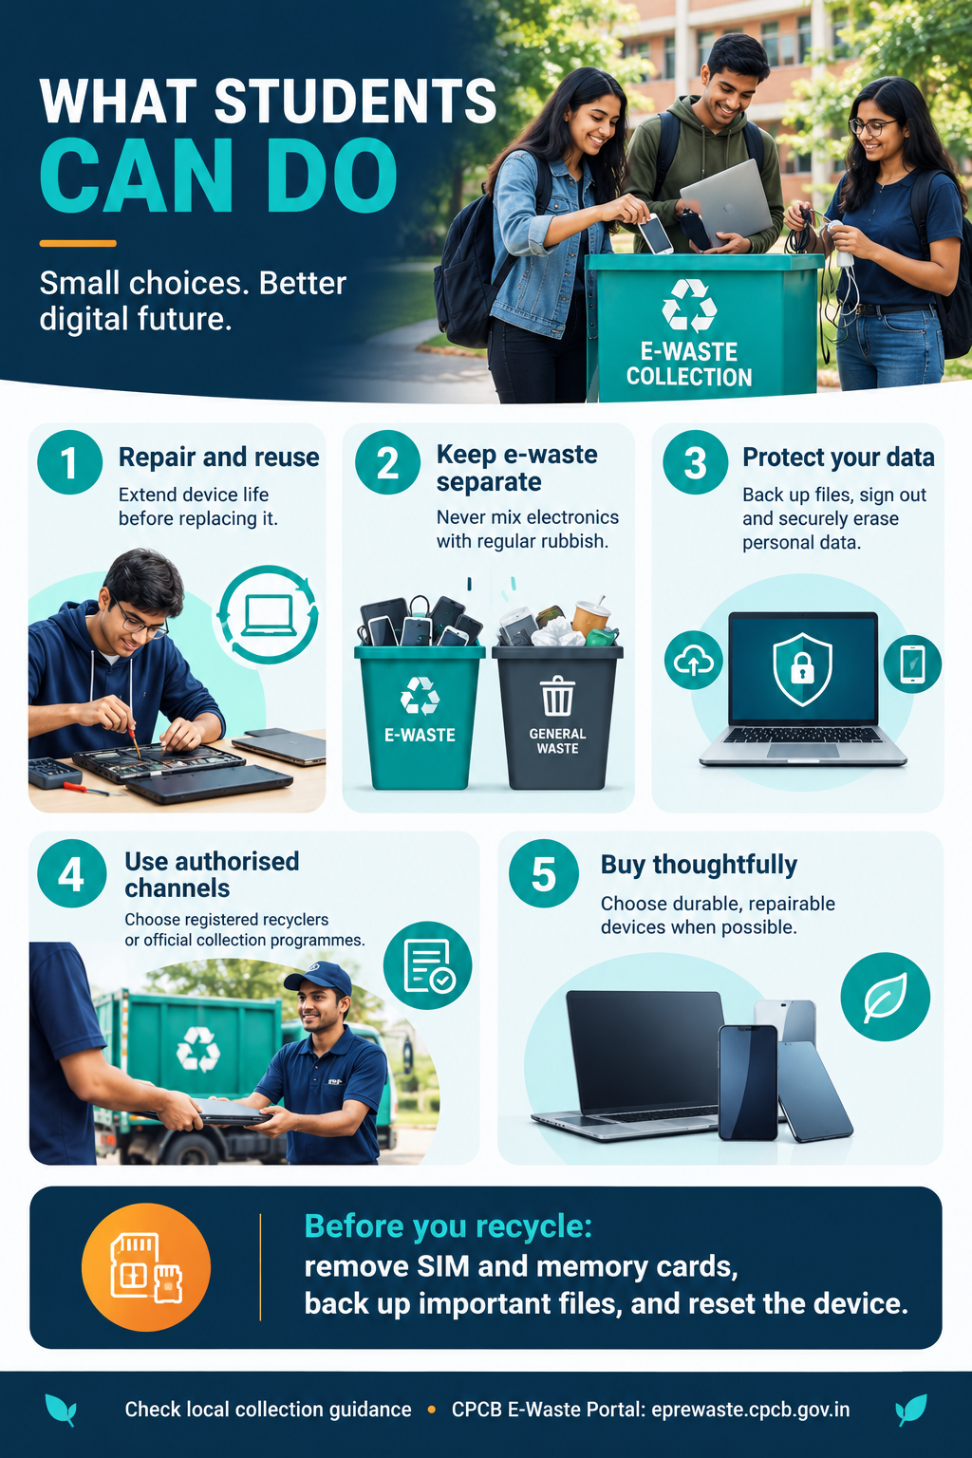
THE OUTPUT
Three infographics, one coordinated message
5
Notes:
These are coordinated mockup panels, not finished artwork. The three final infographic images should share the same facts, visual language, and accessibility checks.

Slide 6
METHOD
AI helps organize the work; verification stays essential
01
Topic selection
02
AI-assisted research
03
Official-source verification
04
Content summarisation
05
Prompt development
06
Infographic design
07
Alt-text and captions
08
Final quality check
ChatGPT (research planning, prompt development, summarisation, captions, and alt text); Microsoft Word/PowerPoint (documentation and presentation); CSV/spreadsheet tools (fact and source verification).
https://github.com/nithiyadharshini06-del/capstone-48-e-waste-india.git
Tools:
Repository:
AI may support research planning, summarisation, prompt refinement, source organization, visual concepts, captions, alt text, and consistency review. Figures, source labels, and alt text must match the final infographic exports.
6
Notes:
Frame AI as support for organising and communicating the work, not as a substitute for verification. Before submission, confirm the actual tools, repository URL, final figures, source labels, and alt text against the exported infographics.

Slide 7
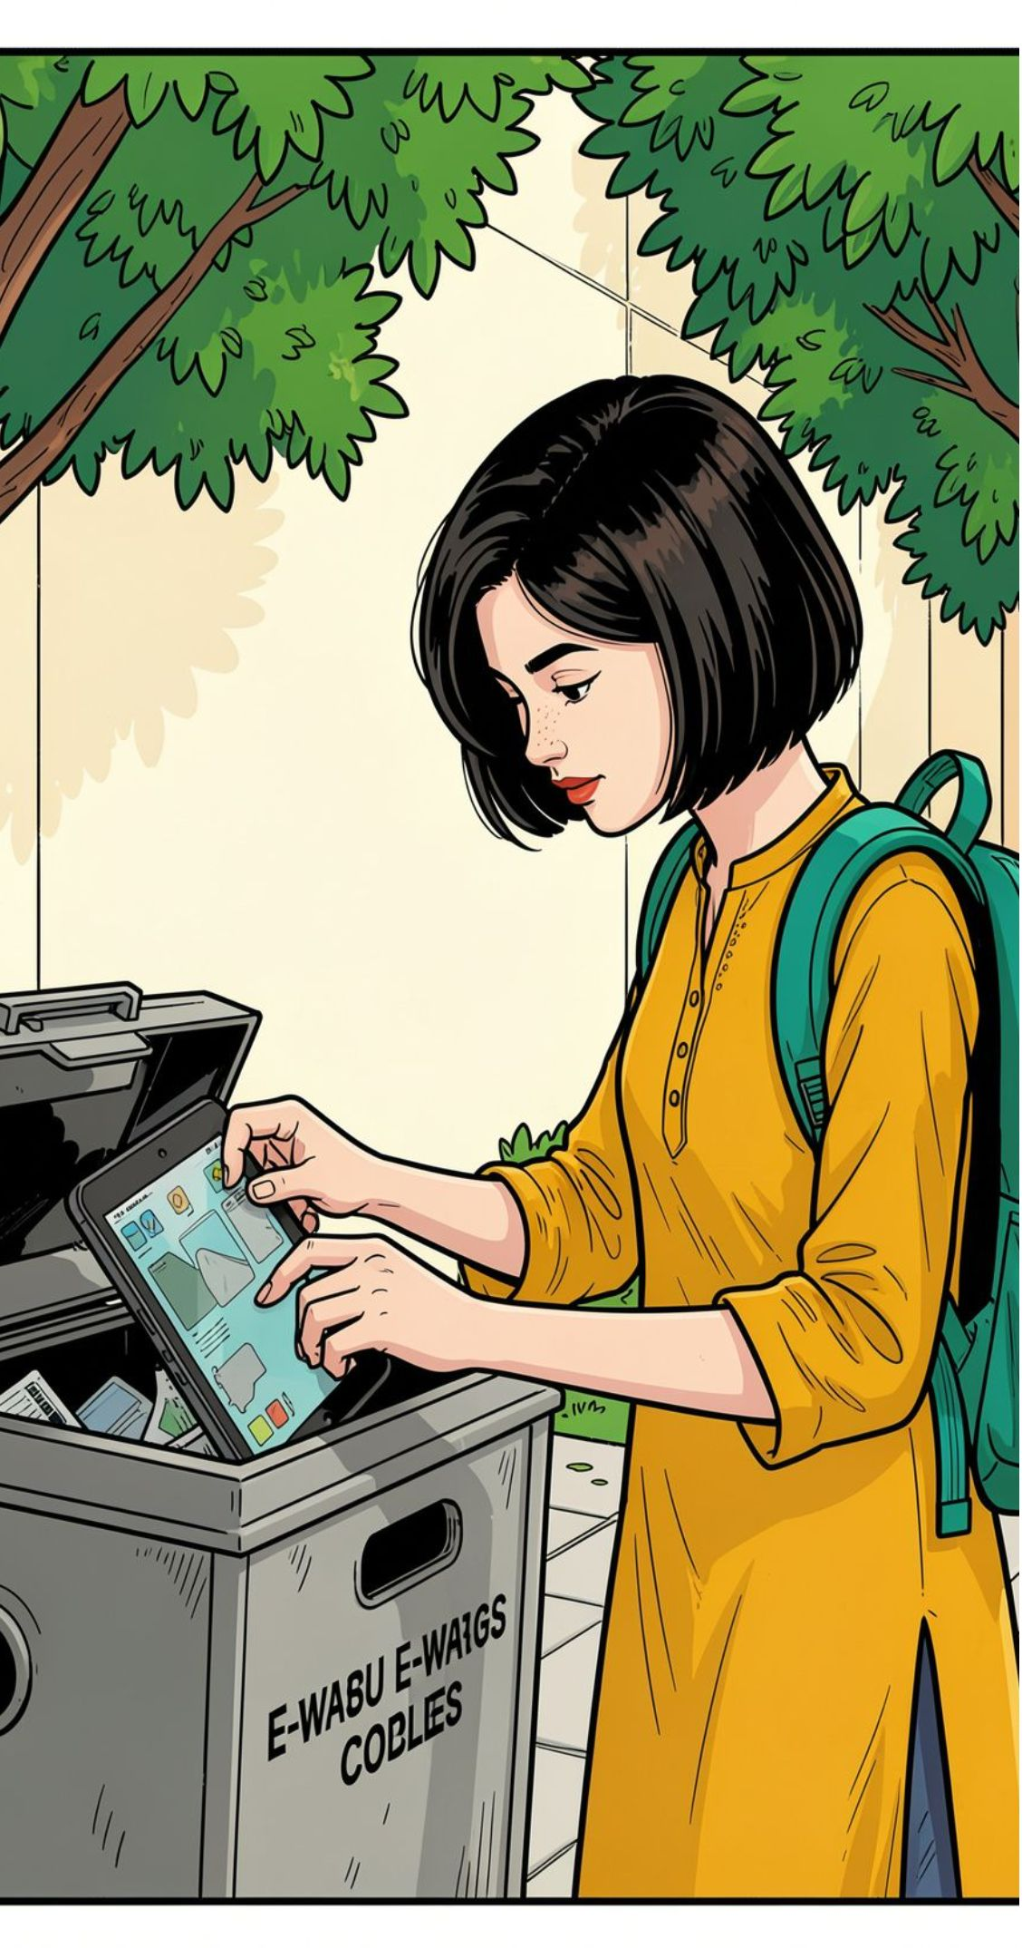
FINAL TAKEAWAY
Responsible disposal is the project’s final takeaway
Three educational infographic themes combine research, fact verification, visual communication, and accessibility to improve students’ understanding of e-waste and responsible disposal.
Limitations: verify every statistic against its original source; keep final graphics readable and accessible.
Next step: distribute infographics through college noticeboards, student groups, and campus awareness campaigns.
Use technology responsibly.
Keep e-waste out of the wrong places.
7
Sources: Government of India PIB · CPCB e-waste portal
Notes:
Close by returning to the practical message. The project is useful when the facts remain accurate, the graphics remain accessible, and students know what to do with their next old device.

