Slide 1
Policy Responses to Covid-19 Pandemic
Team: HeeJun Seo, Jaspreet Singh Bhamra, Nithiya Suresh

Slide 2
Topics covered
For our project we decided to work on the current “hot” topic in the world - COVID -19.
As much as covid is the hot topic, we didn’t want to give the standard graphs of the infected cases, death rates etc. Instead, we explored other areas related to Covid and how it has impacted our day to day lives.
Hence, we concluded that we would do the analysis on the new policy changes introduced in the country because of Covid and how the new policy changes has made any impact on total and new covid cases.

Slide 3
Policy changes for analysis
To make it easier, we have considered 7 countries for our analysis:
Australia, US, UK, India, China, South Korea and Brazil.
Below are some of the policies that was interesting to do a research and analysis on and give our inferences on the effect that each policy as they were introduced in each of the countries.
Covid data vs International travel restrictions.
Covid data vs income debt reliefs.
Covid data vs face coverings across.

Slide 4
Questions and data
How, introducing international travel restrictions, facial coverings and income support in each of the countries has impacted the Covid spreading.
We found data from the below website:
https://ourworldindata.org/covid-cases

Slide 5
Data Clean-up & Exploration
Collect data from the website, which has data of all the countries in the world.
Data range - Jan 2020 and June 2021.
Loaded data into jupyter notebook.
Removed the unnecessary rows which causes duplication.
Reduced the data to only the countries we are doing the analysis on.
Merged the covid data and the data each of us working on.
Finally plotted the graph based on the merged data.

Slide 6
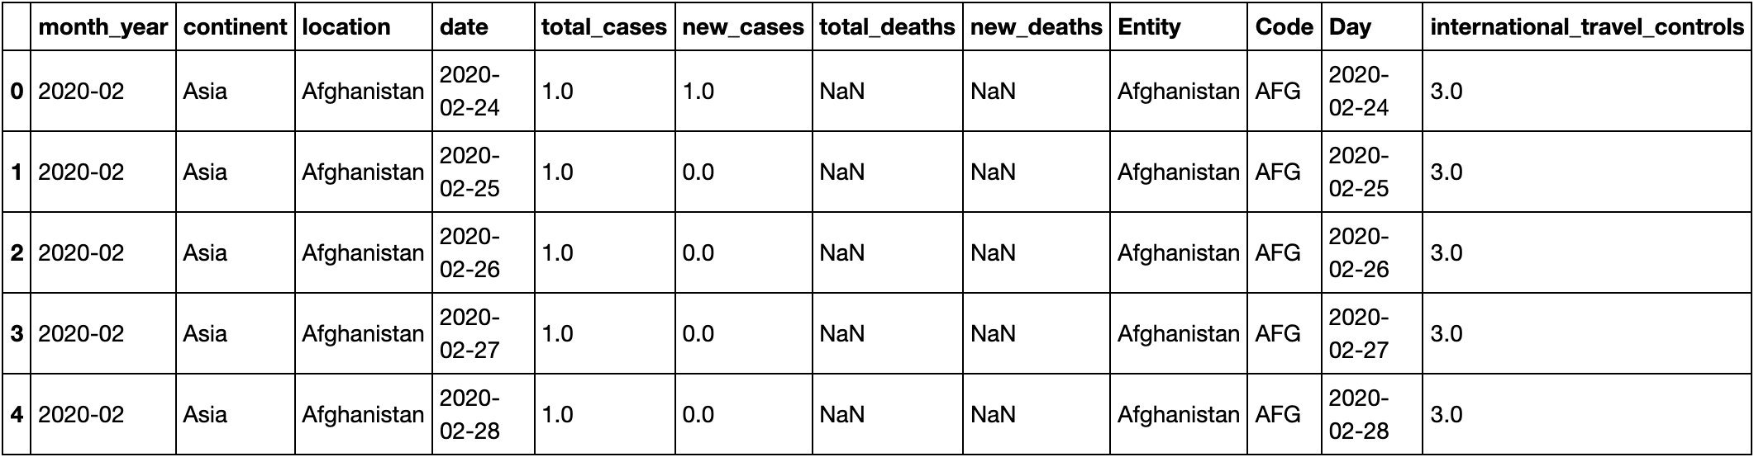
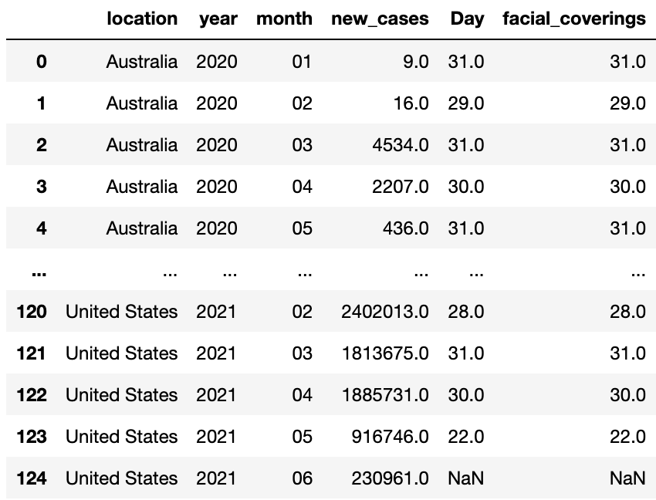
Sample data

Slide 7
New cases vs income support

Slide 8
New cases vs Travel restrictions

Slide 9
New cases vs face mask

Slide 10
Challenges, Discussions and Q&A

