Slide 1
Policy Responses to Covid-19 Pandemic
Team: HeeJun Seo, Jaspreet Singh Bhamra, Nithiya Suresh

Slide 2
Topics covered
For our project we decided to work on the current “hot” topic in the world - COVID -19.
As much as covid is the hot topic, we didn’t want to give the standard graphs of the infected cases, death rates etc. Instead, we explored other areas related to Covid and how it has impacted our day to day lives.
Hence, we concluded that we would do the analysis on the new policy changes introduced in the countries because of Covid and how the new policy changes has made any impact on total and new covid cases.

Slide 3
Policy changes for analysis
For our project, we have selected 7 countries:
Australia, US, UK, India, China, South Korea and Brazil.
We selected following policies to see their effect on Covid-19.
International Travel Restrictions.
Income Support.
Face Covering

Slide 4
Questions and data
How, introducing international travel restrictions, facial coverings and income support has impacted each country’s the Covid spreading.
We gathered data from https://ourworldindata.org/covid-cases

Slide 5
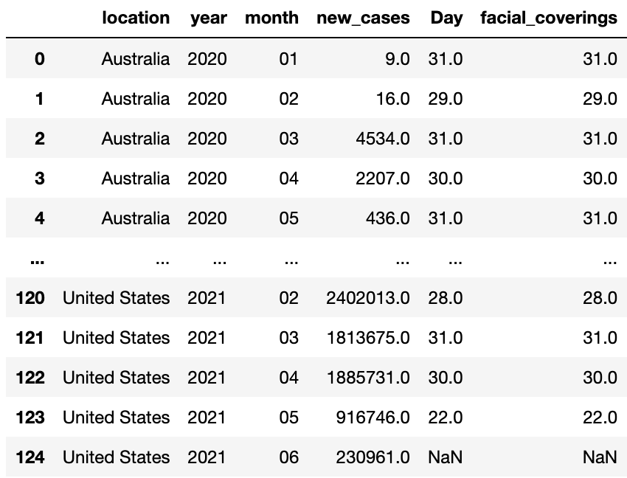
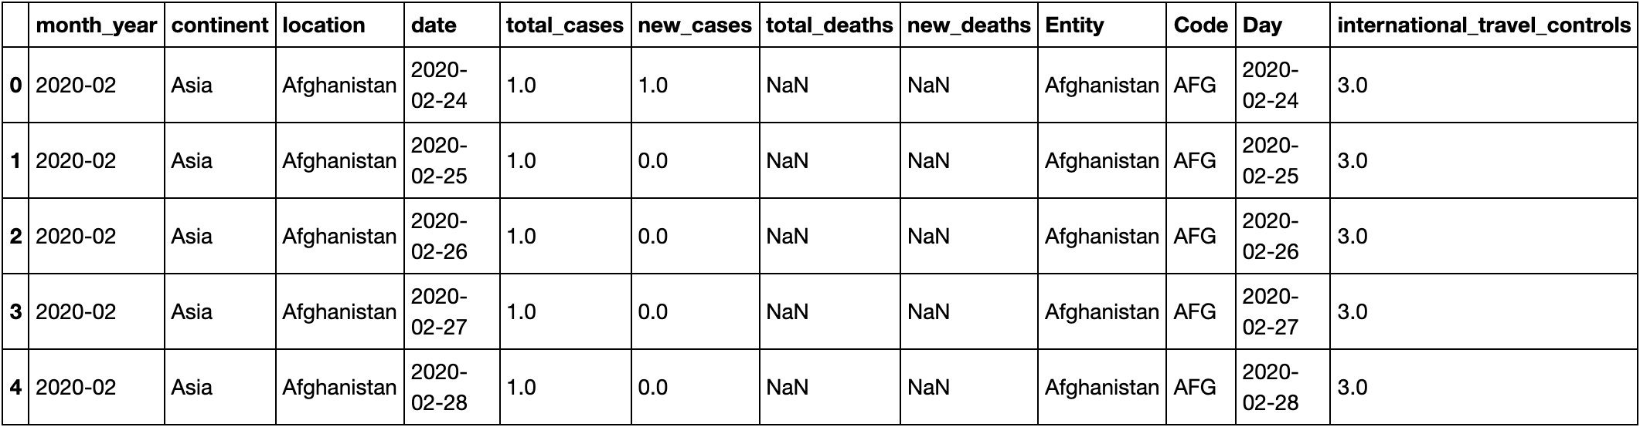
Sample data

Slide 6
Data Clean-up & Exploration
Gathered raw covid data and policy data for all the countries.
Data range - Jan 2020 and June 2021.
Loaded data into jupyter notebook.
Removed the unnecessary rows which causes duplication.
Reduced the data to only the countries we are doing the analysis on.
Merged the covid data and the data each of us working on.
Finally plotted the graph based on the merged data.

Slide 7
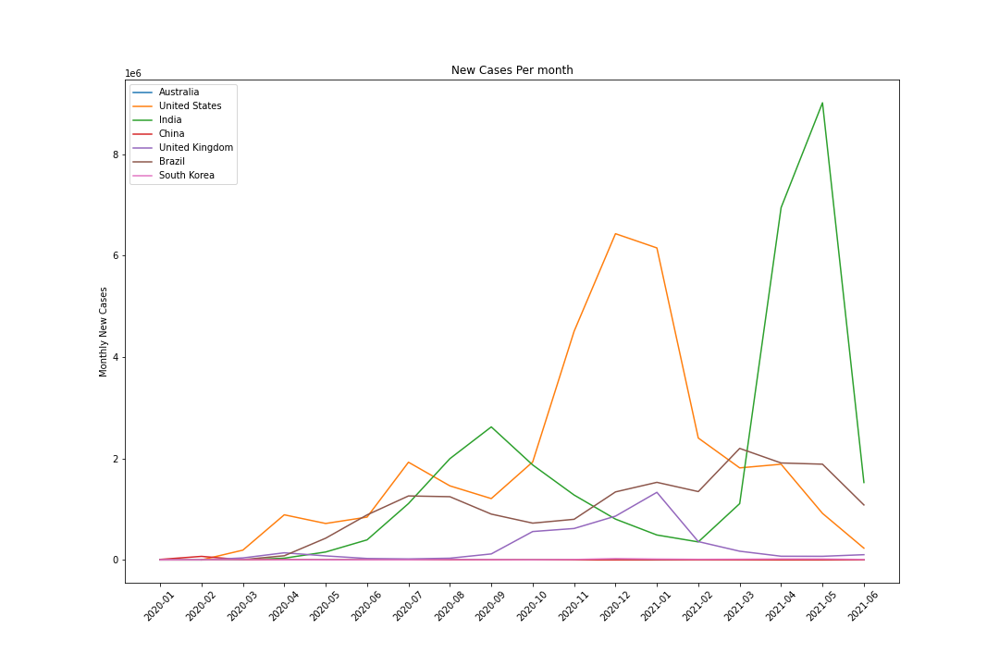
Monthly New cases In The Countries
Total New Cases : 85694948.0

Slide 8
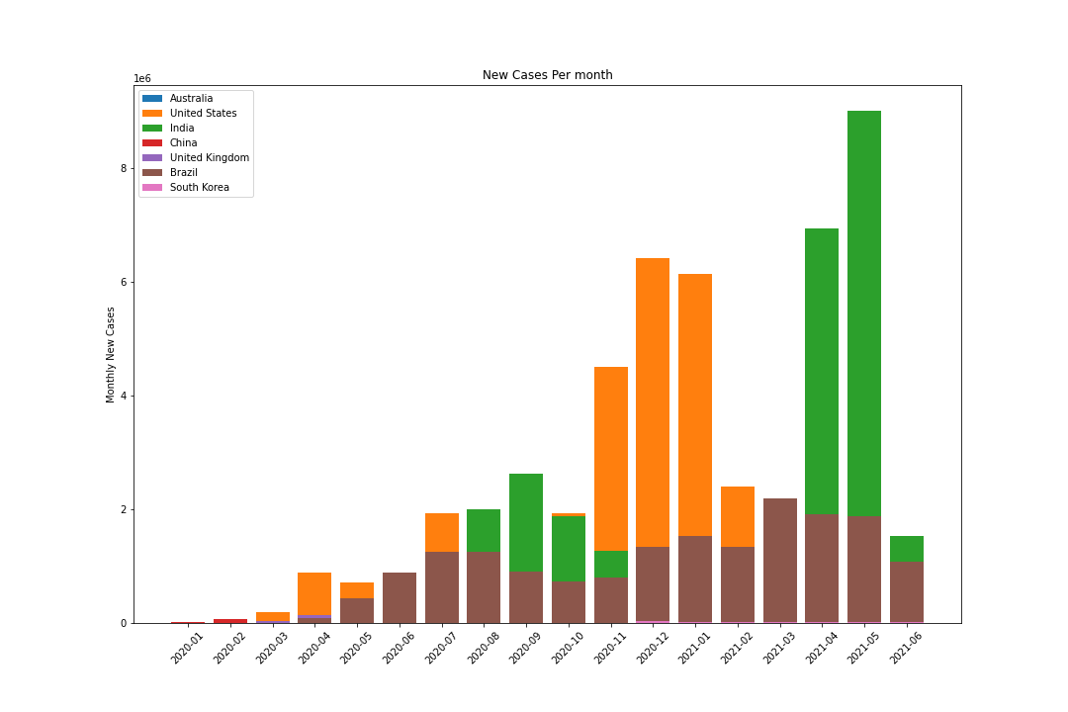
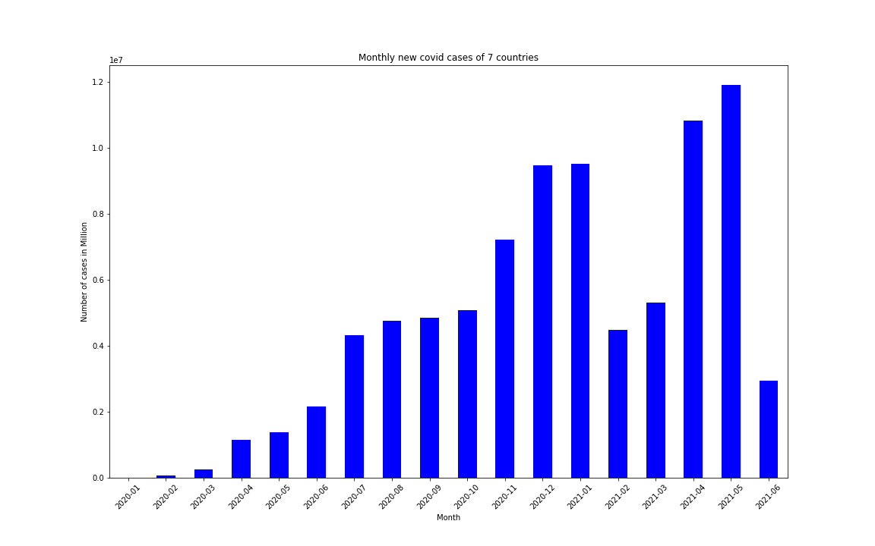
Monthly New Cases Per Country In Each Month
Monthly New Total cases

Slide 9
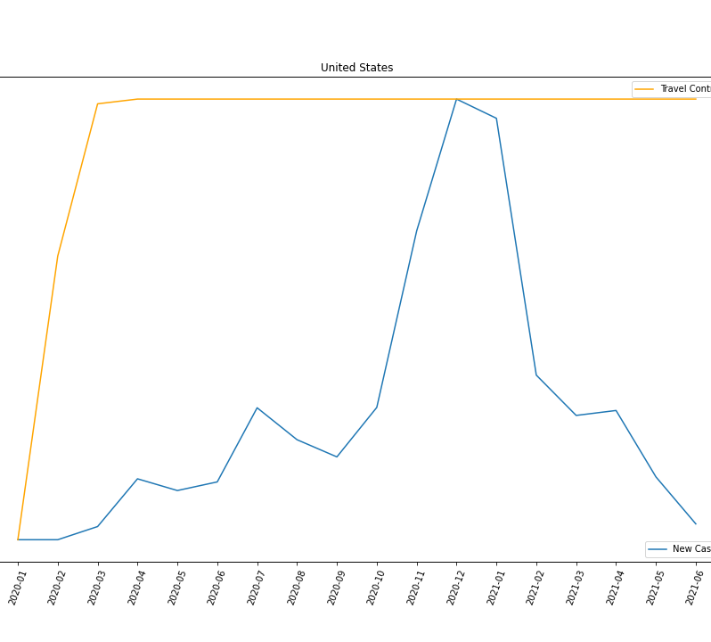
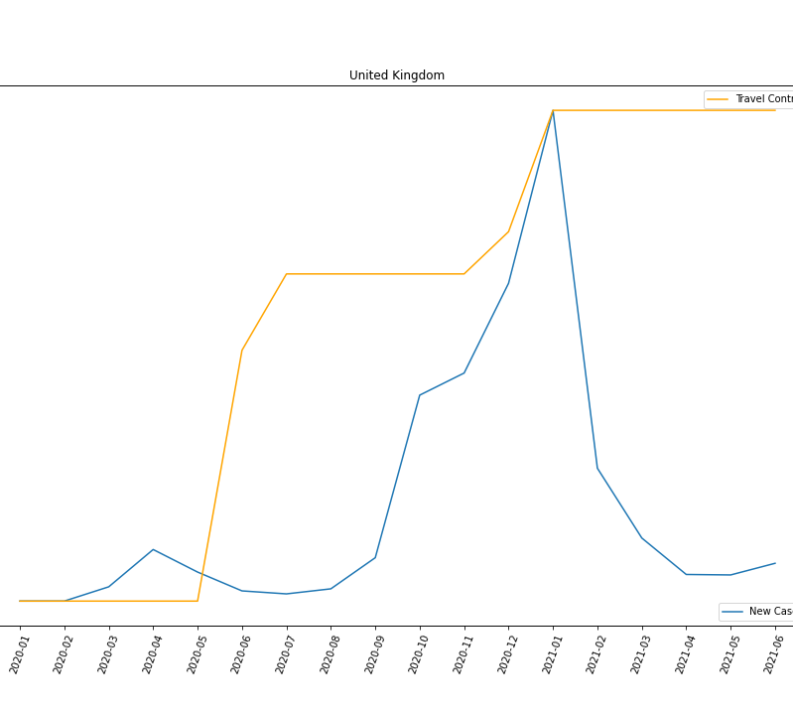
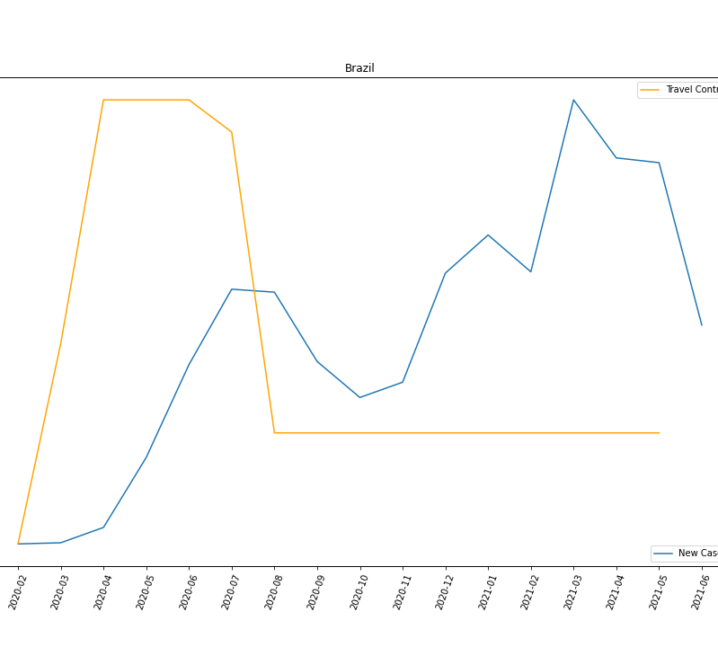
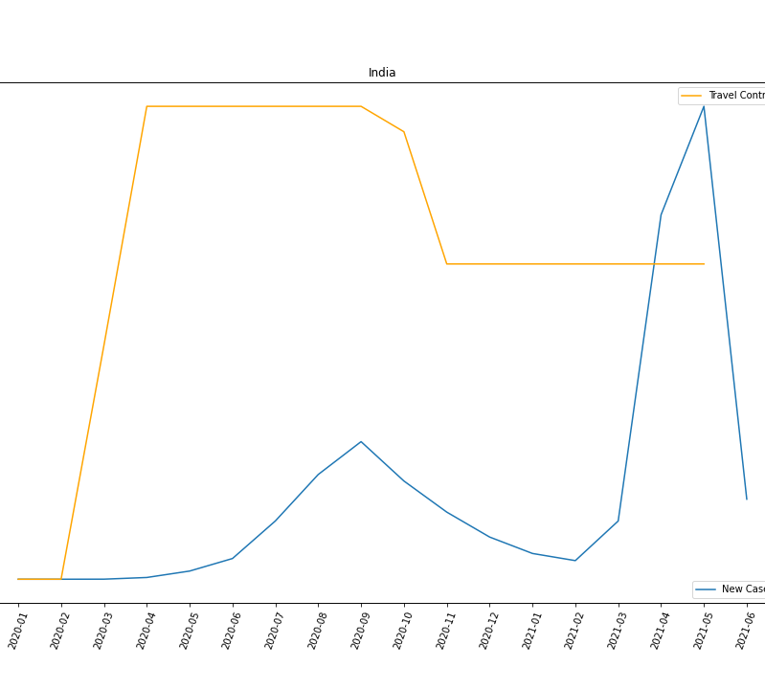
New Cases and International Travel Restrictions

Slide 10

Overall International travel Control
the restriction is not clearly indicating a decrease in the number of new cases, though the effort each government make may ease the number. The relationship between them is not corresponding each other.

Slide 11
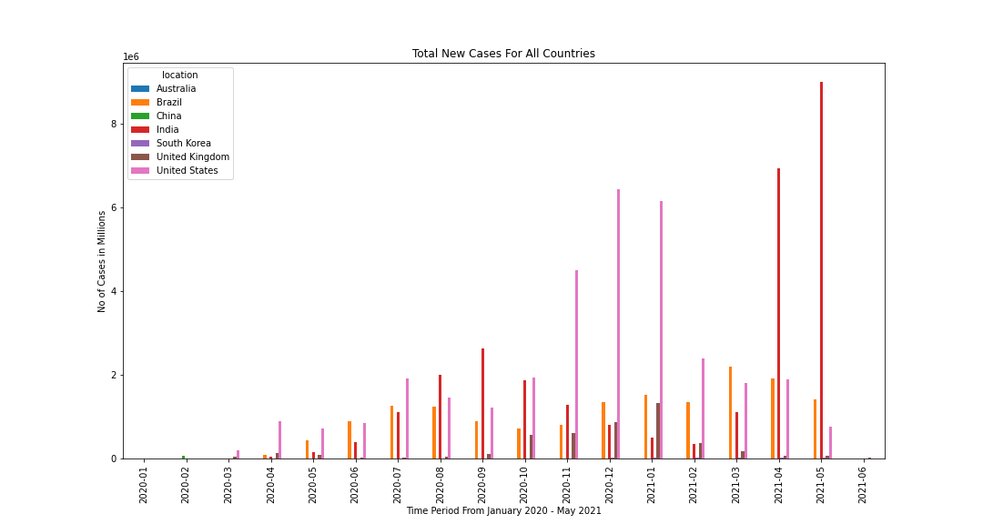
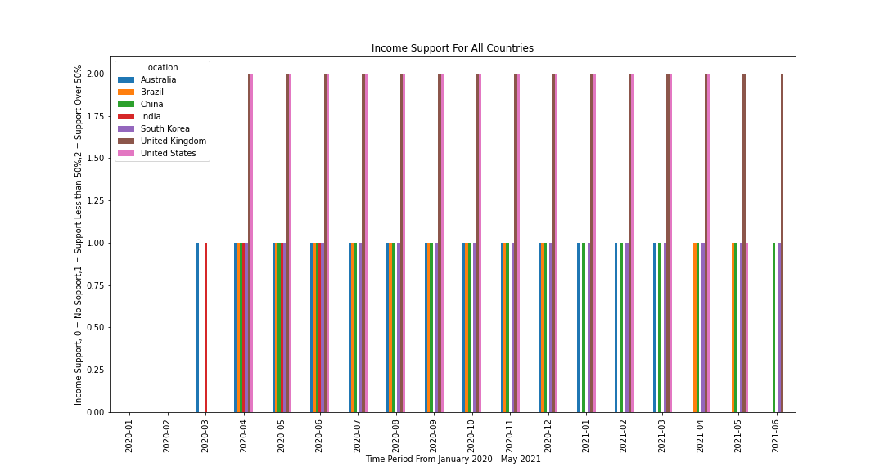
New Cases vs Income Support

Slide 12
Income Support effects on Covid spread
With the data given we can’t be sure that income support has positive effect on controlling covid spread.
In conjunction with face covering and travel restriction we could see the control on covid spread but this can’t be directly connected to income support

Slide 13


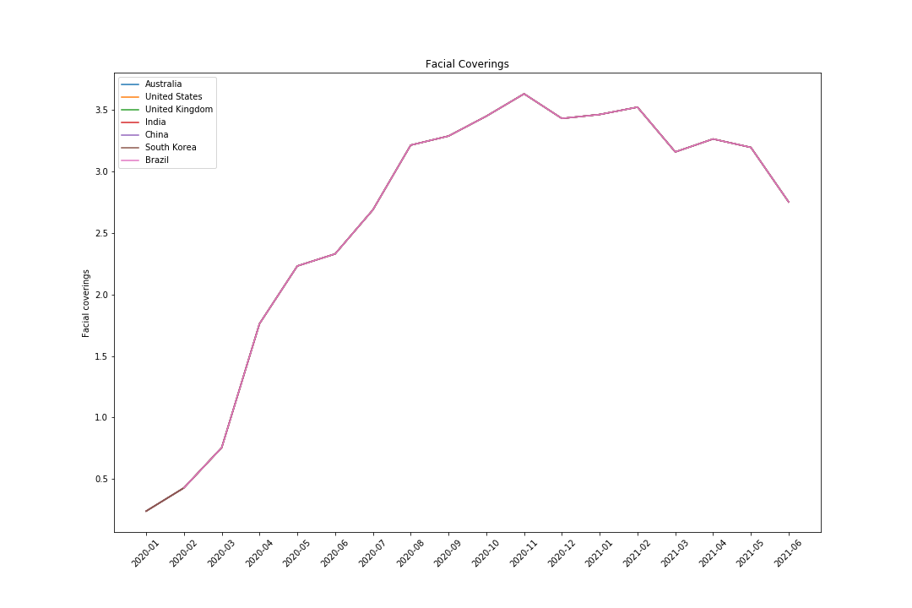
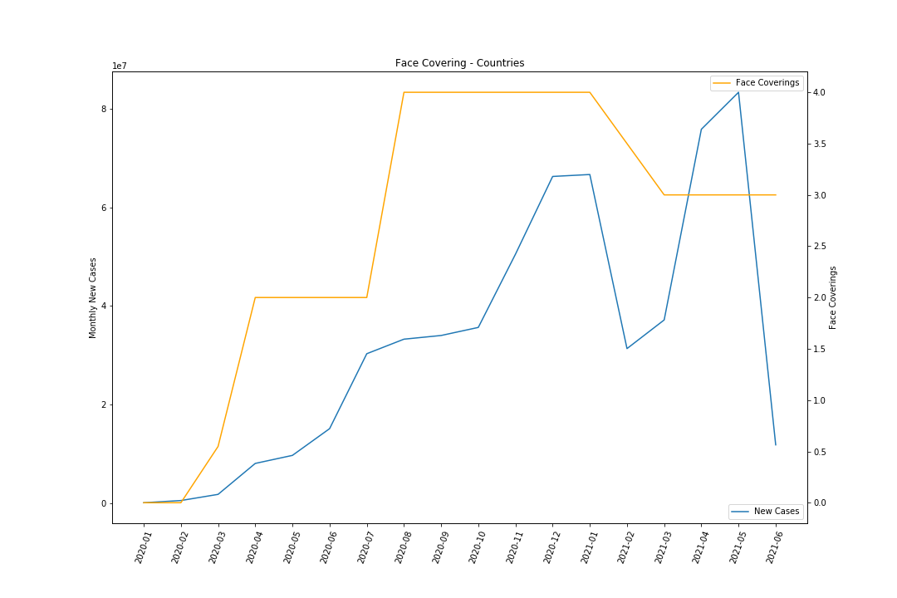
New Cases vs Face Covering

Slide 14
Face mask policy effects on covid spread
As covid started spreading the emphasis on face covering was mandatory in given countries.
Face covering doesn’t seem to have a direct impact on covid, it still is a protective measure.

Slide 15
Challenges, Discussions and Q&A
For all the comparison data the values were categorical.
To draw a direct comparison and effect was hard.
All questions welcome.

