Slide 1


Slide 2
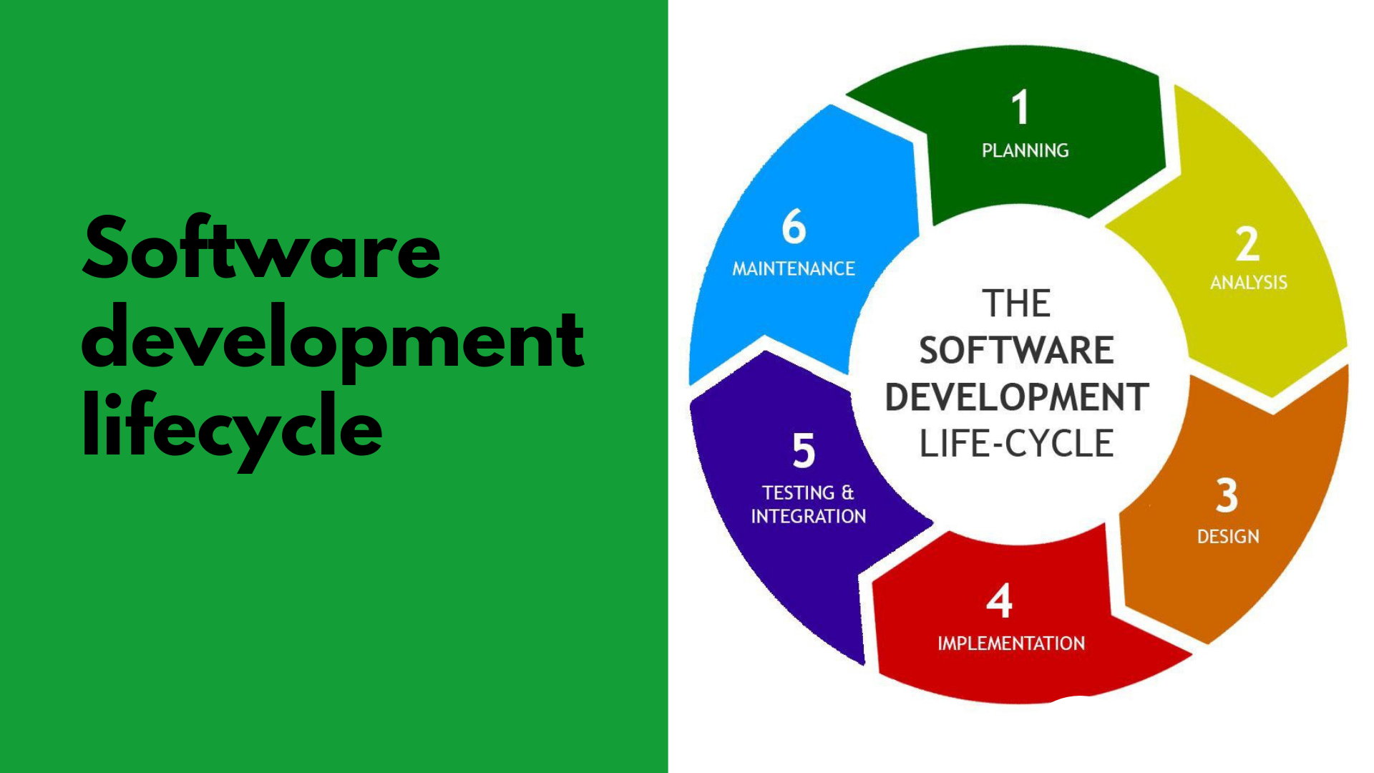

Slide 3
SDLC(Software Development Life Cycle) -SDLC is a structured process that enables the production of high-quality, low-cost software, in the shortest possible production time. -Goal is to produce superior software that meets and exceeds all customer expectations and demands.

Slide 4
-SDLC defines and outlines a detailed plan with stages, or phases, that each encompass their own process and deliverables. -Adherence to the SDLC enhances development speed and minimizes project risks and costs associated with alternative methods of production.

Slide 5
Why is SDLC important? -It provides a standardized framework that defines activities and deliverables -It aids in project planning, estimating, and scheduling -It makes project tracking and control easier -It increases visibility on all aspects of the life cycle to all stakeholders involved in the development process

Slide 6
-It increases the speed of development -It improves client relations -It decreases project risks -It decreases project management expenses and the overall cost of production

Slide 7
WATERFALL MODEL -The Waterfall Model was the first Process Model to be introduced. -It is also referred to as a linear-sequential life cycle model because it illustrates the software development process in a linear sequential flow. -It is very simple to understand and use. -The whole process of software development is divided into separate phases. -Any phase in the development process begins only if the previous phase is complete, the phases do not overlap. -The outcome of one phase acts as the input for the next phase sequentially.

Slide 8
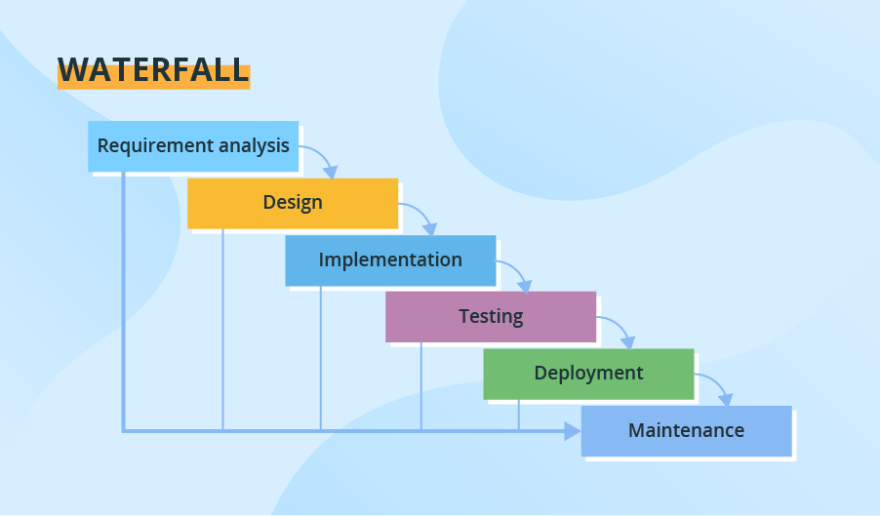

Slide 9
Requirements analysis and specification phase: -Understand the exact requirements of the customer and document them properly. -Both the customer and the software developer work together so as to document all the functions, performance, and interfacing requirement of the software. -It describes the "what" of the system to be produced and not "how." -A large document called Software Requirement Specification (SRS) document is created which contains a detailed description of what the system will do in the common.

Slide 10
Design Phase: -Aims to transform the requirements gathered in the SRS into a suitable form which permits further coding in a programming language. -It defines the overall software architecture together with high level and detailed design. -All this work is documented as a Software Design Document (SDD).

Slide 11
Implementation and unit testing: -Design is implemented. -If the SDD is complete, the implementation or coding phase proceeds smoothly, because all the information needed by software developers is contained in the SDD.

Slide 12
Integration and System Testing: -This phase is highly crucial as the quality of the end product is determined by the effectiveness of the testing carried out. -The better output will lead to satisfied customers, lower maintenance costs, and accurate results. -Unit testing determines the efficiency of individual modules. -The modules are tested for their interactions with each other and with the system.

Slide 13
Operation and maintenance phase: -Maintenance is the task performed by every user once the software has been delivered to the customer, installed, and operational.

Slide 14
Advantages: -Simple to implement also the number of resources that are required for it is minimal. -The requirements are simple and explicitly declared; they remain unchanged during the entire project development. -The start and end points for each phase is fixed, which makes it easy to cover progress. -The release date for the complete product, as well as its final cost, can be determined before development. -It gives easy to control and clarity for the customer due to a strict reporting system.

Slide 15
Disadvantages: -The risk factor is higher, so it is not suitable for more significant and complex projects. -It cannot accept the changes in requirements during development. -It becomes tough to go back to the phase.

Slide 16


Slide 17
AGILE MODEL :commitment to create software incrementally -AGILE is based on RAD model. -Agile model is the combination of iterative and incremental process models. -Designed to help a project to adapt to change requests quickly. -To facilitate quick project completion. -To accomplish this task agility is required. -Agility is achieved by fitting the process to the project, removing activities that may not be essential for a specific project. -Anything that is waste of time and effort is avoided.

Slide 18
-The requirements are decomposed into many small parts that can be incrementally developed. -The Agile model adopts Iterative development. -Each incremental part is developed over an iteration. -Each iteration is intended to be small and easily manageable and can be completed within a couple of weeks only. -At a time one iteration is planned, developed and deployed to the customers. -Long-term plans are not made.

Slide 19
-The time to complete an iteration is known as a Time Box. -Time-box refers to the maximum amount of time needed to deliver an iteration to customers. -The end date for an iteration does not change. -The central principle of the Agile model is the delivery of an increment to the customer after each Time-box.

Slide 20
-Agile offers users new versions, or releases, of software following brief periods of work. -Those brief periods of work are often called sprints.

Slide 21
Steps involve in agile SDLC models are: -Requirement gathering -Requirement Analysis -Design -Coding -Unit testing -Acceptance testing

Slide 22
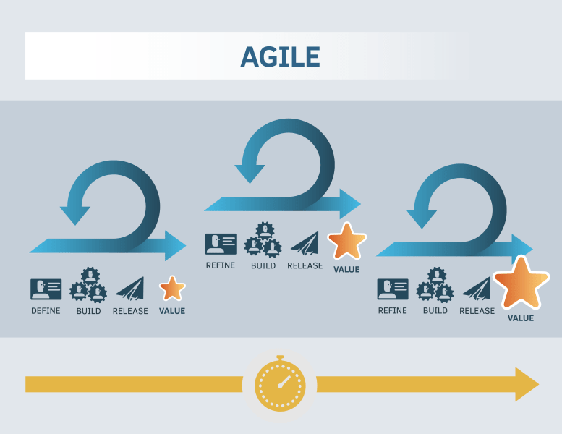

Slide 23
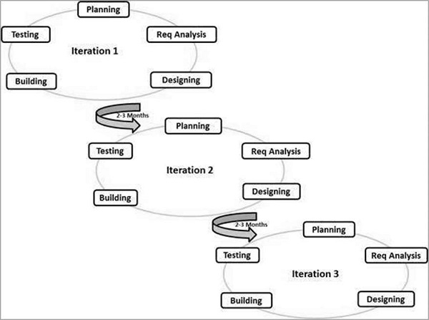
Graphical Illustration of Agile Development Model

Slide 24
The Agile Manifesto's purpose -Proponents of Agile methodologies say the four values outlined in the Agile Manifesto promote a software development process that focuses on quality by creating products that meet consumers' needs and expectations. -The 12 principles are intended to create and support a work environment that is focused on the customer, that aligns to business objectives and that can respond and pivot quickly as user needs and market forces change.

Slide 25
Four values of Agile The four core values of Agile software development as stated by the Agile Manifesto are: 1.Individuals and interactions over processes and tools. 2.Working software over comprehensive documentation. 3.Customer collaboration over contract negotiation. 4.Responding to change over following a plan.

Slide 26
The 12 principles articulated in the Agile Manifesto are: 1.Satisfying customers through early and continuous delivery of valuable work. 2.Breaking big work down into smaller tasks that can be completed quickly. 3.Recognizing that the best work emerges from self-organized teams. 4.Providing motivated individuals with the environment and support they need and trusting them to get the job done. 5.Creating processes that promote sustainable efforts. 6.Maintaining a constant pace for completed work. 7.Welcoming changing requirements, even late in a project.

Slide 27
8.Assembling the project team and business owners on a daily basis throughout the project. 9.Having the team reflect at regular intervals on how to become more effective, then tuning and adjusting behavior accordingly. 10.Measuring progress by the amount of completed work. 11.Continually seeking excellence. 12.Harnessing change for a competitive advantage.

Slide 28
Agile myths: 10: Agile has NO Planning 9: Agile has NO Documentation 8: There is No End to Development 7: There is NO Long-Term Planning 6: Daily Standup & Solutions 5: There are No Requirements Needed 4: There is No Focus on Quality 3: Agile is Faster 2: Agile is Better! 1: Agile Has No Structure

Slide 29
What are the three biggest challenges of Agile project management? -Resistance to change is a common pitfall. -Reluctant to try out new workflows. -Lack of support from management and team members.

Slide 30
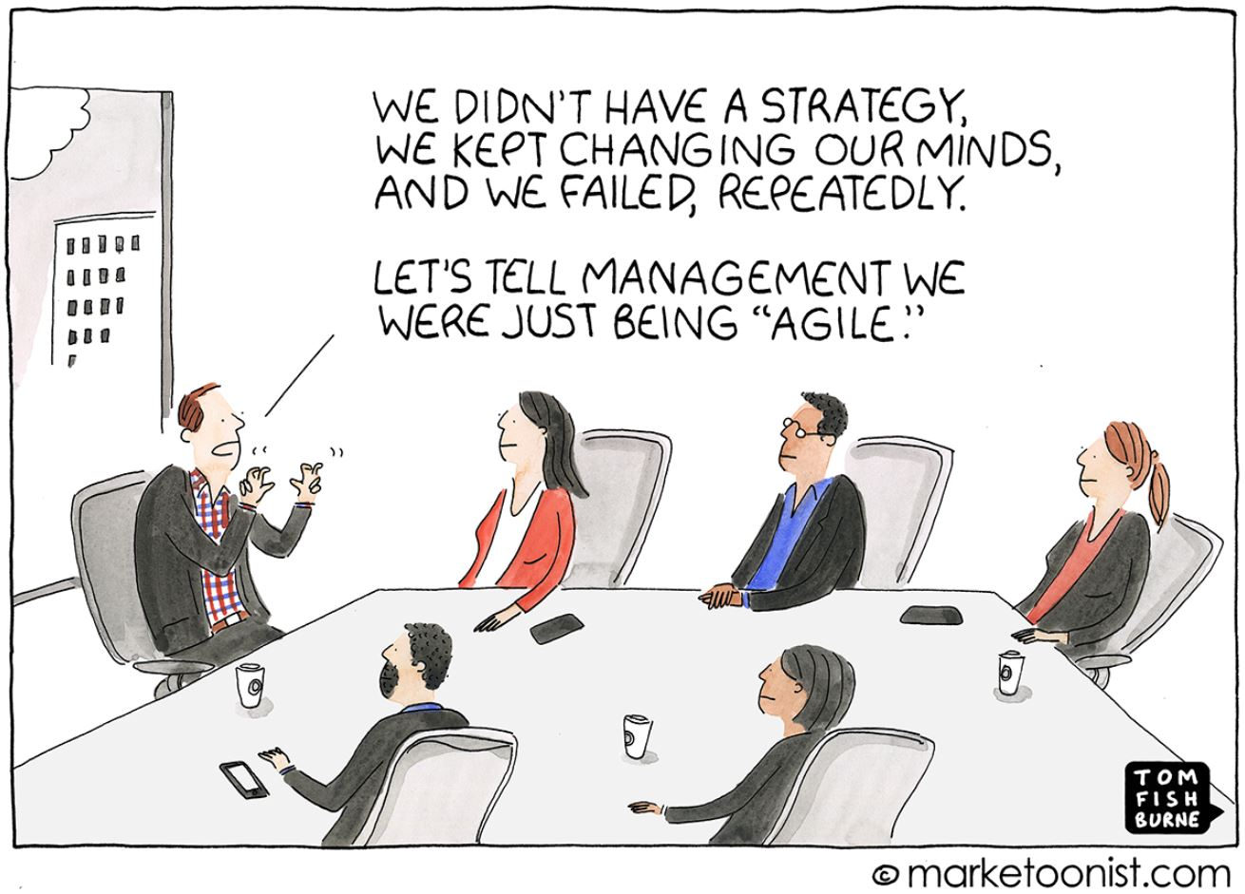

Slide 31
WHEN TO USE AGILE? It is best to use when a project has one or more of the following conditions: -Uncertainty Particularly in requirements and changing conditions -Complexity content, integration, stakeholder mgmt., solution -Innovation New technology, content or system -Urgent High priority, short timeline

Slide 32
When is project management considered truly Agile? -Transparency -Customer focus -Adaptability -Sense of ownership (shared leadership) Continuous improvement

Slide 33
Who uses Agile project management? -Originally created for software development. Other users: -Marketers -Universities -Military -Automotive industry Many organizations can benefit from Agile project management, and it’s simple to set up and utilize.

Slide 34
Agile’s Popular Methodologies Scrum: Characterized by cycles or stages of development, known as sprints, and by the maximization of development time for a software product. Kanban: A workflow management method that aims to visualize work and maximize efficiency. It exists on a board or table that is divided into columns that show every flow of the software product.

Slide 35
Extreme Programming (XP):- A methodology that takes good software development practices to the extreme. -Code reviews become pair programming; programmers constantly review each other’s code, -Unit testing applies to all code. -Extreme programming values a flat management structure and constant communication with both the client and within the programming team.

Slide 36
Lean Development: -Focuses on seven fundamental principles. -Deleting the things that do not matter, quality development, creating knowledge, differing commitments, fast delivery, respecting the team, and optimizing the whole. Crystal: A family of different agile methodologies that includes categories depending on the size of teams. Crystal clear (up to an 8-person team), crystal orange (20 to 50), and crystal red (50 to 1000) Focuses on delivering the best possible software development process.

Slide 37
Adaptive Project Framework (APF):- APF is the project management methodology where teams work in stages and analyze each one.

Slide 38
Advantages: -Working through Pair programming produce well written compact programs which have fewer errors as compared to programmers working alone. -It reduces total development time of the whole project. -Customer representatives get the idea of updated software products after each iteration. So, it is easy to change any requirement if needed.

Slide 39
Disadvantages: -Due to lack of formal documents, it creates confusion and important decisions taken during different phases; can be misinterpreted at any time by different team members. -Due to the absence of proper documentation, when the project completes and the developers are assigned to another project, maintenance of the developed project can become a problem.

Slide 40
Agile vs Waterfall -Waterfall is a Linear Sequential Life Cycle Model, whereas Agile is a continuous iteration of development and testing in the software development process. -The Agile methodology is known for its flexibility, whereas Waterfall is a structured software development methodology. -Agile follows an incremental approach, whereas the Waterfall is a sequential design process.

Slide 41
-Agile performs testing concurrently with software development, whereas in Waterfall methodology, testing comes after the “Build” phase. -Agile allows changes in project development requirements, whereas Waterfall has no scope of changing the requirements once the project development starts.

Slide 42
What Is a User Story? -A user story is a short, informal, plain language description of what a user wants to do within a software product to gain something they find valuable. -Smallest unit of work in an Agile setting. - User stories are a key tool in incremental development. User stories typically follow the role-feature-benefit pattern: As a [type of user], I want [an action] so that [a benefit/value]

Slide 43


Slide 44
SCRUM(RUGBY:TEAM WORK) -A lightweight, iterative, and incremental framework for developing, delivering, and sustaining complex products. -Designed for teams of ten or fewer members. -Work is broken into goals that can be completed within time-boxed iterations, called sprints. -Scrum framework is heuristic; it’s based on continuous learning and adjustment to fluctuating factors.

Slide 45
-Acknowledges that the team doesn’t know everything at the start of a project and will evolve through experience. - Scrum is founded on empiricism and lean thinking. -Empiricism asserts that knowledge comes from experience and making decisions based on what is observed. -Lean thinking reduces waste and focuses on the essentials.

Slide 46
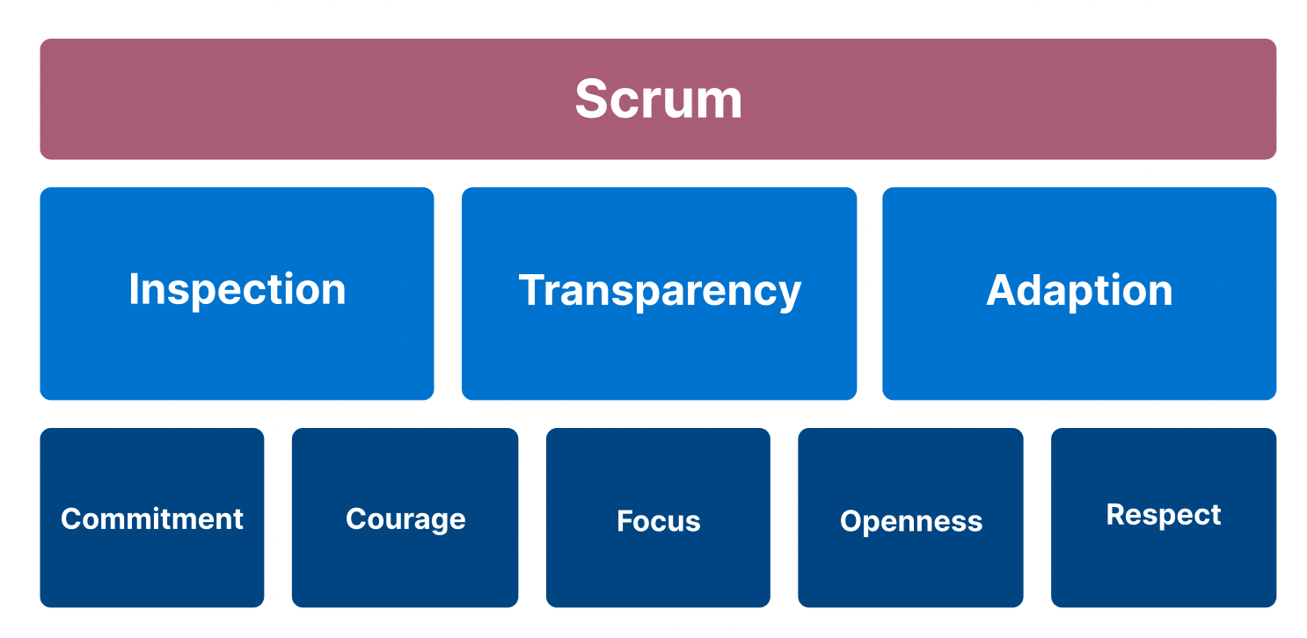

Slide 47
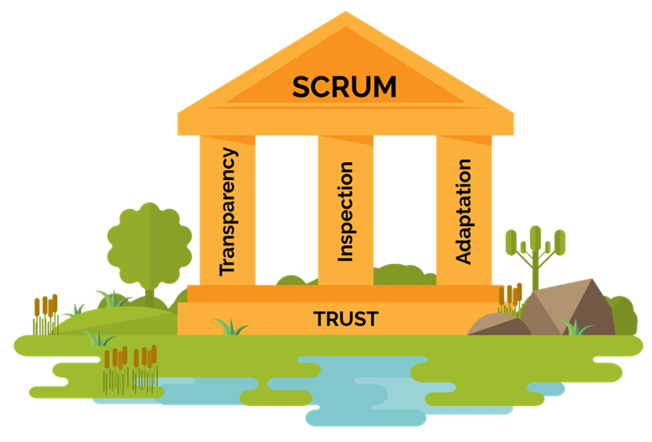
Scrum - 3 pillars

Slide 48
Transparency -Emergent process and work must be visible to those performing the work as well as those receiving the work. -Important decisions are based on the perceived state of its three formal artifacts. -Artifacts that have low transparency can lead to decisions that diminish value and increase risk. -Transparency enables inspection. -Inspection without transparency is misleading and wasteful.

Slide 49
Inspection -The Scrum artifacts and the progress toward agreed goals must be inspected frequently and diligently to detect. potentially undesirable variances or problems. -Inspection enables adaptation. -Inspection without adaptation is considered pointless.

Slide 50
Adaptation -If any aspects of a process deviate outside acceptable limits or if the resulting product is unacceptable, the process being applied or the materials being produced must be adjusted. -The adjustment must be made as soon as possible to minimize further deviation. -A Scrum Team is expected to adapt the moment it learns anything new through inspection.

Slide 51
Five Scrum Values -Commitment -Focus -Openness -Respect -Courage

Slide 52
Commitment -The scrum value of commitment is essential for building an agile culture. -Scrum teams work together as a unit. -Teams trust each other to follow through on what they say they are going to do. -When team members aren’t sure how work is going, they ask. -Agile teams only agree to take on tasks they believe they can complete, so they are careful not to overcommit.

Slide 53
Courage -The Scrum value of courage is critical to an agile team’s success. -Scrum teams must feel safe enough to say no, to ask for help, and to try new things.

Slide 54
Focus -The scrum value of focus is one of the best skills scrum teams can develop. -Focus means that whatever scrum teams start they finish. -Agile teams are relentless about limiting the amount of work in process .

Slide 55
Respect -Scrum team members demonstrate respect to one another. -Strength lies in collaboration. -Everyone has a distinct contribution to make toward completing the work of the sprint. -Respect each other’s ideas. -Give each other permission to have a bad day once in a while, and recognize each other’s accomplishments.

Slide 56
Scrum Team -The Scrum Team consists of one Scrum Master, one Product Owner, and Developers. -Typically 10 or fewer people. -A cohesive unit of professionals focused on one objective at a time, the Product Goal. -Scrum Teams are cross-functional, the members have all the skills necessary to create value each Sprint. -Responsible for all product-related activities from stakeholder collaboration, verification, maintenance, operation, experimentation, research and development, and anything else that might be required.

Slide 57
Developers: Developers are the people in the Scrum Team who are committed to create any aspect of a usable Increment each Sprint. Developers are always accountable for: ● Creating a plan for the Sprint, the Sprint Backlog ● Instilling quality by adhering to a Definition of Done ● Adapting their plan each day toward the Sprint Goal ● Holding each other accountable as professionals.

Slide 58
Scrum Master: Accountable for establishing Scrum as defined in the Scrum Guide. The Scrum Master serves the Scrum Team in following ways: ● Coaching the team members in self-management and cross-functionality. ● Helping the Scrum Team focus on creating high-value Increments that meet the Definition of Done. ● Causing the removal of impediments to the Scrum Team’s progress. ● Ensuring that all Scrum events take place and are positive, productive, and kept within the timebox.

Slide 59
The Scrum Master serves the Product Owner in following ways: ● Helping find techniques for effective Product Goal definition and Product Backlog management. ● Helping the Scrum Team understand the need for clear and concise Product Backlog items. ● Helping establish empirical product planning for a complex environment. ● Facilitating stakeholder collaboration as requested or needed.

Slide 60
The Scrum Master serves the organization in following ways: ● Leading, training, and coaching the organization in its Scrum adoption. ● Planning and advising Scrum implementations within the organization. ● Helping employees and stakeholders understand and enact an empirical approach for complex work. ● Removing barriers between stakeholders and Scrum Teams.

Slide 61
Scrum Events -The Sprint is a container for all other events. -Each event in Scrum is a formal opportunity to inspect and adapt Scrum artifacts. -These events are specifically designed to enable the transparency required. -Failure to operate any events as prescribed results in lost opportunities to inspect and adapt.

Slide 62
Sprint -Sprints are the heartbeat of Scrum, where ideas are turned into value. -They are fixed length events of one month or less to create consistency. -A new Sprint starts immediately after the conclusion of the previous Sprint. -All the work necessary to achieve the Product Goal, including Sprint Planning, Daily Scrums, Sprint Review, and Sprint Retrospective, happen within Sprints.

Slide 63
During the Sprint: ● No changes are made that would endanger the Sprint Goal ● Quality does not decrease. ● The Product Backlog is refined as needed. ● Scope may be clarified and renegotiated with the Product Owner as more is learned.

Slide 64
-Each Sprint may be considered a short project. -Sprints enable predictability by ensuring inspection and adaptation of progress toward a Product Goal. -Various practices exist to forecast progress, like burn-downs, burn-ups, or cumulative flows. -A Sprint could be cancelled if the Sprint Goal becomes obsolete. -Only the Product Owner has the authority to cancel the Sprint.

Slide 65
Sprint Planning -Sprint Planning initiates the Sprint by laying out the work to be performed for the Sprint. -Resulting plan is created by the collaborative work of the entire Scrum Team. -Product Owner ensures that attendees are prepared to discuss the most important Product Backlog items and how they map to the Product Goal.

Slide 66
Topic One: Why is this Sprint valuable? -The Product Owner proposes how the product could increase its value and utility in the current Sprint. -The whole Scrum Team then collaborates to define a Sprint Goal that communicates why the Sprint is valuable to stakeholders. -The Sprint Goal must be finalized prior to the end of Sprint Planning.

Slide 67
Topic Two: What can be Done in this Sprint? -Through discussion with the Product Owner, the Developers select items from the Product Backlog to include in the current Sprint. -Scrum Team may refine these items during this process, which increases understanding and confidence. -Selecting how much can be completed within a Sprint may be challenging. -The more the Developers know about their past performance, their upcoming capacity, and their Definition of Done, the more confident they will be in their Sprint forecasts.

Slide 68
Topic Three: How will the chosen work get done? -For each selected Product Backlog item, the Developers plan the work necessary to create an Increment that meets the Definition of Done. -Done by decomposing Product Backlog items into smaller work items of one day or less.

Slide 69
-The Sprint Goal, the Product Backlog items selected for the Sprint, plus the plan for delivering them are together referred to as the Sprint Backlog. -Sprint Planning is timeboxed to a maximum of eight hours for a one-month Sprint.

Slide 70
Daily Scrum The purpose of the Daily Scrum is to : -Inspect progress toward the Sprint Goal. -Adapt the Sprint Backlog as necessary, adjust the upcoming planned work. *The Daily Scrum is a 15-minute event for the Developers of the Scrum Team. *To reduce complexity, it is held at the same time and place every working day of the Sprint. *Daily Scrum focuses on progress toward the Sprint Goal and produces an actionable plan for the next day of work. *This creates focus and improves self-management. *Daily Scrums improve communications, identify impediments, promote quick decision-making, & consequently eliminate the need for other meetings.

Slide 71
Sprint Review -To inspect the outcome of the Sprint and determine future adaptations. -The Scrum Team presents the results of their work to key stakeholders. -Progress toward the Product Goal is discussed. -Review what was accomplished in the Sprint and what has changed in their environment. -Based on this information, attendees collaborate on what to do next. -The Product Backlog may also be adjusted to meet new opportunities. -Second to last event of the Sprint. -Timeboxed to a maximum of four hours for a one-month Sprint.

Slide 72
Sprint Retrospective -Used to plan ways to increase quality and effectiveness. -Scrum Team inspects how the last Sprint went with regards to individuals, interactions, processes, tools, and their Definition of Done. -Inspected elements often vary with the domain of work. -Assumptions that led them astray are identified and their origins explored. -The Scrum Team discusses what went well during the Sprint, what problems it encountered, and how those problems were solved.

Slide 73
-The Scrum Team identifies the most helpful changes to improve its effectiveness. -The most impactful improvements are addressed as soon as possible. -They may even be added to the Sprint Backlog for the next Sprint. -The Sprint Retrospective concludes the Sprint. -It is timeboxed to a maximum of three hours for a one-month Sprint.

Slide 74
Scrum Artifacts -Scrum’s artifacts represent work or value. -Designed to maximize transparency of key information. -Each artifact contains a commitment to ensure it provides information that enhances transparency and focus against which progress can be measured. ● For the Product Backlog it is the Product Goal. ● For the Sprint Backlog it is the Sprint Goal. ● For the Increment it is the Definition of Done.

Slide 75
Product Backlog:"what is needed, ordered by when it is needed“ -Visible to everyone in team. -An emergent, ordered list of what is needed to improve the product. -A breakdown of work to be done. -An ordered list of product requirements maintained by team for a product. -Product owner is responsible for managing and maintaining the product backlog items. Product Goal is the long-term objective for the Scrum Team.

Slide 76
Sprint Backlog -The subset of items from the product backlog intended for developers to address in the upcoming sprint. -A plan by and for the Developers. -Highly visible, real-time picture of the work that the Developers plan to accomplish during the Sprint in order to achieve the Sprint Goal. -Sprint Backlog is updated throughout the Sprint as more is learned. -It should have enough details so as to inspect progress in the Daily Scrum. -Commitment: Sprint Goal- single objective for the Sprint.

Slide 77
Increment -An Increment is a concrete stepping stone toward the Product Goal. -Each Increment is additive to all prior Increments and thoroughly verified, ensuring that all Increments work together. -The sum of the Increments is presented at the Sprint Review. -Work can be considered as part of an Increment only if it meets the Definition of Done. Commitment: Definition of Done

Slide 78
Definition of Done: -A formal description of the state of the Increment when it meets the quality measures required for the product. -The moment a Product Backlog item meets the Definition of Done, an Increment is born. -Creates transparency by providing everyone a shared understanding of what work was completed as part of the Increment. -If a Product Backlog item does not meet the Definition of Done, it cannot be released or even presented at the Sprint Review. -Developers are required to conform to the Definition of Done.

Slide 79
Burndown chart -Publicly displayed chart showing remaining work. ⁻ Updated every day, it provides quick visualizations for reference. - horizontal axis of the burndown chart shows the days remaining, while the vertical axis shows the amount of work remaining each day. - During sprint planning, the ideal burndown chart is plotted. - During the sprint, developers update the chart with remaining work so the chart is updated day by day, showing a comparison between actual and predicted.

Slide 80
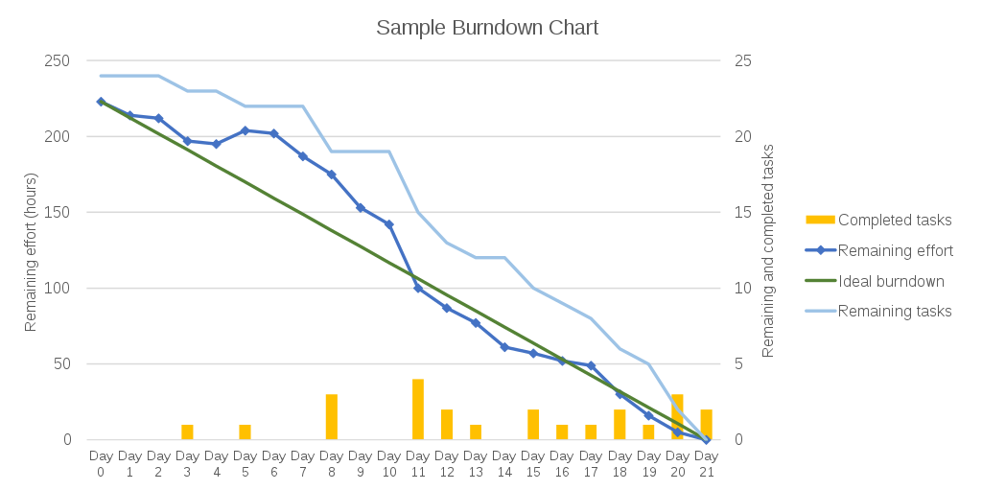
BURNDOWN CHART

Slide 81
Impediment Logs -A single Impediment Log for a Scrum Master to manage. -The process used to create, monitor and maintain the Impediments Log are: Record Prioritize Publish Address Communicate

Slide 82
VELOCITY:

