Slide 1
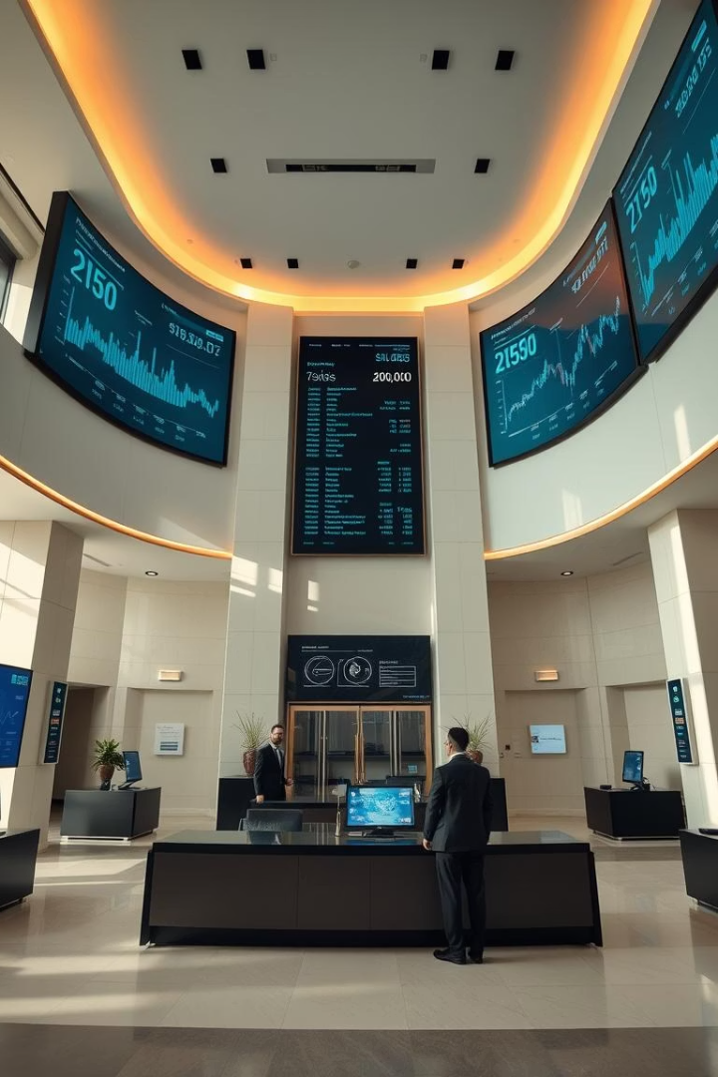
Finance Loan Data Analytics Project
A Performance Monitoring and Insights Report
By S. Nithujan

Slide 2

Addressing Operational Monitoring Gaps
Current systems lack comprehensive loan operation oversight, hindering proactive management.
Current Challenge
Project Objective
Limited visibility into loan performance.
Develop a dynamic grid view report.
Difficulty in real-time portfolio assessment.
Categorize by real-time loan status.
Enable data-driven decision-making.

Slide 3




Key Performance Indicators for Loan Health
Our project focuses on critical KPIs to evaluate loan portfolio health and identify trends.
Loan Application Metrics
Financial Ratios
Total applications received.
Average interest rates.
Funded and received amounts.
Debt-to-Income (DTI) ratio.
Trend Analysis
Month-to-Date (MTD) performance.
Month-over-Month (MoM) growth.

Slide 4





Understanding Loan Performance Metrics
A detailed look at the core KPIs driving our loan portfolio analysis.
Total Loan Applications
Total Funded Amount
Total Amount Received
Volume of new requests.
Capital disbursed to borrowers.
Repayments collected from loans.
Average DTI Ratio
Borrower financial health indicator.
These metrics provide a holistic view of both origination and repayment performance, crucial for risk assessment.

Slide 5
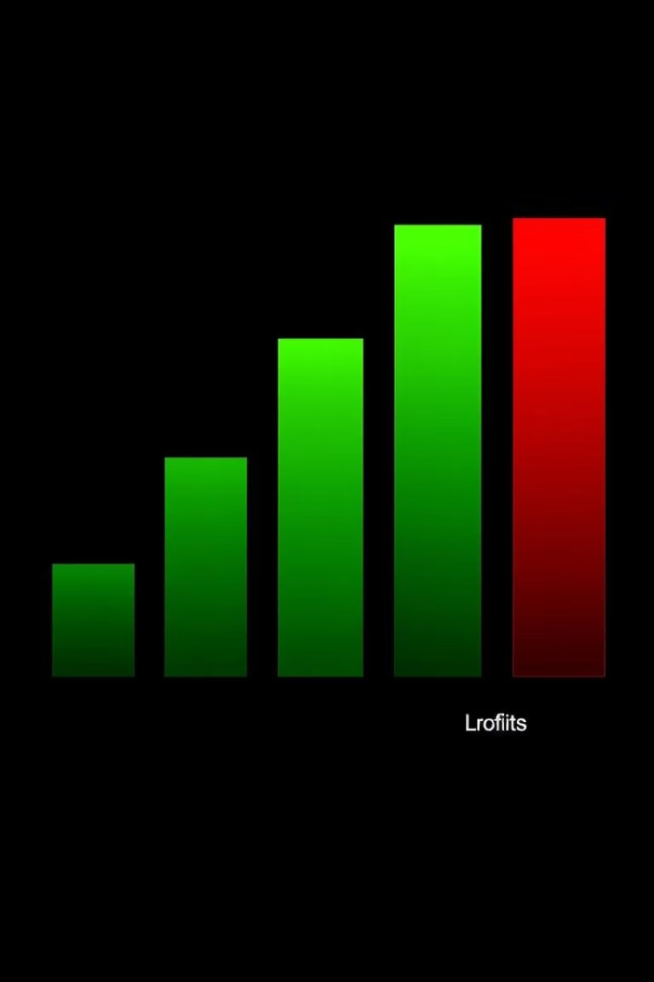
Distinguishing Loan Quality
Analyzing key differences between performing and non-performing loans.
Good Loans
High application approval percentage.
Consistent application counts.
Steady funded and received amounts.
Bad Loans
Lower application approval rates.
Fluctuating application volumes.
Irregular funded and received amounts.

Slide 6
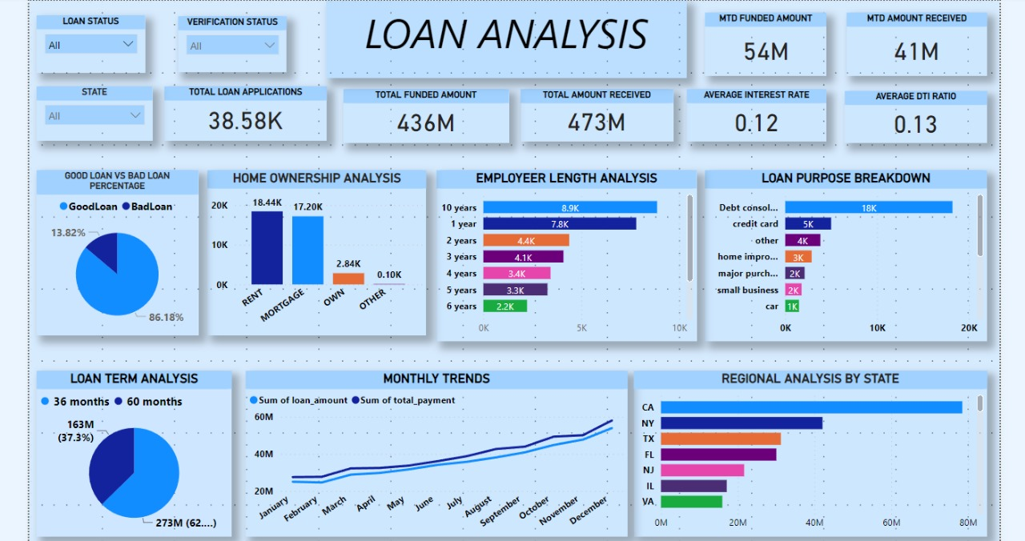
Interactive KPI Dashboard Insights
A visual representation from our Power BI dashboard provides a quick overview of key performance indicators.
The dashboard enables rapid identification of performance, trends, and potential anomalies.

Slide 7
Analyzing Monthly Loan Trends
The line chart illustrates the monthly progression of funded and received amounts, highlighting performance fluctuations.

Slide 8
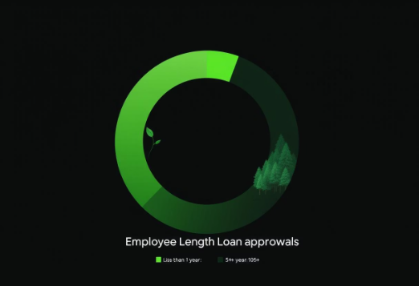
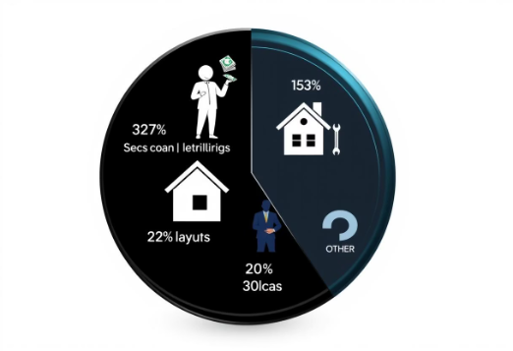
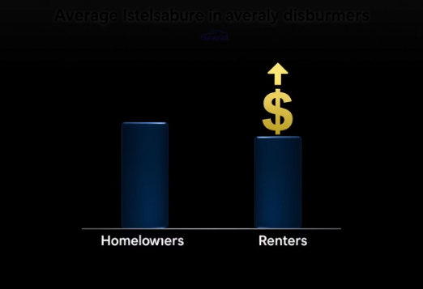
Borrower and Loan Term Analysis
Understanding borrower demographics and loan terms provides deeper insights into portfolio risk.
Employee Length Impact
Loan Purpose Breakdown
Home Ownership Effect
Job tenure affects loan approval rates.
Common reasons for loan applications.
Influence on loan disbursement amounts.

