Slide 1
Digital Portfolio
STUDENT NAME: NITHIYA SRI
REGISTER NO AND NMID: 212406218/ FA8990A3C6E04E0A91C43920D341C7A0
DEPARTMENT: BCA COMPUTER APPLICATION
COLLEGE: MANGALAM COLLAGE OF ARTS AND SCIENCE

Slide 2
PROJECT TITLE
Interactive digital portfolio using front end development

Slide 3


AGENDA
Problem Statement
Project Overview
End Users
Tools and Technologies
Portfolio design and Layout
Features and Functionality
Results and Screenshots
Conclusion
Github Link
3/21/2024 Annual Review

Slide 4

PROBLEM STATEMENt
Students (academic projects, resumes).Job seekers (to share with recruiters).Freelancers (to show clients).Professionals (to highlight experience and achievements).
Github:Portfolio - NITHYA

Slide 5

PROJECT OVERVIEW
HTMLStructure (pages, sections).CSS Styling (colors, layouts, responsiveness).JavaScript Interactivity (navigation menu, animations, form validation)Mention code editor (VS Code) or CODEPEN and hosting platform (GitHub Pages)JavaScript Interactivity (mobile navigation menu toggle)

Slide 6

WHO ARE THE END USERS?
Students often forget or misplace project records. A portfolio website serves as a personal
archive, keeping everything accessible in one place.

Slide 7

TOOLS AND TECHNIQUES
● Project Summary:
A responsive digital portfolio website created to serve as a personal showcase platform.
● Includes:
○ About Me
○ Education
○ Skills
○ Certificates
○ Contact Form
● Main Objective:
To effectively present personal achievements, technical skills, and projects in a structured and
accessible format.

Slide 8
POTFOLIO DESIGN AND LAYOUT
• Home
• About Me
• Skills
• Projects
• Achievements
• Contact
• Responsive navigation with hamburger menu
•Responsive layout (mobile ,desktop view)
8

Slide 9
FEATURES AND FUNCTIONALITY
• Responsive navigation bar with hamburger menu for mobile view
• Skills section displayed using simple list
•Certificates section displayed in grid format
• Contact details with email,-phone number
• Footer copyright

Slide 10
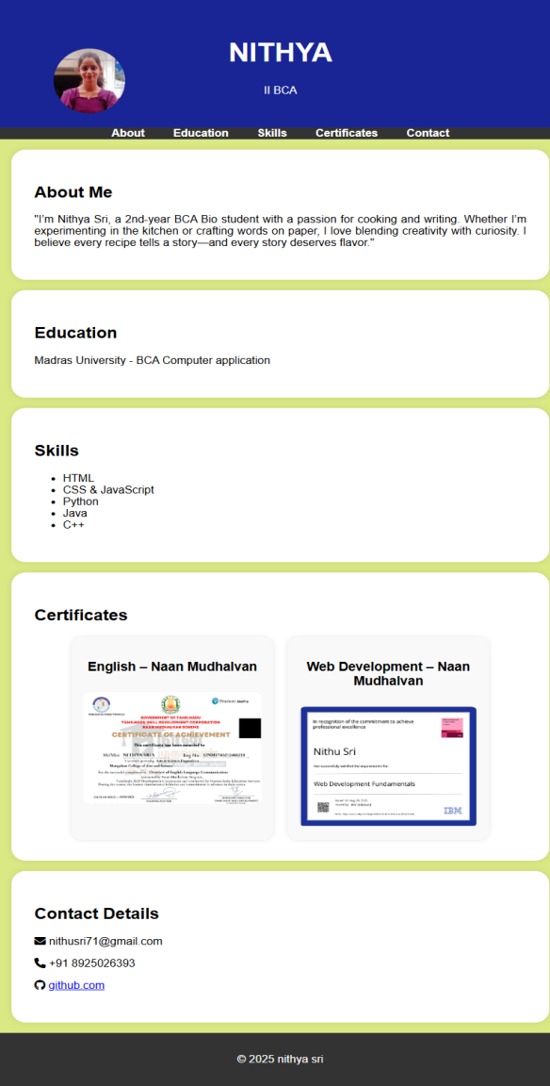
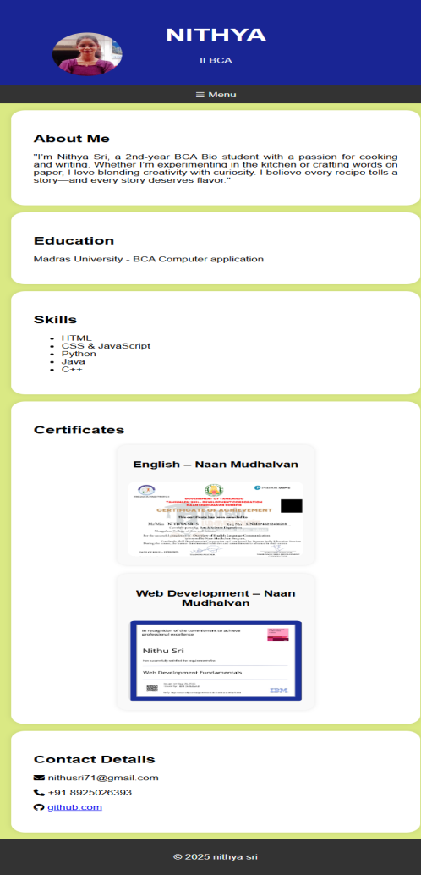

RESULTS AND SCREENSHOTS
Mobile view
Desktop view
3/21/2024 Annual Review
10

Slide 11
CONCLUSION
The portfolio demonstrates how a structured layout can showcase both academic and personal
interests. It provides easy navigation, responsive viewing, and a clean user experience.
11

