Slide 1
Recipe AI – Smart Ingredient based Recipe finder
Name : NITHUVARSHINI K
Date : 24.09.2025

Slide 2
• Problem description
Difficulty in deciding what to cook with limited available ingredients.
Manual recipe search is time-consuming and frustrating.
Recipes online often don’t match ingredients at home, forcing extra purchases.
Leads to food wastage when unused ingredients expire.
• Importance of the problem
Leads to food wastage when unused ingredients expire.
Optimizes cost efficiency by reducing the need to buy extra items.
Busy lifestyles make traditional recipe searching inefficient and impractical.
• Who is affected
Students & working professionals – who have limited time and random ingredients.
Home cooks struggling to decide what to cook daily
People with budget constraints who want to maximize ingredient use.

Slide 3
OBJECTIVES
• Clear goals
Provide personalized recipe suggestions based on ingredients users already have.
Reduce food wastage by recommending recipes that use available ingredients.
Enable quick decision-making for users with limited time.
Integrate AI reasoning to explain why a recipe is suggested.
Provide ingredient match percentage to prioritize best-fit recipes.
• Expected outcomes
Users can find recipes quickly without searching manually.
Reduction in unused ingredients at home.
Users can save and revisit favorite recipes.
AI provides transparent reasoning behind recipe matches.

Slide 4
• Existing solutions
Cookbooks & printed guides – physical recipe books organized by cuisine, diet, or occasion.
Youtube & video tutorials – people watch cooking videos and pick recipes manually.
Popular recipe apps (Allrecipes, Yummly, Tasty) - suggest recipes based on keyword search or pre-set filters.
• Their limitations
Limited ingredient reasoning – most apps just match keywords, not combinations.
No personalized AI suggestions – minimal adaptation to user preferences.
Overwhelming choices – many recipes, but no smart ranking or match score.
Lack of reasoning/explanation – users don’t know why a recipe is recommended.
• Improvement areas
Dynamic AI scoring – rank recipes based on ingredient match, cooking time, and diet preferences, not just keyword search.
Reasoning transparency – show why a recipe fits, helping users make smarter choices.
Creative substitutions – suggest viable ingredient alternatives to maximize pantry utilization.

Slide 5
APPROACH
• Tools and technologies
Front End – HTML , CSS , JavaScript
Data handling and Storage – Local storage , JSON
• Step-by-step approach
User Input: Collect available ingredients, optional filters (cuisine, diet, cooking time).
Normalize Data: Convert ingredients and filter values to lowercase for consistency.
Filter Recipes: Apply cuisine, diet, and time filters to the recipe dataset.
Match Ingredients: Compare user ingredients with recipe ingredients using sets.
Score Recipes: Calculate match percentage and generate reasoning/hints.
Sort & Select Top Recipes: Pick the top 3 recipes based on match score.
Display Results: Render recipe cards with save/view functionality and reasoning.
User Actions: Save recipes to localStorage, view full recipe modal.
Dynamic Updates: Update saved recipes sidebar and advisor hints.

Slide 6
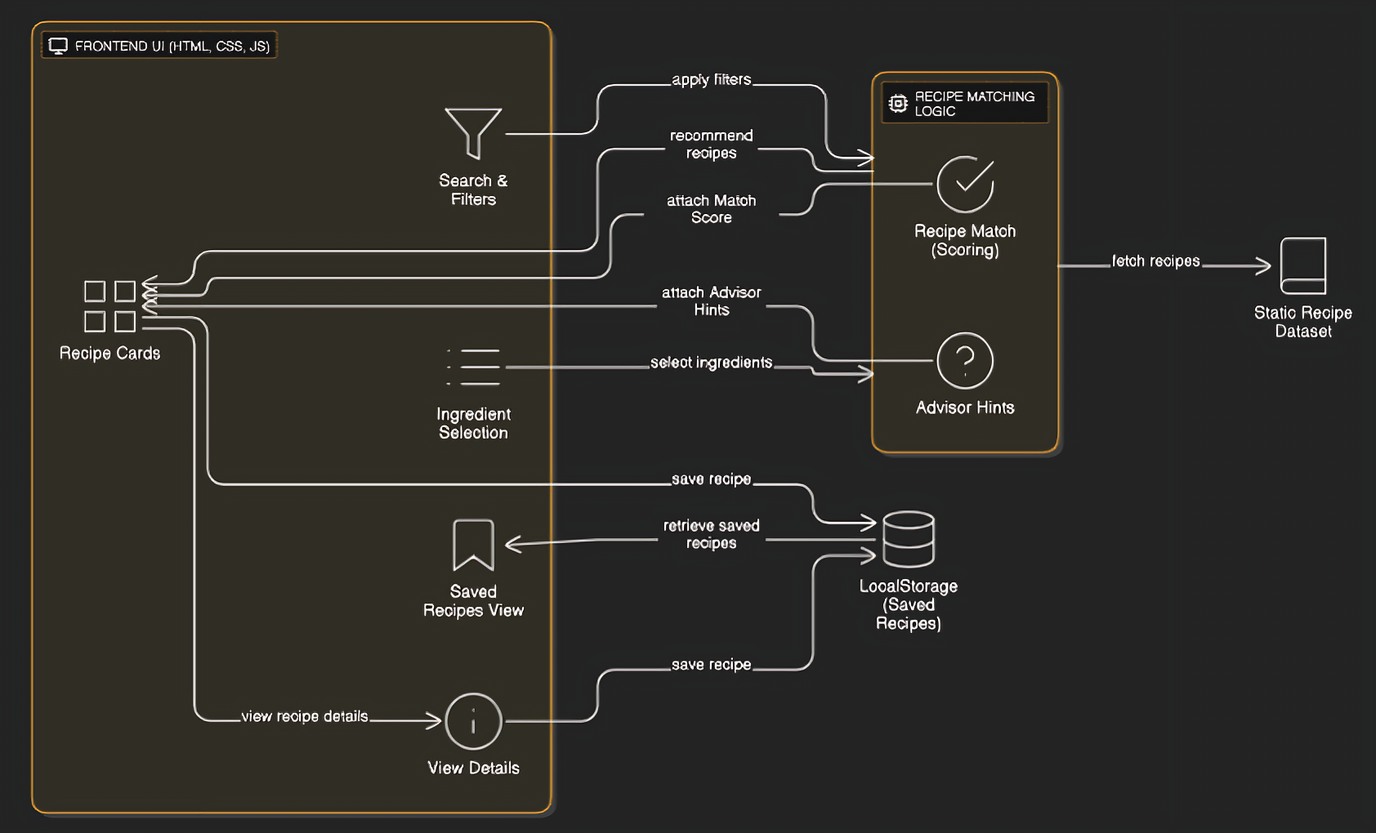
Architecture diagram

Slide 7
IMPLEMENTATION
• Implementation details
Frontend: HTML, CSS, and JavaScript for UI.
Recipe Cards: Dynamically created using JS based on matched ingredients.
Ingredient Selection: Users select available ingredients; filters for cuisine, diet, and cooking time.
AI Reasoning: Generates match percentage, missing ingredients, and advisor hints for recipes.
• Algorithms/models used
Ingredient Match Checker – Compares selected ingredients with each recipe to identify exact and partial matches.
Recipe Scoring Engine – Calculates match percentage and ranks recipes from highest to lowest relevance.
Reasoning Generator – Produces a human-readable explanation for each recommendation (why it’s a good match).
Dynamic Filter Processor – Applies cuisine, diet, and cooking time filters in real-time.

Slide 8
RESULTS
• Results(System Output)
Recipes recommended based on user-selected ingredients.
Match percentage displayed for each recipe (e.g., “80% match”).
Users can save recipes as favorites using local storage.
• Metrics(How You Measure Its Effectiveness)
Recipe Match Coverage → How many recipes are suggested per given input.
Accuracy of Filtering → Whether applying “Italian” only shows Italian recipes.
User Convenience → Recipes appear instantly (low response time).
Scalability check → System still works smoothly as more recipes are added.

Slide 9
IMPACT
• Where this solution applies
Home Cooking: Helps individuals or families decide what to cook based on available ingredients.
Educational Platforms: Cooking classes or culinary schools can use it to demonstrate ingredient combinations and recipe suggestions.
Smart Kitchen Devices: Can be embedded in smart fridges or IoT kitchen devices to suggest recipes based on stored ingredients.
Space Missions / Remote Environments: Astronauts or researchers with limited ingredients can get optimized meal suggestions.
• Benefits to users or society
Reduces Food Waste: Suggests recipes based on what users already have, minimizing unused ingredients.
Saves Time & Effort: Quickly narrows down recipe options instead of browsing multiple cookbooks or websites.
Promotes Culinary Exploration: Introduces users to new cuisines, cooking techniques, and flavor combinations.
Supports Sustainable Living: By using locally available or leftover ingredients, it encourages smarter consumption habits.

Slide 10
CHALLENGES
• Obstacles encountered
Matching user ingredients with recipes dynamically without false positives.
Normalizing ingredient names (like “tomato” vs “Tomatoes”) for accurate matching.
Ensuring filters (cuisine, diet, cooking time) work correctly together.
Implementing save/unsave functionality that persists reliably using localStorage.
• Known limitations
AI reasoning is basic—it doesn’t predict substitutions or suggest alternative ingredients.
Only works with the predefined recipe dataset, adding new recipes requires manual updates.
Filter options are limited to cuisine, diet, and cooking time; no advanced dietary considerations.
Does not handle multi-language ingredients or international variations in recipe names.

Slide 11
FUTURE WORK
• Possible improvements
Adaptive Personalization: Incorporate user history and preferences to suggest recipes based on previously selected or saved recipes.
Advanced Ingredient Matching: Support partial matches, ingredient synonyms, and common substitutes (e.g., “bell pepper” = “capsicum”) to increase recipe relevance.
Enhanced Scoring Algorithm: Include additional factors like seasonal availability, nutritional content, and user-defined priorities (e.g., low-calorie, high-protein).
• Long-term vision
Full AI-Powered Kitchen Assistant: Beyond recommending recipes, the system can suggest weekly meal plans, generate shopping lists, and optimize ingredient usage to minimize wastage.
Gamified Cooking Experience: Reward users for trying new recipes, matching ingredients efficiently, or reducing waste.
Ingredient Inventory Tracking: Keep a virtual pantry that updates as recipes are cooked to suggest what’s left or needs replenishing.
AI-Powered Cooking Assistant: Provide step-by-step voice guidance, timers, and tips for a hands-free cooking experience.

Slide 12
CONCLUSION
• Summary
Developed an AI-powered recipe recommendation system that matches user-provided ingredients with available recipes.
Dynamic scoring and reasoning: Recipes scored based on ingredient match %, filters (cuisine, diet, time), and AI-generated reasoning.
Personalized hints: AI suggests best recipes based on user’s input to reduce waste and optimize cooking choices.
• Final thoughts
Simplifies meal planning and reduces ingredient wastage by recommending practical recipes.
Lays the foundation for future improvements, such as adaptive personalization, recipe learning from user behavior, and integration with smart kitchen appliances.
Can be expanded to broader applications, from sustainable food systems to gamified cooking experiences.

Slide 13
References / Acknowledgments
• Tools
Frontend: HTML, CSS, JavaScript
Backend Logic: JavaScript for recipe matching, scoring, and AI reasoning
Storage: Browser localStorage for saving favorite recipes
Datasets
Recipe dataset manually created (includes recipe names, ingredients, cuisine, diet, cooking time, instructions)
Ingredients list manually curated for testing AI matching

